Slide 1
Project Planning and Scope
Chapter five

Slide 2
Learning Objectives
Manage the planning process of a project
Understand the importance of good project scope management
Describe the process of planning scope management
Explain the importance of validating scope and how it relates to defining and controlling scope
Discuss methods for collecting and documenting requirements to meet stakeholder needs and expectations
Explain the scope definition process and describe the contents of a project scope statement
Discuss the process for creating a work breakdown structure using the analogy, top-down, bottom-up, and mind-mapping approaches

Slide 3
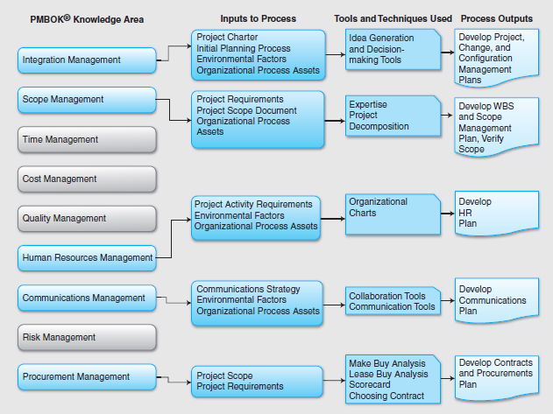
PMBOK Mapping

Slide 4
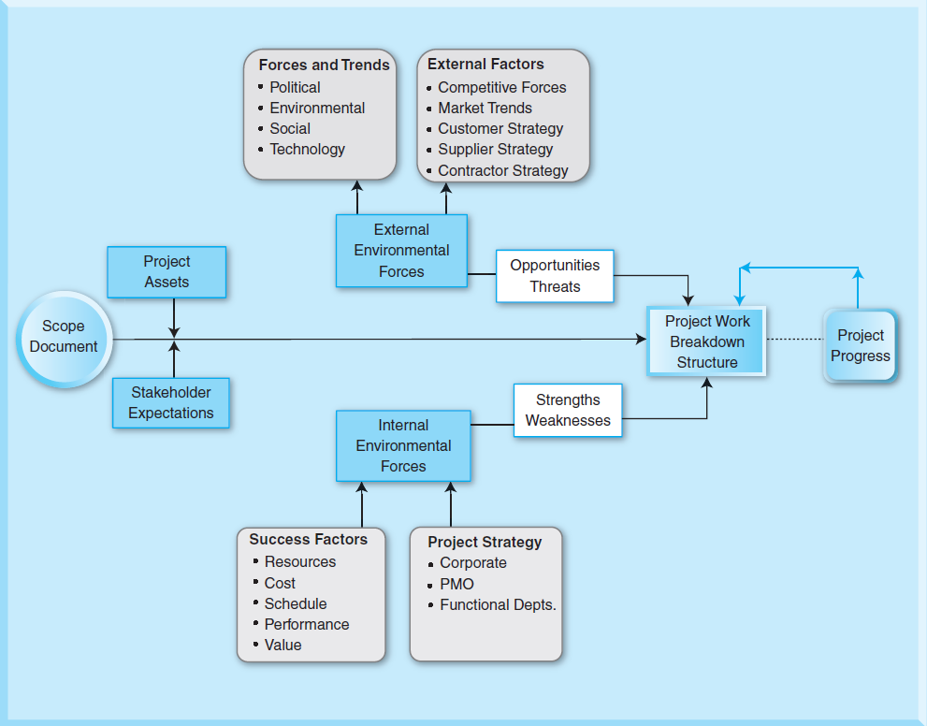
Planning Process

Slide 5
Project Planning
Planning helps project managers:
Clarify and focus a project's development and prospects.
Provide a benchmark against which actual performance can be measured and reviewed.

Slide 6
Project Management Plan
A project management plan is a document used to coordinate all project planning documents and help guide a project’s execution and control
Plans created in the other knowledge areas are subsidiary parts of the overall project management plan

Slide 7
Organizational Process Assets
Any process-related assets that can be used towards a project’s success that include:
Existing policies, procedures, guidelines and templates;
Resources and knowledge of prior projects
Knowledge of technologies, outsourcing, information systems, management systems, and financial systems
Organizational controls
Prior project documents

Slide 8
Elements of the Project Management Plan
Introduction or overview of the project
Description of how the project is organized
Management and technical processes used on the project
Work to be done, schedule, and budget information

Slide 9
Documents during the Planning Process
Customer requirements: Requirements that satisfy the needs of the customers and the end users
Specifications: Specify the requirement in a complete, precise, verifiable manner
Functional requirements: Capture and specify the behavior of the product, system, or service that is being developed in a project
Technical requirements: Detailed description of technology that is suitable for the actual design, development, and production processes of a project
Project plans and planning documents: Formal, approved documents used to guide both project execution and project control

Slide 10
Knowledge Areas | Project Management Plan | Project Documents
Integration Management | Project management plan Change management plan Configuration management plan | Performance reports Project organizational structure Statement of work Project charter Project closure reports Project change requests Project design documents
Scope Management | Scope baseline (scope statement, WBS, and WBS dictionary) Scope management plan Requirements management plan | Requirement document Requirements traceability matrix Stakeholder requirements Scope document
Time Management | Schedule baseline Schedule management plan | Activity list and attributes Duration estimates Milestone list Project schedule
Cost Management | Cost management plan Cost performance baseline | Activity cost estimates Basis of estimates Project funding requirements
Quality Management | Quality management plan Process improvement plan | Quality control measurements Quality control checklists Quality metrics

Slide 11
Knowledge Areas | Project Management Plan | Project Documents
Human Resource Management | Human resources plan Staffing Management Plan | Responsibility assignment matrix or Responsibility, Accountability, Consultative, and Informative (RACI) matrix Resource breakdown structure Resource calendars Resource requirements Roles and responsibilities Team performance assessment
Communications Management | Communications management plan | Forecasts Stakeholder analysis Stakeholder management strategy Stakeholder register
Risk Management | Risk Management plan | Risk register Risk breakdown structure
Procurement Management | Procurement Management plan | Contracts Proposals Procurement documents Vendor lists Source selection criteria Teaming agreements

Slide 12
Project Scope
Scope refers to all the work involved in creating the products of the project and the processes used to create them
A deliverable is a product produced as part of a project, such as hardware or software, planning documents, or meeting minutes
Project scope management includes the processes involved in defining and controlling what is or is not included in a project
Project scope description
Project acceptance criteria
Project deliverables
Project exclusions and constraints
Project assumptions

Slide 13
Project Scope Questions
How much can be achieved in the current project?
When must the project be completed?
When and for how long will resources (people, facilities, equipment, etc.) be available?
Scope creep: Scope creep is the addition of scope after it is defined in the scope document.

Slide 14
Project Scope Processes
Planning scope: determining how the project’s scope and requirements will be managed
Collecting requirements: defining and documenting the features and functions of the products produced during the project as well as the processes used for creating them
Defining scope: reviewing the project charter, requirements documents, and organizational process assets to create a scope statement
Creating the WBS: subdividing the major project deliverables into smaller, more manageable components
Validating scope: formalizing acceptance of the project deliverables
Controlling scope: controlling changes to project scope throughout the life of the project

Slide 15
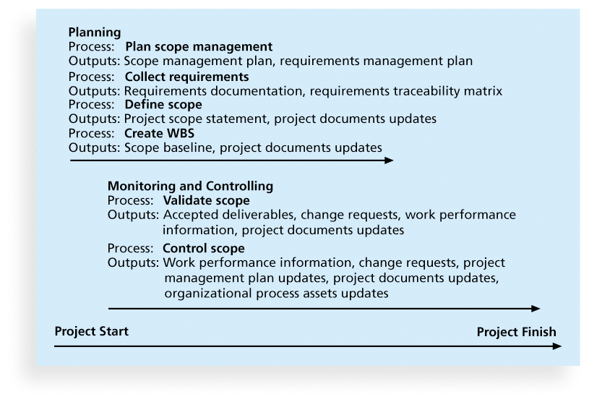
Project Scope Management Summary

Slide 16
Planning Scope Management
The project team uses expert judgment and meetings to develop two important outputs: the scope management plan and the requirements management plan
The scope management plan is a subsidiary part of the project management plan

Slide 17
Scope Management Plan Contents
How to prepare a detailed project scope statement
How to create a WBS
How to maintain and approve the WBS
How to obtain formal acceptance of the completed project deliverables
How to control requests for changes to the project scope

Slide 18
Defining Scope
Project scope statements should include at least a product scope description, product user acceptance criteria, and detailed information on all project deliverables.
It is also helpful to document other scope-related information, such as the project boundaries, constraints, and assumptions.
The project scope statement should also reference supporting documents, such as product specifications
As time progresses, the scope of a project should become more clear and specific

Slide 19
Visual Example of Defining Scope

Slide 20
Media Snapshot
Many people enjoy watching television shows like Trading Spaces, where participants have two days and $1,000 to update a room in their neighbor’s house. Since the time and cost are set, it’s the scope that has the most flexibility
Although most homeowners are very happy with work done on the show, some are obviously disappointed. Part of agreeing to be on the show includes signing a release statement acknowledging that you will accept whatever work has been done
Too bad you can’t get sponsors for most projects to sign a similar release form. It would make project scope management much easier!

Slide 21
Creating the Work Breakdown Structure (WBS)
A WBS is a deliverable-oriented grouping of the work involved in a project that defines the total scope of the project
WBS is a foundation document that provides the basis for planning and managing project schedules, costs, resources, and changes
Decomposition is subdividing project deliverables into smaller pieces
A work package is a task at the lowest level of the WBS
The scope baseline includes the approved project scope statement and its associated WBS and WBS dictionary

Slide 22
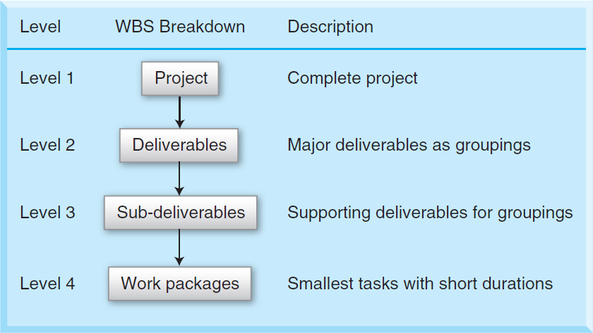
Visual Example of WBS #1

Slide 23
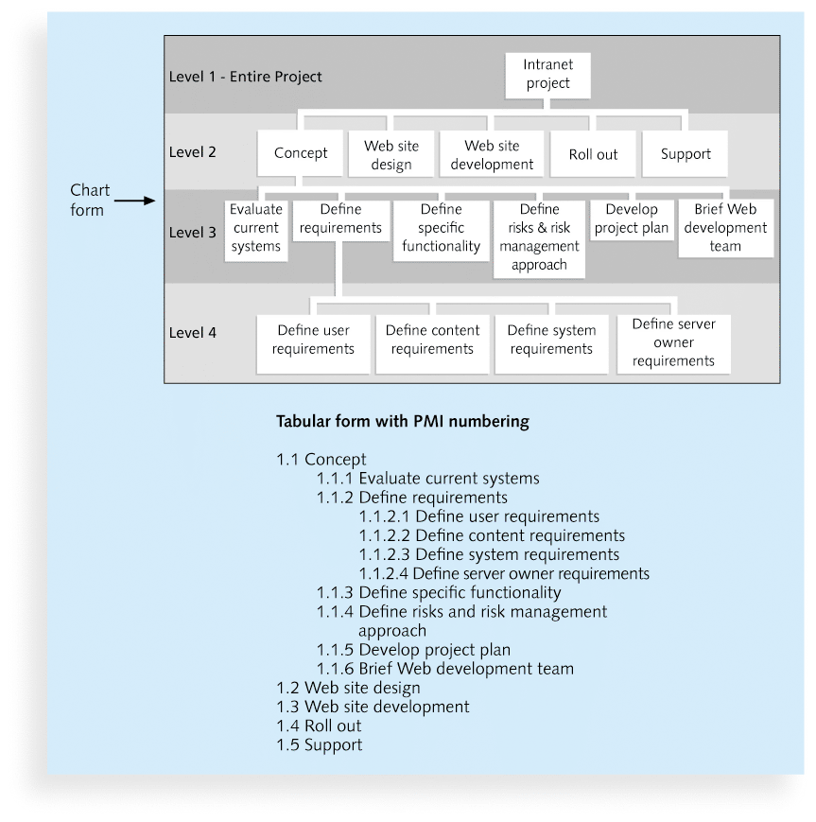
Visual Example WBS #2

Slide 24
WBS
Work packages
Small project activities possibly with very short durations with definable results.
In some complex projects, work packages may be at a lower level, say Level 5 or Level 6.
The smallest level in a project that can be monitored, managed, and controlled by a project manager effectively.
The time frame for a work package may be 40 hours or 4 weeks depending upon the size and complexity of the project.
A work package can be used in a project in a variety of ways including in cost estimation and scheduling.

Slide 25
Creating a WBS
A good scope document and requirements documentations with good input from all stakeholders; and
Availability of organizational process assets including project policies, procedures, and historical information.
Consider:
Cost and scheduling constraints
Project scope Lead time of equipment
Technology, Quality, and other performance criteria
Outsourced and contracted activities
Milestones and other objectives of the project
Reporting and other communication methods
Responsibilities and accountabilities of the project team

Slide 26
Delivery-based WBS
List the committed deliverables
Decompose the committed deliverables into groups of activities
Decompose each of those groups of activities into activities
Identify the supplementary deliverables
Add the supplementary deliverables as activities to the WBS
Evaluate all activities for optimum hierarchical planning
Validate WBS

Slide 27
Visual Example of Delivery-based WBS
Level | WBS Element | Work Breakdown
Level 1 | 1 | New Logistics with 3PL
Level 2 | 1.1 | Selection of 3PL
Level 3 | 1.1.1 | Request for Proposal (RFP)
Level 4 | 1.1.1.1 | RFP requirements and factors of selection
Level 4 | 1.1.1.2 | RFP to all transportation carriers
Level 4 | 1.1.1.3 | Contact all transportation carriers
Level 4 | 1.1.1.4 | Receive all transportation carriers response to RFP
Level 4 | 1.1.1.5 | Select RFP
Level 4 | 1.1.1.6 | Send 2nd RFP to down selects
Level 4 | 1.1.1.7 | Receive RFP response from down selects
Level 4 | 1.1.1.8 | Final Cut selection
Level 4 | 1.1.1.9 | Interviews
Level 4 | 1.1.1.10 | Selection of the transportation carrier
Level 4 | 1.1.1.11 | Transportation carrier Award

Slide 28
Life-span WBS
Take into account the project process for a particular type of project.
The major phases of either the traditional or iterative SDLC can be used as Level 2 with the title of the project as Level 1.
Follow the previously described delivery-based structure method.

Slide 29
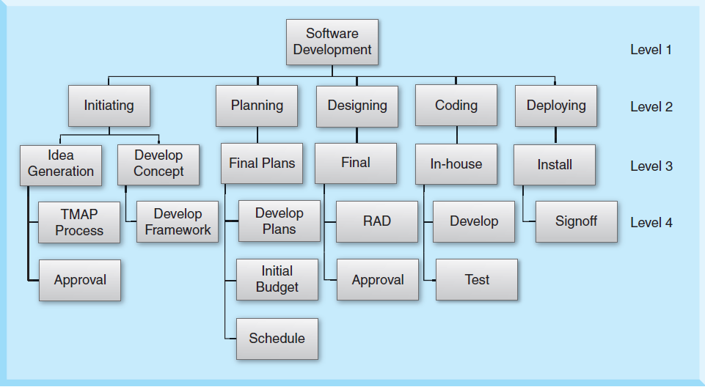
Life-span WBS

Slide 30
Other methods of using WBS
Using guidelines: Some organizations, like the DOD, provide guidelines for preparing WBSs
The analogy approach: Review WBSs of similar projects and tailor to your project
The top-down approach: Start with the largest items of the project and break them down
The bottom-up approach: Start with the specific tasks and roll them up
Mind-mapping approach: Mind mapping is a technique that uses branches radiating out from a core idea to structure thoughts and ideas

Slide 31
WBS Dictionary
A WBS dictionary is a document that describes detailed information about each WBS item
Should be consulted before commencing any activity in order to ensure that proper standards, procedures, and quality control measures are being followed
Many WBS tasks are vague and must be explained more so people know what to do and can estimate how long it will take and what it will cost to do the work
Has to be changed whenever the WBS is changed.

Slide 32
Other WBS Considerations
A unit of work should appear at only one place in the WBS.
The work content of a WBS item is the sum of the WBS items below it
A WBS item is the responsibility of only one individual, even though many people may be working on it
The WBS must be consistent with the way in which work is actually going to be performed; it should serve the project team first, and other purposes only if practical
Project team members should be involved in developing the WBS to ensure consistency and buy-in
Each WBS item must be documented in a WBS dictionary to ensure accurate understanding of the scope of work included and not included in that item
The WBS must be a flexible tool to accommodate inevitable changes while properly maintaining control of the work content in the project according to the scope statement

Slide 33
Validating Scope
It is very difficult to create a good scope statement and WBS for a project
It is even more difficult to verify project scope and minimize scope changes
Scope validation involves formal acceptance of the completed project deliverables
Acceptance is often achieved by a customer inspection and then sign-off on key deliverables

Slide 34
Controlling Scope
Scope control involves controlling changes to the project scope
Goals of scope control are to
influence the factors that cause scope changes
assure changes are processed according to procedures developed as part of integrated change control, and
manage changes when they occur
Variance is the difference between planned and actual performance

Slide 35
Some Best Practices for Avoiding Scope Challenges
. Keep the scope realistic. Don’t make projects so large that they can’t be completed. Break large projects down into a series of smaller ones
2. Involve users in project scope management. Assign key users to the project team and give them ownership of requirements definition and scope verification
3. Use off-the-shelf hardware and software whenever possible. Many IT people enjoy using the latest and greatest technology, but business needs, not technology trends, must take priority
4. Follow good project management processes. As described in this chapter and others, there are well-defined processes for managing project scope and others aspects of projects

