Slide 1
Tutorial 5:
Tracking Progress and Closing the Project

Slide 2
In this tutorial you will:
Set a baseline and create an interim plan
Review baseline, interim, actual, and scheduled dates
Work with the Variance and Tracking tables
Update tasks
Track costs

Slide 3
In this tutorial you will:
Create a custom view, a custom table and a custom report
Analyze variance, slack, and slippage
Use the Detail and Tracking Gantt Chart views to track progress
Add progress lines
Close a project
Notes:
3

Slide 4
Understanding Baseline and Interim Plan
A baseline is a record of the scheduled dates and costs for each task of a project at a particular point in time.
An interim plan is a set of Start and Finish dates that you can save periodically as your project progresses.
You use both baseline and interim plan to understand how the project has either stayed on or fallen off schedule.
Notes:
4

Slide 5
Understanding Baseline and Interim Plan Cont.
Baseline data focuses on scheduled dates, durations, work, and costs.
Interim plans record only Start and Finish dates.
You use the data from the interim plan to compare it with the baseline plan to monitor progress and know whether or not the project is on track.
Notes:
5

Slide 6
Working with a Baseline
The baseline records 20 primary reference points in five categories:
  Start dates, Finish dates, Durations Work, and Cost
You can set additional baselines to a total of 11 for each project.
  You can save a separate baseline at the end of each phase to compare planned values against actual data.
Notes:
6

Slide 7
Variance
A variance is when the baseline data and actual data differ.
It is a good practice to monitor variance and compare actual data with the baseline data on a regular basis.
The variance information will serve as a guide to better estimate project costs and dates.
Variances can be positive or negative.
Notes:
7

Slide 8
Options for Setting the Baseline
By default, a summary task’s baseline is not updated when a subtask is modified, added or deleted.
You can select the “Roll up baseline to all summary tasks” option button or the “Roll up baseline to selected summary tasks” option button in the Baseline Dialog Box.

Slide 9
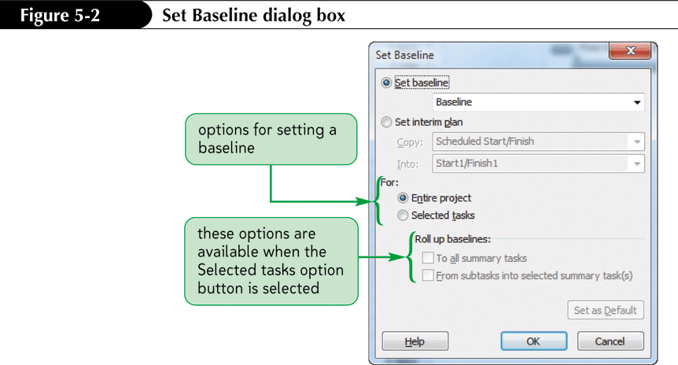
Set Baseline Dialog Box

Slide 10
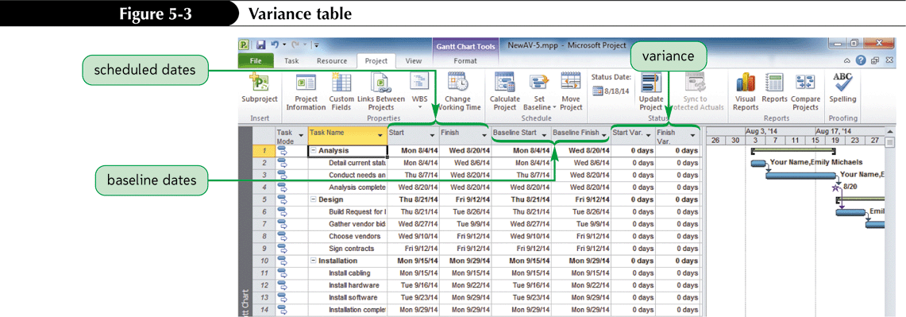
Viewing Baseline Data

Slide 11
Tracking Progress – Status Date
Many project managers set aside a specific day of the week, called the status date to record all actual start dates hour worked and costs.
By default, the Status date is the current date.
It is important to identify the Status date before updating entries so the actual data versus planned data is accurate.

Slide 12
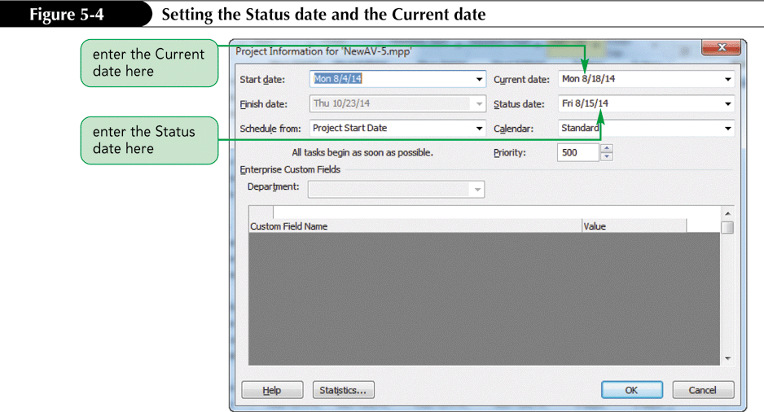
Setting the Status Date and the Current Date

Slide 13
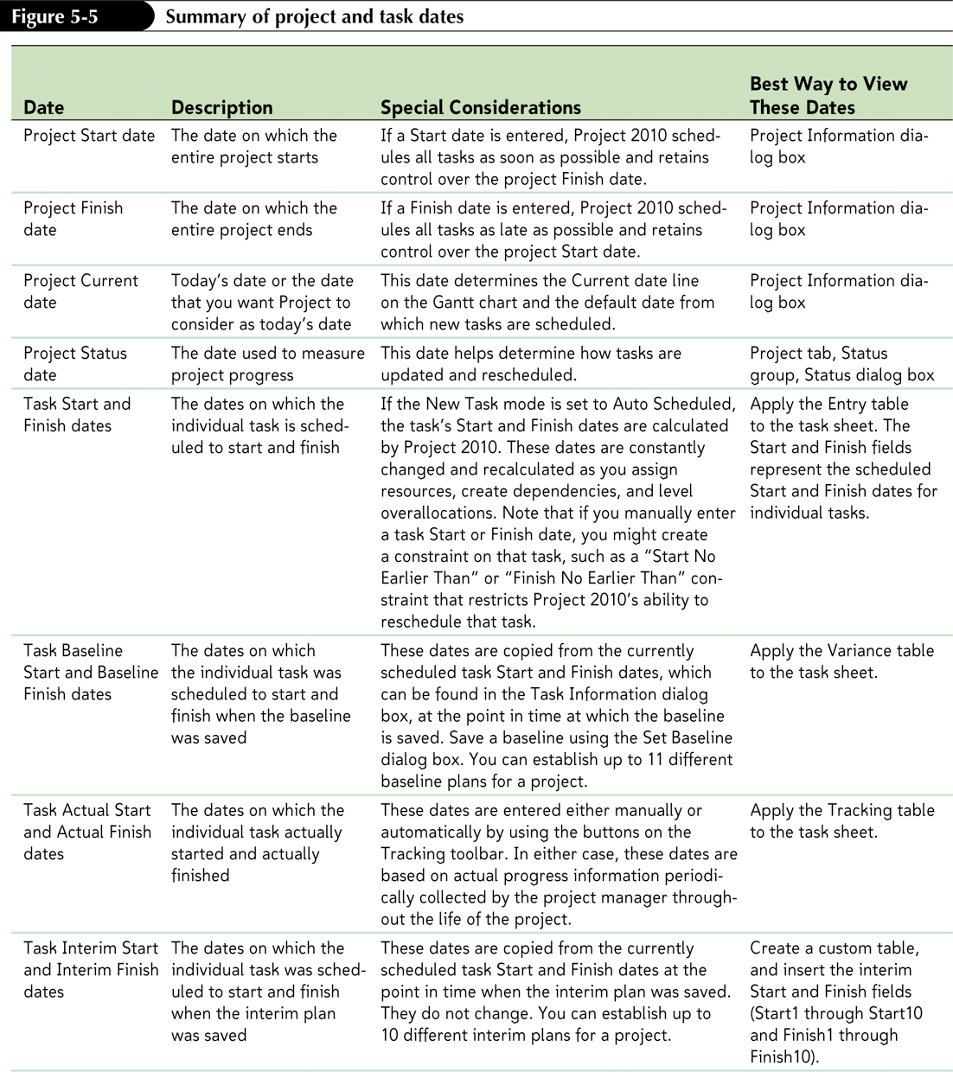
Understanding Project Dates and Task Dates

Slide 14
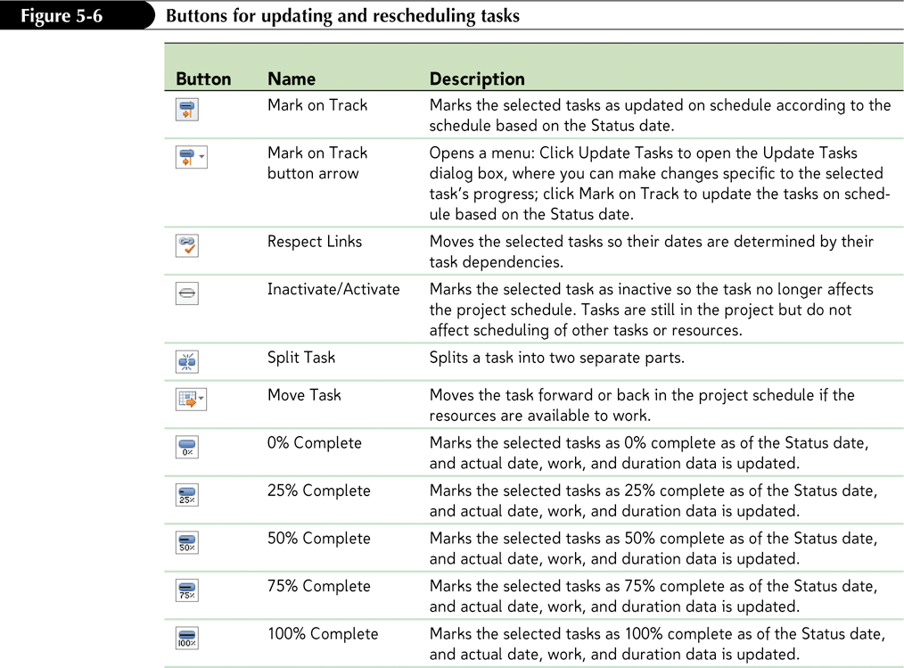
Reviewing the Tracking Buttons

Slide 15
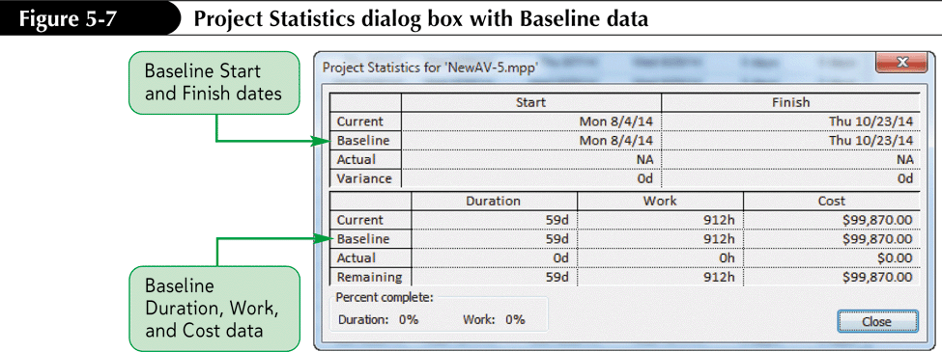
Using Project Statistics to Monitor Progress
The Project Statistics dialog box shows an overall summary of the date, duration, work and cost information for a project as of the Status date.

Slide 16
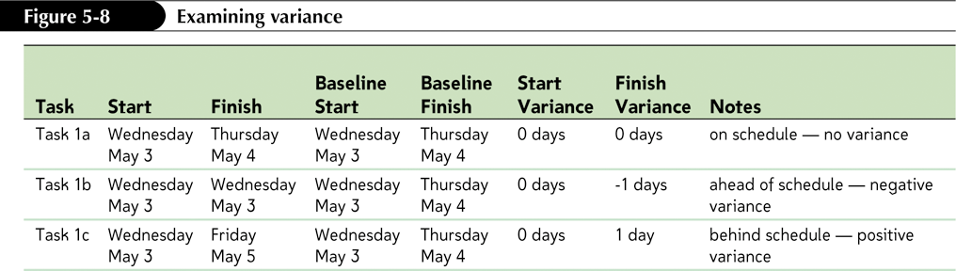
Understanding Variance
Baseline dates and costs are used to calculate the variance.
The formula for calculating variance is Variance = Current (date) – Baseline (date).
Projects ahead of schedule have a negative variance.
Projects behind schedule have a positive variance.
Notes:
16

Slide 17
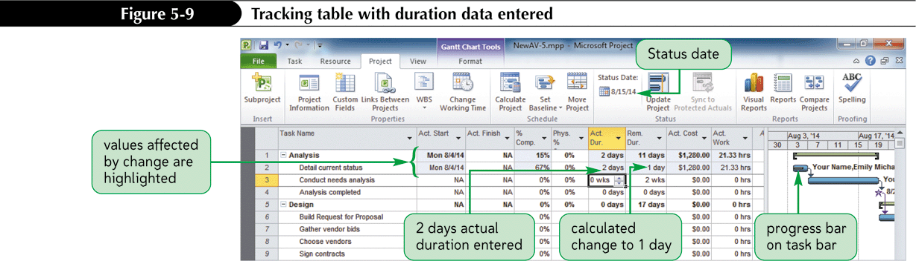
Updating Tasks and Using the Tracking Table
To enter actual progress data into a project, you can use sheet, form, or graphical views.
Some project managers enter actual Start and Finish dates, allowing Project 2010 to automatically update the data for actual duration, cost and work fields based on default formulas

Slide 18
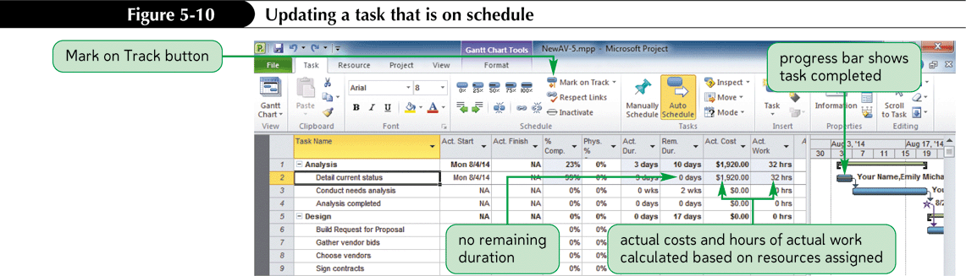
Updating Tasks that are on Schedule
Use the Mark on Track button to update the scheduling information for selected tasks to indicate if actual dates, costs and work match the actual schedule.

Slide 19
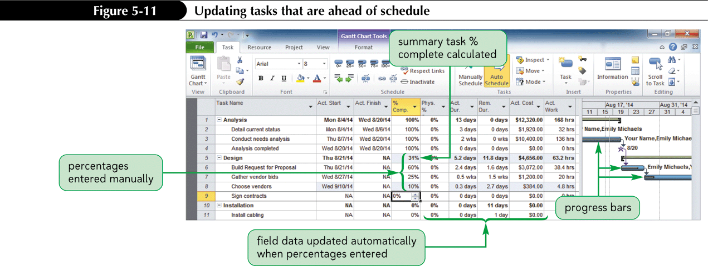
Updating Tasks that are Ahead of Schedule
Use the Percent Complete button on the Task tab in the Schedule group to indicate progress even if the task scheduled for the future.

Slide 20
Understanding the Interim Plan
An interim plan is a set of start and finish dates that you can save periodically as your project progresses.
Interim plans save projected start and finish dates for the chosen tasks, but not cost information.
Project 2010 allows you to save a maximum of 10 interim plans.
Notes:
20

Slide 21
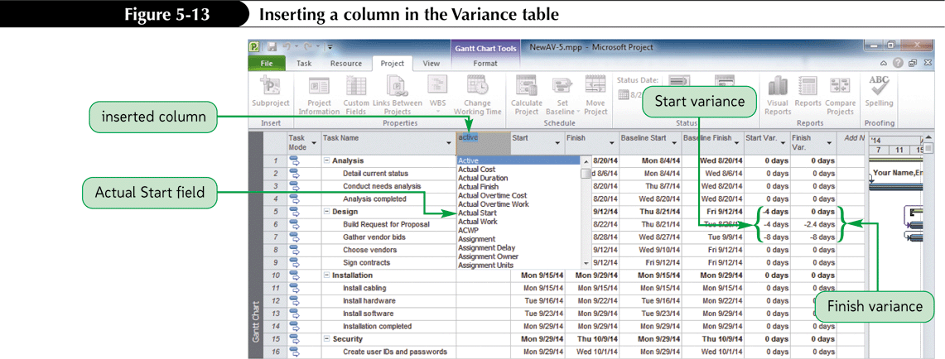
Inserting Interim Plan Columns in the Variance Table

Slide 22
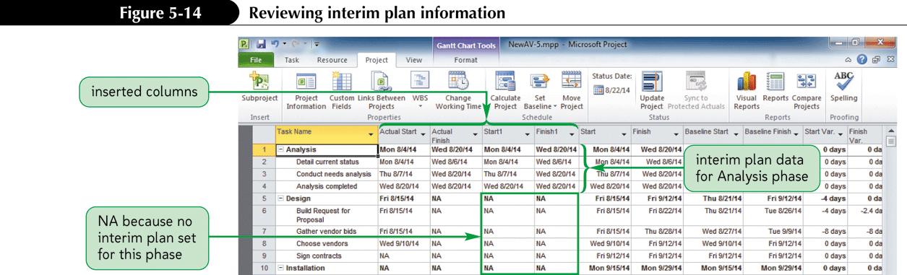
Viewing Interim Plan Information

Slide 23
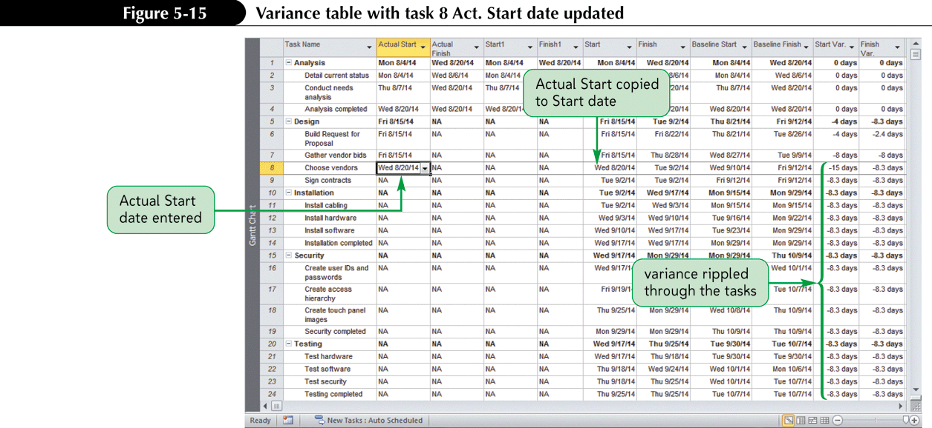
To Enter Data in a Table and View the Changes

Slide 24
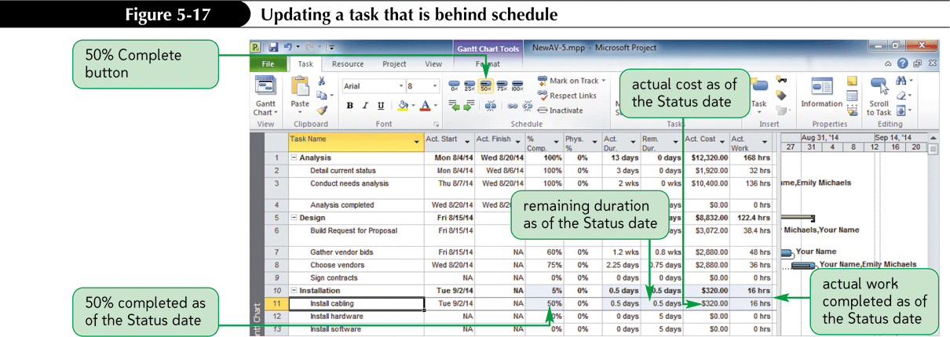
Updating Tasks That Are Behind Schedule

Slide 25
Rescheduling Tasks That Are Behind Schedule
To determine whether a task is on schedule, ahead of schedule, or behind schedule, Project 2010 has several options that allow you to use the Status date to determine on what date actual data is applied to a task and when the remaining work for that task is scheduled.

Slide 26
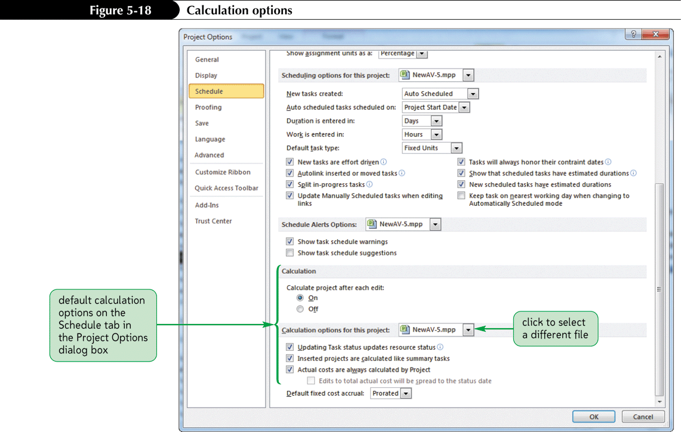
To View Calculation Options

Slide 27
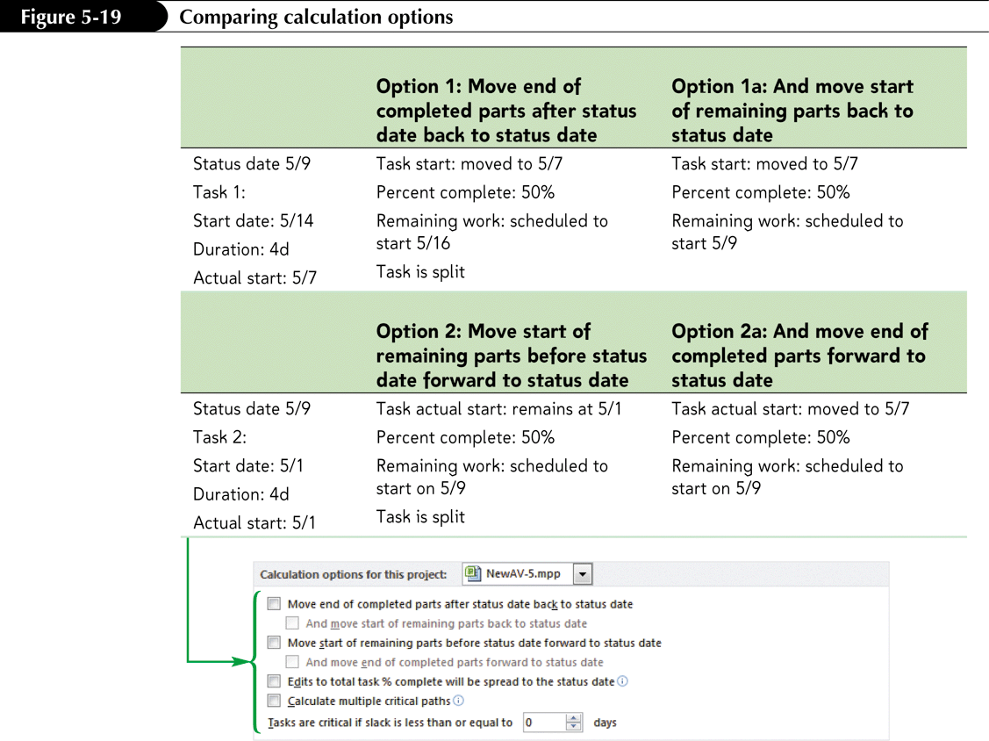
Comparing Calculation Options

Slide 28
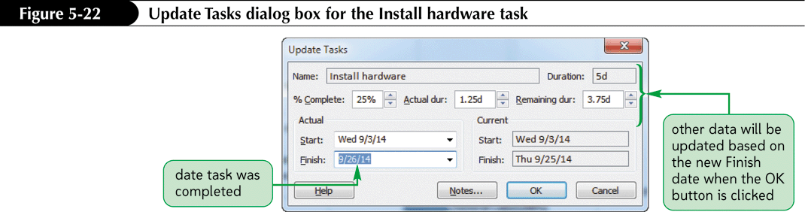
Updating Progress by using the Update Tasks Dialog Box

Slide 29
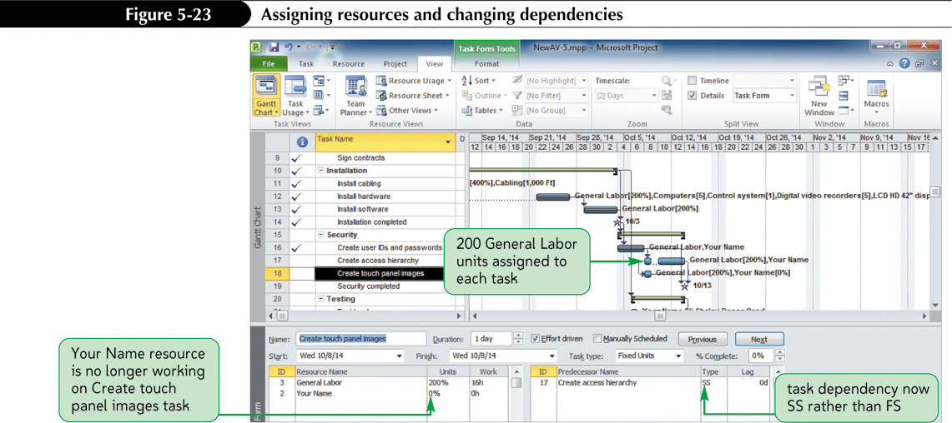
Assigning Resources and Changing Dependencies

Slide 30
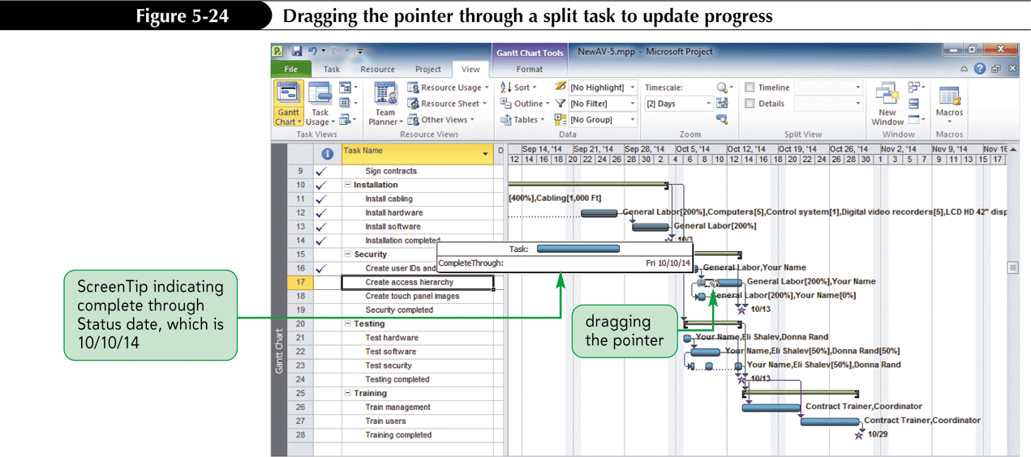
Updating Progress Using the Gantt Chart

Slide 31
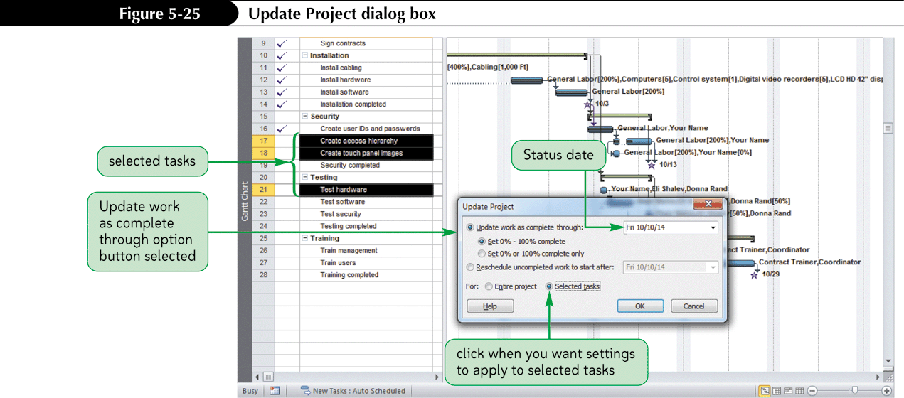
Updating Completed Tasks Using the Update Project Dialog Box

Slide 32
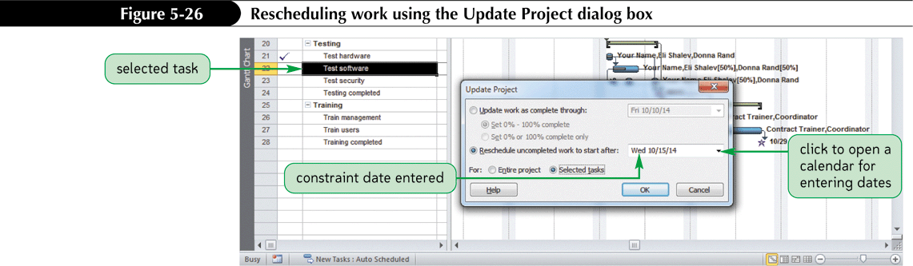
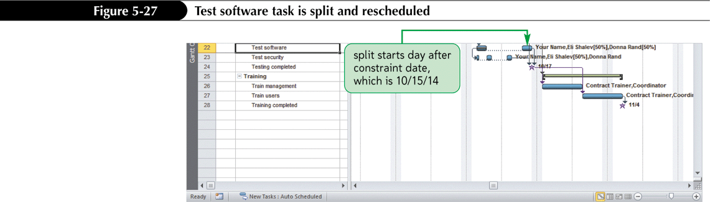
Updating Partially Completed Tasks Using the Update Project Dialog Box

Slide 33
Tracking Costs
Cost tracking is how you determine if the project is staying close to budget or not.
Project 2010 tracks the costs for the tasks, resources, and assignments.
As you update the progress of tasks, actual costs are automatically calculated.
Total costs are the calculated costs of a project, task, resource, or assignment for the duration of a project.
Notes:
33

Slide 34
Tracking Costs Cont.
Total costs include actual fixed costs.
Fixed costs are costs associated with the task but are neither specific nor driven by any particular resource.
Fixed costs are inherent to the task itself.
Timephased costs are task, resource, or assignment costs that are distributed over time.
Notes:
34

Slide 35
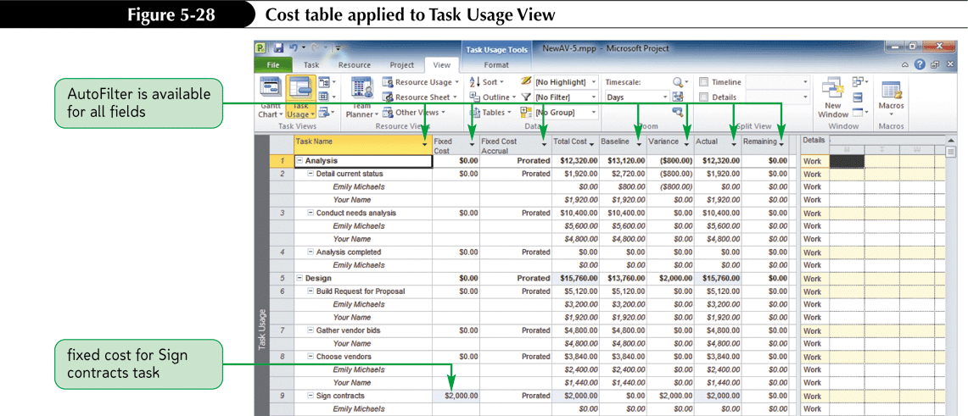
To View Calculated Costs

Slide 36
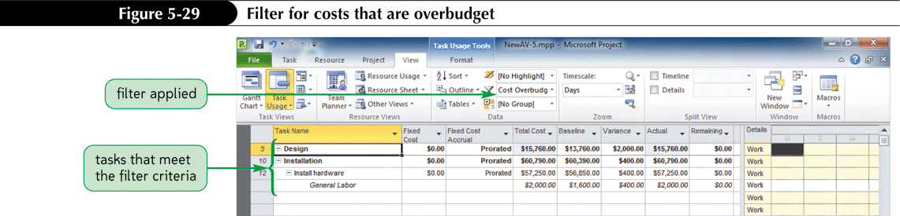
Filtered for Over Budget Costs

Slide 37
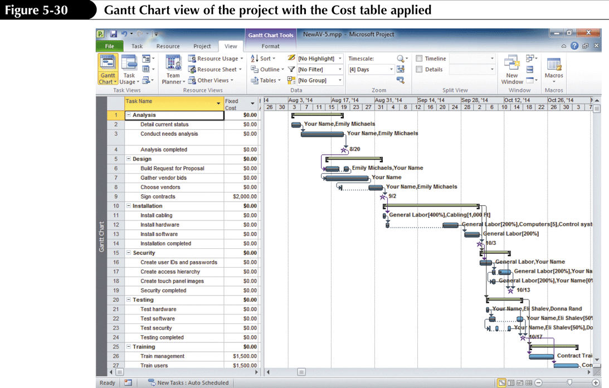
Viewing Costs for Each Resource

Slide 38
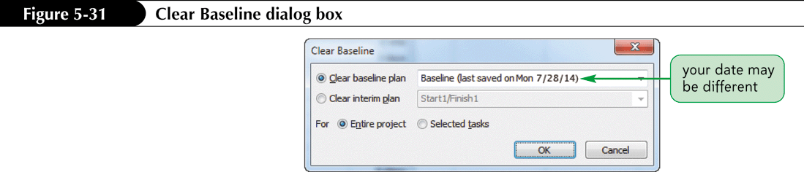
Clearing a Baseline
Project 2010 can save up to 11 baselines for each file. At some point, you may want to clear one or all of them.

Slide 39
Creating a Custom Table
You can create a custom table containing the fields that you want and then give the new table a descriptive name, preserving the default tables that Project 2010 provides.
Task tables can be applied only to Task sheets.
Resource tables can be applied only to Resource sheets
Notes:
39

Slide 40
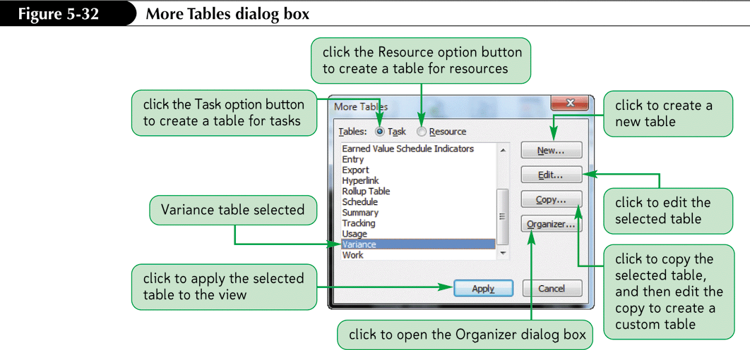
Creating a New Table

Slide 41
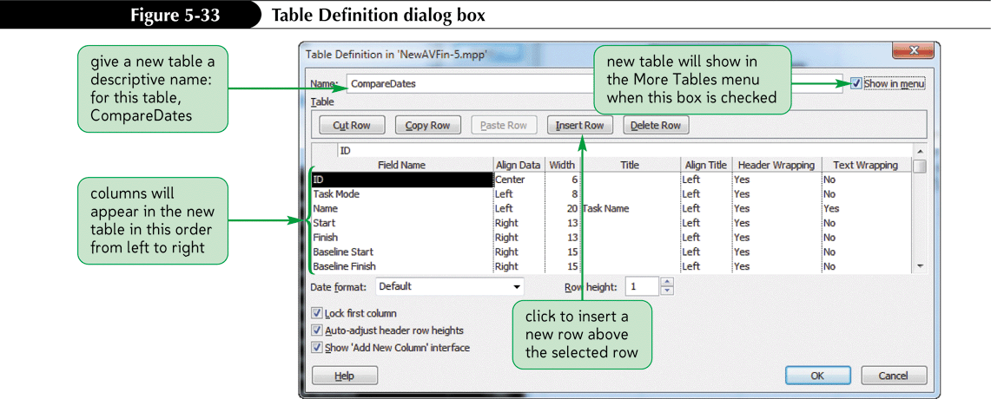
Creating a New Table Cont.

Slide 42
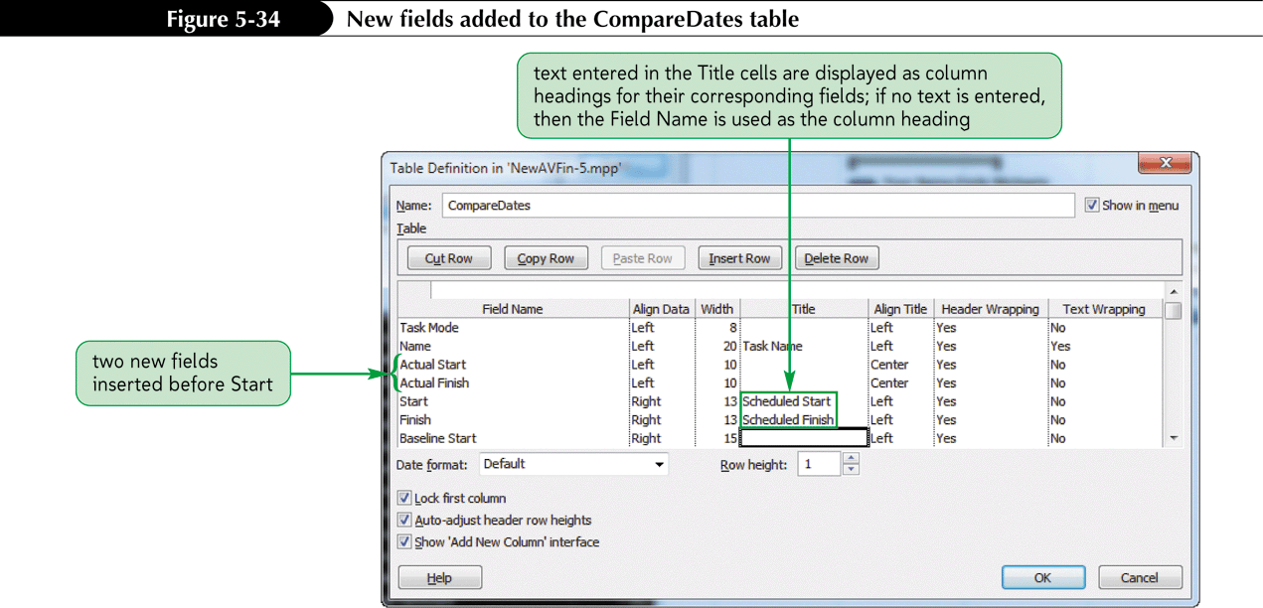
Creating a New Table Cont

Slide 43
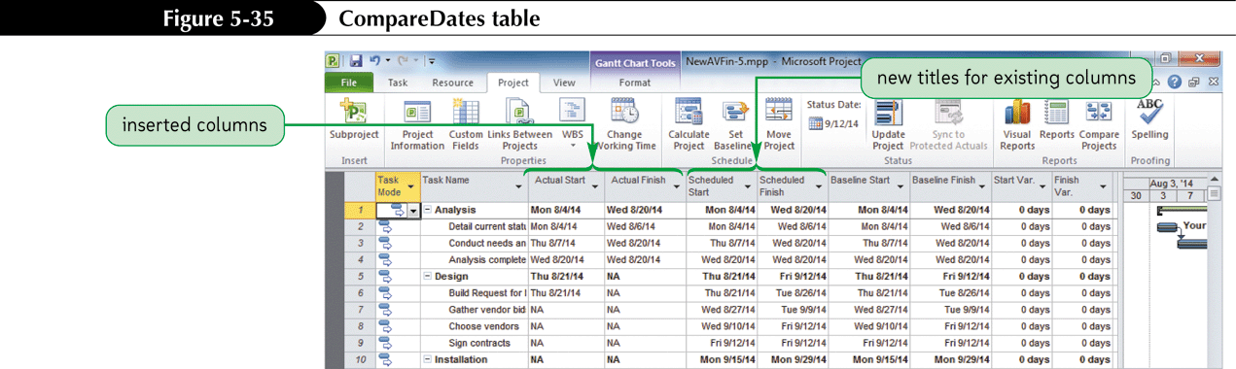
Creating a New Table Cont.

Slide 44
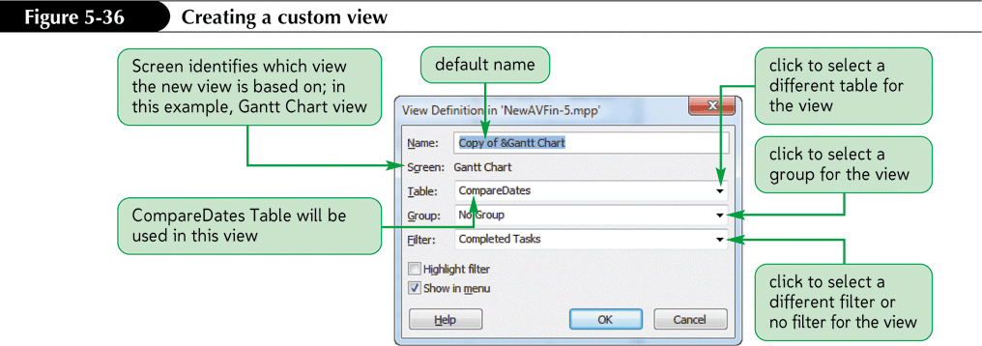
Custom Views
A custom view is any view that is saved with a name and differs from the default views that Project 2010 provides.
Custom views can contain a set of fields in a particular view, grouping, and/or a filter.
Notes:
44

Slide 45
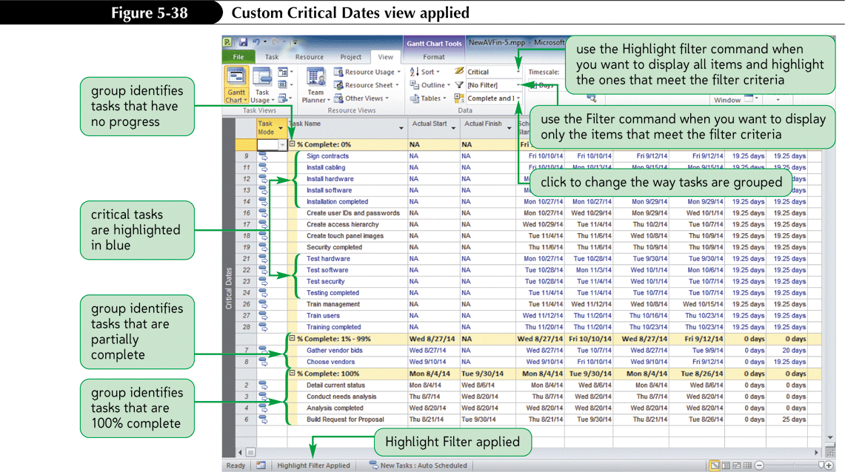
Custom Critical Dates View Applied

Slide 46
Examine Slack and Slippage
The Detail Gantt Chart shows total slack and slippage.
Total slack (also called total float) is the amount of time that a task can be delayed without the delay affecting the entire project.
Free slack is the amount of time that a task can be delayed without the delay affecting any successor tasks.
If the task has no successors, free slack is the amount of time that a task can be delayed without delaying the entire project’s Finish date.
Notes:
46

Slide 47
Examine Slack and Slippage Cont’d
Slippage, or simply slip, is the difference between a task’s scheduled start and baseline start date or its finish date and baseline finish date.
A noncritical task can slip without affecting the project Finish date.
  Recall that a noncritical task is one that has some slip.
  If a noncritical task slips too much it can become critical.
It is important to track slippage on all tasks.
Notes:
47

Slide 48
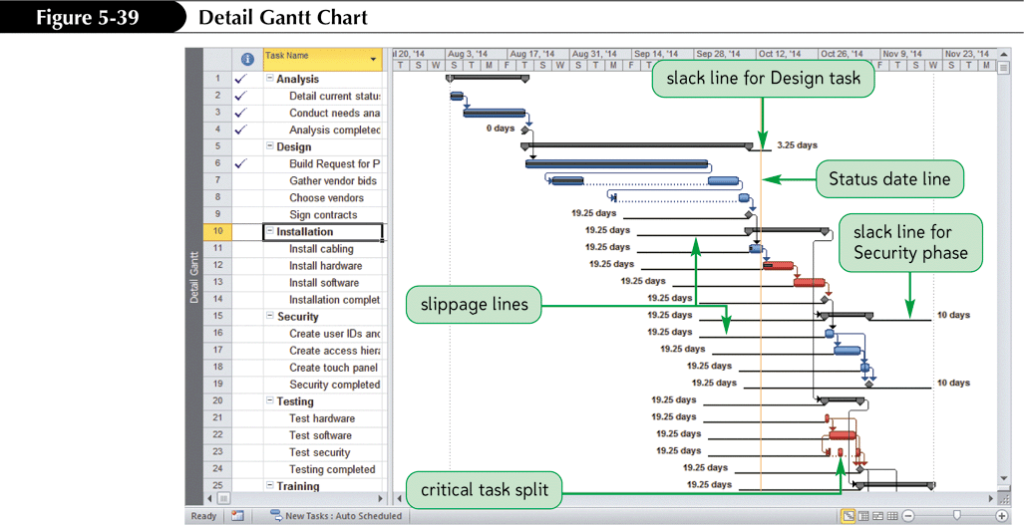
Detail Gantt Chart

Slide 49
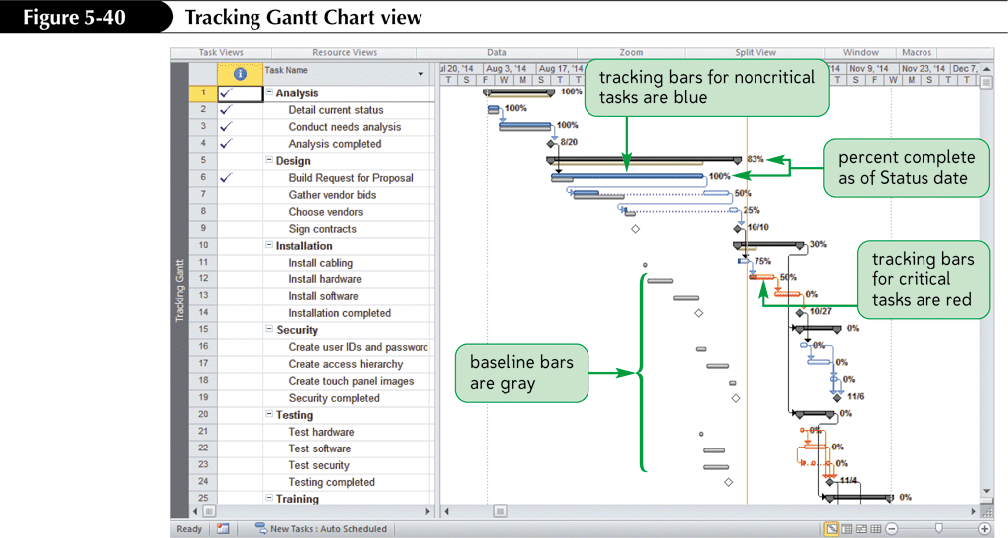
Tracking Gantt Chart

Slide 50
Working with Slack and Deadline Dates
The deadline constraint is a flexible constraint.
It does not dictate the scheduled Start and Finish dates of a task.
It is used more as a guideline than as a fact that your project must obey.
The deadline constraint works well when trying to realistically display total slack values and yet maintain task-scheduling flexibility.

Slide 51
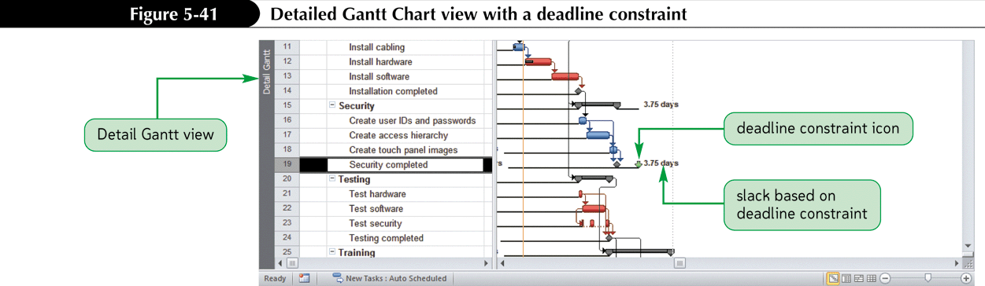
Detailed Gantt Chart View with a Deadline Constraint

Slide 52
Adding Progress Lines
Progress lines give you a visual representation of all tasks that are in progress.
The lines are drawn based on the percentage completion value and the status date for each task.
The lines connect the tasks to create a line chart.
  Peaks that point to the left indicate work that is behind schedule.
  Peaks that point to the right indicate work that is ahead of schedule.
The Progress Lines dialog box provides options for setting preferences for the progress lines.
Notes:
52

Slide 53
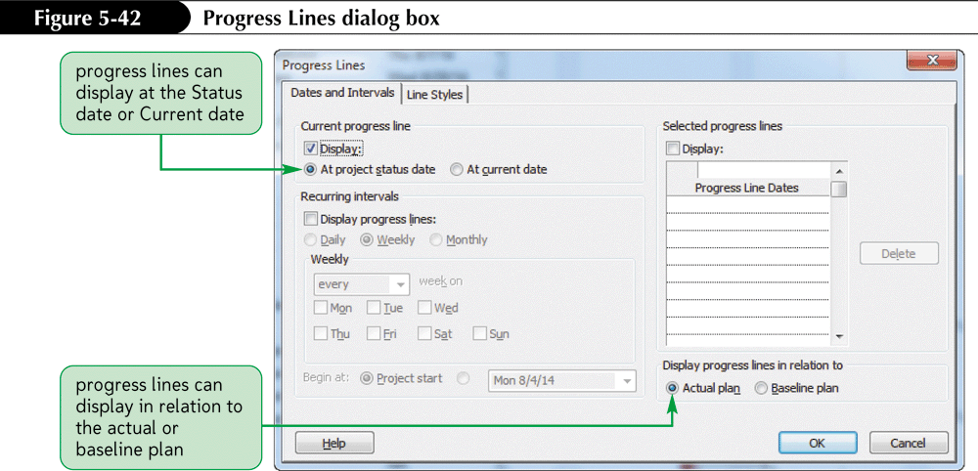
Displaying Progress Lines

Slide 54
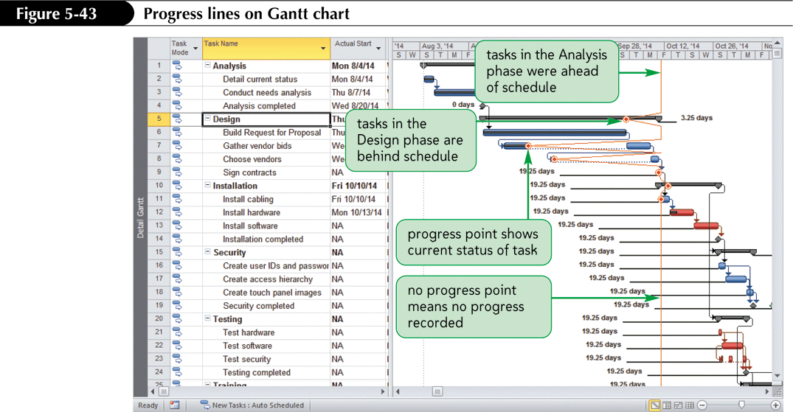
Progress Lines on Gantt Chart

Slide 55
Using Project Progress Reports
Project 2010 provides reports that summarize information and focus on various areas of a project.
Reports help manage and prioritize work in progress.
The Current reports focus on current project date progress.
The Costs reports focus on current project costs.
You can also create Custom reports.
Notes:
55

Slide 56
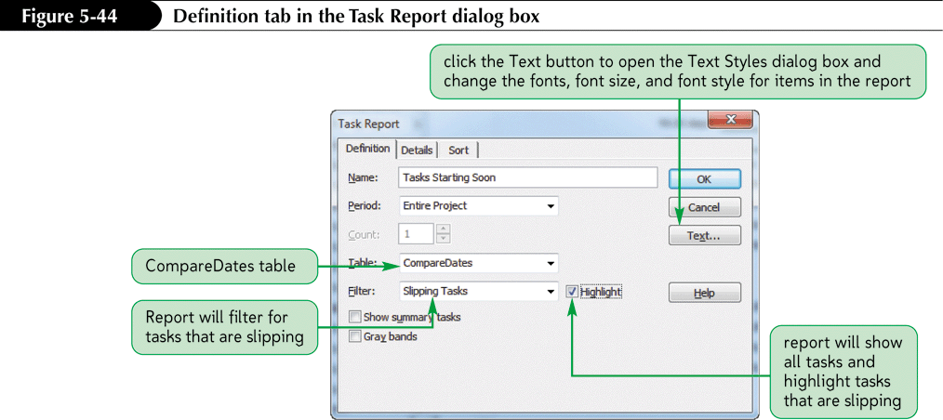
Developing a Custom Report Based on a Custom Table

Slide 57
Creating a New Report
Editing existing reports overrides the report choices originally provided by Project 2010.
Creating an entirely new report preserves the default settings for the Project 2010 reports.
There are four different types of customer reports: Task, Resource, Monthly Calendar and Crosstab.
A crosstab report summarizes a numeric field for a resource or task over time.
A monthly calendar report provides an overview of the project plan formatted similar to the Calendar for a month.

Slide 58
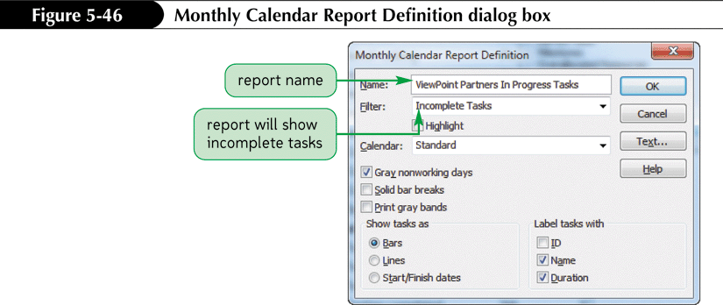
Creating a New Report

Slide 59
Closing a Project
Closing a project means finalizing the data that is stored in the project file.
“Closing a project” is not a feature of Project 2010; it is a point in time that a project manager declares in order to clarify that a project is finished and the reports are final.
Project 2010 provides many summary reports used after a project is closed to analyze its overall success.
Notes:
59

Slide 60
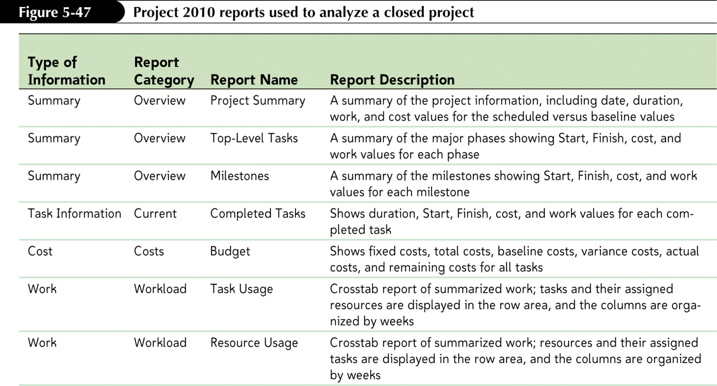
Project 2010 Reports Used to Analyze a Closed Project

Slide 61
Tutorial 5 Summary
Learned how to set a baseline and create an interim plan
Learned how to review baseline, interim, actual, and scheduled dates
Learned how to work with the Variance and Tracking tables
Learned how to update tasks and track costs.

Slide 62
Tutorial 5 Summary Cont.
Learned how to create a custom view, a custom table and a custom report
Learned how to analyze variance, slack, and slippage
Learned how to use the Detail and Tracking Gantt Chart views to track progress
Learned how to add progress lines
Learned how to close a project

