Slide 1
Tutorial 3:
Communicating Project Information

Slide 2
In this tutorial you will:
Review Project 2010 reports
Examine the critical path
Filter tasks
Format a Gantt Chart
Work with the Network Diagram
Shorten the critical path
Analyze task constraints

Slide 3
Creating Reports Using Project 2010
In addition to printing graphical views, Project 2010 can be used to create other reports.
Reports can be used to:
  disseminate information
  report project status
  plan a project
Viewing different reports will help you to analyze your current project plan in different ways.

Slide 4
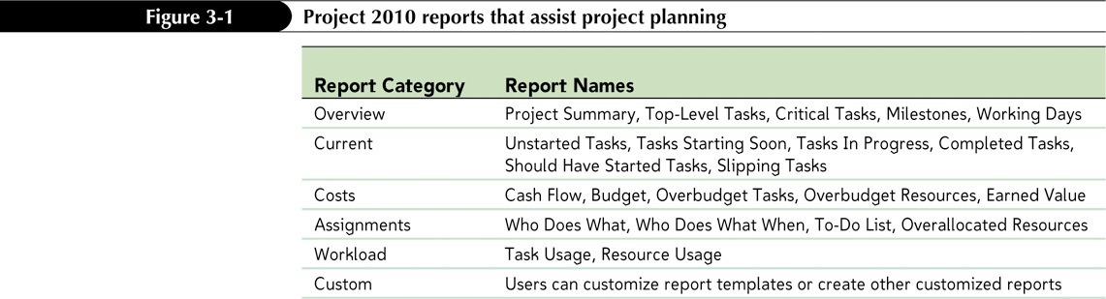
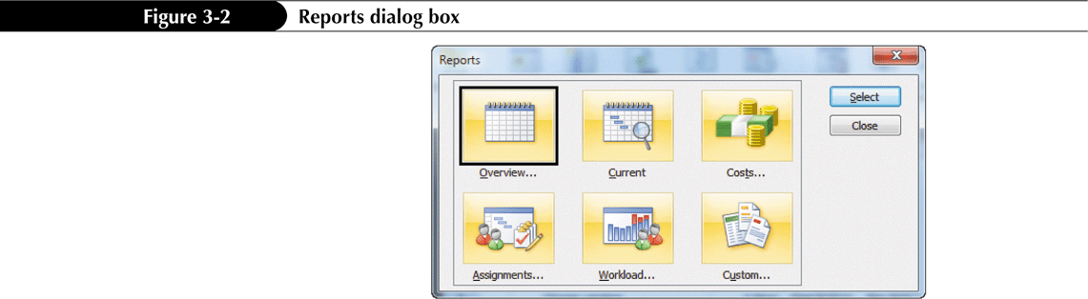
Project 2010 Reports

Slide 5
Understanding the Critical Path
A critical task is a task that must be completed as scheduled in order for the project to finish on time.
  Any delay in a critical task could delay the project completion date.
The critical path is the series of critical tasks (or even a single critical task) that indicates the calculated Finish date of the project.
  The critical path determines the earliest the project can be completed.

Slide 6
Understanding the Critical Path Cont.
The critical path changes if tasks on the critical path are completed ahead of or behind schedule.
Another way to define the critical path is that it consists of those tasks having a float of zero.
  Float, also called total slack, is the amount of time that a task can be delayed from its planned start date without delaying the project Finish date.
  Total slack differs from free slack. Free slack is the amount of time that a task can be delayed without delaying any successor tasks.

Slide 7
Understanding the Critical Path Cont’d
If any tasks on the critical path take longer then planned, the project completion date will slip unless corrective action is taken.
Viewing the Network Diagram makes it easy to see the critical path because critical tasks are automatically displayed in red.

Slide 8
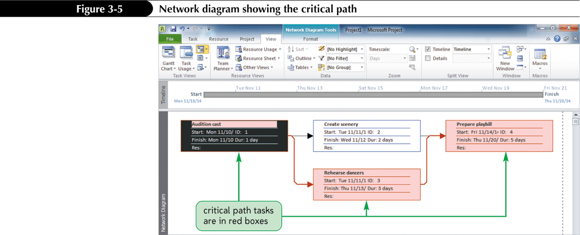
Critical Path

Slide 9
The Importance of Communicating Information about the Critical Path
It is very important for a project manager to have excellent skills in finding, analyzing, and communicating information about the critical path throughout the life of the project.
Filters, formats, and customizing the Network Diagram help the manager accomplish this.

Slide 10
Filtering Tasks for Information
A filter temporarily hides some of the tasks so that only those tasks that you are interested in are displayed.
Filters help you to focus your attention on specific aspects of the project based on different criteria.
Project 2010 offers many built-in filters, available using the Filter list arrow on the Formatting toolbar.
One of the most important filters used is “Critical” because it filters out all tasks not currently on the critical path.

Slide 11
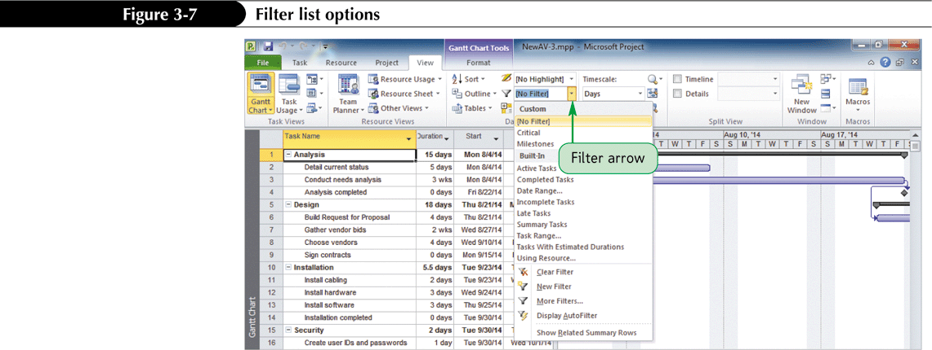
Filter List Options

Slide 12
Filtering Tasks for Information Cont.
Filters can be applied in any view, but each view is filtered independently of the others.
Other filters such as Milestones, Task Range, and Date Range can be used at any time.
Filters temporarily hide those tasks that do not meet the filter criteria.
It is also important to note that filters are only “correct” as of the moment they are applied.
If you make a change to a filtered project, you must reapply the filter.

Slide 13
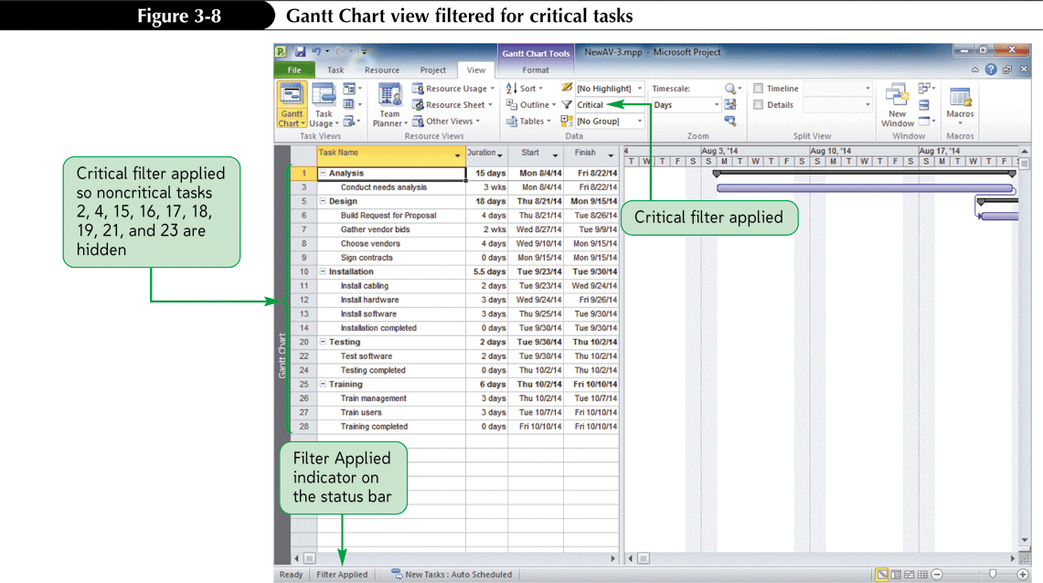
Filtered for “Critical”

Slide 14
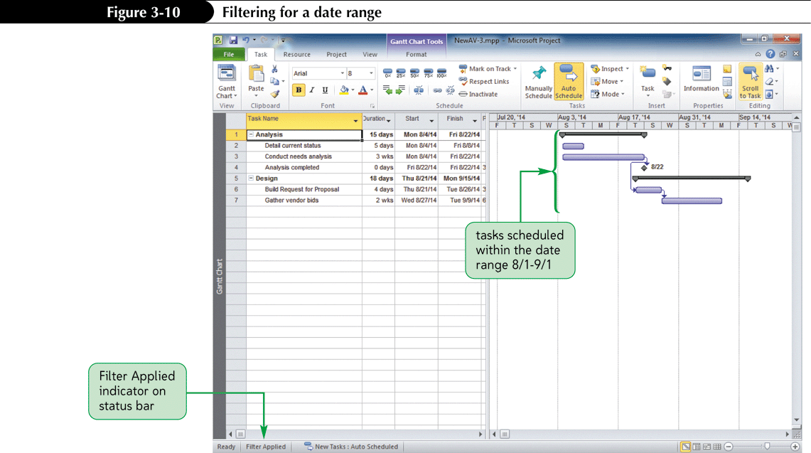
Filtered for a date range

Slide 15
Using the AutoFilter
The AutoFilter allows you to determine the filter criteria by selecting from a criteria list associated specifically with each column in the Entry table.
  When you select AutoFilter on the Formatting Toolbar, a list arrow is displayed to the right of each field name in the Entry table.
  You choose filter criteria for a column by clicking the list arrow in the column heading.
You can apply custom filters using the AutoFilter list arrows.

Slide 16
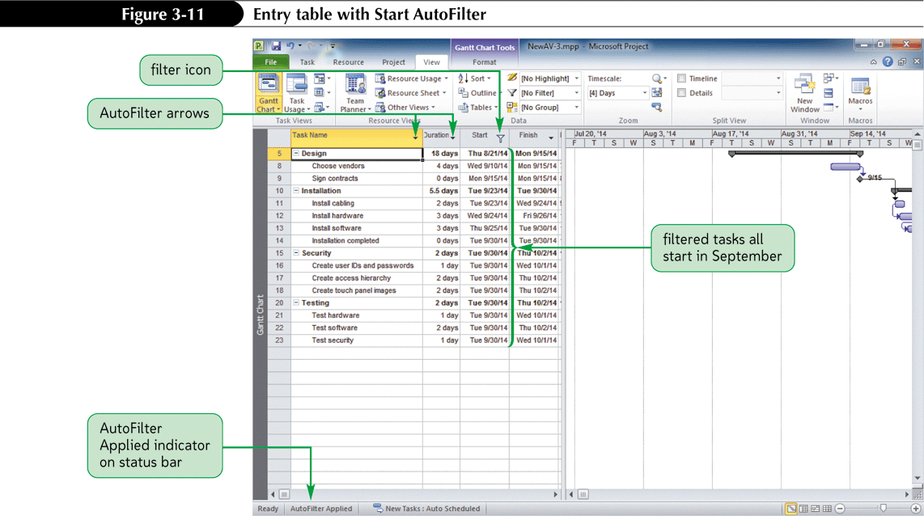
AutoFilter for Starts in Sept.

Slide 17
Custom Filters
Useful to filter using two criteria
Useful to filter using comparison operators.
  <=, >= can be combined with AND or OR
The Custom AutoFilter box is used to create custom filters.

Slide 18
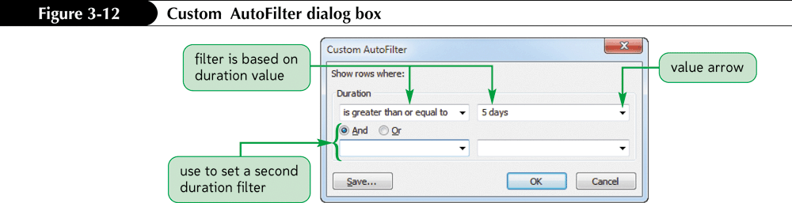
Custom AutoFilter Dialog Box

Slide 19
Printing Filtered View
You can print any filtered view of a project.
Entering information such as your name, the date, perhaps a time, and filename into the header and footer sections help identify the project file on the printout.
This can be helpful when presenting a filtered list of tasks.

Slide 20
Formatting a Project
Sometimes you want to highlight information in a project by changing the appearance of the default views. For example:
  Change the color of certain types of task bars.
  Change the text font size within a table.
Project 2010 provides many ways to format the colors, shapes, and text within each project view to help you clearly communicate your message.

Slide 21
Formatting a Gantt Chart
Project 2010 applies default formatting choices such as blue for task bars and black for summary bars.
You can change the default options individually or by using Gantt Chart Styles.
Enhancing the appearance of certain task bars of a Gantt Chart customizes the project and helps you communicate the information to management.

Slide 22
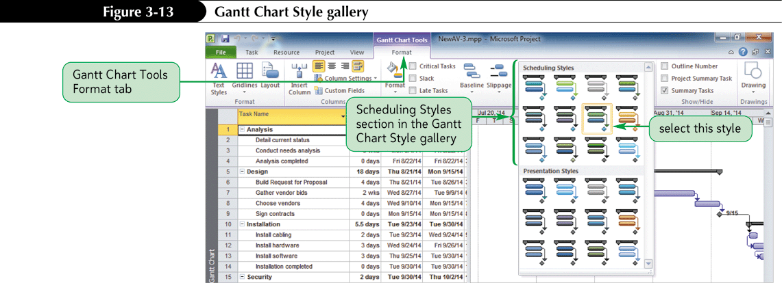
Changing Bar Style with the Gantt Chart Style Gallery

Slide 23
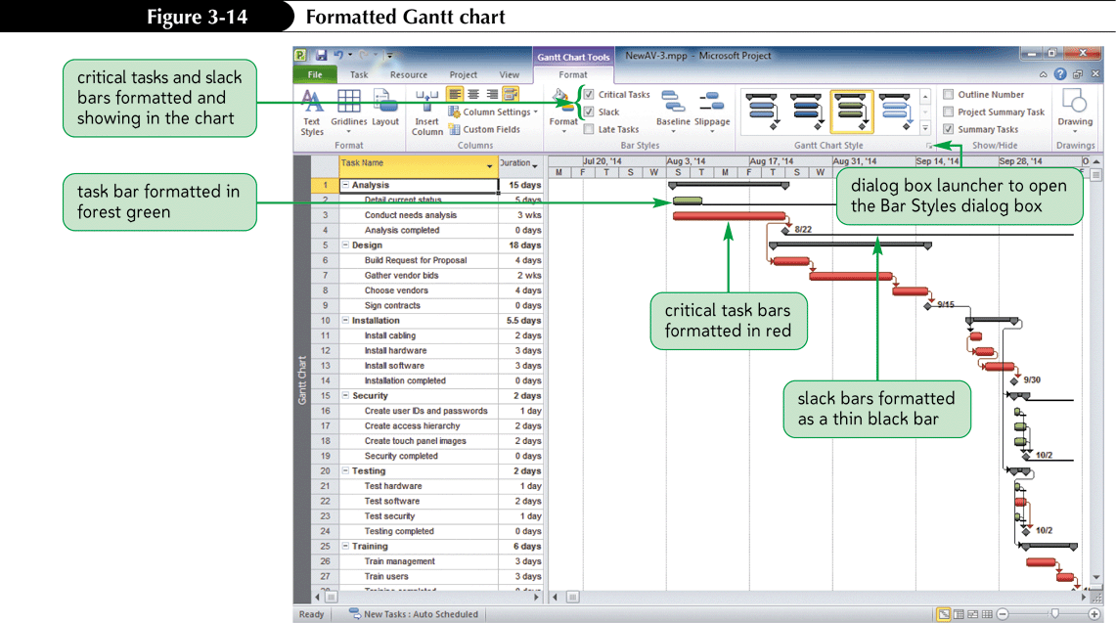
Formatted Gantt Chart

Slide 24
Formatting a Gantt Chart Cont.
Project 2010 has many formatting options for the Gantt Chart.
The key to formatting the Gantt Chart is that the final product should clearly and quickly communicate the information that is important to the project manager and management.
As the project progresses, you can always reformat the Gantt Chart to highlight any new important messages.

Slide 25
Formatting an Entry Table
You can click any cell within the Entry table and choose a new font, font size, font effect, or color.
By visually organizing the tasks, you help communicate what needs to be done in the project.
Formatting tasks by category changes all formatting for the specified category.
Formatting options are available to help you communicate project information to management as you work with Project 2010.

Slide 26
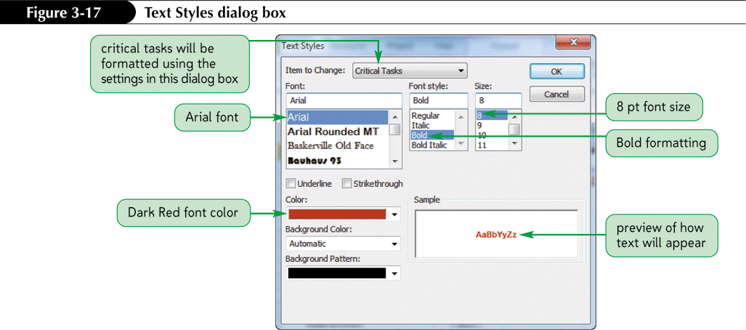
Text Styles Dialog Box

Slide 27
Formatting Individual Items in the Entry Table and Gantt Chart
Many options on the Formatting toolbar and Format menu are used for formatting individual tasks. For example:
  Format the tasks that you have assigned to an outside contractor with an italic font.
  Temporarily change the color of one Gantt Chart bar to highlight it for a meeting.

Slide 28
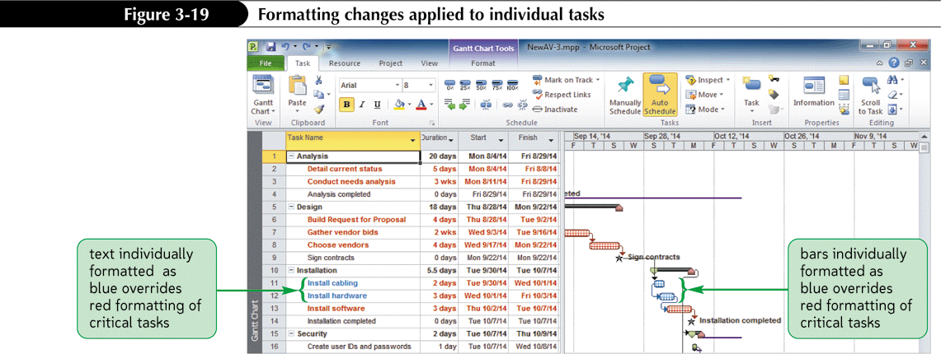
Individual Formatting Changes Applied

Slide 29
Formatting the Timescale
The timescale can display three tiers simultaneously.
You may be working on a project that requires that level of detail on the timescale.
You can set the timescale to show all three tiers and format each one.

Slide 30
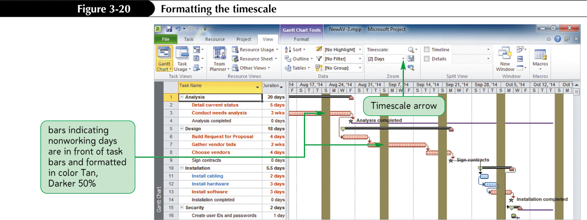
Timescale with Formatting

Slide 31
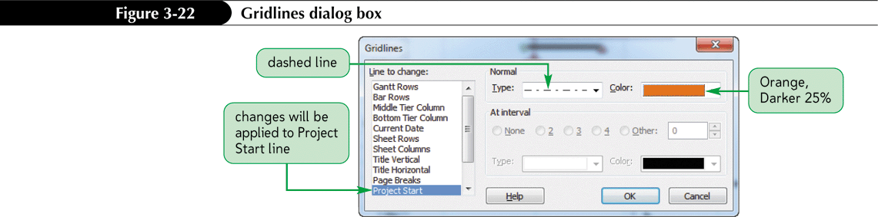
Formatting Gridlines & Link Lines
Gridlines are nonprinting lines that improve readability.
Gridlines help you locate current dates or intervals.
Link lines show connections between bars and are used to add visual impact.

Slide 32
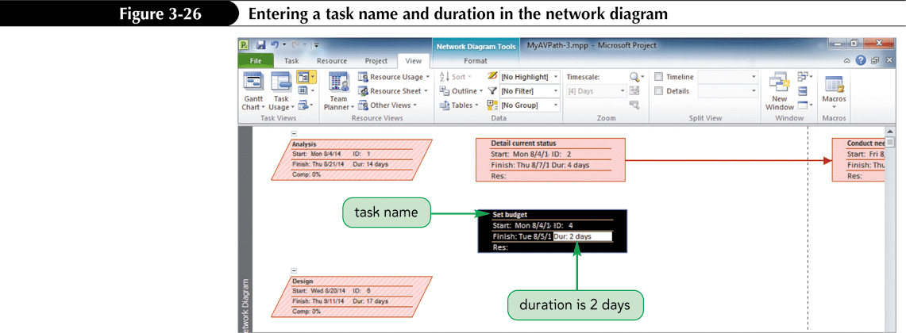
Working with the Network Diagram View
Network Diagram most clearly identifies the dependencies (also called relationships) between the tasks, as well as the critical path.
You need to be able to complete basic actions such as entering and editing tasks in any view that you use.

Slide 33
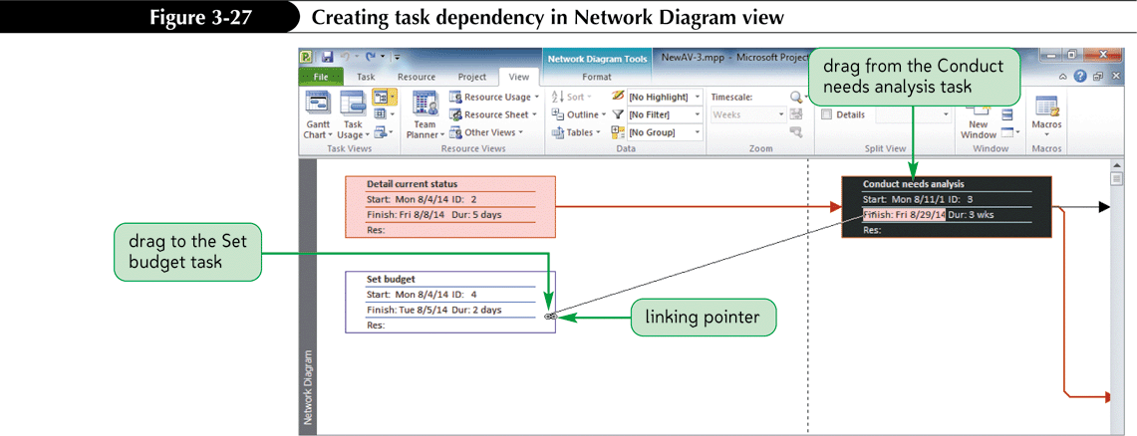
Examining Dependencies and the Critical Path
The primary purpose of the Network Diagram is to clearly illustrate the sequential progression of tasks and the critical path.
Project managers often use the Network Diagram view to enter and edit task dependencies.

Slide 34
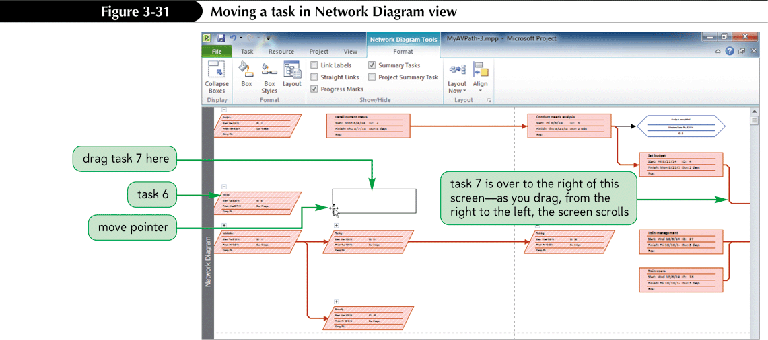
Manually Moving Tasks for Printouts
Network Diagram printouts can be quite wide, so you might want to move tasks in order to better arrange them for printouts.
If you plan to show them to your colleagues or to management, you must be organized so as to best communicate the information.

Slide 35
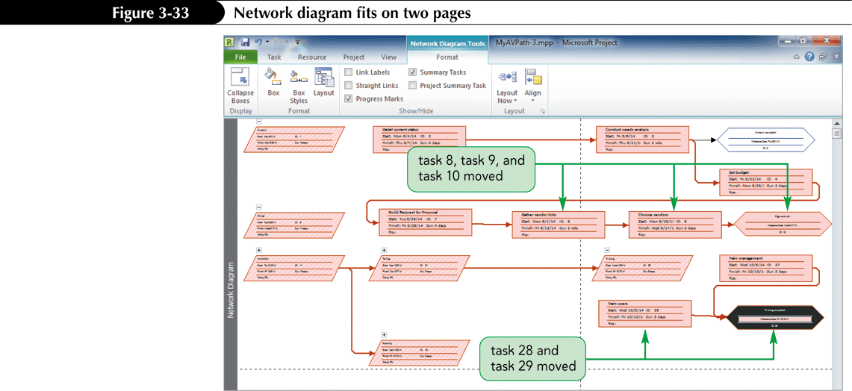
Revised Network Diagram

Slide 36
Filtering and Formatting in Network Diagram View
Filtering
  Almost the same as in Gantt view
  AutoFilter is not available
Formatting
  Almost the same as in Gantt View
  Changes are made by modifying settings in the Box Styles dialog box.
Notes:
36

Slide 37
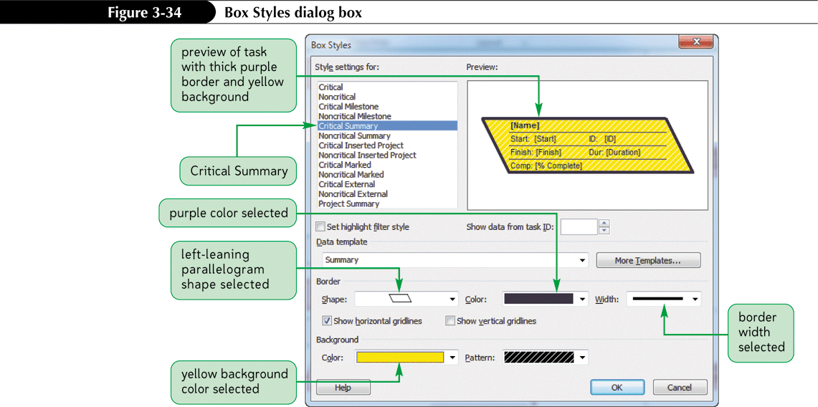
Box Styles Dialog Box

Slide 38
Shortening the Critical Path by Using Task Information
There are several ways to shorten the Critical Path:
  Change the task duration
  Change the task dependencies
  Add more resources (Crashing)
  Run tasks in parallel (Fast-tracking)
  Add negative lag-time
  Modify the work calendar
  Remove task constraints

Slide 39
Shortening the Critical Path by Using Task Information Cont.
Any direct change to a task must be a true reflection of reality.
Shortening the path purely for the sake of shortening the project on paper only confuses participants and brings them stress.
Find ways to shorten the critical path by using techniques that can realistically be accomplished once the project is started.
Notes:
39

Slide 40
The Project 2010 Task Inspector
Identifies factors that affect the start date of tasks
Displays error messages for the tasks
Provides suggestions for changing start dates and dependencies
Can identify if a task begins before its predecessor ends
Offers selectable suggestions to ‘fix’ tasks.

Slide 41
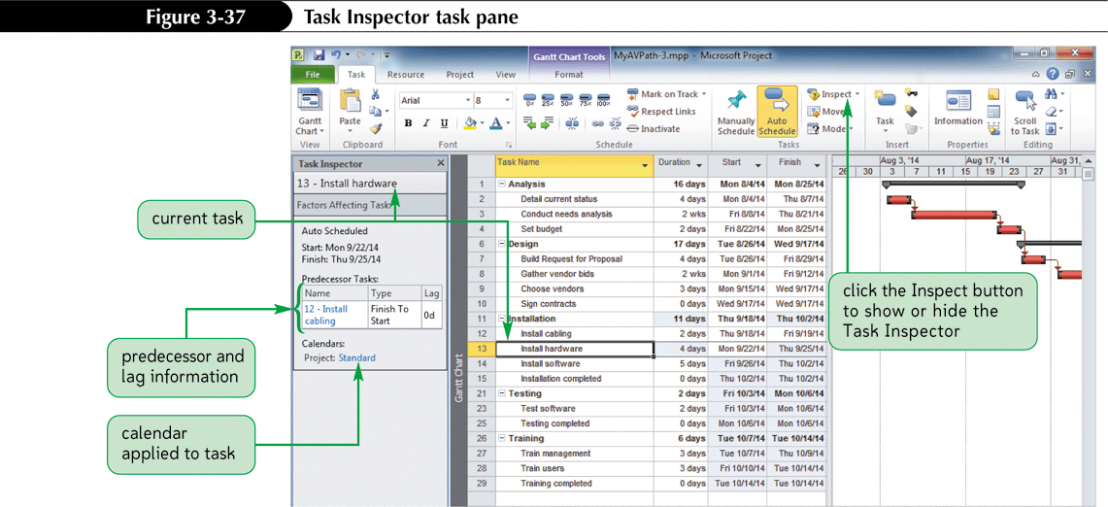
Task Inspector Task Pane
Notes:
41

Slide 42
Shorten the Critical Path by Changing Task Dependencies
Sometimes a Finish-to-Start (FS) dependency is created when it is not necessary.
A dependency that requires less total time, such as a Start-to-Start (SS) or Finish-to-Finish (FF) might be more appropriate.
To change a task dependency, double-click on the link between tasks to open the Task Dependency dialog box, then alter the dependency type.

Slide 43
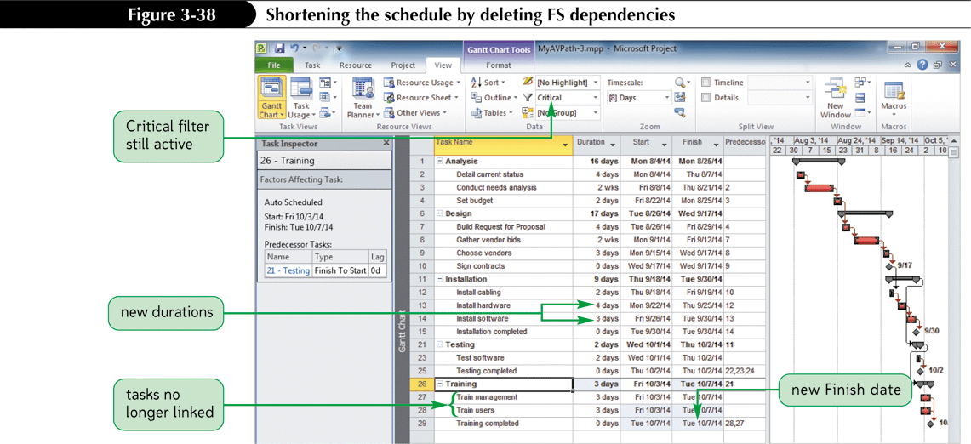
Shortening the Schedule by deleting FS Dependencies
Notes:
43

Slide 44
Fast Tracking
Fast tracking is when you perform activities in parallel that you would normally do in sequence. For example:
  You might have planned to finish all of the analysis work before starting design, but you decide to start the design when the analysis is 75 percent complete.

Slide 45
Negative Lag Time
Another technique to shorten the critical path is to add negative lag time to an existing Finish-to-Start (FS) dependency between two critical tasks.
  Negative lag time always allows the tasks to overlap, regardless of whether the project is scheduled from a given Start or Finish date.
  When a project is scheduled from a given Start date, negative lag time pulls the second task in the dependency backward in time.

Slide 46
Changing Calendar and Task Constraints
If you know of a task whose working time does not follow that of the Standard calendar, you should create a special calendar with the appropriate working and nonworking times and assign it to that task.
Another way to shorten the critical path is to analyze and eliminate unnecessary date constraints that have been applied to the tasks within your project.
A constraint is a restriction that you put on a task’s Start or Finish date.

Slide 47
Changing Calendar and Task Constraints Cont’d
Be very careful about entering date constraints because they will definitely remove some flexibility in recalculating individual task Start and Finish dates.
Project 2010 places an icon in the Indicator column for any constraint other than As Soon As Possible and As Late As Possible to alert you.

Slide 48
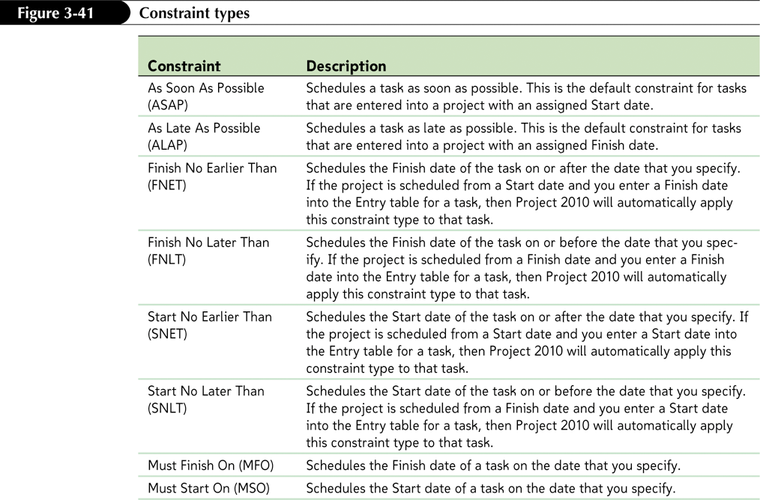
Constraint Types

Slide 49
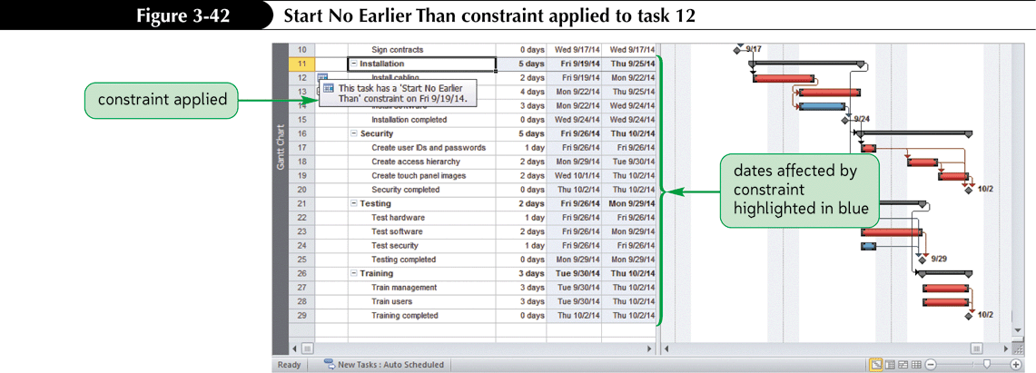
Constraint Applied

Slide 50
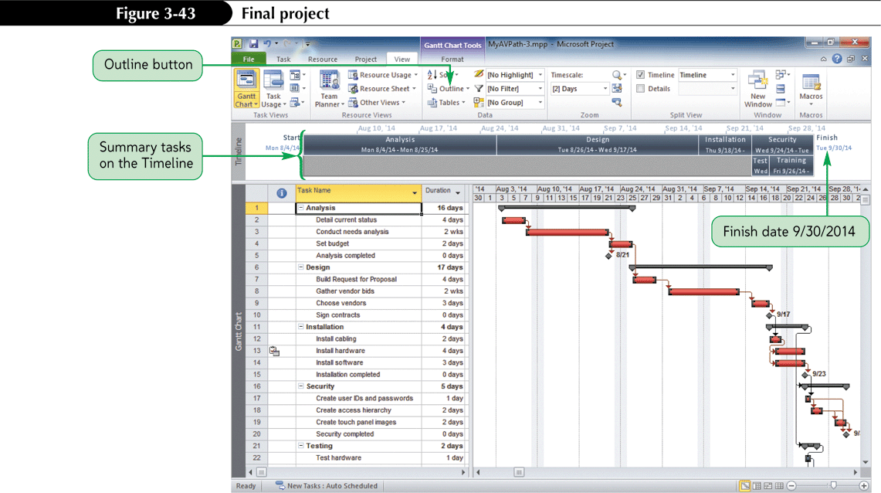
Viewing the Entire Project Using the Timeline to show Summary Tasks

Slide 51
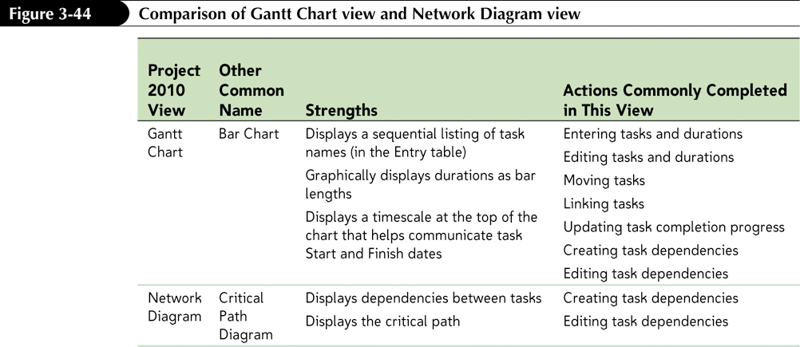
Comparison of Gantt Chart View and Network Diagram View

