Slide 1
Information
Systems
for
Managers

Slide 2
Course Roadmap
Introduction
Ch. 1 : Information Systems and the Role of General and Functionnal Managers
Ch. 2 : Information Systems Defined
Ch. 3 : Organizational Information Systems and Their Impact
Ch. 4 : The Changing Competitive Environment
Ch. 5 : Electronic Commerce: New Ways of Doing Business
Ch. 6 : Strategic Information Systems Planning
Ch. 7 : Value Creation & Strategic Information Systems
Ch. 8 : Value Creation with Information Systems
Ch. 9 : Appropriating IT-Enabled value Over Time
Ch. 10 : Funding & Governance of Information Systems
Ch. 11 : Creating Information Systems
Ch. 12 : Information Systems Trends
Ch. 13 : Security, Privacy & Ethics

Slide 3
Learning Objectives
Introduction
To understand the relationship between strategic information systems planning and the yearly budgeting and prioritization process.
To be able to articulate the role that general and functional managers play in the yearly budgeting and prioritization process.
To define, comprehend, and use the appropriate vocabulary, including concepts such as total cost of ownership (TCO), business case, and steering committee.
To evaluate the three main funding methods used by modern organizations: chargeback, allocation, and overhead. You will also learn their respective advantages and disadvantages.
To understand the yearly budgeting and prioritization project, and be able to evaluate individual and portfolio risks of information systems projects.
To define the terms outsourcing and offshoring, and identify the primary drivers of this enduring trend. You will also be able to articulate the principal risks of outsourcing and offer some general guidelines with respect to the outsourcing decision.

Slide 4
Introduction
Introduction
Strategic information systems planning involves identifying the long-term direction of information systems use and management within the organization
Managers need to understand how the budgeting and prioritization processes work so that you can make the most of them
Too often we see organizations funding information systems using simple metrics, like percentage of revenue or fixed increments over the previous year’s budget
This prioritization should not be delegated to the information systems group, but should be made in concert with business managers (i.e., those who need the information systems) and IS professionals (i.e., those who make and manage the information systems)

Slide 5
Information Systems Governance
IS Governance
Information Systems governance is generally defined as the set of decisions rights and the guiding accountability framework designed to ensure that IT resources are employed appropriately in the organization
IT governance in the modern firm has two principal aspects:
management of downside risk
fostering of upside potential

Slide 6
Risk vs. Value
IS Governance
IT Risk Governance
Concerned with decisions for minimizing threats (e.g., security risks) and failures (e.g., unsuccessful project implementations)
IT Value Governance
Concerned with maximizing the value of IT investments and the firm’s ability to leverage its information systems resources

Slide 7
Risk Categories
IS Governance
IT Competence Risk | This risk factor captures the degree of IT related knowledge of the board of directors. While boards of directors need not all be as knowledgeable as CIOs or IT professionals, it is critical that they have the ability to follow IT discussions and ask relevant questions. Moreover, there should be a leading IT director who maintains an up-to-date competence on IT matters.
Infrastructure Risk | A firm’s IT infrastructure represents the set of IT components that are interconnected and managed by IT specialists with the objective of providing a set of standard services to the organization. It provides the foundation for the delivery of business applications. The board of directors must be keenly aware of the weaknesses and risks associated with the firm’s IT infrastructure.
IT Project Risk | In Chapter 3 we provide a sample of high profile IT project failures. IT projects are generally complex and expensive undertakings that, if not properly managed, can put the organization in peril. The board of directors must ensure that the appropriate guiding framework for IT projects is in place. In large organizations this may require a project office, a certification process for project managers, and a portfolio approach to IT project management (see below).
Business Continuity Risk | Business continuity refers to the activities a firm performs to ensure that critical business functions remain operational in a crisis, and that the organization can withstand unforeseen disasters (see chapter 13). The board of directors must ensure the existence of a business continuity plan and that such a plan is periodically tested and revised.
Information Risk | Information risk pertains to the many hazards associated with the collection and use of organizational, partner, and customer data (see chapter 13). The board of directors must craft a governance system that ensures that an officer of the organization has clear responsibility for signing off and ensuring compliance with established privacy and security policies.

Slide 8
Steering Committee
IS Governance
Used in large organizations
It brings together representatives from the various functional areas
It focuses on Information Systems issues
It formalizes information systems involvement and decision making

Slide 9
Funding Information Systems
Funding IS
Three approaches to funding Information Systems:
Chargeback
Allocation
Overhead
Each approach has advantages and disadvantages

Slide 10
Funding IS: Chargeback
Funding IS
Chargeback Approach
The direct billing of IS resources and services to the function or department that uses them
Grounded in the pay-per-use principle
Chargeback mechanisms are perceived as fair by the organization
They create accountability for both users and the IS function

Slide 11
Funding IS: Allocation
Funding IS
Allocation Approach
The allocation approach calls for direct billing of IS resources and service
Based on fairly stable indicators such as size, revenues, and number of users
Seeks to strike a balance between pay-per-use fairness and the high cost of the chargeback method.
The allocation approach creates more predictable department expenses

Slide 12
Funding IS: Overhead
Funding IS
Overhead Approach
Treats information systems as a shared expense for the organization’s overall budget
It is the simplest of the three approaches. Budget decisions are made annually.
The main drawback of the overhead approach is the lack of accountability for the functional areas and the IS department

Slide 13
The Budgeting Process
Budgeting and
Prioritization
As a planning tool, the budget provides an assessment of what the firm believes future financial flows will be
As a control mechanism, the budget helps enforce specific behaviors
The budget can be used to allocate decision rights and power

Slide 14
The Budgeting Process
Budgeting and
Prioritization
Making the Budget
Requires trade-offs between diverging interests and the prioritization of projects
Based on two decisions:
Determining the appropriate budget for ongoing operational expenses
Evaluating large capital expenditures
A prerequisite to budgeting is an appreciation of the role of Information Systems in the firm

Slide 15
Example: Large Hotel Chain
Budgeting and
Prioritization
Sample Operational IT Budget
This sample operational IT budget is loosely based on that of a major hotel chain.
Expenses | Amount (U.S. dollars) | Percentage
Payroll | 3,140,000 | 31.4
Travel & entertainment | 270,000 | 2.7
Depreciation¹ | 450,000 | 4.5
Amortization² | 1,080,000 | 10.8
Training | 30,000 | 0.3
Equipment/hardware/software purchases³ | 90,000 | 0.9
Maintenance | 680,000 | 6.8
Telecommunications expense | 520,000 | 5.2
Disaster recovery | 10,000 | 0.1
Misc. other operating expense | 180,000 | 1.8
Corporate IT allocation⁴ | 3,530,000 | 35.3
¹ Capitalized equipment is subject to depreciation.
² Capitalized software is subject to amortization.
³ Equipment below the capitalization threshold.
⁴ IT allocation from the parent company. For firms without a parent company, this line would spread over the other items in roughly the same percentages.

Slide 16
Business Case
Budgeting and
Prioritization
A formal document providing the rationale for pursuing new projects and opportunities
Prepared by general or functional managers and presented to the executive team or board.
Designed to articulate the project and provide evidence that it will pay off
Often used to evaluate ongoing spending decisions and to evaluate existing systems
Skeptics suggest that business cases are based too much on speculation and assumptions

Slide 17
Limitations
Budgeting and
Prioritization
Business cases strictly based on fact will often require so many assumptions and speculations that they will become based on fiction
Business cases for projects that rely on business or technical innovation are characterized by significant uncertainty as to the final outcome
Financial projections are also difficult to make for projects that have mostly “soft” benefits.
Key questions that are hard to answer:
What is the value of such customer engagement?
How much more revenue would an initiative like this generate?

Slide 18
Overcoming Limitations
Budgeting and
Prioritization
In order to overcome limitations, you need to focus on the value of heuristics
A heuristic is a simple rule that is good enough to make decisions, recognizing that adjustments along the way will be necessary
This approach systematizes the reevaluation of both the costs and benefits of projects during their development
Another valuable approach consists of relaxing the focus on fact-based business cases and allowing proponents of a project to ground their request on faith and fear
Faith: project rationale based on beliefs about market trends, customer expectations, competition, strategy, etc.
Fear: need to engage in projects to keep from falling behind the competition or to avert a likely negative outcome
A well-crafted business case will include all of the above: fact, faith, and fear-based arguments

Slide 19
Developing a Business Case
Budgeting and
Prioritization
Define business drivers and investment objectives
Begin the case by establishing the business drivers underlying the need for the project and by clearly spelling out the investment objectives and their relationship with the business drivers
When the firm relies on the strategic IS planning process, much of the work here has already been completed.
Identify benefits, measures, and owners
Must identify all the potential benefits accruing to all stakeholders if the project is successfully implemented
Explain how benefits will be measured and who will own them
Structure the benefits
Assess the actual realizable benefits of the project

Slide 20
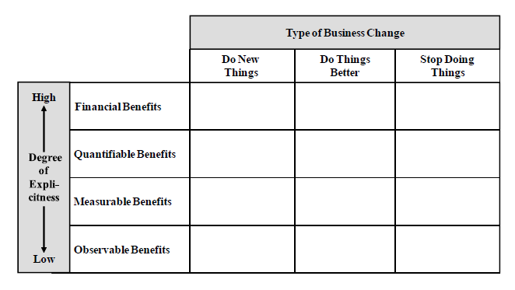
Structure the Benefits
Budgeting and
Prioritization

Slide 21
Developing a Business Case
Budgeting and
Prioritization
Identify organizational changes enabling benefits
Doing new things
Doing things better
Ceasing to do things
Determine the explicit value of each benefit
Categorized by the extent to which they can be made explicit
To the extent to which a benefit is measurable in order to ensure the maximum degree of precision in their estimation.
Identify costs and risks
Estimation of the costs the firm will incur to see the project through to completion
Estimation of the degree of uncertainty and risk surrounding successful completion

Slide 22
Benefits Categories
Budgeting and
Prioritization
Financial Benefits: Computed by applying cost/price metrics or other recognized financial formula to measure the benefit.
Quantifiable Benefits: Computed by gathering metrics, expressed in number form, that provide evidence of change univocally attributable to the project.
Measurable Benefits: A measure is available to monitor a given benefit, but changes in such metrics cannot be univocally tied to the project.
Observable Benefits: There exist agreed upon criteria, albeit not quantifiable, to evaluate the impact of the project on this class of benefits

Slide 23
Identifying Project Costs
Budgeting and
Prioritization
TCO is a financial estimate designed to explicitly recognize the full life cycle costs of IT assets
Requires significant estimation
Includes assumptions about future events
An important variable to consider when funding IT and making budgeting decisions
Project costs will include all technology development expenses, licensing fees, training, and change management initiatives

Slide 24
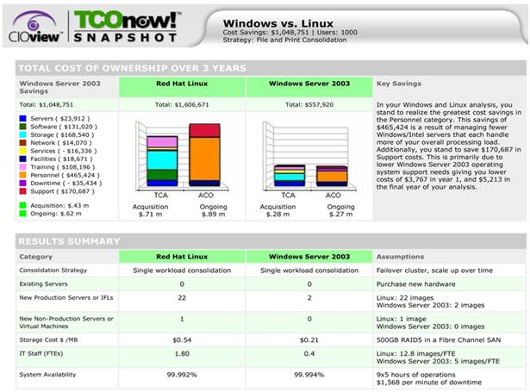
TCO
Budgeting and
Prioritization

Slide 25
Identifying Project Risks
Budgeting and
Prioritization
The risks associated with an initiative can vary widely based on:
Project Size: The estimated monetary investment
Focus should be on relative size
Experience with Technology: The degree of experience a firm has with technology
Working with new and unproven technologies carries more risk
Organizational Change: The degree of organizational change the project requires

Slide 26
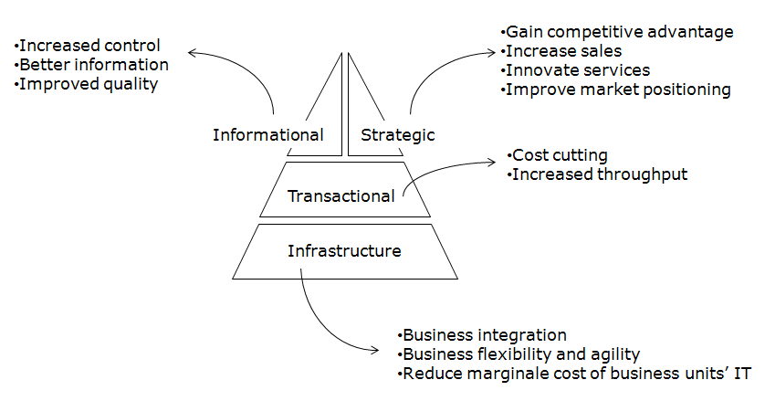
Portfolio Management
Budgeting and
Prioritization
Portfolio Management
The leadership must determine the appropriate level of aggregate risks the organization will accept
Uses individual project risk profiles
Must be informed by the firms overall strategic information systems plan and vision

Slide 27
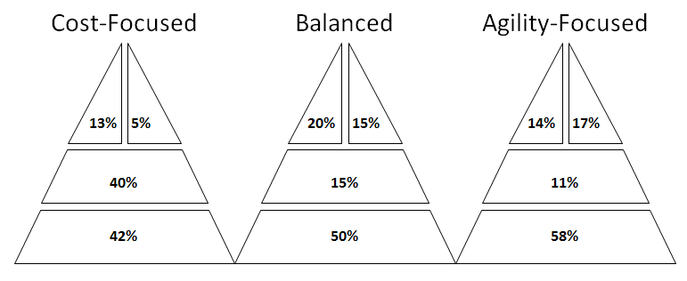
Sample Project Portfolio Profiles
Budgeting and
Prioritization

Slide 28
Outsourcing
Outsourcing
Used as a means of funding information systems operations by engaging outside providers
Outsourcing is the process of acquiring products or services that used to be created internally by the organization, from an outside provider
Information systems outsourcing is the process of contracting with an outside firm to obtain information systems services
Such services can range from automation of specific processes (e.g., payroll), to management of specific assets (e.g., data center), to development of new applications, to outright management of the IS function as a whole (i.e., full outsourcing)

Slide 29
Outsourcing Drivers
Outsourcing
Reduce cost: Capitalize on the provider’s ability to create economies of scale
Access to superior talent: IT service providers have access to top IT talent and Information Systems management expertise
Improve control: To reclaim control over inefficient IT function service
Improve strategic focus: Eliminates the IS function to free resources and focus on “core competences”
Financial appeal: Some tangible and intangible IT infrastructure assets may be liquidated to strengthen the balance sheet

Slide 30
Risks of Outsourcing
Outsourcing
The outsourcing paradox: Outsourcing does not guarantee performance, managerial involvement from the firm is still necessary
The dark side of partnerships: Each partner has a responsibility to shareholders to maximize its own performance
Changing requirements: Over a long period of time, technological and business changes will have an effect on the organization’s Information Systems needs
Hidden coordination costs – There are many necessary and costly coordination efforts between the firm and provider
Deceptive role of Information Systems – Many firms underestimate the critical role that information systems play as enablers of business success

Slide 31
Optimal Outsourcing Decisions
Outsourcing
Understand the current and future role of Information Systems in the firm
Most firms should rely on selective outsourcing arrangements
Maintain a core group of Information Systems specialists and a strong CIO function
It is critical to have a group of knowledgeable internal employees whose allegiance is to the organization

Slide 32
Offshoring
Outsourcing
Offshoring, short for offshore outsourcing, is the process of engaging a foreign provider to supply the products or services the firm no longer intends to produce internally
Offshoring has received much impetus since the commercialization of the Internet, which significantly lessened the impact of geographical and time differences on the transaction of information-based services
Offshoring growth has been fueled by many of the same drivers of outsourcing, particularly cost and quality, with much of the business moving to India and China—countries that enjoy a significantly lower cost of living than the United States or Europe, and offer a seemingly endless pool of highly qualified IT talent

Slide 33
The Recap
Conclusions
Total cost of ownership (TCO) is a financial estimate designed to explicitly recognize the life cycle cost of IT assets.
The costs of information systems and technology typically far exceed the cost of acquisition (e.g., selection, licensing, implementation), and include expenses that occur after the system is up and running but are necessary to maintain it in operation over its life span
The business case is the formal documentation used to garner support and win funding for the initiative.
Modern organizations use one of three approaches to the funding of information systems operations and projects:
Chargeback
Allocation
Overhead

Slide 34
The Recap
Conclusions
The yearly budgeting process is the tool organizations use to assess future information systems requirements and prioritize funding
The budgeting process enables the firm to encourage and enforce specific behaviors and to allocate information systems decision rights and control
During the budgeting process the firm has an opportunity to evaluate the risk of proposed projects, both individually and as a portfolio
The firm must take this opportunity to evaluate whether the degree of risk associated with its current portfolio of projects matches the risk profile the firm deemed appropriate during strategic information systems planning
Information systems outsourcing is the process of contracting with an outside firm to obtain information systems services
Modern organizations outsource their complete IS function (i.e., full outsourcing) or some of their IS assets and services (i.e., selective outsourcing), seeking one or more benefits

Slide 35
What we Learned
Conclusions
To understand the relationship between strategic information systems planning and the yearly budgeting and prioritization process.
To be able to articulate the role that general and functional managers play in the yearly budgeting and prioritization process.
To define, comprehend, and use the appropriate vocabulary, including concepts such as total cost of ownership (TCO), business case, and steering committee.
To evaluate the three main funding methods used by modern organizations: chargeback, allocation, and overhead. You will also learn their respective advantages and disadvantages.
To understand the yearly budgeting and prioritization project, and be able to evaluate individual and portfolio risks of information systems projects.
To define the terms outsourcing and offshoring, and identify the primary drivers of this enduring trend. You will also be able to articulate the principal risks of outsourcing and offer some general guidelines with respect to the outsourcing decision.

