Slide 1

Information
Systems
for
Managers

Slide 2

How to categorize systems according to the hierarchical, functional, and process perspectives. You will also learn the rationale for each perspective and its limitations.
The definition, underlying principles, and applications of business process reengineering (BPR), as well as the advantages and disadvantages of BPR.
The definition of integration and its role in the modern firm. We will explore the pressures toward integration and the challenges integration creates. We will also discuss business and systems integration trends and the relationship between the two.
The genesis of the enterprise systems (ES) trend and why so many companies are employing or introducing them. You will also learn to articulate the principal benefits and risks associated with these systems.
The definition of the term supply chain management and how to explain the role that supply chain management applications play in modern organizations.
The definition of the term best of breed and how to describe the benefits and drawbacks of this approach to systems integration. You will also learn to draw comparisons between the best-of-breed and enterprise systems approaches.
How to describe what is meant by knowledge management, how to categorize the different types of knowledge commonly found in organizations, and how to explain why organizations feel the need to employ knowledge management applications.
The definition of the terms business intelligence (BI) and BI infrastructure. You will also learn how to identify and describe the role of the technologies that comprise a modern BI infrastructure.
The definition of the term customer relationship management (CRM) and how to articulate both its benefits and limitations. You will also learn how the CRM and BI trends relate to one another.
Notes:
Rappel de la séance précédente

Slide 3
A « textbook » for better learning
Introduction
Ch. 1 : Information Systems and the Role of General and Functionnal Managers
Ch. 2 : Information Systems Defined
Ch. 3 : Organizational Information Systems and Their Impact
Ch. 4 : The Changing Competitive Environment
Ch. 5 : Electronic Commerce: New Ways of Doing Business
Ch. 6 : Strategic Information Systems Planning
Ch. 7 : Value Creation & Strategic Information Systems
Ch. 8 : Value Creation with Information Systems
Ch. 9 : Appropriating IT-Enabled value Over Time
Ch. 10 : Funding & Governance of Information Systems
Ch. 11 : Creating Information Systems
Ch. 12 : Information Systems Trends
Ch. 13 : Security, Privacy & Ethics
Notes:
Préciser que le livre est LE support du cours ! Les inviter à lire les Ch.itres avant d’aller en cours, etc. 35 € librairie interphilliv
C’est un cours créé avec un prof américain reconnu, on le fait en français mais on vous demande un minimum d’investissement, notamment un peu de lecture.

Slide 4
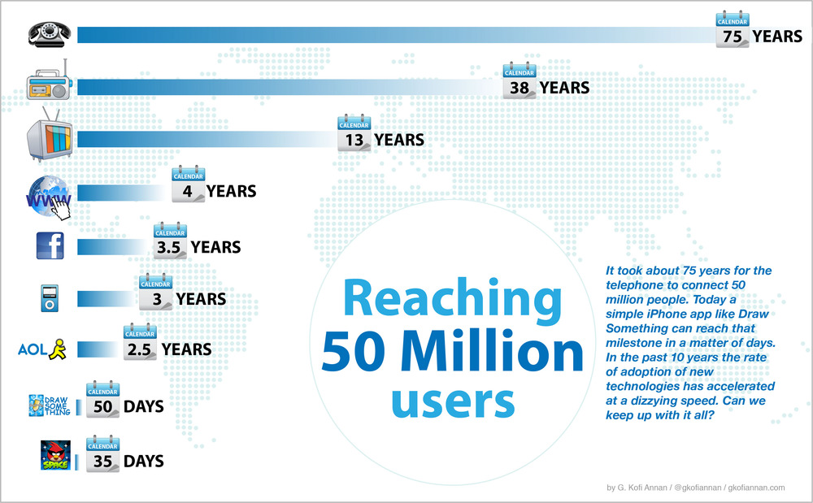
Technology Adoption
Changing
environment
Notes:
Le graphe ci-dessus met en avant la pénétration des technologies dans les foyers américains. Le constat est clair: la vitesse d'adoption des haut/très haut débits est sidérante; jamais une technologie n'a été adoptée aussi rapidement. Dix ans après son introduction, le haut débit est présent dans 70% des foyers américains; l'automobile, elle, a mis plus de 100 ans pour atteindre une pénétration équivalente.

Slide 5



Amazon vs Ebay! Well, that’s interesting
Changing
environment
Notes:
Amazon : 74 / 20 / 0,65
Ebay : 14 / 10 / 3

Slide 6

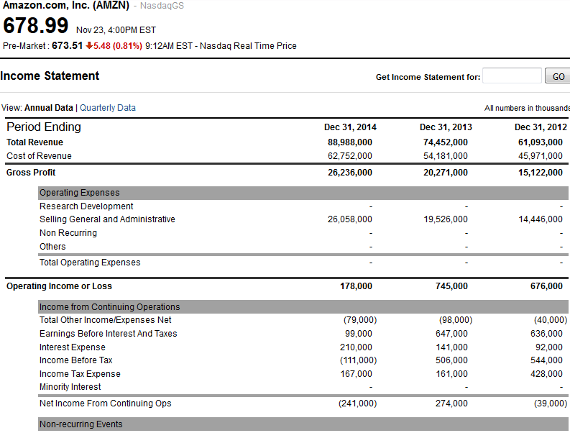
Amazon vs Ebay !
Changing
environment
http://finance.yahoo.com/q/is?s=AMZN+Income+Statement&annual
http://finance.yahoo.com/q/is?s=EBAY+Income+Statement&annual

Slide 7

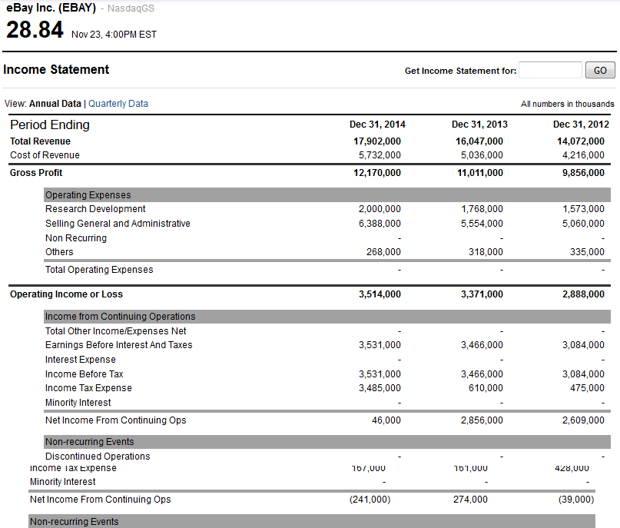
Amazon vs Ebay !
Changing
environment
http://finance.yahoo.com/q/is?s=AMZN+Income+Statement&annual
http://finance.yahoo.com/q/is?s=EBAY+Income+Statement&annual

Slide 8
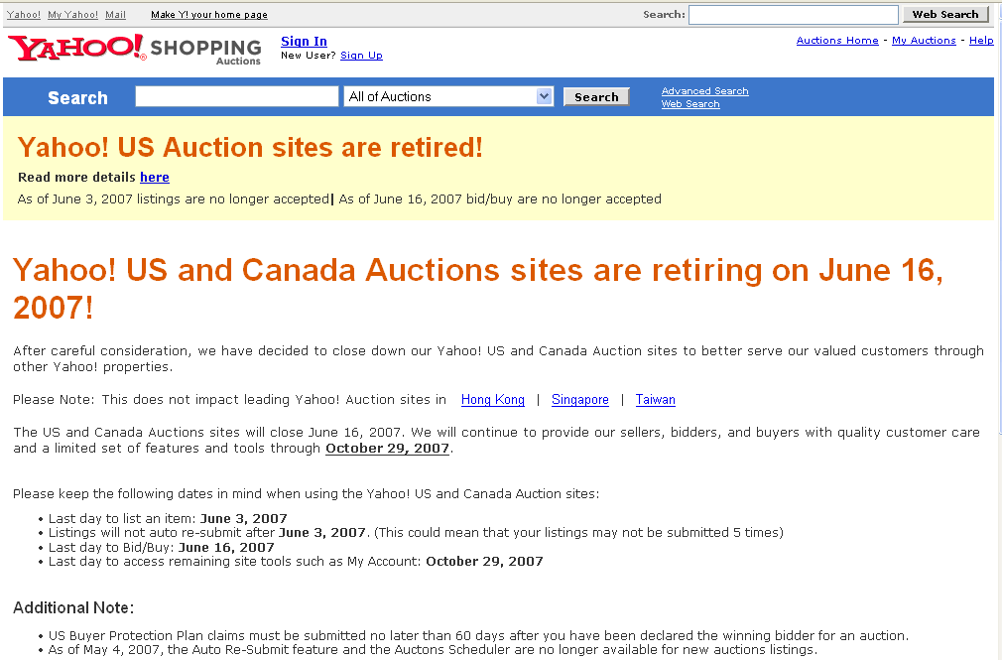
Changing
environment
Once upon a time..

Slide 9

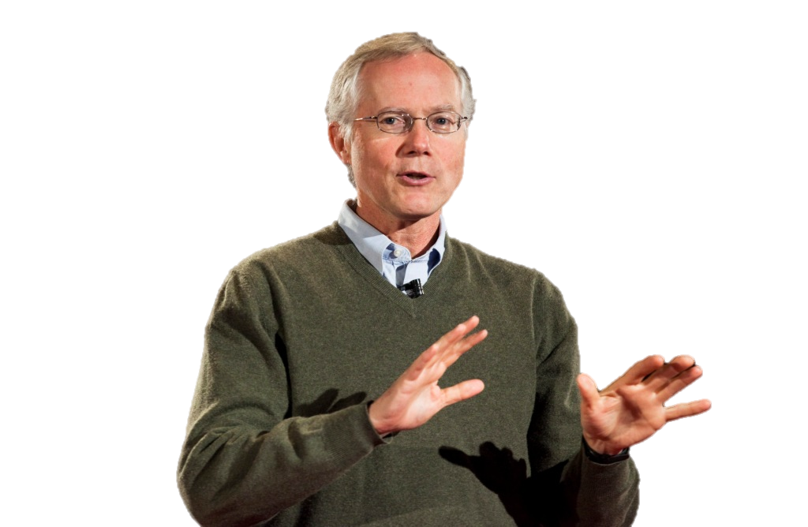
Know the Power !
Network
Effects
I also think that a fundamental understanding of network effects is very important. ... Network effects are a fundamental characteristic of certain technology businesses.
When network effects are possible, it is the most important thing in the world to follow, to understand, and to make happen.
Scott Cook
Notes:
Pèse 1.3 millards de $ (fondateur d’Intuit) siège au CA d’ebay ou de la harvard business school…

Slide 10

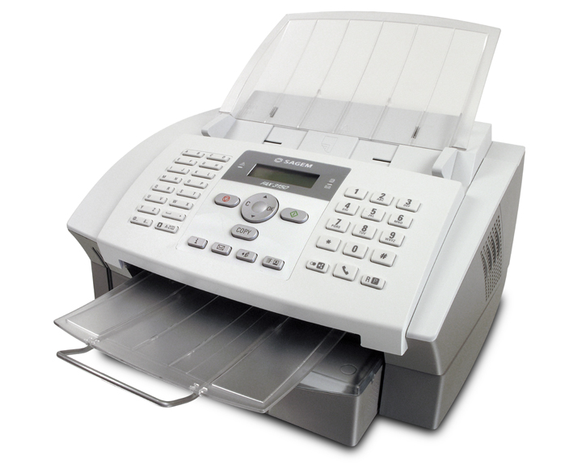
Value in the netwok
Network
Effects
≠

Slide 11
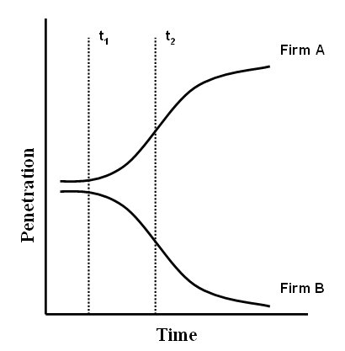
Stronger gets stronger: the positive feedback
Network
Effects
Tipping point
Notes:
Le méchanisme auto-réenforcé qui rend les forts plus forts et les faibles plus faibles.
Économies d’échelles
les forts plus forts
les faibles plus faibles.

Slide 12
Tipping Point vs.. Tippy Market
Network
Effects
Tippy Market: Market that is subject to strong positive feedback, such that the market will “tip” in favor of the firm that is able to reach critical mass and dominate it
Tipping Point: The moment in the evolution of a market where one organization or technology reaches critical mass

Slide 13
Stronger gets stronger: the positive feedback
Network
Effects

Slide 14
Negative Feedback
Network
Effects
The opposite of positive feedback
  The stronger gets weaker
  The weaker gets stronger
Past a certain size, the dominant firm encounters difficulties, such as coordination costs and increasing overhead, that limit further growth.

Slide 15











Network Effect
Network
Effects
=
Notes:
Effets réseaux : dynamique de feedback positif qui apparait dans les réseaux
Externalités réseau : un nouveau nœud créé de la valeur (symbolisée par le dollar) pour les autres membres en agrandissant le réseau, augmentant ainsi sa valeur (pour l’entreprise qui possède le réseau), et diminuant celle des réseaux concurrents
On peut prendre l’exemple des abeilles, l’externalité étant la capacité polinisatrice, qui maintenant se « vend » plus cher que le miel.
Ou l’exemple de l’externalité négative, celui de la porcherie qui s’installerait, légalement, suffisamment loin de l’hôtel, mais le sens des vents ferait que les odeurs y viendrait… Il ne serait plus 5 étoiles ^_^
Exemples: Skype, Facebook vs Copain d’Avant ou MSN

Slide 16

Do all markets tip?
Network
Effects
Notes:
Effet réseau ? Bien sur que NON ! Fnac.com, amazon.com et tout les autres ne sont que des marchés classiques !

Slide 17

Do all markets tip?
Network
Effects
Do all markets tip?
Notes:
Echange d’appartement, et là oui, ça bascule

Slide 18
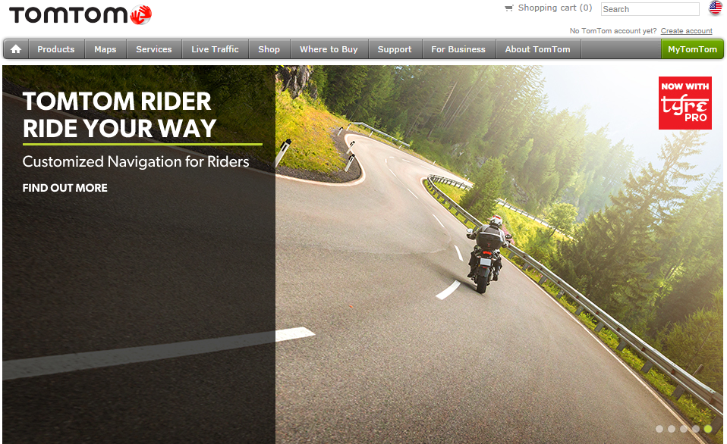
Do all markets tip?
Network
Effects

Slide 19
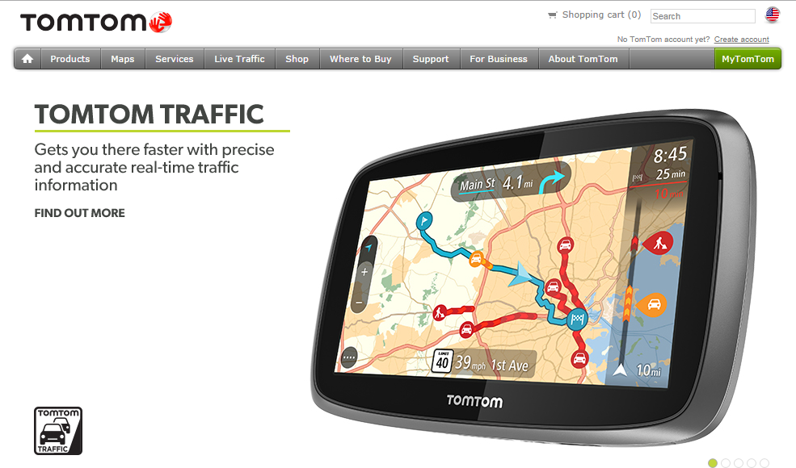
Network
Effects
Do all markets tip?
Do all markets tip?

Slide 20






Types of Networks
Network
Effects
Physical networks
  Telephone network
  Railroad network
Virtual network
  iTunes network
  Skype network
  eBay network

Slide 21




Recognizing Tippy Markets
Network
Effects
Network Effects
Low
High
Low
Unlikely
High
Demand for
variety
High
Low
Depends
Notes:
The presence and strength of economies of scale:
Supply side economies of scale
Demand side economies of scale (network effects)
Variety of customer needs:
Demand for variety engenders
distinct market niches

Slide 22
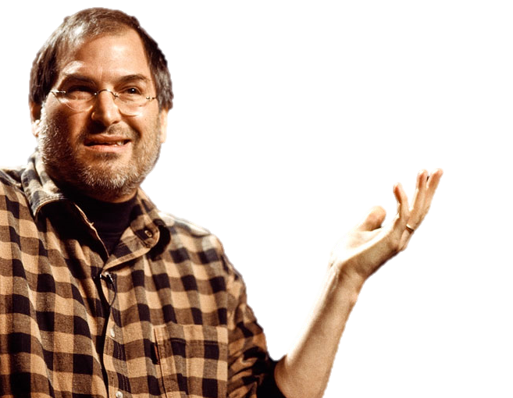

Know the Power !
Network
Effects
If I were running Apple, I would milk the Macintosh for all it’s worth — and get busy on the next great thing. The PC wars are over. Done. Microsoft won a long time ago.
Steve Jobs, 1996
Notes:
http://royal.pingdom.com/2008/07/24/great-quotes-from-bill-gates-steve-jobs-and-linus-torvalds/

Slide 23

Two sided networks
Network
Effects
Networks that have two types of members
  Users of content and suppliers of content (i.e., Adobe PDF format)
  Buyers and suppliers of goods (i.e., Online electronic marketplaces)
The value of the network to one type of member depends on the number of members from the other side that take part in the network

Slide 24

Two sided networks
Network
Effects
Notes:
Ebay, Leboncoin, Jamendo…

Slide 25
Implications of Network Economics
Network
Effects
Network effects occur in the presence of technology standards, virtual networks and communities of interest
It is critical to be an innovator in the market of digital products delivered over the Internet
Customers will pick a network, not a product or a service provider
Sponsoring a dominant network provides competitive advantage
The steeper the costs associated with being a member of competing networks, the more valuable it is to be able to control and retain ownership of the network

Slide 26

The Economics of Information
Information
Economics
The information you can derive from e-commerce is as interesting as the commerce itself.
Andy Cohen
Notes:
ancien Vice Président du département Marketing et Vente d’Instill
Maintenant connu sous le nom de i trade network, The leading provider of supply chain management and intelligence solutions to the food industry

Slide 27
Data and Information
Information
Economics
INFORMATION
 | March 2014
Revenues | 13 245 €
DATA
13 245 03 2014
Notes:
Donnée : fait brut codifié
Choses qui se sont passées
Codées comme lettre de l’alphabet ou des nombres
De plus en plus stockées numériquement
Information : données en contexte
Dépend de l’audience

Slide 28





Classic Information Goods
Information
Economics

Slide 29


Economic Characteristics
Information
Economics
High production costs
Negligible replication
costs
Negligible distribution
costs
  Information is not the carrier
Sunk costs
  Significant risk in producing
  information goods
No natural capacity limits
Not consumed by use
Experience good

Slide 30

Implications of Information Goods
Information
Economics
Information is customizable
Information is reusable
Information is often time-valued
Information goods can produce
significant gross profit margins

Slide 31




Information –Intensive Goods
Information
Economics
every business is an information business.
Philip Evans
Tom Wurtser
http://hbr.org/1997/09/strategy-and-the-new-economics-of-information/ar/1
Notes:
1997
Tom Wurster is a senior partner and managing director in Boston Consulting Group’s San Francisco office, where he leads the West Coast.
Philip Evans is a Senior Vice President with the Boston Consulting Group,
La plupart des biens et services
sont des biens axés sur
l’information.
L’information joue un rôle
essentiel dans :
La création d’un produit / service
La mise sur le marché
L’information peut être :
Autour du produit ou du service
Intégré au produit lui-même comme connaissance

Slide 32
Information in Networks
Information
Economics
Physical carriers of information goods often prevent information goods from behaving like information goods

Slide 33
The Richness and Reach Trade-Off
Implications
Richness:
  The amount of information that can be transmitted
  The degree to which the information can be tailored to individual needs
  The level of interactivity of the message
Reach
  the number of possible recipients of the message
Richness
Reach

Slide 34
The Richness and Reach Trade-Off
Implications
Richness
Reach

Slide 35
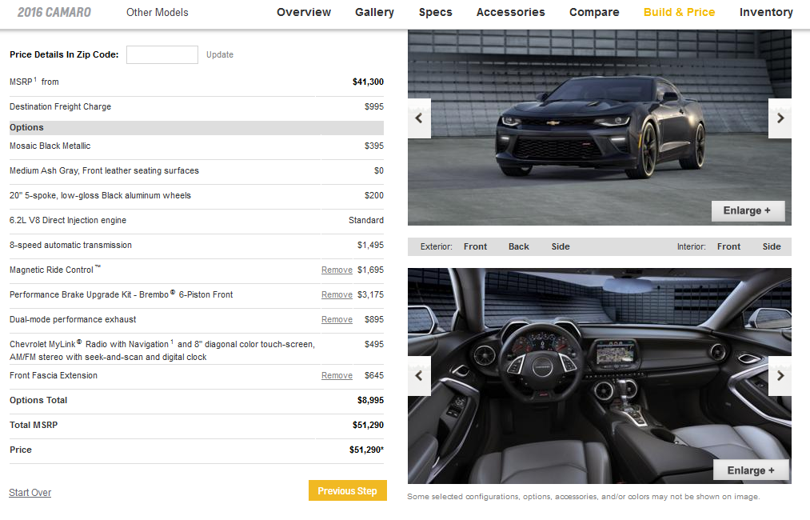
Car Configurator
Implications

Slide 36

Booking.com
Implications

Slide 37


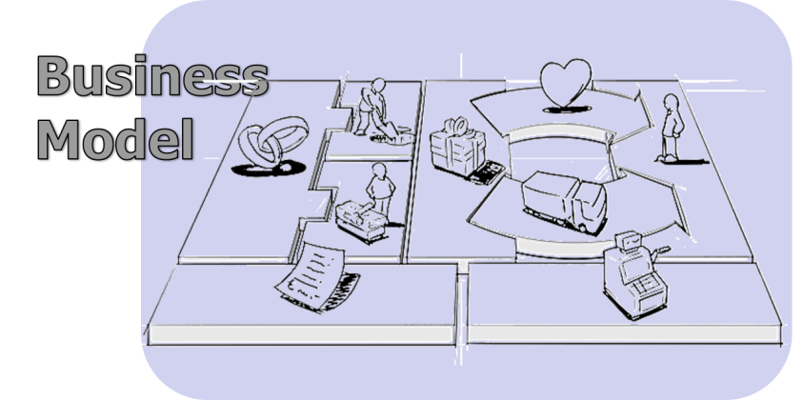










Implications
Implications
=
Notes:
Traditional business models continue to be questioned particularly for those firms where the current business model is predicated on the need to bundle information with a physical carrier
As products that could never be brought together before can now be bundled, it becomes critical to have a direct relationship with the customer, or owning the customer interface, may become critical
The decreasing value of asymmetric information gives pressure to organization bases its value proposition on the inability of individuals to obtain and use information at low costs

Slide 38
Obstacles
Implications
Old technology leave the scene only when new ones have fully replaced the relevant features.
New entrants using new technologies face retaliation from incumbents.
New technologies entail costs:
  Learning obstacles
  Switching costs
  Inertia slows the stopping and dismissal of old routine
A proliferation of information leads to a scarcity of attention
Scarcity of attention leads to slow adoption rates for all but the most revolutionary innovations.

Slide 39
Retaliations
Implications
Legal means
  Music industry vs. digital music
Legislative means
  Car dealership networks vs. direct sales by car manufacturers.
Hybrid offers
  Retailers (physical stores) vs. retailers (online operations)
Heightened competition,
  Traditional telecommunications vs. Voice over IP

Slide 40
Sustaining tech., the “S curve”
Implications
Sustaining S Curve
Performance
Original S Curve
Market performance
improvment expectation
Time
Notes:
Faire la différence entre courbe en S de la technologie et le cycle de vie du produit, qui sont certes liés, mais deux concepts différents.
Technologies that maintain or rejuvenate the current rate of performance improvement of the products and services that use them.
A good candidate to replace a previous generation because it offers the same set of attributes, but it yields superior performance.
Remarquez la taille du deuxième S, l’amélioration va, certes, mais elle est de moins en moins notable, regardez entre iphone 3 et iphone 4, entre 4 et 5, entre 5 et 6… Bref, arrivé un moment, ça va nécessairement stagné et là, la rupture SERA nécessaire. Ce qui constitue la suite de la slide suivante. (n’oublions pas de dire qu’il s’agit là de rappels du cours d’innovation, ou d’introduction à leur cours d’innovation).

Slide 41
Disruptive tech., a bug in the Matrix
Implications
Expected market performance
improvement
Performance
Performance improvement due to
disruptive tech.
Time
Notes:
The technology offers a different set of attributes than the technology the firm currently uses in its products
The performance improvement rate of the technology is higher than the rate of improvement demanded by the market
Exemple les processeurs, cf. la loi de moore, mais pourtant, on sait qu’on mets des milliards de transistors sur une petite puce, arrive le problème de la taille des transistors, on sait qu’on n’arrivera plus à en faire des plus petits que maintenant, la rupture est nécessaire. Par contre, exemple du CMOS vs CCD en photo numérique, ou l’exemple du SSD VS disque dur…

Slide 42
Implications : prediction, anticipation, curiosity
Implications
Forecast change
Which new functionalities?
Performance
Current trend
Temps
Notes:
Managers should estimate whether the disruptive technology will catch up to market needs on the critical performance dimensions
The novel set of attributes of the disruptive technology may become a source of positive differentiation and increasingly attractive to potential customers
Listening attentively to your most aggressive customers will create a bias toward prompt adoption of sustaining technology and a reluctance to buy into disruptive ones

Slide 43
What we learned!
Comprehend the basic principles of network economics, including the sources of value in networks, and the definitions of physical and virtual networks. You will also learn to apply these concepts to strategy and managerial decision making.
Understand the concepts and vocabulary of network economics, including positive feedback, network externalities, and tippy markets. Be able to recognize when network effects occur and what makes a market tip, as well as what market will not tip toward a dominant player.
Comprehend the basic principles of information economics and the role that information plays in the modern competitive environment. Understand the concepts and vocabulary of information economics, including the ability to define classic information goods and information-intensive goods.
Be able to explain how the advent of pervasive networks has enabled information to break the constraints imposed by traditional information carriers. You will also be able to explain what the richness/reach trade-off is and its implications for modern organizations.

