Slide 1
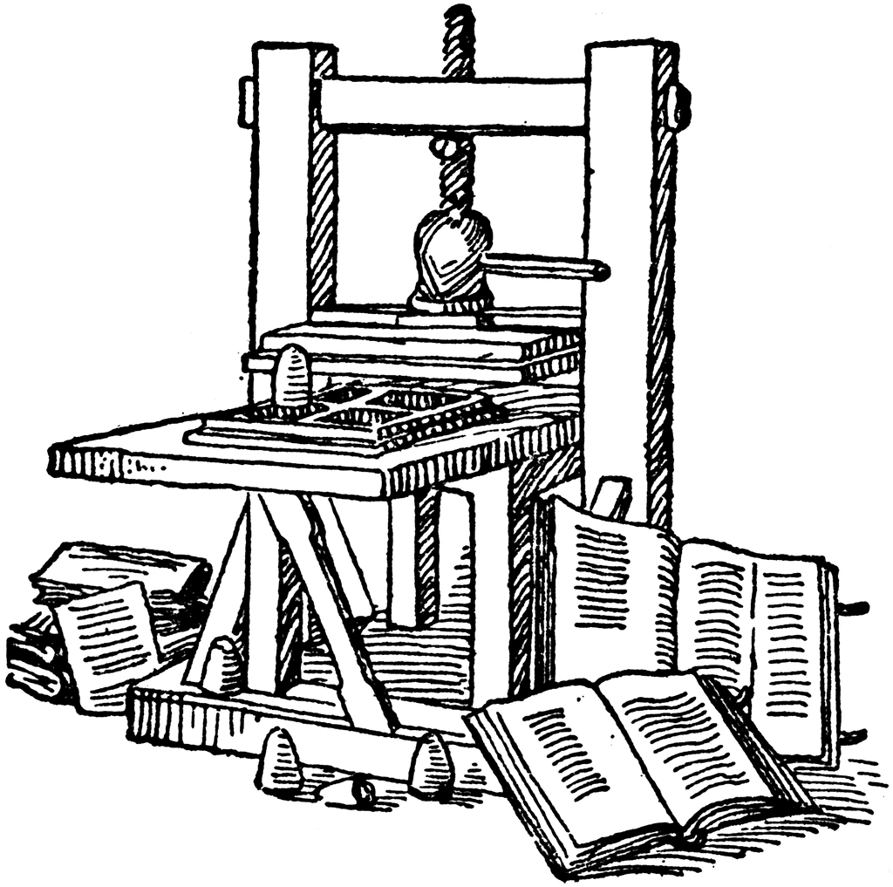
Information
Systems
for
Managers

Slide 2

• Information systems are designed and built with the objective of improving the firm’s efficiency and effectiveness by fulfilling its information processing needs. Successful information systems are those that are used and that achieve their intended goals.
• Information systems exist in an organizational context, characterized by the firm strategy, culture, and IT infrastructure. The organization itself is subject to the influences of its external environment, including regulatory requirements, social and business trends, and competitive pressures.
• Information systems are subject to systemic effects, defined as the notion that the different components of a system are interdependent and that changes in one component affect all other components of the system. Thus, when designing a new information system, or troubleshooting an underperforming one, you can devise multiple ways to achieve the system’s goal.
• Increasingly in modern firms, organizational change stems from the introduction of new information technologies. Depending on the objectives and reach of the new system, we identify three levels of change—first-, second-, and third-order change—each requiring different levels of commitment and sponsorship to be successfully managed.
Notes:
Rappel de la séance précédente

Slide 3
A « textbook » for better learning
Ch. 1 : Information Systems and the Role of General and Functionnal Managers
Ch. 2 : Information Systems Defined
Ch. 3 : Organizational Information Systems and Their Impact
Ch. 4 : The Changing Competitive Environment
Ch. 5 : Electronic Commerce: New Ways of Doing Business
Ch. 6 : Strategic Information Systems Planning
Ch. 7 : Value Creation & Strategic Information Systems
Ch. 8 : Value Creation with Information Systems
Ch. 9 : Appropriating IT-Enabled value Over Time
Ch. 10 : Funding & Governance of Information Systems
Ch. 11 : Creating Information Systems
Ch. 12 : Information Systems Trends
Ch. 13 : Security, Privacy & Ethics

Slide 4
Categorizing Systems
Categorizing
Systems
The Hierarchical Perspective
The Functional Perspective
The Process Perspective

Slide 5
What is the Hierarchical Perspective?
Categorizing
Systems
Decision making and activities in organizations occur at different levels.
Individuals
  have different responsibilities
  make different types of decisions
  carry out different types of activities
Having the correct information is important

Slide 6
Hierarchical Perspective
Categorizing
Systems
Activity | Time horizon | Hierarchical level | Characteristics
Strategic | Long term | General management Functional management | Externally focused Ad-hoc Highly unstructured
Tactical | Mid term | Middle management | Repeatable Semi-structured Recurrent
Operational | Short term | Front line employees | Low discretion Highly structured Transaction focused

Slide 7
Operational Activities
Categorizing
Systems
Concerned with short-term activities, typically those that occur in the immediate term
Operational personnel are focused on performing the day-to-day activities that deliver the firm’s value proposition
Decision making at the operational level is typically highly structured by means of detailed procedures

Slide 8
Operation Examples
Categorizing
Systems
Atomicity | Transactions are atomic. If one part of the transaction fails, the system must cancel the transaction. For example, if while withdrawing money at the ATM the cash dispenser jams, your balance should not be debited.
Consistency | Transactions are consistent. In other words, only valid data is committed to long term memory and stored in the system. For example, if the airline seat assignment system requires only letters in the first name field, no transaction with numbers in the field is accepted.
Isolation | Transactions are non-concurrent. If the system has yet to store the results of a transaction while writing the results of a second transaction, its database may end up holding invalid data. For example, if you are withdrawing money from and ATM while your sister at home is moving money electronically, the resulting balance may be invalid unless the system maintains isolation of the two transactions.
Durability | Transactions are durable when they can be recovered in the face of system failure. In other words, once the system has successfully processed the transaction, it will no longer lose it. For example, once the agent has changed your seat, the change is recorded in a transaction log. If anything were to go wrong with the database, the current state could be re-created by reprocessing the transactions from the log.

Slide 9
Tactical Activities
Categorizing
Systems
The activities performed tend to be semi structured, having both well-known components and some degree of uncertainty
Decision making at this level is typically semi structured, but characterized by repeatable patterns and established methods
The objective is to improve the effectiveness of the organization, or one of its functions, within the broad strategic guidelines set by the executive team

Slide 10
Strategic Activities
Categorizing
Systems
Decision making at this level is highly unstructured
Reliant on internal as well as external data sources
Focus on making decisions by evaluating trends
Little structure and formal methodologies exist for activities at this level.

Slide 11
Hierarchical Perspective
Categorizing
Systems

Slide 12
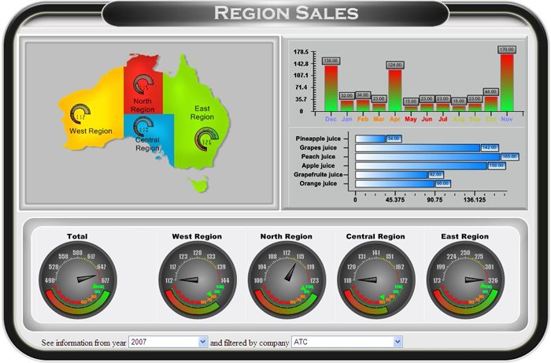
Executive Tools
Categorizing
Systems

Slide 13
Today’s Hierarchy
Categorizing
Systems
Adoption of flatter hierarchies between front-line operations and strategic decision-making
  Empowerment
Limitation:
  Difficult to neatly separate information systems in clear cut categories

Slide 14
Functional Perspective
Categorizing
Systems
Functional systems are expressly designed to support the specific needs of individuals in the same functional area
Functional systems are based that information processing needs are unique and homogeneous within a functional area
Optimal systems are tailored to those highly specific needs and use a language that is familiar to the professionals in that area.

Slide 15
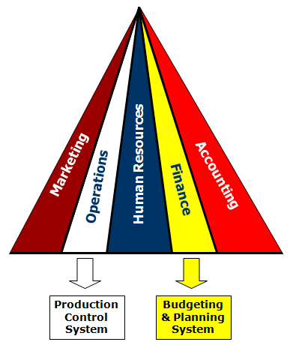
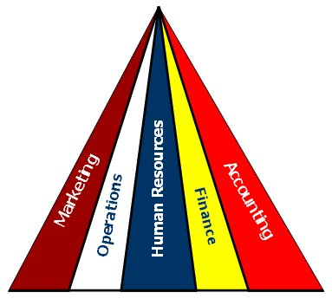
Functional Perspective
Categorizing
Systems

Slide 16
Process Perspective
Categorizing
Systems
The functional and hierarchical perspectives are limited by:
  Lack of integration of separate systems
  Leading to:
    Redundancy
    Inefficiency
Business Process Reengineering offers a potential solution

Slide 17
Business Process Reengineering
Categorizing
Systems
Business processes are inherently cross-functional
BPR is a managerial approach that employs a process view of organizational activities
BPR seeks to break down the organizational silos
BRP achieves internal business integration increases performance
Notes:
http://www.ashburnweb.com/pd/images/silo.jpg

Slide 18
BPR Risks
Categorizing
Systems
BPR requires radical 3rd order change
BPR sees that operational processes are not “glamorous” or highly valued
Significant downsizing and layoffs follow BPR initiatives
Very expensive to implement

Slide 19
The Role of IT in BPR
Categorizing
Systems
As organizations and technology evolve over time, traditional business processes may become obsolete and need to be reevaluated
Evaluation takes time

Slide 20

Integration
The Integration
Imperative
The history of lack of integration
  Coordination costs
  Mergers and acquisitions
Integration
  The process of unifying, or joining together, some tangible or intangible assets

Slide 21
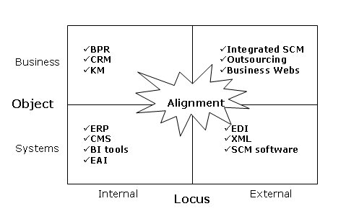
The Dimensions of Integration
The Integration
Imperative

Slide 22
Object & Locus
The Integration
Imperative
Locus:
  Internal
  External
Object:
  The assets the organization seeks to combine

Slide 23
Business Integration
The Integration
Imperative
The introduction of cohesive, streamlined business processes that encompass previously separate activities
Objective:
  Presenting “one face” to the customer
  Providing solutions
  Achieving global inventory visibility

Slide 24
Systems Integration
The Integration
Imperative
Unification or tight linkage of IT-enabled information systems and databases
Primary focus
  Technological component of the IS
Types of systems integration
  Internal
  External

Slide 25
The Integration Trade-offs
The Integration
Imperative
Benefits
  Reduction of duplication and redundancy
  Access to information
  Speed
  Response time
Drawbacks
  Increased coordinate costs
  Reduced local flexibility

Slide 26
Enterprise Systems
Class of standardized software applications that would enable and support integrated business processes
Firms typically live and die by their enterprise systems

Slide 27
ERP Vendors
Enterprise
Systems

Slide 28
ERP Models & Functionality
Enterprise
Systems
Financials | Operations and Logistics
Accounts receivable and payable | Inventory management
Asset accounting | Material requirements planning
Cash management and forecasting | Materials management
Financial consolidation | Plant maintenance
General ledger | Production planning
Product-cost accounting | Routing management
Profit-center accounting | Shipping
Human Resources | Sales and Marketing
Payroll | Order management
Personnel planning | Pricing
Travel expenses | Sales management Sales planning

Slide 29
ERP Pros & Cons
Enterprise
Systems
Advantages
Disadvantages
Efficiency
Responsiveness
Knowledge infusion
Adaptability
Standardization and flexibility
Is the best practice embedded in the enterprise system really the best?
Strategic clash
High costs and Risks

Slide 30
Estimated percentage of benefits actually ralized
Enterprise
Systems

Slide 31
Sample project metrics for ERP implementations
Enterprise
Systems
 | 2009 | 2010 | 2011 | 2012 | 2013
Average project cost | $6.2 million | $5.48 million | $10.5 million | $7.1 million | $2.8 million
Project Duration | 18.4 months | 14.3 months | 16 months | 17,8 months | 16,3 months
Late projects | 35.5% | 61.1% | 54% | 61% | 72%
Projects over budget | 51.4% | 74.1% | 56% | 53% | 54%
(Adapted from Panorama Consulting 2011 and 2015 ERP Reports)

Slide 32
ERP Failures
Enterprise
Systems
Year | ERP Vendor/Integrator | ERP Customer | Reason for ERP Failure and/or Lawsuit
2013 | IBM and SAP | Bridgestone | Bridgestone’s complain alleged “IBM’s defective system lost or deleted scheduled customer orders, would not process orders, duplicated, or partially processed orders and, for those limited orders that were processed, did not complete critical corresponding business applications.”
2013 | Accenture and Microsoft | ScanSource | The suit alleges that Avanade purposely underestimated the cost of the enterprise resource planning (ERP) software system Microsoft Dynamics AX for $17 million in 11 months; however, “within a few months” the cost escalated to an estimated $66 million and took more than three years to complete.
2013 | Infor | Buckley Powder | The system was still not operational after 18 months and “the project has been plagued by setbacks and non-performance on behalf of Infor and no reasonable solution has been presented,”
2012 | SAP and IBM | Avantor Performance Materials | The lawsuit alleges that IBM proposed solution was “woefully unsuited" to its business and the implementation brought its operations to "a near standstill" and that the project was staffed with "incompetent and reckless consultants" who made "numerous design, configuration and programming errors," it states.
2012 | Epicor | Major Brands | Major Brands alleged that the software vendor failed to deliver a satisfactory system after years of effort and significant cost overruns, and then offered a solution that would force the company to install a new version that hadn't yet been completed, pushing back the original "go-live" date by four years.

Slide 33
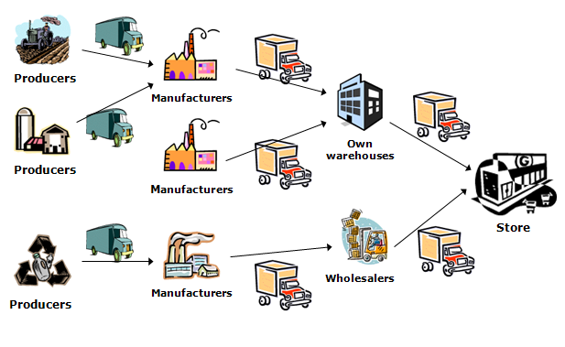
Supply Chain Management
SCM
Supply Chain Management
  the set of logistical and financial processes associated with the planning, executing, and monitoring of supply chain operations.

Slide 34
Knowledge Management (kM)
KM and BI
Set of activities and processes used to create, codify, gather, and disseminate knowledge within the organization
  Creating Knowledge
    employees generate new information, devise novel solutions to handle existing problems, and identify new explanations for recurrent events.
  Capturing and Storing Knowledge
    enables the organization to codify new knowledge and maintain an organizational memory
  Disseminating Knowledge
    investments made in knowledge creation and storage pay off

Slide 35
Business Intelligence
KM and BI
Ability to gather and make sense of information about your business
Encompasses the set of techniques, processes, and technologies designed to enable managers to gain superior insight and understanding of their business and thus make better decisions

Slide 36
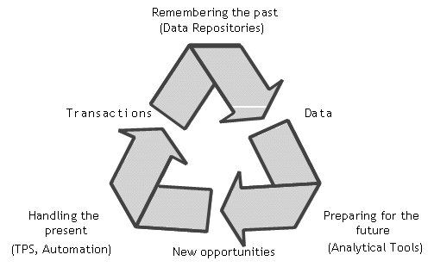
The Information Systems Cycle
KM and BI
Models the progression of data
From its inception in transaction processing systems
To its storage in data repositories
To its use in analytical tools

Slide 37
Components of BI
KM and BI
Data Warehouse
  Data repository that collects and consolidates data from multiple source systems with the purpose of enabling analysis
Data Mart
  Scaled-down version of a data warehouse that focuses on the needs of a specific audience
Online Analytical Processing (OLAP)
  Class of software programs that enable a knowledge worker to easily and selectively extract and view data from analytical database
Data Mining
  Process of automatically discovering non-obvious relationships in large databases

Slide 38
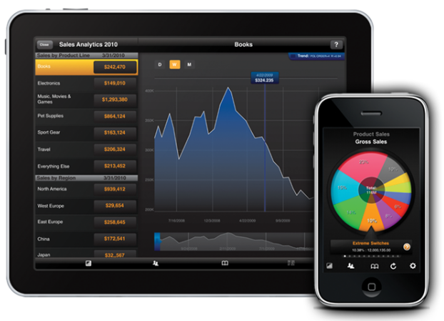
BI Tools
KM and BI

Slide 39
From BI to Big Data
KM and BI
Data is defined as codified raw facts—events, occurrences or descriptions coded as letters and numbers and stored, increasingly, by way of digital devices
Information is defined as data in context.
  data become information when it has been given meaning and can therefore be interpreted by individual users or machines
  information is audience dependent; one person’s data is another person’s information
Knowledge is the capacity to identify required problem-related information and interpret it

Slide 40
Big Data
Big Data
Volume is the amount of digital data that organizations have to store and manage
Velocity is the speed of creation and use of new digital data. This dimension relates to the need to gather, process and communicate information in real-time
Variety is the kind of digital data that organizations have to store and manage

Slide 41


A changing world
Big Data
Today, in a single day,
we are creating more data
than mankind did from its beginning through 2000
Andreas Weigend
Ex Chief Scientist at Amazon.com
Director of the Social Data Lab - Stanford

Slide 42
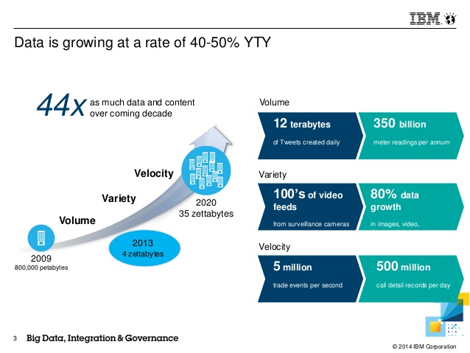
The data explosion
Big Data

Slide 43
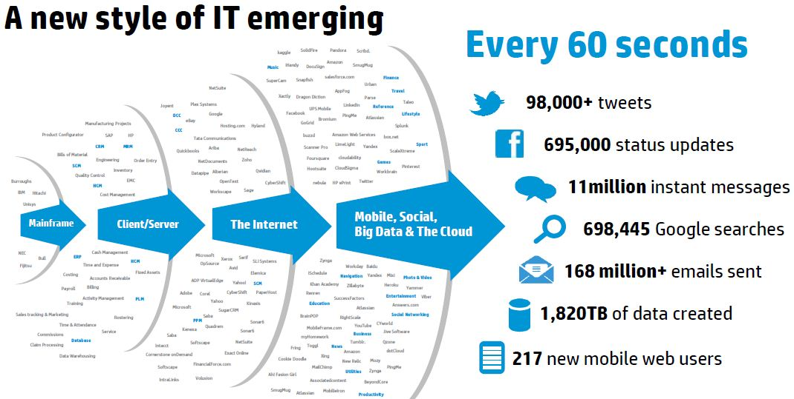
The social data
Big Data

Slide 44
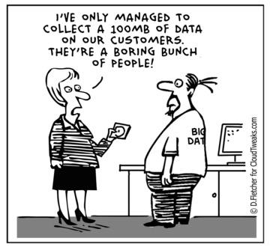
Big Data is..
Big Data

Slide 45
Big Data tools
Big Data
(Source: http://www.glennklockwood.com/data-intensive/hadoop/overview.html)

Slide 46
Customer Relationship Management (CRM)
CRM
CRM is a strategic initiative, not a technology. Information technology is an essential enabler of all but the smallest CRM initiatives
CRM relies on customer personal and transactional data, and is designed to help the firm learn about them
The ultimate objective of a CRM initiative is to help the firm use customer data to make inferences about customer behaviors, needs, and value to the firm so as to increase its profitability

Slide 47
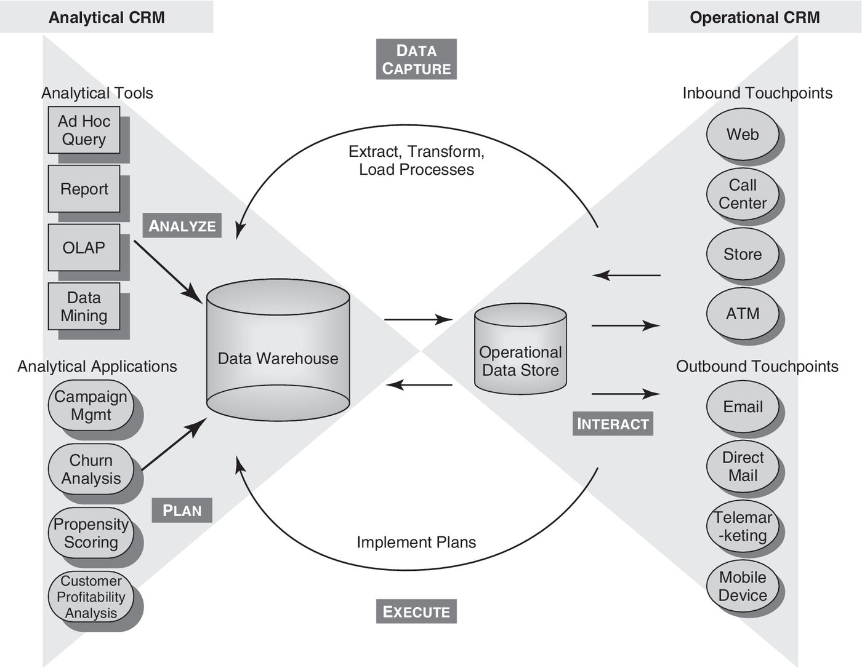
CRM Infrastructure
CRM

Slide 48
Limitations of CRM
CRM
CRM Is Firm Centric
  a firm’s CRM strategy only relies on transactional and behavioral customer data pertaining to the interactions of the customer with the firm
CRM Has Limited Predictive Ability
  Some events are unforeseeable and only the customer knows about their occurrence or future plans about them

Slide 49
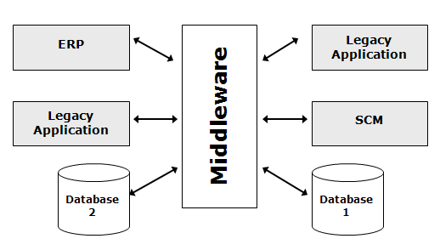
Enterprise Application Integration (EAI)
The Integration
Imperative

Slide 50
Cloud Computing
Cloud
Cloud computing
  the use of the Internet as the environment for pooling IT resources
  IT resources utilization and payment is dynamic and agile
  utility billing model
  scalable

Slide 51
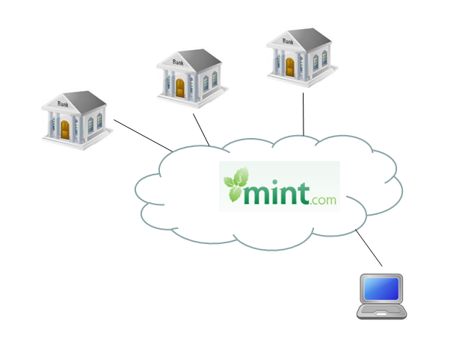
Cloud Computing
Cloud
A new approach to computing
  Virtualization
  Service-oriented architecture
  Utility pricing of computing resources
A computing delivery approach that divorces use of resources from the actual management of those resources

Slide 52
Cloud Computing delivery modes
Cloud

Slide 53
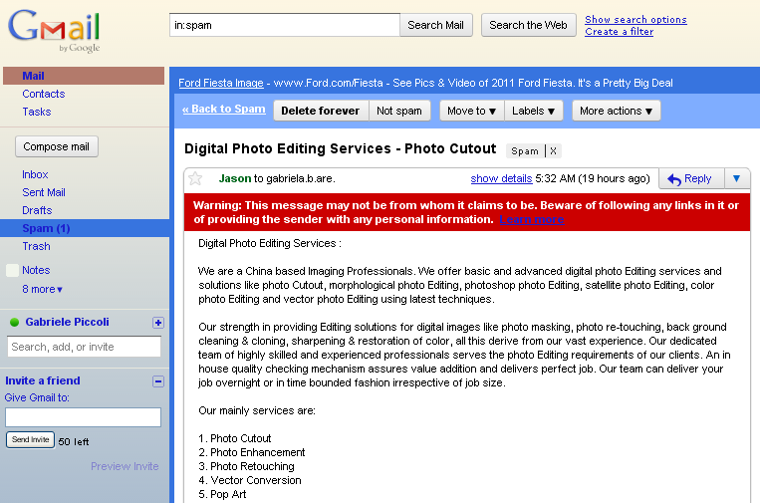
Software as a Service (SaaS)
Cloud
Focuses on the services (i.e., functionalities) being provided, not on the physical products (software) being sold
Application Service Provision (ASP)
  A provider hosts and manages a standard application (e.g., e-Mail)
  Clients access the application over a network (e.g., the Internet)

Slide 54
Platform as a Service (PaaS)
Cloud
focus on the platform on which customers builds their own applications
generally used for development, testing, and deployment of applications as components are already in place

Slide 55
Infrastructure as a Service (IaaS)
Cloud
the client purchases the use of hardware functionality
  computational power
  storage capacity
  network connectivity

Slide 56
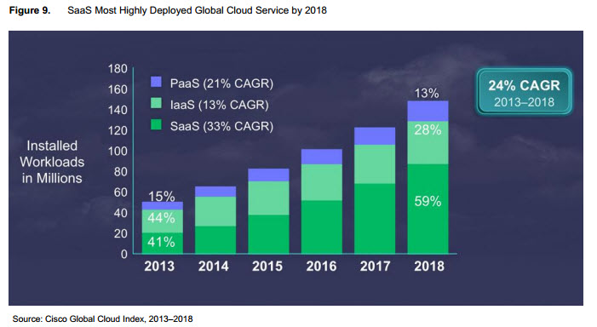
The evolution of Cloud platform delivery modes
Cloud

Slide 57
Major cloud providers by market shares
Cloud
(Source: Synergy Research Group, 2015)

Slide 58
Cloud advantages
Cloud
Lower Entry barriers
  firms with limited investment capacity have access to dynamic priced enterprise class IT resources, shifting IT costs from capital investments (Cap-ex) to operational expenses (Op-ex)
  startups can realize their IT project with initial investments an order of magnitude lower than in the past.
Faster Innovation
  the immediate access to IT resources reduces time to market
  without upfront investment firms can deploy solutions faster facilitating innovation
Higher Scalability
  solutions can easily scale and new IT resources can be allocated or reduced depending on the actual need.

Slide 59
The modern ERP integration
The Integration
Imperative
 | Traditional ERP | Modern ERP
 | ERP Vendor 1 | Core ERP Vendor 1 | SaaS Vendor 2 | Public Cloud Vendor 3 | Outsourced Vendor 4
Integration | Tight integration within the ERP solution | Tight integration remains only within the ERP solution | Integration within business application, loosely to other apps | Integration within business application, loosely to other apps | Integration within outsourced processes, loosely to other apps
Integration Tools | ERP vendor | Possibly ERP vendor | Vendor's integration platform (cloud) | Vendor's integration platform (cloud) | Provider's integration platform (cloud) Client's (integration platform (cloud)
Data Integrity and Consistency | Inherent within suite, client responsibility to ancillary apps | Within suite,client responsibility to ancillary apps | Within business app, client responsibility to ancillary apps | Within business app, client responsibility to ancillary apps | Maintained within outsourced process,client responsibility elsewhere
Process Integrity | Inherent within suite | Within suite,client responsibility to ancillary apps | Within business app, client responsibility to ancillary apps | Within business app, client responsibility to ancillary apps | Outsourced to vendor, but ancillary processes responsibility of client
Upgrades (Test and Patch Workload) | Major upgrade every 12-18 months | Major upgrade every 12-18 months | Multiple: 3-4 per year | Multiple: 2-3 per year | None: 3-4 per year
The italicized text indicates where more responsibility and complexity on the end-user organization is being generated.

Slide 60
The Recap
Different organizational information systems can be characterized through a hierarchical perspective or functional perspective
BPR is as a managerial approach calling for a process view of organizational activities
Enterprise systems are modular, integrated software applications that span (all) organizational functions and rely on one database at the core
Enterprise systems have traditionally focused on internal organizational processes

Slide 61
The Recap
Knowledge management is the set of activities and processes that an organization enacts to manage the wealth of knowledge it possesses and ensure that such knowledge is properly safeguarded and put to use to help the firm achieve its objectives
Business intelligence encompasses the set of techniques, processes, and technologies designed to enable managers to gain superior insight and understanding of their business and thus make better decisions.
Big data is the umbrella term under which the major recent trends converge. The impacts on decision making and knowledge extraction are a paradigm shift in the way management and organizations have traditionally made decisions

