Slide 1
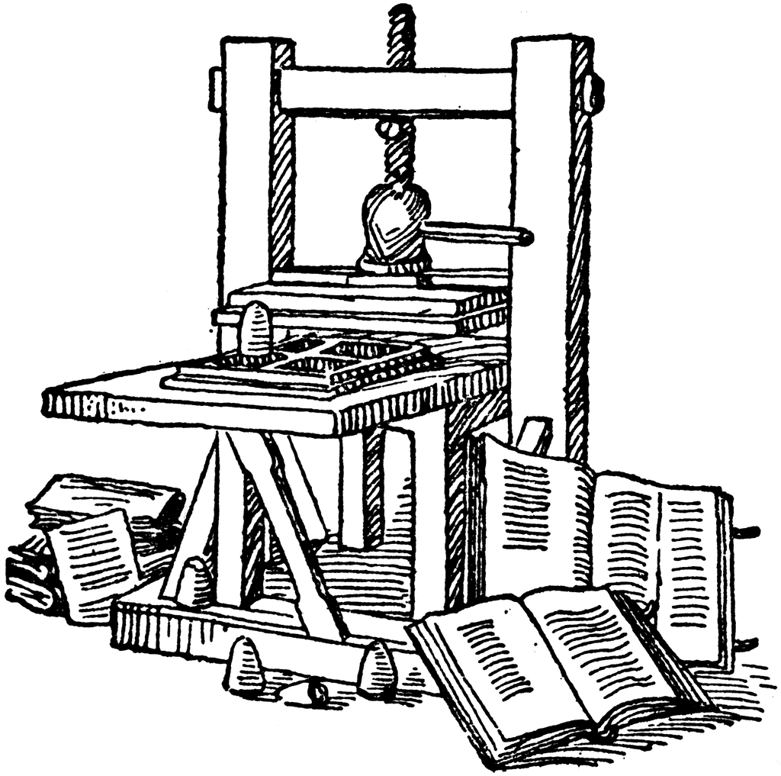
Information
Systems
for
Managers

Slide 2

• General and functional managers, those individuals in organizations who have the responsibility to lead a functional area or a business, can no longer abdicate their right, and duty, to be involved in information systems and IT decisions. They should act in partnership with the firm’s information systems and technology professionals.
• The information systems skill set required of the modern general and functional manager pertains to decisions about identifying opportunities to use information technologies to the firm’s advantage; planning for the use of information systems resources; and managing the design, development, selection, and implementation of information systems. While end-user skills (i.e., the ability to use computers proficiently) are an important asset for any knowledge worker, the critical skills for modern managers relate to the organizational, not personal, uses of information technology.
• Chief information officers (CIOs), the leading figures in the information systems and technology function, are increasingly being selected from the functional and managerial ranks rather than from the technology ranks.
• The enduring effects of Moore’s law have led to increasingly powerful yet cheaper computing strength, declining costs of computer memory, and a dramatic improvement in the ease and breadth of use of digital devices. Moreover, increasingly available network connectivity and storage capacity, improved battery life for portable devices, and the proliferation of intelligent devices have contributed to dramatically change the business and social landscape.

Slide 3
A « textbook » for better learning
Introduction
Ch. 1 : Information Systems and the Role of General and Functionnal Managers
Ch. 2 : Information Systems Defined
Ch. 3 : Organizational Information Systems and Their Impact
Ch. 4 : The Changing Competitive Environment
Ch. 5 : Electronic Commerce: New Ways of Doing Business
Ch. 6 : Strategic Information Systems Planning
Ch. 7 : Value Creation & Strategic Information Systems
Ch. 8 : Value Creation with Information Systems
Ch. 9 : Appropriating IT-Enabled value Over Time
Ch. 10 : Funding & Governance of Information Systems
Ch. 11 : Creating Information Systems
Ch. 12 : Information Systems Trends
Ch. 13 : Security, Privacy & Ethics

Slide 4


IS is not a technology!
Definitions
Did they have an
IS in 1804?
https://www.callmewine.com/media/catalog/product/cache/2/image/9df78eab33525d08d6e5fb8d27136e95/b/a/xbarone-ricasoli.produttore_12.jpg.pagespeed.ic.uT2CKsa1tR.jpg

Slide 5


Definitions
Defining the information system
Information Systems are formal,
sociotechnical, organizational systems designed to collect, process, store,
and
distribute information.
Gabriele Piccoli

Slide 6
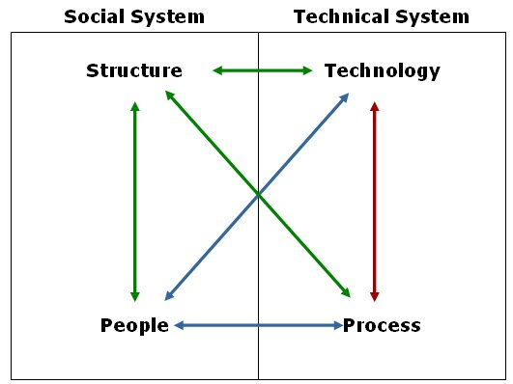
Four Components of an Information System
Definitions

Slide 7


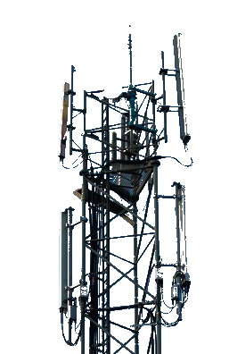


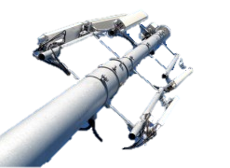
Component #1: Information Technology
Definitions
Hardware
  Laptops, desktops,
  mobiles…
Software
  Microsoft Office,
  Operating Systems…
Telecommunication equipment
  Internet, telephone networks…

Slide 8

Component #2: Process
Definitions
The series of steps necessary to complete a business activity
There are multiple ways to perform an activity: Every process is designed to be efficient & effective
Step 1
Step 2
...
Mission accomplished

Slide 9
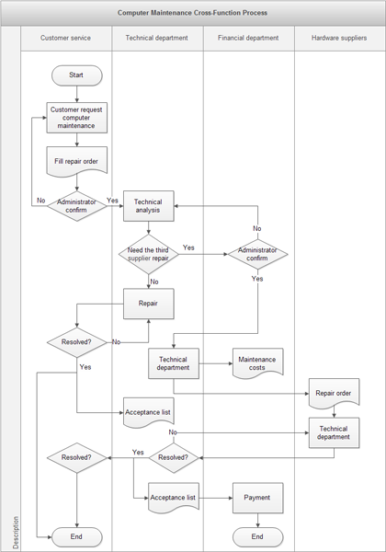



Official vs Informal business process
Definitions
Informal Process
Official Business process
…
…
https://www.edrawsoft.com/images/examples/computer-maintenance-swimlanes.png
https://s3.amazonaws.com/thumbnails.illustrationsource.com/huge.16.80983.JPG

Slide 10

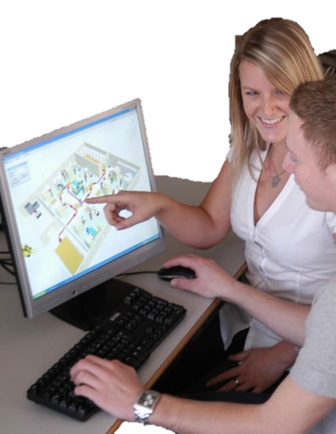

Component #3: People
Definitions

Slide 11
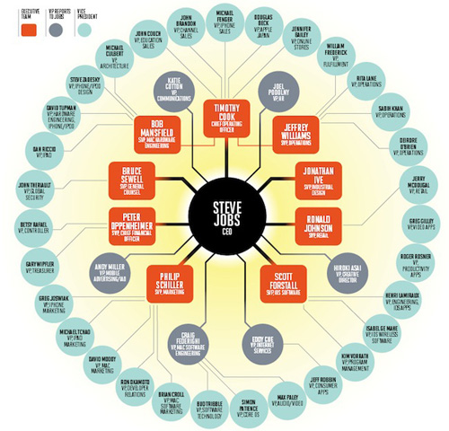
Component #4: Structure
Definitions
The organizational structure component (structure for short) encompasses:
  The organizational design
    Hierarchy, decentralized, loose coupling
  The reporting configuration
    Functional, divisional, matrix
  The organizational relationships
    Communication and reward mechanisms
    Culture
http://www.macnn.com/articles/11/05/07/apple.corporate.structure.gets.detailed.look/

Slide 12

Systemic effect : the components together
Definitions
The 4 IS components are Interdependent
Success is based on the
Interaction of these four
components

Slide 13


Modern IS
Information System: 4 Components
Many companies rush out, buy software solutions, install them quickly, and then can’t understand why the system failed.
We look at what business issues exist, what people and processes pertain to that business issue, what those people do. Technology won’t solve by itself – other components have to be part of the solution.
Mark Hedley
Photo : http://hotel-online.com/News/PR2005_1st/Jan05_WyndhamHedley.html

Slide 14
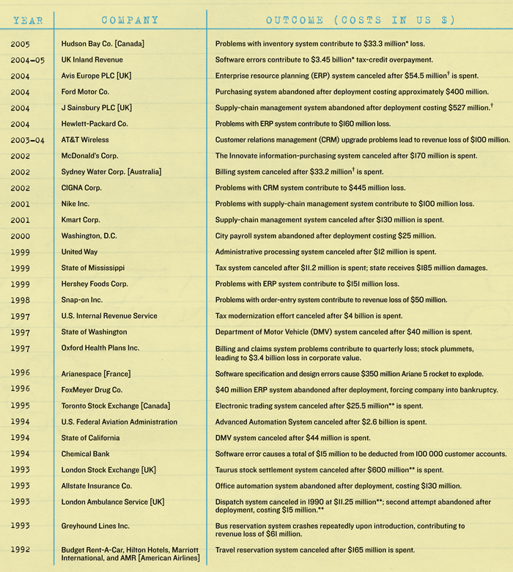
IS Success is often Elusive
Modern IS

Slide 15
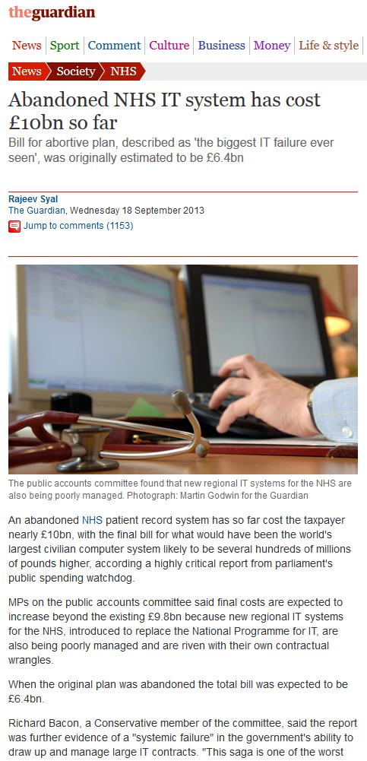
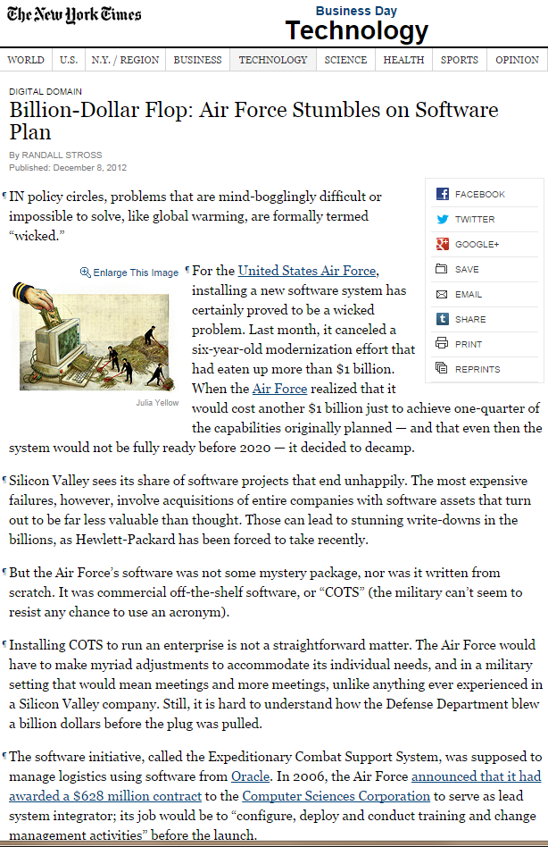
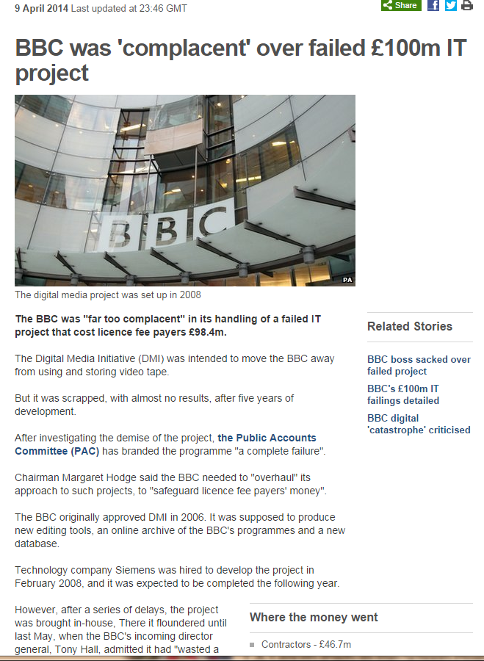
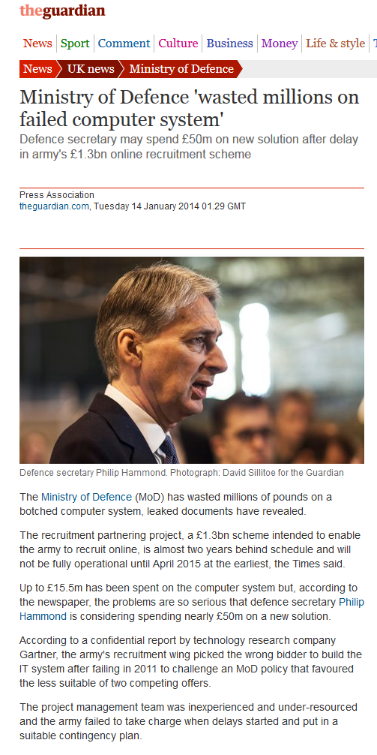
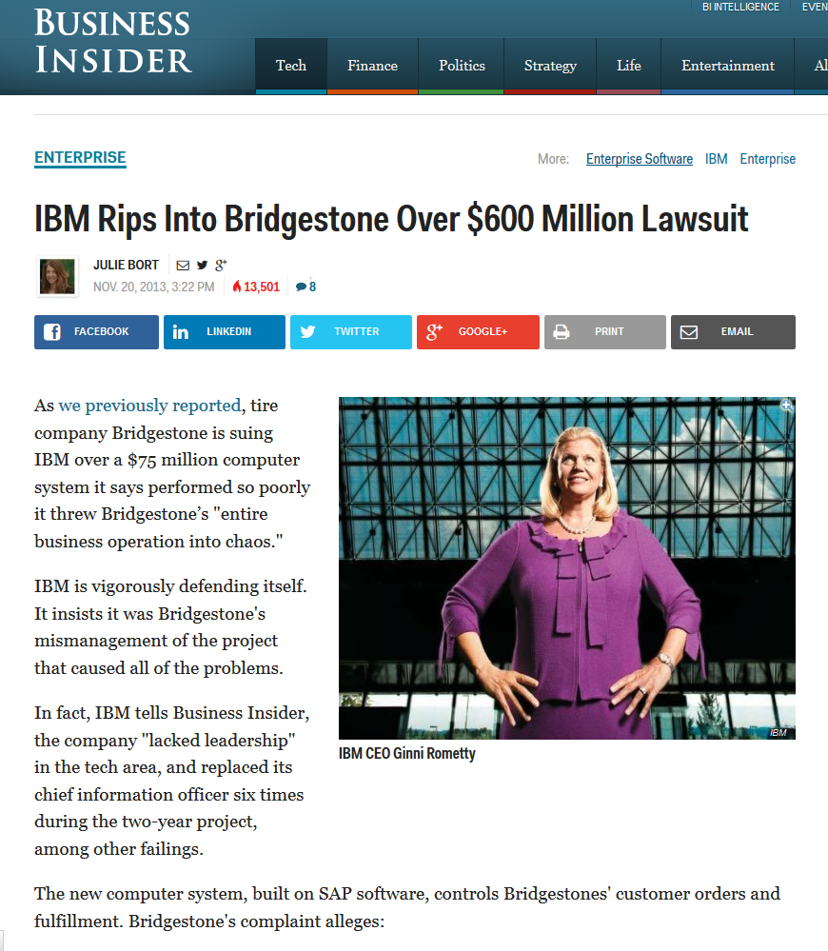
Still, IS Success is really often Elusive
Modern IS

Slide 16


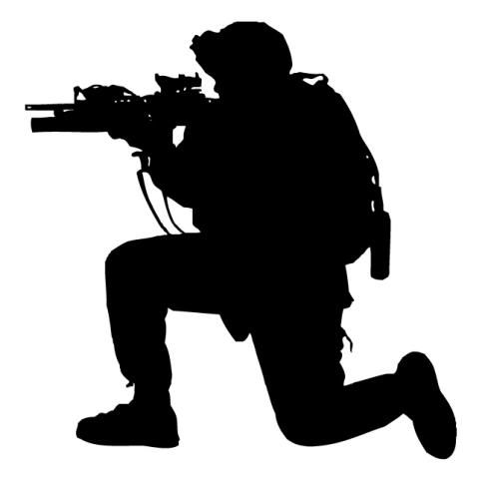
Every organization is unique
Modern IS
Every organization is unique
Even fierce competitors often have different
Strategy
Infrastructure
Culture
≠
≠

Slide 17

Systemic Effects: Components Working Together
Modern IS
The four components of an Information System are Interdependent
Changes in on component may affect all others
Success is based on the proper interaction of IT with the other components

Slide 18


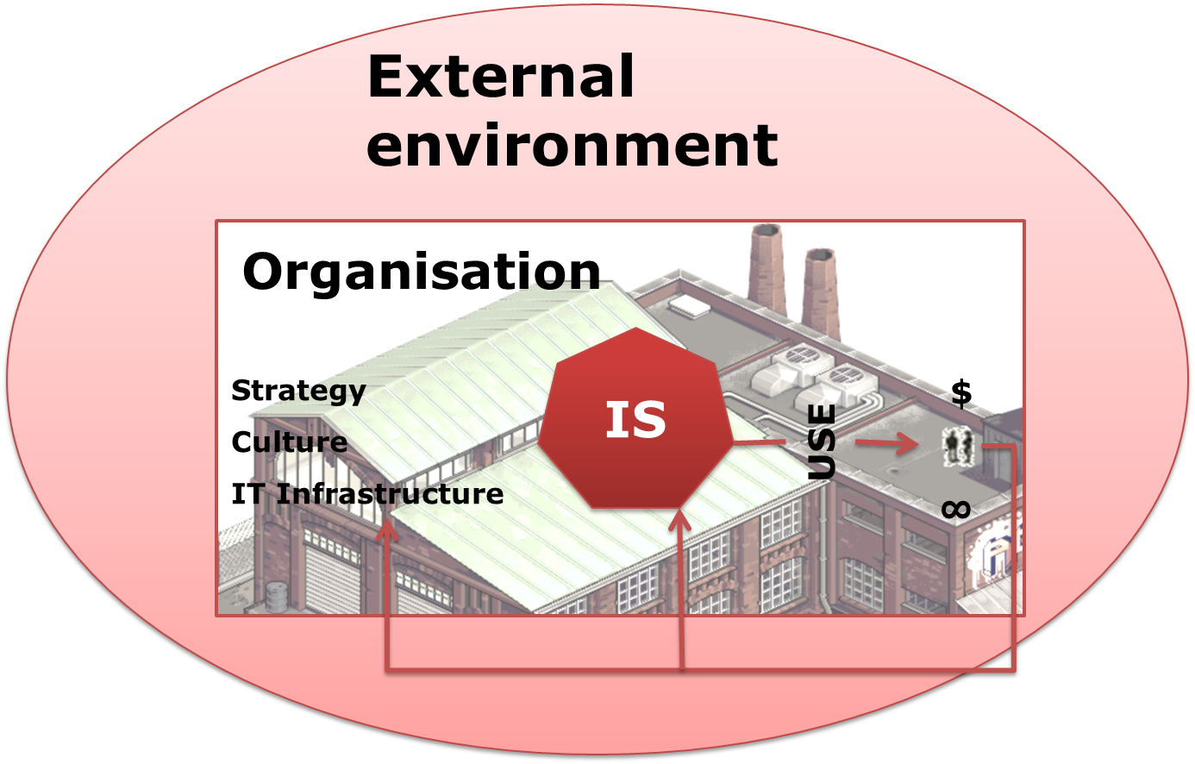


Bringing it all Together: Information Systems in Context
Modern IS

Slide 19
Information Systems and Organizational Change
IS and
organization
Third Order Change: Transform
Second Order Change:
Informate
First Order Change: Automate

Slide 20
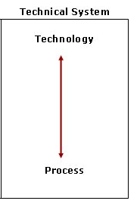
First Order Change: Automate
IS and
organization

Slide 21
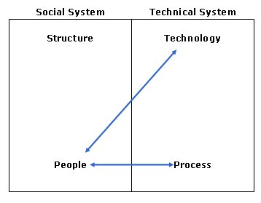
Second Order Change: Informate
IS and
organization

Slide 22
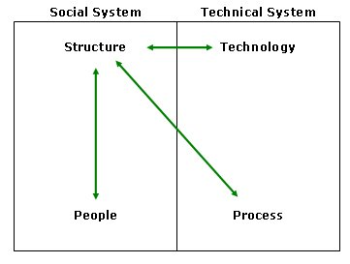
Third Order Change: Transform
IS and
organization

Slide 23

National Culture
IS and
organization
Collectivism: feeling interdependent & bound to role by rules of position, loyalty and relatedness.
Hierarchy: the degree to which subordinate people accept their position as natural
Aggression: the corresponding dimension is called Masculinity versus Femininity.
Otherness: Anxiety in the face of the
unknown
Context: Short- versus Long-term
orientation.
Happiness: Indulgence versus
Restraint.

Slide 24
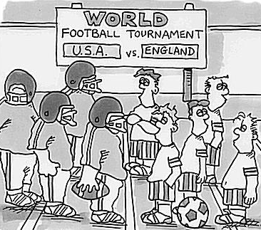
Organizational Culture
IS and
organization
Firms have a culture
They assume an organization culture that fits with an individualistic, egalitarian, uncertainty tolerant mindset
There has to be a fit between organizational culture and the IS design
in order for the IS to be effective in the firm

Slide 25
Implications
Implications
IT should NOT be the start of your Information System design process
  Strategy may be inspired by IT but
  IT selection is a point of arrival not departure
Never forget Systemic Effects
  components of an IS mutually influence one another
Anticipate the Ripples
  Successful introduction a of new IS can only occur of your team can anticipate & manage the ripples

Slide 26
Implications /2
Implications
Design and use of an IS is iterative
  cyclical evaluation of individual IS components
  assessment of how different organizational systems work together to support the business
Optimize the Information System
  as a whole, not the components individually
Organizations are dynamic
  They need to be re-evaluate often

Slide 27
What we learned
• Information systems are designed and built with the objective of improving the firm’s efficiency and effectiveness by fulfilling its information processing needs. Successful information systems are those that are used and that achieve their intended goals.
• Information systems exist in an organizational context, characterized by the firm strategy, culture, and IT infrastructure. The organization itself is subject to the influences of its external environment, including regulatory requirements, social and business trends, and competitive pressures.
• Information systems are subject to systemic effects, defined as the notion that the different components of a system are interdependent and that changes in one component affect all other components of the system. Thus, when designing a new information system, or troubleshooting an underperforming one, you can devise multiple ways to achieve the system’s goal.
• Increasingly in modern firms, organizational change stems from the introduction of new information technologies. Depending on the objectives and reach of the new system, we identify three levels of change—first-, second-, and third-order change—each requiring different levels of commitment and sponsorship to be successfully managed.

Slide 28
Not cited sources
http://businesspeopleblog.com/competition/understanding-your-competitors/ competitors picture
http://sergecar.perso.neuf.fr/cours/crise.htm economic context

