Slide 1
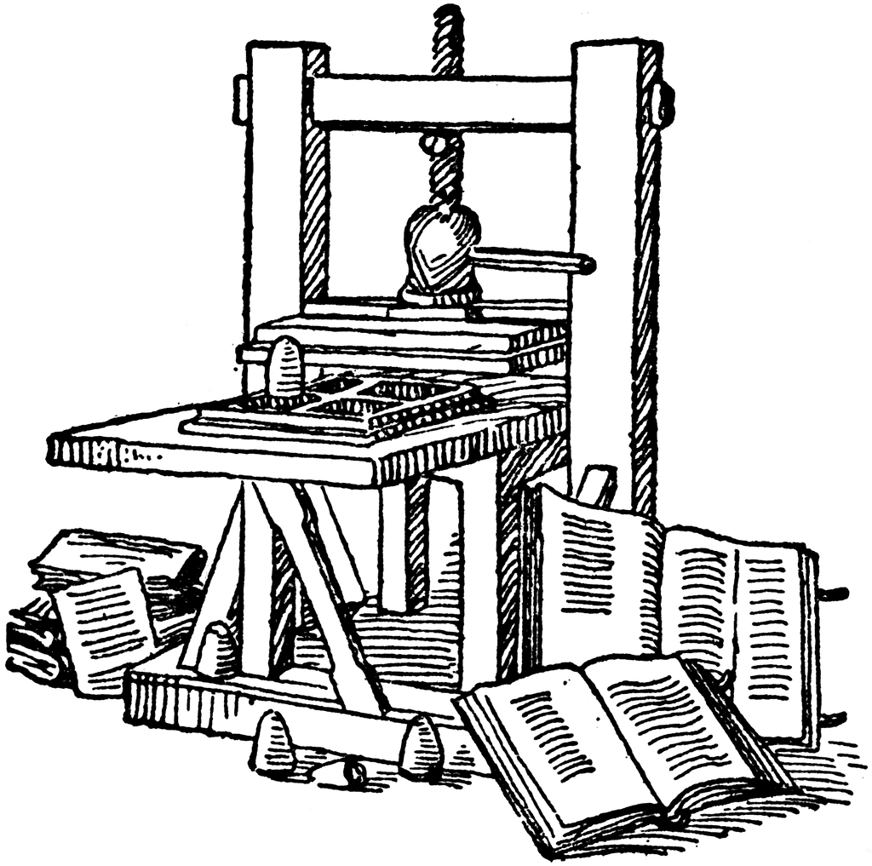
Information
Systems
for
Managers

Slide 2
A « textbook » for better learning
Introduction
Ch. 1 : Information Systems and the Role of General and Functionnal Managers
Ch. 2 : Information Systems Defined
Ch. 3 : Organizational Information Systems and Their Impact
Ch. 4 : The Changing Competitive Environment
Ch. 5 : Electronic Commerce: New Ways of Doing Business
Ch. 6 : Strategic Information Systems Planning
Ch. 7 : Value Creation & Strategic Information Systems
Ch. 8 : Value Creation with Information Systems
Ch. 9 : Appropriating IT-Enabled value Over Time
Ch. 10 : Funding & Governance of Information Systems
Ch. 11 : Creating Information Systems
Ch. 12 : Information Systems Trends
Ch. 13 : Security, Privacy & Ethics

Slide 3

Moore’s law
Main trends
Processing
power
5x10⁹
X 2 200 000
2,3x10³
1971
2014
Gordon Moore
Source : http://en.wikipedia.org/wiki/Transistor_count

Slide 4
Dropping prices!
Main trends
Price/Performance
index
100
÷ 500 000
0,0002
1995
2016
Source : http://www.singularity.com/charts/page62.html

Slide 5
Dropping storage costs
Main trends
1260$
Cost for 1Gb of storage
÷ 42 000
0,03$
1995
2015
Source : http://www.mkomo.com/cost-per-gigabyte-update

Slide 6
The explosion of the net
Main trends
Network
Nodes
1Billion
X 250
4 Millions
1994
2015
Source : Internet Systems Consortium

Slide 7
The IoT pervasivness
Main trends
22 900 Millions
Internet of Things
connected objects
X 22 900
1 Million
1992
2016
Source https://www.ncta.com/platform/broadband-internet/behind-the-numbers-growth-in-the-internet-of-things/

Slide 8



Big Data at a crossroad
Main trends
In a single day, we are creating more data than mankind did from its beginning through 2000
Andreas Weigend
Photo : https://vimeo.com/64520891

Slide 9


Main trends
And it’s just the beginning!
99% of the
application have
not been
invented!
Vinton Cerf
http://www.paganelliphotography.com/

Slide 10
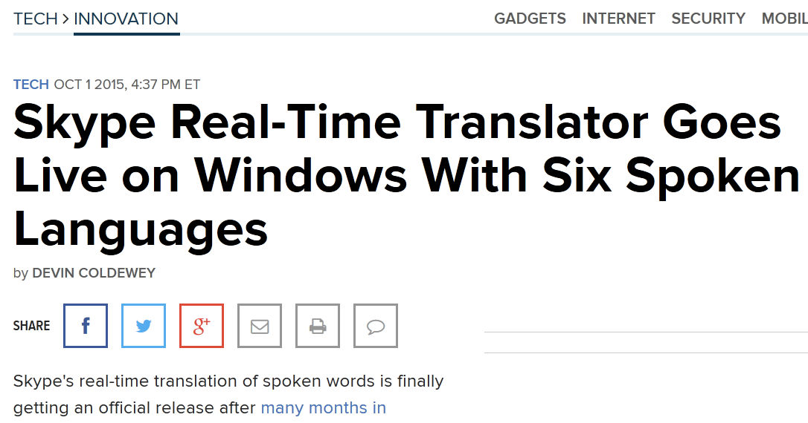
And it’s just the beginning!
Main trends

Slide 11


IT Trends of Managerial Significance
Main trends
Interface
Battery
Costs

Slide 12
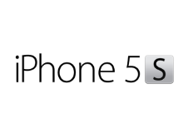



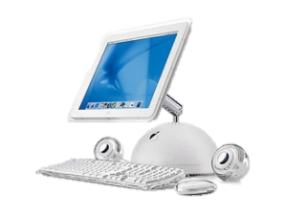
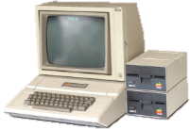

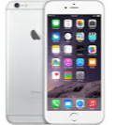
Main trends
30 years of evolution in 4 products
1983
2003
2013
2016
Height: 3290mm
Width: 3870mm
Depth: 4570mm
Weight: 3402g
Price: $4780 ($1995)
CPU: 0.001Ghz
Transistors: 3,5x10³
RAM: 0,125Mio
Display: 560x192
Camera: 0
Storage: 0
Battery life: 0
Height: 3540mm
Width: 4390mm
Depth: 2690mm
Weight: 18200g
Price: $2852 ($2199)
CPU: 1.3Ghz
Transistors: 3,3x10⁶
RAM: 256Mio
Display: 1680x1050
Camera: 0
Storage: 80Go
Battery life: 0
Height: 123.8mm
Width: 58.6mm
Depth: 7.3mm
Weight: 112g
Price: $921($899)
CPU: DualCore 1.3Ghz
Transistors: 1x10⁹
RAM: 1024Mio
Display: 1136x640
Camera: 8Mpx + HD video
Storage: 64Go
Battery life: 10hours
Height: 158.2mm
Width: 77.9mm
Depth: 7.3mm
Weight: 192g
Price: $949
CPU: DualCore 1.8Ghz
Transistors: 2x10⁹
RAM: 2048Mio
Display: 1920x1080
Camera: 12Mpx + 4K video
Storage: 128Go
Battery life: 24hours
About Apple IIe : http://applemuseum.bott.org/sections/computers/IIe.html ; http://apple-history.com/compare/aiigs/aiic/aiii ; http://fr.wikipedia.org/wiki/MOS_Technology_6502 ; http://research.swtch.com/6502 ; http://www.hackzapple.com/INDEX0.HTM ; http://www.nytimes.com/1983/01/25/science/appraising-the-apple-iie.html
About Imac G4 : http://fr.wikipedia.org/wiki/IMac_G4 ; http://www.everymac.com/systems/apple/imac/specs/imac_1.25_20_fp.html
About iphone 5s : http://store.apple.com/us/buy-iphone/iphone5s/64gb-gold-unlocked ; http://fr.wikipedia.org/wiki/Apple_A7 ; http://fr.wikipedia.org/wiki/IPhone_5s
Inflation calculator : http://data.bls.gov/cgi-bin/cpicalc.pl (price in 2015, in brackets price at realase)

Slide 13
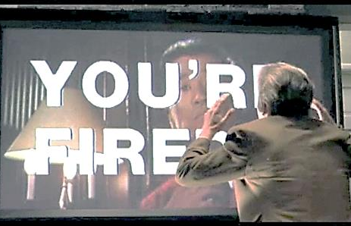
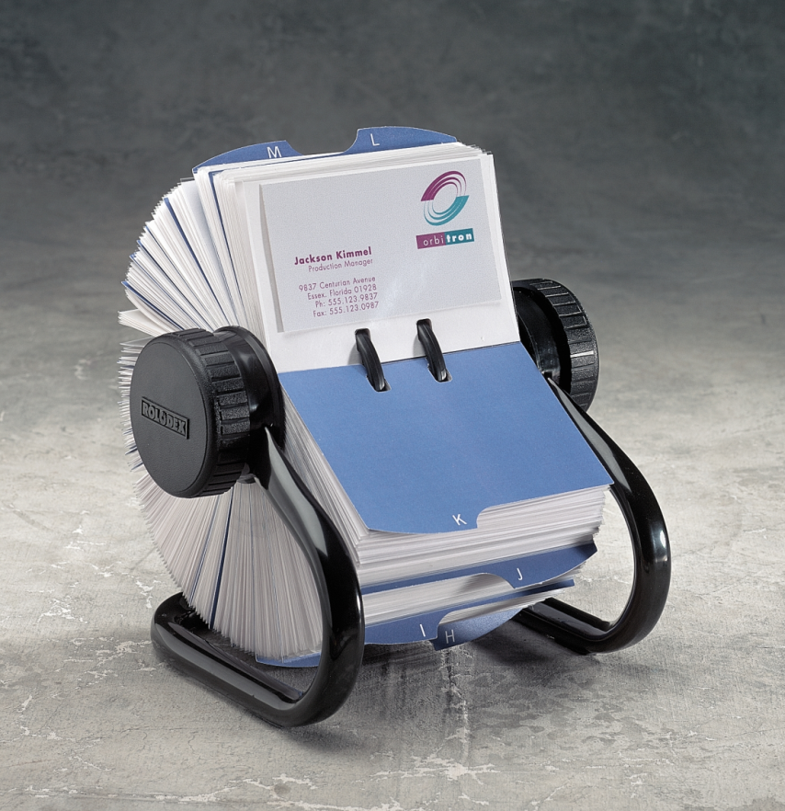

Facing Termination
Fundation
Rolodex

Slide 14

What about you?
Fundation
[Today's' MBAs], armed with their laptops and their Netscape browsers, think they know everything
[about technology].
They don't know
squat zero about
how to construct
bullet-proof software systems.
F. Warren McFarlan

Slide 15

Fundation
Top responsabilities: the General Manger
Knowledge worker in charge of an entire organization or business unit
Jeff Bezos
Photo : http://www.time.com/time/specials/packages/article/0,28804,2107952_2107953_2109567,00.html

Slide 16

Fundation
Team leader : the Functional Manager
Knowledge worker in charge of a functional area or team
Photo : http://www.onlinedegrees.org/calculator/salary/purchasing-managers

Slide 17

Fundation
The one you should care: end User
Individuals who have direct contact with software applications as they use them to carry out specific tasks
Photo : http://www.tetras.univ-savoie.fr/france/DT1202894320/page/TGI.html

Slide 18

The one you should listen to: IT professionals
individuals with technical training and education

Slide 19
The whole system
Fundation
General and Functional Managers often are also end-users
OFTEN
=

Slide 20
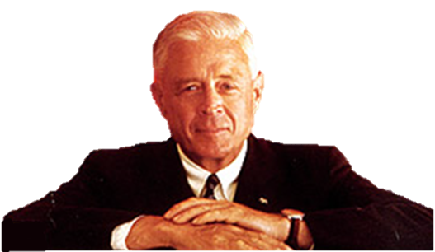

Fundation
The importance of IS
All the value of this company is in its people. If you burned down all our plants, and we just kept our people and our information files, we
should soon be
as strong as ever.
Thomas Watson Jr.
Photo : www.ivy-style.com/machine-man-thomas-j-watson-ibm.html

Slide 21

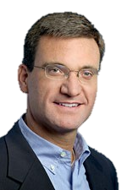

Fundation
A success story
Million $ / day
3
2
1
6 m.
12 m.
18 m.
Michael Dell
Scott Eckert

Slide 22
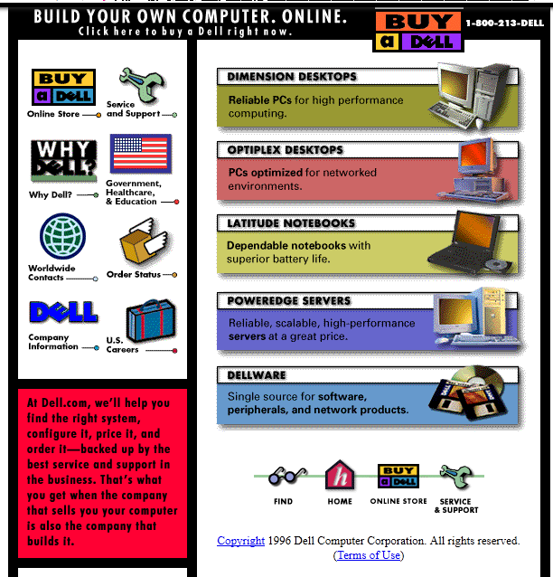
A success story
https://web.archive.org/web/19961222091824/http://www.dell.com/

Slide 23
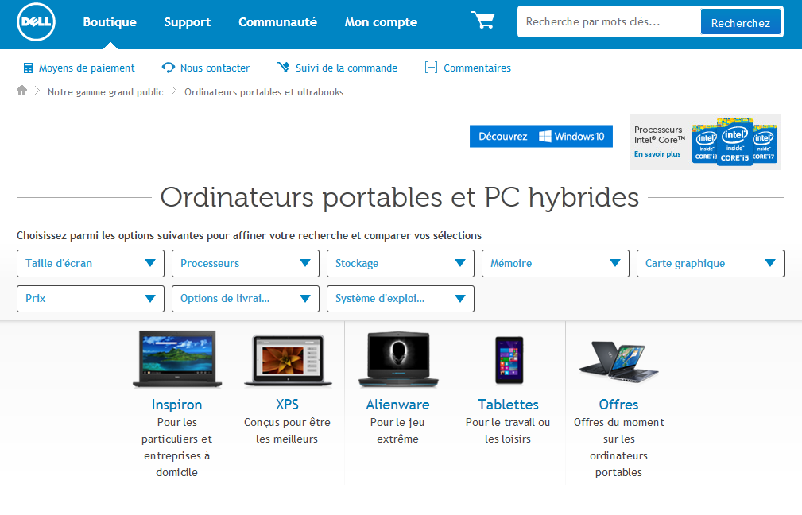
A success story
Exemple d’un succès fulgurant!

Slide 24
Critical Lessons!
Managers have to make educated decisions about the use of IT
Organizations use new IT to serve growing/changing business needs
Savvy managers partner with IT pros to ensure information systems success
Managers may or may not be end-users of the new systems they help introduce

Slide 25
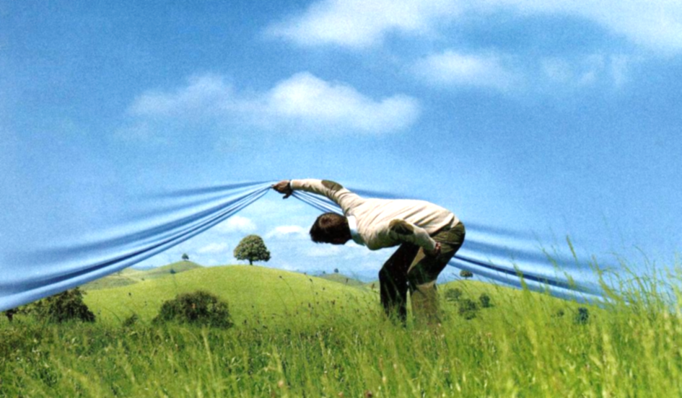
What’s next
All that lies over the horizon
IT is the enabler of new strategy, initiatives, and effective management

Slide 26
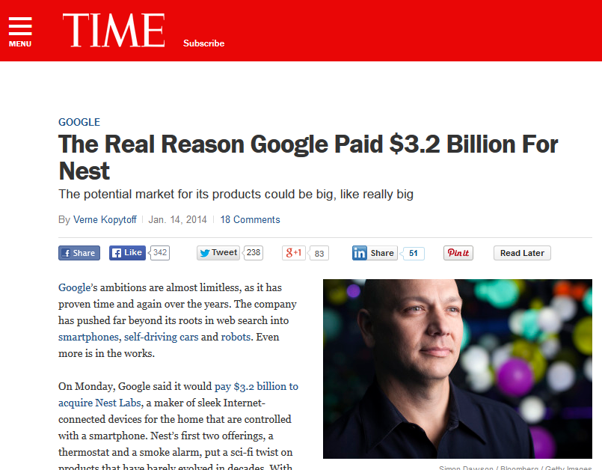

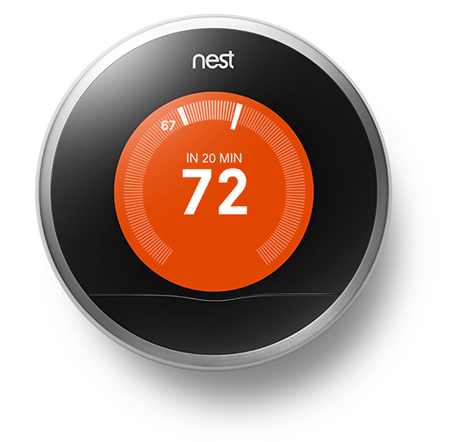
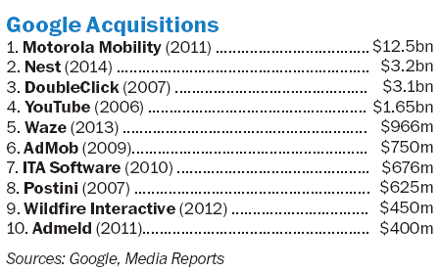
What’s next
Implications of IT trends…

Slide 27
What’s next
Implications of IT Trends
Computing power increases
Cost of computing power declines
Network bandwidth increases
Cost of data transmission declines
Computers become easier to use
Digitization and miniaturization increase
Computers become interconnected
Interconnected computing devices become more pervasive and embedded in more aspect of our lives

Slide 28



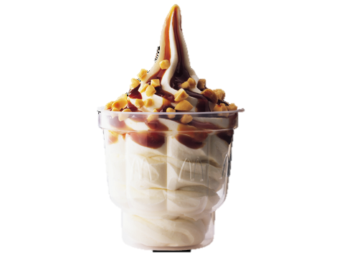

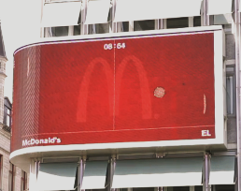
A big screen game is just something by geeks?
Implications
=
+

Slide 29
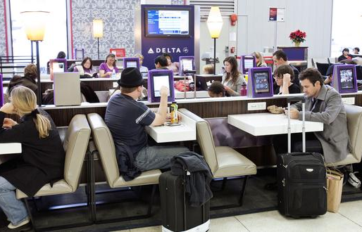

iPad Menu at McDonald’s?
Implications
http://eatocracy.cnn.com/2012/12/21/ipad-ordering-becoming-the-new-norm-at-airport-restaurants/

Slide 30
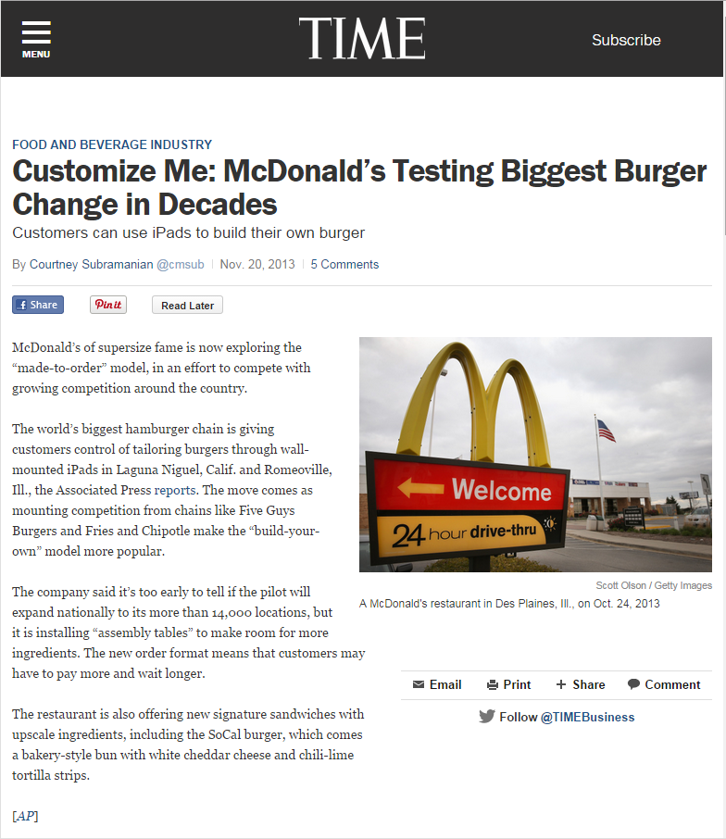

iPad Menu at McDonald’s? What’s next?
Implications

Slide 31
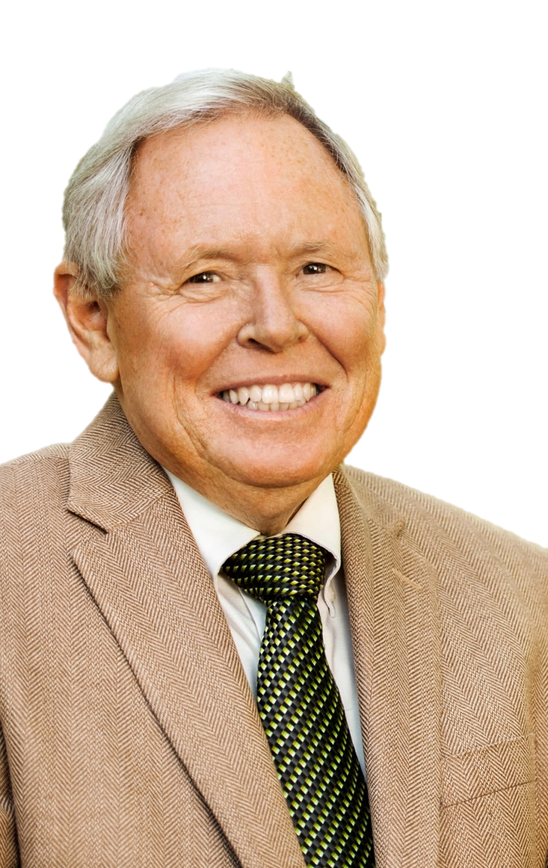
Implications
And that’s just the beginning!
To become an organizational leader, you will need to demonstrate that you can design, lead, and execute transformational [information systems] projects.
Richard T. Watson J. Rex Fuqua Distinguished Chair for Internet Strategy University of Georgia's Terry College of Business

Slide 32

Implications
And that’s just the beginning!
There will continue
to be a proliferation
of devices and
of information
on the Internet
Vinton Cerf
Photo : http://www.guardian.co.uk/technology/2008/oct/02/interviews.internet

Slide 33
What we learned!
• General and functional managers, those individuals in organizations who have the responsibility to lead a functional area or a business, can no longer abdicate their right, and duty, to be involved in information systems and IT decisions. They should act in partnership with the firm’s information systems and technology professionals.
• The information systems skill set required of the modern general and functional manager pertains to decisions about identifying opportunities to use information technologies to the firm’s advantage; planning for the use of information systems resources; and managing the design, development, selection, and implementation of information systems. While end-user skills (i.e., the ability to use computers proficiently) are an important asset for any knowledge worker, the critical skills for modern managers relate to the organizational, not personal, uses of information technology.
• Chief information officers (CIOs), the leading figures in the information systems and technology function, are increasingly being selected from the functional and managerial ranks rather than from the technology ranks.
• The enduring effects of Moore’s law have led to increasingly powerful yet cheaper computing strength, declining costs of computer memory, and a dramatic improvement in the ease and breadth of use of digital devices. Moreover, increasingly available network connectivity and storage capacity, improved battery life for portable devices, and the proliferation of intelligent devices have contributed to dramatically change the business and social landscape.

Slide 34
Other sources
Gordon Moore picture :
http://celebslists.com/images/gordon-moore-04.jpg
Samsung Galaxy Camera :
http://static.viedegeek.fr/media/2013/04/Samsung-galaxy-camera-android.jpg
4G LTE Car:
http://www.extremetech.com/wp-content/uploads/2013/02/GM-OnStar-003-medium.jpg
Michael Dell picture: http://hollywoodnose.com/images/net_worth1/michael-dell-wealth/how-much-is-michael-dell-worth.jpg
Scott Eckert picture: http://www.robotshop.com/blog/en/files/Scott-Eckert.jpg
Picture slide Mc Donald :
http://www.mcdonalds.fr/produits/desserts/sundae http://www.markethinkzone.com/wp-content/uploads/2013/06/mcdonalds_logo.jpg, http://veritra.com/sites/default/files/free.jpeg

