Slide 1
The Role of the IT Manager
Dr. Carl M. Rebman, Jr.

Slide 2
The IT Manager Description
As businesses are increasingly reliant on technology, your role as IT manager is crucial to business continuity and success.
You will be advising organizations on IT solutions that will best help them grow and perform more efficiently. You’ll work with companies from beginning to end, outlining the most effective resources and oversee projects through design, development to completion.

Slide 3
The IT Manager Description continued
You’ll be working closely with the client to ensure projects are completed on time and to budget. You’ll be in charge of your project team and it’ll be your responsibility to ensure everyone is doing the right thing at the right time.
It can be a highly varied job, and you’ll find there are opportunities to work alongside a wide range of sectors. For example, you might be helping to create a new patient database for the NHS or assisting a private company to switch to a new phone system.

Slide 4
The IT Department
Programmers
  Highly trained specialists who write the software
Systems Analysts
  Liaisons between the IT groups and the rest of the organizations. It is their job to translate business problems and requirements into information systems requirements
IT Managers
  Leaders of teams of programmers and analysts, project managers, physical facility managers, telecommunications managers, or database specialists.
  They are also managers of computer operations and data entry staff.
  In addition they have to deal with external vendors such as hardware companies and manufacturers, software firms, and consultants.
  They often participate in the day-to-day operations and long term planning of information technology and systems.
Other positions, CIO, CTO, CSO, CPO

Slide 5
Your IT Team
Software Engineer
Systems Analyst
Business Analyst
Network Engineer
Technical Consultant
Technical Sales
Project Manager
Web Developer
Software Tester
Helpdesk

Slide 6
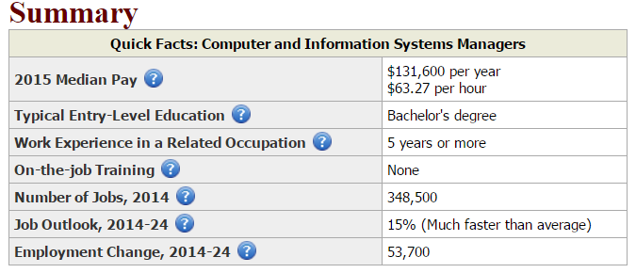
Current IS Managers Statistics
https://www.bls.gov/oes/current/oes113021.htm

Slide 7
Business Activities of IT
Business analysis
Business intelligence
Communications technology
Consulting
Data analytics
Data/information management
Development
Infrastructure/architecture development
Networks
Outsourcing services
Package implementation
Project delivery
Research and development
Security technology development
Support
Systems integration
Web development

Slide 8
If you’re looking to become an IT manager, employers will be looking for the following attributes:
You should have:
  Excellent organizational skills
  Strong leadership and decision making skills
  Excellent analytical and problem solving skills
  Understanding of complex information and requirements
  Good prioritization skills and be flexible enough to adapt plans
  Great IT skills combined with a good head for business
  Ability to explain complex systems in simple terms
  Ability to work to tight deadlines and within constraints
  Ability to work in teams

Slide 9
Your daily tasks may include:
Speaking to your management team/clients to find out what they want and to advise them objectively on where IT might make a difference to the business
Planning the stages of the project and how each affects the business
  Coordinating the project team
  Agreeing costs, timescales and standards to be met and monitoring these throughout the project
  Adjusting the plans where needed
  Making sure there is a smooth change over from the old system to the new one
  Keeping management and clients updated on progress
  Evaluation of each project stage and once completed

Slide 10
Leadership Styles
Commanding – “Follow me because I say so”
Pacesetting – “Follow me – do what I do”
Visionary – “Follow me because I see the future”
Affiliative – “Follow me because we are in this together”
Consulting – “Try doing it this way”
Democratic – “What do you think?”

Slide 11
Pros and cons of Management
Pro | Con
May have more control over your life and you can delegate | May have less control over your life as you have to deal with OPP
Typically can make more money | Have more responsibilities
Do work on a larger scale | Often perceived as not doing much work other than going to meetings
Have greater potential to make a difference | Numerous headaches comes with different demands, managing people, budgets
You get all the credit | You get all the blame
Get the opportunity to develop non-IT skills | Have to make tough hire/fire decisions
Get the opportunity to set strategy, can add more value to company
Have the opportunity to develop, coach, and mentor other people

Slide 12
Management and Leadership
 | Management | Leadership
Creating an agenda | Planning and budgeting – establishing detailed steps and timetables for achieving needed results and then allocating the resources necessary to make it happen | Establishing direction – developing a vision for the future, often the distant future, and strategies for producing the changes needed to achieve that vision
Developing a network for achieving the goals | Organizing and staffing – establishing some structure for accomplishing plan requirements, staffing the structure with individuals, delegating responsibility, and authority for carrying out the plan, providing policies and procedures to help guide people and creating methods or systems to monitor implementation | Aligning people- communicating the direction by words and deeds to all those whose cooperation may be needed so as to influence the creation of teams and coalitions that understand the vision and strategies, and accept their validity
Execution | Controlling and problem solving—monitoring results vs plan in some detail, identifying deviations, and then planning and organizing to solve these problems | Motivating and inspiring – energizing people to overcome major political, bureaucratic, and resources barriers to change by satisfying vey basics, but often unfilled human needs
Outcomes | Produces a degree of predictability and order and has the potential of consistently producing key results expected by various stakeholders (e.g. for customers—always being on time, for stakeholders being on budget | Produces change, often to a dramatic degree, and has the potential of producing extremely useful change (e.g. new products that customers want, new approaches to labor relations that help make a firm more competitive

Slide 13
3 Other Important Skills for an IT Manager
Communicate
Promote
Make a friend

Slide 14
Other Comments on the IT Manager Role
What can make being an IT manager a challenge is that there is not one specific thing that you need to do. Instead, there are a number of different things that you’ll be called on to do – perhaps several times during a day.
At any moment in time, you may be called on to play a different role. This role could be that of a teacher, a coach, a performance appraiser, a standards setter, or even a motivator.
Many people who suddenly find themselves in the role of an IT manager assume that they’ll be able to accomplish their new goals by telling the members of their team what they need to do.
Instead, what you need to do is to search for ways that you can enable the members of your team to become self-directed.

Slide 15
Top Ten Priorities for IT Managers
Lead don’t just manage.
Understand the fundaments of your organization
Create a vision for how IT will help your organization
Shape and inform expectations for an IT-enabled enterprise
Work to create clear and appropriate IT governance
Weave business and IT strategy together.
Work to build a new IT organization that is leaner and more focused than its more traditional predecessor.
Develop and nurture a high-performing team in your IT organization.
Manage the enterprise and IT risks.
Communicate IT performance in business-relevant language.

Slide 16
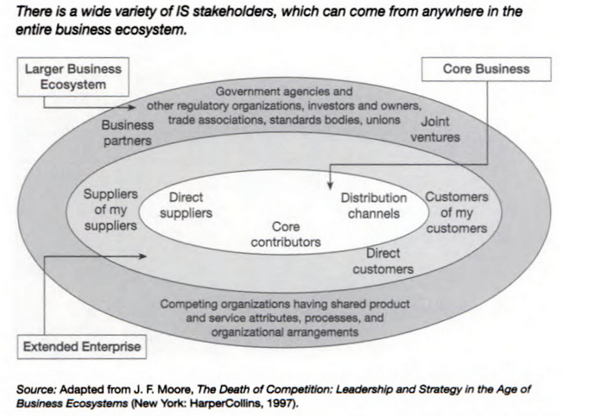
IT Stakeholders and the Business Ecosystem

Slide 17
Managing in Four directions
Managing up
Managing your peers
Managing your users/customers/clients
Managing your staff

Slide 18
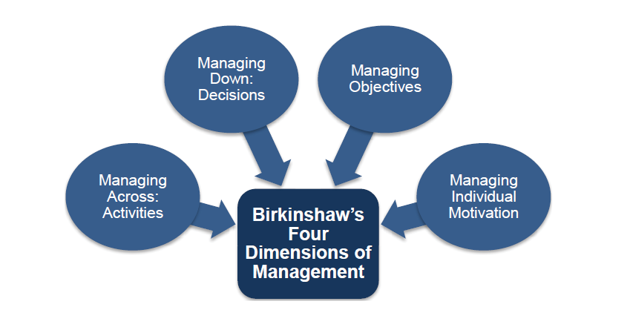

Slide 19
Segment your stakeholders with PUL
Power (clout):; how much political, financial, or other clout does a stakeholder have to affection a decision. The more power the more pull.
Urgency(immediacy of a claim) What’s the true time pressure of a stakeholder’s claim? Immediacy can increase pull.
Legitimacy (right to make a claim) How much moral, legal, contractual, or other right does a stakeholder have in a decision? The more legitimate the stakeholder’s right to be heard the greater the pull.

Slide 20
Four Different Relationship Roles
Adversarial – friction due to differences in opinions regarding operations, governance
Transactional – IT is viewed as a service provider as opposed to strategic partner
Aspiring – IT performance is high and department works proactively towards company’s mission
Trusted Ally – perhaps the highest level of interaction where IT is perceived and considered to be a valued strategic partner

Slide 21

The new strategic value of IT
Source: Howard Kingsnorth/The Image
Bank/Getty Images, Inc.
Traditional
New (Consultative)
Managing systems development
Systems project management
Managing computer operations
Providing technical services
Infrastructure planning, development, and control
Incorporating Ecommerce into the business
Managing system integration
Internet, Intranet, Extranet
Education
Managing Outsourcing
Notes:
Initiating and designing specific strategic information systems
As an end user, your information needs will often mandate the development of new strategic information systems.
You will decide which strategic systems you need (because you know your business needs better than the MIS department does), and you will provide input into developing these systems.
Incorporating the Internet and electronic commerce into the business
As an end user, you will be primarily responsible for effectively using the Internet and electronic commerce in your business. You will work with the MIS department to accomplish this task.
Managing system integration, including the Internet, intranets, and extranets
As an end user, your business needs will determine how you want to use the Internet, your corporate intranets, and extranets to accomplish your goals. You will be primarily responsible for advising the MIS department on the most effective use of the Internet, your corporate intranets, and extranets.
Educating the non-MIS managers about IT
Your department will be primarily responsible for advising the MIS department on how best to educate and train your employees about IT.
Educating the MIS staff about the business
Communication between the MIS department and the business units is a two-way street. You will be responsible for educating the MIS staff on your business, its needs, and its goals.

Slide 22
Developing and IT Strategy
Determine how important technology is to your organization
Determine who you are customers are and what there needs are
Keep your department central to the company’s operations
Determine who your team members are

Slide 23
8 Tactics for dealing with Haters
It doesn’t matter how many don’t get it. What matters is how many people do.
10% of people will find a way to take anything personally. Expect it and treat it like math.
When in doubt starve it (criticism) of oxygen ( ignore it 90%) . Pour gasoline on it (promote it 8%). Engage in it (2%).
If you respond don’t over-apologize.
You can’t reason someone out of something they didn’t reason themselves into.
“Trying to get everyone to like you is a sign a mediocrity. You’ll avoid the tough decisions, and you’ll avoid confronting the people who need to be confronted” Colin Powell
“If you want to improve, be content to be though foolish and stupid” Epictetus
“Living well is the best revenge” George Herbert
Taken from Tools of Titans: The tactics, routines and habits of billionaires. Tim Ferris

Slide 24
Quotes from actual IT Directors
What/how would you define the role of an IT manager?
a. Make sure the company is secure from harm: theft, data loss, malware, attack, while at the same time allowing innovation to flourish. There must be a combination of security and the ability to conduct business.
b. Create and nurture relationships with the management of the company.
c. Work with company managers and employees to define processes. Get to know and understand the business, which will then help you design and manage the IT.
d. Assist with systems evaluation, purchase, implementation, integration, support.
e. Integrate applications. This is where the company saves a substantial amount of money.
f. Negotiate the best prices for hardware, software, services. The negotiation class I took was one of the most valuable I have ever taken.
g. Budget and keep costs in line. Bigger part of the job than people recognize.
h. Make sure company is in compliance with laws and regulations.
i. Hire and retain the best IT employees. Takes more time than people recognize.
j. Train and nurture IT employees. Saves money and headache.

Slide 25
What qualities/characteristics do you feel is important for an IT manager to have? Or what do you look for in a candidate?
a. Business skills. This improves IT skills and value.
b. Communication skills: essential for success.
c. Technical understanding: notice this comes in third place!
d. Customer service attitude – after all, IT is a service.
e. Team player – if you cannot collaborate, you hurt the company and your career.

Slide 26
How/what qualities does an IT Manager need to have to be a leader
a. Empathy – the ability to feel what the team members are going through. This allows the leader to communicate per person need. This therefore increases productivity and reduces turnover and their related expenses.
b. Public speaking skills – very valuable in a corporate setting. Public speakers are admired and looked upon as experts.
c. Desire to serve others, to help others, teach others.
d. Reader – books, magazines, etc to keep up on the latest trends.
e. Networker – builds relationships, helps to hear what’s the latest going on in the company and the industry.

Slide 27
Can you think of a challenging experience either you had as an IT Manager (or one that you knew)?
a. Layoffs: from 290 to 37 people. An IT department of one – me. Becoming a jack-of-all-trades and keeping a positive, I Believe attitude.
b. Growing an IT department from one (me) to 67 people. How to hire, who to hire, how to budget, etc.
c. A poison employee who was undermining the company and not working. How to deal with them, get help from HR, and turn them around.

Slide 28
Can you think of a positive experience either you had as an IT Manager (or one that you knew)?
a. Growing a company from 37 people to 2,100. Exciting!
b. Hiring people who did not have specific IT skills, but had the right attitude and intelligence. Believing in them and mentoring them to become successful in the IT as well as other industries.

Slide 29
Any other advice you could provide for a person who is either contemplating or about to become an IT Manager.
a. Understand business first. This will help IT decisions.
b. Become a strong public speaker. A public speaker is admired and seen as an expert.
c. Grow and nurture your people network.
d. Read, read, read. Keep up on the IT industry, as well as the industry your company is in.
e. Take a negotiating class.
f. Learn budgeting and accounting concepts.
g. Learn about Compliance.

Slide 30
Importance of Teams
The job of every IT manager is to find ways to use your IT manager skills to get the most productive work out of your team.
As an IT manager you are not going to be effective if you don’t have a team to manage. Trying to manage a collection of individuals will be too hard and will consume too much of your time.

Slide 31
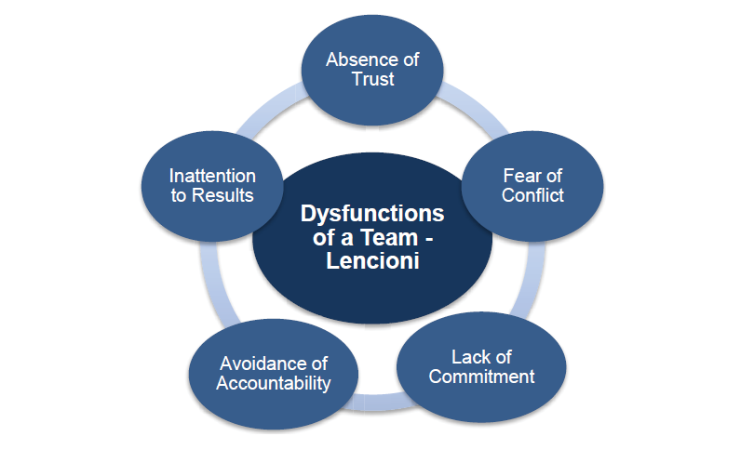

Slide 32
Myers/Briggs Test
According to Carl G. Jung's theory of psychological types [Jung, 1971], people can be characterized by their preference of general attitude:
  Extraverted (E) vs. Introverted (I),
their preference of one of the two functions of perception:
  Sensing (S) vs. Intuition (N),
and their preference of one of the two functions of judging:
  Thinking (T) vs. Feeling (F)
The three areas of preferences introduced by Jung are dichotomies (i.e. bipolar dimensions where each pole represents a different preference). Jung also proposed that in a person one of the four functions above is dominant – either a function of perception or a function of judging. Isabel Briggs Myers, a researcher and practitioner of Jung’s theory, proposed to see the judging-perceiving relationship as a fourth dichotomy influencing personality type [Briggs Myers, 1980]:
  Judging (J) vs. Perceiving (P)

Slide 33
Myers/Briggs Test continued
The first criterion, Extraversion – Introversion, signifies the source and direction of a person’s energy expression. An extravert’s source and direction of energy expression is mainly in the external world, while an introvert has a source of energy mainly in their own internal world.
The second criterion, Sensing – Intuition, represents the method by which someone perceives information. Sensing means that a person mainly believes information he or she receives directly from the external world. Intuition means that a person believes mainly information he or she receives from the internal or imaginative world.
The third criterion, Thinking – Feeling, represents how a person processes information. Thinking means that a person makes a decision mainly through logic. Feeling means that, as a rule, he or she makes a decision based on emotion, i.e. based on what they feel they should do.
The fourth criterion, Judging – Perceiving, reflects how a person implements the information he or she has processed. Judging means that a person organizes all of his life events and, as a rule, sticks to his plans. Perceiving means that he or she is inclined to improvise and explore alternative options.
All possible permutations of preferences in the 4 dichotomies above yield 16 different combinations

Slide 34
Two online tests for personality styles
http://www.humanmetrics.com/cgi-win/jtypes2.asp
https://www.123test.com/disc-personality-test/

Slide 35

Questions?

Slide 36
Appendix of Job Descriptions
Software Engineer
Also known as: application programmer, software architect, system programmer/engineer.
This job in brief: The work of a software engineer typically includes designing and programming system-level software: operating systems, database systems, embedded systems and so on. They understand how both software and hardware function. The work can involve talking to clients and colleagues to assess and define what solution or system is needed, which means there's a lot of interaction as well as full-on technical work. Software engineers are often found in electronics and telecommunications companies. A computing, software engineering or related higher degree is often needed.
Key skills required: Analysis, logical thinking, teamwork and attention to detail.

Slide 37
Systems Analyst
Also known as: Product specialist, systems engineer, solutions specialist, technical designer.
This job in brief: Systems analysts investigate and analyse business problems and then design information systems that provide a feasible solution, typically in response to requests from their business or a customer. They gather requirements and identify the costs and the time needed to implement the project. The job needs a mix of business and technical knowledge, and a good understanding of people. It's a role for analyst programmers to move into and typically requires a few years' experience from graduation.
Key skills include: Ability to extract and analyse information, good communication, persuasion and sensitivity.

Slide 38
Business Analyst
Also known as: Business architect, enterprise-wide information specialist.
This job in brief: Business analysts are true midfielders, equally happy talking with technology people, business managers and end users. They identify opportunities for improvement to processes and business operations using information technology. The role is project based and begins with analysing a customer's needs, gathering and documenting requirements and creating a project plan to design the resulting technology solution. Business analysts need technology understanding, but don't necessarily need a technical degree.
Key skills required: Communication, presentation, facilitation, project management and problem solving.

Slide 39
Technical Support
Also known as: Helpdesk support, operations analyst, problem manager.
This job in brief: These are the professional troubleshooters of the IT world. Many technical support specialists work for hardware manufacturers and suppliers solving the problems of business customers or consumers, but many work for end-user companies supporting, monitoring and maintaining workplace technology and responding to users' requests for help. Some lines of support require professionals with specific experience and knowledge, but tech support can also be a good way into the industry for graduates.
Key skills required: Wide ranging tech knowledge, problem solving, communication/listening, patience and diplomacy.

Slide 40
Network Engineer
Also known as: Hardware engineer, network designer.
This job in brief: Network engineering is one of the more technically demanding IT jobs. Broadly speaking the role involves setting up, administering, maintaining and upgrading communication systems, local area networks and wide area networks for an organisation. Network engineers are also responsible for security, data storage and disaster recovery strategies. It is a highly technical role and you'll gather a hoard of specialist technical certifications as you progress. A telecoms or computer science-related degree is needed.
Key skills include: Specialist network knowledge, communication, planning, analysis and problem solving.

Slide 41
Technical Consultant
Also known as: IT consultant, application specialist, enterprise-wide information specialist.
This job in brief: The term 'consultant' can be a tagline for many IT jobs, but typically technical consultants provide technical expertise to, and develop and implement IT systems for, external clients. They can be involved at any or all stages of the project lifecycle: pitching for a contract; refining a specification with the client team; designing the system; managing part or all of the project; after sales support... or even developing the code. A technical degree is preferred, but not always necessary.
Key skills include: Communication, presentation, technical and business understanding, project management and teamwork.

Slide 42
Technical Sales
Also known as: Sales manager, account manager, sales executive.
This job in brief: Technical sales may be one of the least hands-on technical roles, but it still requires an understanding of how IT is used in business. You may sell hardware, or extol the business benefits of whole systems or services. Day to day, the job could involve phone calls, meetings, conferences and drafting proposals. There will be targets to meet and commission when you reach them. A technology degree isn't necessarily essential, but you will need to have a thorough technical understanding of the product you sell.
Key skills required: Product knowledge, persuasion, interpersonal skills, drive, mobility and business awareness.
Project manager
Also known as: Product planner, project leader, master scheduler.

Slide 43
Project Manager
Also known as: Product planner, project leader, master scheduler.
This job in brief: Project managers organize people, time and resources to make sure information technology projects meet stated requirements and are completed on time and on budget. They may manage a whole project from start to finish or manage part of a larger 'program'. It isn't an entry-level role: project managers have to be pretty clued up. This requires experience and a good foundation of technology and soft skills, which are essential for working with tech development teams and higher-level business managers.
Key skills required: Organization, problem solving, communication, clear thinking, and the ability to stay calm under pressure.

Slide 44
Web Developer
Also known as: Web designer, web producer, multimedia architect, internet engineer.
This job in brief: Web development is a broad term and covers everything to do with building websites and all the infrastructure that sits behind them. The job is still viewed as the trendy side of IT years after it first emerged. These days web development is pretty technical and involves some hardcore programming as well as the more creative side of designing the user interfaces of new websites. The role can be found in organisations large and small.
Key skills required: Basic understanding of web technologies (client side, server side and databases), analytical thinking, problem solving and creativity

Slide 45
Software Tester
Also known as: Test analyst, software quality assurance tester.
This job in brief: Bugs can have a massive impact on the productivity and reputation of an IT firm. Testers try to anticipate all the ways an application or system might be used and how it could fail. They don't necessarily program but they do need a good understanding of code. Testers prepare test scripts and macros, and analyse results, which are fed back to the project leader so that fixes can be made. Testers can also be involved at the early stages of projects in order to anticipate pitfalls before work begins. You can potentially get to a high level as a tester.
Key skills required: Attention to detail, creativity, organisation, analytical and investigative thinking, and communication.

