Slide 1
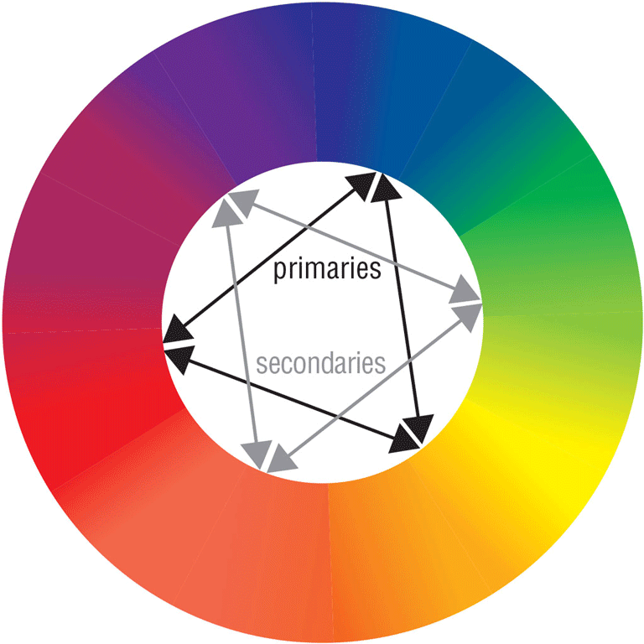
Web Design 6e
Chapter 2: Web Publishing Fundamentals

Slide 2
Chapter Objectives
Describe the advantages of web publishing
Discuss basic web design principles
Define the requirements for writing for the web
Explain the use of color as a web design tool
Identify web publishing issues

Slide 3
Advantages of Web Publishing
Web publishing offers distinct advantages over print
Currency
Connectivity
Interactivity
Cost
Delivery

Slide 4
The Currency Advantage (1 of 2)
Websites can be updated continuously, while print publications are only as current as their date of publication
To keep visitors on your site, always supply timely, changing material
Use Connectivity tools to communicate with customers and enable social media sharing

Slide 5
The Currency Advantage (2 of 2)

Slide 6
The Connectivity Advantage
The web’s connectivity advantage, or ability to instantaneously distribute and share content
Content aggregators
Digg
StumbleUpon
Streamline the writing process

Slide 7
The Interactivity Advantage (1 of 2)
Internet and web technologies promote data and resource sharing
Page of contact information
Links to blog, Twitter feed, Facebook page
Account signups
Web-based forms
Comments

Slide 8
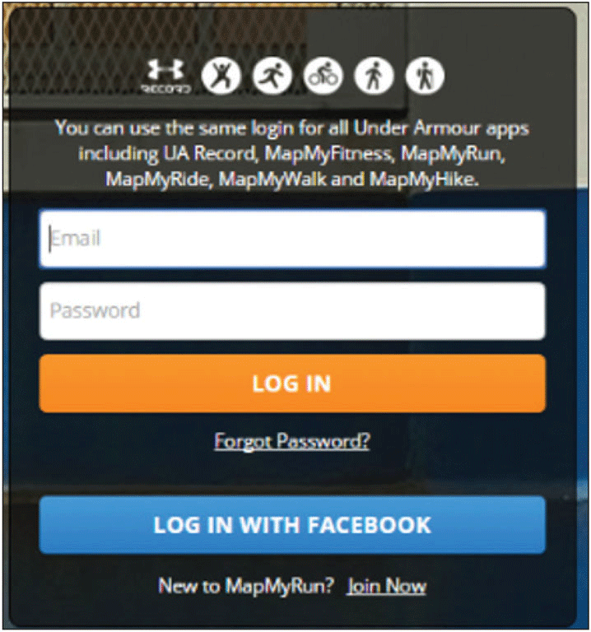
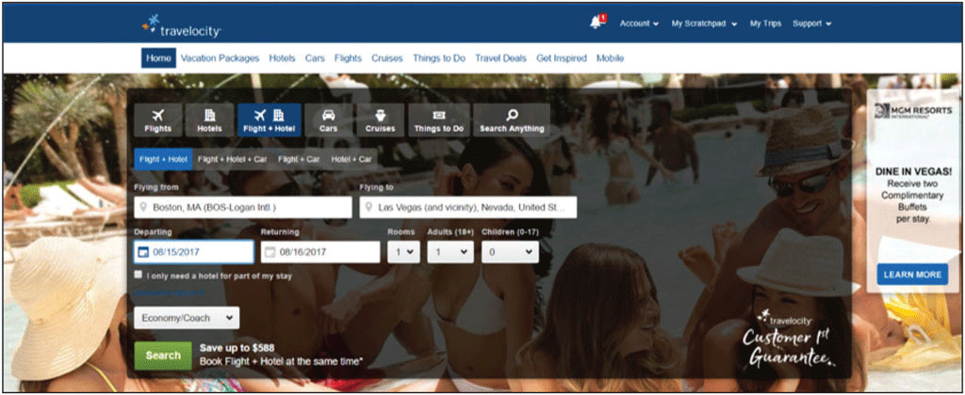
The Interactivity Advantage (2 of 2)

Slide 9
The Cost Advantage (1 of 2)
Updating web content is more cost effective than updating print content
Web publishing costs do not vary based on length, color, or design complexity

Slide 10
The Cost Advantage (2 of 2)
Developing a website can be expensive:
Web design
Content writing or adaptation
Multimedia development
Website hosting
Domain name registration
Promotional Services

Slide 11
The Delivery Advantage
Distributing information via the web can be fast and inexpensive
With the same immediacy and cost, the web can reach both global and local audiences
Consider the web when the need exists for economical and rapid distribution of information
Use your website to expand upon printed content

Slide 12
Basic Web Design Principles
Balance and proximity
Contrast and focus
Unity and visual identity

Slide 13
Balance and Proximity (1 of 4)
Arrange web elements symmetrically (centered and balanced) to suggest a conservative, safe, peaceful atmosphere
Arrange web elements asymmetrically (off balance) to create an energetic mood
Asymmetrical designs typically do not adapt well to mobile devices

Slide 14
Balance and Proximity (2 of 4)

Slide 15
Balance and Proximity (3 of 4)
Proximity (closeness) is closely associated with balance
Elements that have a relationship should be placed close to each other
White space can help define proximity and organize webpage elements

Slide 16
Balance and Proximity (4 of 4)

Slide 17
Contrast and Focus (1 of 2)
Contrast is a mix of elements to stimulate attention
Use different text styles, colors, and size
Focus is the center of interest or activity
A webpage needs a focal point
Create webpages with contrast to elicit awareness and establish a focal point, the center of interest or activity

Slide 18
Contrast and Focus (2 of 2)

Slide 19
Unity and Visual Identity (1 of 4)
All pages at a website must have unity, a sense of oneness or belonging, to create the visual identity
Create unity with consistency and repetition throughout a website
Unity is associated with branding
Branding specifications
Tag line

Slide 20
Unity and Visual Identity (2 of 4)

Slide 21
Unity and Visual Identity (3 of 4)
Alignment is the arrangement of objects in fixed or predetermined positions
Using grids for layout is part of RWD

Slide 22
Unity and Visual Identity (4 of 4)

Slide 23
Color as Web Design Tool
Color can be a powerful design tool
Reinforces branding
Brings focus
Increases contrast
Improves readability
Sets mood

Slide 24
The Color Wheel (1 of 2)
The color wheel can help you choose effective and appealing color combinations
Primary colors
Secondary colors
Cool colors
Warm colors
Complementary colors

Slide 25
The Color Wheel (2 of 2)

Slide 26
The RGB Color System (1 of 2)
Monitors project color using the RGB color system
Combines red, green, and blue light
Levels of intensity are measured from 0 to 255
Values
A monitor’s color depth is the actual number of colors that a monitor displays
The hexadecimal system uses 16 symbols to signify values

Slide 27
The RGB Color System (2 of 2)

Slide 28
Target Audience Expectations
Certain colors have come to symbolize particular qualities
Keep in mind the qualities generally associated with different colors when selecting colors for your website
Review several commercial and noncommercial website color schemes

Slide 29
Writing for the Web (1 of 2)
Use language that is:
Straightforward
Contemporary
Geared toward an educated audience
Avoid overly-promotional language
Use headings to communicate content
Be cautious with humor

Slide 30
Writing for the Web (2 of 2)
Accuracy and Currency
Scannability
Organization

Slide 31
Accuracy and Currency
Confirm the accuracy of your material with a reliable source
Avoid spelling and grammar errors
Keep content current
Indicate the date and time of the last update to your website

Slide 32
Scannability (1 of 3)
Chunked text is easier to scan
Small sections
Headings
Subheadings
Bulleted lists

Slide 33
Scannability (2 of 3)

Slide 34
Scannability (3 of 3)
Use chunked text
Begin long paragraphs with topic sentences
Avoid colored text or underline for emphasis
Avoid using only uppercase characters

Slide 35
Organization (1 of 2)
Inverted pyramid style
Summary
Details
Background information

Slide 36
Organization (2 of 2)

Slide 37
Web Publishing Issues
Technical
Legal and Privacy
Accessibility and Usability

Slide 38
Technical Issues (1 of 4)
Bandwidth is the quantity of data that can be transmitted in a specific time frame
Keep file sizes to a minimum
Use thumbnails
Optimize graphics
Browser differences
Graphical vs. non-graphical display
Alternative text

Slide 39
Technical Issues (2 of 4)
Resolution
The measure of sharpness and clarity
A pixel is a single point in an electronic image
Page elements display differently at different resolutions
When designing websites for mobile devices, you must account for a smaller screen size and the auto-rotate feature included in many smartphones and tablets

Slide 40
Technical Issues (3 of 4)

Slide 41
Technical Issues (4 of 4)
Mobile-friendly practices
RWD
Bandwidth
Mobile-first

Slide 42
Legal and Privacy Issues (1 of 5)
Legal Issues
Easy to acquire images from the web
Make sure the material on your website is free of copyright infringement
Ownership of intellectual property
Obtain permission from the owner to use any copyrighted material
Use connectivity tools

Slide 43
Legal and Privacy Issues (2 of 5)
Protect your work by copyrighting your material

Slide 44
Legal and Privacy Issues (3 of 5)

Slide 45
Legal and Privacy Issues (4 of 5)
Privacy Issues
Cautiously give out personally identifiable information (PII)
Encryption
Decryption
Secure Sockets Layer (SSL)
Cookies
Privacy policy statement

Slide 46
Legal and Privacy Issues (5 of 5)

Slide 47
Accessibility and Usability Issues (1 of 3)
Web accessibility deals with ensuring access to web-based information
W3C sets web standards
WAI
Section 508

Slide 48
Accessibility and Usability Issues (2 of 3)

Slide 49
Accessibility and Usability Issues (3 of 3)
Web usability involves designing a website and its pages so that all visitors to the website can easily and quickly satisfy their goals
Web designers incorporate user experience (UX) practices into webpage design

Slide 50
Chapter Summary
Describe the advantages of web publishing
Discuss basic web design principles
Define the requirements for writing for the web
Explain the use of color as a web design tool
Identify web publishing issues

