Slide 1
Web Design 6E
Chapter 1: The Environment and the Tools

Slide 2
Chapter Objectives
Describe the Internet and the World Wide Web
Discuss ways to access the Internet and the web
Categorize types of websites
Identify web design tools
Explain web design principles, roles, and required skills

Slide 3
The Internet and the World Wide Web (1 of 3)
A computer network consists of connected computers, mobile devices, printers, and data storage devices that share computing resources and data
The Internet is a worldwide public network that connects millions of these private networks

Slide 4
The Internet and the World Wide Web (2 of 3)

Slide 5
The Internet and the World Wide Web (3 of 3)
The World Wide Web (web) is a part of the Internet that consists of connected computers called web servers that store electronic documents called webpages
A webpage is a specially formatted document that can contain images, text, interactive elements, and hyperlinks, which are links to other pages
A website is a group of related webpages

Slide 6
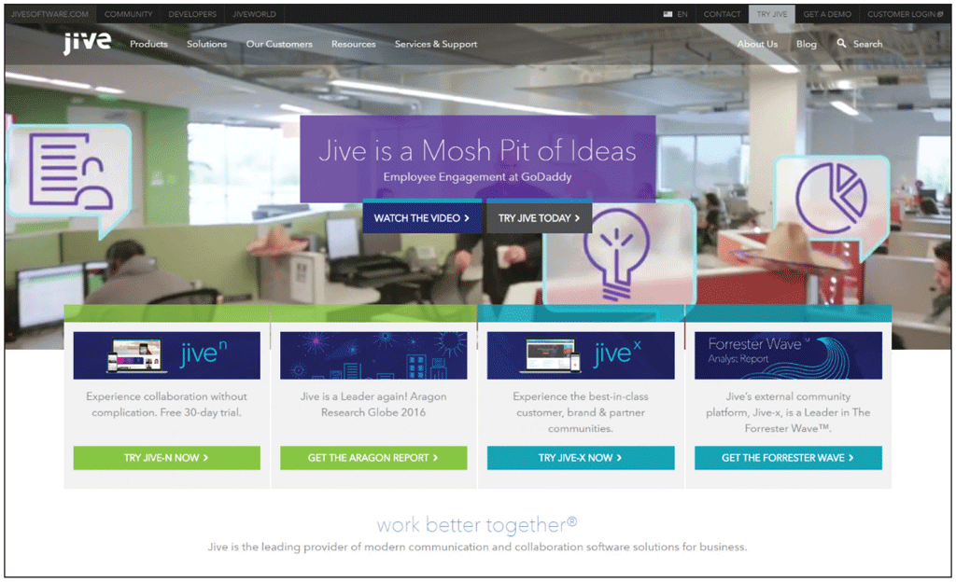
World Wide Web (1 of 2)
A website’s primary page is its home page

Slide 7
World Wide Web (2 of 2)
Browsing or surfing the web is exploring the web by moving from one webpage to another

Slide 8
Influence on Society
Communication
Education
Entertainment and News
E-commerce

Slide 9
Communication (1 of 2)
Blog
Video sharing / Video blogging
Social networking
Social bookmarking
Massively multiplayer online games (MMOGs)
3D virtual worlds
Wiki
Bookmark / favorite
Shortcut
Internet Relay Chat (IRC)
Web chat
Instant messaging / IM chat
Group messaging apps
Collaborative workspaces / virtual meeting spaces

Slide 10
Communication (2 of 2)

Slide 11
Education
Take an online course from an academic institution to earn a degree or certificate
Watch a video or read a blog post by an amateur expert
Several universities and academic institutions publish some or all educational materials online

Slide 12
Entertainment and News
Popular entertainment sites include music, videos, sports, games, and more
News websites allow you to read news stories, and some even allow you to watch video clips
Some provide interactive elements

Slide 13
E-Commerce
Electronic commerce or e-commerce encompasses a wide variety of online business activities, including consumer shopping and investing and the exchange of business data and transactions within a company or among multiple companies
Business-to-consumer (B2C)
Business-to-business (B2B)
Consumer-to-consumer (C2C)

Slide 14
Ways to Access the Internet
The speed at which data travels from one device to another is the transfer rate
Bits per second (bps)
From thousands (kbps) to millions (Mbps)
Higher-quality connections needed for streaming media

Slide 15
Broadband Connections
Broadband defines high-speed data transmissions over a communications channel that can transmit multiple signals at one time
Digital subscriber line (DSL)
Cable television (CATV) line
FTTP: Fiber to the Premises
Satellite

Slide 16
Connecting to the Internet and the Web
Mobile wireless technologies:
Radio signals
Wi-Fi (wireless fidelity)
Cellular telephones
Wireless providers’ broadband networks

Slide 17
Mobile Internet Access
Generations classify standards for mobile communications:
3G: speech and data services
4G: gaming apps and streaming media

Slide 18
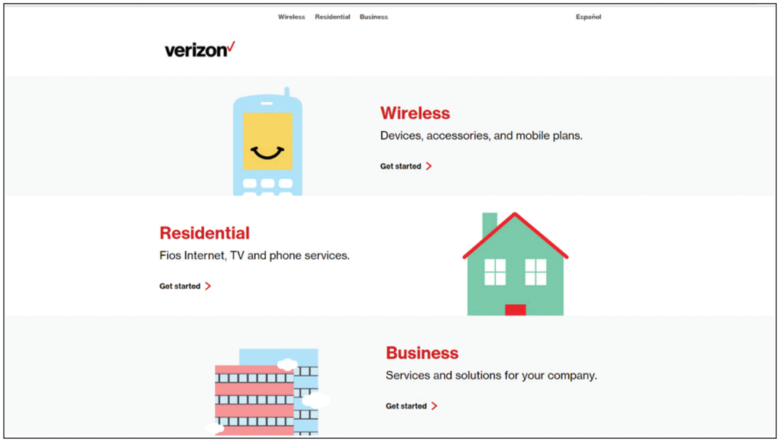
Internet Service Providers
Internet Service Provider (ISP)
Has permanent Internet connection
Provides temporary connections
Regional ISP
National ISP
Verizon

Slide 19
Web Browsers (1 of 6)
A web browser is a program or app that requests, downloads, and displays webpages stored on a web server
Google Chrome
Microsoft Edge
Mozilla Firefox

Slide 20
Web Browsers (2 of 6)

Slide 21
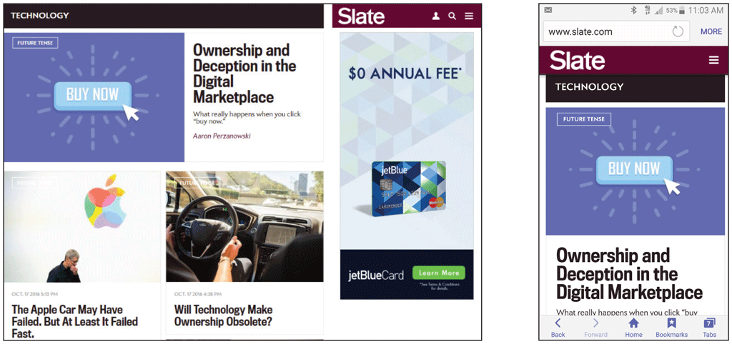
Web Browsers (3 of 6)
Responsive web design (RWD) is used to create websites that adjust to the device and screen size displaying the webpage

Slide 22
Web Browsers (4 of 6)
Access webpages by entering its Uniform Resource Locator (URL) into the browser’s Address bar
URL is comprised of the protocol, domain name and top-level domain designation
Hypertext Transfer Protocol (HTTP)
Domain name can be an IP address or a text version of this address

Slide 23
Web Browsers (5 of 6)

Slide 24
Web Browsers (6 of 6)

Slide 25
Types of Websites
Personal
Organizational / Topical
Commercial

Slide 26
Personal
Limited developmental resources
Content management systems
Uses:
Promote employment credentials
Share news and photos with friends and family
Share common interests or hobbies
Do not post information that can be misused

Slide 27
Organizational / Topical
Organizational websites contain information on particular organizations
Topical websites focus on a specific subject

Slide 28
Commercial
Used to promote and sell a product or service
More sophisticated commercial websites generally produce greater revenue

Slide 29
Search Tools (1 of 4)
Web-based search tools
Search engines
Keywords
Search engines might use a variety of methods to create its index
Spiders or robots
Meta tags
Metasearch engines

Slide 30
Search Tools (2 of 4)

Slide 31
Search Tools (3 of 4)
Search Engine Optimization (SEO)
Designing webpages to appear higher in search engine results
Meta tags
Descriptive page titles
Relevant inbound links
Clearly written text

Slide 32
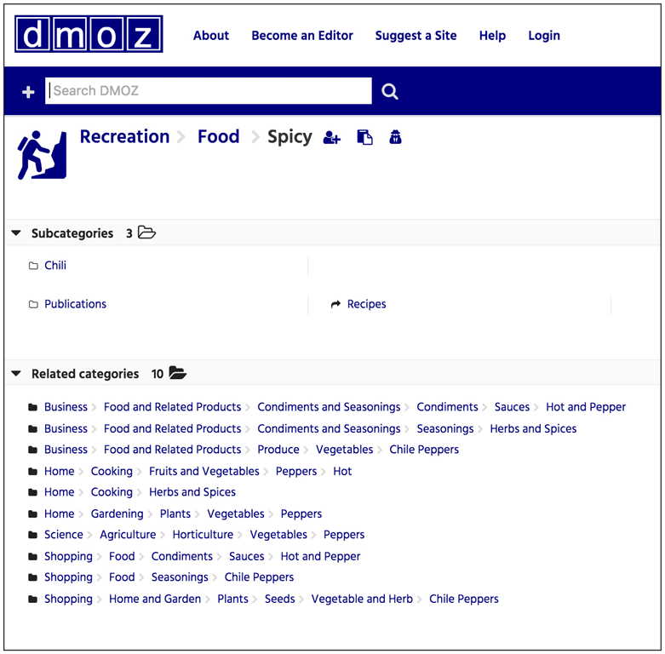
Search Tools (4 of 4)
Search Directory
Builds index using human interaction
Click category and subcategory links to find webpages

Slide 33
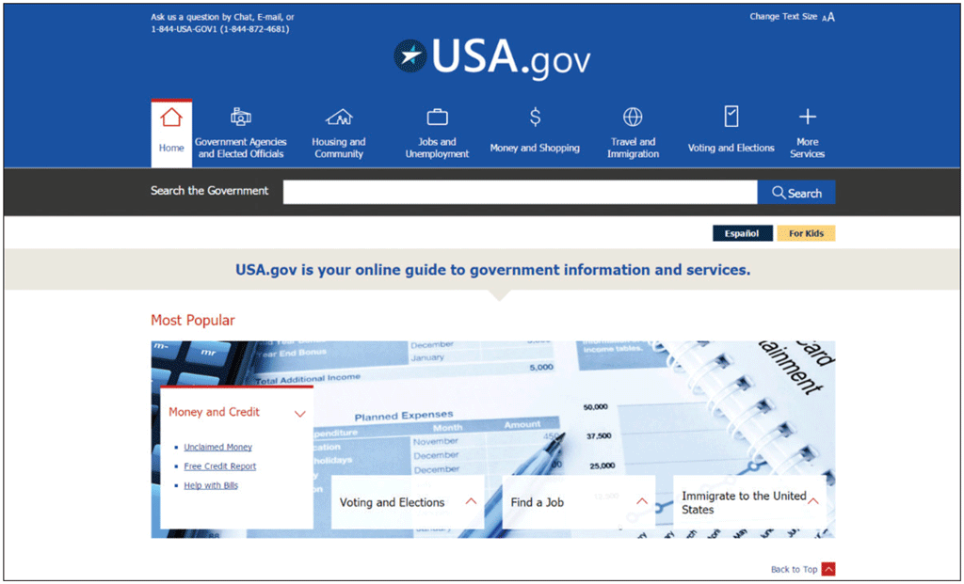
Portals
A portal is a website that offers a starting point for accessing information
General consumer
Personal
Vertical
Corporate

Slide 34
Other Types of Websites

Slide 35
Web Design Tools
Before adding new technology, ask:
Does it meet currently accepted standards?
What can it do to further my purpose?
How will it affect my website’s visual appeal, accessibility, and usability?
What impact will it have on security and other website elements?
What are the direct and indirect costs?
How soon will I see a return on investing?

Slide 36
Markup Languages (1 of 2)
Hypertext Markup Language (HTML)
Uses tags to define format and organization of webpage elements
HTML5
W3C sets standards
Extensible Markup Language (XML)
Facilitates sharing of information

Slide 37
Markup Languages (2 of 2)

Slide 38
Cascading Style Sheets
Standardize the presentation of the content by applying styles to such elements
Font
Margins
Positioning
Background colors
Style sheets can be attached to multiple webpages

Slide 39
Scripting Languages
Programming languages used to write short programs that run on the server or the browser
Javascript
PHP: Hypertext Preprocessor (PHP)
CoffeeScript
Active content
Malware

Slide 40
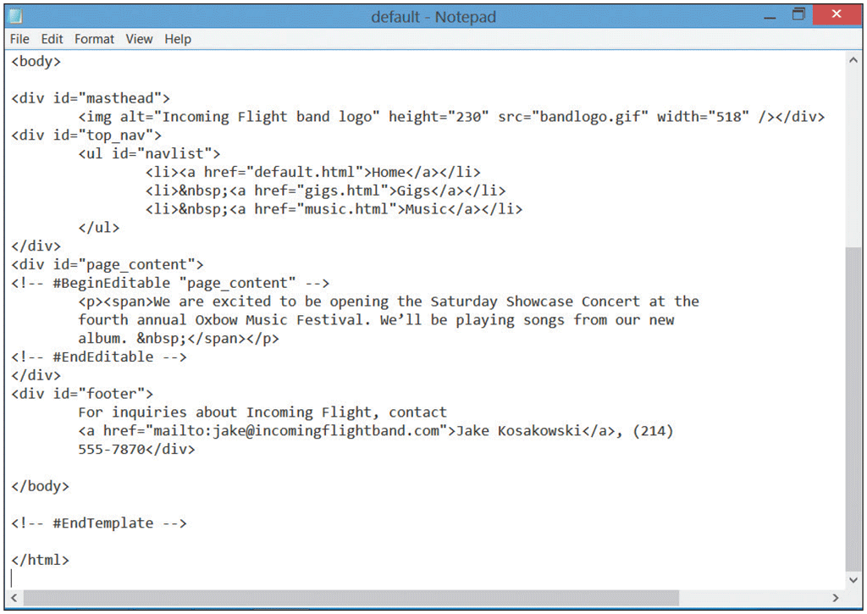
Text and HTML Editors
A text editor is software used to create plain (ASCII) text files
An HTML editor is a text editor enhanced with special features that are used to more easily insert HTML tags and their attributes
HTML-Kit
CoffeeCup
BBEdit
NoteTab

Slide 41
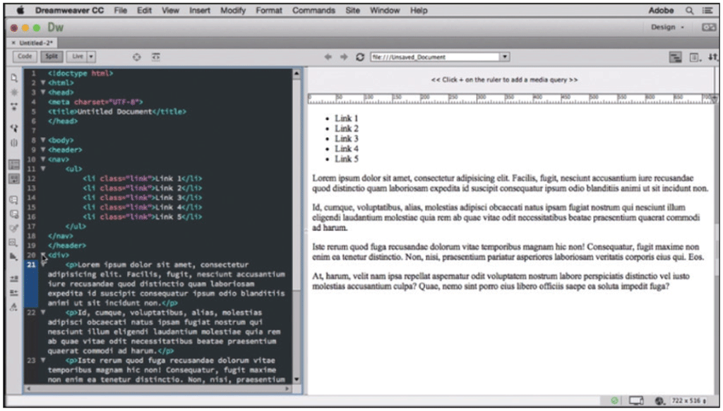
Web Development Tools (1 of 2)
Packages that automatically generate HTML code
WYSIWYG
IDEs

Slide 42
Web Development Tools (2 of 2)
Challenges to using web development tools:
Might look different than what you see in browser
Unnecessary codes create large, slow-loading webpages
Might not use latest markup language standards

Slide 43
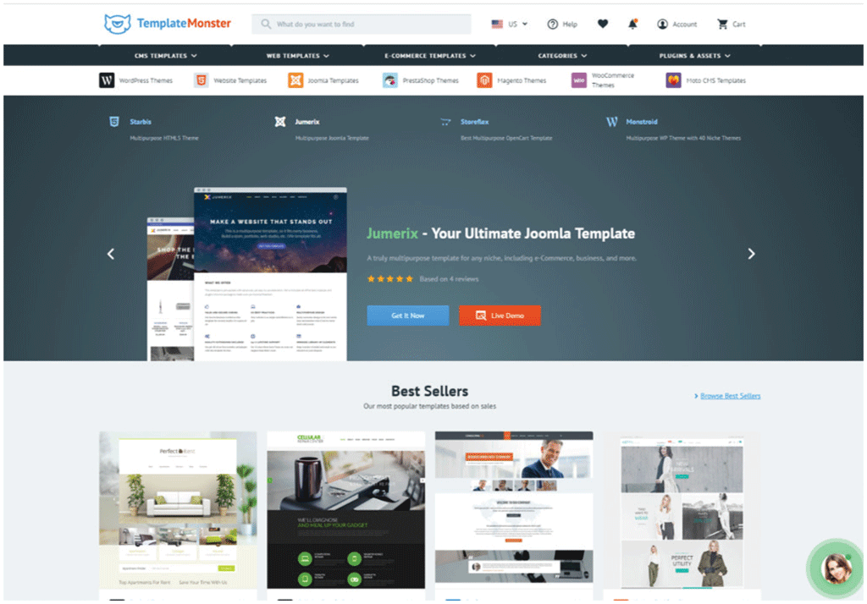
Web Templates and Content Management Systems (1 of 3)
A Web template or theme is a predesigned model that can be customized for fast website or webpage creation or updating

Slide 44
Web Templates and Content Management Systems (2 of 3)
A content management system (CMS) facilitates the management of web content development
Drupal
WordPress
Joomla
Content repository

Slide 45
Web Templates and Content Management Systems (3 of 3)
An intranet is a private network within a large organization or commercial entity that uses Internet and web technologies to share information among only its members, employees, or business partners

Slide 46
Web Design Roles (1 of 4)
Creative
Technical
Oversight

Slide 47
Web Design Roles (2 of 4)
Creative Roles
Content writer / editor
SEO expert
Web designer
UI / UX manager
Web artist / graphic designer
Multimedia producer

Slide 48
Web Design Roles (3 of 4)
Technical Roles
Web programmer / developer
Front-end
Back-end
Full-stack
Database developer
Web server administrator

Slide 49
Web Design Roles (4 of 4)
Oversight Roles
Web administrator
System architect
Tester
Social media expert

Slide 50
Chapter Summary
Describe the Internet and the World Wide Web
Discuss ways to access the Internet and the web
Categorize types of websites
Identify web design tools
Explain web design principles, roles, and required skills

