Slide 1
Creating a web site
Part I
Structure Design

Slide 2
Creating a web site Step One
Planning the web site—what type
Billboard
Publishing
Special/public interest/nonprofit
Virtual gallery
Ecommerce, catalog, online shopping
Product support
Intranet/extranet

Slide 3
Step Two Analyze your audience
What is it that users want when they come to your site?
How can you attract and entice them to return for repeat visits?
What type of computer and connection speed does your typical visitor have?

Slide 4
More considerations…
Gender
Education Level
Technical Aptitude
What motivation?
Informational
Economic
Social
Do you have a captive audience?

Slide 5
Step 3 Building a Web Development Team
Server Administrator
Designers
HTML coders
Writers
Software programmers
Database administrators
Marketing

Slide 6
Step 4 File Names and URLs
Names
Front door URL
Page names
Case Sensitivity
Character Exceptions that you CANNOT USE
/,/,&,*, <,>, and blank spaces
File Extensions
.htm
.html
.asp/aspx
.xls/xlsx
.gif
.jpg

Slide 7
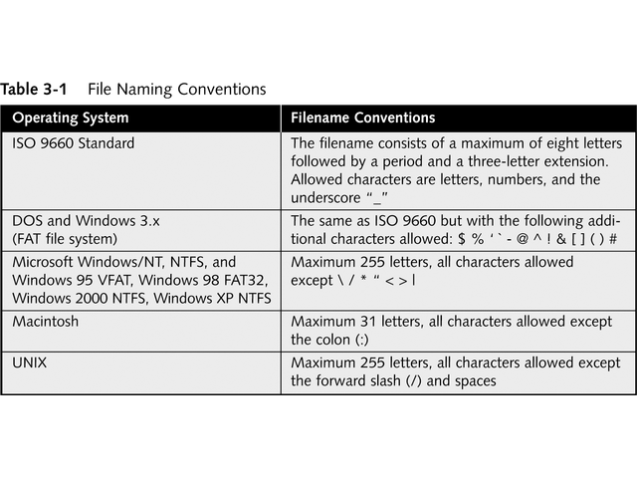

Slide 8
Complete URLs and Directory Structure
http://carl.sandiego.edu/itmg340.asp
Versus itmg340.asp
Relative versus absolute paths

Slide 9
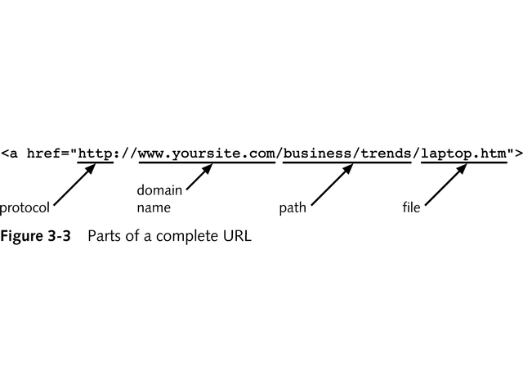

Slide 10
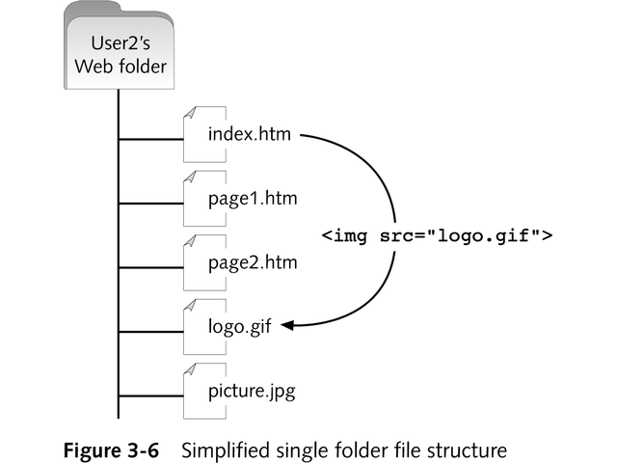

Slide 11
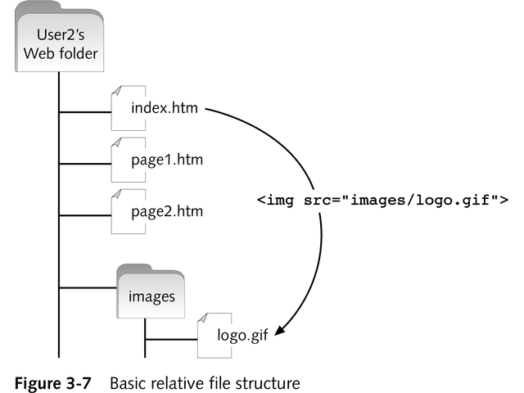

Slide 12
Diagram the Site
Plan your site by creating a flowchart that shows the structure and logic behind the content presentation and navigation choices
This preliminary step is one of the most important that you take in planning your site
Structures
Linear information
Tutorial
Web
Hierarchical
Catalog
cluster

Slide 13
Linear Structure
The linear information structure lets you guide the user along a path. This structure lends itself to book-type presentations or content that requires the user to follow a predefined path.

Slide 14
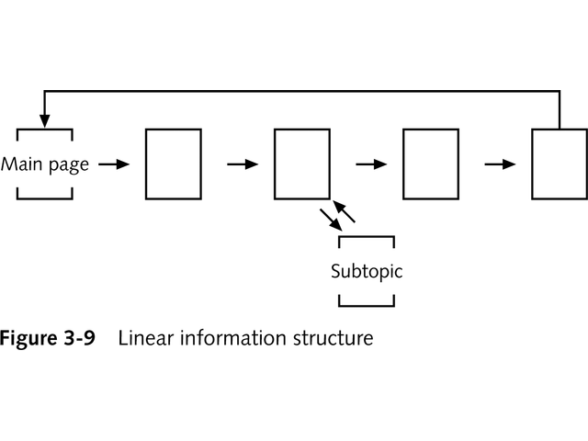

Slide 15
Tutorial Structure
The tutorial structure is perfect for computer-based training content such as lessons, tutorials, or task-oriented procedures

Slide 16
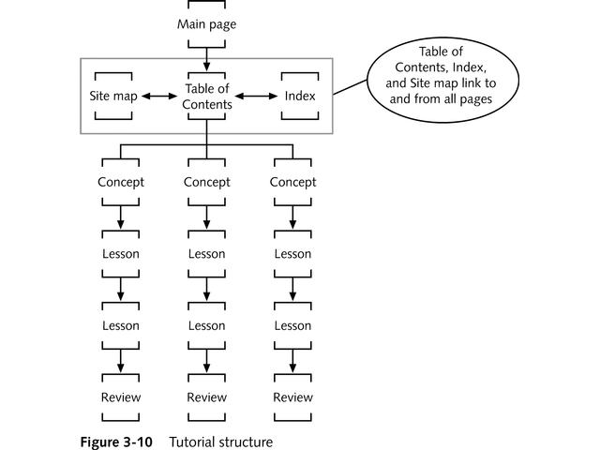

Slide 17
Web Structure
Many smaller Web sites follow the Web structure which offers links to and from every page in the site. This allows the user to jump freely to any page from any other page.

Slide 18
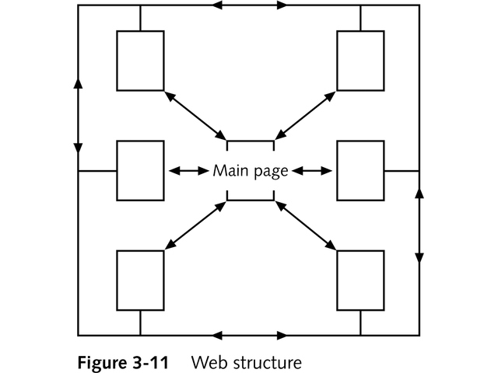

Slide 19
Hierarchical Structure
The hierarchical structure is probably the most common information design. It lends itself to larger content collections because the section pages break up and organize the content at different levels throughout the site.

Slide 20
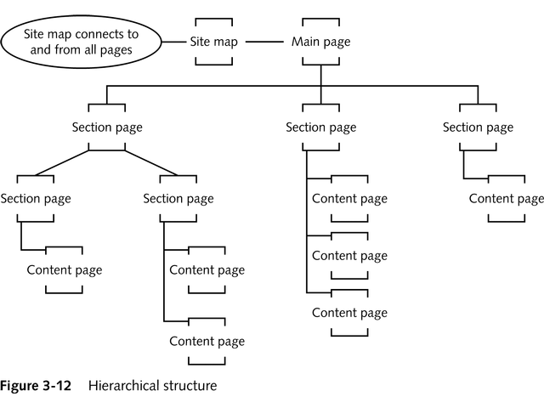

Slide 21
Cluster Structure
The cluster structure is similar to the hierarchical structure, except that every topic area is an island of information unto itself, with all pages in each cluster linked to each other

Slide 22
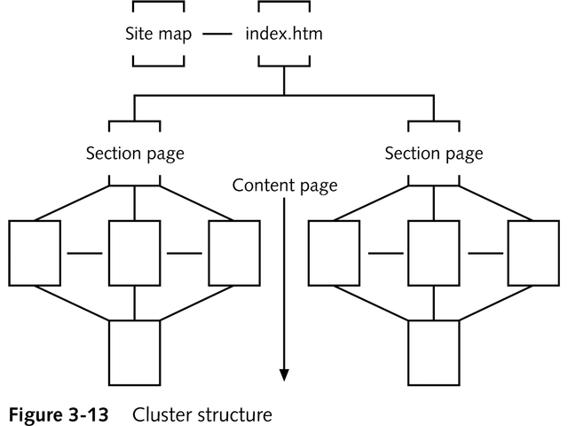

Slide 23
Catalog Structure
The catalog structure accommodates electronic shopping. The user can browse or search for items and view specific information about each product on the item pages.

Slide 24
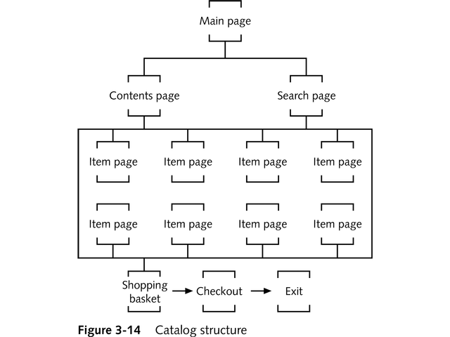

Slide 25
Structure Summary
Start with pencil and paper. Your ideas will be less restricted and you can easily revise and recast without recoding.
Write a site specification document. You’ll find it invaluable as a reference while building your site.

