Slide 1
Connecting to Data
Data Prep with Text and Excel Files
[Presenter Name] | [Presenter Title]
[Date] | [Contact Info (social media, email, etc.)]
Notes:
Title Slide

Slide 2
Table of Contents/Agenda
Poorly Formatted Data
Data Interpreter
Pivot
Split
Custom Split
Slide 3
Slide 9
Slide 16
Slide 19
Slide 23
Notes:
Table of Contents

Slide 3
Poorly Formatted Data
Notes:
Section Header

Slide 4
Poorly Formatted Data
In our first example of connecting to data, we used an Excel file that was already formatted nicely – we just brought it straight into Tableau. In reality, data files are not always so well-formatted. Now we will practice using a file that needs some work before it is ready for analysis.
For this example we’ll be using the “Data Prep – Flights” Excel file, which you can download from the course website. (Global Superstore, our main dataset, is too well-structured! This gives us a messier example to work with.)

Slide 5
Poorly Formatted Data
Open the file in Excel. Here we have a report in Excel, showing the number of resolved incidents per Employee per month. The “Ideal” tab shows how we wish the data would be formatted – like a database table.
Notes:
Image & Copy

Slide 6
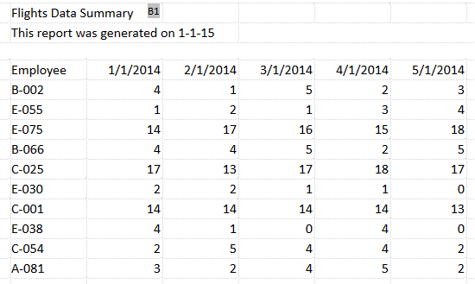
Poorly Formatted Data
However, sometimes we receive data that looks more like what we see in the “Resolved Incidents” tab. Luckily, there are several features in Tableau Desktop to help automatically reshape Text and Excel files to get them ready for analysis in Tableau.
Notes:
Image & Copy

Slide 7
Poorly Formatted Data
Let’s connect to this Excel file and see if we can work with that poorly formatted sheet.
In Tableau Desktop, click on Excel, navigate to where you saved the file and click open.
Drag out the “Resolved Incidents” sheet.

Slide 8
Notes:
Full Page Image – No Color Bar

Slide 9
Data Interpreter
Notes:
Section Header

Slide 10
Data Interpreter
Although Tableau can connect to this sheet, we can see here in the preview that there are some issues. There are no column names, the headers from Excel have a lot of nulls, and so on. Tableau has also recognized this and suggests the Data Interpreter (Tableau’s built-in tool for preparing your data for analysis).
Click turn on

Slide 11
Data Interpreter
Notes:
Image & Copy

Slide 12
Data Interpreter
Now we see that those headers and nulls have been stripped out, and our columns are properly identified!

Slide 13
Data Interpreter
If we want more specifics on what the Data Interpreter did, we can click “Review Results” on the right. This will open an Excel file describing the changes.
If we click to the tab we used, Resolved Incidents, we see which fields are being used as headers, in red, and which are considered data, in green

Slide 14
Data Interpreter
Notes:
Image & Copy

Slide 15
Data Interpreter
Before we go back to Tableau and our data connection, let’s take one more look at that “Ideal” tab. Note that instead of having a column for each month with data underneath, in this format, there is a “Date” column and each row contains the number of resolved incidents for each unique combination of date and employee. This data is in the preferred format for analysis: taller, with more rows, rather than wider, with more columns. Let’s see if we can do that in Tableau.
Notes:
Image & Copy

Slide 16
Pivot
Notes:
Section Header

Slide 17
Pivot
Back in Tableau, we want to change the format from that column-per-month layout into a single date column and a single column for Resolved Incidents.
To do this easily, we’ll simply select all the date columns. Click on the first, scroll if necessary, then shift click on the last. We’ll open the menu and select “Pivot”
This pivot feature essentially merges the information from the original columns and rows into two new columns – Pivot field names, and Pivot field values.
We can see that “Pivot field names” is actually our Date, so we can click to open the menu and select rename.
Similarly, “Pivot field values” can be renamed “Resolved Incidents”

Slide 18
Pivot
Notes:
Image & Copy

Slide 19
Split
Notes:
Section Header

Slide 20
Split
There’s one more thing we can do to prepare this data. Note that the “Employee” field is actually two pieces of information – a location code, A, B, C, D, or E, followed by an Employee ID number. We can split the column based on the hyphen delimiter:
Click to open the menu and select Split
There are now two new fields – Employee - Split 1 and Split 2
We’ll use the Metadata Grid view (click the icon to the left of Sort Fields) to rename our split fields

Slide 21
Split
Click on the name to edit in-line, Split 1 should be Location, and we’ll hit tab, Split 2 should be Employee ID
There’s an Abc next to the Date field indicating this column is considered a String. We know it’s actually a Date, though, so we can click on the Abc and select Date to update the data type.
Now if we click on Sheet 1, we’ll see nice tidy data ready for analysis!

Slide 22
Split
Notes:
Image & Copy

Slide 23
Custom Split
Notes:
Section Header

Slide 24
Custom Split
Let’s create a viz now: bring Employee ID to the view, Resolved Incidents to Columns, and sort it.
It’s clear from this view that there are really two groups of employees – some who resolve a much higher number of incidents than others. Looks like some employees are often able to get through more cases, and they have a Tier II designation.

Slide 25
Custom Split
Notes:
Image & Copy

Slide 26
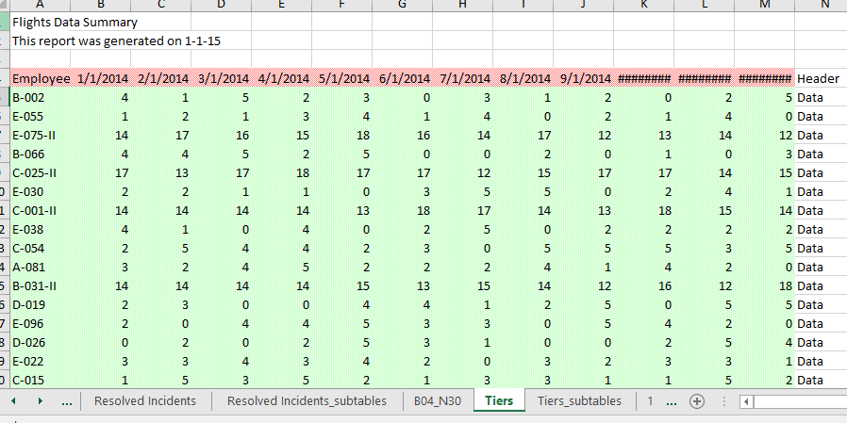
Custom Split
If we look at our original data set in Excel, we see there’s a tab called Tiers. This report adds a –II to the end of an employee ID if they’re tier II. Because not all rows have this –II, a standard split won’t work. Let’s see if we can create a viz that incorporates this Tier designation.
[[side note: both Split and Custom Split require consistent delimiters. If our data has irregular delimiters, Tableau won’t be able to split out the data using these options.]]
Notes:
Image & Copy

Slide 27
Custom Split
Open a new Tableau file and recreate the viz, this time using the Tiers sheet from Excel.
Remember to use the Data Interpreter, and Pivot the dates again
Click on the Employee column to open the menu and select Custom Split
We can choose our delimiter, we’ll use a hyphen
And now we can say we want to have 3 columns
This forces Tableau to break off that 3rd column with the tier II indicator
Now students should all try to finish the viz by themselves: rename all columns, and do your bar chart as above, and this time color the bars by Tier.

Slide 28
Custom Split
Notes:
Image & Copy

Slide 29
Notes:
Tableau Logo

