Slide 1
Shelly Cashman: Microsoft Access 2016
Module 11: Database Design
© 2017 Cengage Learning. All Rights Reserved. May not be copied, scanned, or duplicated, in whole or in part, except for use as permitted in a license distributed with a certain product or service or otherwise on a password-protected website for classroom use.

Slide 2
Objectives (1 of 2)
Understand the terms entity, attribute, and relationship
Understand the terms relation and relational database
Understand functional dependence and identify when one column is functionally dependent on another
Understand the term primary key and identify primary keys in tables

Slide 3
Objectives (2 of 2)
Design a database to satisfy a set of requirements
Convert an unnormalized relation to first normal form
Convert tables from first normal form to second normal form
Convert tables from second normal form to third normal form
Understand how to represent the design of a database using diagrams

Slide 4
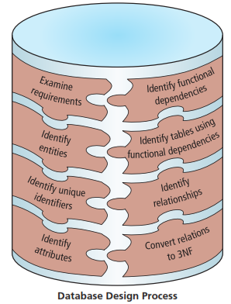
Project – Design a Database
Notes:
Figure 11-1: display of database design process

Slide 5
Entities, Attributes, and Relationships
An entity is like a noun: it is a person, place, thing, or event
An attribute is a property of an entity
A relationship is an association between entities

Slide 6
Relational Databases (1 of 4)
The formal term for a table is relation
Each column in a table should have a unique name, and entries in each column should match this column name
A relation is a two-dimensional table in which:
The entries in the table are single-valued; that is, each location in the table contains a single entry
Each column has a distinct name, technically called the attribute name
All values in a column are values of the same attribute; that is, all entries must correspond to the column name
Each row is distinct; that is, no two rows are identical

Slide 7
Relational Databases (2 of 4)
A relational database is a collection of relations
Rows in a table (relation) often are called records or tuples
Columns in a table (relation) often are called fields or attributes
To depict the structure of a relational database, you can use a commonly accepted shorthand representation

Slide 8
Relational Databases (3 of 4)
If you know that whenever you are given a value for one field, you will be able to determine a single value for a second field, the first field is said to determine the second field
The second field is said to be functionally dependent on the first

Slide 9
Relational Databases (4 of 4)
The primary key of a table is the field or minimum collection of fields — the fewest number of fields possible — that uniquely identifies a given row in that table
Notes:
Figure 11-6: display of complete shorthand representation

Slide 10
Database Design
Examine the requirements and identify the entities, or objects, involved
Identify a unique identifier for each entity
Identify the attributes for all the entities
Identify the functional dependencies that exist among the attributes
Use the functional dependencies to identify the tables
Determine and implement relationships among the entities
One-to-many
Foreign key
Many-to-many

Slide 11
Normalization (1 of 2)
After you create your database design, you should analyze it using a process called normalization to make sure the design is free of potential update, redundancy, and consistency problems
The normalization process involves converting tables into various types of normal forms
A table that contains a repeating group, or multiple entries for a single row, is called an unnormalized table

Slide 12
Normalization (2 of 2)
Conversion to First Normal Form
In general, when converting a non-1NF table to 1NF, the primary key typically will include the original primary key concatenated with the key of the repeating group, that is, the field that distinguishes one occurrence of the repeating group from another within a given row in the table
Second Normal Form
A table (relation) is in second normal form (2NF) if it is in first normal form and no nonkey field is dependent on only a portion of the primary key
Third Normal Form
A table is in third normal form (3NF) if it is in second normal form and if the only determinants it contains are candidate keys
Any field or collection of fields that determines another field is called a determinant

Slide 13
Special Topics (1 of 3)
Obtaining Information from Existing Documents
Existing documents can often furnish helpful information concerning the database design
You need to know how to obtain information from the document that you will then use in the design process

Slide 14
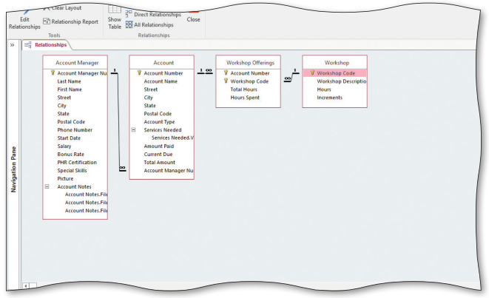
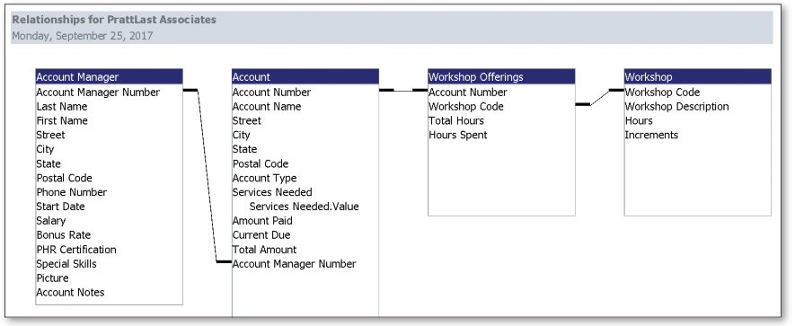
Special Topics (2 of 3)
Diagrams for Database Design
Notes:
Figure 11-29 (a): display of Access relationship diagram for PrattLast Associates database
Figure 11-29 (b): display of Access relationship report for PrattLast Associates database

Slide 15
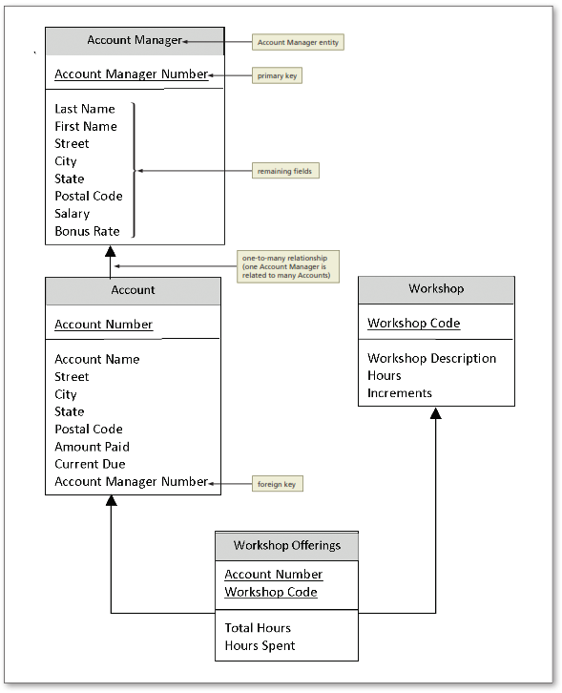
Special Topics (3 of 3)
Entity-Relationship Diagrams (ERD)
Notes:
Figure 11-31: display of sample ERD for the PrattLast Associates database

