Slide 1
Shelly Cashman: Microsoft Access 2016
Module 10: Using SQL
© 2017 Cengage Learning. All Rights Reserved. May not be copied, scanned, or duplicated, in whole or in part, except for use as permitted in a license distributed with a certain product or service or otherwise on a password-protected website for classroom use.

Slide 2
Objectives (1 of 2)
Understand the SQL language and how to use it
Change the font or font size for queries
Create SQL queries
Include fields in SQL queries
Include simple and compound criteria in SQL queries
Use computed fields and built-in functions in SQL queries
Sort the results in SQL queries

Slide 3
Objectives (2 of 2)
Use aggregate functions in SQL queries
Group the results in SQL queries
Join tables in SQL queries
Use subqueries
Compare SQL queries with Access-generated SQL
Use INSERT, UPDATE, and DELETE queries to update a database

Slide 4
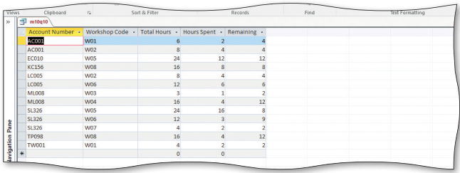
Project – Using SQL (1 of 2)
Notes:
Figure 10-1 (a): display of query in SQL
Figure 10-1 (b): display of results

Slide 5
Project – Using SQL (2 of 2)
Roadmap
Create a query in SQL view
Use simple criteria in a query
Use compound criteria in a query
Sort results of a query
Group results of a query
Join tables in a query
Use a subquery in a query
Update data with a query

Slide 6
SQL Background
To Change the Font Size
Click FILE on the ribbon to open the Backstage view
Click Options to display the Access Options dialog box
Click Object Designers to display the Object Designer options
In the Query design area, click the Size box arrow, and then click the desired font size
Click the OK button to close the Access Options dialog box

Slide 7
SQL Queries (1 of 14)
To Create a New SQL Query
Close the Navigation Pane
Display the CREATE tab
Click the Query Design button to create a query
Close the Show Table dialog box without adding any tables
Click the View arrow to display the View menu
Click SQL View to view the query in SQL view

Slide 8
SQL Queries (2 of 14)
SQL Commands
The basic form of SQL expressions is quite simple: SELECT-FROM-WHERE
The command begins with a SELECT clause, which consists of the word, SELECT, followed by a list of those fields you want to include
Next, the command contains a FROM clause, which consists of the word, FROM, followed by a list of the table or tables involved in the query
Finally, there is an optional WHERE clause, which consists of the word, WHERE, followed by any criteria that the data you want to retrieve must satisfy

Slide 9
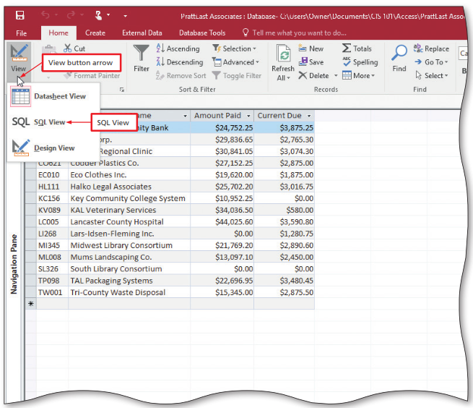
SQL Queries (3 of 14)
To Prepare to Enter a New SQL Query
Click the View arrow to display the View menu
Click SQL View to return to SQL view
Notes:
Figure 10-6: display of View button arrow and SQL View

Slide 10
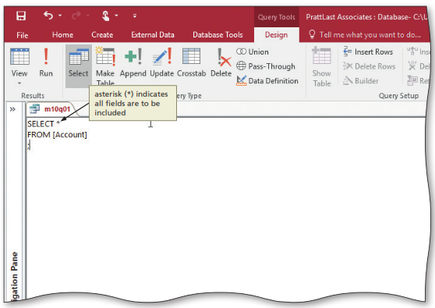
SQL Queries (4 of 14)
To Include All Fields
To include all fields, you could use the same approach as in the previous steps, that is, list each field in the table after the word, SELECT
There is a shortcut, however. Instead of listing all the field names after SELECT, you can use the asterisk (*) symbol
Notes:
Figure 10-7 (a): display of query to list all fields and all records in the Account table with the asterisk (*)

Slide 11
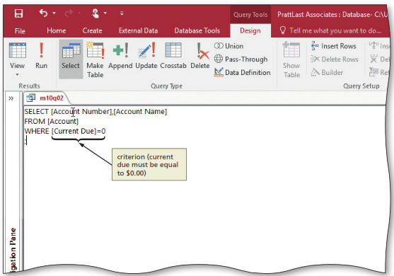
SQL Queries (5 of 14)
To Use Criterion Involving a Numeric Field
To restrict the records to be displayed, include the word WHERE followed by a criterion as part of the command
If the field involved is a numeric field, you simply type the value
Notes:
Figure 10-8 (a): display of query to list the Account Number and Account Name for those accounts where current due is equal to 0

Slide 12
SQL Queries (6 of 14)
A simple criterion has the form: field name, comparison operator, then either another field name or a value
Table 10-1 Comparison Operators
Comparison Operator | Meaning
= | equal to
< | less than
> | greater than
<= | less than or equal to
>= | greater than or equal to
<> | not equal to
Notes:
Table 10-1: Comparison Operators

Slide 13
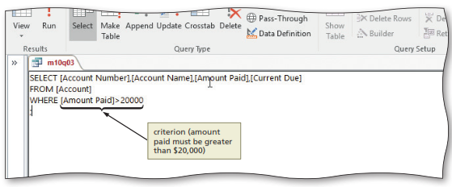
SQL Queries (7 of 14)
To Use a Comparison Operator
Notes:
Figure 10-9 (a): display of query to list the Account Number, Account Name, Amount Paid, and Current Due for those accounts where amount paid is greater than $20,000

Slide 14
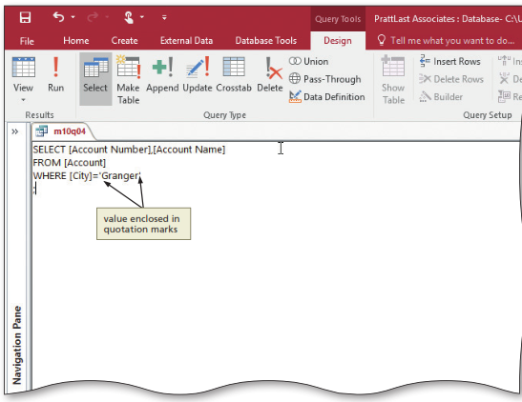
SQL Queries (8 of 14)
To Use Criterion Involving a Text Field
If the criterion involves a text field, the value must be enclosed in single quotation marks
Notes:
Figure 10-10 (a): display of query to list the Account Number and Account Name for those accounts whose city is Granger

Slide 15
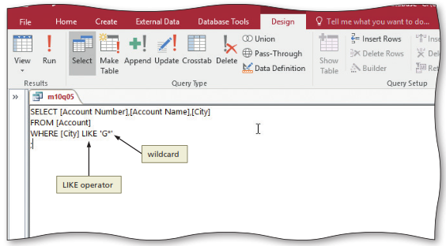
SQL Queries (9 of 14)
To Use a Wildcard
In most cases, the conditions in WHERE clauses involve exact matches
The LIKE operator uses one or more wildcard characters to test for a pattern match
One common wildcard in Access, the asterisk (*), represents any collection of characters
Notes:
Figure 10-11 (a): display of query to list the Account Number, Account Name, and City for those whose city begins with the letter G

Slide 16
SQL Queries (10 of 14)
Compound Criteria
Compound criteria are formed by connecting two or more simple criteria using AND, OR, and NOT
When simple criteria are connected by the word AND, all the simple criteria must be true in order for the compound criterion to be true
When simple criteria are connected by the word OR, the compound criterion will be true whenever any of the simple criteria are true
Preceding a criterion by the word NOT reverses the truth or falsity of the original criterion

Slide 17
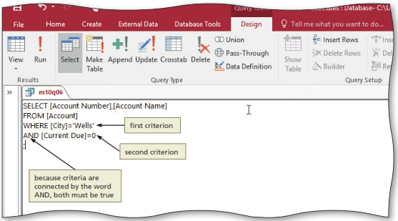
SQL Queries (11 of 14)
To Use Compound Criterion Involving AND
Notes:
Figure 10-12 (a): display of query to list the Account Number and Account Name for those accounts whose city is Wells and whose current due amount is equal to $0

Slide 18
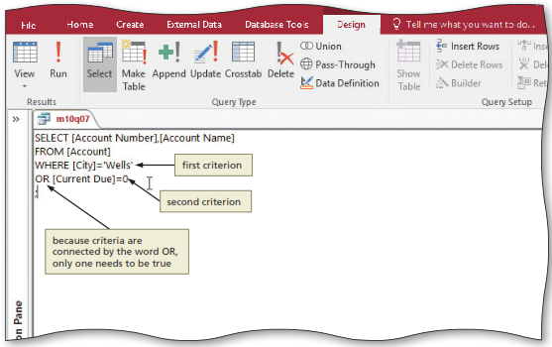
SQL Queries (12 of 14)
To Use Compound Criterion Involving OR
Notes:
Figure 10-13 (a): display of query to list the Account Number and Account Name for those accounts whose city is Wells or whose current due amount is equal to $0

Slide 19
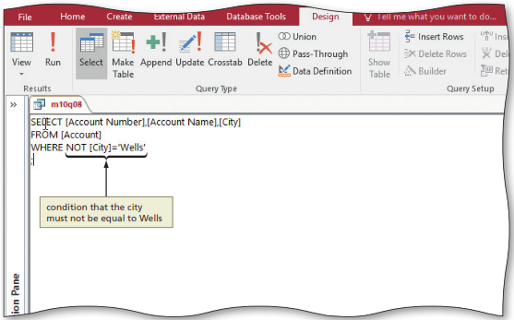
SQL Queries (13 of 14)
To Use NOT in a Criterion
Notes:
Figure 10-14 (a): display of query to list the Account Number, Account Name and City for those accounts whose city is not Wells

Slide 20
SQL Queries (14 of 14)
To Use a Computed Field
Just as with queries created in Design view, you can include fields in queries that are not in the database, but that can be computed from fields that are
Called a computed field
Can involve addition, subtraction, multiplication, or division
To indicate the contents of the new field (the computed field), you can name the field by following the computation with the word, AS, and then the name you want to assign the field

Slide 21
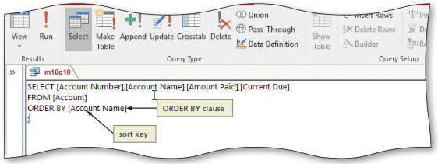
Sorting (1 of 7)
To sort the output, you include an ORDER BY clause, which consists of the words ORDER BY followed by the sort key
To Sort the Results on a Single Field
Notes:
Figure 10-16 (a): display of query to list the Account Number, Account Name, Amount Paid, and Current Due for all accounts with the results sorted by Account Name

Slide 22
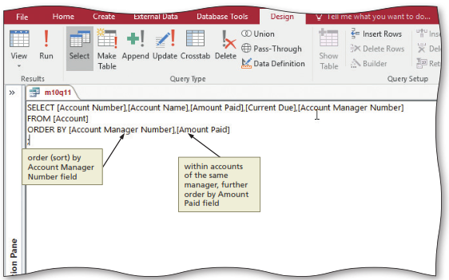
Sorting (2 of 7)
To Sort the Results on Multiple Fields
Notes:
Figure 10-17 (a): display of query to list the Account Number, Account Name, Amount Paid, Current Due and Account Manager Number for all accounts with results sorted by Account Manager Number and Amount Paid

Slide 23
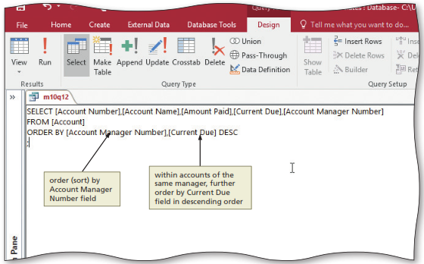
Sorting (3 of 7)
To Sort the Results in Descending Order
To sort in descending order, you follow the name of the sort key with the DESC operator
Notes:
Figure 10-18 (a): display of query to list the Account number, Account Name, Amount Paid, Current Due, and Account Manager Number for all accounts with results sorted by Account Manger Number and Descending Current Due

Slide 24
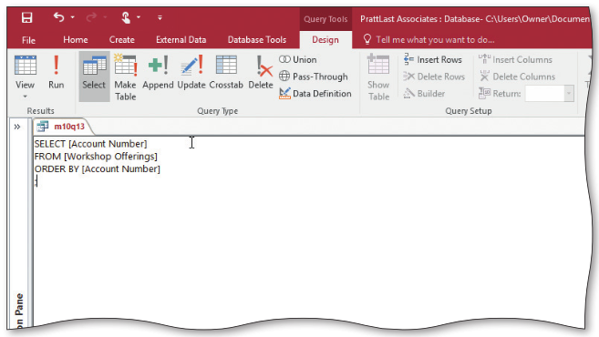
Sorting (4 of 7)
To Omit Duplicates when Sorting
The DISTINCT operator eliminates duplicate values in the results of a query
To use the operator, you follow the word DISTINCT with the field name in parentheses
Notes:
Figure 10-19 (a): display of query to list the Account Numbers in the Workshop Offerings Table sorted by Account Number

Slide 25
Sorting (5 of 7)
To Use a Built-In Function
SQL has built-in functions, also called aggregate functions, to perform various calculations
COUNT
SUM
AVG
MAX
MIN

Slide 26
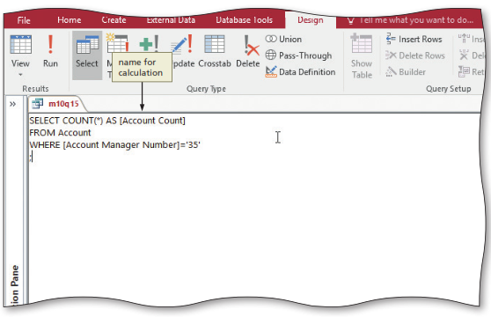
Sorting (6 of 7)
To Assign a Name to the Results of a Function
You can assign a name to the results of a function
To do so, follow the expression for the function with the word AS and then the name to be assigned to the result
Notes:
Figure 10-22 (a): display of query to count the number of accounts whose Account Manager Number is 35 with results called to account count

Slide 27
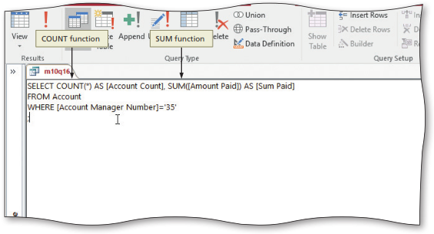
Sorting (7 of 7)
To Use Multiple Functions in the Same Command
Notes:
Figure 10-23 (a): display of query to count the number of accounts whose Account Manger Number is 35 with results called Account Count and calculate the sum of amount paid with results called Sum Paid

Slide 28
Grouping
To Use Grouping
Grouping means creating groups of records that share some common characteristic
When you group rows, any calculations indicated in the SELECT command are performed for the entire group
GROUP BY clause
To Restrict the Groups That Appear
The HAVING clause, which consists of the word HAVING followed by a criterion, is used to restrict the groups to be included

Slide 29
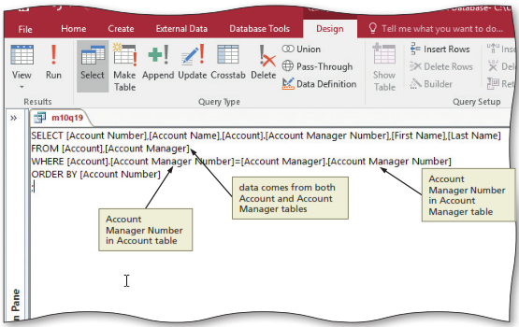
Joining Tables (1 of 5)
To Join Tables
Many queries require data from more than one table
Notes:
Figure 10-26 (a): display of query to list the Account Number, Account Name, Account Manager Number, First Name, and Last Name for all accounts

Slide 30
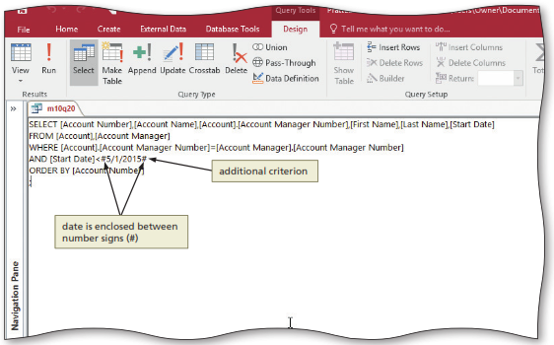
Joining Tables (2 of 5)
To Restrict the Records in a Join
You can restrict the records to be included in a join by creating a compound criterion
Notes:
Figure 10-27 (a): display of query to restrict the results of previous query to only those accounts whose start date is before 5/1/2015

Slide 31
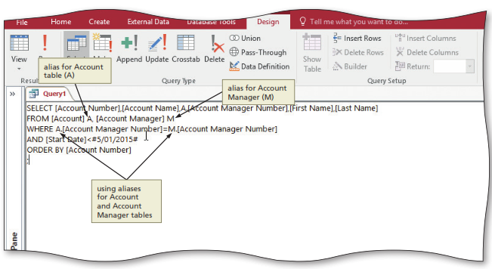
Joining Tables (3 of 5)
Aliases
When tables appear in the FROM clause, you can give each table an alias, or an alternative name, that you can use in the rest of the statement
Notes:
Figure 10-28: display of alias for Account table (A), alias for Account Manager (M), and using aliases for Account and Account Manager tables

Slide 32
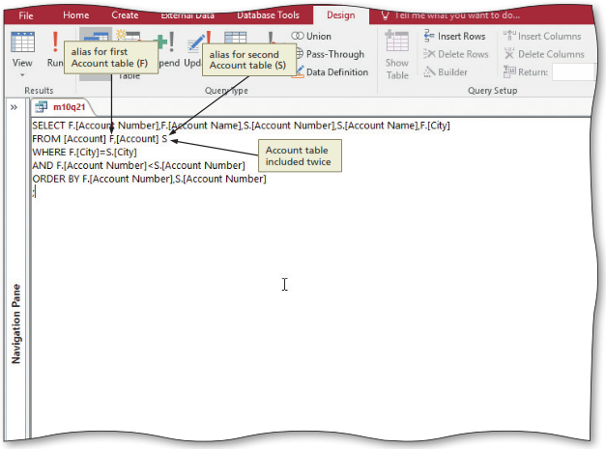
Joining Tables (4 of 5)
To Join a Table to Itself
Notes:
Figure 10-29 (a): display of query to list the Account Name and Account Number for pairs of accounts located in the same city

Slide 33
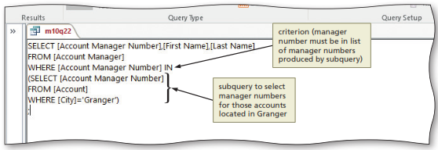
Joining Tables (5 of 5)
Subqueries
A subquery is a query within another query
To Use a Subquery
Notes:
Figure 10-31 (a): display of query to list the Account Manager Number, First Name, and Last Name for all Account Managers who represent at least one account located in Granger

Slide 34
Updating Data Using SQL (1 of 3)
To Use an INSERT Command
You can add records to a table using the SQL INSERT command
The command consists of the words INSERT INTO followed by the name of the table into which the record is to be inserted
Next is the word VALUE followed by the values for the fields in the record
Values for Text fields must be enclosed within quotation marks

Slide 35
Updating Data Using SQL (2 of 3)
To Use an UPDATE Command
You can update records in SQL by using the UPDATE command
The command consists of UPDATE, followed by the name of the table in which records are to be updated
Next, the command contains one or more SET clauses, which consist of the word SET, followed by a field to be updated, an equal sign, and the new value

Slide 36
Updating Data Using SQL (3 of 3)
To Use a DELETE Command
You can delete records in SQL using the DELETE command
The command consists of DELETE FROM, followed by the name of the table from which records are to be deleted
Finally, you include a WHERE clause to specify the criteria

