Slide 1
ITMG 320 Database Implementation and Business Intelligence
Introduction to Databases

Slide 2
Learning Objectives
Understand the importance of databases in information access
Describe the characteristics of information
Explain the major components of a DBMS
Describe the need for database knowledge in business careers

Slide 3
Databases: The Unseen Services
Let us examine some examples.
Login and use Facebook, Twitter or Instagram: Your login and personal information is kept in a database, as is the information for all of your friends, posts, and messages.
Make a phone call or send a text message: The lists of phone numbers and locations are maintained by databases. All the information about your phone calls and messages is maintained at a very detailed level in databases.
Read your email: Not only is your login information kept in a database, but also all the history of incoming and outgoing emails is kept in very large databases.
Go shopping (Groceries, clothes, gasoline): First, the product, inventory levels, and price information is kept in a database so that the checkout register can identify it correctly. Then if you use a credit or debit card, that information must be retrieved from another database.

Slide 4
Databases: The Unseen Services II
Check a book out of the library: The database is checked to make sure you are a valid patron of the library. Then information about the book, its availability, and check out status is all verified and updated for your library loan. The database is used to obtain both patron information and book information.
Withdraw money from an ATM: First, your authorization information must be verified, and then the availability of sufficient funds is verified. Finally, your account balances must be updated. All this information is stored in the bank's databases.
Have a physical exam with your doctor: All of your patient information is maintained in your medical database. Your records will be updated from the results of your exam. The accounting, billing, and insurance records will also all be updated.

Slide 5
Databases: The Unseen Services III
We seldom think about these databases, unless they become unavailable or there has been a security breach where private data has been accessed by unauthorized individuals or been made public.
When they do not work correctly, we get frustrated and upset that the level of service that we expect is not being provided.
The availability and integrity of databases is an important issue in the daily activities of each of our lives.

Slide 6
Databases: The Ubiquitous Information Provider
The primary contributor in our access to abundant information is database technology. Ways databases support our need to obtain in-depth information:
Searching to buy a specific item (e.g. an appliance, a service, clothing, a book...):
Researching more in-depth before purchasing a major item such as a car: The information you need for this includes items like repair history, performance data, and safety record.
Planning a vacation or trip: In this case, we want geographical and resort information – information about places and things to do.

Slide 7
Databases: The Ubiquitous Information Provider II
Learning about a particular hobby or sport that you enjoy such as skiing, boating, or geocaching:
Researching a particular company before investing: Many institutions maintain databases of financial records.
Researching a particular medical condition or medical problem:.
Solving a technical problem or learning a new technical skill such as writing SQL queries:
Writing a research paper or researching for a school project:
Wikipedia

Slide 8
Database Skills for Knowledge-based Careers
Job Title | Job Description | DB Knowledge Required | Skill Level Required
Financial planner | Analyze security market and recommend financial portfolios | Understand financial information available in databases. Know how to extract information in various combinations | Moderate
Market research analyst | Analyze sales and economic data to predict future trends | Understand economic databases. Be able to use databases in novel ways to discover and extract information. | Substantial
Advertising manager | Manage advertising campaigns and budgets | Understand sales and performance data. Be able to extract information in various ways. | Moderate
Human resource manager | Manage all the hiring, evaluation, and monitoring of the work force. | Understand information about employees as well as all financial information. | Moderate

Slide 9
Job Title | Job Description | DB Knowledge Required | Skill Level Required
Accountant | Support all the accounting requirements of an organization | Understand all financial databases. Identify problems or potential fraudulent activity through database analysis | Extensive
Economist | Analyze and predict economic trends based on historical data | Understand economic databases, their structure and data. Be able to extract information in various forms using novel approaches. | Extensive
Sales manager | Manage the sales persons and sales activities of an organization | Understand sales data and be able to extract information in various forms. Evaluate performance. | Moderate
Sociologist | Analyze social trends and social problems in communities and nations | Understand demographic and social data from diverse and disparate databases. Be able to extract information using multiple techniques | Extensive

Slide 10
Job Title | Job Description | DB Knowledge Required | Skill Level Required
Management consultant | Analyze organizational issues and recommend solutions | Understand financial and operational data of an organization as found in various databases | Substantial
Public Administrator | Manage a public government unit | Be able to understand data and information provided in various and diverse databases from the governmental database. | Extensive
Political Scientist | Understand and research demographic data and trends | Be able to analyze data and draw conclusions from demographic databases and questionnaire data. | Substantial

Slide 11
The Database Approach
The central component of the database approach is the DBMS. This software is also referred to as the “database engine” or the “back end.” With regard to the data it manages, it has several responsibilities including the following:
Data Definition: providing a way to define and build the database
Data Manipulation: providing a way to insert and update data in the database
Query Execution: retrieving information from the data in the database
Data Integrity: ensuring that data stored is well formed
Data Security: enforcing restrictions about who is able to access what data
Provenance: logging capabilities to provide an audit trail for data changes
Multiuser Concurrency: supporting the activities of many users at the same time

Slide 12
3 Components of Databases
DBMS – component one: Some of the more popular DBMS's today are MySQL, Microsoft SQL Server, Oracle, PostgreSQL, Microsoft Access, and IBM's DB2.
The second component in the database approach is the data. As long as the DBMS has access and is able to perform its responsibilities with respect to the data, the details of the data storage are not relevant.
The final component of the database approach is the application, also called "front-end" software. Application software interacts with the DBMS to provide information to a user.
All relational databases use a standard language to receive and process requests. The standard language is called Structured Query Language (SQL).

Slide 13
The DATAbase approach

Slide 14
INITIAL TERMINOLOGY
Data - facts that are recorded and can be accessed
Data formats – text, numbers, figures, graphics, images, audio/video recordings and more
Data is recorded and kept because it is considered to be of use to an intended user
Information - refers to the data that is accessed by a user for some particular purpose
Typically, getting the needed information from a collection of data requires performing an activity, such as searching through, processing, or manipulating the data in some form or fashion
Metadata - data that describes the structure and the properties of the data
Metadata is essential for the proper understanding and use of the data
Notes:
The terms “data” and “information” are often interchanged and used as synonyms for each other (information is simply the data that we need)

Slide 15
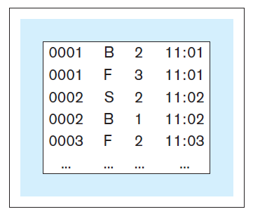
INITIAL TERMINOLOGY
Data without metadata - example

Slide 16
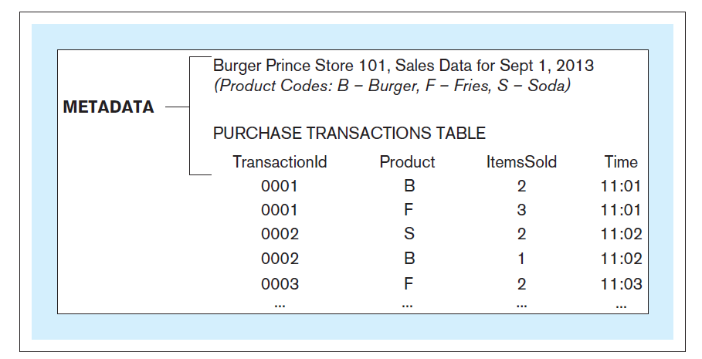
INITIAL TERMINOLOGY
Data with metadata - example

Slide 17
INITIAL TERMINOLOGY
Database - structured collection of related data stored on a computer medium
Organizes the data in a way that facilitates efficient access to the information captured in the data
Database metadata – represents the structure of the database
Database content that is not the data itself (data about the data)
Contains:
Names of data structures
Data types
Data descriptions
Other information describing the characteristics of the data

Slide 18
INITIAL TERMINOLOGY
Database management system (DBMS) - software used for:
Creation of databases
Insertion, storage, retrieval, update, and deletion of the data in the database
Maintenance of databases
Database system - computer-based system whose purpose is to enable an efficient interaction between the users and the information captured in a database

Slide 19
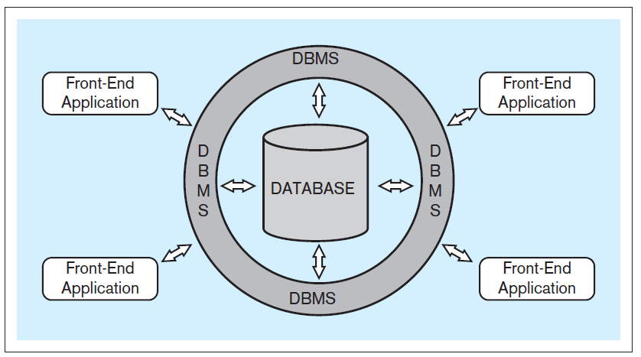
INITIAL TERMINOLOGY
Typical database system architecture

Slide 20
INITIAL TERMINOLOGY
Front-end applications - provide a mechanism for easy interaction between the users and the DBMS
End-users (business-users) - users using a database system to support their tasks and processes
Indirect interaction - end-user communicating with the database through front-end applications
Direct interaction - end-user communicating with the database directly through DBMS

Slide 21
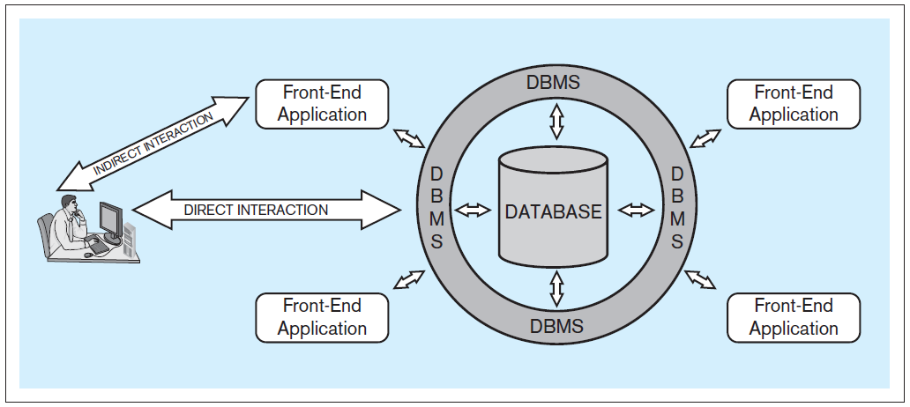
INITIAL TERMINOLOGY
Typical database system architecture
Notes:
Indirect interaction is where the end user has little knowledge of databases, direct is where they know SQL, etc

Slide 22
STEPS IN THE DEVELOPMENT OF DATABASE SYSTEMS

Slide 23
STEPS IN THE DEVELOPMENT OF DATABASE SYSTEMS
Requirements collection, definition, and visualization - results in the requirements specifying which data the future database system will hold and in what fashion, and what the capabilities and functionalities of the database system will be
The collected requirements should be clearly defined and stated in a written document, and then visualized
Notes:
The first and most critical step in the development of the database.

Slide 24
STEPS IN THE DEVELOPMENT OF DATABASE SYSTEMS
Requirements collection, definition, and visualization
Conceptual database model – a visualization of requirements by using a conceptual data modeling technique (such as entity-relationship [ER] modeling)

Slide 25
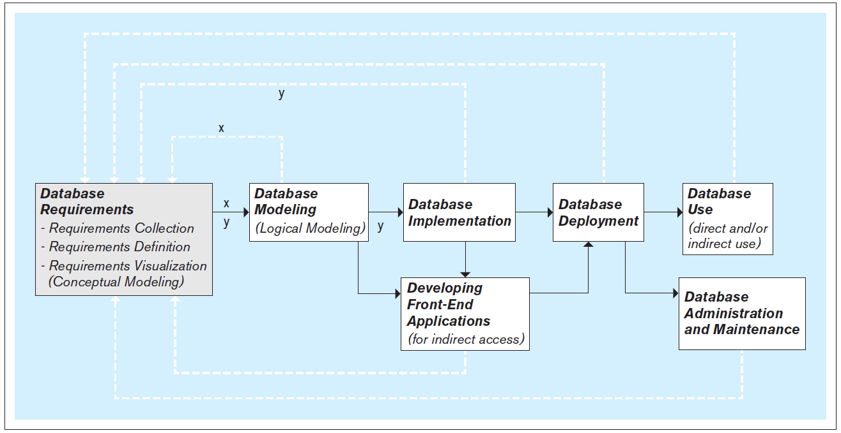
STEPS IN THE DEVELOPMENT OF DATABASE SYSTEMS
Iterative nature of the database requirements collection, definition, and visualization process

Slide 26
STEPS IN THE DEVELOPMENT OF DATABASE SYSTEMS
Database modeling (logical database modeling ) - creation of the database model that is implementable by the DBMS software
Logical database modeling follows conceptual database modeling
Notes:
A database has two models:
Conceptual model - created as a visualization of requirements during the requirements collection, definition, and visualization step and serves as a as a blueprint for the actual (logical) database model
Logical model - actual database model, created during the database modeling step to be used in the subsequent step of database implementation using the DBMS

Slide 27
STEPS IN THE DEVELOPMENT OF DATABASE SYSTEMS
Database implementation - using a DBMS to implement the database model as an actual database
Most modern databases are implemented using a relational DBMS (RDBMS) software
Notes:
SQL is a language used by most relational DBMS software packages.
SQL includes commands for creating, modifying and deleting database structures (these commands are used during database implementation).

Slide 28
STEPS IN THE DEVELOPMENT OF DATABASE SYSTEMS
Developing front-end applications - designing and creating applications for indirect use by the end-users
Front-end applications are based on the database model and the requirements specifying the front-end functionalities
Front-end applications contain interfaces (such as forms and reports) accessible via a navigation mechanism (such as a menu)
Notes:
The design and creation of front-end applications can commence and proceed in parallel with database implementation .The actual creation of a front-end application involves connecting it to the database. Connecting front-end application to the database can only be done once the database is implemented.

Slide 29
STEPS IN THE DEVELOPMENT OF DATABASE SYSTEMS
Database deployment - releasing the database system for use by the end users
Notes:
Typically, database deployment also involves populating the implemented database with the initial set of data.

Slide 30
STEPS IN THE DEVELOPMENT OF DATABASE SYSTEMS
Database use - the insertion, modification, deletion and retrieval of the data in the database system
Notes:
The database system can be used indirectly, via the front-end applications, or directly via the DBMS.
SQL includes commands for insertion, modification, deletion and retrieval of the data. These commands can be issued by front-end applications (indirect use), or directly by the end-users themselves (direct use)

Slide 31
STEPS IN THE DEVELOPMENT OF DATABASE SYSTEMS
Database administration and maintenance - performing activities that support the database end user, including dealing with technical issues, such as:
Providing security for the information contained in the database
Ensuring sufficient hard-drive space for the database content
Implementing the backup and recovery procedures

Slide 32
THE NEXT VERSION OF THE DATABASE
The new version of the database follows the same development steps as the initial version
Notes:
In most cases, after a certain period of use, the need for modifications and expansion of the existing database system becomes apparent, and the development of a new version of the existing database system is initiated.

Slide 33
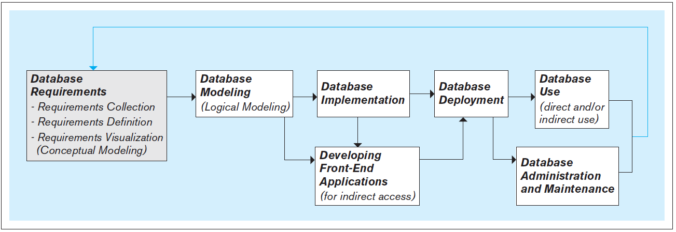
THE NEXT VERSION OF THE DATABASE

Slide 34
DATABASE SCOPE
Databases can vary in their scope from small single-user (personal) databases to large enterprise databases that can be used by thousands of end-users
Regardless of their scope, all databases go through the same fundamental development steps (requirements, modeling, implementation, deployment, use, etc.)
Notes:
The difference in the scope of databases is reflected in the size, complexity and cost in time and resources required for each of the steps.

Slide 35
PEOPLE INVOLVED WITH DATABASE SYSTEMS
Database analysts, designers, and developers
Database analysts - involved in the requirements collection, definition, and visualization stage
Database designers (a.k.a. database modelers or architects) - involved in the database modeling stage
Database developers – in charge of implementing the database model as a functioning database using the DBMS software
Notes:
It is not uncommon for the same people to perform more than one of these roles. In fact (especially in smaller companies and organizations), the same people may be in charge of all aspects of the database system, including the design, implementation, administration, and maintenance.

Slide 36
PEOPLE INVOLVED WITH DATABASE SYSTEMS
Front-end applications analysts and developers
Front-end application analysts - in charge of collecting and defining requirements for front-end applications
Front-end applications developers - in charge of creating the front-end applications

Slide 37
PEOPLE INVOLVED WITH DATABASE SYSTEMS
Database administrators (DBAs) - perform the tasks related to the maintenance and administration of a database system

Slide 38
PEOPLE INVOLVED WITH DATABASE SYSTEMS
Database end users - use a database system to support their work- or life-related tasks and processes
Users differ in:
Level of technical sophistication
Amount of data that they need
Frequency with which they access the database system
Notes:
Arguably, database end users are the most important category of people involved with database systems. They are the reason for the existence of database systems. The quality of a database system is measured by how quickly and easily it can provide the accurate and complete information needed by its end users.

Slide 39
OPERATIONAL VERSUS ANALYTICAL DATABASES
Operational information (transactional information) - the information collected and used in support of day to day operational needs in businesses and other organizations
Operational database - collects and presents operational information in support of daily operational procedures and processes
Analytical information - the information collected and used in support of analytical tasks
Analytical information is based on operational (transactional) information
Analytical database - collects and presents analytical information in support of analytical tasks

