Slide 1
SUPER BOWL 52
David Ye
ITMG 350
February 6, 2018
PREDICTION

Slide 2
PATRIOTS TO WIN
27 21

Slide 3
PROMETHEUS NFL STAT

Slide 4
EXPERT PREDICTIONS
Winner | Number of Picks | Average Patriots Score | Average Eagles Score
Eagles | 24 | 21.6 | 27.1
Patriots | 61 | 27.3 | 20.9

Slide 5
The Tonight Show: “Puppies Predict the Winner of Super Bowl LII”
Notes:
The Tonight Show host Jimmy Fallon used a litter of eleven puppies to predict the outcome of the Super Bowl by releasing them toward two bowls of food, one labeled “Patriots” and the other labeled “Eagles.” The New England Patriots were predicted to be the winner.

Slide 6
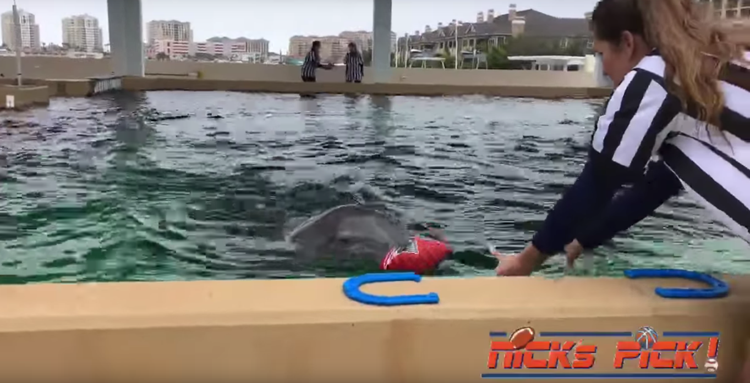
“Nicholas the Dolphin Predicts Super Bowl 2018 Winner”
Notes:
Nicholas the Dolphin was rescued in 2002 near Gibsonton, Florida by the Clearwater Marine Aquarium. Since then, he has a record of 6 for 7 correct sports predictions, including a correct prediction for the outcome of Super Bowl 51 in 2017. A themed football was placed for each team in the bottom a pool and Nicholas dove to retrieve one ball. The ball chosen by Nicholas was that of the New England Patriots.

Slide 7
“Madden NFL 18 - Super Bowl 52 Prediction - Patriots Vs Eagles”
Notes:
Nicholas the Dolphin was rescued in 2002 near Gibsonton, Florida by the Clearwater Marine Aquarium. Since then, he has a record of 6 for 7 correct sports predictions, including a correct prediction for the outcome of Super Bowl 51 in 2017. A themed football was placed for each team in the bottom a pool and Nicholas dove to retrieve one ball. The ball chosen by Nicholas was that of the New England Patriots.

Slide 8
EAGLES WON
33 41

Slide 9
POSTGAME ANALYSIS
Prediction Machine was very accurate
Philadelphia Eagles’ defense was undervalued
Tom Brady set a new Super Bowl QB passing record
Sorry you couldn’t play it Carson Wentz
Notes:
Prediction Machine Eagles +5, OVER 48; $1.2 million in profit for Super Bowl 52, as compared to ~$9.8 million
Foles: 373 passing yards, 3 passing td, 1 interception, 1 receiving td
Brady: 505 passing yards, 3 passing td, 0 int

Slide 10
