Slide 1
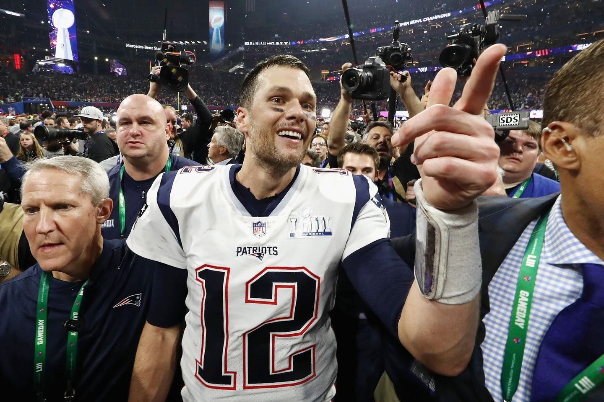
Super Bowl LIV
The Running Game
Prediction
Kansas City is not known for a strong run defense, giving up a 100 yard rusher 6 times, and in those games having a 3-3 record, and giving up an average of 21.33 points, including four instances above 28 points.
Close Game? Definitely
All 3 of the 49er losses this season have been by 7 points or less, and in those types of games, they have a 5-3 record. All 4 of the Chief losses have been by 7 points or less, and in those situations, they have a 5-4 record.
26
24
MVP Prediction: George Kittle
7 Catches
DVOA Rankings: Does Defense Win Championships?
109 Yards
DVOA (Defensive-adjusted Value Over Average) is a stat used by Football Outsiders used to rank teams 1-32 in each offense and defense. Teams ranked in the top 3 in offense are 13-13 in Super Bowl history. Top 3 defenses are 13-7.
2 Touchdowns
Jersey Pattern?
According to SB Nation, 13 of the last 15 Super Bowl Winners have worn their white / primary road jerseys. San Francisco is wearing their road jerseys in this game
DVOA Rankings
Win %
Top 3 DVOA Defense in SB
65%
Top 3 DVOA Offense in SB
50%

