Slide 1
Spring in the Midwest

Slide 4
For all of your landscaping needs, contact Sunny Day Landscaping!

Slide 5
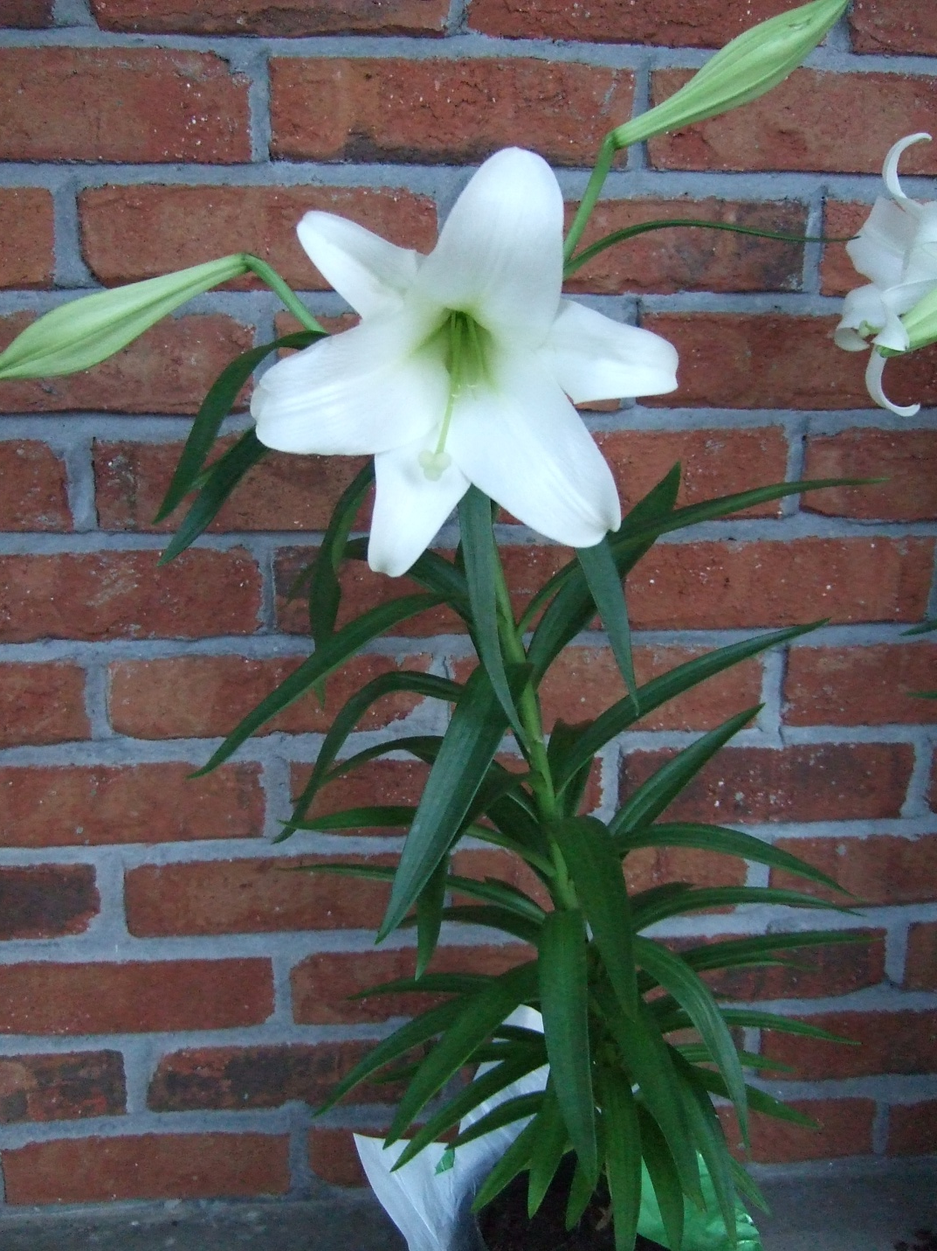

Slide 6
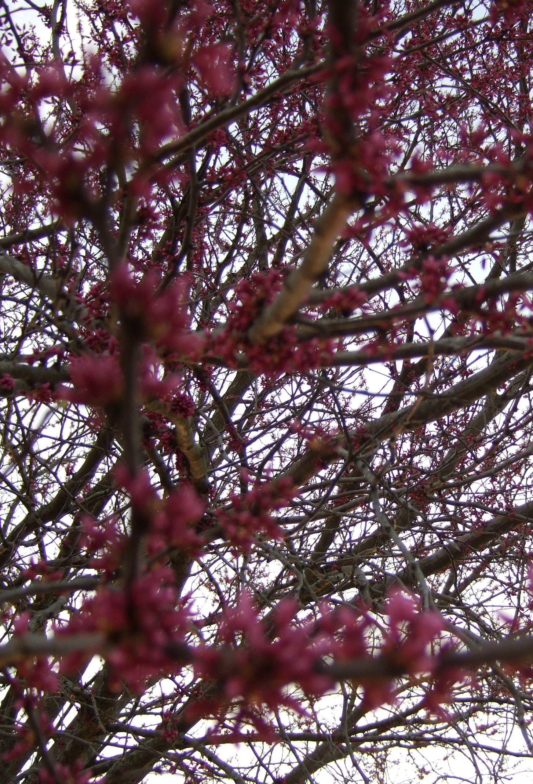
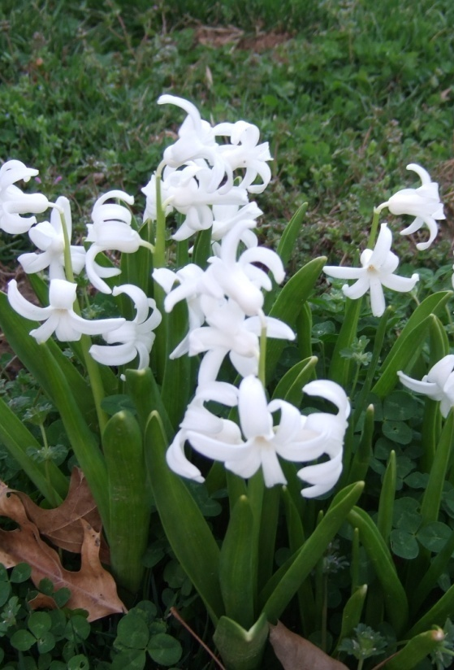

Slide 7
Image*After

