Slide 1
CHAPTER 12
Business Intelligence

Slide 2
CHAPTER OUTLINE
12.1 Managers and Decision Making
12.2 What Is Business Intelligence?
12.3 Business Intelligence Applications for Data Analysis
12.4 Business Intelligence Applications for Presenting Results
12.5 Business Intelligence in Action: Corporate Performance Management

Slide 3
The Manager’s Job and Decision Making
Managers have three basic roles
(Mintzberg 1973)
Interpersonal roles figurehead, leader, liaison
Informational roles monitor, disseminator, spokesperson
Decisional roles entrepreneur, disturbance handler, resource allocator, negotiator.
Notes:
Managers have three basic roles:
Interpersonal roles: figurehead, leader, liaison
Informational roles: monitor, disseminator, spokesperson
Decisional roles: entrepreneur, disturbance handler, resource allocator, negotiator.

Slide 4
The Manager’s Job & Decision Making (continued)
Decisions and Decision making
Decision refers to a choice that individuals and group make among two or more alternatives.
Decision making is a systematic process composed of three major phases: intelligence, design and choice (Simon 1977), with the implementation phase added later.
Notes:
Decision refers to a choice that individuals and group make among two or more alternatives.
Decision making is a systematic process composed of three major phases: intelligence, design and choice (Simon 1977), with the implementation phase added later.

Slide 5
Decision Making Process

Slide 6
Why Managers Need IT Support
The number of alternatives to be considered constantly increases.
Decisions must be made under time pressure.
Decisions are more complex.
Decision makers can be in different locations and so is the information.

Slide 7
A Framework for Computerized Decision Analysis
Notes:
Lower-level managers usually perform the structured and operational-control oriented
tasks in cells 1, 2, and 4. (Blue color above).
Middle managers and staff usually perform the tasks in cells 3, 5, and 7. (Orange color above).
Senior executives usually perform the tasks in cells 6, 8, and 9. (Yellow color above.)

Slide 8
Problem Structure
The first dimension deals with the problem structure, where the decision making processes fall along the continuum ranging from highly structured to highly unstructured decisions.
Highly structured
Semistructured
Higly
unstructured
Order entry
Loan approval
Building new plant
Notes:
Structured problems are routine and repetitive problems for which standard solutions exist.
Unstructured problems are fuzzy, complex problems for which there are no cut-and-dried
solutions.
Semistructured problems are problems in which only some of the decision process phases
are structured.

Slide 9
The Nature of Decisions
The second dimension of decision support deals with the nature of decisions
Operational control involves executing specific tasks efficiently and effectively.
Management control involves decisions concerning acquiring and using resources efficiently in accomplishing organizational goals.
Strategic planning involves decisions concerning the long range goals and policies for growth and resource allocation.
Notes:
Operational control involves executing specific tasks efficiently and effectively.
Management control involves decisions concerning acquiring and using resources efficiently
in accomplishing organizational goals.
Strategic planning involves decisions concerning the long range goals and policies for growth
and resource allocation.

Slide 10
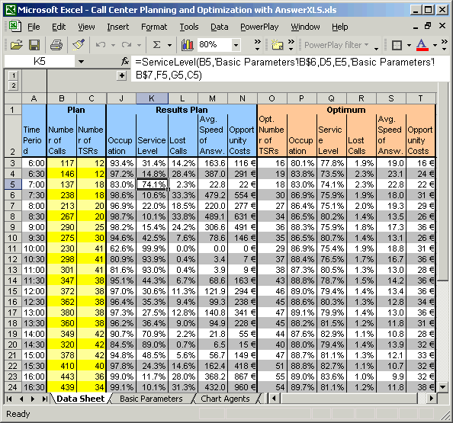
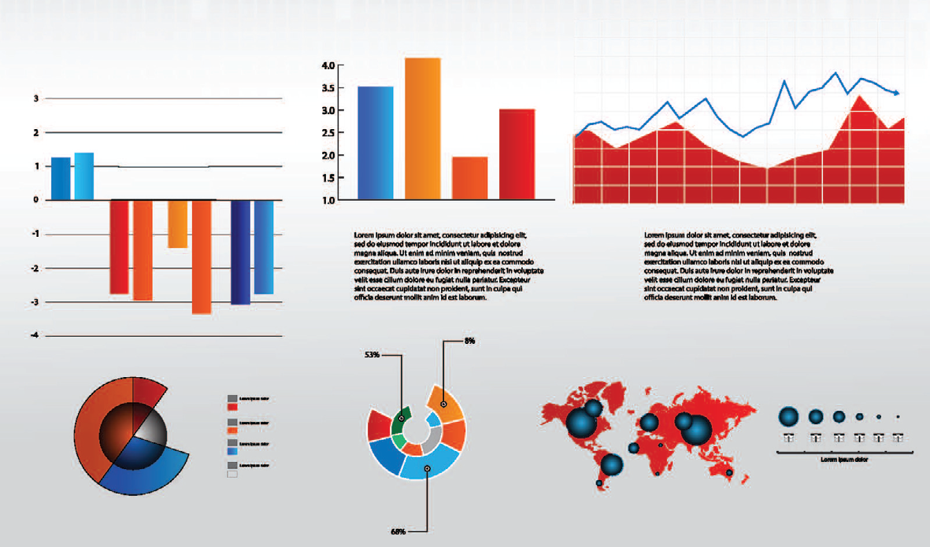
The Scope of Business Intelligence
Smaller organizations:
Excel spreadsheets
Larger organizations:
Data mining, predictive analytics, dashboards
Source: Dundas Software, www.dundas.com/ dashboard/online-examples/
screenshots/Marketing-Dashboard.aspx

Slide 11
How Organizations Use BI
Develop few, related BI applications
Data mart
Develop infrastructure to support enterprisewide BI
Enterprise data warehouse
Support organizational transformation
Enterprise data warehouse

Slide 12
12.3 Business Intelligence Applications for Data Analysis
Multidimensional Analysis or Online Analytical Processing (OLAP)
Data Mining
Decision Support Systems
© Toh Kheng Ho/Age Fotostock America, Inc.
Notes:
Multidimensional Analysis:
(1) Provides users with a look at what is happening or what has happened.
(2) Allows users to analyze data in such a way that they can quickly answer business questions.

Slide 13
Data Mining
Data mining refers to the process of searching for valuable information in a large database, data warehouse, or data mart.
Data mining performs two basic operations:
Predicting trends and behaviors;
Identifying previously unknown patterns and relationships.

Slide 14
Decision Support Systems (DSS)
DSS capabilities
Sensitivity analysis is the study of the impact that changes in one (or more) parts of a model have on other parts.
What-if analysis is the study of the impact of a change in the assumptions (input data) on the proposed solution.
Goal-seeking analysis is the study that attempts to find the value of the inputs necessary to achieve a desired level of output.
© STOCKBROKERXTRA/Age Fotostock America, Inc.
Notes:
Decision support systems (DSSs) are computer-based information systems that
combine models and data in an attempt to solve semistructured and some unstructured
problems with extensive user involvement.

Slide 15
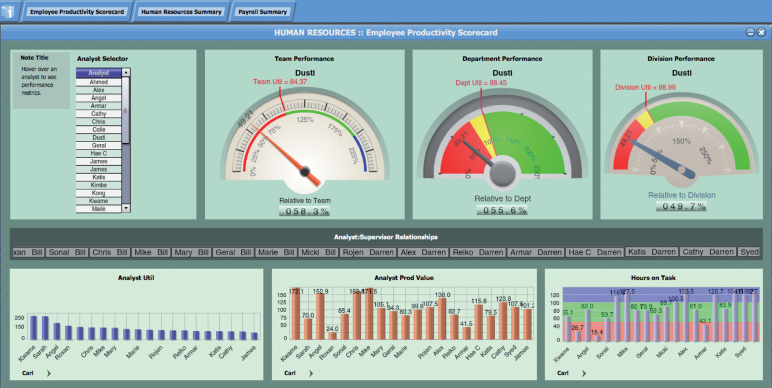
Digital Dashboard (example)
Source: MicroStrategy
Notes:
Digital Dashboards:
Provide rapid access to timely information.
Provide direct access to management reports.
Are very user friendly and supported by graphics.

Slide 16
Digital Dashboard (example)
Source: Dundas Software, www.dundas.com/ dashboard/online-examples/
screenshots/Marketing-Dashboard.aspx

Slide 17
Digital Dashboard Demo
http://www.informationbuilders.com/rfr/qtdemo/AdvVis_ExecDash/AdvVis_ExecDash.html

Slide 18
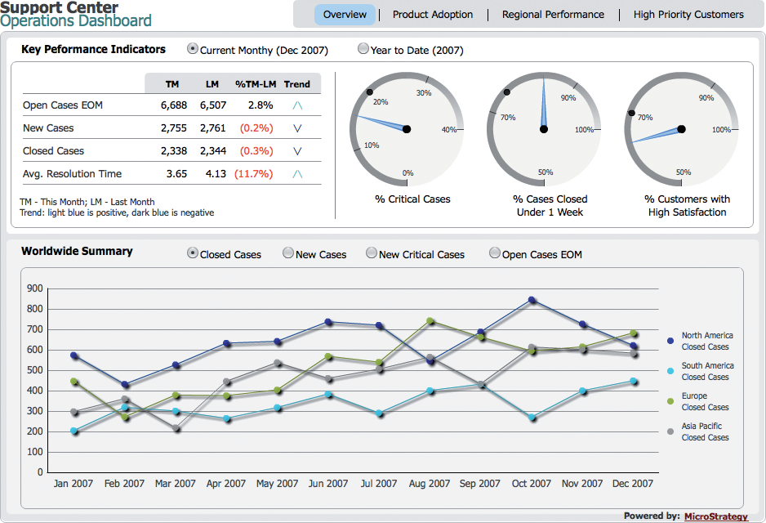
12.5 Business Intelligence in Action: Corporate Performance Management
FIGURE 12.7 1-8000 CONTACTS customer service agent dashboard.
Notes:
Corporate performance management is involved with monitoring and managing
an organization’s performance according to key performance indicators.

