Slide 1
CHAPTER 11
Customer Relationship Management and Supply Chain Management

Slide 2
Defining Customer Relationship Management
© MONKEY BUSINESS-LBR/Age Fotostock America, Inc.
Personal
Notes:
Customer relationship management (CRM) is an organizational strategy that is customer-focused
and customer-driven.

Slide 3
To Today…..
Mobile population
The Web
Giant malls
Impersonal

Slide 4
The Need for CRM
It costs six times more to sell to a new customer than to sell to an existing one.
A typical dissatisfied customer will tell 8-10 people.
By increasing the customer retention rate by 5%, profits could increase by 85%.
Odds of selling to new customers = 15%, compared to the odds of selling to existing customers (50%)
70% of complaining customers will remain loyal if their problem is solved

Slide 5
Goal of a CRM
Treat different customers differently.
Keep profitable customers and maximize
lifetime revenue from them.
Notes:
One-to-one relationship between a customer and a seller.

Slide 6
Lifetime Customer Value
The value of a customer to a company depends on three dimensions:
the duration of the relationship
the number of relationships (e.g., the number of products from a company that a customer purchases)
the profitability of the relationship.
Source: Kzenon/Shutterstock

Slide 7
Notes:
Figure 9.1

Slide 8
CRM Strategy to Systems
All successful CRM’s share two basic elements
Identify customer touch pts.
Consolidate data about each customer

Slide 9
Customer Touch Points

Slide 10
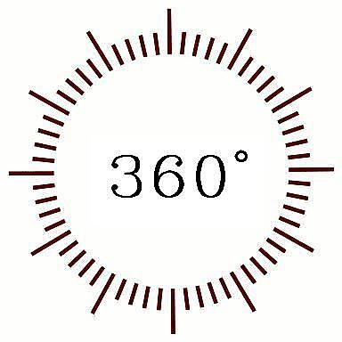
Data Consolidation
Accounting
HR
Finance
Customer
Marketing
MIS
Data Consolidation = 360-Degree View of Customers

Slide 11
2 types of CRM applications
Operational –
Customer Facing applications
Customer Touching applications
Analytical-
Data Mining
Decision Support
Business Intelligence

Slide 12
Customer-Facing Applications
Customer service and support
refers to systems that automate requests, complaints, product returns, and requests for information
Sales force automation automatically records all the aspects in a sales transaction process.
Campaign management applications help organizations plan campaigns so that the right messages are
sent to the right people through the right channels.
© Mustafa Almir Mahmoud/Age Fotostock America, Inc.
Notes:
Customer-facing applications are those applications where an organization’s sales, field service,
and customer interaction center representatives actually interact with customers.
Customer service and support refers to systems that automate requests, complaints, product returns,
and requests for information.
Sales force automation automatically records all the aspects in a sales transaction process.
Campaign management applications help organizations plan campaigns so that the right messages are
sent to the right people through the right channels.

Slide 13
Customer-Touching Applications
Search and comparison capabilities
Technical and other information and services
Customized products and services
Loyalty programs
Source: © Spencer Grant/PhotoEdit
Notes:
In customer-touching applications, customers interact directly with online technologies and applications
rather than interact with a company representative.

Slide 14
Analytical CRM
Analytical CRM systems analyze customer behavior and perceptions in order to provide actionable business intelligence.

Slide 15
The Relationship Between Operational CRM and Analytical CRM
Customer-facing Applications
Customer
Data
Warehouse
Sales
Marketing
Customer Service
Campaign Management
Data Mining
Business Intelligence
Notes:
See Figure 9.3.

Slide 16
The Relationship Between Operational CRM and Analytical CRM
Customer
Data
Warehouse
Customer-touching Applications
Search and Comparison
Customized Products
FAQ
E-mail / Auto Response
Loyalty Programs
Data Mining
Business Intelligence
Notes:
See Figure 9.3.

Slide 17
Analytical CRM
Design and execute targeted marketing campaigns
Increase customer acquisition, cross selling and upselling
Provide guidelines for future product development
Provide financial forecasting and customer profitability analysis

Slide 18
Marketing
Cross selling is the practice of marketing additional, related products to customers based on their previous purchases.
Up selling is a sales strategy in which the sales person will provide customers the opportunity to purchase higher-value related products or services as opposed to, or along with, the consumer’s initial product or service selection.
Bundling is a form of cross selling in which a business sells a group of products or services together at a price that is lower than the combined individual prices of the products.
Source: © Amy Eira/PhotoEdit
Notes:
Cross selling is the practice of marketing additional, related products to customers based on
their previous purchases.
Up selling is a sales strategy in which the sales person will provide customers the opportunity
to purchase higher-value related products or services as opposed to, or along with, the consumer’s
initial product or service selection.
Bundling is a form of cross selling in which a business sells a group of products or services together at a price that is lower than the combined individual prices of the products.

Slide 19
Supply Chain Management
Supply chain management (SCM)
is the function of planning, organizing and optimizing the supply chain’s activities.
Interorganizational information system (IOS)
involves information flows among two or more organizations.
Notes:
Supply chain management (SCM) is the function of planning, organizing and optimizing
the supply chain’s activities.
Interorganizational information system (IOS) involves information flows among two
or more organizations.

Slide 20
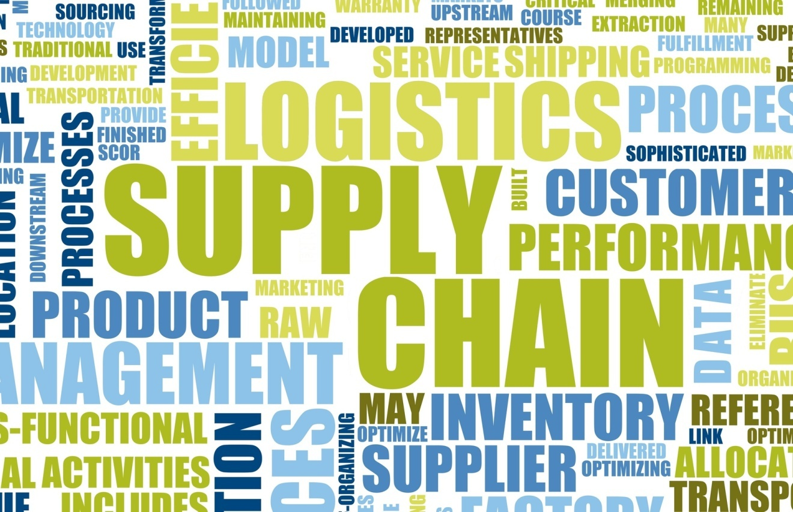
The Flows of the Supply Chain
Material flows Information flows Financial flows
© Toh Kheng Ho/Age Fotostock America, Inc.
Notes:
Material flows are the physical products, raw materials, supplies and so forth that flow along
the chain.
Information flows are all data related to demand, shipments, orders, returns and schedules
as well as changes in any of these data.
Financial flows are all transfers of money, payments and credit-related data.
A supply chain involves a product life cycle approach, from “dirt to dust”.

Slide 21
Supply Chain Management
…refers to the flow of materials, information, money from:
Raw material suppliers Factories Warehouses End consumers.

Slide 22
SCM
Upstream component of a supply chain: sourcing or procurement takes place.
Internal component of a supply chain: packaging, assembly, or manufacturing takes place.
Downstream component of a supply chain: distribution takes place.

Slide 23
Five Basic Components of Supply Chain Management
Plan
Source
Make
Deliver
Return

Slide 24
Interorganizational Information Systems (IOS)
Enable the partners to perform the following:
Reduce the costs of routine business transactions
Improve the quality of the information flow by reducing or eliminating errors
Compress the cycle time involved in fulfilling business transactions
Eliminate paper processing and its associated inefficiencies and costs
Make the transfer and processing of information easier for users

Slide 25
Generic Supply Chain
Notes:
Supply chain: refers to the flow of materials, information, money, and services from raw material
suppliers, through factories and warehouses, to the end consumers.
Upstream component of a supply chain: sourcing or procurement takes place.
Internal component of a supply chain: packaging, assembly, or manufacturing takes place.
Downstream component of a supply chain: distribution takes place.

Slide 26
Push Model

Slide 27
Pull Model
Source: © Milan Zeremski/iStockphoto

Slide 28
Problems Along the Supply Chain
Poor customer service
Poor quality product
High inventory costs
Loss of revenues

Slide 29
The Bullwhip Effect
Order
Quantity
Order
Quantity
Order
Quantity
Order
Quantity
Time
Time
Time
Time
Customer Sales
Retail Orders
To Wholesaler
Wholesaler
Orders to
Manufacturer
Manufacturer
Orders to
Supplier
Notes:
Figure 10.2

Slide 30
Solutions to Supply Chain Problems
Using inventories
Just-in-time inventory a system in which a supplier delivers the precise number of parts to be assembled into a finished product at precisely the right time.
Information sharing
Vendor-managed inventory-an inventory strategy where the supplier monitors a vendor’s inventory for a product and replenishes products when needed.
Notes:
Just-in-time inventory: a system in which a supplier delivers the precise number of parts to
be assembled into a finished product at precisely the right time.
Vendor-managed inventory: an inventory strategy where the supplier monitors a vendor’s
inventory for a product or group of products and replenishes products when needed.

Slide 31
Solutions to Supply Chain Problems
Portals
Procurement- purchasing products between a single buyer and multiple suppliers.
Boeing has deployed a portal which it conducts business with its suppliers
Distribution – selling from a single supplier to multiple buyers.
Dell services its business customers through its distribution portal
Notes:
Just-in-time inventory: a system in which a supplier delivers the precise number of parts to
be assembled into a finished product at precisely the right time.
Vendor-managed inventory: an inventory strategy where the supplier monitors a vendor’s
inventory for a product or group of products and replenishes products when needed.

Slide 32
Information Technology Support for Supply Chain Management
Electronic data interchange (EDI) is a communication standard that enables business partners to exchange routine documents, such as purchase orders, electronically.
Extranets link business partners to one another over the Internet by providing access to certain areas of each other’s corporate intranets
Portals and Exchanges – a single point of access through a Web Browser to critical information in an organization
Notes:
Electronic data interchange (EDI) is a communication standard that enables
business partners to exchange routine documents, such as purchase orders,
electronically.
Extranets link business partners to one another over the Internet by providing
access to certain areas of each other’s corporate intranets.

Slide 33
EDI Benefits/Limitations
Benefits
Minimize data entry errors
Increases productivity
Limitations
Significant initial investment to implement
Traditional EDI system is inflexible
Multiple EDI standards exist

Slide 34
Extranets
Virtual Private Network (VPN)
A Company and Its Dealers, Customers, or Suppliers
An Industry’s Extranet
Joint Ventures and Other Business Partnerships

Slide 35
Portal and Exchanges
Two basic types of corporate portals
Procurement portals
Distribution portals

