Slide 1
CHAPTER 10
Information Systems within the Organization

Slide 2
CHAPTER OUTLINE
10.1 Transaction Processing Systems
10.2 Functional Area Information Systems
10.3 Enterprise Resource Planning Systems
10.4 ERP Support for Business
10.5 Reports

Slide 3
10.1 Transaction Processing Systems (TPS)
Transaction processing system (TPS)
monitors, collects, stores and processes data generated from all business transactions.
Business Transaction
Product manufactured
Service sold
Person hired
Payroll check generated
© Stockbroker/Age Fotostock America, Inc.
Barcode scanner is an example of source data automation- involves collecting data from sensors and entering the data directly into a computer without human intervention
Notes:
Transaction processing system (TPS) monitors, collects, stores and processes data
generated from all business transactions.
Batch Processing is when the firm collects data from transactions as they occur, placing
them in groups or batches, then prepares and processes the batches periodically (say,
every night).
Online Transaction Processing (OLTP) is when business transactions are processed
online as soon as they occur.
Source data automation involves collecting data from sensors (e.g., barcode scanners)
and entering the data directly into a computer without human intervention.

Slide 4
How Transaction Processing Systems Manage Data

Slide 5
10.1 Transaction Processing Systems (TPS)
Batch Processing
is when the firm collects data from transactions as they occur, placing them in groups or batches, then prepares and processes the batches periodically (say, every night)
Online Transaction Processing (OLTP)
is when business transactions are processed online as soon as they occur

Slide 6
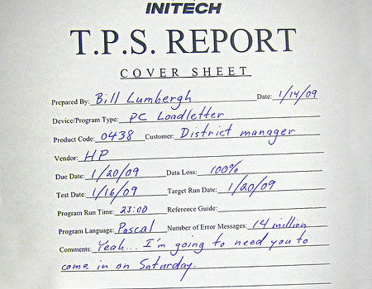
10.1 Transaction Processing Systems (TPS)
Complexities of Transactional data:
Multiple persons access the database at the same time
Transactions involves more than one computer
Transaction must be reversible
Preserve audit trail
Key features of TPS
Dependability
Reliability
Processing capacity
Notes:
Transaction processing system (TPS) monitors, collects, stores and processes data
generated from all business transactions.
Batch Processing is when the firm collects data from transactions as they occur, placing
them in groups or batches, then prepares and processes the batches periodically (say,
every night).
Online Transaction Processing (OLTP) is when business transactions are processed
online as soon as they occur.
Source data automation involves collecting data from sensors (e.g., barcode scanners)
and entering the data directly into a computer without human intervention.

Slide 7
10.2 Functional Area Information Systems
Functional Area Information Systems are designed to support a functional area by increasing its internal effectiveness and efficiency in the following areas:
Accounting
Finance
Marketing
Operations (POM)
Human Resources Management
Notes:
Functional area information systems provide information mainly to lower- and
middle-level managers in the functional areas via a variety of reports.

Slide 8
Examples of Information Systems Supporting the Functional Areas

Slide 9
Productions/Operations Management
In-house Logistics and Materials Management

Slide 10
Marketing
Customer Relationship Management
Sales Force Automation
Email and Automated Response
Loyalty programs
UP/Cross/Bundling

Slide 11
Enterprise Resource Planning Systems (ERP)
ERP systems integrate the functional areas of the organization by enabling seamless information flows across them. That is, ERP systems are designed to break down the information silos of an organization.
Notes:
Enterprise Resource Planning (ERP) systems integrate the planning, management and
use of all resources of the organization. That is, ERP systems are designed to break down
the information silos of an organization.
Many information systems were developed for specific functional areas and did not communicate
with systems in other functional areas. Therefore, these systems are referred to as information silos.

Slide 13
Benefits of ERP Systems
They can make organizations more flexible, agile, and adaptive.
They can improve managers’ ability to make better, more timely decisions.
They can improve customer service, production, and distribution.

Slide 14
Limitations of ERP Systems
May require organizations to change existing business processes to fit the predefined business processes of the ERP software.
Can be complex, expensive, and time consuming to implement.

Slide 15
Major Limitations of ERP Implementations
Since ERP’s are based on best practices companies may need to change their methods of achieving business objectives
ERP systems can be complex, expensive, and time-consuming to implement.

Slide 16
Major Causes of ERP Implementation Failure
Failure to involve affected employees in the planning and development phases and in change management processes
Trying to do too much too fast in the conversion process
Insufficient training in the new work tasks required by the ERP system
The failure to perform proper data conversion and testing for the new system

Slide 17
Implementing ERP Systems
On-Premise ERP Implementation
Vanilla approach
Custom approach
Best of breed approach

Slide 18
Three major advantages of using a cloud-based ERP system are:
The system can be used from any location that provides Internet access
Companies using cloud-based ERP avoid the initial hardware and software expenses that are typical of on-premise implementations
Cloud-based ERP solutions are scalable, meaning it is possible to extend ERP support to new business processes and new business partners (e.g., suppliers) by purchasing new ERP modules.

Slide 19
Three major disadvantages of using cloud-based ERP systems are:
It is not clear whether cloud-based ERP systems are more secure than on-premise systems
Companies that adopt cloud-based ERP systems sacrifice their control over a strategic IT resource
Lack of control over IT resources when the ERP system experiences problems

Slide 20
10.4 ERP Support for Business Processes
The Procurement, Fulfillment, and Production Processes
The Procurement Process
The Fulfillment Process
The Production Process

Slide 21
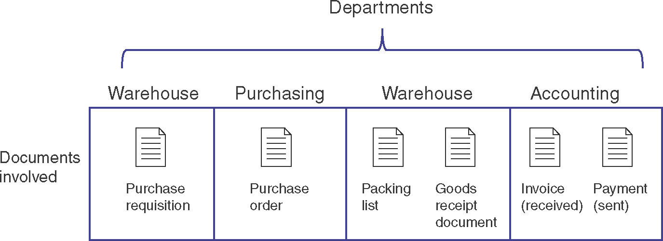
The Procurement Process

Slide 22
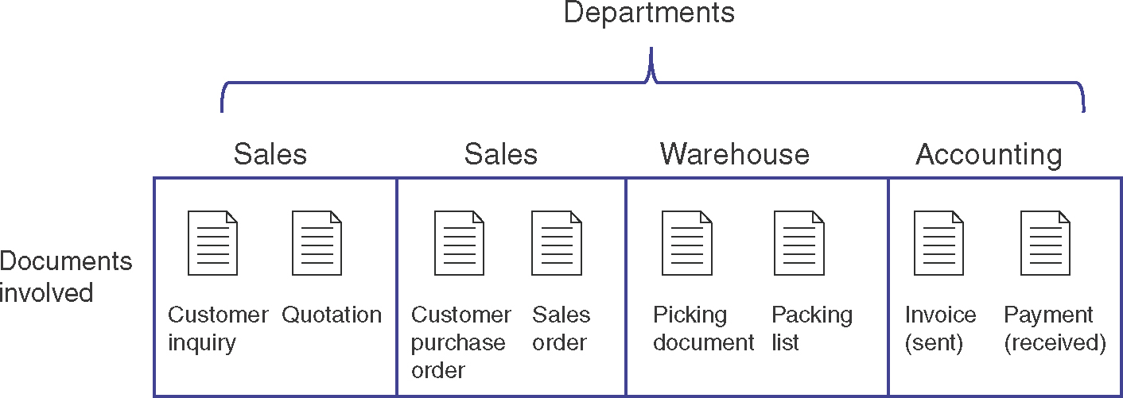
The Fulfillment Process

Slide 23
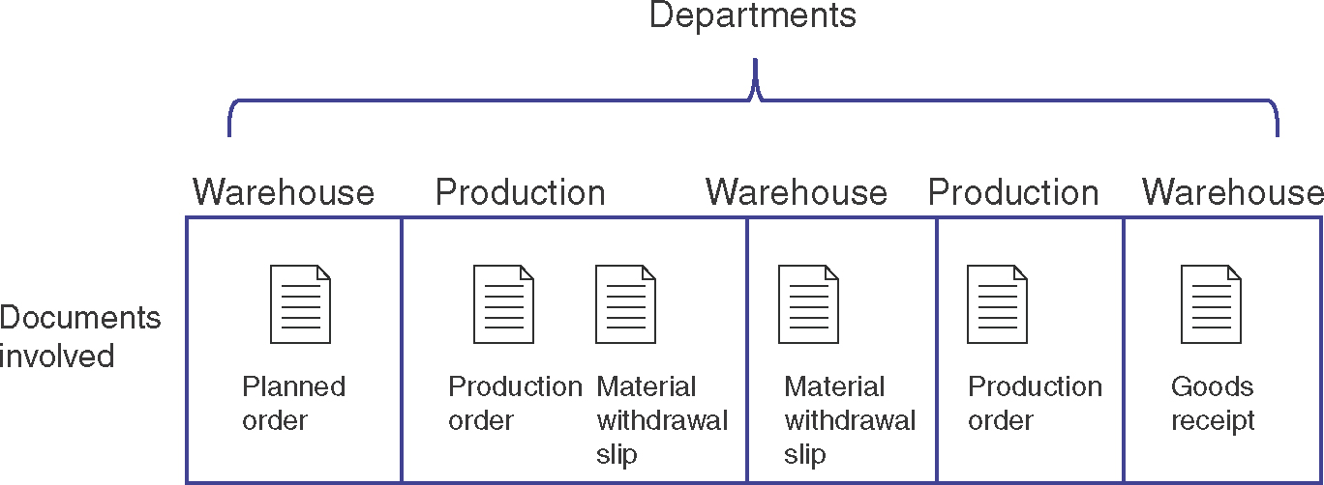
The Production Process

Slide 24
Interorganizational Processes: ERP with SCM and CRM
SCM and CRM
ERP SCM
ERP CRM

Slide 25
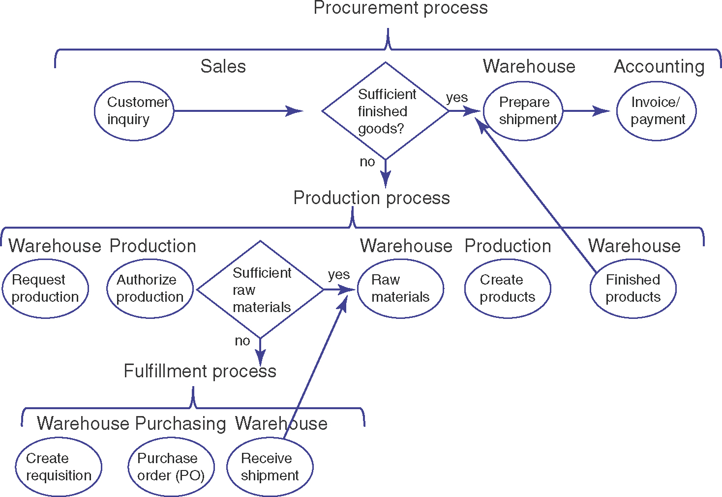

Slide 26
10.5 Functional Area Information Systems Reports
Routine reports
Ad hoc (on demand) reports
Drill-down reports
Key-indicator reports
Comparative reports
Exception reports
Notes:
Functional area information systems generate a wide variety of reports.

Slide 27
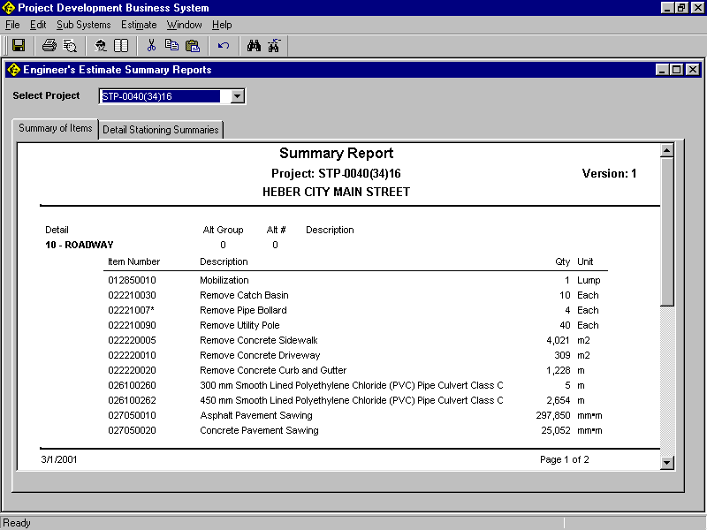
Summary Report
Summary reports provide summarized information, with less detail.
Notes:
Summary reports provide summarized information, with less detail.

Slide 28
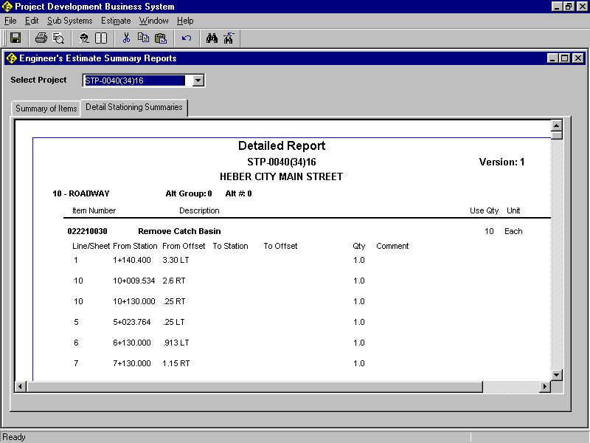
Detailed Report
Detailed reports provide high levels of detailed data, often in support of summary reports.
Notes:
Detailed reports provide high levels of detailed data, often in support of summary reports.
Note that this detailed report provides the underlying data for “Remove Catch Basin”, which is
the second item on the preceding summary report.

Slide 29
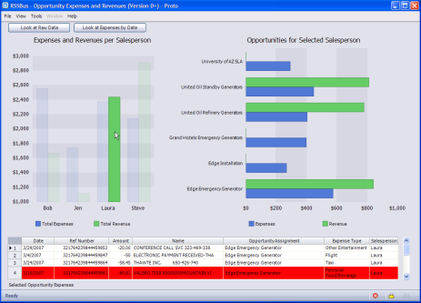
Drill-Down Report
A drill-down report allows users to click on an item in a report and be able to access underlying details about that item.
Notes:
A drill-down report allows users to click on an item in a report and be able to access
underlying details about that item.
RSSbus is a mashup tool that gives you the tools to quickly create structured feeds out of
anything; not just news and blog postings, but business data or application data that
you own or have access to. (Note: RSSBus is not special, it just had an interesting
video on drill-down.)
Clicking on the image of the report above will take you to a video that shows how
RSSBus works and how drill-down works.

Slide 30
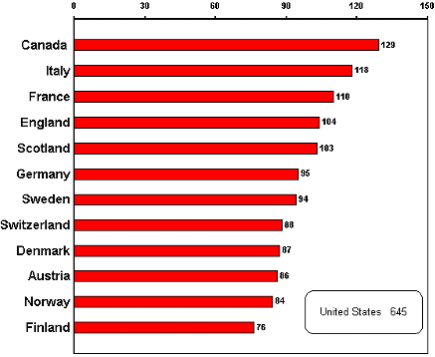
Key-Indicator Report
A key indicator report summarizes the performance of critical activities.
Marketing examples are:
New customers acquisition.
Demographic analysis
Status of existing customers
Turnover (i.e., revenue) generated by segments of the customer population
Notes:
A key indicator report summarizes the performance of critical activities.
The key indicator in this report is the number of prison inmates per 100,000
of population in 1996-1997.

Slide 31
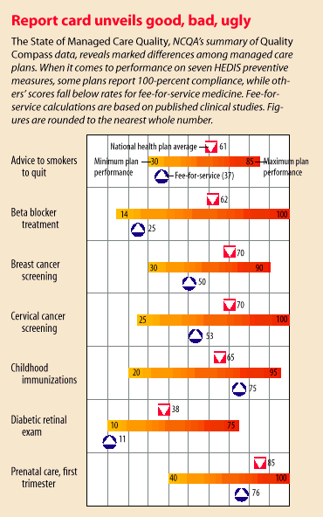
Comparative Report
Comparative report is one type of ad-hoc report.
Notes:
This comparative report compares managed health care to traditional fee-for-service
healthcare. Let’s use one example: Advice to smokers to quit.
* Fee-for-service has a 37% compliance rate on seven Healthcare Effectiveness Data
and Information Set (HEDIS) preventive measures. See purple arrow.
* The minimum managed care plans have a 30% compliance rate. (left end of bar)
* The maximum managed care plans have a 85% compliance rate. (right end of bar)
* The average of all managed care plans (National Health Plan average) is 61% compliance.
(see red arrow).
We can see that there is quite a bit of information in this graphical comparative report.

Slide 32
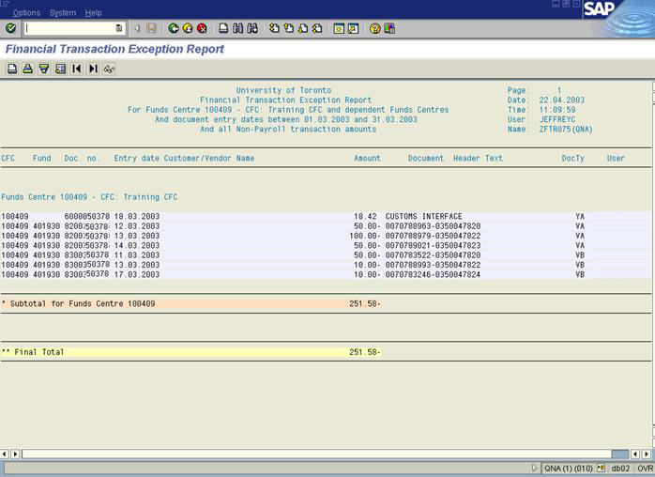
Exception Report
Exception reports include only information that falls outside certain threshold standards.
Notes:
Exception reports include only information that falls outside certain threshold standards.
This image shows a financial transaction exception report using SAP from the University of
Toronto in 2003.

