Slide 1
3
Cloud Computing

Slide 2
[ LEARNING OBJECTIVES]
Describe the problems that modern information technology departments face.
Describe the key characteristics and advantages of cloud computing.
Describe each of the four types of clouds.
Explain the operational model of each of the three types of cloud services.
Identify the key benefits of cloud computing.
Discuss the concerns and risks associated with cloud computing.
Explain the role of Web services in building a firm’s IT applications, providing examples.

Slide 3
[ CHAPTER OUTLINE ]
Introduction
What Is Cloud Computing?
Different Types of Clouds
Cloud Computing Services
The Benefits of Cloud Computing
Concerns and Risks with Cloud Computing
Web Services and Service-Oriented Architecture

Slide 4
[ WEB RESOURCES]
Student PowerPoints for note taking
WileyPLUS Learning Space
  E-Book
  Author video lecture for each chapter section
  Practice quizzes
  Flash Cards for vocabulary review
  Additional “What’s in IT for Me?” cases
  Video interviews with managers
  Lab Manuals - Microsoft Office 2010 & 2013

Slide 5
TG 3.1
Introduction
IT Infrastructure
Evolution of the Modern IT Infrastructure

Slide 6
IT Infrastructure
IT Components
  Hardware
  Software
  Networks
  Databases
  IT Services
    (Developing Information Systems, Managing Security and Risk, and Managing Data)

Slide 7
Evolution of the Modern IT Infrastructure
Stand-alone Mainframes
Mainframe and Dumb Terminals
Stand-alone Personal Computers
Local Area Networks (Client/Server Computing)
Enterprise Computing
Cloud Computing and Mobile Computing
Notes:
Six Stages of Modern IT Infrastructure Evolution
1. Stand-alone Mainframes: Organizations initially used mainframe computers in their engineering and accounting departments. The mainframe was typically housed in a secure area, and only MIS personnel had access to it.
2. Mainframe & Dumb Terminals: Forcing users to go to wherever the mainframe was located was time consuming and inefficient. As a result, firms began placing so-called “dumb terminals”—essentially electronic typewriters with limited processing power—in user departments. This arrangement enabled users to input computer programs into the mainframe from their departments, a process called remote job entry.
3. Stand-alone Personal Computers: In the late 1970s, the first personal computers appeared. The IBM PC’s debut in 1981 legitimized the entire personal computer market. Users began bringing personal computers to the workplace to improve their productivity—for example, by using spreadsheet and word processing applications. These computers were not initially supported by the firm’s MIS department. However, as the number of personal computers increased dramatically, organizations decided to support these devices, and they established policies as to which PCs and soft ware they would support.
4. Local Area Networks: (client/server computing). When personal computers are networked, individual productivity is substantially increased. For this reason, organizations began to connect personal computers into local area networks (LANs) and then connect these LANs to the mainframe, a type of processing known as client/server computing.
5. Enterprise Computing: In the early 1990s, organizations began to use networking standards to integrate different kinds of networks throughout the firm, thereby creating enterprise computing. As the Internet became widespread after 1995, organizations began using the TCP/IP networking protocol to integrate different types of networks. All types of hardware were networked, from mainframes to personal computers to smartphones. Soft ware applications and data could now flow seamlessly throughout the enterprise and between organizations.
6. Cloud Computing and Mobile Computing: Today, organizations and individuals can use the power of cloud computing. As you will see in this Plug IT In, cloud computing provides access to a shared pool of computing resources, including computers, storage, applications, and services, over a network, typically the Internet.

Slide 8
TG 3.2
What is Cloud Computing?
Cloud Computing Characteristics
Notes:
Cloud Computing: a type of computing that delivers convenient, on-demand, pay-as-you-go access for multiple customers to a shared pool of configurable computing resources (e.g., servers, networks, storage, applications, and services) that can be rapidly and easily accessed over the Internet. Cloud computing allows customers to acquire resources at any time and then delete them the instant they are no longer needed.

Slide 9
Cloud Computing Characteristics
  Cloud Computing Provides On-Demand Self-Service
  Cloud Computing Encompasses the Characteristics of Grid Computing
    Grid Computing enables organizations to utilize resources more efficiently
    Grid Computing provides fault tolerance and redundancy
    Grid Computing makes it easy to scale up
    Grad Computing makes it easy to scale down
Notes:
Cloud Computing Provides On-Demand Self- Service: A customer can access needed computing resources automatically.
Cloud Computing Encompasses the Characteristics of Grid Computing: Grid computing pools various hardware and soft ware components to create a single IT environment with shared resources. Grid computing shares the processing resources of many geographically dispersed computers across a network.
• Grid computing enables organizations to utilize their computing resources more efficiently.
• Grid computing provides fault tolerance and redundancy, meaning that there is no single point of failure, so the failure of one computer will not stop an application from executing.
• Grid computing makes it easy to scale up—that is, to access increased computing resources (i.e., add more servers)—to meet the processing demands of complex applications.
• Grid computing makes it easy to scale down (remove computers) if extensive processing is not needed.

Slide 10
Cloud Computing Characteristics (Continued)
  Cloud Computing Encompasses the Characteristics of Utility Computing
  Cloud Computing Utilizes Broad Network Access
  Cloud Computing Pools Computing Resources
  Cloud Computing Often Occurs on Virtualized Servers
    Server Farms
    Server Virtualization
Notes:
Cloud Computing Encompasses the Characteristics of Utility Computing: In utility computing, a service provider makes computing resources and infrastructure management available to a customer as needed. The provider then charges the customer for its specific usage rather than a flat rate. Utility computing enables companies to efficiently meet fluctuating demands for computing power by lowering the costs of owning the hardware infrastructure.
Cloud Computing Utilizes Broad Network Access: The cloud provider’s computing resources are available over a network, accessed with a Web browser, and they are configured so that they can be used with any computing device.
Cloud Computing Pools Computing Resources: The provider’s computing resources are available to serve multiple customers. These resources are dynamically assigned and reassigned according to customer demand.
Cloud Computing Often Occurs on Virtualized Servers: Cloud computing providers have placed hundreds or thousands of networked servers inside massive data centers called server farms. Server farms require massive amounts of electrical power, air-conditioning, backup generators, and security. They also need to be located fairly closely to fiber-optic communications links.

Slide 11
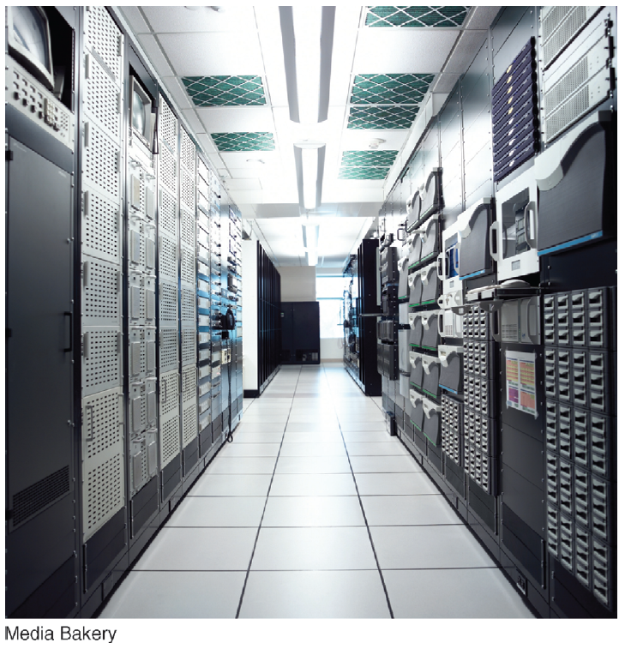
FIGURE TG 3.1 A server farm. Notice the ventilation in the racks and ceiling.
Notes:
FIGURE TG 3.1 A server farm. Notice the ventilation in the racks and ceiling.

Slide 12
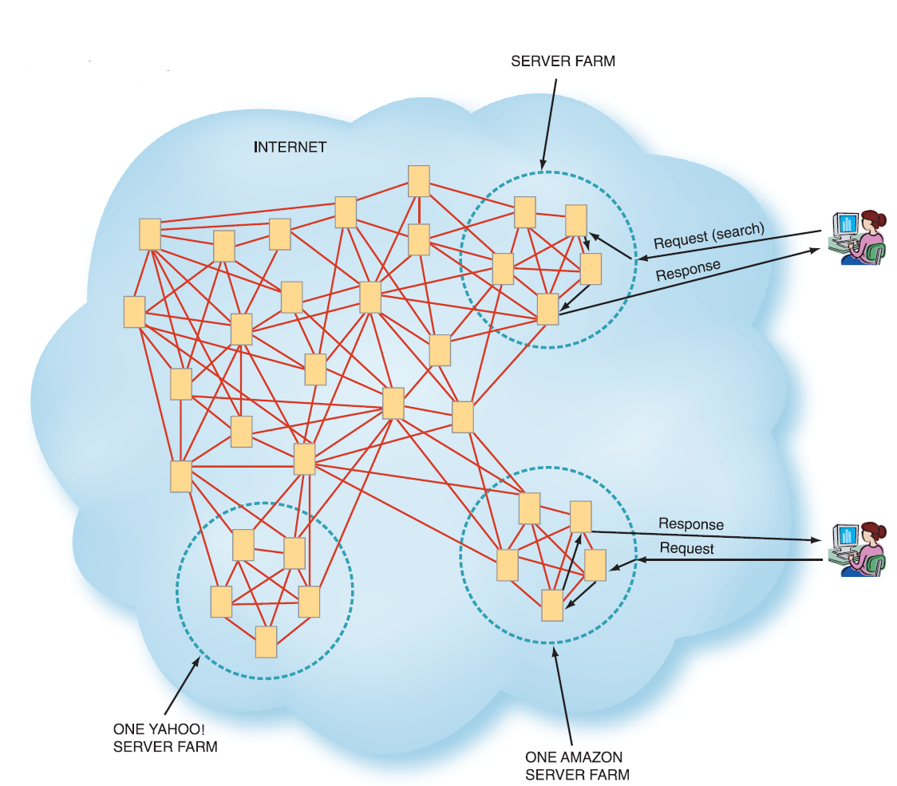
FIGURE TG 3.2 Organizational server farms in relation to the Internet.
Notes:
FIGURE TG 3.2 Organizational server farms in relation to the Internet.

Slide 13
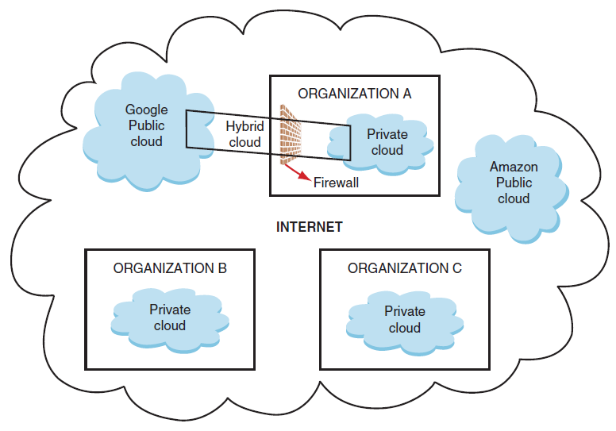
FIGURE TG 3.3 Public clouds, private clouds, and hybrid clouds.
Notes:
FIGURE TG 3.3 Public clouds, private clouds, and hybrid clouds.

Slide 14
TG 3.3
Different Types of Clouds
Public Cloud
Private Cloud (or Corporate Cloud)
Hybrid Cloud
Vertical Clouds
Notes:
Public Clouds: shared, easily accessible, multi-customer IT infrastructures that are available nonexclusively to any entity in the general public (individuals, groups, and/or organizations). Public cloud vendors provide applications, storage, and other computing resources as services over the Internet.
Private Clouds: (also known as internal clouds or corporate clouds) IT infrastructures that can be accessed only by a single entity or by an exclusive group of related entities that share the same purpose and requirements, such as all of the business units within a single organization. Private clouds provide IT activities and applications as a service over an intranet within an enterprise. Enterprises adopt private clouds to ensure system and data security. For this reason these systems are implemented behind the corporate firewall.
Hybrid Clouds: composed of public and private clouds that remain unique entities, but are nevertheless tightly integrated. This arrangement offers users the benefits of multiple deployment models. Hybrid clouds deliver services based on security requirements, the mission-critical nature of the applications, and other company-established policies.
Vertical Clouds: cloud infrastructure and applications built for different businesses—the construction, finance, or insurance businesses, for example—thus building vertical clouds.

Slide 15
TG 3.4
Cloud Computing Services
Infrastructure-as-a-Service (IaaS)
Platform-as-a-Service (PaaS)
Software-as-a-Service (SaaS)
Notes:
Infrastructure-as-a-Service (IaaS): cloud computing providers offer remotely accessible servers, networks, and storage capacity. They supply these resources on demand from their large resource pools, which are located in their data centers.
Platform-as-a-Service (PaaS): customers rent servers, operating systems, storage, a database, software development technologies such as Java and .NET, and network capacity over the Internet. The PaaS model allows the customer both to run existing applications and to develop and test new applications.
Software-as-a-Service (SaaS): cloud computing vendors provide software that is specific to their customers’ requirements. SaaS is the most widely utilized service model, and it provides a broad range of software applications. SaaS providers typically charge their customers a monthly or yearly subscription fee. SaaS applications reside in the cloud instead of on a user’s hard drive or in a data center.

Slide 16
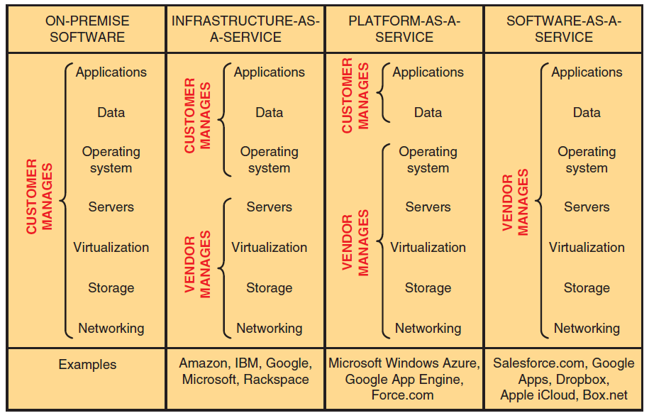
FIGURE TG 3.4 Comparison of on-premise software, infrastructure-as-a-service, platform-as-a-service, and software-as-a-service.
Notes:
FIGURE TG 3.4 Comparison of on-premise software, infrastructure-as-a-service, platform-as-a-service, and software-as-a-service.

Slide 17
Platform-as-a-Service (PaaS)
PaaS offers several advantages to customers:
  Application developers can develop and run their software solutions on a cloud platform without the cost of buying and managing the underlying hardware and software layers
  Underlying computing and storage resources automatically scale to match application demand
  Operating system features can be upgraded frequently

Slide 18
Platform-as-a-Service (PaaS) (Con’t)
PaaS offers several advantages to customers (Con’t):
  Geographically distributed development teams can work together on software development projects
  PaaS services can be provided by diverse sources located throughout the world
  Initial and ongoing costs can be reduced by the use of infrastructure services from a single vendor

Slide 19
It’s Personal:
“The Cloud”

Slide 20
TG 3.5
The Benefits of Cloud Computing
Major Benefits to Individuals and Organizations

Slide 21
Concerns Cloud Computing
Benefit 1: Cloud Computing Has a Positive Impact on Employees
Benefit 2: Cloud Computing Can Save Money
Benefit 3: Cloud Computing Can Improve Organizational Flexibility and Competitiveness

Slide 22
TG 3.6
Concerns and Risks with Cloud Computing
Five Categories of Concerns

Slide 23
Five Categories of Cloud Computing Concerns
Concern 1: Legacy IT Systems
Concern 2: Reliability
  Example: Amazon Web Services
Concern 3: Privacy
Concern 4: Security
Concern 5: The Regulatory and Legal Environment
Concern 6: Criminal Use of Cloud Computing

Slide 24
TG 3.7
Web Services and Service-Oriented Architecture
Benefits Provided to Organizations by Web Services
Service-Oriented Architecture
Web Services are based on Four Key Protocols
Notes:
Web Services: applications delivered over the Internet (the cloud) that MIS professionals can select and combine through almost any device, from personal computers to mobile phones. By using a set of shared standards, or protocols, these applications permit different systems to “talk” with one another.
------------------
Benefits of Web services:
The organization can utilize the existing Internet infrastructure without having to implement any new technologies.
Organizational personnel can access remote or local data without having to understand the complexities of this process.
The organization can create new applications quickly and easily.
------------------
Service-oriented Architecture: The collection of Web services used to build a firm’s IT applications. Businesses accomplish their processes by executing a series of these services.
Extensible Markup Language (XML): is a computer language that makes it easier to exchange data among a variety of applications and to validate and interpret these data.
Hypertext Markup Language (HTML): HTML is a page-description language for specifying how text, graphics, video, and sound are placed on a Web page document.
Hypertext Markup Language 5 (HTML5): enables users to embed images, audio, and video directly into a document without the use of add-ons (Adobe Flash Player). HTML5 also makes it easier for Web pages to function across different display devices, including mobile devices and desktops.
Simple Object Access Protocol (SOAP): a set of rules that define how messages can be exchanged among different network systems and applications through the use of XML. These rules essentially establish a common protocol that allows different Web services to interoperate.
Web Services Description Language (WSDL): creates the XML document describing the tasks performed by the various Web services. Tools such as VisualStudio.Net automate the process of accessing the WSDL, reading it, and coding the application to reference the specific Web service.
Universal Description, Discovery, and Integration (UDDI): allows MIS professionals to search for needed Web services by creating public or private searchable directories of these services.

Slide 25
Benefits Provided to Organizations by Web Services
The organization can utilize the existing Internet infrastructure without having to implement any new technologies.
Organizational personnel can access remote or local data without having to understand the complexities of this process.
The organization can create new applications quickly and easily.

Slide 26
Web Services are based on four key protocols:
Extensible Markup Language (XML)
Simple Object Access Protocol (SOAP)
Web Services Description Language (WSDL)
Universal Description, Discovery, and Integration (UDDI)
Notes:
------------------
Service-oriented Architecture: The collection of Web services used to build a firm’s IT applications. Businesses accomplish their processes by executing a series of these services.
Extensible Markup Language (XML): is a computer language that makes it easier to exchange data among a variety of applications and to validate and interpret these data.
Hypertext Markup Language (HTML): HTML is a page-description language for specifying how text, graphics, video, and sound are placed on a Web page document.
Hypertext Markup Language 5 (HTML5): enables users to embed images, audio, and video directly into a document without the use of add-ons (Adobe Flash Player). HTML5 also makes it easier for Web pages to function across different display devices, including mobile devices and desktops.
Simple Object Access Protocol (SOAP): a set of rules that define how messages can be exchanged among different network systems and applications through the use of XML. These rules essentially establish a common protocol that allows different Web services to interoperate.
Web Services Description Language (WSDL): creates the XML document describing the tasks performed by the various Web services. Tools such as VisualStudio.Net automate the process of accessing the WSDL, reading it, and coding the application to reference the specific Web service.
Universal Description, Discovery, and Integration (UDDI): allows MIS professionals to search for needed Web services by creating public or private searchable directories of these services.

