Slide 1
CHAPTER 2 addon
Organizational Strategy, Competitive Advantage, and Information Systems

Slide 2
Business Processes
Business Process- related activities that produce a product or a service of value to the organization, its business partners/ and or customers
Comprised of three elements:
Inputs
Resources
Outputs
Can be cross-functional processes
No single functional area is responsible
steps executed in a coordinated, collaborative way

Slide 3
Examples of Business Process
Accounts Collection
After Sale follow-up
Managing packing, storage, and distribution

Slide 4
Information Systems & Business Processes
IS’s vital role in three areas of business processes
Executing the process
Capturing and storing process data
Monitoring process performance

Slide 5
Executing the Process
IS’s help Execute the Process by:
Informing employees when it is time to complete a task
Providing required data
Providing a means to complete the task

Slide 6
Capturing & Storing Process Data
Processes generate data
Dates, times, product numbers, quantities, prices, addresses, names, employee actions
IS’s capture & store process data (aka, transaction data)
Capturing & storing data provides immediate, ‘real time’ feedback

Slide 7
Monitoring Process Performance
IS evaluates information to determine how well a process is being executed
Evaluations occur at two levels
Process level
Instance level
Monitoring identifies problems for process improvement

Slide 8
Business Pressures, Organizational Responses, and IT Support
Business Pressures
Market Pressures
Technology Pressures
Societal Pressures
Notes:
Business Pressure - The business environment is the combination of social, legal, economic, physical, and political factors that affect business activities.
Significant changes in any of these factor are likely to create business pressure on the organization.
The three types of business pressures faced are: market, technology, and societal pressures.

Slide 9
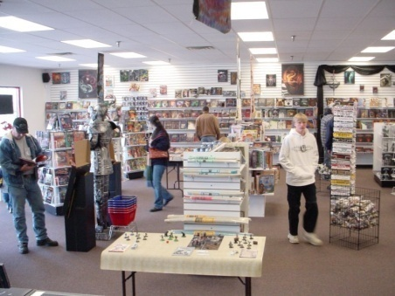
Market Pressures
The Global Economy and
Strong Competition
The Changing Nature of the Workforce
Powerful Customers

Slide 10
Globalization
The integration and interdependence of economic, social, cultural, and ecological facets of life, made possible by rapid advances in IT.

Slide 11
Changing Nature of the Workforce
Workforce is Becoming More Diversified
Women
Single Parents
Minorities
Persons with Disabilities
IT is Enabling Telecommuting Employees

Slide 12
Powerful Customers
Increasing consumer sophistication & expectations
Consumer more knowledgeable about
Products and services
Price comparisons
Electronic auctions
Customer Relationship Management

Slide 13
Technology Pressures
Technological Innovation and Obsolescence
Information Overload

Slide 14
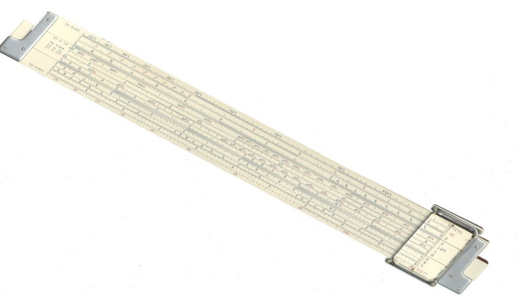
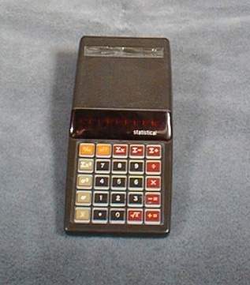
Technological Innovation and Obsolescence
Obsolescence: Slide Rule
Innovation: Early calculator

Slide 15
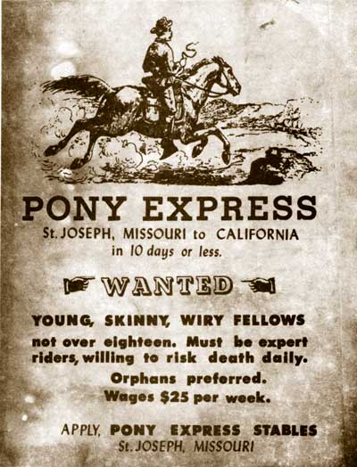
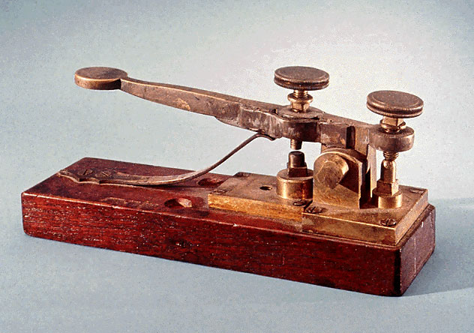
Technological Innovation and Obsolescence (continued)
Innovation: Telegraph
Obsolescence: Pony Express

Slide 16
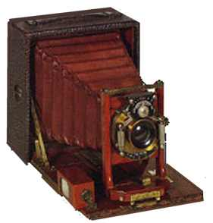
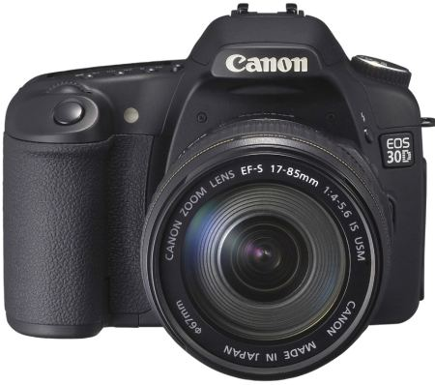
Technological Innovation and Obsolescence (continued)
Obsolescence: old analog camera
Innovation: digital camera

Slide 17
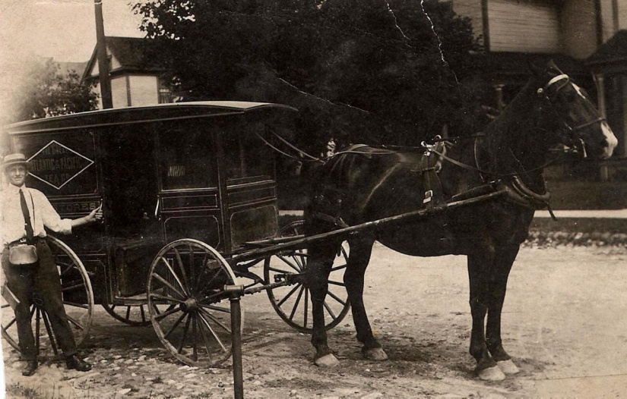
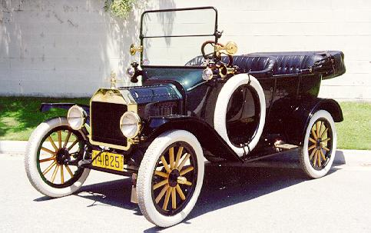
Technological Innovation and Obsolescence (continued)
Obsolescence:
Horse and Buggy
Innovation: Ford Model T

Slide 18
Information Overload

Slide 19
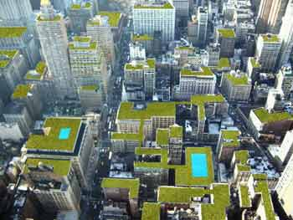
Societal/Political/Legal
Social Responsibility
Manufacturing sustainability
Distribution
Humane working conditions
Government Regulations
Protection Against Terrorist Attacks
Ethical Issues

Slide 20
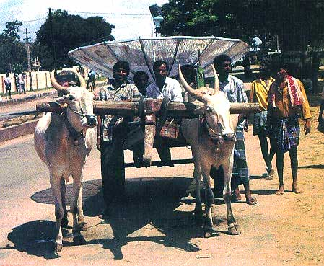
Social Responsibility (continued)
Bridging the Digital Divide
Notes:
Getting the satellite dish to the rural hamlet
* Interesting juxtaposition of Agricultural Age and Information Age

Slide 21
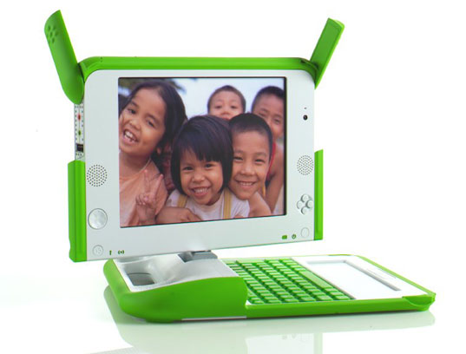
Social Responsibility (continued)
One Laptop per Child initiative
Notes:
Bridging the Digital Divide

Slide 22
Social Responsibility & Philanthropy in Business
www.patientslikeme.com
www.giftflow.org
www.ourgoods.org
www.sparked.com
www.thredup.com
www.collaborativeconsumption.com
www.kiva.org
www.donorschooce.org

Slide 23
Compliance with Government Regulations
Sarbanes-Oxley Act
USA PATRIOT act
Gramm-Leach-Bliley Act
Health Insurance Portability & Accountability Act (HIPAA)

Slide 24
Protection against Terrorist Attacks
Employees in military reserves called to active duty
Information Technology used to identify and protect against terrorists and cyberattacks
Department of Homeland Security’s (DHS) US-VISIT program
Network of biometric-screening systems

Slide 25
Ethical Issues
General standards of right and wrong
Information-processing activities
Monitoring employee email
Monitoring employee Internet activity at work
Privacy of customer data

Slide 26
Porter’s Competitive Forces Model
The best-known framework for analyzing competitiveness is Michael Porter’s competitive forces model (Porter, 1985).
Michael Porter
Notes:
* Model is used to develop strategies to increase their competitive edge.
* Demonstrates how IT can make a company more competitive.

Slide 27
Porter’s Competitive Forces Model

Slide 28
Porter’s Competitive Forces Model
Threat of entry of new competitors is high when it is easy to enter a market and low when significant barriers to entry exist.
A barrier to entry is a product or service feature that customers expect from organizations in a certain industry.
For most organizations, the Internet increases the threat that new competitors will enter a market.

Slide 29
Porter’s Competitive Forces Model
The bargaining power of suppliers is high when buyers have few choices and low when buyers have many choices.
Internet impact is mixed. Buyers can find alternative suppliers and compare prices more easily, reducing power of suppliers.
On the other hand, as companies use the Internet to integrate their supply chains, suppliers can lock in customers.

Slide 30
Porter’s Competitive Forces Model
The bargaining power of buyers is high when buyers have many choices and low when buyers have few choices.
Internet increases buyers’ access to information, increasing buyer power.
Internet reduces switching costs, which are the costs, in money and time, to buy elsewhere. This also increases buyer power.

Slide 31
Porter’s Competitive Forces Model
The threat of substitute products or services is high when there are many substitutes for an organization’s products or services and low where there are few substitutes.
Information-based industries are in the greatest danger from this threat (e.g., music, books, software). The Internet can convey digital information quickly and efficiently.

Slide 32
Porter’s Competitive Forces Model
The rivalry among firms in an industry is high when there is fierce competition and low when there is not.

Slide 33
Competitive Advantage
Notes:
Competitive advantage is an advantage over competitors in some measure such as cost,
quality, or speed; leads to control of a market and to larger-than-average profits.

Slide 34
Strategies for Competitive Advantage
Cost Leadership
Differentiation
Innovation
Operational Effectiveness
Customer-orientation
Notes:
Cost Leadership. Produce products and/or services at the lowest cost in the industry.
Differentiation. Offer different products, services or product features.
Innovation. Introduce new products and services, add new features to existing products and services or develop new ways to produce them.
Operational Effectiveness. Improve the manner in which internal business processes are executed so that a firm performs similar activities better than its rivals.
Customer-orientation. Concentrate on making customers happy.

Slide 35
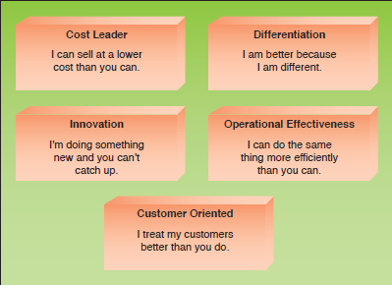
Strategies for Competitive Advantage
Figure 2.5

Slide 36
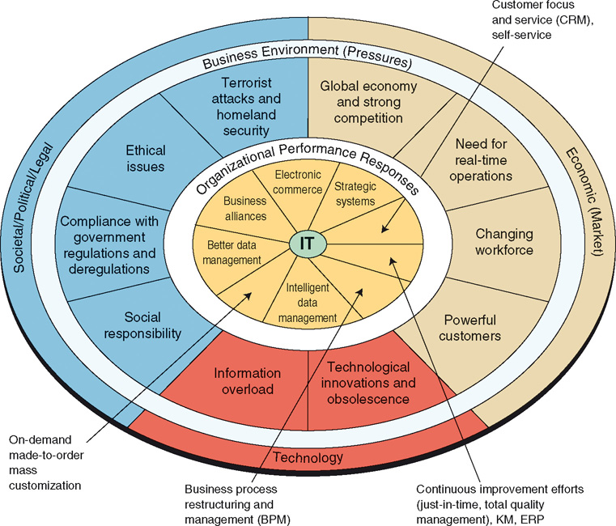
Business Pressures, Organizational Responses, and IT Support

Slide 37
Organizational Responses
ERP
Fulfillment Automation
Ecommerce
CRM

Slide 38
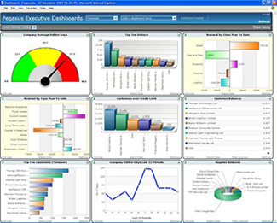
Organizational Responses
Collaborative Workflow software
Intranet
On-Demand, Mass customization
Strategic Systems
Dashboards
Business Intelligence
Expert Systems

Slide 39
Six Characteristics of Excellent Business-IT Alignment
IT viewed as an engine of innovation continually transforming the business and often creating new revenue streams.
Organizations view their internal & external customers and their customer service function as supremely important.
Organizations rotate business and IT professionals across departments and job functions.

Slide 40
Six Characteristics of Excellent Business-IT Alignment
Organizations provide overarching goals that are completely clear to each IT and business
Organizations ensure that IT employees understand how the company makes (or loses) money.
Organizations create a vibrant and inclusive company culture.

Slide 41
Major Reasons Business-IT Alignment Does Not Occur
Business managers and IT managers have different objectives.
The business and IT departments are ignorant of the other group’s expertise.
A lack of communication.

