Slide 1
CHAPTER 6
Networks

Slide 2
Objectives
After completing this chapter, you will be able to:
Identify and briefly describe three network topologies and four different network types
Identify and briefly discuss several types of both guided and wireless communications
Identify several network hardware devices and define their functions
Briefly describe how the Internet and the Web work, including various methods for connecting to the Internet
Outline the process and tools used in developing Web content and applications
List and describe several Internet and Web applications
Explain how intranets and extranets use Internet technologies, and describe how the two differ

Slide 3
Objectives
Define what is meant by the Internet of Things (IoT)
Identify and discuss several practical applications of the Internet of Things (IoT)
Categorize and summarize several potential issues and barriers associated with the expansion of the Internet of Things (IoT)
Discuss how cloud computing can increase the speed and reduce costs of new product launches
Summarize three common problems organizations encounter in moving to the cloud
Discuss the pros and cons of private and hybrid cloud computing compared to public cloud computing

Slide 4
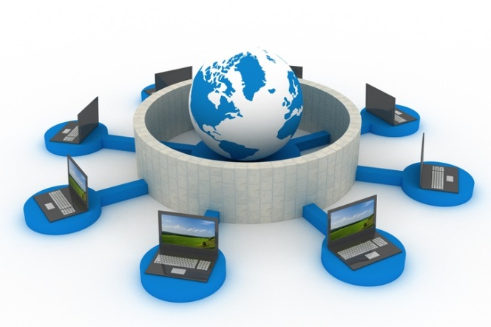
What Is a Computer Network?
A computer network is a system that connects computers and other devices via communications
media so that data and information can be transmitted among them.
In a computer network, connected computers:
            Work together
            Are interdependent
            Exchange data with each other
© Ilin Sergey/Age Fotostock America, Inc.
Notes:
A computer network is a system that connects computers and other devices via communications
media so that data and information can be transmitted among them.

Slide 5
Network topology
  The shape or structure of a network, including the arrangement of the communications links and hardware devices on the network
Three most common network topologies
  Star network
  Bus network
  Mesh network

Slide 6
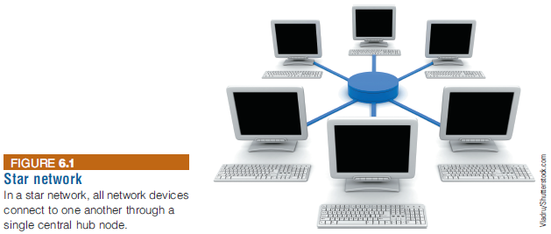

Slide 7
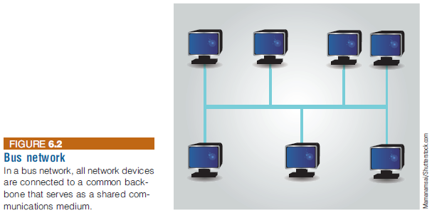

Slide 8
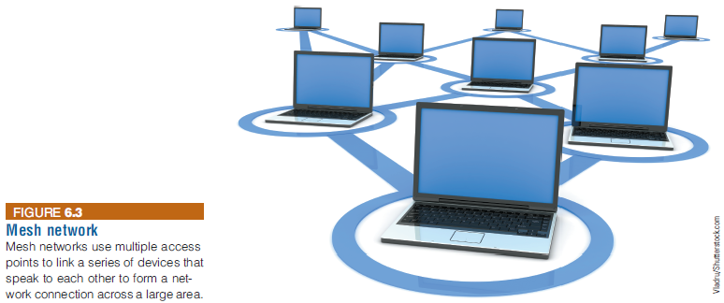

Slide 9
Network Types
A personal area network (PAN) supports the interconnection of information technology close to one person
A local area network (LAN) connects computer systems and devices within a small area (e.g., an office or a home)
A metropolitan area network (MAN) connects users and their devices in an area that spans a campus or city

Slide 10
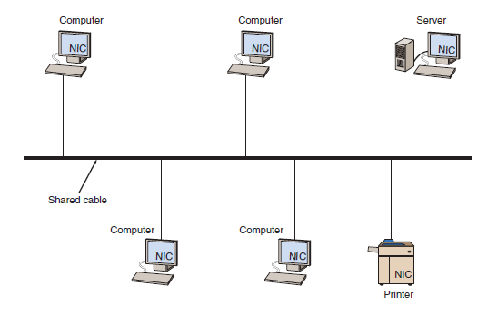
Local Area Networks
Notes:
A local area network connects two or more devices in a limited geographical region so
that every device on the network can communicate with every other device.

Slide 11
Network Types
A wide area network (WAN) connects large geographic regions
WANs consist of:
  Computer equipment owned by the user
  Data communications equipment and telecommunications links provided by various carriers and service providers
Communications may involve transborder data flow
Notes:
Network Types
A wide area network (WAN) connects large geographic regions
WANs consist of:
Computer equipment owned by the user
Data communications equipment and telecommunications links provided by various carriers and service providers
Communications may involve transborder data flow

Slide 12
Network Fundamentals
Analog and Digital Signals
Communications Media and Channels
Network Protocols
Types of Network Processing

Slide 13
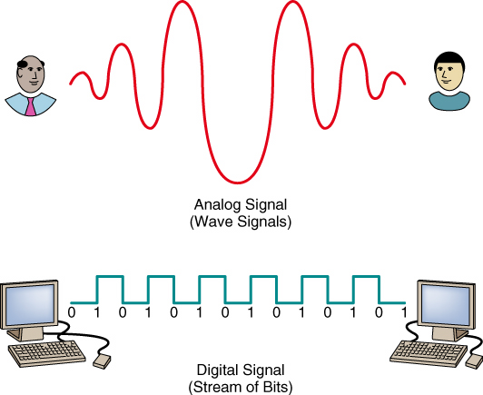
Analog and Digital Signals

Slide 14
Channel Bandwidth
Channel bandwidth: the rate at which data is exchanged
  Usually measured in bits/sec
Broadband communications: a relative term; a telecommunications system that can transmit data very quickly
Notes:
Channel Bandwidth
Channel bandwidth: the rate at which data is exchanged
Usually measured in bits/sec
Broadband communications: a relative term; a telecommunications system that can transmit data very quickly

Slide 15
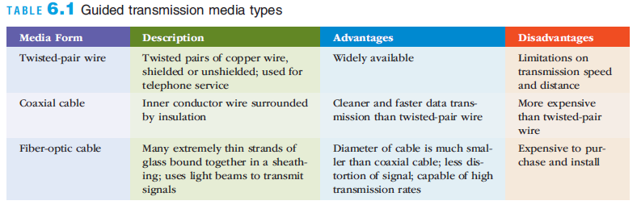
Communications Media
Two broad categories
  Guided (wired) transmission media: signals are guided along a solid medium
  Wireless: the signal is broadcast over airwaves as a form of electromagnetic radiation
Notes:
Communications Media
Two broad categories
Guided (wired) transmission media: signals are guided along a solid medium
Wireless: the signal is broadcast over airwaves as a form of electromagnetic radiation

Slide 16
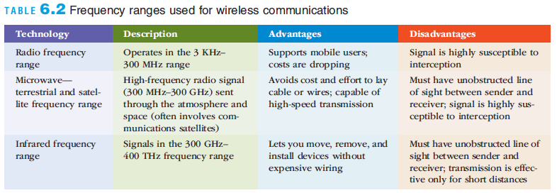
Communications Media
Wireless Technologies
  Wireless transmission involves the broadcast of communications in one of three frequency ranges
    Radio, microwave, or infrared frequencies
  In some cases, use of wireless communications is regulated
    The signal must be broadcast within a specific frequency range to avoid interference with other wireless transmissions
Notes:
Communications Media

Slide 17
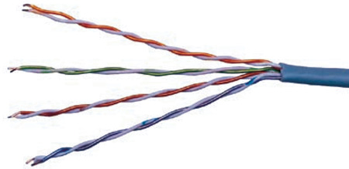
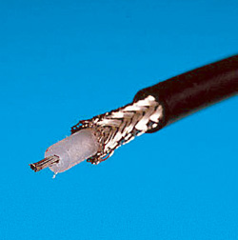
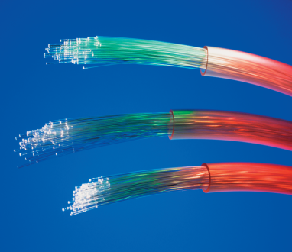
Communications Media and Channels
Twisted-pair wire
Coaxial cable
Fiber optics
Sources: deepspacedave/Shutterst ock, GIPhotoStock/Photo Researchers, Inc, Philip Hatson/Photo Researchers

Slide 18
Communications Media
Near field communication (NFC): a very short-range wireless connectivity technology
  Designed for consumer electronics, cell phones, and credit cards
Bluetooth: a wireless communications specification that describes how cell phones, computers, personal digital assistants, etc., can be interconnected
Wi-Fi
  A wireless telecommunications technology brand owned by the Wi-Fi Alliance
  Employs a wireless access point (a transmitter with an antenna) that receives the signal and decodes it
    Translates signals into a radio signal and sends it to device’s wireless adapter
  The area covered by one or more interconnected wireless access points is called a “hot spot”
Notes:
Communications Media
Near field communication (NFC): a very short-range wireless connectivity technology
Designed for consumer electronics, cell phones, and credit cards
Bluetooth: a wireless communications specification that describes how cell phones, computers, personal digital assistants, etc., can be interconnected
Wi-Fi
A wireless telecommunications technology brand owned by the Wi-Fi Alliance
Employs a wireless access point (a transmitter with an antenna) that receives the signal and decodes it
Translates signals into a radio signal and sends it to device’s wireless adapter
The area covered by one or more interconnected wireless access points is called a “hot spot”

Slide 19
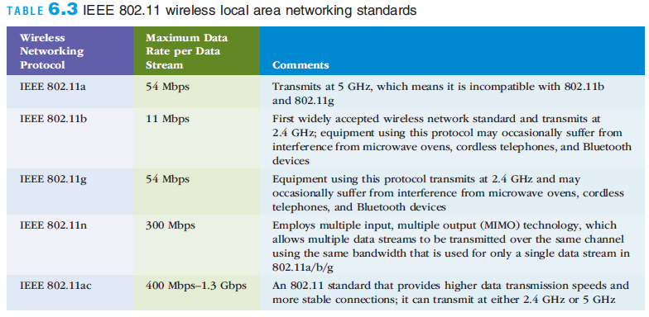
Communications Media
Notes:
Communications Media

Slide 20
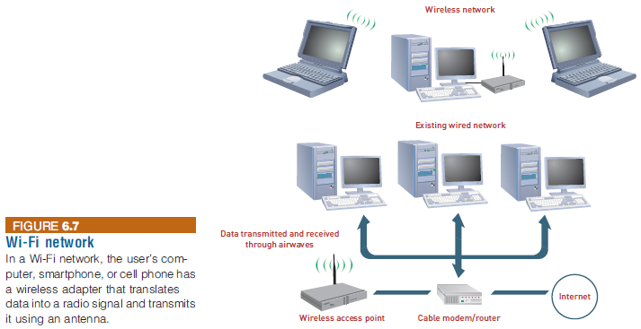
Communications Media
Notes:
Communications Media

Slide 21
Communications Media
Microwave Transmission
  Microwave is a high-frequency (300 MHz–300 GHz) signal sent through the air
  Common forms of satellite communications:
    Geostationary satellite
    Low earth orbit (LEO) satellite
Notes:
Communications Media
Microwave Transmission
Microwave is a high-frequency (300 MHz–300 GHz) signal sent through the air
Common forms of satellite communications:
Geostationary satellite
Low earth orbit (LEO) satellite

Slide 22
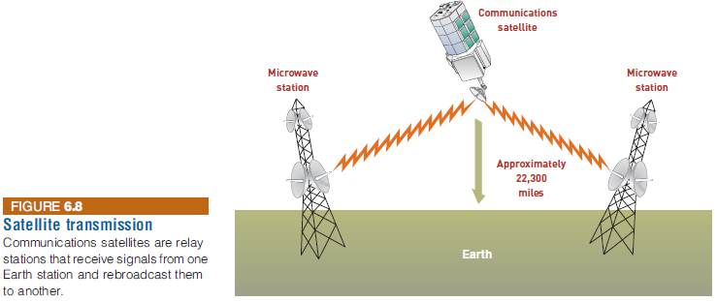
Communications Media
Notes:
Communications Media

Slide 23
Communications Media
Historical perspective
  1G (first generation) of wireless communications standards: originated in the 1980s; based on analog communications
  2G (second generation) employed fully digital networks; superseded 1G networks in the early1990s
  3G supports wireless voice and broadband speed data communications in a mobile environment at speeds of 2 to 4 Mbps
  4G wireless provides increased data transmission rates
    3 to 20 times the speed of 3G networks for mobile devices
  4G networks are based on Long Term Evolution (LTE)
    LTE is a standard for wireless communications for mobile phones based on packet switching
Notes:
Communications Media
Historical perspective
1G (first generation) of wireless communications standards: originated in the 1980s; based on analog communications
2G (second generation) employed fully digital networks; superseded 1G networks in the early1990s
3G supports wireless voice and broadband speed data communications in a mobile environment at speeds of 2 to 4 Mbps
4G wireless provides increased data transmission rates
3 to 20 times the speed of 3G networks for mobile devices
4G networks are based on Long Term Evolution (LTE)
LTE is a standard for wireless communications for mobile phones based on packet switching

Slide 24
Communications Media
5G Wireless Communications
  Expected characteristics
    Higher data transmission rates
    Lower power consumption
    Higher connect reliability and more coverage
    Lower infrastructure costs
  Commercial deployment expected to start by 2017
Notes:
Communications Media
5G Wireless Communications
Expected characteristics
Higher data transmission rates
Lower power consumption
Higher connect reliability and more coverage
Lower infrastructure costs
Commercial deployment expected to start by 2017

Slide 25
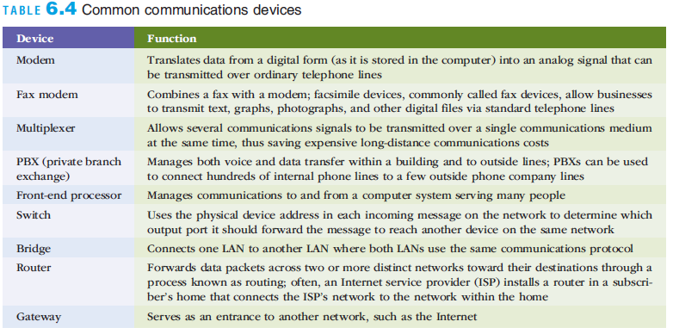
Communications Hardware
Notes:
Communications Hardware

Slide 26
Communications Software
Network operating system (NOS)
  Systems software that controls the computer systems and devices on a network
  Linux, UNIX, Windows Server, and Mac OS X are common NOSs
Network-management software:
  Protects software from being copied, modified, or downloaded illegally
  Locates telecommunications errors and potential network problems
Notes:
Communications Software
Network operating system (NOS)
Systems software that controls the computer systems and devices on a network
Linux, UNIX, Windows Server, and Mac OS X are common NOSs
Network-management software:
Protects software from being copied, modified, or downloaded illegally
Locates telecommunications errors and potential network problems

Slide 27
Network Protocols
A protocol is the set of rules and procedures governing transmission across a network.
Ethernet is a common LAN protocol.
Transmission Control Protocol/Internet Protocol (TCP/IP) is a file transfer protocol that can send large files of information across sometimes unreliable networks with assurance that the data will arrive uncorrupted
Notes:
A protocol is the set of rules and procedures governing transmission across a network.
Ethernet is a common LAN protocol.
Transmission Control Protocol/Internet Protocol (TCP/IP) is a file transfer protocol that can send large files of information across sometimes unreliable networks with assurance that the data will arrive uncorrupted

Slide 28
How the Internet Works
Internet backbone: one of the Internet’s high-speed, long-distance communications links
IP protocol
  The set of rules used to pass packets from one host to another
Transmission Control Protocol (TCP): the widely used transport layer protocol that most Internet applications use with IP
IP address: a 64-bit number that identifies a computer on the Internet
Notes:
How the Internet Works
Internet backbone: one of the Internet’s high-speed, long-distance communications links
IP protocol
The set of rules used to pass packets from one host to another
Transmission Control Protocol (TCP): the widely used transport layer protocol that most Internet applications use with IP
IP address: a 64-bit number that identifies a computer on the Internet

Slide 29
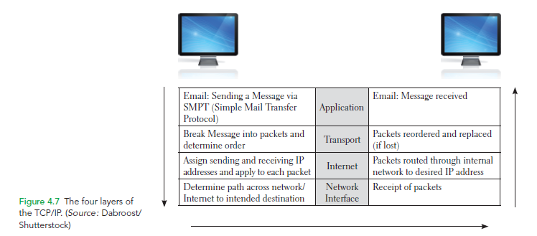
The Four Layers of the TCP/IP Protocol

Slide 30
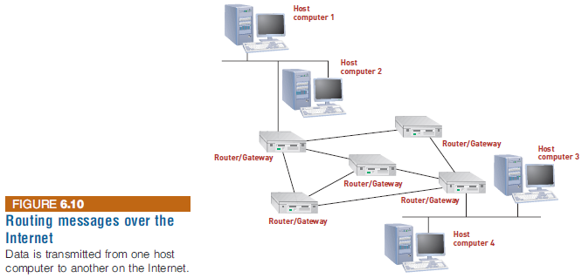
How the Internet Works
Notes:
How the Internet Works

Slide 31
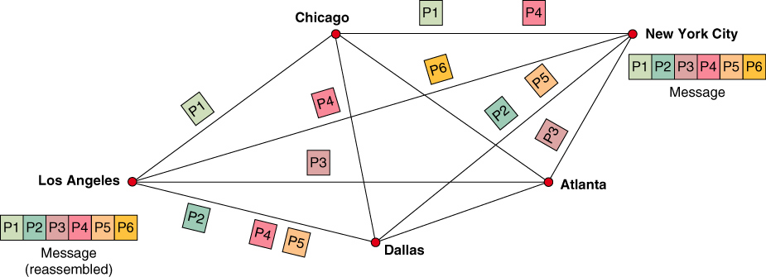
Packet Switching

Slide 32
The Internet and World Wide Web
The Internet is international in scope with users on every continent
Internet sites have a profound impact on world politics
Internet censorship
  Some countries try to control Internet content and services
ARPANET
  Ancestor of the Internet
  Project started by the U.S. Department of Defense (DoD) in 1969
Internet Protocol (IP) enables computers to route communications traffic from one network to another
Notes:
The Internet and World Wide Web
The Internet is international in scope with users on every continent
Internet sites have a profound impact on world politics
Internet censorship
Some countries try to control Internet content and services
ARPANET
Ancestor of the Internet
Project started by the U.S. Department of Defense (DoD) in 1969
Internet Protocol (IP) enables computers to route communications traffic from one network to another

Slide 33


Types of Network Processing
Client/server computing
Peer-to-peer processing
The first type of peer-to-peer (P2P) processing accesses unused CPU power among networked computers.
The second type of P2P is real-time, person-to-person collaboration.
The third type of P2P is open-source, free, peer-to-peer file-sharing.
© Matthias Pahl/Age Fotostock America, Inc.
© Toh Kheng Ho/Age Fotostock America, Inc.
Notes:
The first type of peer-to-peer (P2P) processing accesses unused CPU power among networked computers.
The second type of P2P is real-time, person-to-person collaboration.
The third type of P2P is open-source, free, peer-to-peer file-sharing.

Slide 34
Client/Server Systems
Client/server architecture features multiple computer platforms dedicated to special functions, e.g., database management, printing, or communications
A client is any computer that sends messages requesting services from the servers on the network
A database server sends only the data that meets a specific query—not the entire file
Notes:
Client/Server Systems
Client/server architecture features multiple computer platforms dedicated to special functions, e.g., database management, printing, or communications
A client is any computer that sends messages requesting services from the servers on the network
A database server sends only the data that meets a specific query—not the entire file

Slide 35
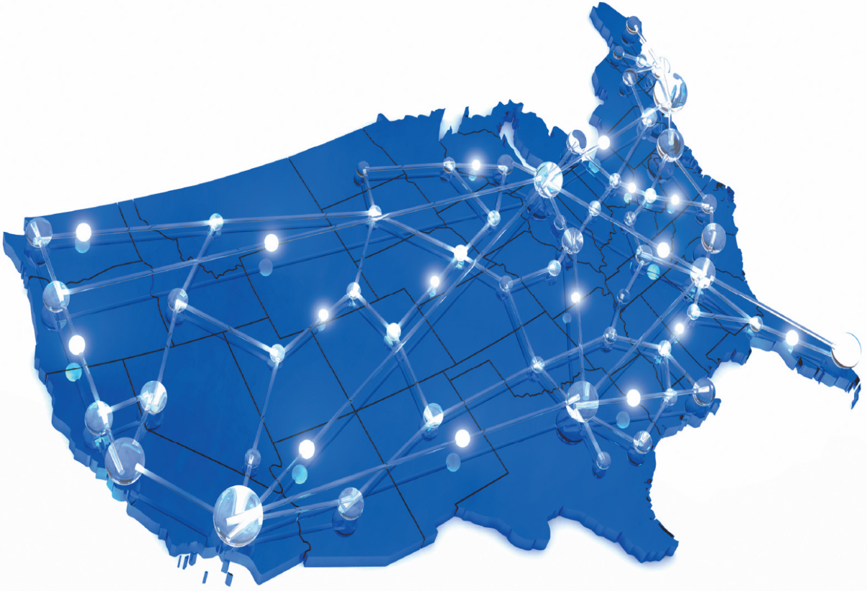
Accessing the Internet
Cable Modem
Satellite
Wireless
Fiber to the Home
Source: © Mark Stay/iStockphoto)

Slide 36
Addresses on the Internet
IPv4
IPv6
32 bits
128 bits

Slide 37
How the Internet Works
Uniform Resource Locator (URL): a Web address that specifies the exact location of a Web page using letters and words that map to an IP address and a host location
Internet Corporation for Assigned Names and Numbers (ICANN) is responsible for managing IP addresses and Internet domain names
  Domain names must adhere to strict rules
Notes:
How the Internet Works
Uniform Resource Locator (URL): a Web address that specifies the exact location of a Web page using letters and words that map to an IP address and a host location
Internet Corporation for Assigned Names and Numbers (ICANN) is responsible for managing IP addresses and Internet domain names
Domain names must adhere to strict rules

Slide 38
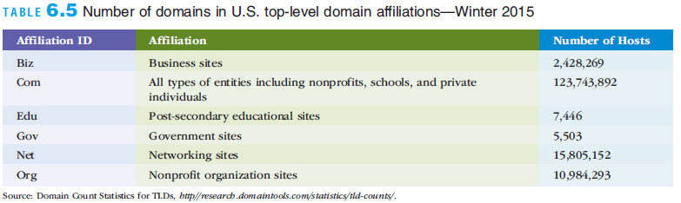
How the Internet Works
Notes:
How the Internet Works

Slide 39
Addresses on the Internet
Domain names consist of multiple parts, separated by dots, which are read from right to left.
  Top-level domain the rightmost part of an Internet name; common top-level domains are .com, .edu, .gov
  Name of the organization the next section of the Internet name
  Name of the specific computer the next section of the Internet name
Notes:
Domain names consist of multiple parts, separated by dots, which are read from right to left.
Top-level domain: the rightmost part of an Internet name; common top-level domains are .com, .edu, .gov
Name of the company: the next section of the Internet name
Name of the specific computer: the next section of the Internet name

Slide 40
Internet Address example
http://.carl.sandiego.edu
Name of the specific computer: carl
Name of the organization:
University of San Diego
Top level domain: edu

Slide 41

How the Web Works
The Internet
  The infrastructure on which the Web exists
  Made up of computers, network hardware such as routers and fiber-optic cables, software, and the TCP/IP protocols
The World wide web: (Web)
  Consists of server and client software, the hypertext transfer protocol (http), system of universally accepted standards, and markup languages that combine to deliver information and services over the Internet
Not the same thing as the Internet
© Ilin Sergey/Age Fotostock America, Inc.
Notes:
How the Web Works
The Internet
The infrastructure on which the Web exists
Made up of computers, network hardware such as routers and fiber-optic cables, software, and the TCP/IP protocols
The World Wide Web (Web)
Consists of server and client software, the hypertext transfer protocol (http), standards, and markup languages that combine to deliver information and services over the Internet

Slide 42
How the Web Works
Hyperlink: highlighted text or graphics in a Web document that, when clicked, opens a new Web page
Web browser: Web client software used to view Web pages
  Examples: Internet Explorer, Firefox, Chrome, and Safari
Web site: a collection of pages on one particular topic, accessed under one Web domain
Notes:
How the Web Works
Hyperlink: highlighted text or graphics in a Web document that, when clicked, opens a new Web page
Web browser: Web client software used to view Web pages
Examples: Internet Explorer, Firefox, Chrome, and Safari
Web site: a collection of pages on one particular topic, accessed under one Web domain

Slide 43
How the Web Works
Hypertext Markup Language (HTML): the standard page description language for Web pages
  Tells the browser how to display font characteristics, paragraph formatting, page layout, image placement, hyperlinks, and the content of a Web page
HTML tags tell the Web browser how to format text and elements to be inserted
Extensible Markup Language (XML): a markup language designed to transport and store data on the Web
Cascading Style Sheets (CSS): a file or portion of an HTML file that defines the visual appearance of content in a Web page
  Uses special HTML tags to globally define characteristics for a variety of page elements as well as how those elements are laid out on the Web page
Notes:
How the Web Works
Hypertext Markup Language (HTML): the standard page description language for Web pages
Tells the browser how to display font characteristics, paragraph formatting, page layout, image placement, hyperlinks, and the content of a Web page
HTML tags tell the Web browser how to format text and elements to be inserted
Extensible Markup Language (XML): a markup language designed to transport and store data on the Web
Cascading Style Sheets (CSS): a file or portion of an HTML file that defines the visual appearance of content in a Web page
Uses special HTML tags to globally define characteristics for a variety of page elements as well as how those elements are laid out on the Web page

Slide 44
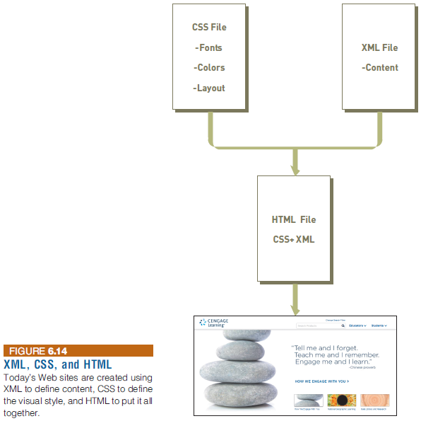
How the Web Works
Notes:
How the Web Works

Slide 45
Web Programming Languages
JavaScript
  A popular programming language for client-side applications
  Use to create Web pages that respond to user actions
Java
  An object-oriented programming language from Sun Microsystems based on C++
  Allows small programs (applets) to be embedded within an HTML document
Notes:
Web Programming Languages
JavaScript
A popular programming language for client-side applications
Use to create Web pages that respond to user actions
Java
An object-oriented programming language from Sun Microsystems based on C++
Allows small programs (applets) to be embedded within an HTML document

Slide 46
Web Programming Languages
Other client-side programming languages include:
  ASP.NET
  C
  C++
  Perl
  PHP
  Python
Notes:
Web Programming Languages
Other client-side programming languages include:
ASP.NET
C
C++
Perl
PHP
Python

Slide 47
Web Services
Standards and tools that streamline and simplify communication among Web sites
XML
  The key to Web services
  Used within a Web page to describe and transfer data between Web service applications
Amazon Web Services (AWS)
  Basic infrastructure that Amazon employs to make the contents of its online catalog available to other Web sites or software applications
Notes:
Web Services
Standards and tools that streamline and simplify communication among Web sites
XML
The key to Web services
Used within a Web page to describe and transfer data between Web service applications
Amazon Web Services (AWS)
Basic infrastructure that Amazon employs to make the contents of its online catalog available to other Web sites or software applications

Slide 48
Developing Web Content and Applications
Popular tools for creating Web pages and managing Web sites
  Adobe Dreamweaver, RapidWeaver (for Mac developers), and Nvu
Many products make it easy to develop Web content and interconnect Web services
  Example: Microsoft’s .NET platform which allows developers to use various programming languages to create and run programs
Notes:
Developing Web Content and Applications
Popular tools for creating Web pages and managing Web sites
Adobe Dreamweaver, RapidWeaver (for Mac developers), and Nvu
Many products make it easy to develop Web content and interconnect Web services
Example: Microsoft’s .NET platform which allows developers to use various programming languages to create and run programs

Slide 49
Internet and Web Applications
Web 2.0 and the Social Web
  Web 2.0: the Web as a computing platform that supports software applications and the sharing of information among users
  Social networking Web sites enable users to share information abut themselves and to find, meet, and converse with others
  Rich Internet applications are available that run in a Web browser and do not require local installation
Notes:
Internet and Web Applications
Web 2.0 and the Social Web
Web 2.0: the Web as a computing platform that supports software applications and the sharing of information among users
Social networking Web sites enable users to share information abut themselves and to find, meet, and converse with others
Rich Internet applications are available that run in a Web browser and do not require local installation

Slide 50
Internet Network Applications
      Discovery
      Communication
      Collaboration
      Selling
      Telecommuting

Slide 51

Discovery
  Broswer Competitioin
  Search engines
  Metasearch engines
  Discovery of material in foreign languages
  Portals
Notes:
Discovery allows users to browse and search data sources, in all topic areas,
on the Web.
Search engines are computer programs that search for specific information
by key words and report the results.
Metasearch engines search several engines at once and integrate the findings of
the various search engines to answer queries posted by users.

Slide 52
Portals - is a Web-based, personalized gateway to information and knowledge that provides relevant information from different IT systems and the Internet using advanced search and indexing techniques.
Commercial (public) portals- offer content for diverse communities and are most popular portals on the Internet.
Affinity portals support communities such as a hobby group or a political party.
Mobile portals are accessible from mobile devices
Corporate portals offer a personalized single point of access through a Web browser
Industry wide portals for entire industries.
Notes:
Portal is a Web-based, personalized gateway to information and knowledge that provides
relevant information from different IT systems and the Internet using advanced search and
indexing techniques.
Commercial (public) portals offer content for diverse communities and are most popular portals
on the Internet.
Affinity portals support communities such as a hobby group or a political party.
Mobile portals are accessible from mobile devices.
Corporate portals offer a personalized single point of access through a Web browser
Industrywide portals for entire industries.

Slide 53

Communication
Electronic mail (e-mail)
Web-based call centers (customer call center)
Electronic chat room
Voice (VOIP, SKYPE)
Unified (integrates voice, fax, chat, location, etc.)
© Mario S Ragma Jr/Age Fotostock America, Inc.
Notes:
Electronic mail (e-mail) is the largest-volume application running on the Internet.
Web-based call centers (customer call center) are services that provide effective personalize customer contact as an imporant part of Web-based customer support.
Electronic chat room is a virtual meeting place where groups of regulars come to “gab”.

Slide 54

Collaboration
Work group refers specifically to two or more individuals who act together to perform some task.
Virtual group (team) is when group members are in different locations.
Source: Howard Kingsnorth/The Image
Bank/Getty Images, Inc.
Notes:
Collaboration refers to efforts of two or more entities (individuals, teams, groups,
or organizations) who work together to accomplish certain tasks.
Work group refers specifically to two or more individuals who act together to perform some task.
Virtual group (team) is when group members are in different locations.

Slide 55
Collaboration (continued)
Virtual collaboration is the use of digital technologies that enable organizations or individuals to collaboratively plan, design, develop, manage and research products, services and innovative applications.
Workflow technologies facilitate the movement of information as it flows through the sequence of steps that make up an organization’s work procedures. Includes workflow management and workflow systems
Groupware refers to software products that support groups of people who share a common task or goal and who collaborate to accomplish it.
Electronic Tele/Videoconferencing
E-Learning and Distance Learning
Notes:
Virtual collaboration is the use of digital technologies that enable organizations or individuals to collaboratively plan, design, develop, manage and research products, services and innovative applications.
Workflow technologies facilitate the movement of information as it flows through the sequence of steps that make up an organization’s work procedures. Includes workflow management and workflow systems.
Groupware refers to software products that support groups of people who share a common task or goal and who collaborate to accomplish it.
Teleconferencing is the use of electronic communication that allows two or more people at different locations to hold a simultaneous conference.
Videoconference is when participants in one location can see participants at other locations and share data, voice, pictures, graphics and animation by electronic means.
Web conferencing is videoconferencing conducted over the Internet.
Real-time collaboration tools support synchronous communication of graphical and text-based information i.e. computer-based whiteboards.

Slide 56

Crowdsourcing refers to outsourcing a task to an undefined, generally large group of people in the form of an open call.
© YURI ACURS/Age Fotostock America, Inc.
Notes:
Crowdsourcing refers to outsourcing a task to an undefined, generally large group of people
in the form of an open call.

Slide 57
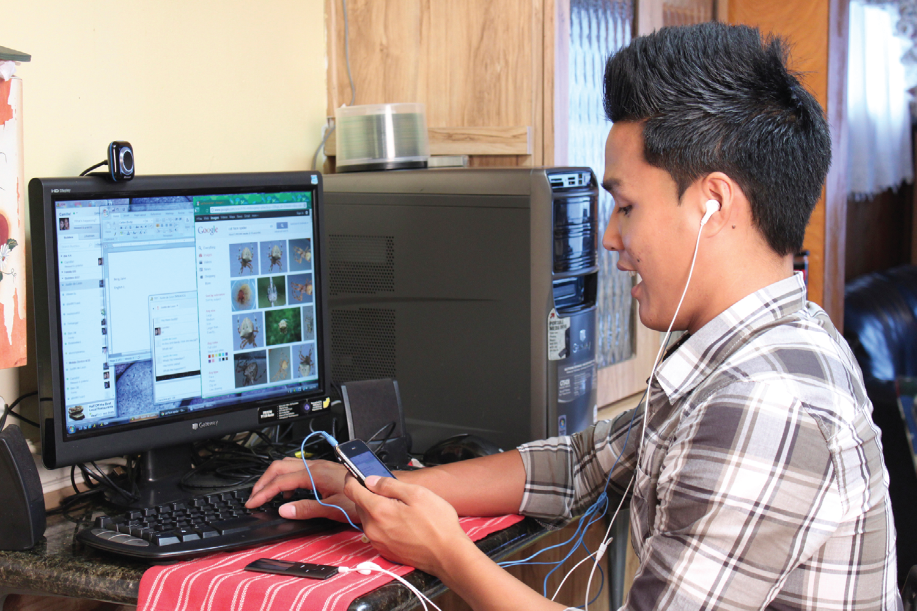
Telecommuting
Source: © Maria R.T. Deseo/PhotoEdit

Slide 58
Telecommuting Benefits
For Employees
  Reduced stress, improved family life
  Employment opportunities for single parents and persons with disabilities
For Employers
  Increased productivity
  Ability to retain skilled employees

Slide 59
Telecommuting Disadvantages
For Employees
  Feelings of isolation
  No workplace visibility
  Potential for slower promotions
For Employers
  Difficulties in supervising work
  Potential information security problems
  Additional training costs

Slide 60
Intranets and Extranets
Intranet: an internal corporate network built using Internet and World Wide Web standards and technologies
Extranet: a network based on Web technologies that links resources of a company’s intranet with its customers, suppliers, or other business partners
Virtual private network (VPN): A secure connection between two points on the Internet
Tunneling: the process by which VPNs transfer information by encapsulating traffic in IP packets over the Internet
Notes:
Intranets and Extranets
Intranet: an internal corporate network built using Internet and World Wide Web standards and technologies
Extranet: a network based on Web technologies that links resources of a company’s intranet with its customers, suppliers, or other business partners
Virtual private network (VPN): A secure connection between two points on the Internet
Tunneling: the process by which VPNs transfer information by encapsulating traffic in IP packets over the Internet

Slide 61
The Internet of Things (IoT)
Internet of Things (IoT)
  A network of physical objects (things) embedded with sensors, processors, software, and network connectivity capability to enable them to exchange data with the manufacturer of the device, device operators, and other connected devices
Sensor: a device that is capable of sensing something about its surroundings such as
  Pressure, temperature, humidity, pH level, motion, vibration, or level of light
Notes:
The Internet of Things (IoT)
Internet of Things (IoT)
A network of physical objects (things) embedded with sensors, processors, software, and network connectivity capability to enable them to exchange data with the manufacturer of the device, device operators, and other connected devices
Sensor: a device that is capable of sensing something about its surroundings such as
Pressure, temperature, humidity, pH level, motion, vibration, or level of light

Slide 62
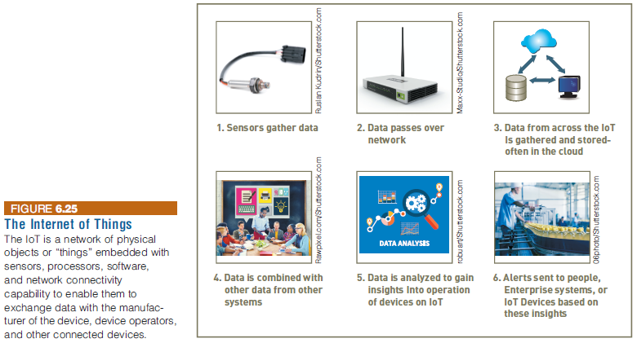
The Internet of Things (IoT)
Notes:
The Internet of Things (IoT)

Slide 63
The Internet of Things (IoT)
Examples of using sensors and the IoT to monitor and control key operational activities:
  Asset monitoring
  Construction
  Agriculture
  Manufacturing
  Monitoring parking spaces
  Predictive Maintenance
  Retailing
  Traffic monitoring
Notes:
The Internet of Things (IoT)
Examples of using sensors and the IoT to monitor and control key operational activities:
Asset monitoring
Construction
Agriculture
Manufacturing
Monitoring parking spaces
Predictive Maintenance
Retailing
Traffic monitoring

Slide 64
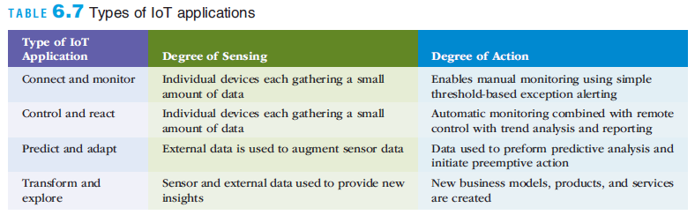
The Internet of Things (IoT)
Notes:
The Internet of Things (IoT)

Slide 65
Cloud Computing
Cloud computing: a computing environment in which software and storage are provided as an Internet service and accessed with a Web browser
Advantages to businesses:
  Businesses can save on system design, installation, and maintenance
  Increased efficiency and reduce the costs of new product and service launches
  Employees can access corporate systems from any Internet-connected computer
Notes:
Cloud Computing
Cloud computing: a computing environment in which software and storage are provided as an Internet service and accessed with a Web browser
Advantages to businesses:
Businesses can save on system design, installation, and maintenance
Increased efficiency and reduce the costs of new product and service launches
Employees can access corporate systems from any Internet-connected computer

Slide 66
Public Cloud Computing
A service provider owns and manages the infrastructure with cloud user organizations (tenants) accessing slices of shared hardware resource via the Internet
Public cloud computing can be a faster, cheaper, and more agile approach to building and managing your own IT infrastructure
However, data security is a key concern
  Because when using a public cloud computing service, you are relying on someone else to safeguard your data
Notes:
Public Cloud Computing
A service provider owns and manages the infrastructure with cloud user organizations (tenants) accessing slices of shared hardware resource via the Internet
Public cloud computing can be a faster, cheaper, and more agile approach to building and managing your own IT infrastructure
However, data security is a key concern
Because when using a public cloud computing service, you are relying on someone else to safeguard your data

Slide 67
Public Cloud Computing
Cloud computing can be divided into three main types of services:
  Infrastructure as a service (IaaS)
  Software as a service (SaaS)
  Platform as a Service (PaaS)
Notes:
Public Cloud Computing
Cloud computing can be divided into three main types of services:
Infrastructure as a service (IaaS)
Software as a service (SaaS)
Platform as a Service (PaaS)

Slide 68
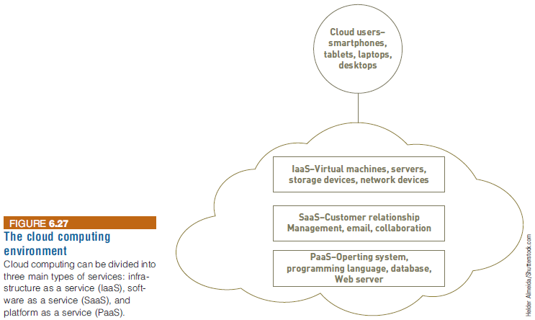
Public Cloud Computing
Notes:
Public Cloud Computing

Slide 69
Private Cloud Computing
Private cloud environment
  A single tenant cloud
  Organization often implement due to concerns that their data will not be secure in a public cloud
  Can be divided into two types:
    On-premise private cloud
    Service provider managed private cloud
Notes:
Private Cloud Computing
Private cloud environment
A single tenant cloud
Organization often implement due to concerns that their data will not be secure in a public cloud
Can be divided into two types:
On-premise private cloud
Service provider managed private cloud

Slide 70
Hybrid Cloud Computing
Hybrid cloud
  Composed of both private and public clouds integrated through networking
  Organizations typically use the public cloud to run applications with less sensitive security requirements
  Runs more critical applications on the private portion of the hybrid cloud
Notes:
Hybrid Cloud Computing
Hybrid cloud
Composed of both private and public clouds integrated through networking
Organizations typically use the public cloud to run applications with less sensitive security requirements
Runs more critical applications on the private portion of the hybrid cloud

Slide 71
Autonomic Computing
Autonomic computing
  The ability of IT system to manage themselves and adapt to changes in the computing environment, business policies, and operating objectives
The goal of autonomic computing:
  To create complex systems that run themselves, while keeping the system’s complexity invisible to the end user
Addresses four key functions:
  Self-configuring, self-healing, self-optimizing, and self-protecting
Notes:
Autonomic Computing
Autonomic computing
The ability of IT system to manage themselves and adapt to changes in the computing environment, business policies, and operating objectives
The goal of autonomic computing:
To create complex systems that run themselves, while keeping the system’s complexity invisible to the end user
Addresses four key functions:
Self-configuring, self-healing, self-optimizing, and self-protecting

Slide 72
Summary
A network has many fundamental components, which enable people to meet personal and organizational objectives
Together, the Internet and the World Wide Web provide a highly effective infrastructure for delivering and accessing information and services
Organizations are using the Internet of Things (IoT) to capture and analyze streams of sensor data to detect patterns and anomalies in order to have a considerable impact on the event outcome
Cloud computing provides access to state-of-the-art technology at a fraction of the cost of ownership and without the lengthy delays that can occur when an organization tries to acquire its own resources
Notes:
Summary
A network has many fundamental components, which enable people to meet personal and organizational objectives
Together, the Internet and the World Wide Web provide a highly effective infrastructure for delivering and accessing information and services
Organizations are using the Internet of Things (IoT) to capture and analyze streams of sensor data to detect patterns and anomalies in order to have a considerable impact on the event outcome
Cloud computing provides access to state-of-the-art technology at a fraction of the cost of ownership and without the lengthy delays that can occur when an organization tries to acquire its own resources

