Slide 1
TECHNOLOGY GUIDE TWO
Software

Slide 2
Objectives
After completing this chapter, you will be able to (cont’d):
Discuss how application software can support personal, workgroup, and enterprise business objectives
Identify three basic approaches to developing application software and discuss the pros and cons of each
Identify programming languages in use today
Identify several key software issues and trends that have an impact on organizations and individuals
Notes:
Objectives
After completing this chapter, you will be able to (cont’d):
Discuss how application software can support personal, workgroup, and enterprise business objectives
Identify three basic approaches to developing application software and discuss the pros and cons of each
Identify programming languages in use today
Identify several key software issues and trends that have an impact on organizations and individuals

Slide 3
An Overview of Software
Software
Consists of computer programs that control the workings of computer hardware
Software can be divided into two types:
System software – includes operating system (OS), utilities, and middleware that coordinate the activities and functions of the hardware and other programs
Application software – programs that help users solve particular computing problems
Notes:
An Overview of Software
Software
Consists of computer programs that control the workings of computer hardware
Software can be divided into two types:
System software – includes operating system (OS), utilities, and middleware that coordinate the activities and functions of the hardware and other programs
Application software – programs that help users solve particular computing problems

Slide 4
Software Sphere of Influence
Sphere of influence: the scope of problems and opportunities addressed by a particular organization
Personal sphere of influence
Serves the needs of an individual user
Personal productivity software
Enables users to improve their personal effectiveness
Notes:
Software Sphere of Influence
Sphere of influence: the scope of problems and opportunities addressed by a particular organization
Personal sphere of influence
Serves the needs of an individual user
Personal productivity software
Enables users to improve their personal effectiveness

Slide 5
Software Sphere of Influence
Workgroup: two or more people working together to achieve a common goal
Workgroup sphere of influence
Helps workgroup members attain their common goals
Enterprise sphere of influence
Serves the needs of the firm in its interaction with its environment
Notes:
Software Sphere of Influence
Workgroup: two or more people working together to achieve a common goal
Workgroup sphere of influence
Helps workgroup members attain their common goals
Enterprise sphere of influence
Serves the needs of the firm in its interaction with its environment

Slide 6
Software Sphere of Influence
Notes:
Software Sphere of Influence

Slide 7
Introduction to Software
Software a set of computer programs that enable the hardware to process data.
Computer program The sequences of instructions for the computer, which comprise software.
Stored program concept Modern hardware architecture in which stored software programs are accessed and their instructions are executed (followed) in the computer’s CPU, one after another.
Documentation
© Karsten Ehlers/Age Fotostock America, Inc.
Notes:
Software: a set of computer programs that enable the hardware to process data.
Computer program. The sequences of instructions for the computer, which comprise software.
Stored program concept. Modern hardware architecture in which stored software programs are accessed and their instructions are executed (followed) in the computer’s CPU, one after another.
Documentation. Written description of the functions of a software program.

Slide 8
Software Issues
Software Defects – code that is inefficient, poorly designed, or riddled with errors
Software Licensing- either direct purchase for single/multi use or subscription
Open Systems – a contemporary approach that allows all application software to work on all platforms
Open Source Software source code available to developers at no cost
© Karsten Ehlers/Age Fotostock America, Inc.

Slide 9
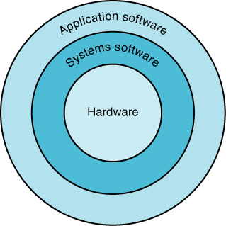
Types of Software
System software The class of computer instruction that serve primarily as an intermediary between computer hardware and application programs; provides important self-regulatory functions for computer systems.
Application software The class of computer instructions that direct a computer system to perform specific processing activities and provide functionality for users.
Notes:
System software: The class of computer instruction that serve primarily as an intermediary between computer hardware and application programs; provides important self-regulatory functions for computer systems.
Application software: The class of computer instructions that direct a computer system to perform specific processing activities and provide functionality for users.

Slide 10
Systems Software
Operating Systems The main system control program, which supervises the overall operations of the computer, allocates CPU time and main memory to programs, and provides an interface between the user and the hardware.
Notes:
Operating system: The main system control program, which supervises the overall operations of the computer, allocates CPU time and main memory to programs, and provides an interface between the user and the hardware.

Slide 11
Functions of the Operating System
Graphical User Interface system software that allows users to have direct control of visible objects (such as icons) and actions, which replace command syntax.
Social Interface A user interface that guides the user through computer applications by using cartoonlike characters, graphics, animation, and voice commands.
See this video about an enhanced interface
Notes:
Graphical user interface (GUI): system software that allows users to have direct control of visible objects (such as icons) and actions, which replace command syntax.
Social interface: A user interface that guides the user through computer applications by using cartoonlike characters, graphics, animation, and voice commands.

Slide 12
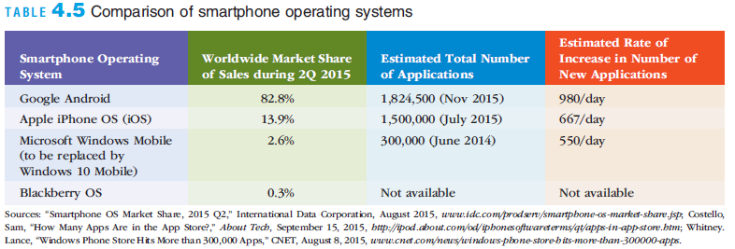
Mobile Operating Systems
Smartphones employ full-fledged computer OSs
Google Android
Apple iOS
Microsoft Windows Phone
Notes:
Mobile Operating Systems
Smartphones employ full-fledged computer OSs
Google Android
Apple iOS
Microsoft Windows Phone

Slide 13
Embedded Operating Systems
Embedded system: a computer system (including a processor) implanted in and dedicated to the control of another device
Popular OSs for embedded systems
Windows embedded
Proprietary Linux-based systems: Sony’s Wii; and OSs in e-book readers, ATMs, smartphones, networking devices, and media players
Notes:
Embedded Operating Systems
Embedded system: a computer system (including a processor) implanted in and dedicated to the control of another device
Popular OSs for embedded systems
Windows embedded
Proprietary Linux-based systems: Sony’s Wii; and OSs in e-book readers, ATMs, smartphones, networking devices, and media players

Slide 14
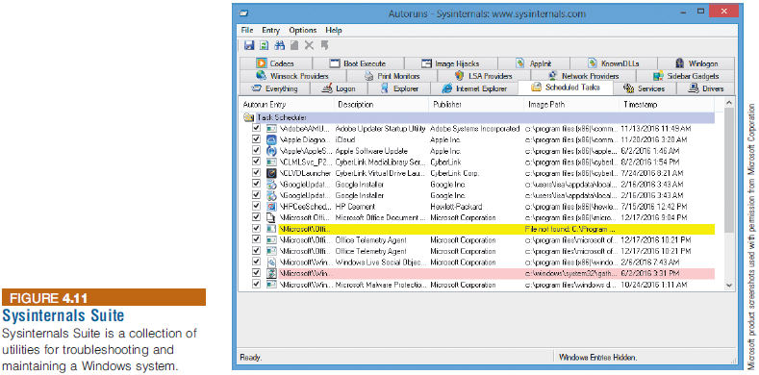
Utility Programs
Utility program: a program that helps to perform maintenance or correct problems with a system
Notes:
Utility Programs
Utility program: a program that helps to perform maintenance or correct problems with a system

Slide 15
Utility Programs
Hardware utilities
Security utilities
File-compression utilities
Spam-filtering utilities
Network and Internet utilities
Server and mainframe utilities
Other utilities: mobile device management (MDM), defraggers, system cleaners, etc.
Notes:
Utility Programs
Hardware utilities
Security utilities
File-compression utilities
Spam-filtering utilities
Network and Internet utilities
Server and mainframe utilities
Other utilities: mobile device management (MDM), defraggers, system cleaners, etc.

Slide 16
Middleware
Middleware
Software that allows different systems to communicate and exchange data
Can also be used as an interface between the Internet and private corporate systems
Enterprise application integration (EAI): tying together of disparate applications
Service-oriented architecture (SOA): a software design approach using modules to provide specific functions as services to other applications
Notes:
Middleware
Middleware
Software that allows different systems to communicate and exchange data
Can also be used as an interface between the Internet and private corporate systems
Enterprise application integration (EAI): tying together of disparate applications
Service-oriented architecture (SOA): a software design approach using modules to provide specific functions as services to other applications

Slide 17
Application Software

Slide 18
Application Software
Application programs’ primary function
To apply the power of the computer to enable people, workgroups, and the entire enterprise to solve problems and perform specific tasks
Many software options are available
Software can be selected that best meets the needs of the individual, workgroup, or enterprise
Notes:
Application Software
Application programs’ primary function
To apply the power of the computer to enable people, workgroups, and the entire enterprise to solve problems and perform specific tasks
Many software options are available
Software can be selected that best meets the needs of the individual, workgroup, or enterprise

Slide 19
Overview of Application Software
Proprietary software: a one-of-a-kind program for a specific application
Owned by the company, organization, or person that uses it
Off-the-shelf software: software mass-produced by software vendors
Addresses needs that are common across businesses, organizations, or individuals
Notes:
Overview of Application Software
Proprietary software: a one-of-a-kind program for a specific application
Owned by the company, organization, or person that uses it
Off-the-shelf software: software mass-produced by software vendors
Addresses needs that are common across businesses, organizations, or individuals

Slide 20
Overview of Application Software
Notes:
Overview of Application Software

Slide 21
Overview of Application Software
Cloud service providers
Companies that provide software, data storage, and other services via the Internet
Software as a service (SaaS)
Businesses subscribe to Web-delivered business application software
Vendors include Oracle, SAP, NetSuite, Salesforce, and Google
Amazon is considered one of the leading public cloud service providers because of Amazon Web Services (AWS) platform
Notes:
Overview of Application Software
Cloud service providers
Companies that provide software, data storage, and other services via the Internet
Software as a service (SaaS)
Businesses subscribe to Web-delivered business application software
Vendors include Oracle, SAP, NetSuite, Salesforce, and Google
Amazon is considered one of the leading public cloud service providers because of Amazon Web Services (AWS) platform

Slide 22
Personal Application Software
Word Processing
Create, edit, and print text documents
Spreadsheet Analysis
Perform statistical, financial, logical, database, graphics, and date and time calculations using a wide range of built-in functions
Database Applications
Store, manipulate, and retrieve data
Notes:
Personal Application Software
Word Processing
Create, edit, and print text documents
Spreadsheet Analysis
Perform statistical, financial, logical, database, graphics, and date and time calculations using a wide range of built-in functions
Database Applications
Store, manipulate, and retrieve data

Slide 23
Personal Application Software
Notes:
Personal Application Software

Slide 24
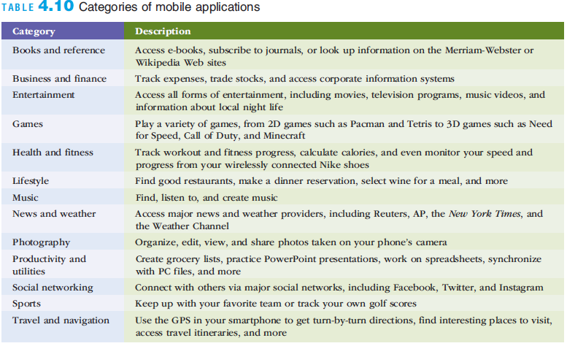
Personal Application Software
Notes:
Personal Application Software

Slide 25
Workgroup Application Software
Workgroup application software
Designed to support teamwork with people in the same location or dispersed around the world
Groupware helps groups of people work together more effectively
Also called collaborative software
Notes:
Workgroup Application Software
Workgroup application software
Designed to support teamwork with people in the same location or dispersed around the world
Groupware helps groups of people work together more effectively
Also called collaborative software

Slide 26
Enterprise Application Software
Enterprise application software
Software that benefits an entire organization
Helps managers and workers stay connected
Cost, installation and ability to integrate with other software are major considerations in selecting this software
Usability on smartphones and mobile devices is also an important factor
Notes:
Enterprise Application Software
Enterprise application software
Software that benefits an entire organization
Helps managers and workers stay connected
Cost, installation and ability to integrate with other software are major considerations in selecting this software
Usability on smartphones and mobile devices is also an important factor

Slide 27
Enterprise Application Software
Notes:
Enterprise Application Software

Slide 28
Software Bugs
Software bug: a defect in a program that keeps it from performing as it should
Tips for reducing the impact of software bugs
Register all software
Check read-me files for solutions to known problems
Access the support area of the manufacturer’s Web site for patches
Install the latest software updates
Make sure you can recreate the bug and then call the manufacturer’s tech support line
Notes:
Software Bugs
Software bug: a defect in a program that keeps it from performing as it should
Tips for reducing the impact of software bugs
Register all software
Check read-me files for solutions to known problems
Access the support area of the manufacturer’s Web site for patches
Install the latest software updates
Make sure you can recreate the bug and then call the manufacturer’s tech support line

Slide 29
Copyrights and Licenses
Most software products are protected by law using copyright or licensing provisions:
In some cases, you are given unlimited use of software on one or two computers
In other cases, you pay for your usage; if you use the software more, you pay more
Some software now requires that you register or activate it before it can be fully used
Single-user license
Permits you to install the software on one or more computers, used by one person
Notes:
Copyrights and Licenses
Most software products are protected by law using copyright or licensing provisions:
In some cases, you are given unlimited use of software on one or two computers
In other cases, you pay for your usage; if you use the software more, you pay more
Some software now requires that you register or activate it before it can be fully used
Single-user license
Permits you to install the software on one or more computers, used by one person

Slide 30
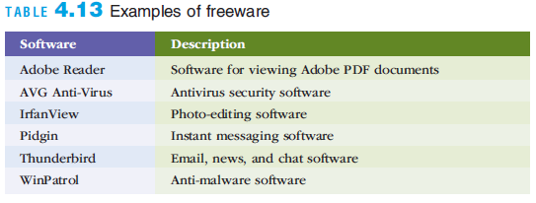
Freeware and Open-Source Software
Freeware: software that is made available to the public for free
Open-source software: distributed, typically for free, with the source code
Notes:
Freeware and Open-Source Software
Freeware: software that is made available to the public for free
Open-source software: distributed, typically for free, with the source code

Slide 31
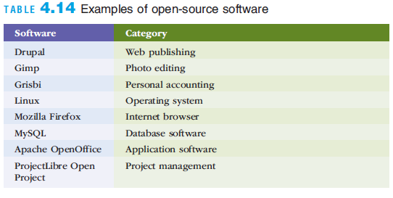
Freeware and Open-Source Software
Notes:
Freeware and Open-Source Software

Slide 32
Freeware and Open-Source Software
GNU General Public License (GPL) grants you the right to:
Run the program for any purpose
Study how the program works and adapt it to your needs
Redistribute copies so you can help others
Improve the program and release improvements to the public
Notes:
Freeware and Open-Source Software
GNU General Public License (GPL) grants you the right to:
Run the program for any purpose
Study how the program works and adapt it to your needs
Redistribute copies so you can help others
Improve the program and release improvements to the public

Slide 33
Software Upgrades
Software companies revise their programs and sell new versions periodically
Software upgrades vary widely in the benefits that they provide
Developing an upgrading strategy is important for many businesses
Helps to ensure that updated software is more stable with fewer errors and problems
Notes:
Software Upgrades
Software companies revise their programs and sell new versions periodically
Software upgrades vary widely in the benefits that they provide
Developing an upgrading strategy is important for many businesses
Helps to ensure that updated software is more stable with fewer errors and problems

Slide 34
Global Software Support
Supporting local operations is one of the biggest challenges IS teams face when putting together standardized, company-wide systems
Outsourcing global support to one or more third-party distributors is gaining acceptance
Notes:
Global Software Support
Supporting local operations is one of the biggest challenges IS teams face when putting together standardized, company-wide systems
Outsourcing global support to one or more third-party distributors is gaining acceptance

Slide 35
Summary
Software is valuable in helping individuals, workgroups, and entire enterprises achieve their goals
The OS is called the “soul of the computer” because it controls how you enter data into your computer, perform meaningful work, and display results
Organizations typically use off-the-shelf software to meet common business needs and proprietary software to meet unique business needs
The software industry continues to undergo constant change; computer users need to be aware of recent trends and issues in the software industry to be effective in their business and personal life
Notes:
Summary
Software is valuable in helping individuals, workgroups, and entire enterprises achieve their goals
The OS is called the “soul of the computer” because it controls how you enter data into your computer, perform meaningful work, and display results
Organizations typically use off-the-shelf software to meet common business needs and proprietary software to meet unique business needs
The software industry continues to undergo constant change; computer users need to be aware of recent trends and issues in the software industry to be effective in their business and personal life

