Slide 1
Welcome to ITMG100!!

Slide 2
Agenda
Syllabus Review
My Educator
Gmetrix
GUAC
About me
ITK ACT

Slide 3
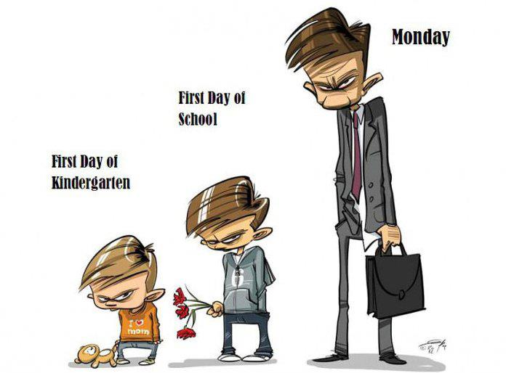
ITMG 100
Carl M. Rebman, Jr. Ph.D
Phone: 619-260-4135
E-mail: carlr@sandiego.edu
Office: Olin 127
Office Hours: T 1:45-2:15 pm &
4:00- 5:00 pm
W 12:00- 2:00pm
TH 1:45-2:15 pm &
4:00- 5:00 pm

Slide 4
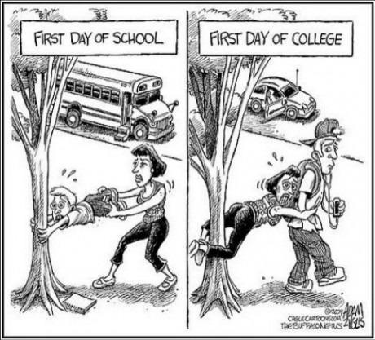
Course Breakdown
8 weeks of Excel- Excel Certified through Microsoft
5 weeks of Theory about Information Systems/Technology Theory…. What, How, When, Why
5 weeks of Access (in conjunction with Theory)

Slide 5
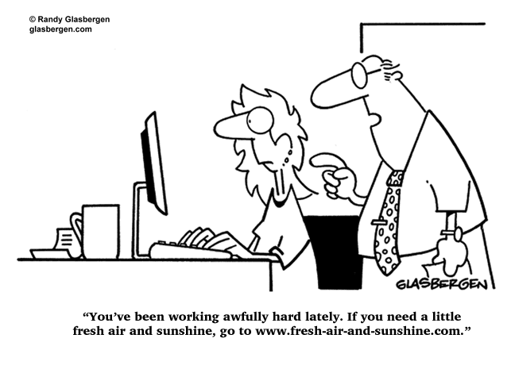
Software Application
You will learn
Excel- MOS certified
Access
Microsoft Office homework is done through
MyEducator.com
Gmetrix.com

Slide 6
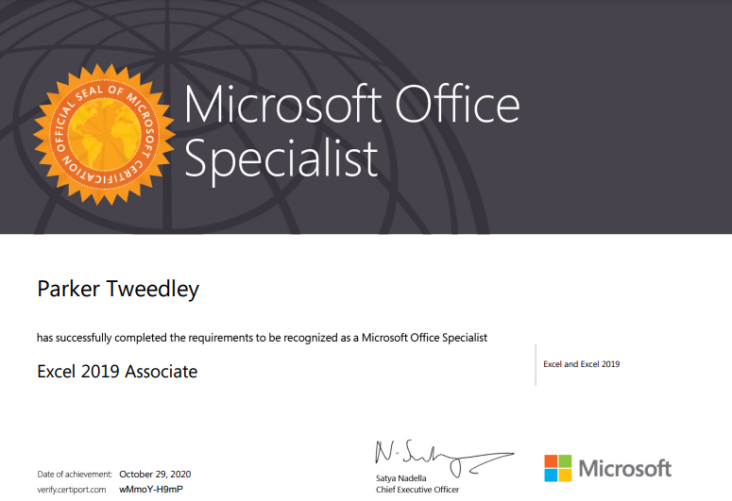

Slide 7
Excel Certification
Microsoft Office Specialist (MOS)
Demonstrate that you have the skills needed to get the most out of Microsoft Office by earning a Microsoft Office Specialist certification in a specific Office program.

Slide 8
Get Certified
You need a 700 to pass, however a 700 is a 70%
MOS Retake Exam:
There is NO retake after the exam is passed
If you do not pass the MOS exam on your first attempt you can retake the exam.
If you pass the exam on your second attempt, your graded score will equal the score obtained on your second attempt up to a maximum of 825 points.

Slide 9
Excel Certification
Microsoft Office Specialist- MOS Excel Exam
Excel Exam- included in course fee
Retake offered at no charge
Disability Services for Excel Certification exam
Students that are in enrolled at Disability Services will need to complete this form (www.certiport.com/ada). Please provide completed form to Disability Services no later than three weeks prior to the test date

Slide 10
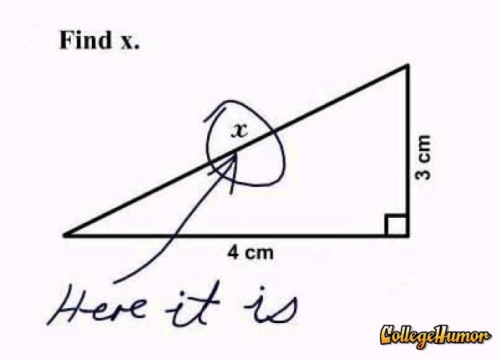
Excel Exam Dates
Excel Exam
November 16th
Retake
November 21st

Slide 11
Lecture and labs
Lecture book- Applied Business Computing Concepts By Matt McCarthy
Lab Book My Educator Prometheus Series Micrsoft Excel and Access
Here are the linx
(next two slides)
--- and (they are bundled) ----
Available at www.myeducator.com

Slide 12
Link for section 3
For students in Section 3:
Copy and paste the following link into your internet browser: https://app.myeducator.com/s/2q54qhYUO01/2q54njcEy01/
Click on the “Checkout” button. Payment information will be needed ($99.99).
You will be asked to create an account with MyEducator if you do not already have one. If you already have an account, please just log in.
Once your account is created and payment is made, you will be directed to the course material.

Slide 13
Section 4
For students in Section 4:
Copy and paste the following link into your internet browser: https://app.myeducator.com/s/2q55cz0Jc01/2q55atEdi01/
Click on the “Checkout” button. Payment information will be needed ($99.99).
You will be asked to create an account with MyEducator if you do not already have one. If you already have an account, please just log in.
Once your account is created and payment is made, you will be directed to the course material.

Slide 14
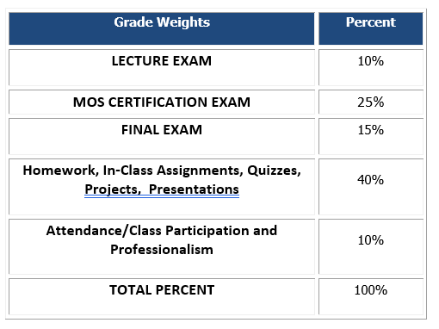
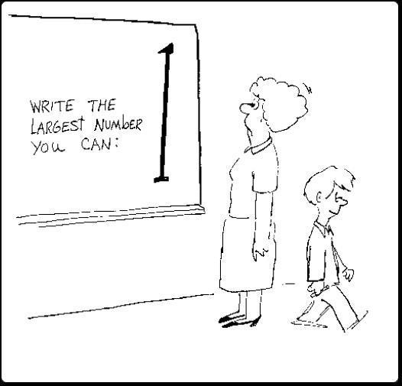
Course Grade

Slide 15
Disability Services
Disability Services- In order to protect student privacy there is to be no discussion whatsoever pertaining to your personal disability accommodations.
Discussions will be done via email or in my office hours.
You will need to make accommodations at least a week in advance for any special testing arrangements.

Slide 16
Late Work
Homework is usually due by Friday at 11:59 pm. Check Blackboard for due dates.
Late assignments will be accepted for up to three-quarters-credit (75% or 25% OFF) on TAKE-HOME ASSIGNMENTS.
You have UP TO ONE WEEK AFTER THE ASSIGNMENT WAS DUE TO TURN IN LATE WORK AND YOU MUST EMAIL ME WHEN YOU HAVE SUBMITTED YOUR LATE ASSIGNMENT.
There are no MAKE UPS or LATE ASSIGNMENTS for IN-CLASS ASSIGNMENTS

Slide 17
LMS
https://ole.sandiego.edu/
Simulcast http://carl.sandiego.edu/itmg100/default.asp
Guacmole (USD online computer lab) https://guacamole.sandiego.edu/guacamole/#/
Myeducator
Requires a link that you will be given in class
www.gmetrix.com
Requires a code that will be given to you today after you create your account
Certiport www.Certiport.com (company that certifies you as an MS Excel Specialist)
Your do not need a code just need to create your account (NOW!)

Slide 18
Tips for Success
Show up and do the work! Don’t get behind
The best way to learn Excel – is to use Excel a lot!
Do the practice assessments and take all Gmetrix practice exams.
Study for the GMetrix like it is the real thing!
Ask for help if you need it
ITS help desk on campus: 619-260-7900
Blackboard: Phone (619) 260-7900 help@sandiego.edu
Use the buddy system
Time manage the class!

Slide 19
College Tips…
Time Manage
Let common sense rule your life
Compartmentalize and Prioritize
Develop networking skills and a network
Don’t make a “mountain out of a mole hill”

Slide 20
Other links and class survey
LINK FOR MS OFFICE
Use this link to obtain your own personal copy of MS office (both MAC and PC) you just enter your USD email to verify
https://products.office.com/en-us/student/office-in-education
LINK TO DOWNLOAD GMETRIX
http://www.gmetrix.net/download
LINK FOR COMPUTING SURVEY
LINK FOR EXCEL SURVEY

Slide 21
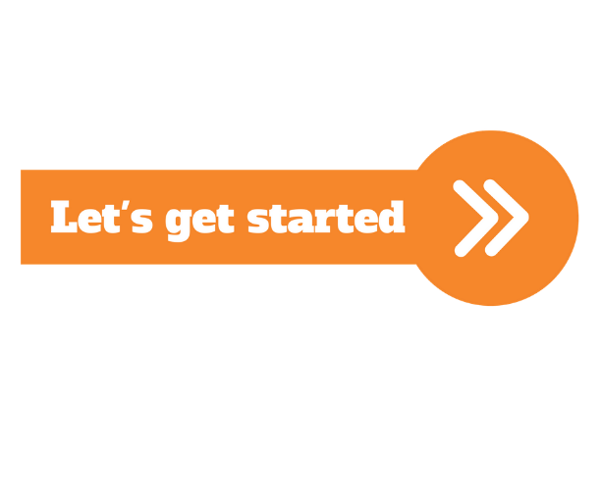
Here’s to an AWESOME SEMESTER!

Slide 22
The ITK fun Activity
IN THE KNOW ACTIVITY Groups of Three – 3 roles (Interviewer, interviewee, and recorder) each takes turn Ask the following questions of each person: Name and Hometown
PICK TWO FROM THIS LIST 1. Are you more like your mom or your dad? 2. What is your favorite day of the year? 3. What’s your favorite planet in our solar system? 4. Who would you have dinner with if you could have it with any person, living or dead? 5. If you could instantly learn another language without studying it, which one would you pick? 6. If you could go back in time, but couldn’t change anything, what time would you go to? 7. What fictional character would you like to meet? 8. What acquired skill have you always wanted to learn? AND ONE FROM THIS SET LIST You can only watch one movie and you can only pick ONE of out the sets provided. Dirty Dancing or The Notebook Shawshank Redemption or The Godfather Titanic or A Star is Born

