Slide 1
CHAPTER 12 and supp
Information Systems within the Organization

Slide 2
OUTLINE
Core functional business behaviors
Transaction Processing Systems
Functional Area Information Systems
Enterprise Resource Planning Systems
Reports

Slide 3
10.2 Functional Area Information Systems
Functional Area Information Systems are designed to support a functional area by increasing its internal effectiveness and efficiency in the following areas:
Accounting
Finance
Marketing
Operations (POM)
Human Resources Management
Notes:
Functional area information systems provide information mainly to lower- and
middle-level managers in the functional areas via a variety of reports.

Slide 4
Core Business Departments
Accounting Department
Human Resource Department
Marketing Department
Research & Development Department
Production Department

Slide 5
Accounting/Finance
Measures and provides financial information about an organization for decision makers, investors, and taxing authorities.
Accounting is often referred to as the language, or mathematics, of business.
Finance looks at the how the organization is utilizing its capital for growth and debt management

Slide 6
Human Resources
People are the most important asset of a company
Traditional roles of human resource departments involve
recruiting and hiring new employees,
evaluating and managing personnel,
tracking personnel data,
administering payroll and pensions, and
providing advice to employees regarding work-related issues.

Slide 7
Marketing
Marketing is the promotion of a business’ products and focus on customers with responsibilities of advertising and branding.
Four Ps of Marketing
Product
Pricing
Promotion
Placement

Slide 8
Marketing
Customer Relationship Management
Sales Force Automation
Email and Automated Response
Loyalty programs
UP/Cross/Bundling

Slide 9
Research and Development
Main focus of R&D is to keep the business growing
Consider if their ideas are feasible and if they can be implemented.

Slide 10
Production
Responsible for providing goods and services to be sold
Responsible for focusing on cost effective ways to produce goods and services

Slide 11
Productions/Operations Management
In-house Logistics and Materials Management

Slide 12
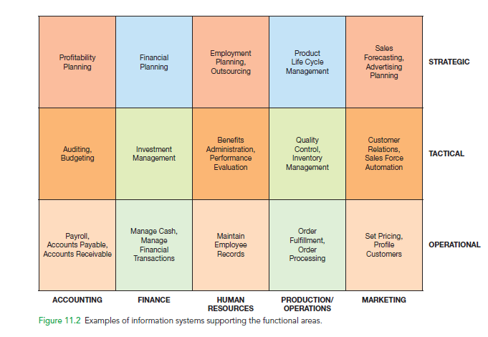
Examples of Information Systems Supporting the Functional Areas

Slide 13
Information Systems Collaboration
IS Collaboration is two or more people using information systems working towards a common goal
IS collaboration tools
Instant messaging
Email
Video conferencing
Project management software
Knowledge Management Systems (KMS)
Online Application Systems (Google Docs, etc.)

Slide 14
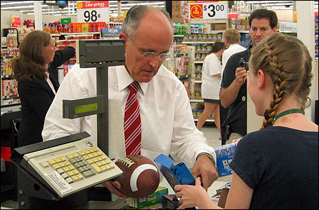
10.1 Transaction Processing Systems (TPS)
Transaction processing system (TPS)
monitors, collects, stores and processes data generated from all business transactions.
Business Transaction
Product manufactured
Service sold
Person hired
Payroll check generated
© Stockbroker/Age Fotostock America, Inc.
Barcode scanner is an example of source data automation- involves collecting data from sensors and entering the data directly into a computer without human intervention
Notes:
Transaction processing system (TPS) monitors, collects, stores and processes data
generated from all business transactions.
Batch Processing is when the firm collects data from transactions as they occur, placing
them in groups or batches, then prepares and processes the batches periodically (say,
every night).
Online Transaction Processing (OLTP) is when business transactions are processed
online as soon as they occur.
Source data automation involves collecting data from sensors (e.g., barcode scanners)
and entering the data directly into a computer without human intervention.

Slide 15
How Transaction Processing Systems Manage Data

Slide 16
10.1 Transaction Processing Systems (TPS)
Batch Processing
is when the firm collects data from transactions as they occur, placing them in groups or batches, then prepares and processes the batches periodically (say, every night)
Online Transaction Processing (OLTP)
is when business transactions are processed online as soon as they occur

Slide 17
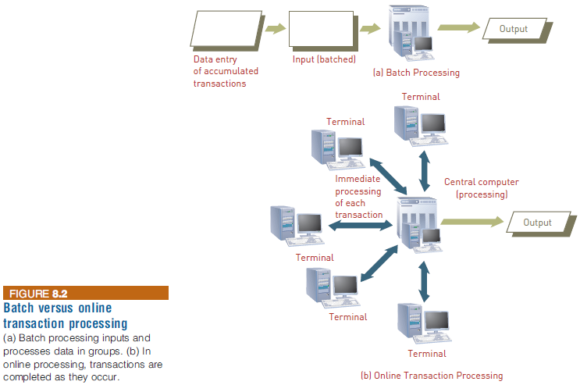
Traditional Transaction Processing Methods and Objectives
Notes:
Traditional Transaction Processing Methods and Objectives

Slide 18
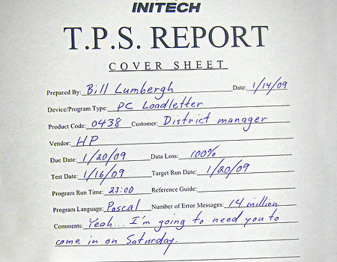
10.1 Transaction Processing Systems (TPS)
Complexities of Transactional data:
Multiple persons access the database at the same time
Transactions involves more than one computer
Transaction must be reversible
Preserve audit trail
Key features of TPS
Dependability
Reliability
Processing capacity
Notes:
Transaction processing system (TPS) monitors, collects, stores and processes data
generated from all business transactions.
Batch Processing is when the firm collects data from transactions as they occur, placing
them in groups or batches, then prepares and processes the batches periodically (say,
every night).
Online Transaction Processing (OLTP) is when business transactions are processed
online as soon as they occur.
Source data automation involves collecting data from sensors (e.g., barcode scanners)
and entering the data directly into a computer without human intervention.

Slide 19
Traditional Transaction Processing Methods and Objectives
Organizations expect their TPSs to:
Capture, process, and update databases
Ensure that the data is processed accurately and completely
Avoid processing fraudulent transactions
Produce timely user responses and reports
Reduce clerical and other labor requirements
Help improve customer service
Achieve competitive advantage
Notes:
Traditional Transaction Processing Methods and Objectives
Organizations expect their TPSs to:
Capture, process, and update databases
Ensure that the data is processed accurately and completely
Avoid processing fraudulent transactions
Produce timely user responses and reports
Reduce clerical and other labor requirements
Help improve customer service
Achieve competitive advantage

Slide 20
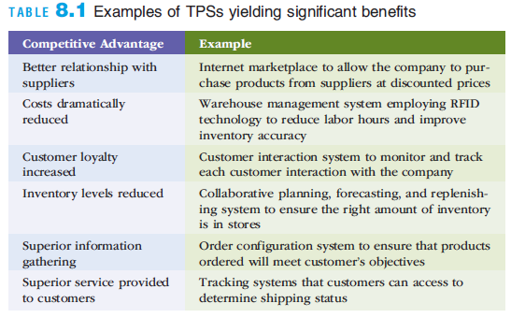
Traditional Transaction Processing Methods and Objectives
Notes:
Traditional Transaction Processing Methods and Objectives

Slide 21
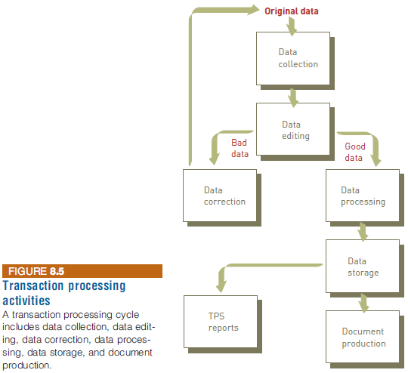
Transaction Processing Activities
The transaction processing cycle
Data collection
Data editing
Data correction
Data manipulation
Data storage
Document production
Notes:
Transaction Processing Activities
The transaction processing cycle
Data collection
Data editing
Data correction
Data manipulation
Data storage
Document production

Slide 22
Data Collection
Capturing and gathering all data necessary to complete the processing of transactions
Data collection can be:
Manual
Automated via special input devices
Source data automation
Involves capturing data at its source and recording it accurately in a timely fashion with minimal manual effort and in an electronic or digital form so that it can be directly entered into the computer
Example: a scanner reading a UPC code
Cloud-based POS systems provide a range of capabilities
Including advanced integration with digital loyalty programs, various accounting tools, and the ability to generate gift cards and coupons
Notes:
Data Collection
Capturing and gathering all data necessary to complete the processing of transactions
Data collection can be:
Manual
Automated via special input devices
Source data automation
Involves capturing data at its source and recording it accurately in a timely fashion with minimal manual effort and in an electronic or digital form so that it can be directly entered into the computer
Example: a scanner reading a UPC code
Cloud-based POS systems provide a range of capabilities
Including advanced integration with digital loyalty programs, various accounting tools, and the ability to generate gift cards and coupons

Slide 23
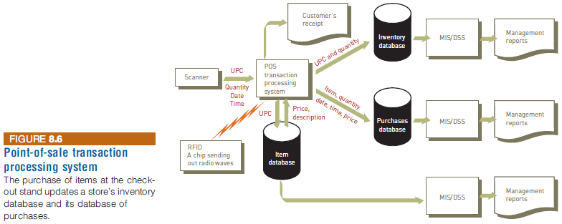
Data Collection
Notes:
Data Collection

Slide 24
Data Editing
Data editing
Checking data for validity and completeness to detect any problems
Examples
Quantity and cost data must be numeric
Names must be alphabetic
Codes associated with an individual transaction are edited against a database containing valid codes
Notes:
Data Editing
Data editing
Checking data for validity and completeness to detect any problems
Examples
Quantity and cost data must be numeric
Names must be alphabetic
Codes associated with an individual transaction are edited against a database containing valid codes

Slide 25
Data Correction
Systems should provide error messages that alert those responsible for editing the data
Error messages should specify the problem so proper corrections can be made
Data correction involves reentering data that was not typed or scanned properly
Notes:
Data Correction
Systems should provide error messages that alert those responsible for editing the data
Error messages should specify the problem so proper corrections can be made
Data correction involves reentering data that was not typed or scanned properly

Slide 26
Data Processing
Performing calculations and other data transformations related to business transactions including:
Classifying data
Sorting data into categories
Performing calculations
Summarizing results
Storing data in the organization’s database for further processing
Notes:
Data Processing
Performing calculations and other data transformations related to business transactions including:
Classifying data
Sorting data into categories
Performing calculations
Summarizing results
Storing data in the organization’s database for further processing

Slide 27
Data Storage
Data Storage
Involves updating one or more databases with new transactions
After being updated, this data can be further processed and manipulated by other systems
Notes:
Data Storage
Data Storage
Involves updating one or more databases with new transactions
After being updated, this data can be further processed and manipulated by other systems

Slide 28
Document Production
Document Production involves generating output records, documents, and reports
Hard-copy paper reports
Displays on computer screens (soft copy)
Results from one TPS can be input to another system
Most TPSs provide other useful management information, such as:
Printed or on-screen reports that help managers and employees perform various activities
Reports showing current inventory
Reports required by local, state, and federal agencies
Notes:
Document Production
Document Production involves generating output records, documents, and reports
Hard-copy paper reports
Displays on computer screens (soft copy)
Results from one TPS can be input to another system
Most TPSs provide other useful management information, such as:
Printed or on-screen reports that help managers and employees perform various activities
Reports showing current inventory
Reports required by local, state, and federal agencies

Slide 29
Enterprise Systems
An enterprise system is central to individuals and organizations of all sizes
Ensures that information can be shared across all business functions and all levels of management to support the running and managing of a business
The ultimate goal is to satisfy customers and provide significant benefits by reducing costs and improving service
Businesses rely on enterprise systems to perform daily activities in areas such as:
Product supply and distribution
Sales and marketing
Human resources
Manufacturing
Accounting and taxes
Notes:
Enterprise Systems
An enterprise system is central to individuals and organizations of all sizes
Ensures that information can be shared across all business functions and all levels of management to support the running and managing of a business
The ultimate goal is to satisfy customers and provide significant benefits by reducing costs and improving service
Businesses rely on enterprise systems to perform daily activities in areas such as:
Product supply and distribution
Sales and marketing
Human resources
Manufacturing
Accounting and taxes

Slide 30
Enterprise Resource Planning Systems (ERP)
ERP systems integrate the functional areas of the organization by enabling seamless information flows across them. That is, ERP systems are designed to break down the information silos of an organization.
Notes:
Enterprise Resource Planning (ERP) systems integrate the planning, management and
use of all resources of the organization. That is, ERP systems are designed to break down
the information silos of an organization.
Many information systems were developed for specific functional areas and did not communicate
with systems in other functional areas. Therefore, these systems are referred to as information silos.

Slide 31
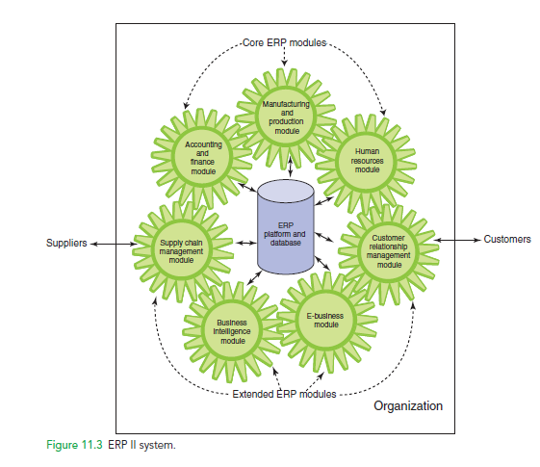

Slide 32
Benefits of ERP Systems
They can make organizations more flexible, agile, and adaptive.
They can improve managers’ ability to make better, more timely decisions.
They can improve customer service, production, and distribution.

Slide 33
Limitations of ERP Systems
May require organizations to change existing business processes to fit the predefined business processes of the ERP software.
Can be complex, expensive, and time consuming to implement.

Slide 34
Major Limitations of ERP Implementations
Since ERP’s are based on best practices companies may need to change their methods of achieving business objectives
ERP systems can be complex, expensive, and time-consuming to implement.

Slide 35
Major Causes of ERP Implementation Failure
Failure to involve affected employees in the planning and development phases and in change management processes
Trying to do too much too fast in the conversion process
Insufficient training in the new work tasks required by the ERP system
The failure to perform proper data conversion and testing for the new system

Slide 36
Implementing ERP Systems
On-Premise ERP Implementation
Vanilla approach
Custom approach
Best of breed approach

Slide 37
Three major advantages of using a cloud-based ERP system are:
The system can be used from any location that provides Internet access
Companies using cloud-based ERP avoid the initial hardware and software expenses that are typical of on-premise implementations
Cloud-based ERP solutions are scalable, meaning it is possible to extend ERP support to new business processes and new business partners (e.g., suppliers) by purchasing new ERP modules.

Slide 38
Three major disadvantages of using cloud-based ERP systems are:
It is not clear whether cloud-based ERP systems are more secure than on-premise systems
Companies that adopt cloud-based ERP systems sacrifice their control over a strategic IT resource
Lack of control over IT resources when the ERP system experiences problems

Slide 39
10.5 Functional Area Information Systems Reports
Routine reports
Ad hoc (on demand) reports
Drill-down reports
Key-indicator reports
Comparative reports
Exception reports
Notes:
Functional area information systems generate a wide variety of reports.

Slide 40
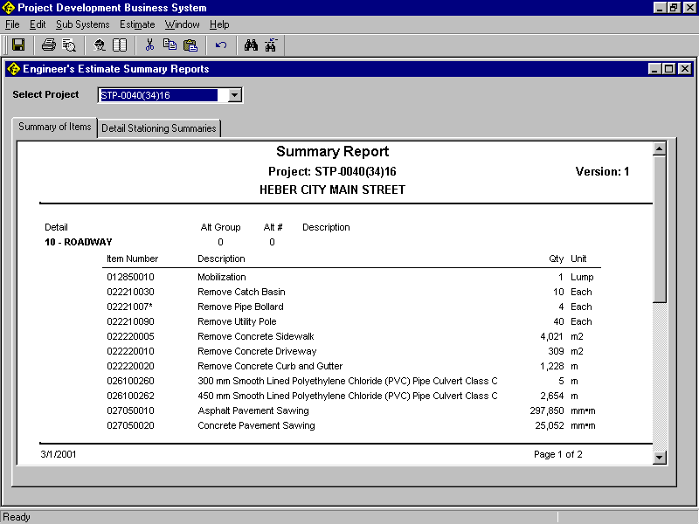
Summary Report
Summary reports provide summarized information, with less detail.
Notes:
Summary reports provide summarized information, with less detail.

Slide 41
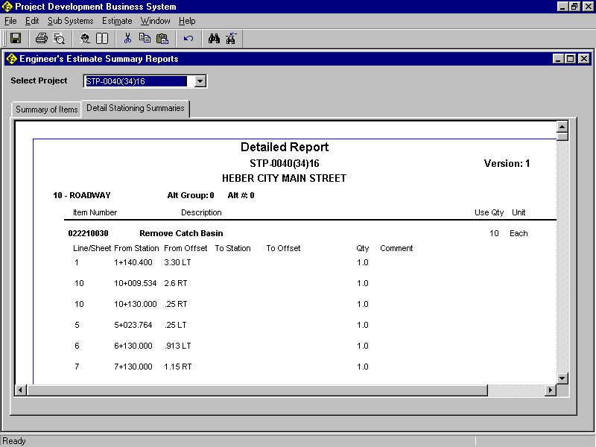
Detailed Report
Detailed reports provide high levels of detailed data, often in support of summary reports.
Notes:
Detailed reports provide high levels of detailed data, often in support of summary reports.
Note that this detailed report provides the underlying data for “Remove Catch Basin”, which is
the second item on the preceding summary report.

Slide 42
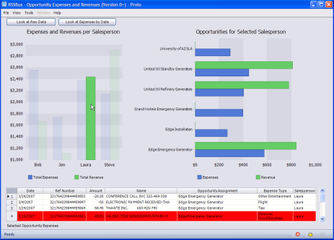
Drill-Down Report
A drill-down report allows users to click on an item in a report and be able to access underlying details about that item.
Notes:
A drill-down report allows users to click on an item in a report and be able to access
underlying details about that item.
RSSbus is a mashup tool that gives you the tools to quickly create structured feeds out of
anything; not just news and blog postings, but business data or application data that
you own or have access to. (Note: RSSBus is not special, it just had an interesting
video on drill-down.)
Clicking on the image of the report above will take you to a video that shows how
RSSBus works and how drill-down works.

Slide 43
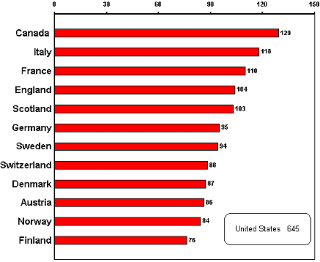
Key-Indicator Report
A key indicator report summarizes the performance of critical activities.
Marketing examples are:
New customers acquisition.
Demographic analysis
Status of existing customers
Turnover (i.e., revenue) generated by segments of the customer population
Notes:
A key indicator report summarizes the performance of critical activities.
The key indicator in this report is the number of prison inmates per 100,000
of population in 1996-1997.

Slide 44
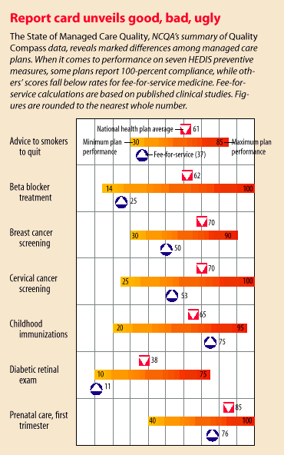
Comparative Report
Comparative report is one type of ad-hoc report.
Notes:
This comparative report compares managed health care to traditional fee-for-service
healthcare. Let’s use one example: Advice to smokers to quit.
* Fee-for-service has a 37% compliance rate on seven Healthcare Effectiveness Data
and Information Set (HEDIS) preventive measures. See purple arrow.
* The minimum managed care plans have a 30% compliance rate. (left end of bar)
* The maximum managed care plans have a 85% compliance rate. (right end of bar)
* The average of all managed care plans (National Health Plan average) is 61% compliance.
(see red arrow).
We can see that there is quite a bit of information in this graphical comparative report.

Slide 45
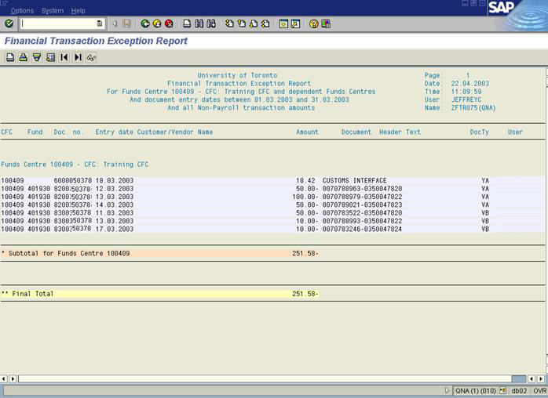
Exception Report
Exception reports include only information that falls outside certain threshold standards.
Notes:
Exception reports include only information that falls outside certain threshold standards.
This image shows a financial transaction exception report using SAP from the University of
Toronto in 2003.

