Slide 1
CHAPTER 2
Organizational Strategy, Competitive Advantage, and Information Systems

Slide 2
Strategy!
A high level plan to achieve a goal
under conditions of uncertainty.(Wikipedia)
A desired outcome
Gaining market share
Outperform competitors
Cost, quality and time to market

Slide 3
Chapter 2- Corporate Strategy
Business Process- Examine Value Chain Model
Pressures
Responses
Global Flatteners

Slide 4
Business Processes
Business Process- related activities that produce a product or a service of value to the organization, its business partners/ and or customers
Comprised of three elements:
Inputs
Resources
Outputs
Can be cross-functional processes
No single functional area is responsible
steps executed in a coordinated, collaborative way

Slide 5
Examples of Business Process
Accounts Collection
After Sale follow-up
Managing packing, storage, and distribution

Slide 6
Example: Purchasing Airline Tickets Online

Slide 7
Information Systems & Business Processes
IS’s vital role in three areas of business processes
Executing the process
Capturing and storing process data
Monitoring process performance

Slide 8
Executing the Process
IS’s help Execute the Process by:
Informing employees when it is time to complete a task
Providing required data
Providing a means to complete the task

Slide 9
Capturing & Storing Process Data
Processes generate data
Dates, times, product numbers, quantities, prices, addresses, names, employee actions
IS’s capture & store process data (aka, transaction data)
Capturing & storing data provides immediate, ‘real time’ feedback

Slide 10
Monitoring Process Performance
IS evaluates information to determine how well a process is being executed
Evaluations occur at two levels
Process level
Instance level
Monitoring identifies problems for process improvement

Slide 11
Business Process Management
Business process management is a management technique that includes methods and tools to support the design, analysis, implementation, management, and optimization of business processes.
Optimize
Manufacturing and logistics process
Marketing and innovation
Individual work
Important components of BPM:
Process modeling
Web-enabled technologies
Business Activity Monitoring (BAM)

Slide 12
Measures of Excellence in Executing Business Processes
Customer Satisfaction
Cost Reduction
Cycle and fulfillment time reduction
Quality
Differentiation
Productivity

Slide 13
Innovation
Innovation: the application of new ideas to the products, processes, and activities of a firm, leading to increased value
A catalyst for the growth and success of an organization
Can lead to cutting-edge products
New revenue streams
Increased profits
Types of innovation
Sustaining innovation: results in enhancements to existing products, services, and ways of operating
Enable an organization to continually increase profits, lower costs, and gain market share
Disruptive innovation: one that initially provides a lower level of performance than the marketplace has grown to accept
Improved to provide new performance characteristics

Slide 14
Reengineering and Continuous Improvment
Reengineering
Also called process redesign and business process reengineering (BPR)
Involves the radical redesign of business processes, organizational structures, information systems, and values of the organization to achieve a breakthrough in business results
Continuous improvement
Constantly seeking ways to improve business processes and add value to products and services

Slide 15
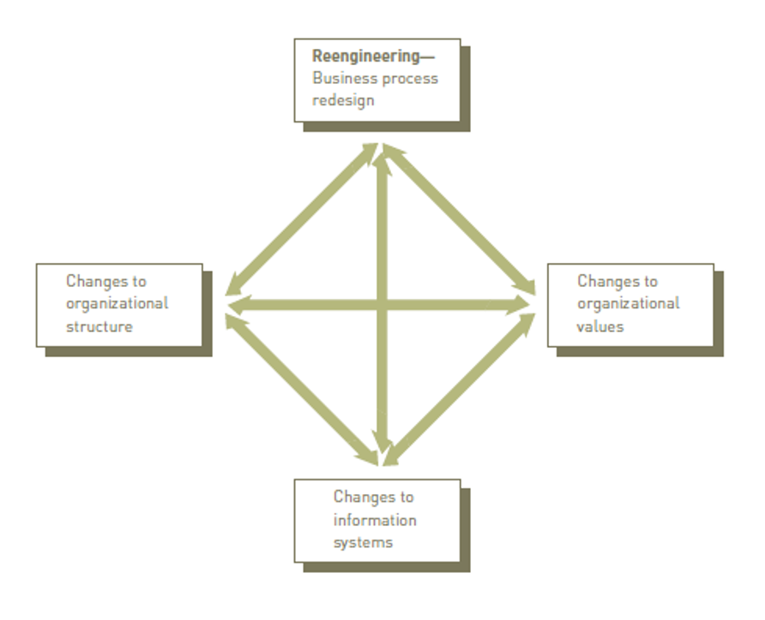

Slide 16
Business Process Re-engineering (BPR) and Business Process Improvement (BPI)
BPR is a radical redesign that improved efficiency and effectiveness
BPI is less radical, less disruptive, and more incremental
Six Sigma is one popular methodology
Effectiveness versus Efficiency what is the difference?

Slide 17
Effectiveness vs Efficiency
 | Effectiveness | Efficiency
Meaning: | Effectiveness is about doing the right task, completing activities and achieving goals. | Efficiency is about doing things in an optimal way, for example doing it the fastest or in the least expensive way. It could be the wrong thing, but it was done optimally.
Effort oriented: | No | Yes
Process Oriented: | No | Yes
Goal oriented: | Yes | Yes
Time oriented: | No | Yes

Slide 18
Business Process Improvement (BPI)
Five basic phases of successful BPI
Define
Measure
Analyze
Improve
Control

Slide 19
BPI versus BPR
BPI
BPR
Low risk / low cost
Incremental change
Bottom-up approach
Takes less time
Quantifiable results
All employees trained in BPI
High risk / high cost
Radical redesign
Top-down approach
Time consuming
Impacts can be overwhelming
High failure rate

Slide 20
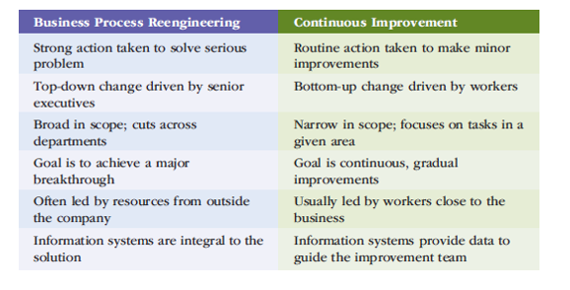

Slide 21
Business Pressures, Organizational Responses, and IT Support
Business Pressures
Market Pressures
Technology Pressures
Societal Pressures
Notes:
Business Pressure - The business environment is the combination of social, legal, economic, physical, and political factors that affect business activities.
Significant changes in any of these factor are likely to create business pressure on the organization.
The three types of business pressures faced are: market, technology, and societal pressures.

Slide 22
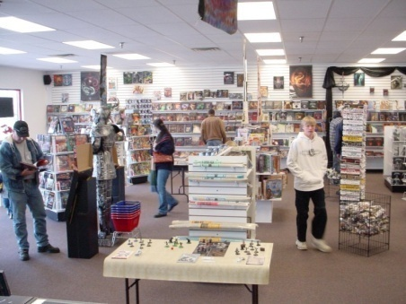
Market Pressures
The Global Economy and
Strong Competition
The Changing Nature of the Workforce
Powerful Customers

Slide 23
Globalization
The integration and interdependence of economic, social, cultural, and ecological facets of life, made possible by rapid advances in IT.

Slide 24
Changing Nature of the Workforce
Workforce is Becoming More Diversified
Women
Single Parents
Minorities
Persons with Disabilities
IT is Enabling Telecommuting Employees

Slide 25
Powerful Customers
Increasing consumer sophistication & expectations
Consumer more knowledgeable about
Products and services
Price comparisons
Electronic auctions
Customer Relationship Management

Slide 26
Technology Pressures
Technological Innovation and Obsolescence
Information Overload

Slide 27
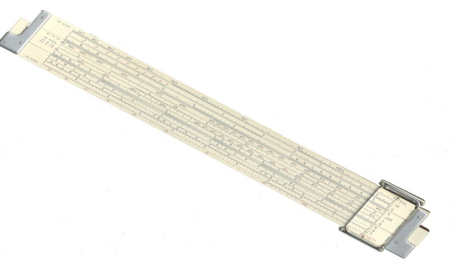
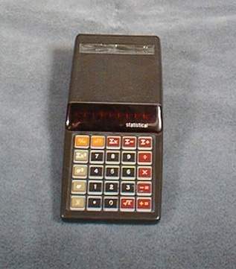
Technological Innovation and Obsolescence
Obsolescence: Slide Rule
Innovation: Early calculator

Slide 28
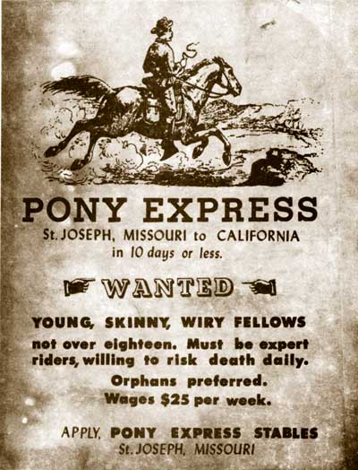
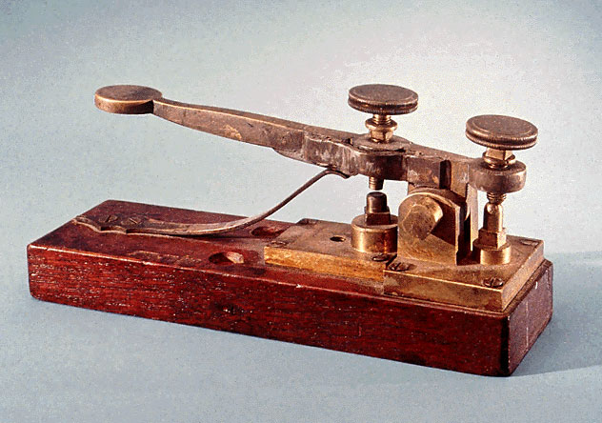
Technological Innovation and Obsolescence (continued)
Innovation: Telegraph
Obsolescence: Pony Express

Slide 29
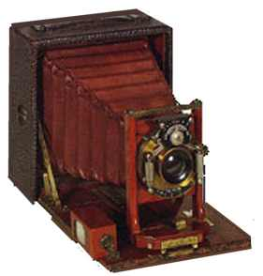
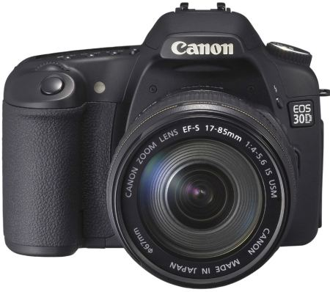
Technological Innovation and Obsolescence (continued)
Obsolescence: old analog camera
Innovation: digital camera

Slide 30
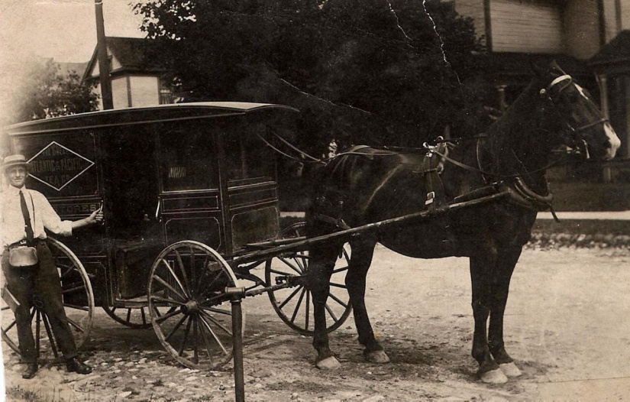
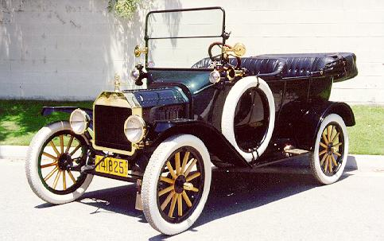
Technological Innovation and Obsolescence (continued)
Obsolescence:
Horse and Buggy
Innovation: Ford Model T

Slide 31
Information Overload

Slide 32
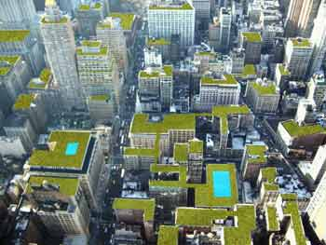
Societal/Political/Legal
Social Responsibility
Manufacturing sustainability
Distribution
Humane working conditions
Government Regulations
Protection Against Terrorist Attacks
Ethical Issues

Slide 33
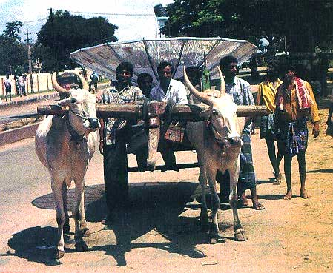
Social Responsibility (continued)
Bridging the Digital Divide
Notes:
Getting the satellite dish to the rural hamlet
* Interesting juxtaposition of Agricultural Age and Information Age

Slide 34
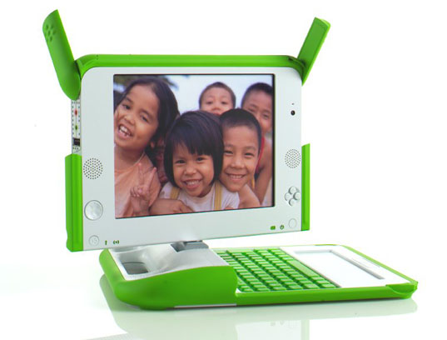
Social Responsibility (continued)
One Laptop per Child initiative
Notes:
Bridging the Digital Divide

Slide 35
Social Responsibility & Philanthropy in Business
www.patientslikeme.com
www.giftflow.org
www.ourgoods.org
www.sparked.com
www.thredup.com
www.collaborativeconsumption.com
www.kiva.org
www.donorschooce.org

Slide 36
Compliance with Government Regulations
Sarbanes-Oxley Act
USA PATRIOT act
Gramm-Leach-Bliley Act
Health Insurance Portability & Accountability Act (HIPAA)

Slide 37
Protection against Terrorist Attacks
Employees in military reserves called to active duty
Information Technology used to identify and protect against terrorists and cyberattacks
Department of Homeland Security’s (DHS) US-VISIT program
Network of biometric-screening systems

Slide 38
Ethical Issues
General standards of right and wrong
Information-processing activities
Monitoring employee email
Monitoring employee Internet activity at work
Privacy of customer data

Slide 39
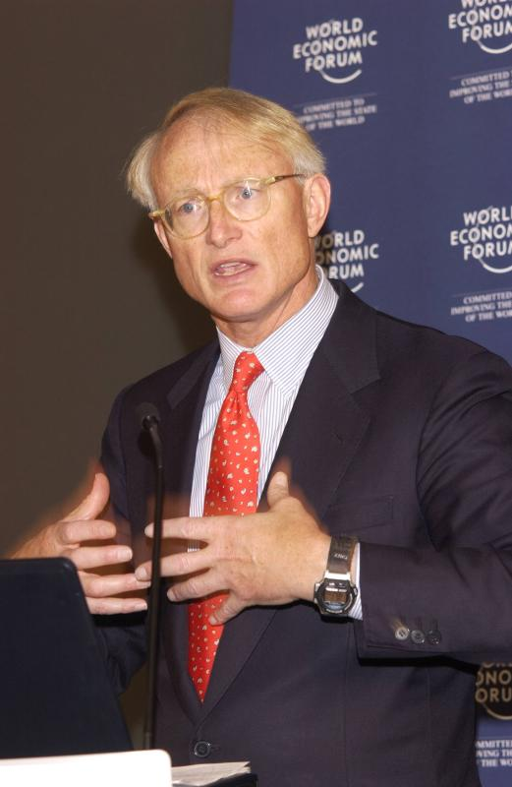
Porter’s Competitive Forces Model
The best-known framework for analyzing competitiveness is Michael Porter’s competitive forces model (Porter, 1985).
Michael Porter
Notes:
* Model is used to develop strategies to increase their competitive edge.
* Demonstrates how IT can make a company more competitive.

Slide 40
Porter’s Competitive Forces Model

Slide 41
Porter’s Competitive Forces Model
Threat of entry of new competitors is high when it is easy to enter a market and low when significant barriers to entry exist.
A barrier to entry is a product or service feature that customers expect from organizations in a certain industry.
For most organizations, the Internet increases the threat that new competitors will enter a market.

Slide 42
Porter’s Competitive Forces Model
The bargaining power of suppliers is high when buyers have few choices and low when buyers have many choices.
Internet impact is mixed. Buyers can find alternative suppliers and compare prices more easily, reducing power of suppliers.
On the other hand, as companies use the Internet to integrate their supply chains, suppliers can lock in customers.

Slide 43
Porter’s Competitive Forces Model
The bargaining power of buyers is high when buyers have many choices and low when buyers have few choices.
Internet increases buyers’ access to information, increasing buyer power.
Internet reduces switching costs, which are the costs, in money and time, to buy elsewhere. This also increases buyer power.

Slide 44
Porter’s Competitive Forces Model
The threat of substitute products or services is high when there are many substitutes for an organization’s products or services and low where there are few substitutes.
Information-based industries are in the greatest danger from this threat (e.g., music, books, software). The Internet can convey digital information quickly and efficiently.

Slide 45
Porter’s Competitive Forces Model
The rivalry among firms in an industry is high when there is fierce competition and low when there is not.

Slide 46
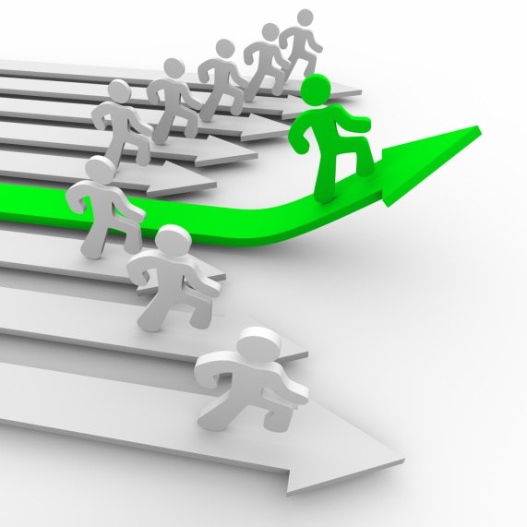
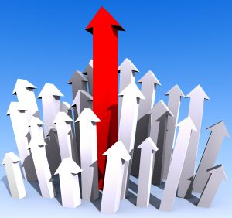
2.4 Competitive Advantage
Notes:
Competitive advantage is an advantage over competitors in some measure such as cost,
quality, or speed; leads to control of a market and to larger-than-average profits.

Slide 47
Strategies for Competitive Advantage
Cost Leadership
Differentiation
Innovation
Operational Effectiveness
Customer-orientation
Notes:
Cost Leadership. Produce products and/or services at the lowest cost in the industry.
Differentiation. Offer different products, services or product features.
Innovation. Introduce new products and services, add new features to existing products and services or develop new ways to produce them.
Operational Effectiveness. Improve the manner in which internal business processes are executed so that a firm performs similar activities better than its rivals.
Customer-orientation. Concentrate on making customers happy.

Slide 48
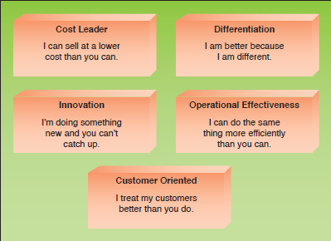
Strategies for Competitive Advantage
Figure 2.5

Slide 49
Porter’s Value Chain Model
This model identifies specific activities where organizations can use competitive strategies for greatest impact.
Primary activities
Support activities
Notes:
Primary activities are those business activities that relate to the production and distribution of the firm’s products and services, thus creating value for which customers are willing to pay. Primary activities include inbound logistics, operations, outbound logistics, marketing and sales, and customer service.
Support activities do not add value directly to a firm’s products and services, but support the primary activities. Support activities include accounting, finance, management, human resources management, product and technology development (R&D), and procurement.

Slide 50
Primary Activities
Inbound logistics
Operations
Outbound logistics
Marketing and Sales
Customer service

Slide 51
Support Activities
Accounting, Finance, Management
Human Resources
Product and technology development
Procurement

Slide 52
Porter’s Value Chain Model
These bottom ones are actually PRIMARY ACTIVITIES

Slide 53
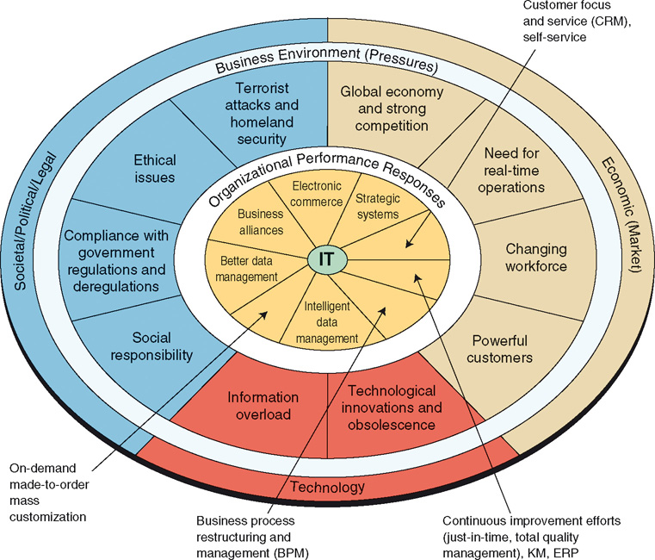
Business Pressures, Organizational Responses, and IT Support

Slide 54
Organizational Responses
ERP
Fulfillment Automation
Ecommerce
CRM

Slide 55
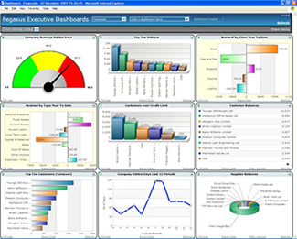
Organizational Responses
Collaborative Workflow software
Intranet
On-Demand, Mass customization
Strategic Systems
Dashboards
Business Intelligence
Expert Systems

Slide 56
2.5 Six Characteristics of Excellent Business-IT Alignment
IT viewed as an engine of innovation continually transforming the business and often creating new revenue streams.
Organizations view their internal & external customers and their customer service function as supremely important.
Organizations rotate business and IT professionals across departments and job functions.

Slide 57
Six Characteristics of Excellent Business-IT Alignment
Organizations provide overarching goals that are completely clear to each IT and business
Organizations ensure that IT employees understand how the company makes (or loses) money.
Organizations create a vibrant and inclusive company culture.

Slide 58
Major Reasons Business-IT Alignment Does Not Occur
Business managers and IT managers have different objectives.
The business and IT departments are ignorant of the other group’s expertise.
A lack of communication.

Slide 59
Outsourcing, Offshoring, and Downsizing
Outsourcing
A long-term business arrangement in which a company contracts for services with an outside organization that has expertise in providing a specific function
Offshore outsourcing (offshoring)
The service is located in a country different than the firm obtaining the services
A number of companies are finding that outsourcing does not necessarily lead to reduced costs
Notes:
Outsourcing, Offshoring, and Downsizing
Outsourcing
A long-term business arrangement in which a company contracts for services with an outside organization that has expertise in providing a specific function
Offshore outsourcing (offshoring)
The service is located in a country different than the firm obtaining the services
A number of companies are finding that outsourcing does not necessarily lead to reduced costs

Slide 60
Outsourcing, Offshoring, and Downsizing
Downsizing
Reducing the number of employees to cut costs
Also referred to as “rightsizing”
Product quality and employee morale can suffer
Notes:
Outsourcing, Offshoring, and Downsizing
Downsizing
Reducing the number of employees to cut costs
Also referred to as “rightsizing”
Product quality and employee morale can suffer

Slide 61
Organizational Culture and Change
Culture: a set of major understandings and assumptions shared by a group
Organizational culture: the major understandings and assumptions for a business, corporation, or other organization
Organizational change: how organizations plan for, implement, and handle change
Soft side of implementing change: involves work designed to help employees embrace a new information system and way of working
Notes:
Organizational Culture and Change
Culture: a set of major understandings and assumptions shared by a group
Organizational culture: the major understandings and assumptions for a business, corporation, or other organization
Organizational change: how organizations plan for, implement, and handle change
Soft side of implementing change: involves work designed to help employees embrace a new information system and way of working

Slide 62
Organizational Culture and Change
Change management model
Describes the phases an individual or organization goes through in making a change
Provides principles for successful implementation of change
There are a number of models for dealing with the soft side of implementing change
Notes:
Organizational Culture and Change
Change management model
Describes the phases an individual or organization goes through in making a change
Provides principles for successful implementation of change
There are a number of models for dealing with the soft side of implementing change

Slide 63
Lewin’s Change Model
Lewin’s change model consists of a three-stage approach for change
Unfreezing: preparing for change
Moving: making the change
Refreezing: institutionalizing
Notes:
Lewin’s Change Model
Lewin’s change model consists of a three-stage approach for change
Unfreezing: preparing for change
Moving: making the change
Refreezing: institutionalizing

Slide 64
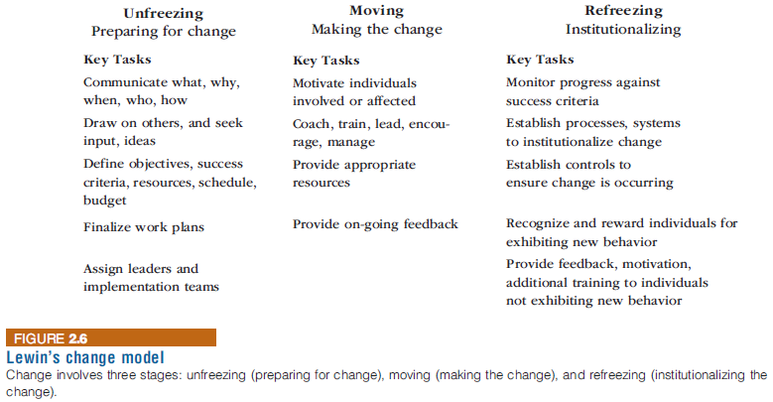
Lewin’s Change Model
Lewin’s change model consists of a three-stage approach for change
Unfreezing: preparing for change
Moving: making the change
Refreezing: institutionalizing
Notes:
Lewin’s Change Model

Slide 65
Lewin’s Force Field Analysis
Lewin extended his change model theory to include force field analysis
Identifies both the driving (positive) and restraining (negative) forces that influence whether change can occur
Driving forces: beliefs, expectations, and cultural norms that tend to encourage a change and give it momentum
Restraining forces: those that make it difficult to accept a change or to work to implement a change
Notes:
Lewin’s Force Field Analysis
Lewin extended his change model theory to include force field analysis
Identifies both the driving (positive) and restraining (negative) forces that influence whether change can occur
Driving forces: beliefs, expectations, and cultural norms that tend to encourage a change and give it momentum
Restraining forces: those that make it difficult to accept a change or to work to implement a change

Slide 66
Lewin’s Force Field Analysis
Notes:
Lewin’s Force Field Analysis

Slide 67
Lewin’s Force Field Analysis
Notes:
Lewin’s Force Field Analysis

Slide 68
Leavitt’s Diamond
A theory that proposes that every organizational system is made up of four main components—people, tasks, structure, and technology—with an interaction among the four components
Any change in one of these elements will necessitate a change in the other three elements
Organizational learning
The adaptations and adjustments based on experience and ideas over time
Adjustments can require reengineering or can result from continuous improvement
Notes:
Leavitt’s Diamond
A theory that proposes that every organizational system is made up of four main components—people, tasks, structure, and technology—with an interaction among the four components
Any change in one of these elements will necessitate a change in the other three elements
Organizational learning
The adaptations and adjustments based on experience and ideas over time
Adjustments can require reengineering or can result from continuous improvement

Slide 69
Leavitt’s Diamond
Notes:
Leavitt’s Diamond

Slide 70
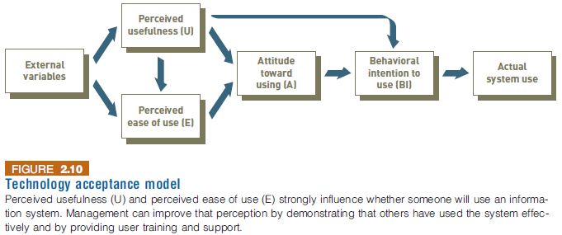
User Satisfaction and Technology Acceptance
Technology acceptance model (TAM)
Specifies the factors that can lead to better attitudes about the information system
Notes:
User Satisfaction and Technology Acceptance
Technology acceptance model (TAM)
Specifies the factors that can lead to better attitudes about the information system

Slide 71
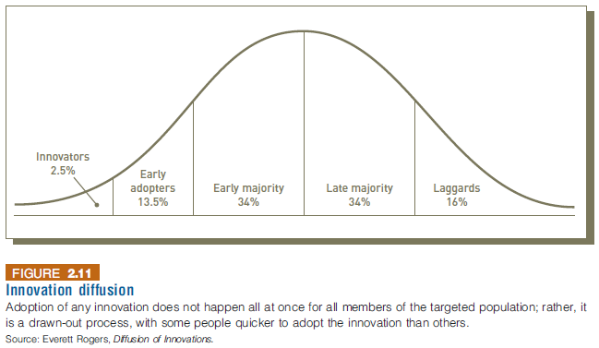
Diffusion of Innovation Theory
A theory developed by E.M. Rogers
Explains how a new idea or product gains acceptance and diffuses (or spreads) through a specific population or subset of an organization
Notes:
Diffusion of Innovation Theory
A theory developed by E.M. Rogers
Explains how a new idea or product gains acceptance and diffuses (or spreads) through a specific population or subset of an organization

Slide 72
Diffusion of Innovation Theory
Notes:
Diffusion of Innovation Theory

