Slide 1
CHAPTER 1
Introduction to Information Systems

Slide 2
CHAPTER OUTLINE
1.1 Why Should I Study Information Systems?
1.2 Overview of Computer-Based Information Systems
1.3 How Does IT Impact Organizations?
1.4 Importance of Information Systems to Society

Slide 3
Information Technology
IT is making our world smaller, enabling more and more people to communicate, collaborate and compete…

Slide 4
We are…or it is…
Global
Massively interconnected
Intensely competitive
24/7/365
Real time
Rapidly change
Information intensive

Slide 5
1.1 Why Should I Study Information Systems
The Informed User—You!
IT Offers Career Opportunities
Managing Information Resources

Slide 6
The Informed User – You!
Homo Conexus
You are the most connected generation in history.
You practice continuous computing.
You are surrounded by a personal, movable information network.
Other Items
You benefit when you understand what is behind the application.
You can recommend and help select IT applications
You will be aware of new technology and understand how IT improves performance
Understanding IT is beneficial to entrepreneurs
© Voon Nam Fook/iStockphoto
Notes:
Your personal information network is created by constant cooperation between:
the digital devices you carry;
the wired and wireless networks that you access as you move about;
Web-based tools for finding information and communicating and collaborating with other people.
You can pull information from the Web and push your ideas back to the Web.

Slide 7
Digital Nomads
Source: Media Bakery
Notes:
A digital nomad is someone who uses information technologies such as smart phones,
wireless Internet access, and Web-based applications to work remotely from anywhere.

Slide 8
Build Your Own Multinational Company
http://www.domystuff.com/
http://www.vworker.com/
http://www.webgrity.com/
http://www.b2kcorp.com/
http://www.globetask.com/
http://www.guru.com/
https://www.elance.com/
© Alex Gumerov/iStockphoto

Slide 9
Capabilities of Information Systems
Store huge amounts of information in small space
Allow quick, inexpensive access to vast amounts of information worldwide
Interpret vast amounts of data quickly and efficiently
Increase effectiveness and efficiency of people working in groups in one place or around the world

Slide 10
Capabilities of Information Systems
Perform high-speed, high-volume numerical computations
Automate semiautomatic business process and manual tasks
Provide fast, accurate communication and collaboration within and among organizations

Slide 11
MIS- Management Information Systems
The planning for and the development, management and use of information technology tools…

Slide 12
MIS- Management Information Systems
to help people perform all the tasks related to information processing and management.

Slide 13
MIS Department
Source: Howard Kingsnorth/The Image
Bank/Getty Images, Inc.
Traditional
New (Consultative)
Managing systems development
Systems project management
Managing computer operations
Providing technical services
Infrastructure planning, development, and control
Incorporating Ecommerce into the business
Managing system integration
Internet, Intranet, Extranet
Education
Managing Outsourcing
Notes:
Initiating and designing specific strategic information systems
As an end user, your information needs will often mandate the development of new strategic information systems.
You will decide which strategic systems you need (because you know your business needs better than the MIS department does), and you will provide input into developing these systems.
Incorporating the Internet and electronic commerce into the business
As an end user, you will be primarily responsible for effectively using the Internet and electronic commerce in your business. You will work with the MIS department to accomplish this task.
Managing system integration, including the Internet, intranets, and extranets
As an end user, your business needs will determine how you want to use the Internet, your corporate intranets, and extranets to accomplish your goals. You will be primarily responsible for advising the MIS department on the most effective use of the Internet, your corporate intranets, and extranets.
Educating the non-MIS managers about IT
Your department will be primarily responsible for advising the MIS department on how best to educate and train your employees about IT.
Educating the MIS staff about the business
Communication between the MIS department and the business units is a two-way street. You will be responsible for educating the MIS staff on your business, its needs, and its goals.

Slide 14
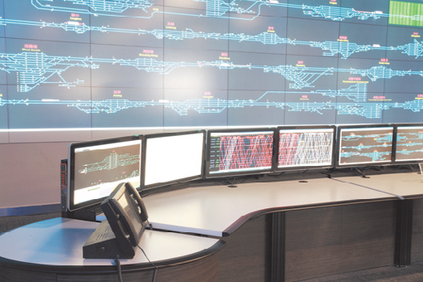
1.2 Overview of Computer-Based Information Systems
© zu difeng/Shutterstock

Slide 15
IT vs IS
Information Technology
Any computer based tool that people use to work with information and to information processing needs of an organization.

Slide 16
IT vs IS
Information Systems
Collects, processes, stores, analyzes and disseminates information of the specific purpose.
Get the
right information to the
right people and the
right time in the
right amount in the
right format

Slide 17
Data, Information, Knowledge, Wisdom
Data: raw facts
Information: collection of data organized in such a way that they have value beyond the facts themselves
One of an organization’s most valuable resources
Often confused with the term data
Knowledge: awareness and understanding of a set of information and the ways it can be made useful to support a task
The process of defining relationships among data to create useful information requires knowledge
Wisdom – accumulated knowledge over time
Process: set of logically related tasks performed to achieve a defined outcome
Turning data into information is a process

Slide 18
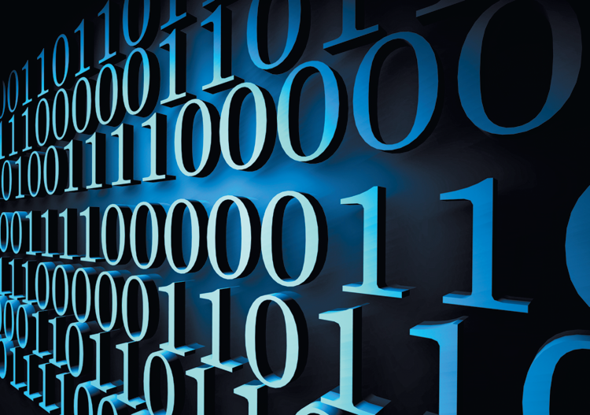
transactions that are recorded, classified and stored but are not organized to convey any specific meaning
Data
Information
meaning and value
Knowledge
accumulated learning and expertise as they apply to a current problem or activity.
Notes:
Data Item. Elementary description of things, events, activities and transactions that are recorded, classified and stored but are not organized to convey any specific meaning.
Information. Data organized so that they have meaning and value to the recipient.
Knowledge. Data and/or information organized and processed to convey understanding, experience, accumulated learning and expertise as they apply to a current problem or activity.

Slide 19
Types of data

Slide 20
Difference
Wisdom takes knowledge and applies it with discernment based on experience, evaluation, and lessons learned.
A quote by an unknown author sums up the differences well: “Knowledge is knowing what to say. Wisdom is knowing when to say it. [dictionary.com]
Knowledge is gathered from learning and education, while most say that wisdom is gathered from day-to-day experiences and is a state of being wise.
Knowledge is merely having clarity of facts and truths, while wisdom is the practical ability to make consistently good decisions in life. [diffen.com]

Slide 21
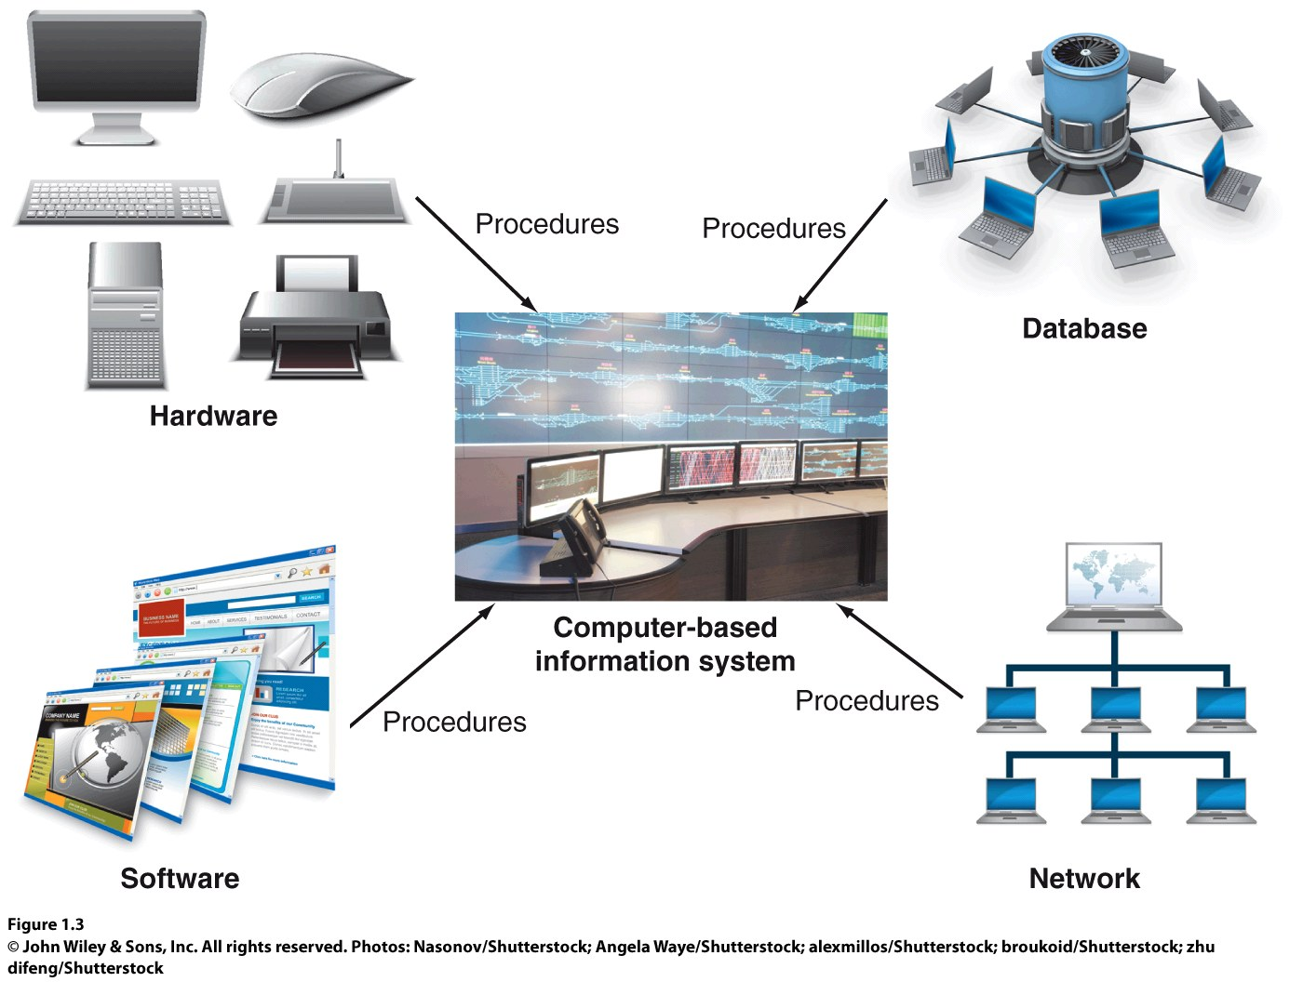
Basic Components of a CBIS
Notes:
Hardware: consists of devices such as the processor, monitor, keyboard, and printer
Software: is a program or collection of programs that enable the hardware to process data
Database is a collection of related files or tables containing data
Network- is connecting system that permits different computers to share resources
Procedures are the instructions for coming the above components in order to process information and generate the desired output

Slide 22
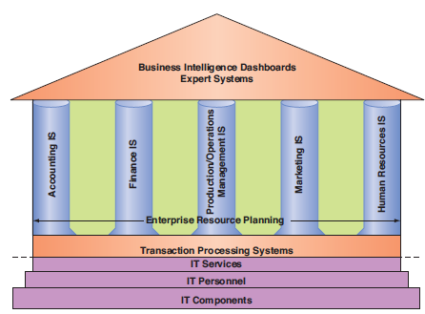
Types of Information Systems Figure 1.4
Functional
Area information
systems
Information Systems Inside an Organization

Slide 23
Information Technology Services
IT Personnel
IT Platform (or otherwise know as IT Components)
Hardware
Software
Networks
Database
develop IS systems
oversee security and risk
manage data

Slide 24
Functional Area Systems
A collection of application programs within an area is called Functional Area Systems
Accounting
Finance
POM- Production/ Operations/ Management
Marketing
Human Resources IS

Slide 25
Accounting Systems
Forecast revenues and business activity
Determine the best sources and uses of funds
Perform audits
Financial reports and documents are accurate.

Slide 26
Marketing
Product analysis: developing new goods and services
Site analysis: determining the best location for production and distribution facilities
Promotion analysis: identifying the best advertising channels
Price analysis: setting product prices to obtain the highest total revenues

Slide 27
POM
Customer orders
Develop production schedules
Control inventory levels
Monitor product quality

Slide 28
Human Resources
Recruiting process
Analyze and screen job applicants
Hire new employees
Monitor employee productivity
Employ Health and Retirement benefits

Slide 29
Data- Information-Knowledge-Wisdom
Business Intelligence -helps analyze information to make better informed decisions
Expert Systems – attempt to duplicate human experts by applying reasoning and expertise to a domain area (navigation routes)
Dashboards- provide rapid access to timely information

Slide 30
Two Information Systems that support the entire organization
Enterprise Resource Planning- connects all functional areas together
Transaction Processing System- captures data from every where and everything
( more about these in later chapter)

Slide 31
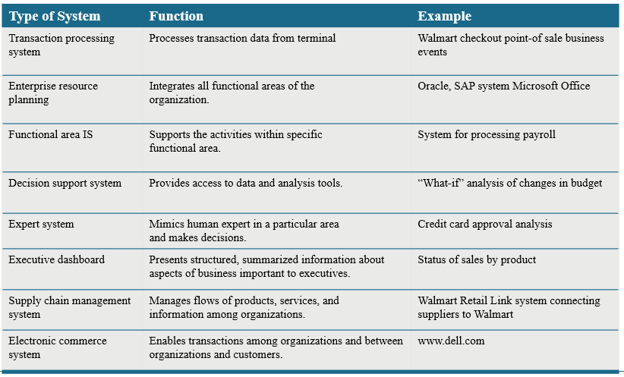
Table 1.4 types of organizational systems

Slide 32
Information Systems between Organizations
Once you figured out your information systems within the walls of your company
Streamline your business so you can purchase supplies and sell goods
Stay competitive

Slide 33
Information Systems between Organizations
Better known as supply chain management:
Suppliers of raw materials through factories and warehouses to YOU
Flow of:
Materials
Information
money

Slide 34
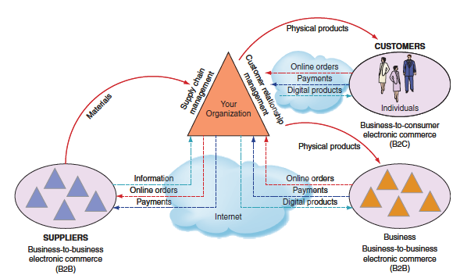
Information Systems Among Organizations

Slide 35
1.3 How does IT Impact Organizations?
IT Reduces the Number of Middle Managers
IT makes middle managers more productive, thus less needed
IT Changes the Manager’s Job (changes decision making process)
IT provides near-real-time information
Managers have less time to make decisions
IT provides tools for analysis to assist in decision making
Will IT Eliminate Jobs?
Creates new job categories, and requires more employees with IT knowledge and skills

Slide 36
How Does IT Impact Organizations? Examples
Book Industry
Music Industry
Video Industry
Software Industry
Videogame Industry
Photography Industry

Slide 37
How Does IT Impact Organizations? Examples
Marketing Industry
Recruiting Industry
Financial Services Industry
Motion Picture Industry
DreamWorks Animation
Automobile Industry
Agriculture Industry

Slide 38
How Does IT Impact Organizations? Examples
National Defense Industry
Fashion Industry
Education
Legal Profession

Slide 39
IT Reduces the Number of Middle Managers
IT makes middle managers more productive
Consequently, IT reduces the number of middle managers required

Slide 40
IT Changes the Manager’s Job
Decision making is the most important managerial task
IT changes the way managers make decisions
IT provides near-real-time information
Managers have less time to make decisions
IT provides tools for analysis to assist in decision making

Slide 41
Will IT Eliminate Jobs?
The competitive advantage of replacing people with IT & machines is increasing rapidly
Increasing the use of IT in business also:
Creates new job categories
Requires more employees with IT knowledge and skills

Slide 42
Social Effects
Positive
Opportunities for people with disabilities
Provide people with flexibility in their work
Robots will take over mundane chores
Enable improvement in healthcare
Make better/faster diagnoses
Monitor critically ill patients more accurately
Streamline the process of researching & developing new drugs

Slide 43
Ergonomic Products
Source: Media Bakery
Notes:
Wrist support
Back support
Eye-protection filter
Adjustable foot rest

Slide 44
1.4
Importance of Information Systems to Society
IT Affects Our Quality of Life
The Robot Revolution Is Here Now
Improvements in Healthcare

Slide 45
IT Affects Our Quality of Life
The speed and widespread use of information systems
Opens users to a variety of threats from unethical people
Computer-related attacks can come from individuals, groups, companies, and countries

Slide 46
Enabling People with Disabilities to Work with Computers
Computer solutions available to
Visually-impaired users
Hearing-impaired users
Motor-impaired users
© Harry Huber/Age Fotostock America, Inc.
Notes:
Computer for visually-impaired user
Computer for hearing-impaired user
Computer for motor-impaired user

Slide 47
Improvements in Healthcare
IT used in Healthcare to:
Make better/faster diagnoses
Monitor critically ill patients more accurately
Streamline the process of researching & developing new drugs
To enhance the work of radiologists
Allow surgeons to use virtual reality to plan complex surgeries & use robots to remotely perform surgery

Slide 48
The Robot Revolution is Here Now
Robotics used in Industry:
Manufacturing
Hospitals
Farming operations

Slide 49
The Robot Revolution is Here Now
Robotics used in the Home:
Roomba to vacuum our floors
Scooba to wash our floors
Verro to clean our pools
Looj to clean our gutters

Slide 50
Video Break
Telepresence (big bang clip)
Telepresence (in office ex clip)

Slide 51
Information Systems in Business and Society
The speed and widespread use of information systems
Opens users to a variety of threats from unethical people
Computer-related attacks can come from individuals, groups, companies, and countries
Notes:
Information Systems in Business and Society
The speed and widespread use of information systems
Opens users to a variety of threats from unethical people
Computer-related attacks can come from individuals, groups, companies, and countries

Slide 52
Cybercrime and Information System Security
Cybercriminals
Motivated by the potential for monetary gain
Hack into computers systems to steal
Cyberterrorism
The intimidation of a government or a civilian population by using information technology to disable critical national infrastructure
To achieve political, religious, or ideological goals
Notes:
Cybercrime and Information System Security
Cybercriminals
Motivated by the potential for monetary gain
Hack into computers systems to steal
Cyberterrorism
The intimidation of a government or a civilian population by using information technology to disable critical national infrastructure
To achieve political, religious, or ideological goals

Slide 53
Cybercrime and Information System Security
Notes:
Cybercrime and Information System Security

Slide 54
Ethical, Legal, and Social Issues of Information Systems
Ethics
A set of beliefs about right and wrong behavior
Ethical behavior
Conforms to generally accepted social norms
The use of information about people
Requires balancing the needs of those who want to use the information against the rights and desires of the people whose information may be used
Notes:
Ethical, Legal, and Social Issues of Information Systems
Ethics
A set of beliefs about right and wrong behavior
Ethical behavior
Conforms to generally accepted social norms
The use of information about people
Requires balancing the needs of those who want to use the information against the rights and desires of the people whose information may be used

Slide 55
Ethical, Legal, and Social Issues of Information Systems
Notes:
Ethical, Legal, and Social Issues of Information Systems

Slide 56
Ethical, Legal, and Social Issues of Information Systems
Internet censorship
The control or suppression of the publishing or accessing of information on the Internet
Digital divide
A term used to describe the gulf between those who do and those who don’t have access to modern information and communications technology
Net neutrality
The principle that Internet service providers (ISPs) should be required to treat all Internet traffic running over their networks the same
Notes:
Ethical, Legal, and Social Issues of Information Systems
Internet censorship
The control or suppression of the publishing or accessing of information on the Internet
Digital divide
A term used to describe the gulf between those who do and those who don’t have access to modern information and communications technology
Net neutrality
The principle that Internet service providers (ISPs) should be required to treat all Internet traffic running over their networks the same

