Slide 1
Chapter 10/13 Cybercrime, Computer and Information System Security
Notes:
Principles of Information Systems, Thirteenth Edition
Chapter 13
Cybercrime and Information System Security

Slide 2
Objectives
After completing this chapter, you will be able to:
Explain why computer incidents are so prevalent
Identify and briefly describe the types of computer exploits and their impact
Describe the earmarks of a strong security program
Identify specific measures used to prevent computer crime
Outline actions that must be taken in the event of a successful security intrusion
Notes:
Objectives
After completing this chapter, you will be able to:
Explain why computer incidents are so prevalent
Identify and briefly describe the types of computer exploits and their impact
Describe the earmarks of a strong security program
Identify specific measures used to prevent computer crime
Outline actions that must be taken in the event of a successful security intrusion

Slide 3
The Threat Landscape
Number of cybercrimes are increasing
Organizations are putting in place a range of countermeasures to combat cybercrime
Computer security incidents surged from 2014 to 2015 in the following industries:
Public sector organizations
Entertainment, media, and communications
Technology and telecommunications companies
Pharmaceuticals and life sciences
Power and utilities organizations
Notes:
The Threat Landscape
Number of cybercrimes are increasing
Organizations are putting in place a range of countermeasures to combat cybercrime
Computer security incidents surged from 2014 to 2015 in the following industries:
Public sector organizations
Entertainment, media, and communications
Technology and telecommunications companies
Pharmaceuticals and life sciences
Power and utilities organizations

Slide 4
Why Computer Incidents Are So Prevalent
Increasing Complexity Increases Vulnerability
Cloud computing, networks, computers, mobile devices, virtualization, OS applications, Web sites, switches, routers, and gateways are interconnected and driven by millions of lines of code
Higher Computer User Expectations
Computer help desks are under intense pressure to respond very quickly to users’ questions
Expanding and Changing Systems Introduce New Risks
It is difficult for IT organizations to keep up with the pace of technological change, successfully perform an ongoing assessment of new security risks, and implement approaches for dealing with them
Notes:
Why Computer Incidents Are So Prevalent
Increasing Complexity Increases Vulnerability
Cloud computing, networks, computers, mobile devices, virtualization, OS applications, Web sites, switches, routers, and gateways are interconnected and driven by millions of lines of code
Higher Computer User Expectations
Computer help desks are under intense pressure to respond very quickly to users’ questions
Expanding and Changing Systems Introduce New Risks
It is difficult for IT organizations to keep up with the pace of technological change, successfully perform an ongoing assessment of new security risks, and implement approaches for dealing with them

Slide 5
Why Computer Incidents Are So Prevalent
Increased Prevalence of Bring Your Own Device Policies
Bring your own device (BYOD): a business policy that permits (encourages) employees to use their own mobile devices to access company computing resources and applications
BYOD makes it difficult for IT organizations to adequately safeguard additional portable devices with various OSs and applications
Growing Reliance on Commercial Software with Known Vulnerabilities
An exploit is an attack on an information system that takes advantage of a particular system vulnerability
Often this attack is due to poor system design or implementation
Users should download and install patches for known fixes to software vulnerabilities
Any delay in doing so exposes the user to a potential security breach
Notes:
Why Computer Incidents Are So Prevalent
Increased Prevalence of Bring Your Own Device Policies
Bring your own device (BYOD): a business policy that permits (encourages) employees to use their own mobile devices to access company computing resources and applications
BYOD makes it difficult for IT organizations to adequately safeguard additional portable devices with various OSs and applications
Growing Reliance on Commercial Software with Known Vulnerabilities
An exploit is an attack on an information system that takes advantage of a particular system vulnerability
Often this attack is due to poor system design or implementation
Users should download and install patches for known fixes to software vulnerabilities
Any delay in doing so exposes the user to a potential security breach

Slide 6
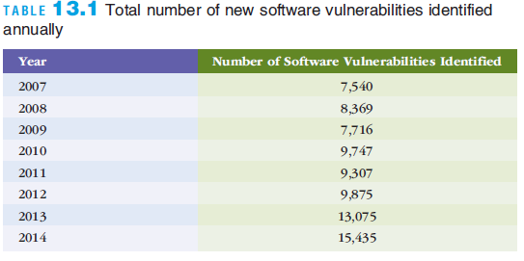
Why Computer Incidents Are So Prevalent
Notes:
Why Computer Incidents Are So Prevalent

Slide 7
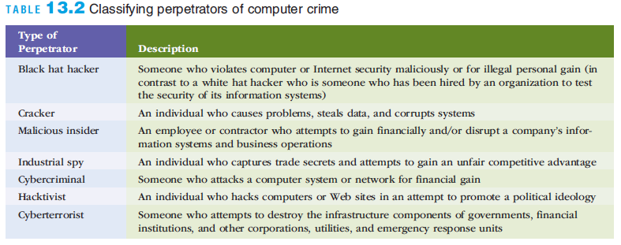
Why Computer Incidents Are So Prevalent
Increasing Sophistication of Those Who Would Do Harm
Today’s computer menace is organized and may be part of an organized group that has an agenda and targets specific organizations and Web sites
Notes:
Why Computer Incidents Are So Prevalent
Increasing Sophistication of Those Who Would Do Harm
Today’s computer menace is organized and may be part of an organized group that has an agenda and targets specific organizations and Web sites

Slide 8
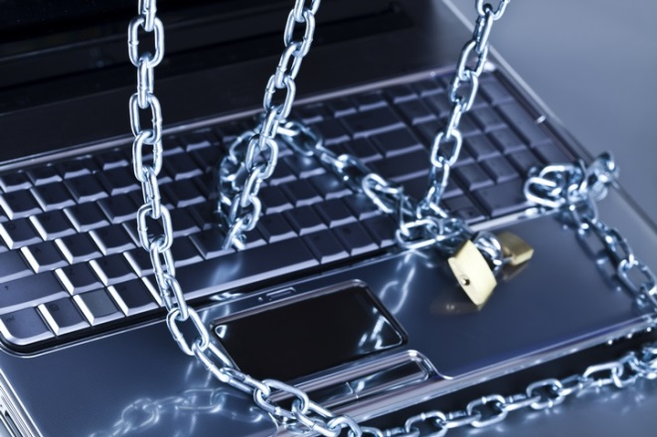
Key Information Security Terms
Information Security refers to all of the processes and policies designed to protect an organization’s information and information systems from unauthorized access, use, disclosure, disruption, modification, or destruction.
Threat any danger to which a system may be exposed.
Exposure the harm, loss or damage that can result if a threat compromises that resource.
Vulnerability the possibility that the system will suffer harm by a threat.
Notes:
Information security refers to all of the processes and policies designed to protect an organization’s
information and information systems from unauthorized access, use, disclosure, disruption,
modification, or destruction.
A threat to an information resource is any danger to which a system may be exposed.
The exposure of an information resources is the harm, loss or damage that can result if a threat
compromises that resource.
A system’s vulnerability is the possibility that the system will suffer harm by a threat.

Slide 9
Five Factors Increasing the Vulnerability of Information Resources
Today’s interconnected, interdependent, wirelessly-networked business environment
Smaller, faster, cheaper computers and storage devices
Decreasing skills necessary to be a hacker
Organized crime taking over cybercrime
Lack of management support
Notes:
Organizations and individuals are now exposed to untrusted networks.
An untrusted network, in general, is any network external to your organization.
The Internet, by definition, is an untrusted network.

Slide 10
Security Threats

Slide 11
Human Errors
Carelessness with laptops and portable computing devices
Opening questionable e-mails
Careless Internet surfing
Poor password selection and use
And more (see table 4.1)
Most Dangerous Employees
HUMAN RESOURCE
MIS
Notes:
As we are discussing human errors, we should note that the biggest threat to the security of an organization’s information assets are the company’s employees.
In fact, the most dangerous employees are those in human resources and MIS. HR employees have access to sensitive personal data on all employees. MIS employees not only have access to sensitive personal data, but also control the means to create, store, transmit, and modify these data.
The image represents how a human resources or MIS employee has access to, or controls, sensitive information in the organization.

Slide 12
Social Engineering
Social engineering is an attack where the attacker uses social skills to trick a legitimate employee into providing confidential company information such as passwords.
Two examples
Tailgating
Shoulder surfing
© Purestock/Age Fotostock America, Inc
Notes:
To deter tailgating, many companies have anti-tailgating doors protecting the entrance into high-security areas. Note that only one person at a time can go through this type of door. Shoulder surfing occurs when the attacker watches another person’s computer screen over that person’s shoulder. Particularly dangerous in public areas such as airports, commuter trains, and on airplanes.

Slide 13
Deliberate Threats to Information Systems
• Espionage or Trespass
• Information extortion
• Sabotage or vandalism
• Theft of equipment or information (dumpster diving)
• Identity theft
• Compromises to intellectual property
• Soft ware attacks
• Alien soft ware
• Supervisory control and data acquisition (SCADA) attacks
• botnet and spam
• distributed denial of service (DDOS)
• advanced persistent threat
• Cyberterrorism and cyberwarfare

Slide 14
Compromises to intellectual property
Intellectual property. Property created by individuals or corporations which is protected under trade secret, patent, and copyright laws.
Trade secret. Intellectual work, such as a business plan, that is a company secret and is not based on public information.
Patent. Document that grants the holder exclusive rights on an invention or process for 20 years.
Copyright. Statutory grant that provides creators of intellectual property with ownership of the property for life of the creator plus 70 years.
Notes:
The identity theft video gives an excellent overview of the problem and how it affects lives. The video continues with a look at how to prevent identity theft.
Compromises to intellectual property
Intellectual property. Property created by individuals or corporations which is protected under trade secret, patent, and copyright laws.
Trade secret. Intellectual work, such as a business plan, that is a company secret and is not based on public information.
Patent. Document that grants the holder exclusive rights on an invention or process for 20 years.
Copyright. Statutory grant that provides creators of intellectual property with ownership of the property for life of the creator plus 70 years.
Piracy. Copying a software program without making payment to the owner.
Virus is a segment of computer code that performs malicious actions by attaching to another computer program.
Worm is a segment of computer code that performs malicious actions and will spread by itself without requiring another computer program.
Trojan horse is a computer program that hides in another computer program and reveals its designated behavior only when it is activated.
Logic bomb is a segment of computer code that is embedded inside an organization’s existing computer programs and is designed to activate and perform a destructive action at a certain time or date.

Slide 15
Software attacks
A virus is a segment of computer code that performs malicious actions by attaching to another computer program.
A worm is a segment of computer code that spreads by itself and performs malicious actions without requiring another computer program.
A Trojan horse is a software program that hides in other computer programs and reveal its designed behavior only when it is activated.
A logic bomb is a segment of computer code that is embedded within an organization’s existing computer programs and is designed to activate and perform a destructive action at a certain time and date.
Ransomware is Malware that stops you from using your computer or accessing your data until you meet certain demands such as paying a ransom or sending photos to the attacker
Distributed denial-of-service attacks the attacker first takes over many computers. These computers are called zombies or bots. Together, these bots form a botnet.
See botnet demonstration
Notes:
A typical behavior of a Trojan horse is to capture your sensitive information (e.g., passwords, account numbers, etc.) and send them to the creator of the Trojan horse.

Slide 16
Types of Exploits
Blended Threat
A sophisticated threat that combines the features of a virus, worm, Trojan horse, and other malicious code into a single payload
Might use server and Internet vulnerabilities to initiate and then transmit and spread an attack using EXE files, HTML files, and registry keys
Spam
The use of email systems to send unsolicited email to large numbers of people
Also an inexpensive method of marketing used by many legitimate organizations
Controlling the Assault of Non-Solicited Pornography and Marketing (CAN-SPAM) Act states that it is legal to spam, provided the messages meet a few basic requirements
Spammers cannot disguise their identity by using a false return address
The email must include a label specifying that it is an ad or a solicitation
The email must include a way for recipients to opt out of future mass mailings
Notes:
Types of Exploits
Blended Threat
A sophisticated threat that combines the features of a virus, worm, Trojan horse, and other malicious code into a single payload
Might use server and Internet vulnerabilities to initiate and then transmit and spread an attack using EXE files, HTML files, and registry keys
Spam
The use of email systems to send unsolicited email to large numbers of people
Also an inexpensive method of marketing used by many legitimate organizations
Controlling the Assault of Non-Solicited Pornography and Marketing (CAN-SPAM) Act states that it is legal to spam, provided the messages meet a few basic requirements
Spammers cannot disguise their identity by using a false return address
The email must include a label specifying that it is an ad or a solicitation
The email must include a way for recipients to opt out of future mass mailings

Slide 17
Types of Exploits
Spam (cont’d)
CAPTCHA (Completely Automated Public Turing Test to Tell Computers and Humans Apart) software generates and grades tests that humans can pass and all but the most sophisticated computer programs cannot
Notes:
Types of Exploits
Spam (cont’d)
CAPTCHA (Completely Automated Public Turing Test to Tell Computers and Humans Apart) software generates and grades tests that humans can pass and all but the most sophisticated computer programs cannot

Slide 18
Deliberate Threats (continued)
Alien Software
Spyware (see video) collects personal information about users without consent like keystroke loggers and screen scrapers.
Spamware
Cookies
Supervisory control and data acquisition (SCADA) attacks Links the physical and electronic world
example power outages like one in 2003
© Manfred Grafweg/Age Fotostock America, Inc.
Notes:
Spyware collects personal information about users without their consent. Two types of spyware are keystroke loggers (keyloggers) and screen scrapers. Keystroke loggers record your keystrokes and your Web browsing history. Screen scrapers record a continuous “movie” of what you do on a screen.
The spyware video provides a nice overview of spyware and how to avoid it.
Spamware is alien software that is designed to use your computer as a launchpad for spammers. Spam is unsolicited e-mail.
Cookies are small amounts of information that Web sites store on your computer.
The cookie demo will show you how much information your computer sends when you connect to a Web site.

Slide 19
Types of Exploits
Distributed Denial-of-Service Attacks
An attack in which a malicious hacker takes over computers via the Internet and causes them to flood a target site with demands for data and other small tasks
Keeps target so busy responding to requests that legitimate users cannot get in
Botnet
A large group of computers, controlled from one or more remote locations by hackers, without the consent of their owners
Sometimes called zombies
Frequently used to distribute spam and malicious code
Notes:
Types of Exploits
Distributed Denial-of-Service Attacks
An attack in which a malicious hacker takes over computers via the Internet and causes them to flood a target site with demands for data and other small tasks
Keeps target so busy responding to requests that legitimate users cannot get in
Botnet
A large group of computers, controlled from one or more remote locations by hackers, without the consent of their owners
Sometimes called zombies
Frequently used to distribute spam and malicious code

Slide 20
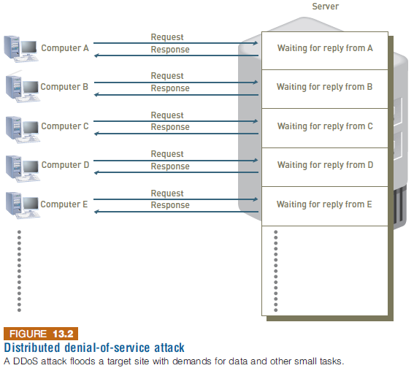
Types of Exploits
Notes:
Types of Exploits

Slide 21
Types of Exploits
Rootkit
A set of programs that enables its user to gain administrator-level access to a computer without the end user’s consent or knowledge
Attackers can use the rootkit to execute files, access logs, monitor user activity, and change the computer’s configuration
Symptoms of rootkit infections:
Computer locks up or fails to respond to input from the keyboard
Screen saver changes without any action on the part of the user
Taskbar disappears
Network activities function extremely slow
Notes:
Types of Exploits
Rootkit
A set of programs that enables its user to gain administrator-level access to a computer without the end user’s consent or knowledge
Attackers can use the rootkit to execute files, access logs, monitor user activity, and change the computer’s configuration
Symptoms of rootkit infections:
Computer locks up or fails to respond to input from the keyboard
Screen saver changes without any action on the part of the user
Taskbar disappears
Network activities function extremely slow

Slide 22
Types of Exploits
Advanced Persistent Threat
APT is a network attack in which an intruder gains access to a network and stays undetected with the intention of stealing data over a long period of time
An APT attack advances through the following five phases:
Reconnaissance
Incursion
Discovery
Capture
Export
Detecting anomalies in outbound data is the best way for administrators to discover that the network has been the target of an APT attack
Notes:
Types of Exploits
Advanced Persistent Threat
APT is a network attack in which an intruder gains access to a network and stays undetected with the intention of stealing data over a long period of time
An APT attack advances through the following five phases:
Reconnaissance
Incursion
Discovery
Capture
Export
Detecting anomalies in outbound data is the best way for administrators to discover that the network has been the target of an APT attack

Slide 23
Types of Exploits
Phishing
The act of fraudulently using email to try to get the recipient to reveal personal data
Con artists send legitimate-looking emails urging recipients to take action to avoid a negative consequence or to receive a reward
Spear-phishing is a variation of phishing where fraudulent emails are sent to a certain organization’s employees
Much more precise and narrow
Designed to look like they came from high-level executives within organization
Notes:
Types of Exploits
Phishing
The act of fraudulently using email to try to get the recipient to reveal personal data
Con artists send legitimate-looking emails urging recipients to take action to avoid a negative consequence or to receive a reward
Spear-phishing is a variation of phishing where fraudulent emails are sent to a certain organization’s employees
Much more precise and narrow
Designed to look like they came from high-level executives within organization

Slide 24
Phishing attacks
Phishing slideshow
Phishing quiz
Phishing example
Phishing example
Notes:
Phishing attacks use deception to acquire sensitive personal information by masquerading as official-looking e-mails or instant messages.
The phishing slideshow presents a nice demonstration of how phishing works.
The phishing quiz presents a variety of e-mails. You must decide which are legitimate and which are phishing attempts.
The phishing examples show actual phishing attempts.
In a distributed denial-of-service attack, the attacker first takes over many computers. These computers are called zombies or bots. Together, these bots form a botnet.
The botnet demonstration shows how botnets are created and how they work.

Slide 25
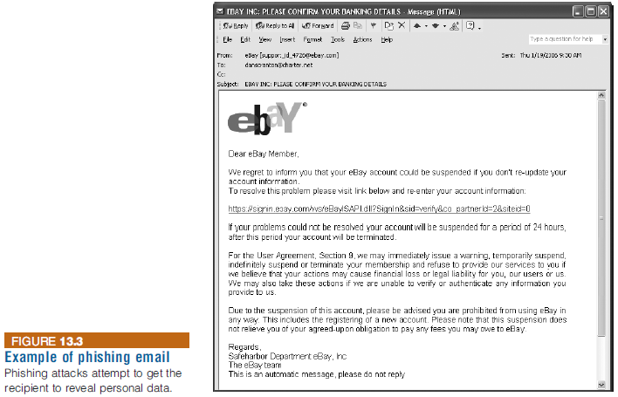
Types of Exploits
Notes:
Types of Exploits

Slide 26
Types of Exploits
Smishing and Vishing
Smishing is a variation of phishing that involves the use of texting
Vishing is similar to smishing except the victims receive a voice mail message telling them to call a phone number or access a Web site
Identity Theft
The theft of personal information and then used without their permission
Data breach is the unintended release of sensitive data or the access of sensitive data by unauthorized individuals
Often results in identity theft
Most e-commerce Web sites use some form of encryption technology to protect information as it comes from the consumer
Notes:
Types of Exploits
Smishing and Vishing
Smishing is a variation of phishing that involves the use of texting
Vishing is similar to smishing except the victims receive a voice mail message telling them to call a phone number or access a Web site
Identity Theft
The theft of personal information and then used without their permission
Data breach is the unintended release of sensitive data or the access of sensitive data by unauthorized individuals
Often results in identity theft
Most e-commerce Web sites use some form of encryption technology to protect information as it comes from the consumer

Slide 27
Types of Exploits
Cyberespionage
Involves the development of malware that secretly steals data in the computer systems of organizations, such as government agencies, military contractors, political organizations, and manufacturing firms
Mostly targeted toward high-value data such as the following:
Sales, marketing, and new product development plans, schedules, and budgets
Details about product designs and innovative processes
Employee personal information
Customer and client data
Sensitive information about partners and partner agreements
Notes:
Types of Exploits
Cyberespionage
Involves the development of malware that secretly steals data in the computer systems of organizations, such as government agencies, military contractors, political organizations, and manufacturing firms
Mostly targeted toward high-value data such as the following:
Sales, marketing, and new product development plans, schedules, and budgets
Details about product designs and innovative processes
Employee personal information
Customer and client data
Sensitive information about partners and partner agreements

Slide 28
Types of Exploits
Cyberterrorism
The intimidation of government of civilian population by using information technology to disable critical national infrastructure to achieve political, religious, or ideological goals
Department of Homeland Security (DHS) provides a link that enables users to report cyber incidents
Incident reports go to the U.S. Computer Emergency Readiness Team (US-CERT)
Cyberterrorists try daily to gain unauthorized access to a number of important and sensitive sites
Notes:
Types of Exploits
Cyberterrorism
The intimidation of government of civilian population by using information technology to disable critical national infrastructure to achieve political, religious, or ideological goals
Department of Homeland Security (DHS) provides a link that enables users to report cyber incidents
Incident reports go to the U.S. Computer Emergency Readiness Team (US-CERT)
Cyberterrorists try daily to gain unauthorized access to a number of important and sensitive sites

Slide 29
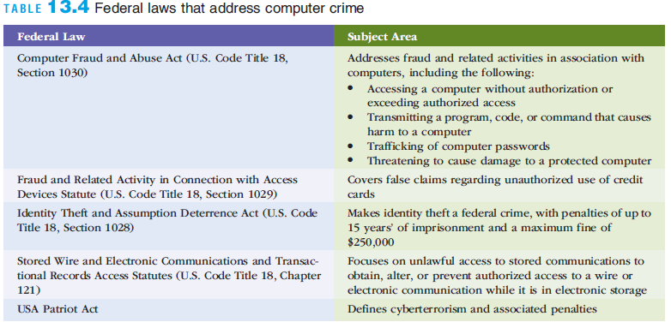
Federal Laws for Prosecuting Computer Attacks
Notes:
Federal Laws for Prosecuting Computer Attacks

Slide 30
Implementing Secure, Private, Reliable Computing
A strong security program begins by
Assessing threats to the organization’s computers and network
Identifying actions that address the most serious vulnerabilities
Educating users about the risks involved and the actions they must take to prevent a security incident
If an intrusion occurs, there must be a clear reaction plan that addresses:
Notification
Evidence protection
Activity log maintenance
Containment
Eradication
Recovery
Notes:
Implementing Secure, Private, Reliable Computing
A strong security program begins by
Assessing threats to the organization’s computers and network
Identifying actions that address the most serious vulnerabilities
Educating users about the risks involved and the actions they must take to prevent a security incident
If an intrusion occurs, there must be a clear reaction plan that addresses:
Notification
Evidence protection
Activity log maintenance
Containment
Eradication
Recovery

Slide 31
Risk Assessment
Risk assessment
The process of assessing security-related risks to an organization’s computer and networks form both internal and external threats
Steps in a general risk assessment process are:
Identify the set of IS assets about which the organization is most concerned
Identify the loss events or the risks or threats that could occur
Assess the frequency of events or the likelihood of each potential threat
Determine the impact of each threat occurring
Determine how each threat can be mitigated so it is less likely to occur
Assess the feasibility of implementing the mitigation options
Perform a cost-benefit analysis to ensure that your efforts will be cost effective
Make the decision on whether or not to implement a particular countermeasure
Notes:
Risk Assessment
Risk assessment
The process of assessing security-related risks to an organization’s computer and networks form both internal and external threats
Steps in a general risk assessment process are:
Identify the set of IS assets about which the organization is most concerned
Identify the loss events or the risks or threats that could occur
Assess the frequency of events or the likelihood of each potential threat
Determine the impact of each threat occurring
Determine how each threat can be mitigated so it is less likely to occur
Assess the feasibility of implementing the mitigation options
Perform a cost-benefit analysis to ensure that your efforts will be cost effective
Make the decision on whether or not to implement a particular countermeasure

Slide 32
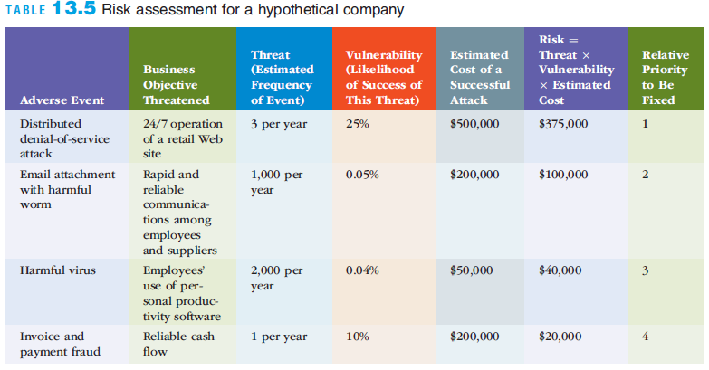
Risk Assessment
Notes:
Risk Assessment

Slide 33
Risk Management
Risk. The probability that a threat will impact an information resource.
Risk management. To identify, control and minimize the impact of threats.
Risk analysis. To assess the value of each asset being protected, estimate the probability it might be compromised, and compare the probable costs of it being compromised with the cost of protecting it.
Risk mitigation is when the organization takes concrete actions against risk. It has two functions:
(1) implement controls to prevent identified threats from occurring, and
(2) developing a means of recovery should the threat become a reality.
© Youri van der Schalk/Age Fotostock
America, Inc.

Slide 34
Risk Mitigation Strategies
Risk Acceptance. Accept the potential risk, continue operating with no controls, and absorb any damages that occur.
Risk limitation. Limit the risk by implementing controls that minimize the impact of threat.
Risk transference. Transfer the risk by using other means to compensate for the loss, such as purchasing insurance.

Slide 35
Establishing a Security Policy
Security policy
Defines an organization’s security requirements along with the controls and sanctions needed to meet those requirements
Outlines what needs to be done but not how to do it
Automated system rules should mirror an organization’s written policies
Some companies have begun to include special security requirements for mobile devices as part of their security policies
Notes:
Establishing a Security Policy
Security policy
Defines an organization’s security requirements along with the controls and sanctions needed to meet those requirements
Outlines what needs to be done but not how to do it
Automated system rules should mirror an organization’s written policies
Some companies have begun to include special security requirements for mobile devices as part of their security policies

Slide 36
Educating Employees and Contract Workers
Users can protect an organization’s information systems by:
Guarding their passwords to protect against unauthorized access to their accounts
Prohibiting others from using their passwords
Applying strict access controls (file and directory permissions) to protect data from disclosure or destruction
Reporting all unusual activity to the organization’s IT security group
Taking care to ensure that portable computing and data storage devices are protected (hundreds of thousands of laptops are lost or stolen per year)
Notes:
Educating Employees and Contract Workers
Users can protect an organization’s information systems by:
Guarding their passwords to protect against unauthorized access to their accounts
Prohibiting others from using their passwords
Applying strict access controls (file and directory permissions) to protect data from disclosure or destruction
Reporting all unusual activity to the organization’s IT security group
Taking care to ensure that portable computing and data storage devices are protected (hundreds of thousands of laptops are lost or stolen per year)

Slide 37
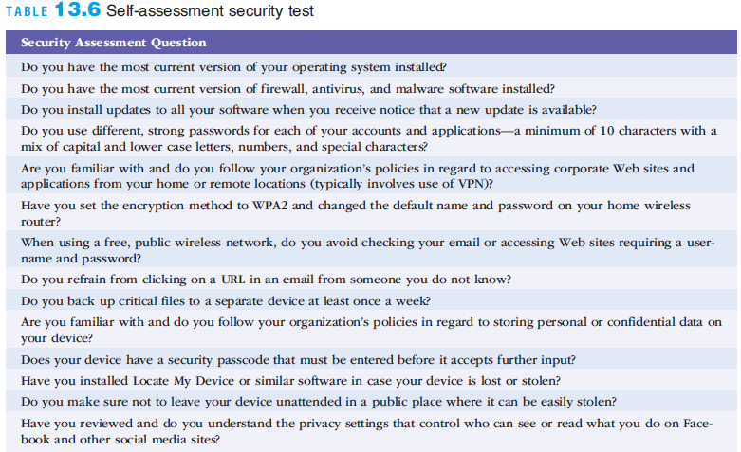
Educating Employees and Contract Workers
Notes:
Educating Employees and Contract Workers

Slide 38
Prevention
Organizations should implement a layered security solution to make computer break-ins so difficult that an attacker gives up
If an attacker breaks through one layer, another layer must then be overcome
Layers of protective measures are explain in more detail in the following sections
Notes:
Prevention
Organizations should implement a layered security solution to make computer break-ins so difficult that an attacker gives up
If an attacker breaks through one layer, another layer must then be overcome
Layers of protective measures are explain in more detail in the following sections

Slide 39
Information Security Controls
Physical controls
Access controls
Communications (network) controls
Virtual private networking
Secure Socket Layer (now transport layer security)
Employee monitoring systems
Notes:
Physical controls. Physical protection of computer facilities and resources.
Access controls. Restriction of unauthorized user access to computer resources; use biometrics and passwords controls for user identification.
Communications (network) controls. To protect the movement of data across networks and include
border security controls, authentication and authorization.
A virtual private network is a private network that uses a public network (usually the Internet) to connect users.
Secure socket layer (SSL), now called transport layer security (TLS), is an encryption standard used for secure transactions such as credit card purchases and online banking.
Employee monitoring systems monitor employees’ computers, e-mail activities, and Internet surfing activities.

Slide 40
Access Controls
Authentication - Major objective is proof of identity.
Something the User Is - Also known as biometrics, these access controls examine a user's innate physical characteristics.
Something the User Has - These access controls include regular ID cards, smart cards, and tokens.
Something the User Does - These access controls include voice and signature recognition.
Something the User Knows - These access controls include passwords and passphrases. A password is a private combination of characters that only the user should know. A passphrase is a series of characters that is longer than a password but can be memorized easily.
Notes:
Authorization - Permission issued to individuals and groups to do certain activities with information resources, based on verified identity.
A privilege is a collection of related computer system operations that can be performed by users of the system.
Least privilege is a principle that users be granted the privilege for some activity only if there is a justifiable need to grant this authorization.

Slide 41
Communications Controls
Anti-malware systems (also called antivirus software) are software packages that attempt to identify and eliminate viruses, worms, and other malicious software. The logos show three well-known anti-malware companies. Clicking on the link will take you to each company’s homepage, respectively.
Whitelisting is a process in which a company identifies the software that it will allow to run and does not try to recognize malware.
Blacklisting is a process in which a company allows all software to run unless it is on the blacklist.
Encryption. Process of converting an original message into a form that cannot be read by anyone except the intended receiver.

Slide 42
Implementing a Corporate Firewall
Firewalls System that enforces access-control policy between two networks
A system of software, hardware, or a combination of both that stands guard between an organization’s internal network and the Internet and limits network access based on the organization’s access policy
Next-generation firewall (NGFW)
A hardware- or software-based network security system that is able to detect and block sophisticated attacks by filtering network traffic dependent on the packet contents
Goes deeper to inspect the payload of packets and match sequences of bytes for harmful activities
Notes:
Implementing a Corporate Firewall
Firewall
A system of software, hardware, or a combination of both that stands guard between an organization’s internal network and the Internet and limits network access based on the organization’s access policy
Next-generation firewall (NGFW)
A hardware- or software-based network security system that is able to detect and block sophisticated attacks by filtering network traffic dependent on the packet contents
Goes deeper to inspect the payload of packets and match sequences of bytes for harmful activities

Slide 43
Business Continuity Planning, Backup, and Recovery
Hot Site is a fully configured computer facility, with all services, communications links, and physical plant operations.
Warm Site provides many of the same services and options of the hot site, but it typically does not include the actual applications the company runs.
Cold Site provides only rudimentary services and facilities and so does not supply computer hardware or user workstations.

Slide 44
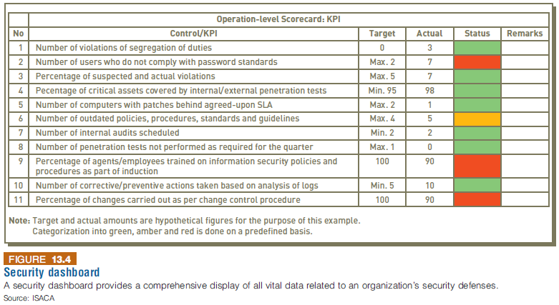
Utilizing a Security Dashboard
Security dashboard software provides a comprehensive display of all vital data related to an organization’s security defenses
Notes:
Utilizing a Security Dashboard
Security dashboard software provides a comprehensive display of all vital data related to an organization’s security defenses

Slide 45
Installing Antivirus Software on Personal Computers
Antivirus software
Scans for specific sequence of bytes, known as a virus signature, that indicates the presence of a specific virus
If virus is found
Antivirus software informs the user and may clean, delete, or quarantine any files, directories, or disks affected by the malicious code
It is crucial that antivirus software be continually updated with the latest virus signatures
Notes:
Installing Antivirus Software on Personal Computers
Antivirus software
Scans for specific sequence of bytes, known as a virus signature, that indicates the presence of a specific virus
If virus is found
Antivirus software informs the user and may clean, delete, or quarantine any files, directories, or disks affected by the malicious code
It is crucial that antivirus software be continually updated with the latest virus signatures

Slide 46
Implementing Safeguards against Attacks by Malicious Insiders
User accounts that remain active after employees leave a company are a potential security risk
IS staff must promptly delete computer accounts, login IDs, and passwords of departing employees
Another safeguard
Create roles and user accounts so that users have the authority to perform their responsibilities and nothing more
Notes:
Implementing Safeguards against Attacks by Malicious Insiders
User accounts that remain active after employees leave a company are a potential security risk
IS staff must promptly delete computer accounts, login IDs, and passwords of departing employees
Another safeguard
Create roles and user accounts so that users have the authority to perform their responsibilities and nothing more

Slide 47
Addressing the Most Critical Internet Security Threats
Computer attackers
Know that many organizations are slow to fix problems
Scan the Internet for vulnerable systems
US-CERT regularly updates a summary of the most frequent, high-impact vulnerabilities being reported
Find it at www.us-cert.gov/current
Actions required to address these issues include installing a known patch to the software
And keeping applications and OSs up-to-date
Notes:
Addressing the Most Critical Internet Security Threats
Computer attackers
Know that many organizations are slow to fix problems
Scan the Internet for vulnerable systems
US-CERT regularly updates a summary of the most frequent, high-impact vulnerabilities being reported
Find it at www.us-cert.gov/current
Actions required to address these issues include installing a known patch to the software
And keeping applications and OSs up-to-date

Slide 48
Conducting Periodic IT Security Audits
Security audit
Evaluates whether an organization has well-considered security policy in place and if it is being followed
The audit should
Review who has access to particular systems and data and what level of authority each user has
Test system safeguards to ensure that they are operating as intended
Some organizations also perform a penetration test
Individuals try to break through the measures and identify vulnerabilities
Notes:
Conducting Periodic IT Security Audits
Security audit
Evaluates whether an organization has well-considered security policy in place and if it is being followed
The audit should
Review who has access to particular systems and data and what level of authority each user has
Test system safeguards to ensure that they are operating as intended
Some organizations also perform a penetration test
Individuals try to break through the measures and identify vulnerabilities

Slide 49
Detection
Intrusion detection system (IDS)
Software and/or hardware that monitors system and network resources and activities
Notifies network security personnel when it detects network traffic that attempts to circumvent the security measures of a networked computer environment
Knowledge-based IDS
Contain information about specific attacks and system vulnerabilities
Behavior-based IDS
Models normal behavior of a system and its user from reference information collected by various means
Notes:
Detection
Intrusion detection system (IDS)
Software and/or hardware that monitors system and network resources and activities
Notifies network security personnel when it detects network traffic that attempts to circumvent the security measures of a networked computer environment
Knowledge-based IDS
Contain information about specific attacks and system vulnerabilities
Behavior-based IDS
Models normal behavior of a system and its user from reference information collected by various means

Slide 50
Detection
Notes:
Detection

Slide 51
Response
A response plan should be developed well in advance of any incident
Should be approved by the organization’s legal department and senior management
A well-developed response plan helps keep an incident under technical and emotional control
In a security incident, the primary goal must be to:
Regain control and limit damage, not to attempt to monitor or catch an intruder
Notes:
Response
A response plan should be developed well in advance of any incident
Should be approved by the organization’s legal department and senior management
A well-developed response plan helps keep an incident under technical and emotional control
In a security incident, the primary goal must be to:
Regain control and limit damage, not to attempt to monitor or catch an intruder

Slide 52
Incident Notification
Key element of a response plan is to
Define who to notify and who not to notify in the event of a security incident
Questions to cover:
Within the company, who needs to be notified, and what information does each person need to have?
Under what conditions should the company contact major customers and suppliers?
How does the company inform them of a disruption in business without unnecessarily alarming them?
When should local authorities or the FBI be contacted?
A critical ethical question:
What to tell customers and others whose personal data may have been compromised?
Notes:
Incident Notification
Key element of a response plan is to
Define who to notify and who not to notify in the event of a security incident
Questions to cover:
Within the company, who needs to be notified, and what information does each person need to have?
Under what conditions should the company contact major customers and suppliers?
How does the company inform them of a disruption in business without unnecessarily alarming them?
When should local authorities or the FBI be contacted?
A critical ethical question:
What to tell customers and others whose personal data may have been compromised?

Slide 53
Protection of Evidence and Activity Logs
Organizations should document all details of a security incident as it works to resolve the incident
Documentation captures valuable evidence for a future prosecution
And provides data to help during the incident eradication and follow-up phases
Organizations should establish a set of document-handling procedures using the legal department as a resource
Notes:
Protection of Evidence and Activity Logs
Organizations should document all details of a security incident as it works to resolve the incident
Documentation captures valuable evidence for a future prosecution
And provides data to help during the incident eradication and follow-up phases
Organizations should establish a set of document-handling procedures using the legal department as a resource

Slide 54
Incident Containment
The incident response plan should clearly define the process for deciding if an attack is dangerous enough to warrant shutting down or disconnecting critical systems from the network
Elements of an effective response plan:
How decisions for shutting down systems is made
How fast those decisions are made
Who makes them
Notes:
Incident Containment
The incident response plan should clearly define the process for deciding if an attack is dangerous enough to warrant shutting down or disconnecting critical systems from the network
Elements of an effective response plan:
How decisions for shutting down systems is made
How fast those decisions are made
Who makes them

Slide 55
Eradication
Before eradication, the IT security group must:
Collect and log all possible criminal evidence from the system
Verify that all necessary backups are current, complete, and free of any malware
Create a forensic disk image of each compromised system
After eradication, a new backup must be created
A log should be kept of all actions taken
All backups should be created with enough frequency to enable a full and quick restoration of data
If an attack destroys the original
Notes:
Eradication
Before eradication, the IT security group must:
Collect and log all possible criminal evidence from the system
Verify that all necessary backups are current, complete, and free of any malware
Create a forensic disk image of each compromised system
After eradication, a new backup must be created
A log should be kept of all actions taken
All backups should be created with enough frequency to enable a full and quick restoration of data
If an attack destroys the original

Slide 56
Incident Follow-Up
Follow-up should include:
Determining how the organization’s security was compromised
A review to determine exactly what happened and to evaluate how the organization responded
A detailed chronology of all events
An estimate of the monetary damage
A decision on how much effort should be put into capturing the perpetrator
A decision on whether it has an ethical or a legal duty to inform customers or clients of a cyber attack
Notes:
Incident Follow-Up
Follow-up should include:
Determining how the organization’s security was compromised
A review to determine exactly what happened and to evaluate how the organization responded
A detailed chronology of all events
An estimate of the monetary damage
A decision on how much effort should be put into capturing the perpetrator
A decision on whether it has an ethical or a legal duty to inform customers or clients of a cyber attack

Slide 57
Using a Managed Security Service Provider (MSSP)
Managed Security Service Provider (MSSP)
A company that monitors, manages, and maintains computer and network security for other organizations
Includes companies such as AT&T, Computer Sciences Corporation, Dell SecureWorks, IBM, Symantec, and Verizon
Some MSSPs provide vulnerability scanning and Web blocking and filtering capabilities
Notes:
Using a Managed Security Service Provider (MSSP)
Managed Security Service Provider (MSSP)
A company that monitors, manages, and maintains computer and network security for other organizations
Includes companies such as AT&T, Computer Sciences Corporation, Dell SecureWorks, IBM, Symantec, and Verizon
Some MSSPs provide vulnerability scanning and Web blocking and filtering capabilities

Slide 58
Computer Forensics
Computer Forensics
A discipline that combines elements of law and computer science to identify, collect, examine, and preserve data from computer systems, networks, and storage devices in a manner that preserves the integrity of the data gathered
Computer forensics investigators work as a team to investigate an incident and conduct the forensic analysis
Proper handling of computer forensics investigation is the key to fighting computer crime successfully in a court of law
Numerous certifications exist:
CCE (Certified Computer Examiner), CISSP (Certified Information Systems Security Professional), CSFA (CyberSecurity Forensic Analyst), and GCFA (Global Information Assurance Certification Certified Forensic Analyst)
Notes:
Computer Forensics
Computer Forensics
A discipline that combines elements of law and computer science to identify, collect, examine, and preserve data from computer systems, networks, and storage devices in a manner that preserves the integrity of the data gathered
Computer forensics investigators work as a team to investigate an incident and conduct the forensic analysis
Proper handling of computer forensics investigation is the key to fighting computer crime successfully in a court of law
Numerous certifications exist:
CCE (Certified Computer Examiner), CISSP (Certified Information Systems Security Professional), CSFA (CyberSecurity Forensic Analyst), and GCFA (Global Information Assurance Certification Certified Forensic Analyst)

Slide 59
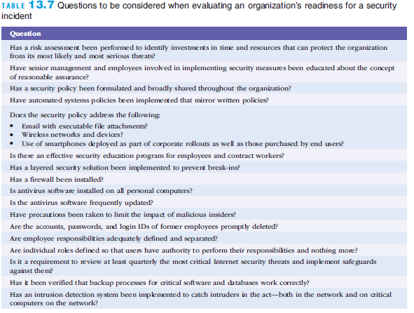
Computer Forensics
Notes:
Computer Forensics

Slide 60
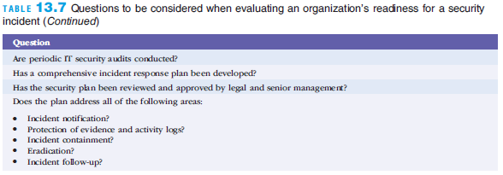
Computer Forensics
Notes:
Computer Forensics

Slide 61
Summary
Computer crime is a serious and rapidly growing area of concern requiring management attention
Organizations must take strong measures to ensure secure, private, and reliable computing experiences for their employees, customers, and business partners
Notes:
Summary
Computer crime is a serious and rapidly growing area of concern requiring management attention
Organizations must take strong measures to ensure secure, private, and reliable computing experiences for their employees, customers, and business partners

