Slide 1
CHAPTER 14
Ethics and Privacy and legal and social issues

Slide 2
Computer Waste and Mistakes
Examples of computer-related waste include:
Organization’s operating unintegrated information systems
Acquiring redundant systems
Wasting information system resources
Computer-related mistakes refer to:
Errors
Failures
Other computer problems that make computer output incorrect or not useful
Most computer-related mistakes are caused by human error
Notes:
Computer Waste and Mistakes
Examples of computer-related waste include:
Organization’s operating unintegrated information systems
Acquiring redundant systems
Wasting information system resources
Computer-related mistakes refer to:
Errors
Failures
Other computer problems that make computer output incorrect or not useful
Most computer-related mistakes are caused by human error

Slide 3
Computer Waste
Unintegrated information systems make it difficult to collaborate and share information
Leads to missed opportunities, increased costs, and lost sales
Systems acquired in different organizational units that perform the same functions
Increases hardware and software costs
Improper use of information systems and resources by employees
Sending texts and personal email, playing computer games, surfing the Web, shopping online, checking for updates on Instagram or Facebook, etc.
Notes:
Computer Waste
Unintegrated information systems make it difficult to collaborate and share information
Leads to missed opportunities, increased costs, and lost sales
Systems acquired in different organizational units that perform the same functions
Increases hardware and software costs
Improper use of information systems and resources by employees
Sending texts and personal email, playing computer games, surfing the Web, shopping online, checking for updates on Instagram or Facebook, etc.

Slide 4
Computer-Related Mistakes
Common causes
Unclear expectations
Inadequate training and feedback
Program development that contains errors
Incorrect input by a data-entry clerk
Some examples:
Data-entry or data-capture errors
Programming errors
Errors in handling files
Mishandling of computer output
Inadequate planning for and control of equipment malfunctions
Notes:
Computer-Related Mistakes
Common causes
Unclear expectations
Inadequate training and feedback
Program development that contains errors
Incorrect input by a data-entry clerk
Some examples:
Data-entry or data-capture errors
Programming errors
Errors in handling files
Mishandling of computer output
Inadequate planning for and control of equipment malfunctions

Slide 5
Preventing Computer-Related Waste and Mistakes
IS efficiency and effectiveness involves:
Establishing policies and procedures
Implementing policies and procedures
Monitoring policies and procedures
Reviewing policies and procedures
Notes:
Preventing Computer-Related Waste and Mistakes
IS efficiency and effectiveness involves:
Establishing policies and procedures
Implementing policies and procedures
Monitoring policies and procedures
Reviewing policies and procedures

Slide 6
Establishing Policies and Procedures
Training programs as well as manuals and documents covering the use and maintenance of information systems
Can help prevent computer waste and mistakes
Additional preventative measures:
Requirement that all new applications be approved through an established process before they are rolled out
Requirement that documentation and descriptions of certain applications be filed or submitted to a central office
Notes:
Establishing Policies and Procedures
Training programs as well as manuals and documents covering the use and maintenance of information systems
Can help prevent computer waste and mistakes
Additional preventative measures:
Requirement that all new applications be approved through an established process before they are rolled out
Requirement that documentation and descriptions of certain applications be filed or submitted to a central office

Slide 7
Ethical Frameworks
Utilitarian approach: an ethical action is the one that provides the most good or does the least harm.
Rights approach: ethical action is the one that best protects and respects the moral rights of the
affected parties.
Fairness approach: ethical actions treat all humans equally, or if unequally, then fairly, based on some
defensible standard.
Common good approach: highlights the interlocking relationships that underlie all societies.

Slide 8
General Framework for Ethics
Recognize an ethical issue
Get the facts
Evaluate alternative actions
Make a decision and test it
Act and reflect on the outcome of your decision

Slide 9
Including Ethical Considerations in Decision Making
General steps taken during the decision-making process:
Gather information
Develop a problem statement
Consult those involved as well as other appropriate resources
Identify options
Weigh options
Choose an option
Implement a solution
Review results
Some decisions may become complicated because they involves significant value conflicts
Notes:
Including Ethical Considerations in Decision Making
General steps taken during the decision-making process:
Gather information
Develop a problem statement
Consult those involved as well as other appropriate resources
Identify options
Weigh options
Choose an option
Implement a solution
Review results
Some decisions may become complicated because they involves significant value conflicts

Slide 10
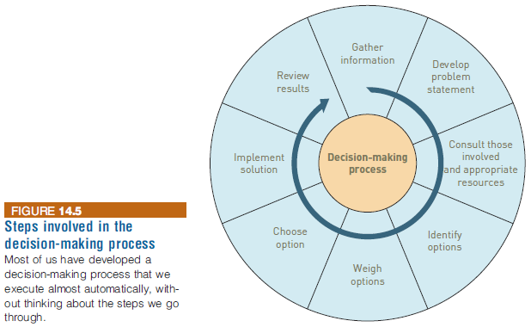
Including Ethical Considerations in Decision Making
Notes:
Including Ethical Considerations in Decision Making

Slide 11
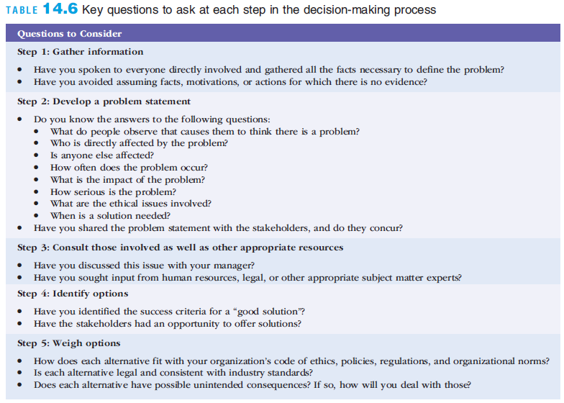
Including Ethical Considerations in Decision Making
Notes:
Including Ethical Considerations in Decision Making

Slide 12
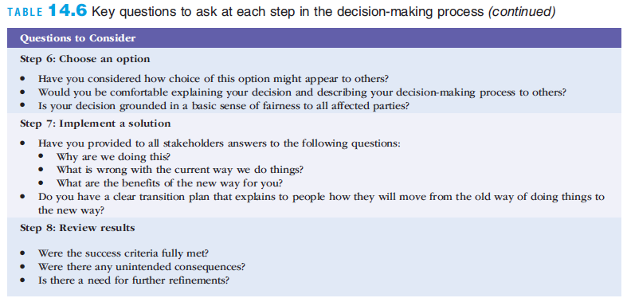
Including Ethical Considerations in Decision Making
Notes:
Including Ethical Considerations in Decision Making

Slide 13
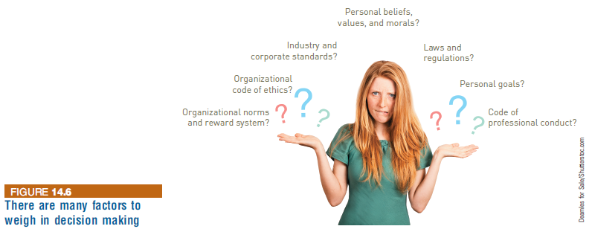
Including Ethical Considerations in Decision Making
Notes:
Including Ethical Considerations in Decision Making

Slide 14
Code of Ethics
A code of ethics:
States the principles and core values essential to a set of people and, therefore, govern their behavior
Can become a reference point for weighing what is legal and what is ethical
Mishandling of the social issues discussed in this chapter—including waste and mistakes, crime, privacy, health, and ethics—can devastate an organization
Prevention of these problems and recovery from them are important aspects of managing information and information systems as critical corporate assets
Notes:
Code of Ethics
A code of ethics:
States the principles and core values essential to a set of people and, therefore, govern their behavior
Can become a reference point for weighing what is legal and what is ethical
Mishandling of the social issues discussed in this chapter—including waste and mistakes, crime, privacy, health, and ethics—can devastate an organization
Prevention of these problems and recovery from them are important aspects of managing information and information systems as critical corporate assets

Slide 15
Ethics in the Corporate Environment
Fundamental tenets of ethics
Responsibility: Accepting the potential costs, duties, and obligations for decisions
Accountability: Mechanisms for identifying responsible parties
Liability: Permits individuals (and firms) to recover damages done to them
Due process: Laws are well known and understood, with an ability to appeal to higher authorities
Notes:
A Code of Ethics is a collection of principles that are intended to guide decision making by members of an organization.
Responsibility means that you accept the consequences of your decisions and actions.
Accountability means a determination of who is responsible for actions that were taken.
Liability is a legal concept meaning that individuals have the right to recover the damages done to them by other individuals, organizations, or systems.

Slide 16
Understanding Ethical and Social Issues Related to Systems
Five moral dimensions of the information age
Information rights and obligations
Property rights and obligations
Accountability and control
System quality
Quality of life
Notes:
Give examples of each of the five major issues. For example, an issue dealing with information rights might be, “What rights do individuals possess with respect to themselves?” What do they have a right to protect? An issue dealing with quality of life might be, “What values should be preserved in an information- and knowledge- based society?” An issue dealing with system quality might be, “What standards of data and system quality should we demand to protect individual rights and the safety of society?”

Slide 17
Ethics in an Information Society
Six Candidate Ethical Principles
Golden Rule
Do unto others as you would have them do unto you
Immanuel Kant’s Categorical Imperative
If an action is not right for everyone to take, it is not right for anyone
Descartes’ Rule of Change
If an action cannot be taken repeatedly, it is not right to take at all
Notes:
This slide and the next review six traditional ethical principles. Ensure students understand the difference between the categorical imperative and the rule of change. Briefly, the difference is that the categorical imperative spans the entirety of the populace, while the rule of change applies to the decisions of one person over time. For example, the categorical imperative applies to an employee who tries to steal money from his employer. He shouldn’t do this, because if all employees attempted to do so, the company would fail. The rule of change applied to the same situation might run as follows: while the employee’s stealing one dollar from the company would not lead to any true problem, repeatedly stealing one dollar, or stealing a lot of dollars, would be unacceptable and ultimately lead to the destruction of the company.

Slide 18
Ethics in an Information Society
Six Candidate Ethical Principles (cont.)
Utilitarian Principle
Take the action that achieves the higher or greater value
Risk Aversion Principle
Take the action that produces the least harm or least potential cost
Ethical “no free lunch” Rule
Assume that virtually all tangible and intangible objects are owned by someone unless there is a specific declaration otherwise
Notes:
How does the “no free lunch” rule relate to copyrights, patents, and trademarks? (These concepts are discussed in later slides.)
Explain that the appearance of unethical behavior is as harmful as actual unethical behavior at times, so adherence to these principles are critical. In an age of “open software” how does the principle of “no free lunch” work out?

Slide 19
Key technology trends that raise ethical issues
Doubling of computer power
More organizations depend on computer systems for critical operations
Rapidly declining data storage costs
Organizations can easily maintain detailed databases on individuals
Networking advances and the Internet
Copying data from one location to another and accessing personal data from remote locations is much easier
Notes:
This slide and the next discuss four main technology trends that raise ethical issues. Which of these trends do students believe might have the most adverse consequences? Why do they feel this way? Do the positives outweigh the negatives for all four issues? Why or why not?

Slide 20
Key technology trends that raise ethical issues (cont.)
Key technology trends that raise ethical issues (cont.)
Advances in data analysis techniques
Companies can analyze vast quantities of data gathered on individuals for:
Profiling
Combining data from multiple sources to create dossiers of detailed information on individuals
Nonobvious relationship awareness (NORA)
Combining data from multiple sources to find obscure hidden connections that might help identify criminals or terrorists
Notes:
Online profiling is one of the most controversial computer-related ethical, social and political issues today. While it is used fairly extensively on the Internet, it is also used by insurance firms, health insurance firms, casinos, and of course national authorities around the globe for finding potential terrorists.

Slide 21
Ethics and Information Technology
Privacy involves collecting, storing and disseminating information about individuals. It has three component issues.
Accuracy Issues involve the authenticity, fidelity and accuracy of information that is collected and processed.
Property Issues involve the ownership and value of information.
Accessibility Issues revolve around who should have access to information and whether they should have to pay for this access.

Slide 22
Privacy
Issue of privacy deals with the right to be left alone or to be withdrawn from public view
Data is constantly being collected and stored on each of us
The data is often distributed over easily accessed networks without our knowledge or consent
Who owns this information and knowledge?
Notes:
Privacy Issues
Issue of privacy deals with the right to be left alone or to be withdrawn from public view
Data is constantly being collected and stored on each of us
The data is often distributed over easily accessed networks without our knowledge or consent
Who owns this information and knowledge?

Slide 23
Privacy
Court decisions have followed two rules:
(1) The right of privacy is not absolute.
Your privacy must be balanced against
the needs of society.
(2) The public’s right to know is superior to
the individual’s right of privacy.
Notes:
Privacy is the right to be left alone and to be free of unreasonable personal intrusions.

Slide 24
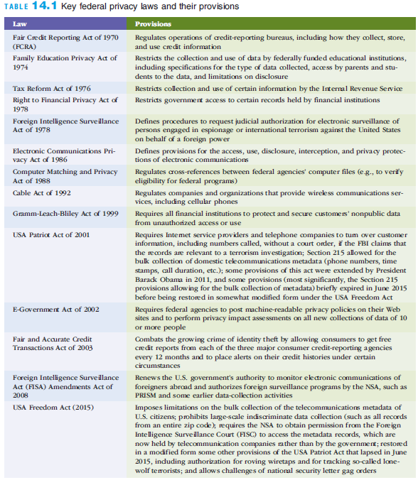
Privacy and the Federal Government
Notes:
Privacy and the Federal Government

Slide 25
Privacy at Work
Employers use technology and corporate policies to manage worker productivity and protect the use of IS resources
Employers are concerned about inappropriate Web surfing
Organizations monitor employees’ email
More than half retain and review messages
Most employers have a policy that explicitly eliminates any expectation of privacy when an employee uses any company-owned computer, server, or e-mail system
The courts have ruled that, without a reasonable expectation of privacy, there is no Fourth Amendment protection for the employee
Notes:
Privacy at Work
Employers use technology and corporate policies to manage worker productivity and protect the use of IS resources
Employers are concerned about inappropriate Web surfing
Organizations monitor employees’ email
More than half retain and review messages
Most employers have a policy that explicitly eliminates any expectation of privacy when an employee uses any company-owned computer, server, or e-mail system
The courts have ruled that, without a reasonable expectation of privacy, there is no Fourth Amendment protection for the employee

Slide 26
Privacy and Email
Federal law permits employers to monitor email sent and received by employees
Email messages that have been erased from hard disks can be retrieved and used in lawsuits
Email use among public officials might violate “open meeting” laws
Notes:
Privacy and Email
Federal law permits employers to monitor email sent and received by employees
Email messages that have been erased from hard disks can be retrieved and used in lawsuits
Email use among public officials might violate “open meeting” laws

Slide 27
Privacy and Instant Messaging
To protect your privacy and your employer’s property:
Do not send personal or private IMs at work
Select a texting or IM app that receives high security ratings
Disable text previews that appear in a pop-up window on the lock screen
Do not open files or click links in messages from people you do not know
Never send sensitive personal data via IM
Choose a nonrevealing, nongender-specific, unprovocative IM screen name
Do not send embarrassing messages
Notes:
Privacy and Instant Messaging
To protect your privacy and your employer’s property:
Do not send personal or private IMs at work
Select a texting or IM app that receives high security ratings
Disable text previews that appear in a pop-up window on the lock screen
Do not open files or click links in messages from people you do not know
Never send sensitive personal data via IM
Choose a nonrevealing, nongender-specific, unprovocative IM screen name
Do not send embarrassing messages

Slide 28
Privacy and Personal Sensing Devices
RFID tags
Microchips with antenna
Embedded in many of the products we buy, e.g., medicine containers, clothing, computer printers, car keys, library books, tires
Generate radio transmissions that, if appropriate measures are not taken, can lead to potential privacy concerns
Some states have passed legislation prohibiting the implantation of RFID chips under people’s skin without their approval
Mobile crowd sensing (MCS) is a means of acquiring data through sensor-enhanced mobile devices
And then sharing data with individuals, healthcare providers, utility firms, and local, state, and federal government agencies
Notes:
Privacy and Personal Sensing Devices
RFID tags
Microchips with antenna
Embedded in many of the products we buy, e.g., medicine containers, clothing, computer printers, car keys, library books, tires
Generate radio transmissions that, if appropriate measures are not taken, can lead to potential privacy concerns
Some states have passed legislation prohibiting the implantation of RFID chips under people’s skin without their approval
Mobile crowd sensing (MCS) is a means of acquiring data through sensor-enhanced mobile devices
And then sharing data with individuals, healthcare providers, utility firms, and local, state, and federal government agencies

Slide 29
Privacy and the Internet
Privacy concerns with the Internet
Sending email messages
Visiting a Web site
Buying products over the Internet
The Children’s Online Privacy Protection Act (COPPA) of 1998
Impacts the design and operations of Web sites that cater to children
Social network services
Examples: Facebook, Twitter, LinkedIn, Pinterest, Google Plus, Tumblr, and Instagram
Parents should discuss potential dangers, check their children’s profiles, and monitor children’s activities
Notes:
Privacy and the Internet
Privacy concerns with the Internet
Sending email messages
Visiting a Web site
Buying products over the Internet
The Children’s Online Privacy Protection Act (COPPA) of 1998
Impacts the design and operations of Web sites that cater to children
Social network services
Examples: Facebook, Twitter, LinkedIn, Pinterest, Google Plus, Tumblr, and Instagram
Parents should discuss potential dangers, check their children’s profiles, and monitor children’s activities

Slide 30
Privacy and Internet Libel Concerns
Libel: publishing an intentionally false written statement that is damaging to a person’s or organization’s reputation
Individuals:
Can post information to the Internet using anonymous e-mail accounts or screen names
Must be careful what they post on the Internet to avoid libel charges
Notes:
Privacy and Internet Libel Concerns
Libel: publishing an intentionally false written statement that is damaging to a person’s or organization’s reputation
Individuals:
Can post information to the Internet using anonymous e-mail accounts or screen names
Must be careful what they post on the Internet to avoid libel charges

Slide 31
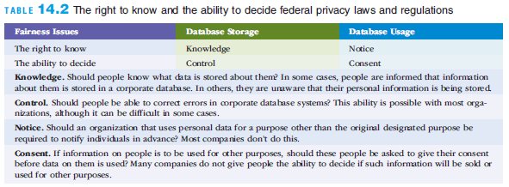
Privacy and Fairness in Information Use
Selling information to other companies can very lucrative; many companies store and sell the data they collect on customers, employees, and others
When is this information storage and use fair and reasonable to the people whose data is stored and sold?
Do people have a right to know about and to decide what data is stored and used?
Notes:
Privacy and Fairness in Information Use
Selling information to other companies can very lucrative; many companies store and sell the data they collect on customers, employees, and others
When is this information storage and use fair and reasonable to the people whose data is stored and sold?
Do people have a right to know about and to decide what data is stored and used?

Slide 32
Privacy and Filtering and Classifying Internet Content
Filtering software screens Internet content
Children’s Internet Protection Act (CIPA)
Schools and libraries subject to CIPA do not receive the discounts offered by the “E-Rate” program unless they certify that they have certain Internet safety measures in place to block or filter “visual depictions that are obscene, child pornography, or are harmful to minors”
Notes:
Privacy and Filtering and Classifying Internet Content
Filtering software screens Internet content
Children’s Internet Protection Act (CIPA)
Schools and libraries subject to CIPA do not receive the discounts offered by the “E-Rate” program unless they certify that they have certain Internet safety measures in place to block or filter “visual depictions that are obscene, child pornography, or are harmful to minors”

Slide 33
Corporate Privacy Policies
Most organizations realize that invasions of privacy can:
Damage their reputation
Turn away customers
Dramatically reduce revenues and profits
Most organizations maintain privacy policies
BBB recommends the following elements:
Policy
Choice
Access
Security
Redress
Updates
Notes:
Corporate Privacy Policies
Most organizations realize that invasions of privacy can:
Damage their reputation
Turn away customers
Dramatically reduce revenues and profits
Most organizations maintain privacy policies
BBB recommends the following elements:
Policy
Choice
Access
Security
Redress
Updates

Slide 34
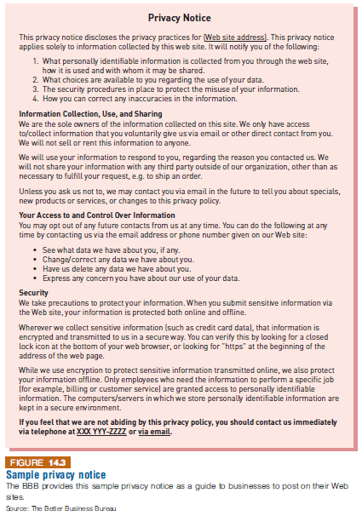
Corporate Privacy Policies
Notes:
Corporate Privacy Policies

Slide 35
Corporate Privacy Policies
Notes:
Corporate Privacy Policies

Slide 36
Individual Efforts to Protect Privacy
Laws to do completely protect individual privacy
Many people take steps to increase their own privacy protection
To protect personal privacy:
Find out what is stored about you in existing databases
Be careful when you share information about yourself
Be proactive to protect your privacy
Take extra care when purchasing anything from a Web site
Notes:
Individual Efforts to Protect Privacy
Laws to do completely protect individual privacy
Many people take steps to increase their own privacy protection
To protect personal privacy:
Find out what is stored about you in existing databases
Be careful when you share information about yourself
Be proactive to protect your privacy
Take extra care when purchasing anything from a Web site

Slide 37
Threats to Privacy
Data aggregators are companies that collect public data
Digital dossiers is an electronic description of you and your habits.
Profiling is the process of creating a digital dossier
Electronic Surveillance
Personal Information in Databases
Information on Internet Bulletin Boards, Newsgroups, and Social Networking Sites
Notes:
Data aggregators are companies that collect public data (e.g., real estate records, telephone numbers) and nonpublic data (e.g., social security numbers, financial data, police records, motor vehicle records) and integrate them to produce digital dossiers.
Digital dossier is an electronic description of you and your habits.
Profiling.
Personal Information in Databases. Information about individuals is being kept in many databases: banks, utilities co., govt. agencies, …etc.; the most visible locations are credit-reporting agencies.
Social Networking Sites often include electronic discussions such as chat rooms. These sites appear on the Internet, within corporate intranets, and on blogs.
A blog (Weblog) is an informal, personal journal that is frequently updated and intended for general public reading.

Slide 38
What Can You Do?
First, be careful what information you post on social networking sites.
Second, a company, ReputationDefender, says it can remove derogatory information from the Web.
Notes:
Clicking on the ReputationDefender logo will take you to its homepage.

Slide 39
Protecting Privacy
Privacy Codes and Policies
Opt-out model of informed consent permits the company to collect personal information until the customer specifically requests that the data not be collected.
Opt-in model of informed consent means that organizations are prohibited from collecting any personal information unless the customer specifically authorizes it. (Preferred by privacy advocates.)
International Aspects of Privacy. Privacy issues that international organizations and governments face when information spans countries and jurisdictions.
© Gunnar/Age Fotostock America, Inc.
Notes:
Privacy Codes and Policies. An organization’s guidelines with respect to protecting the privacy of customers, clients, and employees.

Slide 40
Social Networking Sites Can Cause You Problems
Anyone can post derogatory information about you anonymously.
(See this Washington Post article.)
You can also hurt yourself, as this article shows.
Notes:
The second article shows students how information they (or others) post to
social networking sites can impact their lives, in particular, their job search.
This information may take the form of text, images, etc.

Slide 41
Electronic Surveillance
See "The State of Surveillance" article in BusinessWeek
See the surveillance slideshow
See additional surveillance slides
And you think you have privacy? (video)
Notes:
The BusinessWeek article is an interesting look at the state of surveillance today.
The surveillance slideshow accompanies the BusinessWeek article.
The additional surveillance slides show modern surveillance equipment.
The video is a tongue-in-cheek look at how little privacy all of us have left. The video is a great example of the
impacts that data aggregators, digital dossiers, and profiling might have in the very near future.

Slide 42
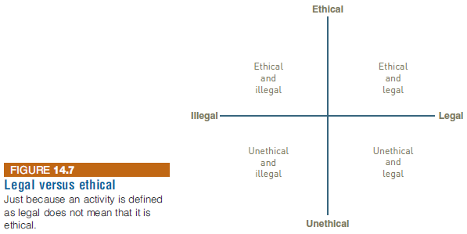
Unethical vs. Illegal
What is unethical is not necessarily illegal.

Slide 43
Work Environment
Use of computer-based information systems has changed the workforce
Jobs that require IS literacy have increased
Less-skilled positions have been eliminated
While information systems increase productivity and efficiency, there are inherent concerns with their use
Notes:
Work Environment
Use of computer-based information systems has changed the workforce
Jobs that require IS literacy have increased
Less-skilled positions have been eliminated
While information systems increase productivity and efficiency, there are inherent concerns with their use

Slide 44
Health Concerns
Occupational stress
Anxieties about job insecurity, loss of control, incompetence, and demotion
Seated immobility thromboembolism (SIT)
Formation of blood clots in the legs or lungs
Repetitive strain injury (RSI)
An injury or disorder of the muscles, nerves, tendons, ligaments, or joints caused by repetitive motion
Carpal tunnel syndrome (CTS)
Inflammation of the nerve that connects the forearm to the palm of the wrist
Notes:
Health Concerns
Occupational stress
Anxieties about job insecurity, loss of control, incompetence, and demotion
Seated immobility thromboembolism (SIT)
Formation of blood clots in the legs or lungs
Repetitive strain injury (RSI)
An injury or disorder of the muscles, nerves, tendons, ligaments, or joints caused by repetitive motion
Carpal tunnel syndrome (CTS)
Inflammation of the nerve that connects the forearm to the palm of the wrist

Slide 45
Avoiding Health and Environmental Problems
Two primary causes of computer-related health problems are
A poorly designed work environment
Failure to take regular breaks to stretch the muscles and rest the eyes
Work stressors are hazardous activities associated with unfavorable conditions of a poorly designed work environment
Repetitive motion, awkward posture, and eye strain are examples
Ergonomics is the science of designing machines, products, and systems to maximize safety, comfort, and efficiency of people who use them
Flexibility is a major component of ergonomics and an important consideration in the design of computer devices
Notes:
Avoiding Health and Environmental Problems
Two primary causes of computer-related health problems are
A poorly designed work environment
Failure to take regular breaks to stretch the muscles and rest the eyes
Work stressors are hazardous activities associated with unfavorable conditions of a poorly designed work environment
Repetitive motion, awkward posture, and eye strain are examples
Ergonomics is the science of designing machines, products, and systems to maximize safety, comfort, and efficiency of people who use them
Flexibility is a major component of ergonomics and an important consideration in the design of computer devices

Slide 46
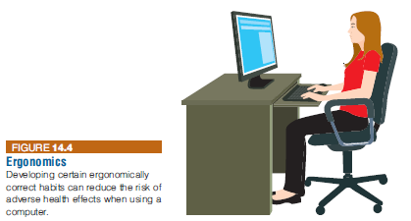
Avoiding Health and Environmental Problems
Notes:
Avoiding Health and Environmental Problems

Slide 47
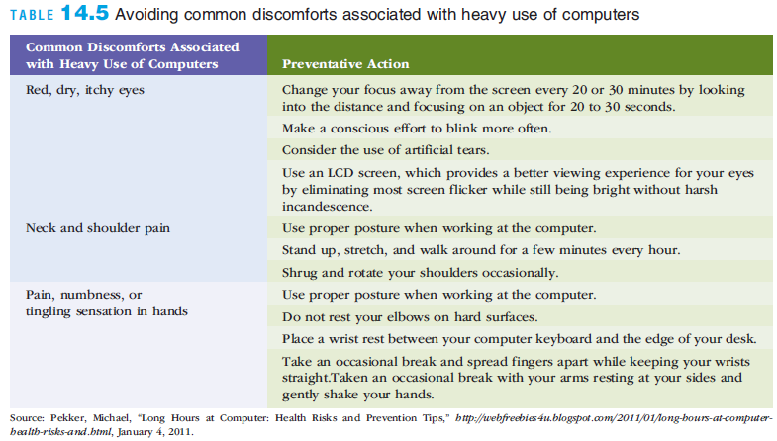
Avoiding Health and Environmental Problems
Notes:
Avoiding Health and Environmental Problems

Slide 48
Avoiding Health and Environmental Problems
Checklist to determine if properly seated at a correctly positioned keyboard:
Your elbows are near your body in an open angle to allow circulation to the lower arms and hands
Your arms are nearly perpendicular to the floor
Your wrists are nearly straight
The height of the surface holding your keyboard and mouse is 1 or 2 inches above your thighs
The keyboard is centered in front of your body
The monitor is about one arm’s length (20 to 26 inches) away
The top of your monitor is at eye level
Your chair has a backrest that supports the curve of your lower (lumbar) back
Notes:
Avoiding Health and Environmental Problems
Checklist to determine if properly seated at a correctly positioned keyboard:
Your elbows are near your body in an open angle to allow circulation to the lower arms and hands
Your arms are nearly perpendicular to the floor
Your wrists are nearly straight
The height of the surface holding your keyboard and mouse is 1 or 2 inches above your thighs
The keyboard is centered in front of your body
The monitor is about one arm’s length (20 to 26 inches) away
The top of your monitor is at eye level
Your chair has a backrest that supports the curve of your lower (lumbar) back

