Slide 1
Welcome to ITMG100
Professor Rebman
Olin Hall Room 127
Office Hours: See syllabus
Email: carlr@sandiego.edu

Slide 2
Agenda
Syllabus Review
My Educator
Gmetrix
Windows on a Mac/GUAC
About me
ITK ACT

Slide 3
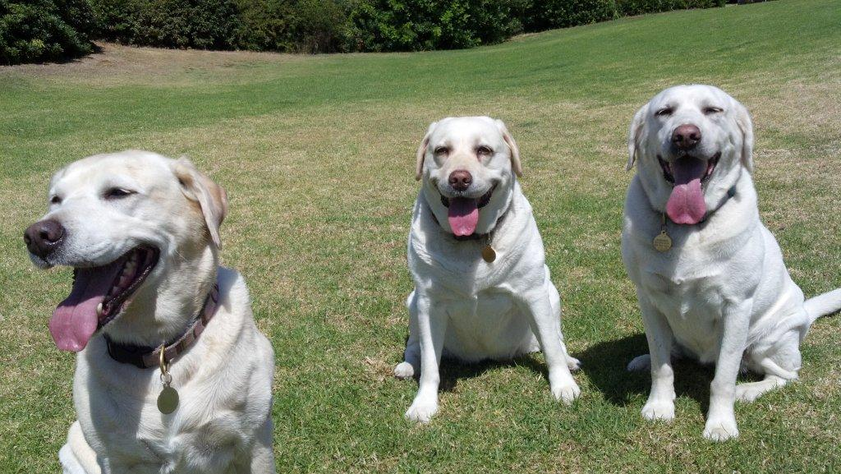
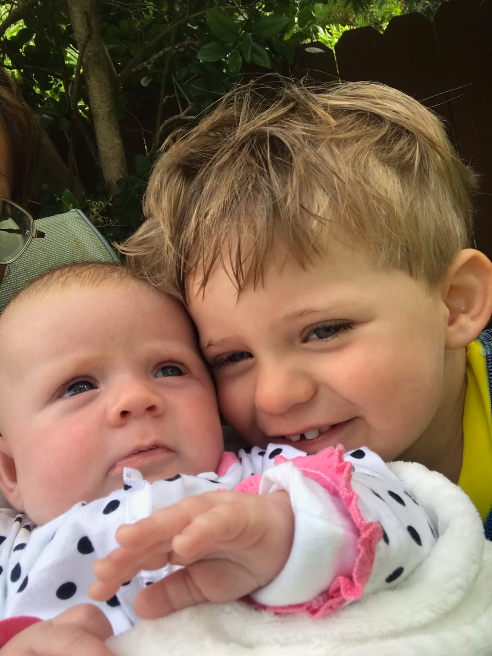
My Background…

Slide 4
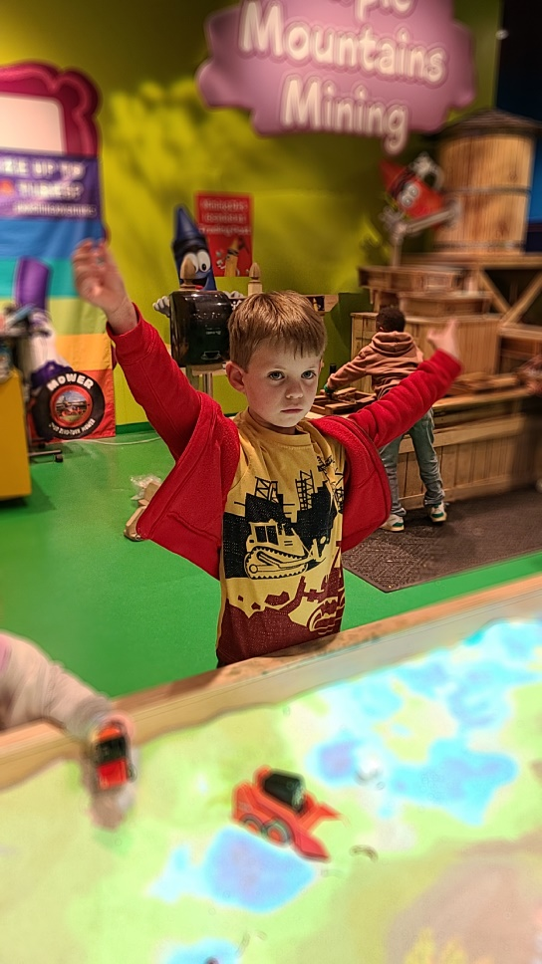
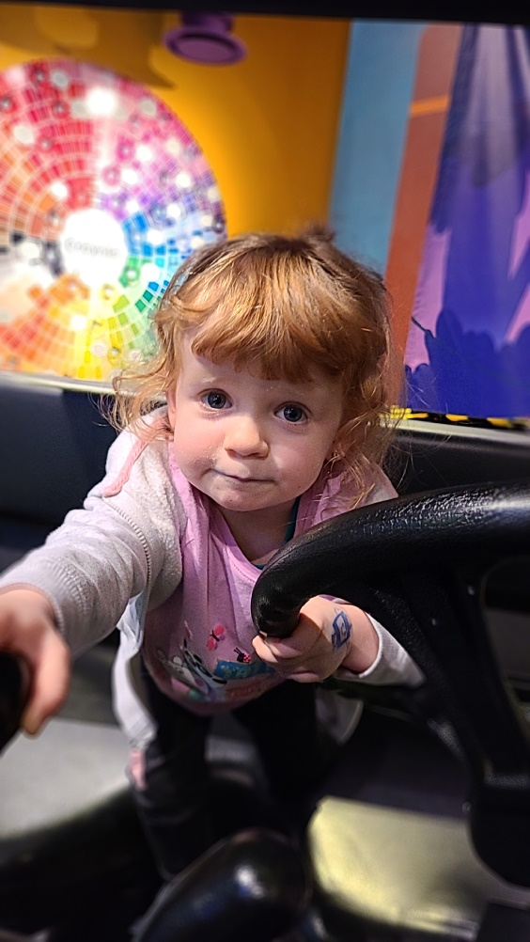
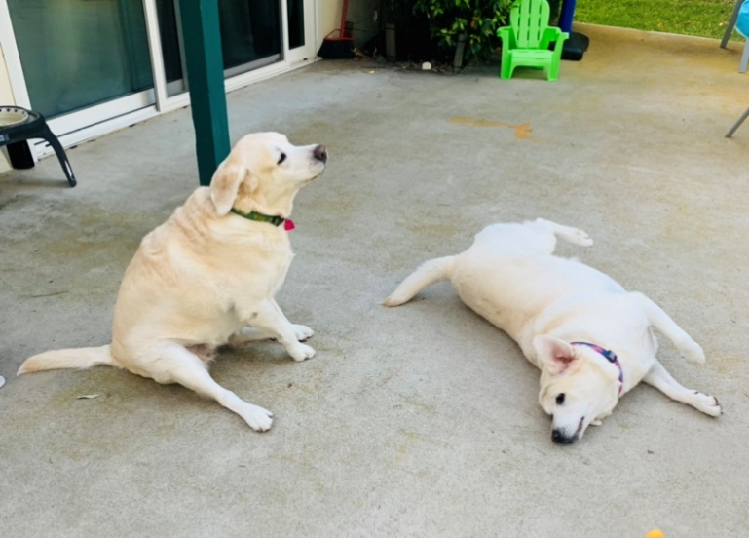
My Background ..a little closer to present

Slide 5
Different Software Used
Blackboard and carl.sandiego.edu website SIMUCAST
Course Content
Grades
Gmetrix
Homework Assignments
PC/Excel 2019
https://guacamole.sandiego.edu/guacamole/#/

Slide 6
Tips for Success
Show up and do the work! Don’t get behind
The best way to learn Excel – is to use Excel a lot!
Do the practice assessments and take all Gmetrix practice exams.
Study for the GMetrix like it is the real thing!
Ask for help if you need it
ITS help desk on campus: 619-260-7900
Blackboard: Phone (619) 260-7900 help@sandiego.edu
Use the buddy system
Time manage the class!

Slide 7
College Tips…
Time Manage
Let common sense rule your life
Compartmentalize and Prioritize
Develop networking skills and a network
Don’t make a “mountain out of a mole hill”

