Slide 1
Chapter Three
Hardware

Slide 2
Some Basic Terms
Bit – a single unit of information, generally in the form of a 1 or 0, when combined with other bits they can make up words or code in which the computer can understand and process. The name bit comes from the derivation of Binary and unIT,
Byte – a combination of 8 bits, one byte is the length of one character (ex. 10010010)
Binary System –a combination of 1’s and 0’s in order to produce numbers, letters, symbols, and words. These letters and symbols are translated by the computer in the form of ASCII and ECBDIC code.
bps, Kbps, Mbps, Gbps, referred to in terms of the rate of data transfer. Can be known as bauds per second or bits per second, the K, M, G, refer to the metric system of kilo, mega, and gig which translates into 1000, 1,000,000, or 1,000,000,000 bits per second, as one could surmise the larger the number the faster the actual transmission of data that occurs
Megahertz (MHz) a measure of clock speed, or the pacing of a events in a computer; represents 1 million cycles per second; also known as a unit of frequency in this case 1 million hertz
Latency – the number of bits (frames, cells, packets) in transit; a figure that tells us how quickly a given bit a data will move from one point to another within a network, usually equated to delay

Slide 3
Some Basic Terminology
Delay – the dominant time interval of the transmission of information, also referred to as the time it takes to send a message from point A to the time it is received at destination point D. Delay is broken down into propagation and transmission delay.
Frequency – number of vibrations per unit time; number of waves that cross a given point per unit time
Wavelength – the spacing of the crests or troughs in a wave train
Analog – a continuous sine wavelength over a certain frequency range with a positive voltage representing a 1 and a negative charge representing a 0; mostly used for voice transmissions
Digital – a discrete flow in which data are coded as 0-bits and 1-bits and transmitted as a series of on-and-off electrical pulses
ITTU/CCITT/CPUC/FCC – (International Telegraph and Telephone Union/International Telegraph and Telephone Consultative Committee) one of the main governing bodies that is responsible for setting the standards of the protocols that we deal with

Slide 4
Computer Hierarchy
Mainframes -- the first. Used for business
Supercomputers -- the largest, very complex
Minicomputers -- the first effort to achieve reduced size (middle-ranged)
Microcomputers -- made possible by microprocessor
PC/MAC-- used by one person, or by a few people in the same area
Workstations, laptops, netbooks, tablets/iPads, smartphone

Slide 5
Servers, Mainframes, and Supercomputers
Notes:
Servers, Mainframes, and Supercomputers

Slide 6
Hardware consists of:
Central processing unit (CPU) manipulates the data and controls the tasks performed by the other components.
Primary storage internal to the CPU; temporarily stores data and program instructions during processing.
Secondary storage external to the CPU; stores data and programs for future use.
Input technologies
Output technologies
Communication technologies provide for the flow of data from external computer networks (e.g. the Internet and intranets) to the CPU, and from the CPU to computer networks.
Notes:
Central processing unit (CPU) manipulates the data and controls the tasks performed by the other components.
Primary storage internal to the CPU; temporarily stores data and program instructions during processing.
Secondary storage external to the CPU; stores data and programs for future use.
Input technologies accept data and instructions and convert them to a form that the computer can understand.
Output technologies present data and information in a form people can understand.
Communication technologies provide for the flow of data from external computer networks (e.g. the Internet and intranets) to the CPU, and from the CPU to computer networks.

Slide 7
Input and Output Devices
Connected to computer via card or USB connection
Translates machine code for input or output to computer
Device driver is software responsible for this action
Input devices translates keystrokes or pictures to bytes
Output devices translates bytes for human comprehension

Slide 8
Examples of Input and Output Devices
Input devices
Keyboard, mouse,
RFID, barcode reader,
microphone, camera
Output devices
Monitor, speakers,
printers, plotters

Slide 9
RFID Devices
Passive device that transmits a radio signal when read by a reader
Examples
Toll stickers for automatic car toll taking
Pet chips implanted by Vets to identify animals
Inventory tags at retailers

Slide 10
Computer Memory
Two basic categories of computer memory:
Primary Storage
Secondary Storage
Memory Capacity:
Bit
Byte
Notes:
Primary Storage stores small amounts of data and information that will be immediately used by the CPU.
Secondary Storage stores much larger amounts of data and information (an entire software program, for example) for extended periods of time.
Bit: Short for binary digit (0s and 1s), the only data that a CPU can process.
Byte: An 8-bit string of data, needed to represent any one alphanumeric character or simple mathematical operation.

Slide 11
Business Data Storage
Computer system can store data and information, which is tangible property
Data is stored in methods analogous to filing cabinets
Storage has become less expensive as technology improves

Slide 12
Primary Storage Characteristics
RAM (Random Access Memory)
Volatile (requires power to retain information)
No physical movement
Random accessibility
Active programs and data reside in RAM for use by CPU

Slide 13
Secondary Storage Characteristics
CDs, DVDs, HDDs, SSDs, and USBs are non-volatile
RAID devices provide data security
Cloud storage—unlimited, available via internet

Slide 14
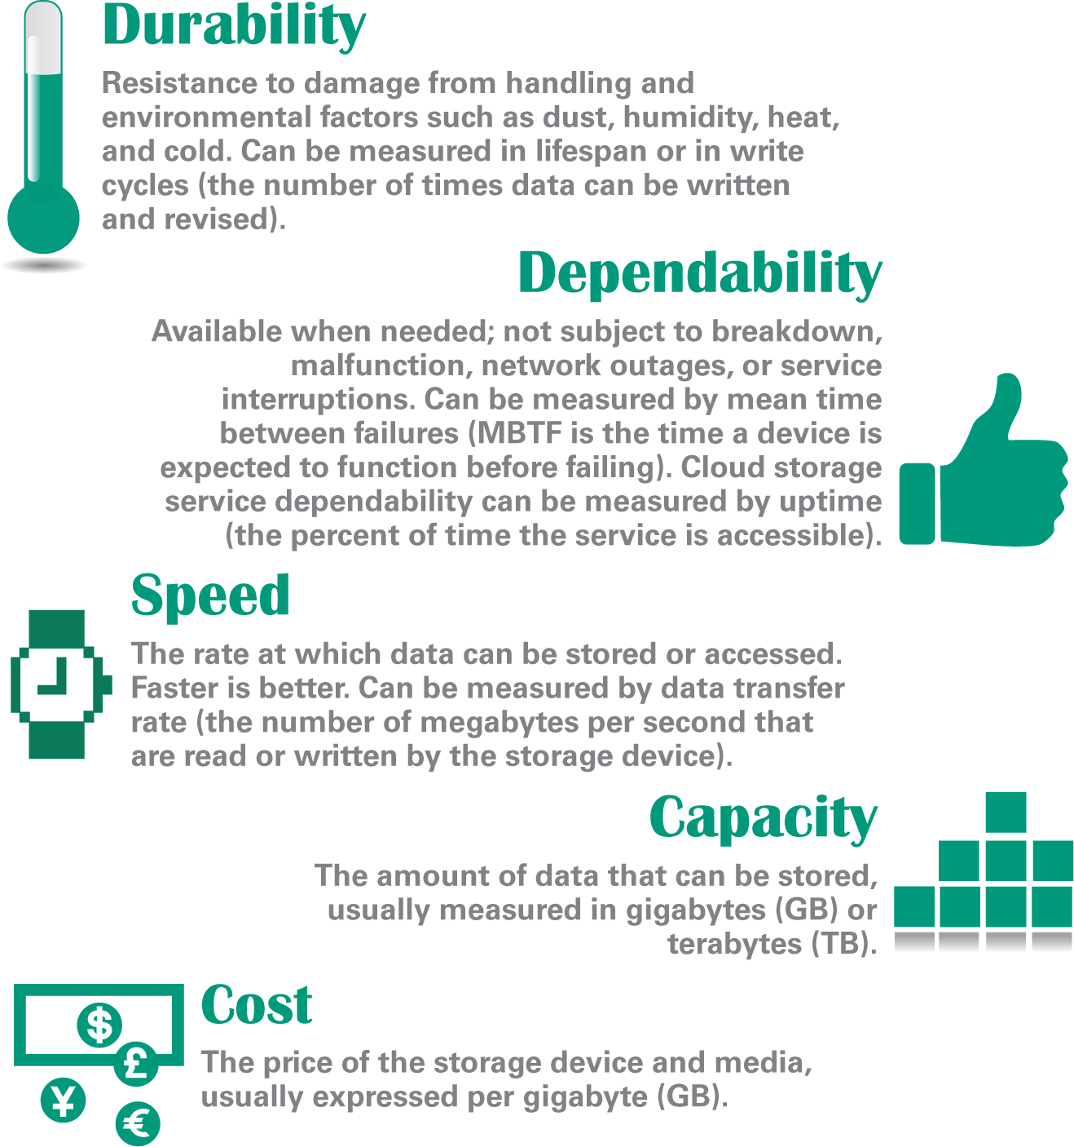
Storage Basics
Each storage technology has its advantages and disadvantages so review their durability, dependability, speed, capacity, and cost before buying

Slide 15
Are you running out of storage space

Slide 16
Magnetic Storage Technology

Slide 17
Magnetic Storage Technology
Hard disk drive specifications include:
Access time – the average time it takes a computer to locate data on the storage medium and read it
Data transfer rate – the amount of data a storage device can move per second from the storage medium to RAM

Slide 18
Optical Storage Technology
CD, DVD, and Blu-ray (BD) technologies are classified as optical storage, which represents data as microscopic light and dark spots on the disc surface
The dark spots are called pits; the lighter, non-pitted surface areas of the disc are called lands

Slide 19
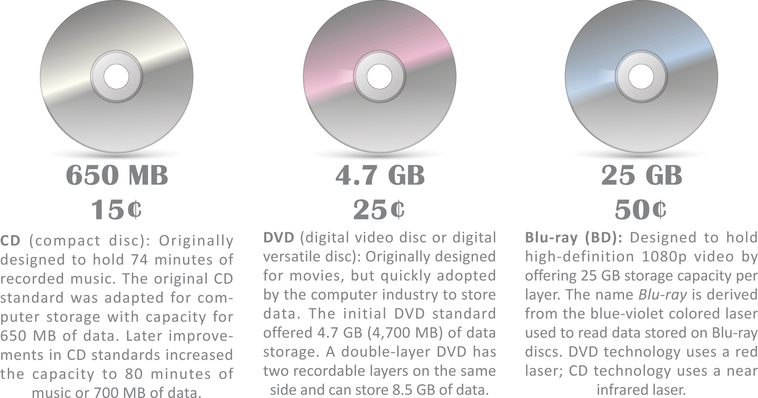
Optical Storage Technology
A single optical drive typically handles CDs, DVDs, and Blu-ray discs, but the costs and capacities of these discs vary

Slide 20
Solid State Storage Technology
A solid state drive (SSD) is a package of flash memory that can be used as a substitute for a hard disk drive
A USB flash drive is a portable storage device that plugs directly into a computer’s system unit using a built-in USB connector

Slide 21
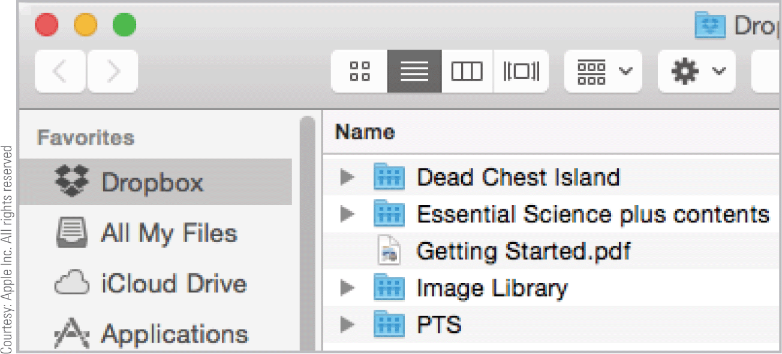
Cloud Storage
Remote storage is housed on an external device that can be accessed from a network
Remote storage can also be available as an Internet service, in which case it is called cloud storage
Cloud storage is provided to individuals by services such as Apple iCloud, Microsoft OneDrive, Google Drive, and Dropbox

Slide 22
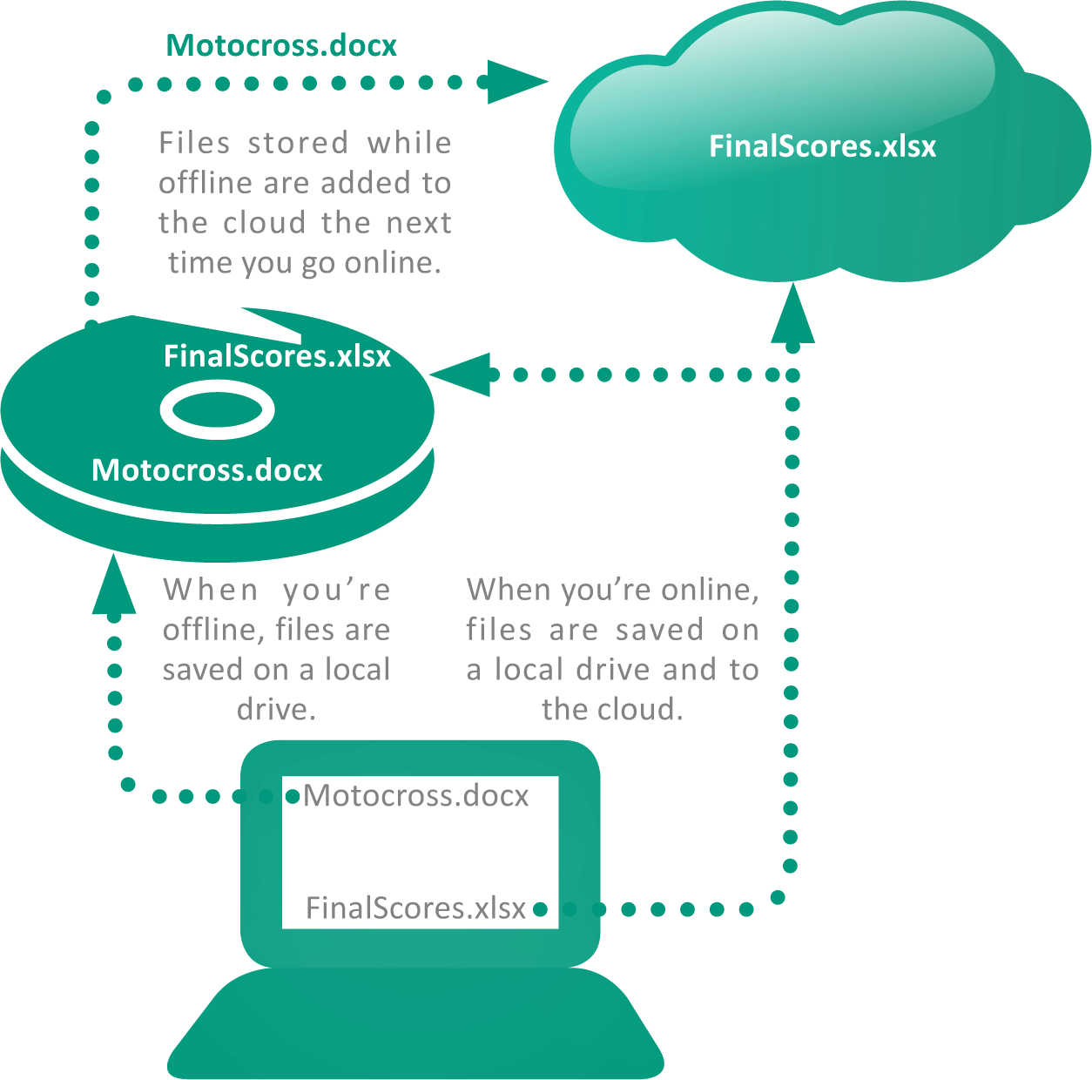
Cloud Storage
Some cloud implementations offer a synchronization feature that automatically duplicates files stored on a local device by also saving them in the cloud

Slide 23
Cloud Storage
Cloud Storage basics:
Security and privacy risks – the more places your data is stored and the more networks on which it tavels, the more susceptible it becomes to hackers and spying agencies
Service outages – when a cloud storage site has an outage, all the data stored there become temporarily inaccessible
Discontinuation of service – some cloud storage providers have closed down their services with little warning

Slide 24
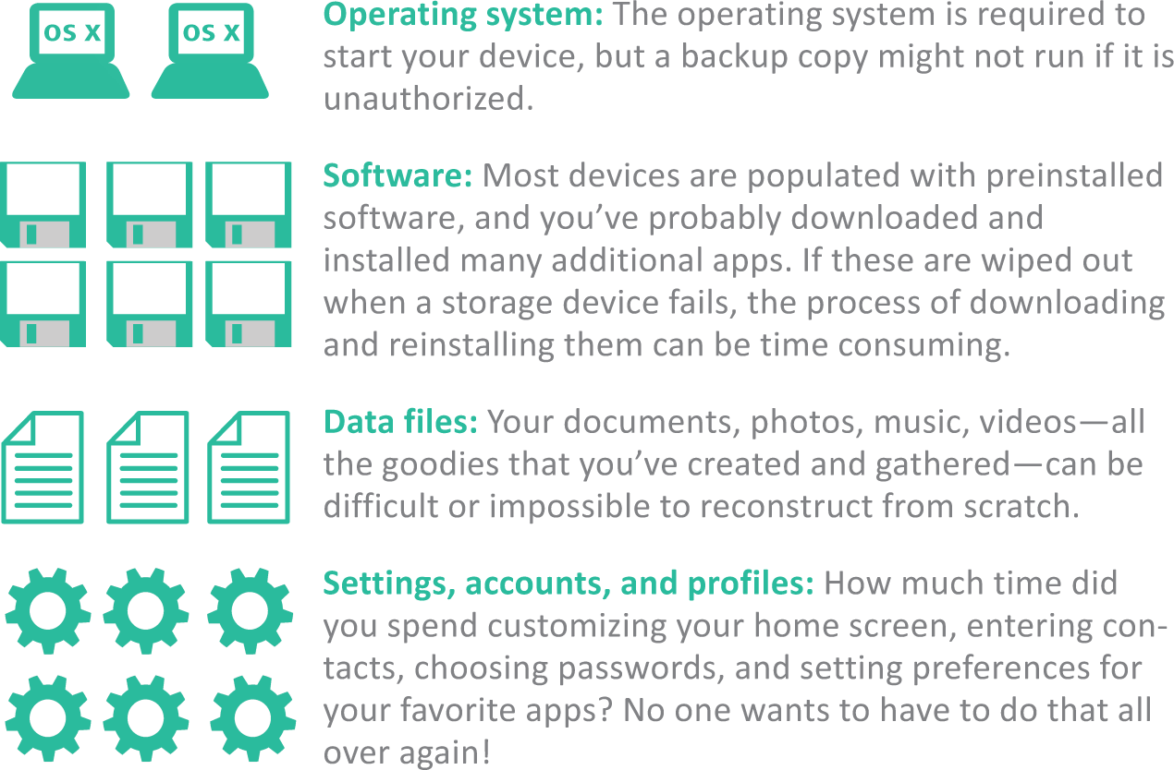
Backup
A backup is a copy of one or more files that is made in case the originals become damaged or lost
Figuring out what to backup is important; backing up everything isn’t always practical

Slide 25
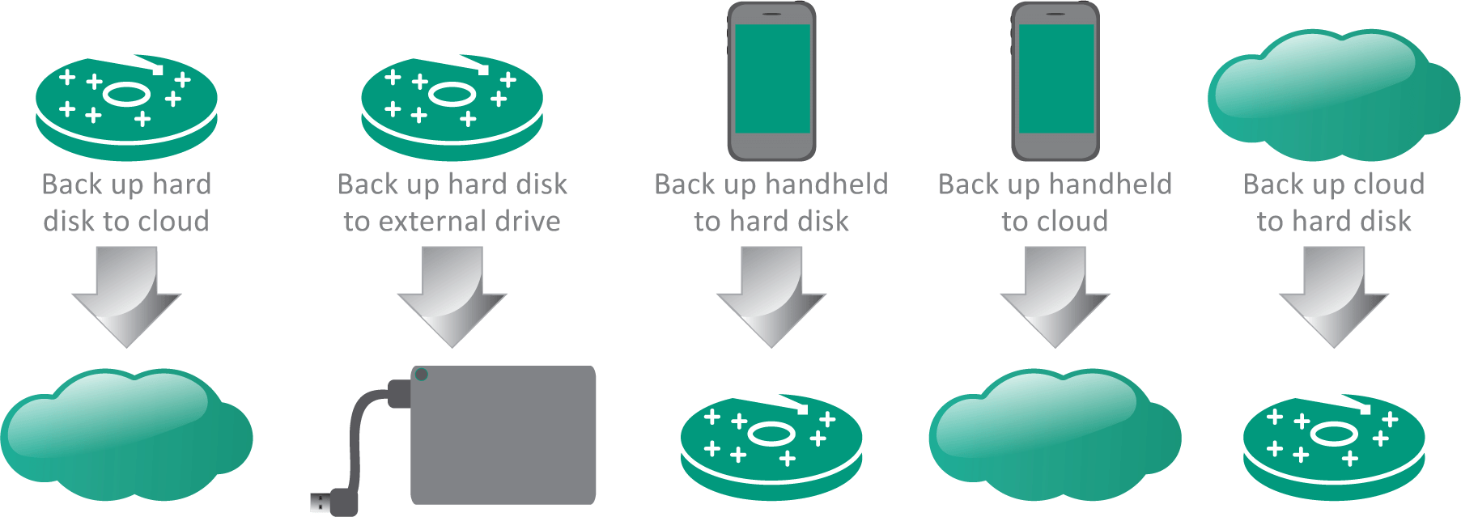
Backup
When deciding on what to back up, know what’s important and ensure that current versions exist on more than one storage device

Slide 26
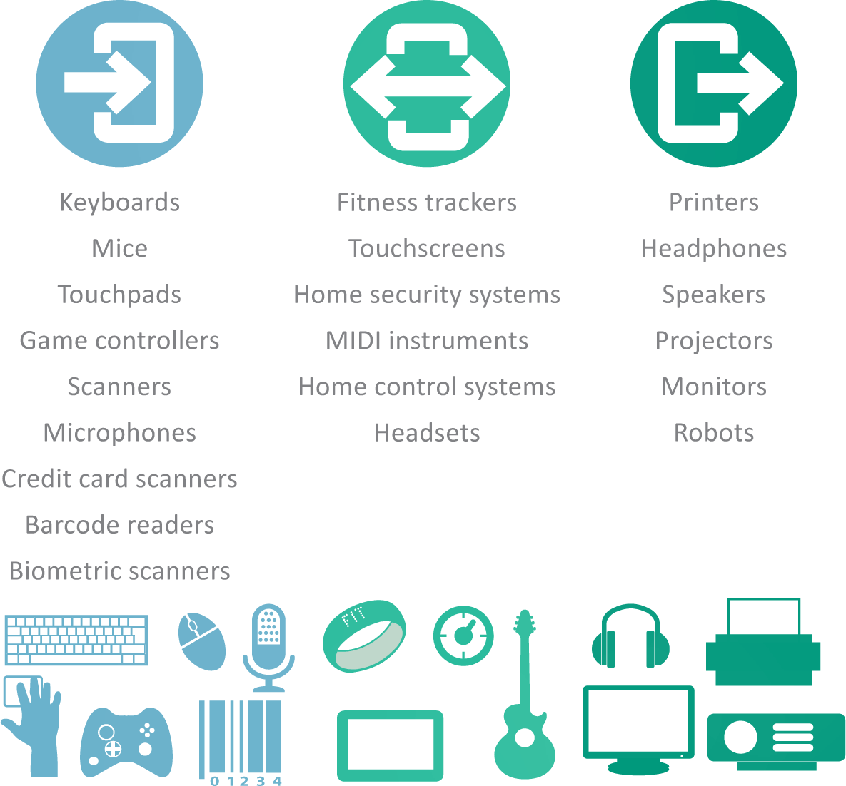
Add-on Gadgets
There are lots of options available for gadgets that accompany your digital devices

Slide 27
Bits and Bytes
The word bit, an abbreviation for binary digit, can be further abbreviated as a lowercase b
A group of eight bits is called a byte and is usually abbreviated as an uppercase B
When reading about digital devices, you’ll frequently encounter references such as 50 kilobits per second, 1.44 megabytes, 2.8 gigahertz, and 2 terabytes.
Kilo, mega, giga, tera, and similar terms are used to quantify digital data

Slide 28
Computer Memory
Holds information stored in the computer
Based on a byte (8 bits)
Different types
Primary Storage (volatile)
RAM holds executable programs and data
Secondary Storage (non-volatile)
HDD or SSD or USB for permanent storage of programs and information
CMOS
Non-programmable, non-volatile memory holding boot program

Slide 29
Memory Facts
Stored as 1s and 0s in the computer in 8-bit increments
Memory
Byte = 8 bits
Kilobyte = 1,024 bytes
Megabyte = 1,024 kilobytes
Gigabyte = 1,024 megabytes
Bytes represent characters and numbers
01000101 = “E”
01011100 = “\”
01110010 = “r”

Slide 30
Hierarchy of Memory Capacity
Kilobyte
Megabyte
Gigabyte
Terabyte
Petabyte
Exabyte
Zettabyte
Notes:
Kilobyte (KB): approximately one thousand bytes.
Megabyte (MB): approximately one million bytes (1,048,576 bytes, or 1,024 x 1,024).
Gigabyte (GB): actually 1,073,741,824 bytes (1,024 x 1,024 x 1,024 bytes).
Terabyte: One trillion bytes.
Petabyte: One thousand terabytes.
Exabyte: One thousand petabytes.
Zettabyte: one thousand exabytes.

Slide 31
The Computer Bytes
Computers deal in either
ASCII- American Standard Code for Information Interchange (7 bits with 1 parity bit)
EX. A = 01000001
EBCDIC- Extended Binary Coded Decimal Interchange Code an 8-bit code used in IBM
EX. A = 11000001

Slide 32
Understanding Bits and Bytes

Slide 33
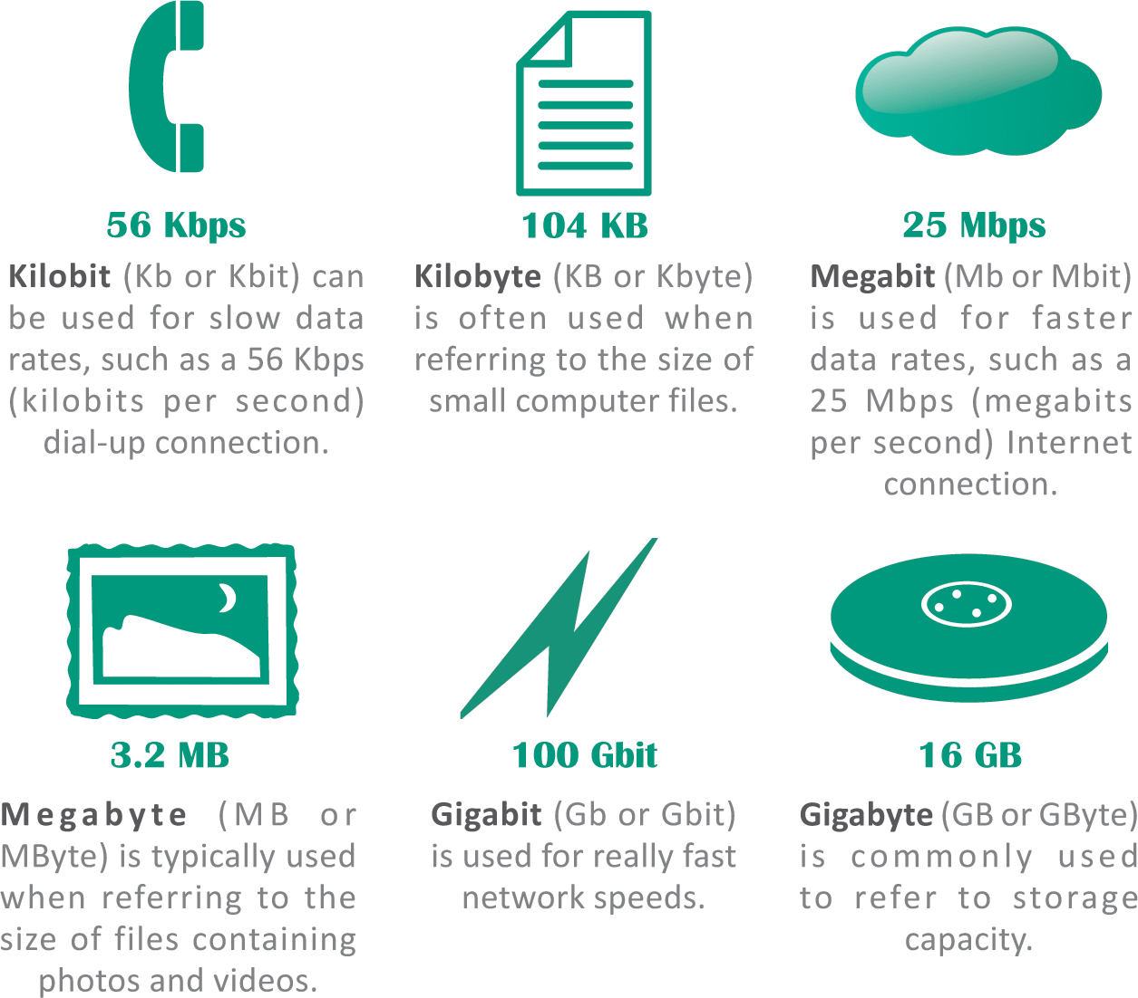
More Bits and Bytes
Use bits for data rates, such as Internet connection speeds, and movie download speeds
Use bytes for file sizes and storage capacities

Slide 34
Converting to Binary

Slide 35
Internal workings of personal computer
Hard disk drive
CPU board with fan
Floppy disk drive
RAM

Slide 36
The Computer Schematic

Slide 37
Improving Performance
There are three main ways to accomplish this
word length -the number of bits that can be processed together as a unit
current computers are either 32 or 64bit
bus width - the amount of bits that can be transferred within the computer at any given computer interrupt
bus width range also varies
clock speed
RISC- reduced instruction set computing
MMX- MultiMedia eXtension

Slide 38
Advances in Microprocessor Design
Moore’s Law: microprocessor complexity would double every two years.
Notes:
Moore’s Law is that microprocessor complexity would double every two years as a result of the following changes:
--Increasing miniaturization of transistors.
--Making the physical layout of the chip’s components as compact and efficient as possible.
--Using materials for the chip that improve the conductivity (flow) of electricity.
--Targeting the amount of basic instructions programmed into the chip.

Slide 39
Choosing a Digital Device
The following activities can get you started on choosing the right digital device:
Consider how you plan to use your device
Choose the type of device
Decide on a budget and stick to it
Select a platform
Check out the device’s specifications

Slide 41
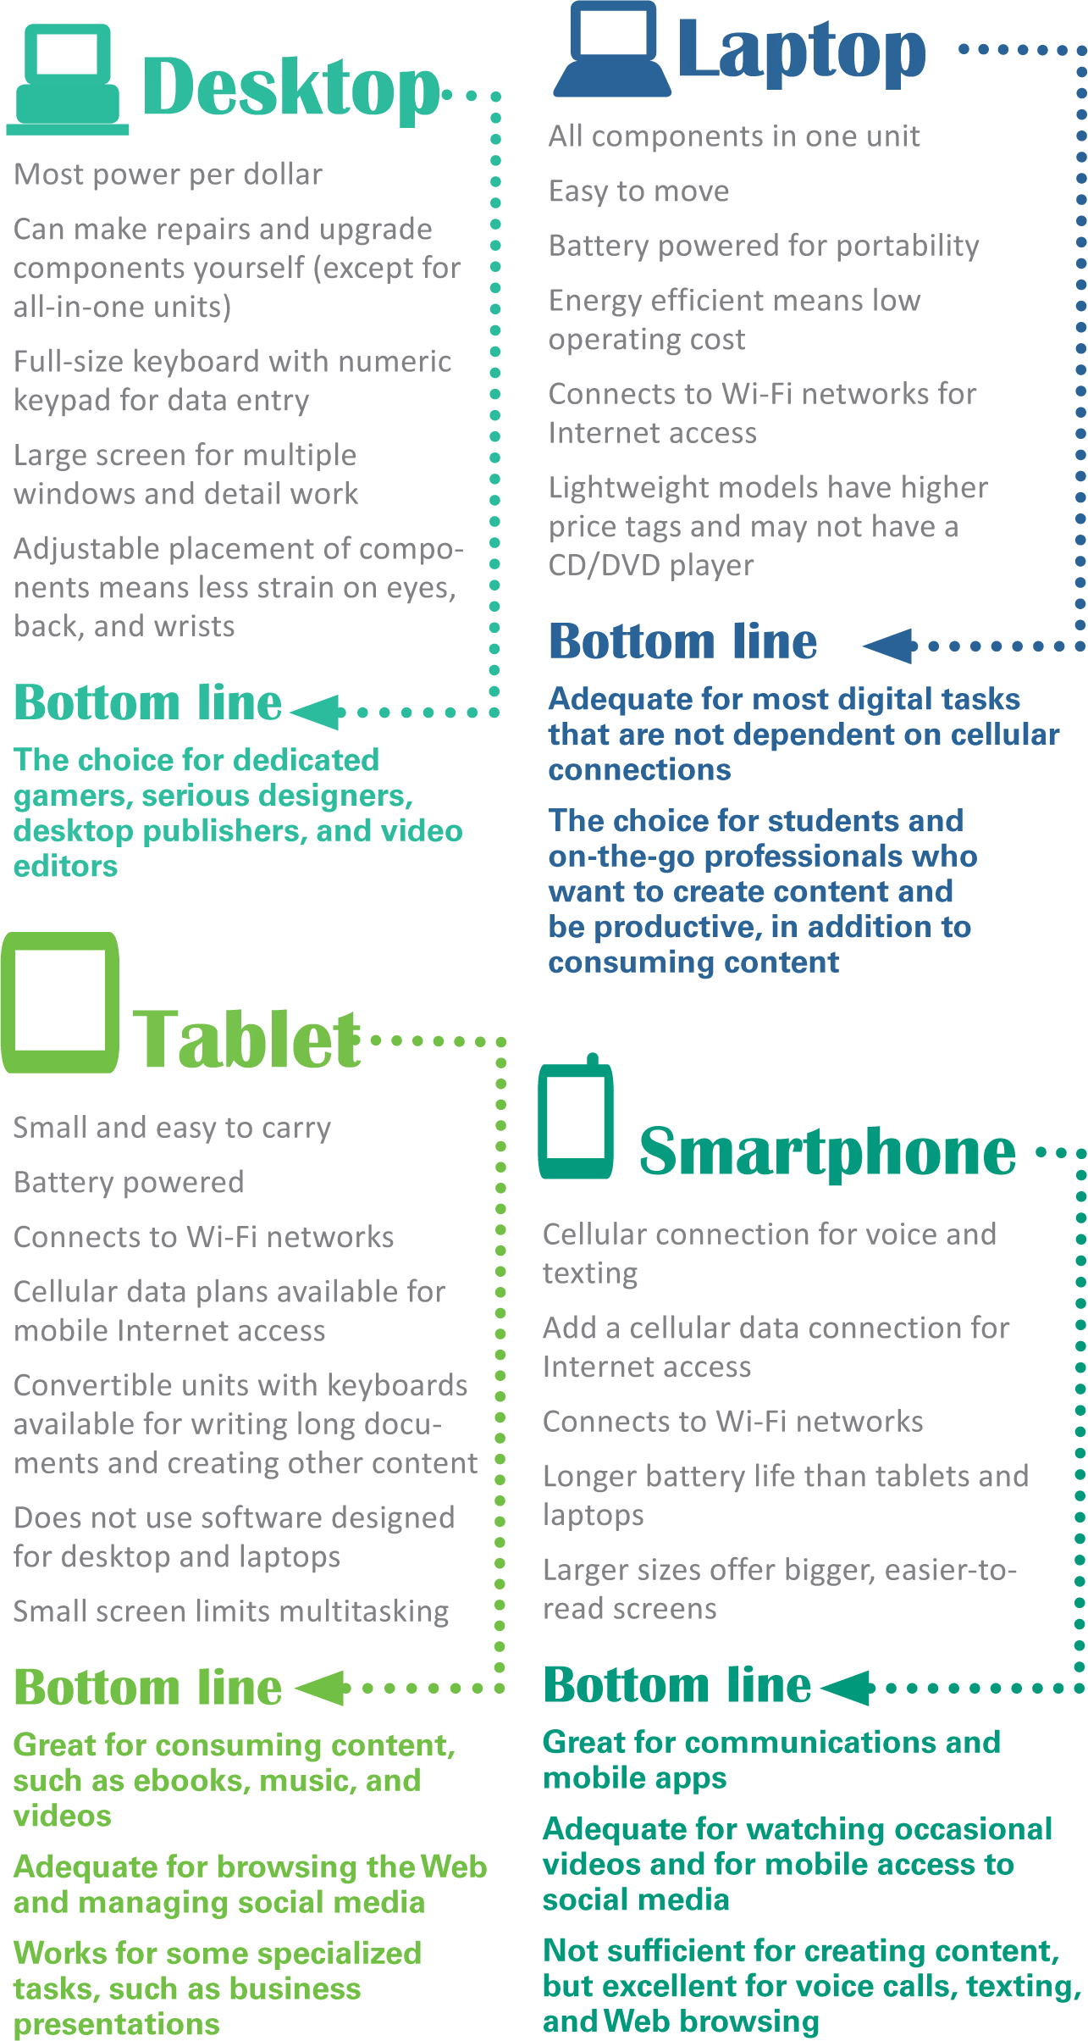
Choosing a Digital Device
The most popular digital devices are desktops, laptops, tablets, and smartphones

Slide 42
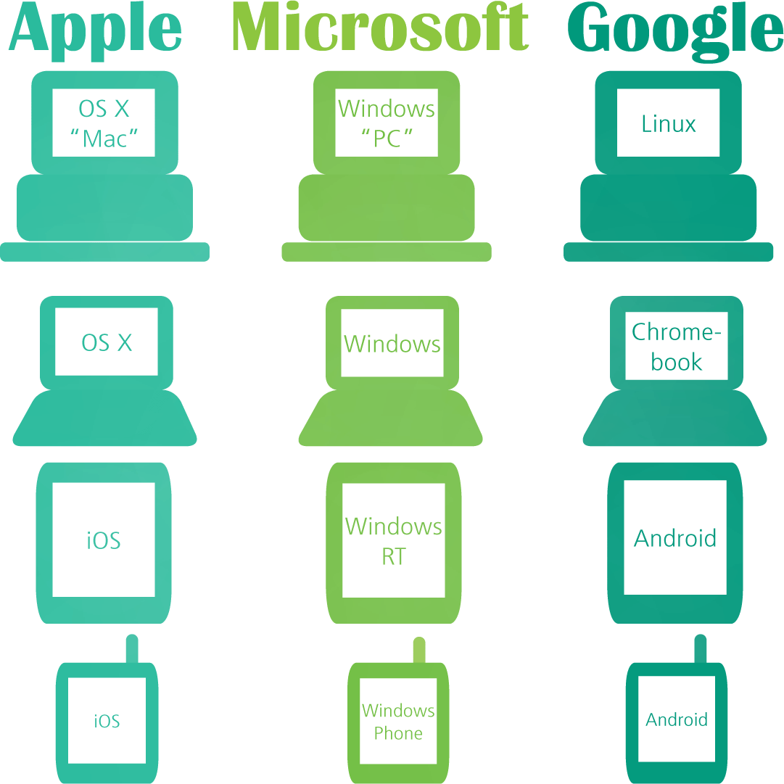
Choosing a Digital Device
Computers that operate essentially the same way and use the same software are said to be compatible or having the same “platform”
You can assess whether two computers are compatible by checking their operating systems

Slide 43
Server Farms, Data Centers, and Green Computing
This section provides an overview of what the computer industry and various organizations are doing to meet their computing needs in a more efficient and environmentally friendly manner
Notes:
Server Farms, Data Centers, and Green Computing
This section provides an overview of what the computer industry and various organizations are doing to meet their computing needs in a more efficient and environmentally friendly manner

Slide 44
Server Farms
Server farm: a room used to house a large number of servers
Access to the machines can be controlled and authorized support personnel can more easily manage and maintain the servers
Virtual server: a method of logically dividing the resources of a single physical server to create multiple logical servers
Each logical server acts as its own dedicated machine
Blade server: a server that houses many individual computer motherboards
Include one or more processors, computer memory, computer storage, and computer network connections
Share a common power supply and air-cooling source within a single chassis
Notes:
Server Farms
Server farm: a room used to house a large number of servers
Access to the machines can be controlled and authorized support personnel can more easily manage and maintain the servers
Virtual server: a method of logically dividing the resources of a single physical server to create multiple logical servers
Each logical server acts as its own dedicated machine
Blade server: a server that houses many individual computer motherboards
Include one or more processors, computer memory, computer storage, and computer network connections
Share a common power supply and air-cooling source within a single chassis

Slide 45
Server Farms
Notes:
Server Farms

Slide 46
Data Center
Data center
A climate-and-access-controlled building or a set of buildings that houses the computer hardware that delivers an organization’s data and information services
Factors driving growth in data centers:
Demand for additional computing capacity
Need for additional storage capacity
Some organizations are consolidating data centers from many locations down to just a few locations
Notes:
Data Center
Data center
A climate-and-access-controlled building or a set of buildings that houses the computer hardware that delivers an organization’s data and information services
Factors driving growth in data centers:
Demand for additional computing capacity
Need for additional storage capacity
Some organizations are consolidating data centers from many locations down to just a few locations

Slide 47
Data Center
Notes:
Data Center

Slide 48
Data Center
Construction Considerations
More efficient operation and reduced energy for processing and cooling
Modular design
Location: areas with milder climates and lower energy rates and land costs
Ability to absorb the impact of a disaster (e.g., hurricane, earthquake, terrorism attack, or war) and quickly restore services
Notes:
Data Center
Construction Considerations
More efficient operation and reduced energy for processing and cooling
Modular design
Location: areas with milder climates and lower energy rates and land costs
Ability to absorb the impact of a disaster (e.g., hurricane, earthquake, terrorism attack, or war) and quickly restore services

Slide 49
Green Computing
A program concerned with the efficient and environmentally responsible design, manufacture, operation, and disposal of IS-related products
Goals
Reduce the use of hazardous material
Allow companies to lower their power-related costs
Enable safe disposal or recycling of equipment
Notes:
Green Computing
A program concerned with the efficient and environmentally responsible design, manufacture, operation, and disposal of IS-related products
Goals
Reduce the use of hazardous material
Allow companies to lower their power-related costs
Enable safe disposal or recycling of equipment

Slide 50
Green Computing
Electronic Product Environmental Assessment Tool (EPEAT)
A system that enables purchasers to evaluate, compare, and select electronic products based on a total of 51 environmental criteria
Notes:
Green Computing
Electronic Product Environmental Assessment Tool (EPEAT)
A system that enables purchasers to evaluate, compare, and select electronic products based on a total of 51 environmental criteria

Slide 51
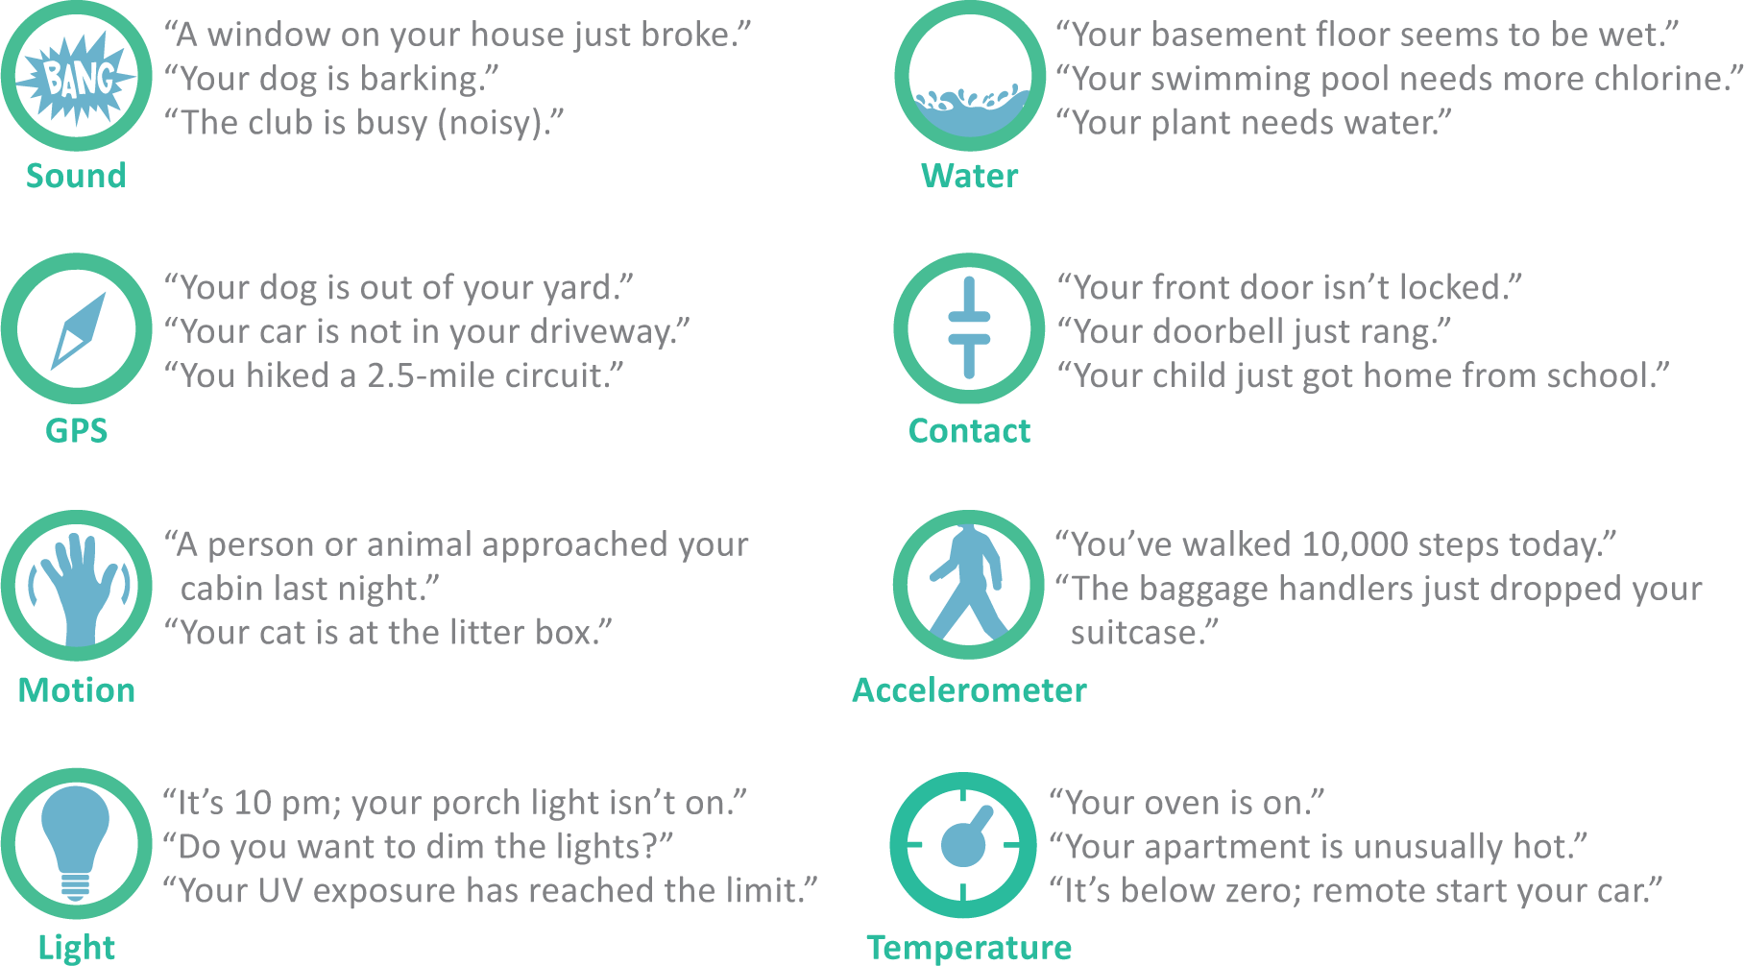
Internet of Things
The utopian vision for the Internet of Things (IoT) is a busy hive of smart sensors that work behind the scenes to collect data and use it to improve just about anything

Slide 52
What does this mean to IT?
Increasing technology
What do we purchase? Why?
How will it impact performance?
How will it affect our current IT investment?

Slide 53
Strategic Hardware Issues
How do organizations keep up with the rapid price and performance advancements in hardware?
How often should an organization upgrade its computers and storage systems?
Will upgrades increase personal and organizational productivity?

Slide 54
Strategic Hardware Issues
How can organizations measure such increase?
How should organizations determine the need for new hardware infrastructures?
How do organizations manage employees who can “work from anywhere?”

