Slide 1
IS in the Organization: CRM SCM
Notes:
Principles of Information Systems, Thirteenth Edition
Chapter 8
Enterprise Systems

Slide 2
Customer Relationship Management
Customer relationship management (CRM) system
Helps a company manage all aspects of customer encounters, including marketing, sales, distribution, accounting, and customer service
The goal of CRM is to understand and anticipate the needs of current and potential customers
CRM is used primarily in sales, marketing, and service organizations:
To capture and view data about customers and to improve communications
CRM software:
Automates and integrates the functions of sales, marketing, and service in an organization
Notes:
Customer Relationship Management
Customer relationship management (CRM) system
Helps a company manage all aspects of customer encounters, including marketing, sales, distribution, accounting, and customer service
The goal of CRM is to understand and anticipate the needs of current and potential customers
CRM is used primarily in sales, marketing, and service organizations:
To capture and view data about customers and to improve communications
CRM software:
Automates and integrates the functions of sales, marketing, and service in an organization

Slide 3
Defining Customer Relationship Management
Personal
© MONKEY BUSINESS-LBR/Age Fotostock America, Inc.
Notes:
Customer relationship management (CRM) is an organizational strategy that is customer-focused
and customer-driven.

Slide 4
To Today…..
Mobile population
The Web
Giant malls
Impersonal

Slide 5
The Need for CRM
It costs six times more to sell to a new customer than to sell to an existing one.
A typical dissatisfied customer will tell 8-10 people.
By increasing the customer retention rate by 5%, profits could increase by 85%.
Odds of selling to new customers = 15%, compared to the odds of selling to existing customers (50%)
70% of complaining customers will remain loyal if their problem is solved

Slide 6
Goal of a CRM
Treat different customers differently.
Keep profitable customers and maximize lifetime revenue from them.
Notes:
One-to-one relationship between a customer and a seller.

Slide 7
Lifetime Customer Value
The value of a customer to a company depends on three dimensions:
the duration of the relationship
the number of relationships (e.g., the number of products from a company that a customer purchases)
the profitability of the relationship.
Source: Kzenon/Shutterstock

Slide 8
Notes:
Figure 9.1

Slide 9
CRM Strategy to Systems
All successful CRM’s share two basic elements
Identify customer touch pts.
Consolidate data about each customer

Slide 10
Customer Touch Points

Slide 11
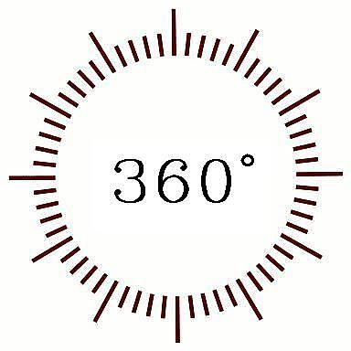
Data Consolidation
Accounting
HR
Finance
Customer
Marketing
MIS
Data Consolidation = 360-Degree View of Customers

Slide 12
2 types of CRM applications
Operational –
Customer Facing applications
Customer Touching applications
Analytical-
Data Mining
Decision Support
Business Intelligence

Slide 13
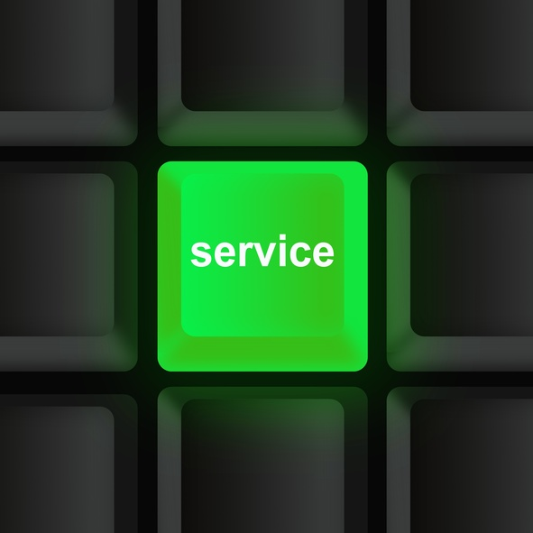
Customer-Facing Applications
Customer service and support
refers to systems that automate requests, complaints, product returns, and requests for information
Sales force automation automatically records all the aspects in a sales transaction process.
Campaign management applications help organizations plan campaigns so that the right messages are
sent to the right people through the right channels.
© Mustafa Almir Mahmoud/Age Fotostock America, Inc.
Notes:
Customer-facing applications are those applications where an organization’s sales, field service,
and customer interaction center representatives actually interact with customers.
Customer service and support refers to systems that automate requests, complaints, product returns,
and requests for information.
Sales force automation automatically records all the aspects in a sales transaction process.
Campaign management applications help organizations plan campaigns so that the right messages are
sent to the right people through the right channels.

Slide 14
Customer-Touching Applications
Search and comparison capabilities
Technical and other information and services
Customized products and services
Loyalty programs
Source: © Spencer Grant/PhotoEdit
Notes:
In customer-touching applications, customers interact directly with online technologies and applications
rather than interact with a company representative.

Slide 15
Analytical CRM
Analytical CRM systems analyze customer behavior and perceptions in order to provide actionable business intelligence.

Slide 16
Analytical CRM
Design and execute targeted marketing campaigns
Increase customer acquisition, cross selling and upselling
Provide guidelines for future product development
Provide financial forecasting and customer profitability analysis

Slide 17
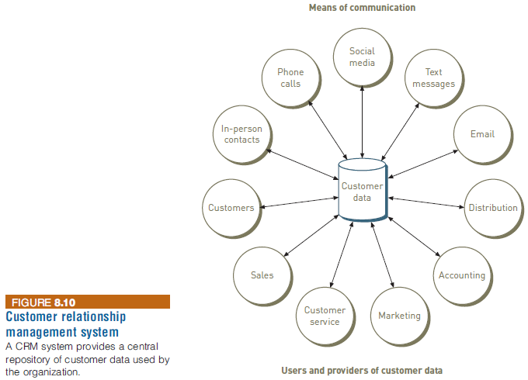
Customer Relationship Management
Notes:
Customer Relationship Management

Slide 18
Customer Relationship Management
Key features of a CRM system include:
Contact management
Sales management
Customer support
Marketing automation
Analysis
Social networking
Access by smartphones
Import contact data
Notes:
Customer Relationship Management
Key features of a CRM system include:
Contact management
Sales management
Customer support
Marketing automation
Analysis
Social networking
Access by smartphones
Import contact data

Slide 19
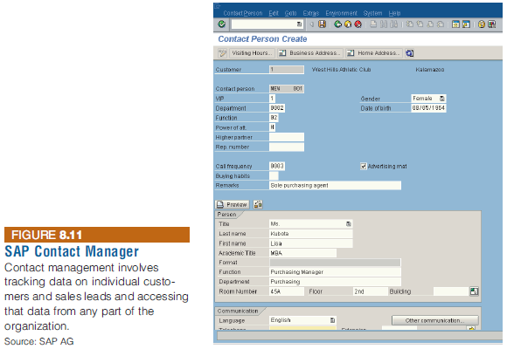
Customer Relationship Management
Notes:
Customer Relationship Management

Slide 20
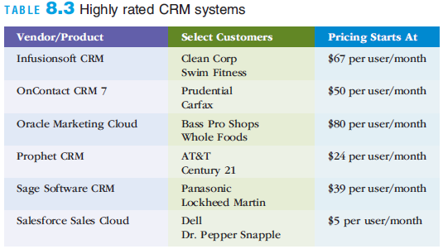
Customer Relationship Management
Notes:
Customer Relationship Management

Slide 21
Customer Relationship Management
Due to the popularity of mobile devices
Shoppers can easily compare products and prices on their mobile phones
Shopper can also tweet their experiences with a brand to dozens of friends
Savvy retailers use their CRM systems to stay on top of what these customers are saying on social networks
Most CRM systems can now be accessed via smartphones
Notes:
Customer Relationship Management
Due to the popularity of mobile devices
Shoppers can easily compare products and prices on their mobile phones
Shopper can also tweet their experiences with a brand to dozens of friends
Savvy retailers use their CRM systems to stay on top of what these customers are saying on social networks
Most CRM systems can now be accessed via smartphones

Slide 22
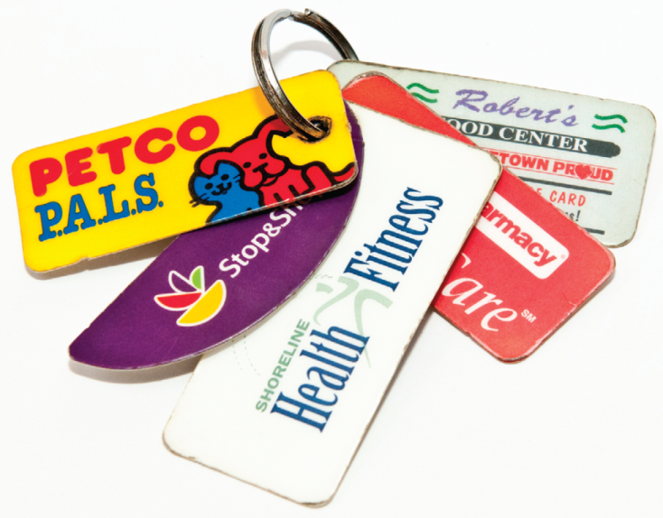
Marketing
Cross selling is the practice of marketing additional, related products to customers based on their previous purchases.
Up selling is a sales strategy in which the sales person will provide customers the opportunity to purchase higher-value related products or services as opposed to, or along with, the consumer’s initial product or service selection.
Bundling is a form of cross selling in which a business sells a group of products or services together at a price that is lower than the combined individual prices of the products.
Source: © Amy Eira/PhotoEdit
Notes:
Cross selling is the practice of marketing additional, related products to customers based on
their previous purchases.
Up selling is a sales strategy in which the sales person will provide customers the opportunity
to purchase higher-value related products or services as opposed to, or along with, the consumer’s
initial product or service selection.
Bundling is a form of cross selling in which a business sells a group of products or services together at a price that is lower than the combined individual prices of the products.

Slide 23
Supply Chain Management
Supply chain management (SCM)
is the function of planning, organizing and optimizing the supply chain’s activities.
Interorganizational information system (IOS)
involves information flows among two or more organizations.
Notes:
Supply chain management (SCM) is the function of planning, organizing and optimizing
the supply chain’s activities.
Interorganizational information system (IOS) involves information flows among two
or more organizations.

Slide 24
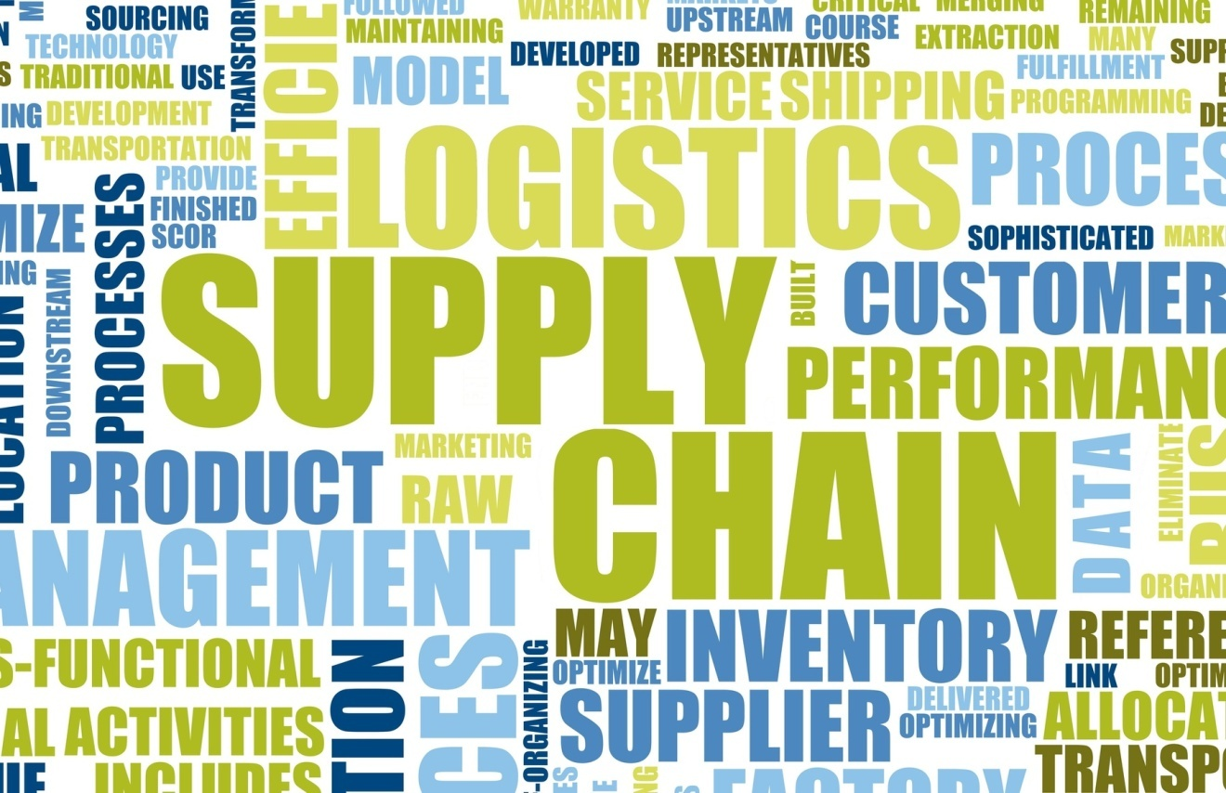
The Flows of the Supply Chain
Material flows Information flows Financial flows
© Toh Kheng Ho/Age Fotostock America, Inc.
Notes:
Material flows are the physical products, raw materials, supplies and so forth that flow along
the chain.
Information flows are all data related to demand, shipments, orders, returns and schedules
as well as changes in any of these data.
Financial flows are all transfers of money, payments and credit-related data.
A supply chain involves a product life cycle approach, from “dirt to dust”.

Slide 25
Supply Chain Management
…refers to the flow of materials, information, money from:
Raw material suppliers Factories Warehouses End consumers.

Slide 26
SCM
Upstream component of a supply chain: sourcing or procurement takes place.
Internal component of a supply chain: packaging, assembly, or manufacturing takes place.
Downstream component of a supply chain: distribution takes place.

Slide 27
Supply Chain Management
Supply chain management (SCM) is a system that includes planning, executing, and controlling all activities involved in:
Sourcing and procurement of raw materials
Converting raw materials to finished products
Warehousing and delivering finished product to customers
SCM manages materials, information, and finances as they move from:
Supplier -> Manufacturer -> Wholesaler -> Retailer -> Consumer
Notes:
Supply Chain Management
Supply chain management (SCM) is a system that includes planning, executing, and controlling all activities involved in:
Sourcing and procurement of raw materials
Converting raw materials to finished products
Warehousing and delivering finished product to customers
SCM manages materials, information, and finances as they move from:
Supplier -> Manufacturer -> Wholesaler -> Retailer -> Consumer

Slide 28
Supply Chain Management
Process for developing a production plan
Sales forecasting
Sales and operations plan (S&OP)
Demand management
Detailed scheduling
Materials requirement planning (MRP)
Purchasing
Production
Sales ordering
Notes:
Supply Chain Management
Process for developing a production plan
Sales forecasting
Sales and operations plan (S&OP)
Demand management
Detailed scheduling
Materials requirement planning (MRP)
Purchasing
Production
Sales ordering

Slide 29
Five Basic Components of Supply Chain Management
Plan
Source
Make
Deliver
Return

Slide 30
Interorganizational Information Systems (IOS)
Enable the partners to perform the following:
Reduce the costs of routine business transactions
Improve the quality of the information flow by reducing or eliminating errors
Compress the cycle time involved in fulfilling business transactions
Eliminate paper processing and its associated inefficiencies and costs
Make the transfer and processing of information easier for users

Slide 31
Generic Supply Chain
Notes:
Supply chain: refers to the flow of materials, information, money, and services from raw material
suppliers, through factories and warehouses, to the end consumers.
Upstream component of a supply chain: sourcing or procurement takes place.
Internal component of a supply chain: packaging, assembly, or manufacturing takes place.
Downstream component of a supply chain: distribution takes place.

Slide 32
Push Model

Slide 33
Pull Model
Source: © Milan Zeremski/iStockphoto

Slide 34
Problems Along the Supply Chain
Poor customer service
Poor quality product
High inventory costs
Loss of revenues

Slide 35
The Bullwhip Effect
Order
Quantity
Order
Quantity
Order
Quantity
Order
Quantity
Time
Time
Time
Time
Customer Sales
Retail Orders
To Wholesaler
Wholesaler
Orders to
Manufacturer
Manufacturer
Orders to
Supplier
Notes:
Figure 10.2

Slide 36
Solutions to Supply Chain Problems
Using inventories
Just-in-time inventory a system in which a supplier delivers the precise number of parts to be assembled into a finished product at precisely the right time.
Information sharing
Vendor-managed inventory-an inventory strategy where the supplier monitors a vendor’s inventory for a product and replenishes products when needed.
Notes:
Just-in-time inventory: a system in which a supplier delivers the precise number of parts to
be assembled into a finished product at precisely the right time.
Vendor-managed inventory: an inventory strategy where the supplier monitors a vendor’s
inventory for a product or group of products and replenishes products when needed.

Slide 37
Solutions to Supply Chain Problems
Portals
Procurement- purchasing products between a single buyer and multiple suppliers.
Boeing has deployed a portal which it conducts business with its suppliers
Distribution – selling from a single supplier to multiple buyers.
Dell services its business customers through its distribution portal
Notes:
Just-in-time inventory: a system in which a supplier delivers the precise number of parts to
be assembled into a finished product at precisely the right time.
Vendor-managed inventory: an inventory strategy where the supplier monitors a vendor’s
inventory for a product or group of products and replenishes products when needed.

Slide 38
Information Technology Support for Supply Chain Management
Electronic data interchange (EDI) is a communication standard that enables business partners to exchange routine documents, such as purchase orders, electronically.
Extranets link business partners to one another over the Internet by providing access to certain areas of each other’s corporate intranets
Portals and Exchanges – a single point of access through a Web Browser to critical information in an organization
Notes:
Electronic data interchange (EDI) is a communication standard that enables
business partners to exchange routine documents, such as purchase orders,
electronically.
Extranets link business partners to one another over the Internet by providing
access to certain areas of each other’s corporate intranets.

Slide 39
Supply Chain Management
Notes:
Supply Chain Management

Slide 40
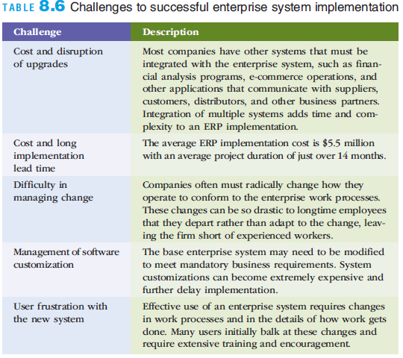
Overcoming Challenges in Implementing Enterprise Systems

Slide 41
Overcoming Challenges in Implementing Enterprise Systems
Tips for avoiding a failed implementation
Assign a full-time executive to manage the project
Appoint an experienced, independent resource to provide project over- sight and to verify and validate system performance
Allow sufficient time to transition from the old way of doing things to the new system and new processes
Allocate sufficient time and money training people
Define metrics to assess project progress and to identify project-related risks
Keep the scope of the project well defined and contained to essential business processes
Be wary of modifying the enterprise system software to conform to your firm’s business practices
Notes:
Overcoming Challenges in Implementing Enterprise Systems
Tips for avoiding a failed implementation
Assign a full-time executive to manage the project
Appoint an experienced, independent resource to provide project over- sight and to verify and validate system performance
Allow sufficient time to transition from the old way of doing things to the new system and new processes
Allocate sufficient time and money training people
Define metrics to assess project progress and to identify project-related risks
Keep the scope of the project well defined and contained to essential business processes
Be wary of modifying the enterprise system software to conform to your firm’s business practices

Slide 42
Hosted Software Model for Enterprise Software
Many business application software vendors are pushing the use of the hosted software model for businesses
The goal is to help customers acquire, use, and benefit from the new technology while avoiding much of the associated complexity and high start-up costs
Using the hosted software model enables businesses to:
Experiment with powerful software capabilities without making a major financial investment
Avoid employing a full-time IT person to maintain key business applications
Notes:
Hosted Software Model for Enterprise Software
Many business application software vendors are pushing the use of the hosted software model for businesses
The goal is to help customers acquire, use, and benefit from the new technology while avoiding much of the associated complexity and high start-up costs
Using the hosted software model enables businesses to:
Experiment with powerful software capabilities without making a major financial investment
Avoid employing a full-time IT person to maintain key business applications

Slide 43
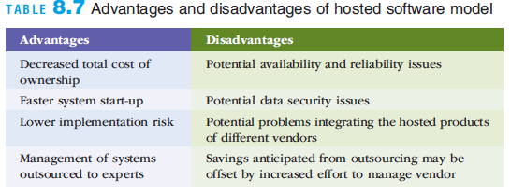
Hosted Software Model for Enterprise Software
Notes:
Hosted Software Model for Enterprise Software

Slide 44
Summary
An organization must have information systems that support routine, day-to-day activities and that help a company add value to its products and services
An organization that implements an enterprise system is creating a highly integrated set of systems, which can lead to many business benefits
Notes:
Summary
An organization must have information systems that support routine, day-to-day activities and that help a company add value to its products and services
An organization that implements an enterprise system is creating a highly integrated set of systems, which can lead to many business benefits

