Slide 1
Reverse Shoulder Prosthesis
Sean Frankle
ITMG Section 06

Slide 2
What is the Reverse Shoulder Prosthesis?
Artificial joint used to replace damaged or malfunctioning shoulder joints in patients
Breakthrough in medical technology with its invention in 2005
Exponential increase in usage since 2005 as it is the most popular shoulder joint in orthopedics to this day
Composed of titanium, cobalt chrome, stainless steel, and polyethylene

Slide 3
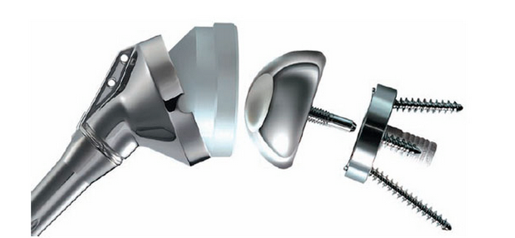
The Device Itself & Components
From Left to Right: Humeral stem, metaphysis, the polyethlene humeral concavity insert, glenoshpere, and the metaglene

Slide 4
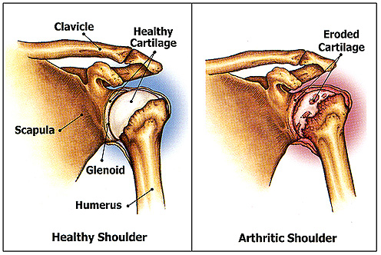
Primary Use in Orthopedics
To replace a biological shoulder that no longer functions properly due to arthritis or damage.
Ideal candidates for this implant include
Elderly individuals with arthritis
Shoulders torn or dislocated by injury

Slide 5
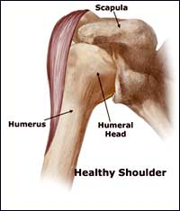
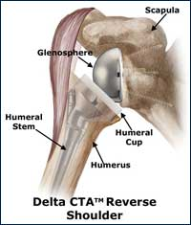
How it works
Reverses the normal anatomy of the biological shoulder by switching the ball and socket locations

Slide 6
Advantages Disadvantages
Drastically reduces discomfort and pain
Increases range of motion
Reduces stress on joint
Potential complications in implantation of device
Potential risk of dislocation
Possible Bone fractures

Slide 7
Common Drawbacks
Complications | Number of Patients out of 20 | Percent of Patients
Bone Fractures | 3 | 15%
Poor Screw Fixation | 3 | 15%
Metal Stem Size Misfit | 2 | 10%
Dislocation | 1 | 5%
Wound Infection | 1 | 5%
Stich Abscess | 3 | 15%

Slide 8
How Can I find out more info?
DJO Surgical Webpage
Reverse Shoulder Replacement

Slide 9
References
http://www.prohealthcare.org/services/orthopediccenter/reverse-shoulder-replacement/
http://www.ncbi.nlm.nih.gov/pmc/articles/PMC2600997/
http://www.umm.edu/orthopaedic/rsr.htm
http://www.blueprintrsp.com/
http://www.mayoclinic.org/medicalprofs/reverse-shoulder-arthroplasty.html

