Slide 1
Windows 8 Tablet
By:
Lourdes Araujo
ITMG 100-06

Slide 2
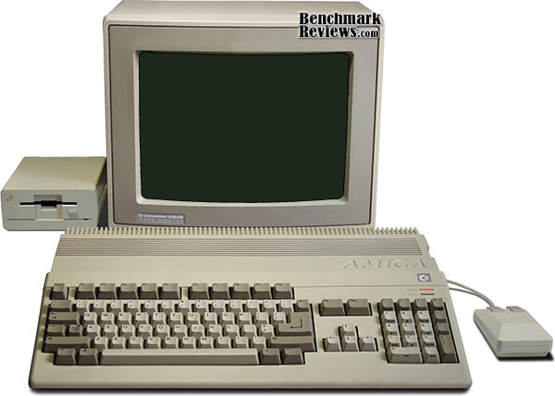
Older Computers

Slide 3
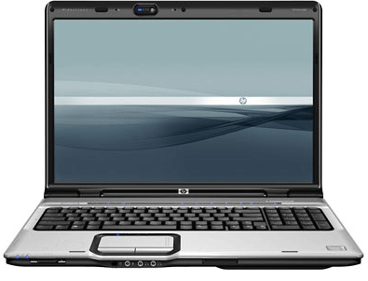
Laptops

Slide 4
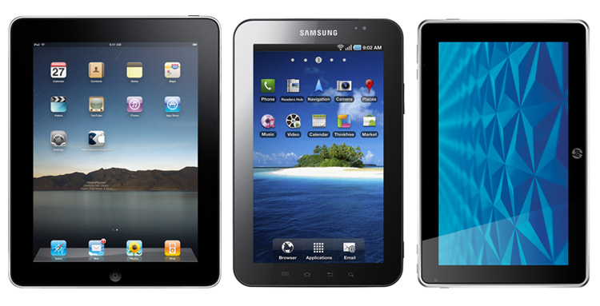
Tablets

Slide 5
Advantages:
Some advantages of owning a Windows 8 Tablet are that whenever you want to take your tablet anywhere it only weighs 1.98 pounds.
Also, the dimensions of the tablet are beneficial because they are only 11.66 x 7.24 x 0.51 in which is great because you can fit the tablet anywhere.

Slide 6
Disadvantages
One big disadvantage for the average consumer is price.
Tablet PCs are more expensive than a laptop because they are a relatively new device and you can expect to pay anywhere from $1,000 and higher.
In addition, even though the size of a tablet can be used as an advantage it can also be a disadvantage because the keyboard is smaller.

Slide 7
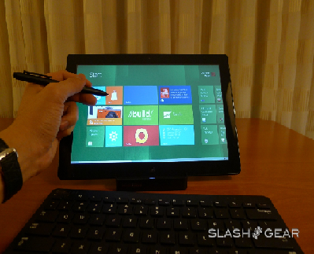
The new PC device that is now being used are Tablets. A tablet we should keep our eyes out for is the Windows 8 Hands on Tablet

Slide 8
The Specs that the Samsung Series 7 offers includes:
Operating System | Windows 8
Memory | 4GB DDR3 1333 MHz
Display | 11.6 in SuperBright LED-backlit HD (1366 x 768)
Hard Drive Space | 128 GB SSD
PC Type | Slate
Optical Drive | None
Media Drive | MicroSD
Audio | HD Audio Codec

Slide 9
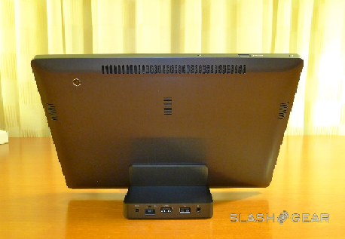
Inputs
Some inputs that are available for the Tablet include:
Mouse
Keyboard
USB Connector

Slide 10
Conclusion:
If you are considering buying a tablet you should wait for mid-2012 because that is when Windows 8 Hands On Tablet will be available

Slide 11
Useful Links:
http://www.youtube.com/watch?v=p92QfWOw88I
http://windows.microsoft.com/en-US/windows-8/preview

