Slide 1
PowerPoint Chapter 2
Creating a Presentation with Illustrations and Shapes

Slide 2
Objectives
Create slides from a blank presentation
Change views to review a presentation
Change slide layouts
Add a background style
Insert, move, and size clip art

Slide 3
Objectives
Insert a photograph from a file
Delete a placeholder
Change font color
Format text using the Format Painter

Slide 4
Objectives
Add and size a shape
Apply Quick Styles to placeholders and shapes
Select slide transitions
Preview and print an outline and handout

Slide 5
Plan Ahead
Focus on slide text content
Use single quotation marks
Adhere to copyright regulations
Use color effectively
Use serif fonts for titles and sans serif fonts for body text
Choose graphics that serve a purpose
Consider graphics for multicultural audiences

Slide 6
Starting PowerPoint
Click the Start button on the Windows Vista taskbar to display the Start menu
Click All Programs at the bottom of the left pane on the Start menu to display the All Programs list and then click Microsoft Office in the All Programs list
Click Microsoft Office PowerPoint 2007 to start PowerPoint and display a new blank presentation in the PowerPoint window
If the PowerPoint window is not maximized, click the Maximize button next to the Close button on its title bar to maximize the window

Slide 7
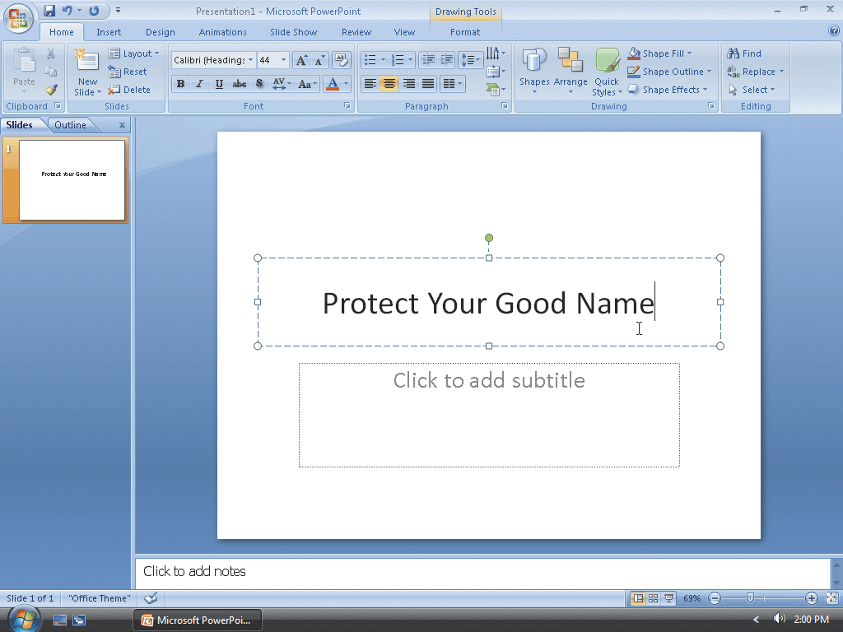
Creating a Title Slide
Type Protect Your Good Name in the title text placeholder

Slide 8
Creating the First Text Slide with a Single-Level Bulleted List
Click the New Slide button in the Slides group
Type Reduce Access to Personal Data in the title text placeholder
Press CTRL+ENTER, type Shred credit card offers in the content text placeholder, and then press the ENTER key
Type Use a locked mailbox and then press the ENTER key

Slide 9
Creating the First Text Slide with a Single-Level Bulleted List
Type Mail envelopes inside the post office and then press the ENTER key
Type Remove listing from telephone directory but do not press the ENTER key
Italicize the word, inside, in the third bulleted paragraph

Slide 10
Creating the First Text Slide with a Single-Level Bulleted List

Slide 11
Creating the Second Text Slide with a Single-Level Bulleted List
Click the New Slide button in the Slides group
Type Internet and Security Safeguards in the title text placeholder
Press CTRL+ENTER, type Install a firewall in the content text placeholder, and then press the ENTER key
Type Install and update virus protection software and then press the ENTER key
Type Never respond to phishing e-mail and then press the ENTER key
Type Use credit, not debit, cards when shopping but do not press the ENTER key

Slide 12
Creating the Second Text Slide with a Single-Level Bulleted List

Slide 13
Creating the Third Text Slide with a Single-Level Bulleted List
Click the New Slide button in the Slides group
Type Beware of 'Shoulder Surfers' in the title text placeholder
Press CTRL+ENTER, type Shield your hand when entering your PIN in the content text placeholder, and then press the ENTER key
Type Thieves may be watching with binoculars but do not press the ENTER key

Slide 14
Creating the Third Text Slide with a Single-Level Bulleted List

Slide 15
Choosing a Background Style
Click Design on the Ribbon to display the Design tab
Click the Background Styles button in the Background group to display the Background Styles gallery
Click Background Style 12 to apply this background to all the slides

Slide 16
Choosing a Background Style

Slide 17
Saving a Presentation
With a USB flash drive connected to one of the computer’s USB ports, click the Save button on the Quick Access Toolbar to display the Save As dialog box
Type Identity Theft in the File name text box to change the file name. Do not press the ENTER key after typing the file name. If Computer is not displayed in the Favorite Links section, drag the top or bottom edge of the Save As dialog box until Computer is displayed. Click Computer in the Favorite Links section
Double-click your USB flash drive in the list of available drives
Click the Save button in the Save As dialog box to save the presentation on the USB flash drive with the file name, Identity Theft

Slide 18
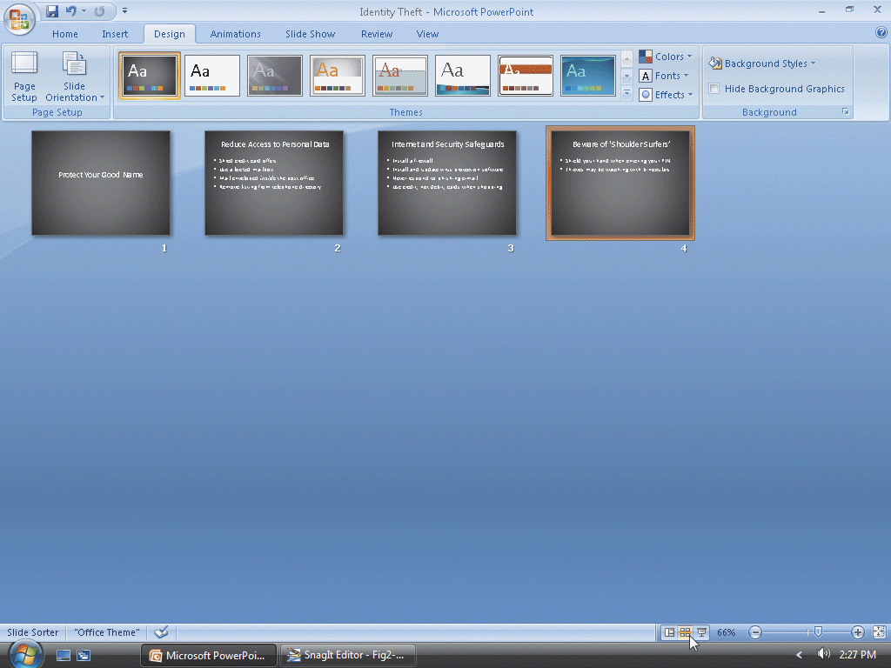
Changing the View to Slide Sorter View
Click the Slide Sorter view button at the lower right of the PowerPoint window to display the presentation in Slide Sorter view

Slide 19
Changing the View to Normal View
Click the Normal view button at the lower right of the PowerPoint window to display the presentation in Normal view

Slide 20
Changing the Slide Layout to Two Content
Click the Previous Slide button on the vertical scroll bar twice to display Slide 2
Click Home on the Ribbon to display the Home tab
Click the Layout button in the Slides group on the Home tab to display the Layout gallery
Click Two Content to apply that layout to Slide 2

Slide 21
Changing the Slide Layout to Two Content

Slide 22
Changing the Slide Layout to Two Content
Click the Next Slide button
Click the Layout button in the Slides group on the Home tab to display the Layout gallery
Click Two Content to apply the layout to Slide 3

Slide 23
Changing the Slide Layout to Two Content

Slide 24
Changing the Slide Layout to Picture with Caption
Click the Next Slide button
Click the Layout button in the Slides group
Click Picture with Caption to apply the layout to Slide 4

Slide 25
Changing the Slide Layout to Picture with Caption

Slide 26
Inserting a Clip from the Clip Organizer into a Content Placeholder
Click the Previous Slide button twice to display Slide 2
Click the Clip Art button in the content placeholder to display the Clip Art task pane
Click the Search for text box in the Clip Art task pane, delete any letters that are present, and then type shredder in the Search for text box
Click the Go button so that the Microsoft Clip Organizer will search for and display all pictures having the keyword, shredder

Slide 27
Inserting a Clip from the Clip Organizer into a Content Placeholder
If necessary, click the Yes button if a Microsoft Clip Organizer dialog box appears asking if you want to include additional clip art images form Microsoft Offi ce Online
If necessary, scroll down the list to display the shredder clip shown on the following slide
Click the clip to insert it into the right content placeholder

Slide 28
Inserting a Clip from the Clip Organizer into a Content Placeholder

Slide 29
Inserting a Photograph from the Clip Organizer into a Slide
Click the Next Slide button to display Slide 3
Click the Search for text box in the Clip Art task pane and then delete the letters in the text box
Type credit card and then click the Go button
If necessary, scroll down the list to display the picture of a credit card shown on the following slide and then click the photograph to insert it into Slide 3

Slide 30
Inserting a Photograph from the Clip Organizer into a Slide

Slide 31
Inserting a Photograph from a File into a Slide
Click the Next Slide button to display Slide 4
Click the Close button in the Clip Art task pane so that it no longer is displayed
Click the Insert Picture from File icon in the content placeholder to display the Insert Picture dialog box
If the Folders list is displayed below the Folders button, click the Folders button to remove the Folders list

Slide 32
Inserting a Photograph from a File into a Slide
With your USB flash drive connected to one of the computer’s USB ports, if necessary, click Computer in the Favorite Links section and then scroll until UDISK 2.0 (E:) appears in the list of available drives
Double-click UDISK 2.0 (E:) to select the USB flash drive, Drive E in this case, as the device that contains the picture
Click ATM to select the file name
Click the Insert button in the dialog box to insert the picture into Slide 4

Slide 33
Inserting a Photograph from a File into a Slide

Slide 34
Resizing Clip Art
Click the Previous Slide button two times to display Slide 2
Click the shredder clip to select it and display the selection rectangle
Point to the upper-left corner sizing handle on the clip so that the mouse pointer shape changes to a two-headed arrow
Drag the sizing handle diagonally toward the center of the slide until the mouse pointer is positioned approximately as shown in Figure 2–21 on page PPT 102
Release the mouse button to resize the clip. If necessary, select the clip and then use the ARROW keys to position the clip as shown in Figure 2-21
Click outside the clip to deselect it

Slide 35
Resizing Clip Art

Slide 36
Resizing a Photograph
Click the Next Slide button to display Slide 3
Click the credit card photograph to select it
Drag the upper-left corner sizing handle on the photograph diagonally inward until the photograph is resized approximately as shown on the following slide

Slide 37
Resizing a Photograph

Slide 38
Deleting a Placeholder
Click the right content placeholder to select it
Click the edge of the placeholder so the border is displayed as a solid line
Press the DELETE key to delete the placeholder from Slide 2

Slide 39
Moving Clips
Click the credit card photograph on Slide 3 to select it and then press and hold down the mouse button
Drag the photograph diagonally upward toward the word, Safeguards
Click the Previous Slide button to display Slide 2
Click the shredder clip to select it, press and hold down the mouse button, and then drag the photograph toward the right side of the slide

Slide 40
Moving Clips

Slide 41
Saving an Existing Presentation with the Same File Name
Click the Save button on the Quick Access Toolbar to overwrite the previous Identity Theft file on the USB flash drive

Slide 42
Formatting Title Text Using Quick Styles
Click the Slide 2 title text placeholder to select it
Click the Quick Styles button in the Drawing group in the Home tab to display the Quick Styles gallery. Point to the Subtle Effect – Accent 6 Quick Style (row 4, column 7) to display a live preview of the style
Click the Subtle Effect – Accent 6 Quick Style (row 4, column 7) to apply this format to the title text placeholder

Slide 43
Formatting Title Text Using Quick Styles

Slide 44
Formatting Remaining Title Text Using Quick Styles
Click the Next Slide button to display Slide 3. Click the title text placeholder and then click the Quick Styles button in the Drawing group to display the Quick Styles gallery
Click the Subtle Effect – Accent 6 Quick Style (row 4, column 7) to apply this format to the title text placeholder
Click the Next Slide button to display Slide 4. Click the title text placeholder, click the Quick Styles button, and then click the Subtle Effect – Accent 6 Quick Style (row 4, column 7) to apply this format to the title text placeholder

Slide 45
Formatting Remaining Title Text Using Quick Styles

Slide 46
Changing the Heading Font
Click the Previous Slide button two times to display Slide 2. Triple-click the title text paragraph. With the text selected, click the Font box arrow in the Font group on the Home tab to display the Font gallery
Scroll through the Font gallery, if necessary, and then point to Cambria (or a similar font) to display a live preview of the title text in Cambria font
Click Cambria (or a similar font) to change the font of the selected text to Cambria

Slide 47
Changing the Heading Font

Slide 48
Shadowing Text
With the text selected, click the Text Shadow button in the Font group on the Home tab to add a shadow to the selected text

Slide 49
Changing Font Color
With the text selected, click the Font Color box arrow in the Font group on the Home tab to display the Font Color gallery
Point to the Dark Red color in the Standard Colors row to display a live preview of the title text in a Dark Red color
Click Dark Red to change the title text font color

Slide 50
Changing Font Color

Slide 51
Formatting Slide 3 Text Using the Format Painter
With the Slide 2 title text still selected, double-click the Format Painter button in the Clipboard group in the Home tab
Move the mouse pointer off the Ribbon
Click the Next Slide button to display Slide 3. Triple-click the title text placeholder to apply the format to all the title text

Slide 52
Formatting Slide 3 Text Using the Format Painter

Slide 53
Formatting the Remaining Title Text
Click the Next Slide button to display Slide 4. Triple-click the title text placeholder to apply the format to all title text characters
Click the Previous Slide button three times to display Slide 1. Triple-click the title text placeholder to apply the format to all title text characters
Press the ESC key to turn off the Format Painter feature

Slide 54
Formatting the Remaining Title Text

Slide 55
Sizing Slide 4 Text
Click the Next Slide button three times to display Slide 4
Select both body text paragraphs in the content text placeholder and then click the Increase Font Size button on the Mini toolbar four times to increase the font size to 24 point
Triple-click the title text placeholder and then click the Decrease Font Size button on the Mini toolbar three times to reduce the font size to 32 point
Click the slide anywhere outside the placeholders to deselect it

Slide 56
Sizing Slide 4 Text

Slide 57
Increasing Title Slide Font Size
Click the Previous Slide button three times to display Slide 1
Select the Slide 1 title text, Protect Your Good Name. Click the Increase Font Size button on the Mini toolbar six times until the font size is 80 point
Click the slide anywhere outside the title text placeholder to deselect it

Slide 58
Increasing Title Slide Font Size

Slide 59
Adding a Shape
Click the Shapes button in the Drawing group on the Home tab to display the Shapes gallery. Point to the Wave banner shape in the Stars and Banners area
Click the Wave shape
Click Slide 1 anywhere below the title text to insert the Wave shape

Slide 60
Adding a Shape

Slide 61
Resizing a Shape
With the Wave shape still selected, point to the lower-right corner sizing handle on the picture so that the mouse pointer shape changes to a two-headed arrow
Drag the sizing handle diagonally outward and downward until the Wave shape is the approximate size of the one shown in Figure 2–45 on page PPT 118
Release the mouse button to resize the shape

Slide 62
Resizing a Shape

Slide 63
Adding Text to a Shape
With the Wave banner shape selected, type Reduce Your Risk of Identity Theft in the shape

Slide 64
Formatting Shape Text and Adding a Shape Quick Style
Triple-click the Wave shape text to select it and then click the Increase Font Size button on the Mini toolbar five times until the font size is 36 point
Click the Shape Quick Styles button in the Drawing group on the Home tab to display the Quick Styles gallery
Point to the Subtle Effect – Accent 6 Shape Quick Style (row 4, column 7) to display a live preview of the style
Click the Subtle Effect – Accent 6 Shape Quick Style (row 4, column 7) to apply this format to the shape
Click outside the shape to deselect it

Slide 65
Formatting Shape Text and Adding a Shape Quick Style

Slide 66
Deleting a Placeholder
Click the subtitle text placeholder border two times to change the border to a solid line
Press the DELETE key to delete the placeholder. If necessary, select the shape and then use the ARROW keys to center the shape under the title text

Slide 67
Deleting a Placeholder

Slide 68
Adding a Transition between Slides
Click the Animations tab on the Ribbon and then point to the More button in the Transition to This Slide group
Click the More button to expand the Transitions gallery
Point to the Uncover Right transition (row 2, column 2) in the Wipes category in the Transitions gallery to display a live preview of this transition
Click Uncover Right in the Wipes category in the Transitions gallery to apply the Uncover Right transition to the title slide

Slide 69
Adding a Transition between Slides
Click the Transition Speed arrow in the Transition to This Slide group on the Animations tab to display three possible speeds: Slow, Medium, and Fast
Click Medium to change the transition speed for Slide 1 to Medium
Click the Apply to All button in the Transition to This Slide group on the Animations tab to apply the Uncover Right transition and Medium speed to all four slides in the presentation

Slide 70
Adding a Transition between Slides

Slide 71
Changing Document Properties
Click the Office Button to display the Office Button menu, point to Prepare on the Office Button menu, and then click Properties on the Prepare submenu to display the Document Information Panel
Click the Author text box, if necessary, and then type your name as the Author property. If a name already is displayed in the Author text box, delete it before typing your name
Click the Subject text box, if necessary delete any existing text, and then type your course and section as the Subject property
Click the Keywords text box, if necessary delete any existing text, and then type identity theft, Internet safeguards, PIN as the Keywords properties
Click the Close the Document Information Panel button so that the Document Information Panel no longer is displayed

Slide 72
Saving an Existing Presentation with the Same File Name
Click the Save button on the Quick Access Toolbar to overwrite the previous Identity Theft file on the USB flash drive

Slide 73
Running an Animated Slide Show
Click the Slide Show button to display the title slide
Click each slide and view the transition effect and slides

Slide 74
Previewing and Printing an Outline
Click the Office Button to display the Office button menu
Point to Print on the Office Button menu to display the Print submenu
Click Print Preview on the Print submenu to display a preview of a slide, handout, or outline of the presentation
If an outline is not previewed, click the Print What box arrow in the Page Setup group on the Print Preview tab to display a list of output types in the Print What list
Click Outline View in the Print What list if this choice is not already selected
Click the Zoom button in the Zoom group on the Print Preview tab to open the Zoom dialog box

Slide 75
Previewing and Printing an Outline
Click 100% in the Zoom dialog box to change the zoom so that you can read the outline easily on the screen
Click the OK button in the Zoom dialog box to zoom the outline
Drag the scroll box on the vertical scroll bar up or down to move through the outline text
Click the Print button in the Print group on the Print Preview tab to display the Print dialog box
Click the OK button to print the outline

Slide 76
Previewing and Printing an Outline

Slide 77
Previewing and Printing Handouts
Click the Print What box arrow in the Page Setup group
Click Handouts (4 Slides Per Page) in the Print What list. Drag the scroll box on the vertical scroll bar up or down to move through the page
Click the Print button in the Print group
Click the OK button in the Print dialog box to print the handout
Click the Close Print Preview button in the Preview group on the Print Preview tab to return to Normal view

Slide 78
Previewing and Printing Handouts

Slide 79
Quitting PowerPoint
Click the Office Button and then click the Exit PowerPoint button
If necessary, click the Yes button in the Microsoft Office PowerPoint dialog box so that any changes you have made are saved

Slide 80
Summary
Create slides from a blank presentation
Change views to review a presentation
Change slide layouts
Add a background style
Insert, move, and size clip art

Slide 81
Summary
Insert a photograph from a file
Delete a placeholder
Change font color
Format text using the Format Painter

Slide 82
Summary
Add and size a shape
Apply Quick Styles to placeholders and shapes
Select slide transitions
Preview and print an outline and handout

Slide 83
PowerPoint Chapter 2 Complete

