Slide 1
Shelly Cashman: Microsoft Excel 2019
Module 6: Creating, Sorting, and Querying a Table
© 2020 Cengage Learning. All Rights Reserved. May not be copied, scanned, or duplicated, in whole or in part, except for use as permitted in a license distributed with a certain product or service or otherwise on a password-protected website for classroom use.

Slide 2
Objectives (1 of 2)
Create and manipulate a table
Delete duplicate records
Add calculated columns to a table with structured references
Use the VLOOKUP function to look up a value in a table
Use icon sets with conditional formatting
Insert a total row
Sort a table on one field or multiple fields
Sort, query, and search a table using AutoFilter

Slide 3
Objectives (2 of 2)
Remove filters
Create criteria and extract ranges
Apply database and statistical functions
Use the MATCH and INDEX functions to find a value in a table
Display automatic subtotals
Use outline features to group, hide, and unhide data
Create a treemap chart

Slide 4
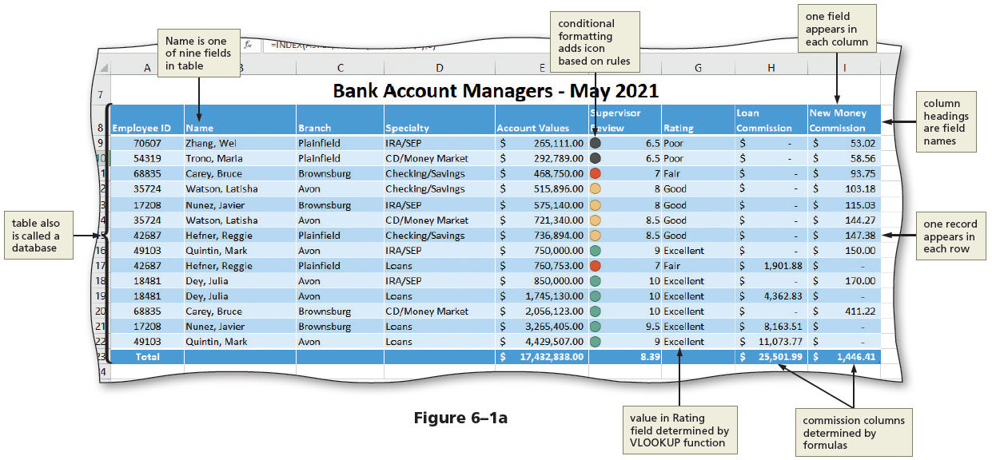
Project: Rating Bank Account Managers (1 of 2)
Notes:
Figure 6-1a: display of worksheet using the proper guidelines

Slide 5
Project: Rating Bank Account Managers (2 of 2)
Table 6-2 Guidelines for Creating a Table in Excel
Table Size and Workbook Location
Do not enter more than one table per worksheet.
Maintain at least one blank row between a table and other worksheet entries.
A table can have a maximum of 16,384 fields and 1,048,576 records on a worksheet.
Column Heading (Field Names)
Place column headings (field names) in the first row of the table.
Do not use blank rows or rows with repeating characters, such as dashes or underscores, to separate the column headings from the data.
Apply a different format to the column headings than to the data. For example, bold the column headings and format the data below the column headings using a regular style. Most table styles follow these guidelines.
While column headings can be up to 32,767 characters in length, it is advisable to keep them short so more information can fit on the screen. The column headings should be meaningful.
Contents of Table
Each cell in any given column should have similar data. For example, Specialty entries should use the company standard wording for the types of accounts, such as IRA/SEP.
Format the data to improve readability, but do not vary the format of the data within the cells of a column.
Notes:
Table 6-2: Guidelines for Creating a Table in Excel

Slide 6
Creating a Table (1 of 3)
To Format a Range as a Table
  Select the range to format
  Click the “Format as Table” button to display the Format as Table gallery
  Click the desired table style
To Name the Table
  Click anywhere in the table and then display the TABLE TOOLS DESIGN tab
  Click the Table Name text box end enter the desired table name

Slide 7
Creating a Table (2 of 3)
To Remove Duplicates
  Click the Remove Duplicates button to display the Remove Duplicates dialog box
  Click the Select All button to select all columns
  Click OK to remove duplicate records from the table
  Click OK to finish the process
To Enter New Rows and Records into a Table
  Select the desired cell
  Type in the information.

Slide 8
Creating a Table (3 of 3)
To Center Across Selection
  Select the desired range. Right-click to display the shortcut menu
  Click Format Cells on the shortcut menu to display the Format Cells dialog box
  Click the Alignment tab and then click the Horizontal button in the Text alignment area
  Click “Center Across Selection” in the Horizontal list to center the title across the selection
  Click OK to apply the settings

Slide 9
Using a Lookup Table (1 of 2)
To Create a Table Array Area
  Select the range. Right-click the selection and then click Format Cells on the shortcut menu to display the Format Cells dialog box
  Click the Alignment tab and then click the Horizontal button
  Click “Center Across Selection.” Click OK
  Click the Format Painter button and then drag through the desired cells to copy the format of the selected cell to the column headings
Notes:
Figure 6-18: display of VLOOKUP function

Slide 10
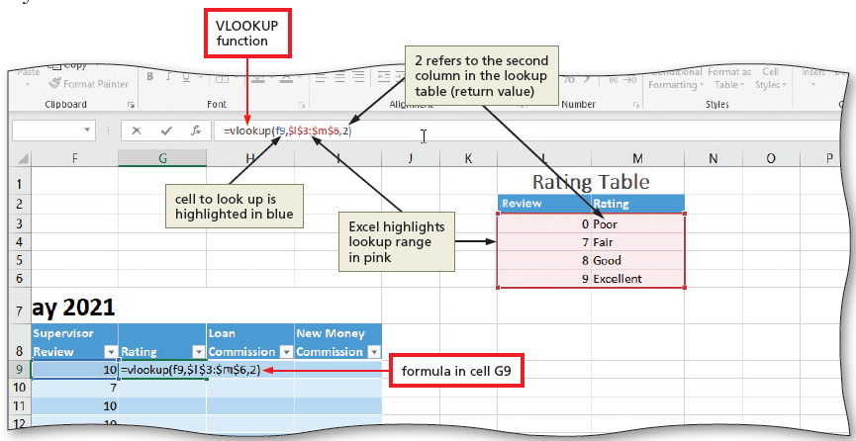
Using a Lookup Table (2 of 2)
To Use the VLOOKUP Function
  With the desired cell selected, type the VLOOKUP function
    Ex: =vlookup(f9, $1$3:$m$6, 2)
Notes:
Figure 6-18: display of VLOOKUP function

Slide 11
Adding Calculated Fields to the Table
To Create Calculated Fields
  Click the desired cell
  Click the “Accounting Number Format” button so that data in the selected column is displayed as a dollar amount with two decimal places
  Double-click Specialty to select the field to use for the IF function
  Type =IF([Specialty]=“Loans”,[Account Values] * .0025, 0) to complete the structured reference and then click the Enter button to create the calculated column

Slide 12
Conditional Formatting
To Add a Conditional Formatting Rule with an Icon Set
  Select the range to contain the conditional formatting
  Click the Conditional Formatting button to display the Conditional Formatting gallery
  Click New Rule in the Conditional Formatting gallery to display the New Formatting Rule dialog box
  Click the Format Style button to display the Format Style list
  Click Icon Sets in the Format Style list to display the Icon Style area
  Click the Icon Style arrow to display the Icon Style list and then click the desired icon style
  Enter the desired values for each icon in the Value box
  Click OK to display icons in each row of the table

Slide 13
Working with Tables in Excel
To Insert a Total Row
  Click anywhere in the table and then display the Table Tools Design tab
  Click the Total Row check box to display the total row and display the sum in the last column of the table
  Click the arrow on the right side of the cell to display a list of available functions. Select the Sum function for the selected cell in the total row

Slide 14
Sorting a Table (1 of 2)
To Sort Ascending
  Click a cell in the column to be sorted, and then click the Sort & Filter button to display the Sort & Filter menu
  Click “Sort A to Z” to sort the table in ascending order by the selected field
To Sort Descending
  Click a cell in the column to be sorted and display the DATA tab
  Click the “Sort Largest to Smallest” button to sort the table in descending sequence by the selected field

Slide 15
Sorting a Table (2 of 2)
To Custom Sort a Table
  With a cell in the table active, click the “Sort & Filter” button on to display the Sort & Filter menu
  Click Custom Sort on the Sort & Filter menu to display the Sort dialog box
  Click the “Column Sort by” button to display the field names in the table
  Click the first field on which to sort to select the first sort level
  Select the desired options for Sort On and Order
  Click the Add Level button to ask a second sort level, and then repeat the previous two steps
  Click OK to sort the table

Slide 16
Querying a Table Using AutoFilter (1 of 3)
To Sort a Table Using AutoFilter
  Click the filter button in the desired column to display the filter menu
  Click “Sort Smallest to Largest” on the filter menu to sort the
  table in ascending sequence by the selected field.
To Query a Table Using AutoFilter
  Click the filter button to display the filter menu for the desired column
  Remove the check marks next to the fields you wish to hide
  Click OK to apply the AutoFilter criterion

Slide 17
Querying a Table Using AutoFilter (2 of 3)
To Remove Filters
  Display the DATA tab
  Click the Clear button to display all of the records in the table
To Search a Table Using AutoFilter
  Click the filter button in the desired column to display the filter menu
  Click the Search box, and then type the desired search string
  Click OK to perform the search

Slide 18
Querying a Table Using AutoFilter (3 of 3)
To Enter Custom Criteria Using AutoFilter
  Click the filter button in the desired cell to display the filter menu
  Point to Number Filters to display the Number Filters submenu
  Click Custom Filter to display the Custom AutoFilter dialog box
  Select the desired options for the AutoFilter
  Click OK to display records in the table that match the custom AutoFilter criteria
To Turn Off AutoFilter
  Click the Filter button to hide the filter buttons in the table
  Click the Filter button again to show the filter buttons in the table

Slide 19
Using Criteria and Extract Ranges (1 of 2)
To Query Using a Criteria Range
  Enter the criteria data in the desired cells
  Click the table to make it active
  Click the Advanced button to display the Advanced Filter dialog box
  Click OK to hide all records that do not meet the comparison criteria

Slide 20
Using Criteria and Extract Ranges (2 of 2)
To Extract Records
  Click the table to make it active
  Click the Advanced button to display the Advanced Filter dialog box
  Click “Copy to another location” in the Action area to cause the records that meet the criteria to be copied to a different location on the worksheet
  Click OK to copy any records that meet the comparison criteria in the criteria range from the table to the extract range

Slide 21
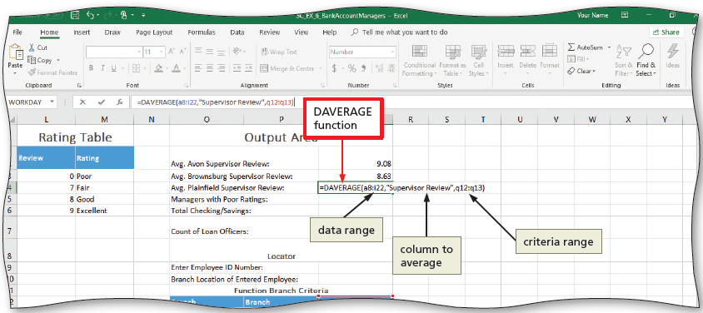
Using Database Functions
To Use the DAVERAGE and DCOUNT Database Functions
  With the desired cell selected, type the DAVERAGE function or DCOUNT function
    Ex: =DAVERAGE(a8:i22, “Supervisor Review”,o12:o13)
    Ex: =DCOUNT (a8:i22, “Supervisor Review” m2:m3)
Notes:
Figure 6-61: display of DAVERAGE function

Slide 22
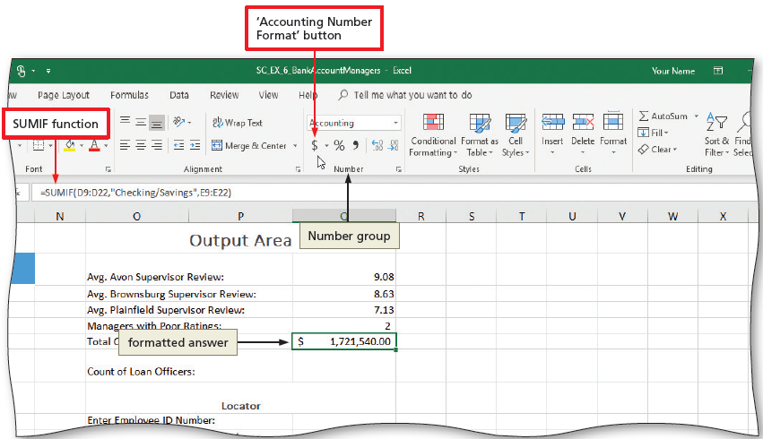
Using the Sumif, Countif, Match and Index Function (1 of 3)
To Use the SUMIF Function
  With the desired cell selected, type the SUMIF Function
    Ex: =sumif(d9:d22, ”Checking/Savings”, e9:e22)
Notes:
Figure 6-63: display of SUMIF function

Slide 23
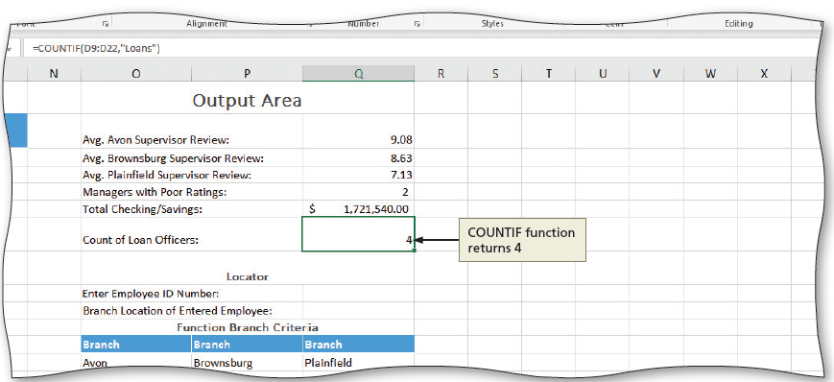
Using the Sumif, Countif, Match and Index Function (2 of 3)
To Use the COUNTIF Functions
  With the desired cell selected, type the COUNTIF function
    Ex: =countif(d9:d22, ”Loans”)
Notes:
Figure 6-64: display of COUNTIF function

Slide 24
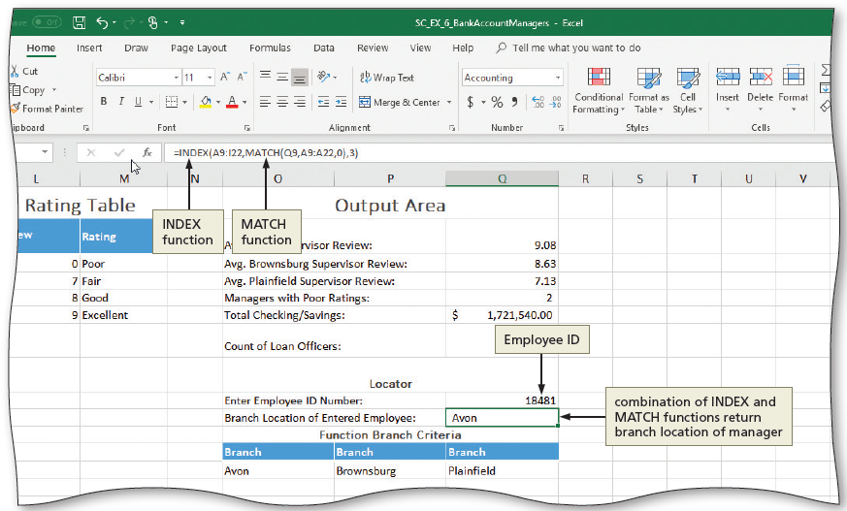
Using the SUMIF, Countif, Match and Index Function (3 of 3)
To Use the MATCH and INDEX Functions
  With the desired cell selected, type a lookup value
    Ex: =index (a9:i22, match(q9, a9:a22, 0), 3)
Notes:
Figure 6-65: display of INDEX and MATCH function

Slide 25
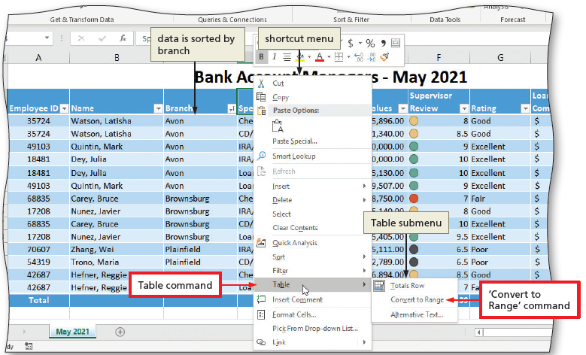
Summarizing Data (1 of 3)
To Convert a Table to a Range
  Right-click anywhere in the table and point to Table on the shortcut menu to display the Table submenu
  Click “Convert to Range” to display a Microsoft Excel dialog box
  Click the Yes button to convert a table to a range
Notes:
Figure 6-66: display of Table command and “Convert to Range” command

Slide 26
Summarizing Data (2 of 3)
To Display Subtotals
  Click in the desired criterion field
  Click the Subtotal button to display the Subtotal dialog box
  Click the “At each change in” button and then click Branch to select the control field
  If necessary, click the Use function button and then select Sum in the Use function list
  In the “Add subtotal to” list, click desired values to subtotal
  Click OK to add subtotals to the range

Slide 27
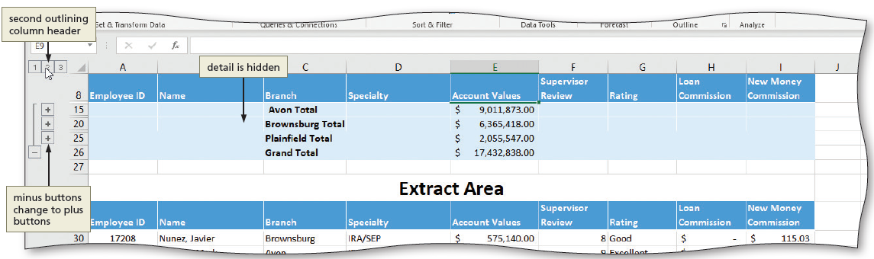
Summarizing Data (3 of 3)
To Use the Outline Feature
  Click the desired column heading
  One at a time, click each of the plus signs (+) in column two on the left side of the window to display detail records
Notes:
Figure 6-69: display of second outlining column header

Slide 28
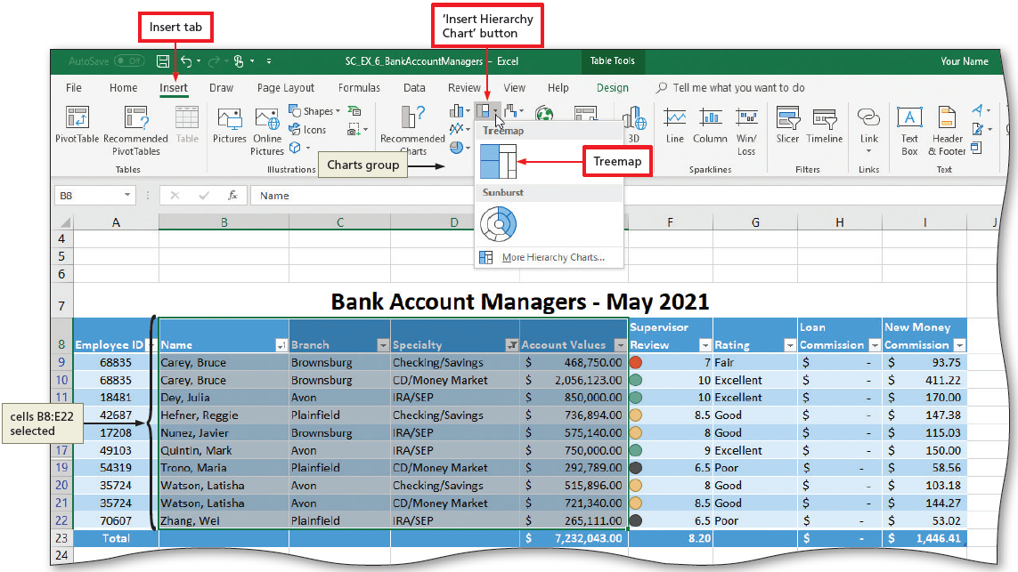
Treemap Charts
To Create a Treemap Chart
  Display the Insert tab and then click the “Insert Hierarchy Chart” button to display the gallery
  Click Treemap to insert the chart, select a chart style, chart elements, and create a legend
Notes:
Figure 6-71: display of Insert tab, “Insert Hierarchy Chart” button and Treemap

