Slide 1
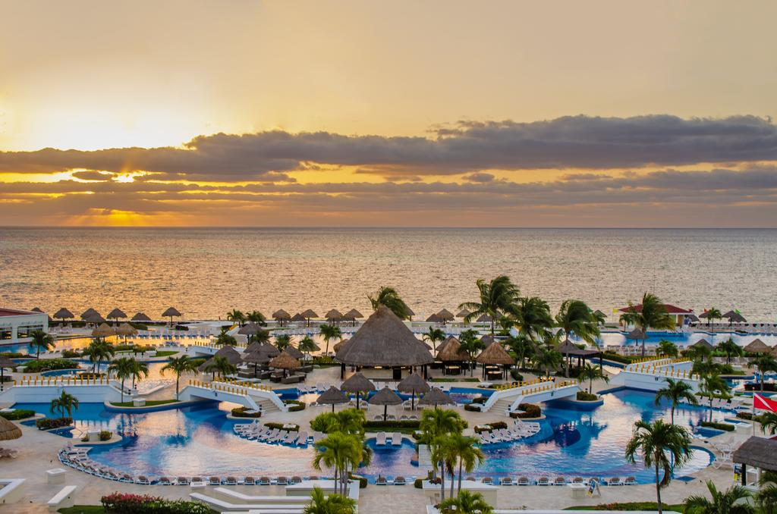
Travel to Cancun, Mexico
Addie Pinomesa

Slide 2
Cancun, Mexico on a Map

Slide 3
Resorts located in Cancun
All Inclusive Resorts | Price (Based on Average Rates of a Standard Room)
Moon Palace Golf and Spa Resort | $376-$978
Ventus at Marina El Cid Spa and Beach Resort Cancun Rivera Maya | $285-$808
Grand Sunset Princess All Suites and Spa Resort | $150-$386
Valentin Imperial Riviera Maya | $260-$596
Hard Rock Hotel Cancun | $376-$807

Slide 4
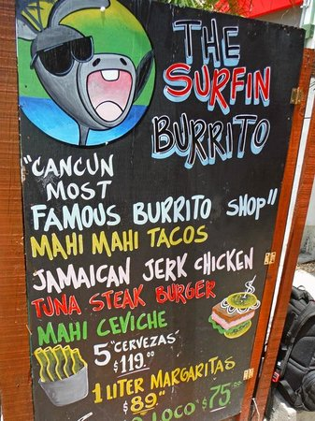
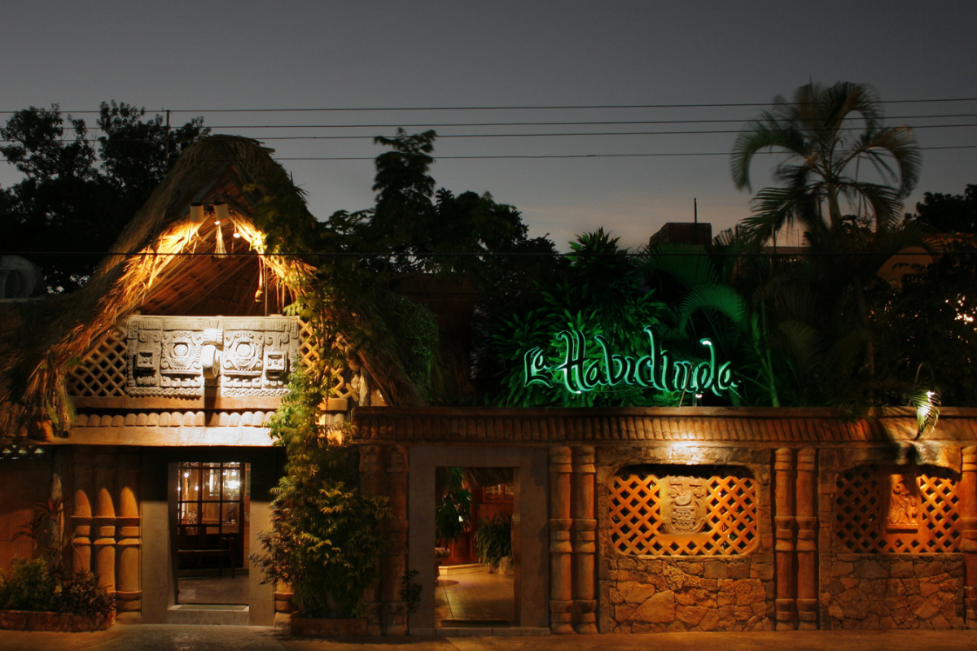
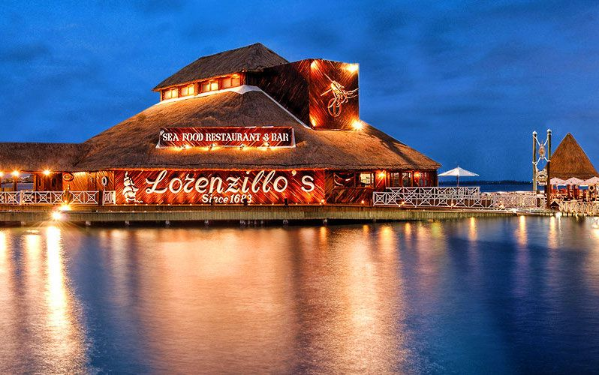
Restaurants in Cancun
Restaurants in Cancun | Stars
Lerenzillo’s | 4.6 Stars
The Surfin Burrito | 4.4 Stars
Restaurante La Habichuela | 4.6 Stars

Slide 5
Tourist Attractions in Cancun
Xplor- “Xplor is a park that will take you to enjoy adventures flying across the sky on zip-lines, go through the paths of the jungle on amphibious vehicles and to swim and float on rafts in underground rivers Earth created millions of years ago.”
360 Surf School- “Our mission for our students is to push the basics, teaching the proper surfing techniques and providing a solid foundation needed for the safety and growth in their surfing experience”
Always Diving- “Always Diving is your diving expert in Cancun. We have been helping both beginner and experienced scuba enthusiasts explore the world underneath the waves of the Yucatan Peninsula. For over thirty years, we’ve been organizing diving expeditions from Cancun to Cozumel, to the conotes around Rivera Maya.

Slide 6
Daily and Nightly Temperatures in Cancun

Slide 7
References
https://www.moonpalacecancun.com/en-us
https://ventusatmarinaelcid.com
http://www.grandsunsetprincess.com
https://www.valentinmaya.com
https://www.hrhcancun.com
http://www.hiddencancun.com/mexico-info/cancun-weather/
https://www.lorenzillos.com.mx/menu-2/
https://www.facebook.com/thesurfinburrito/menu/
http://www.lahabichuela.com/entradas2/
https://www.xplor.travel/en/xplor-admission/?gclid=Cj0KCQiA5NPjBRDDARIsAM9X1GL8b_g8VUvyn2-rm_63Ww12IpqNPfnRKc2fFyfkQyhrAq__YduyQ-EaAiUHEALw_wcB&gclsrc=aw.ds
https://www.360surfschoolcancun.com
https://alwaysdiving.com

