Slide 1
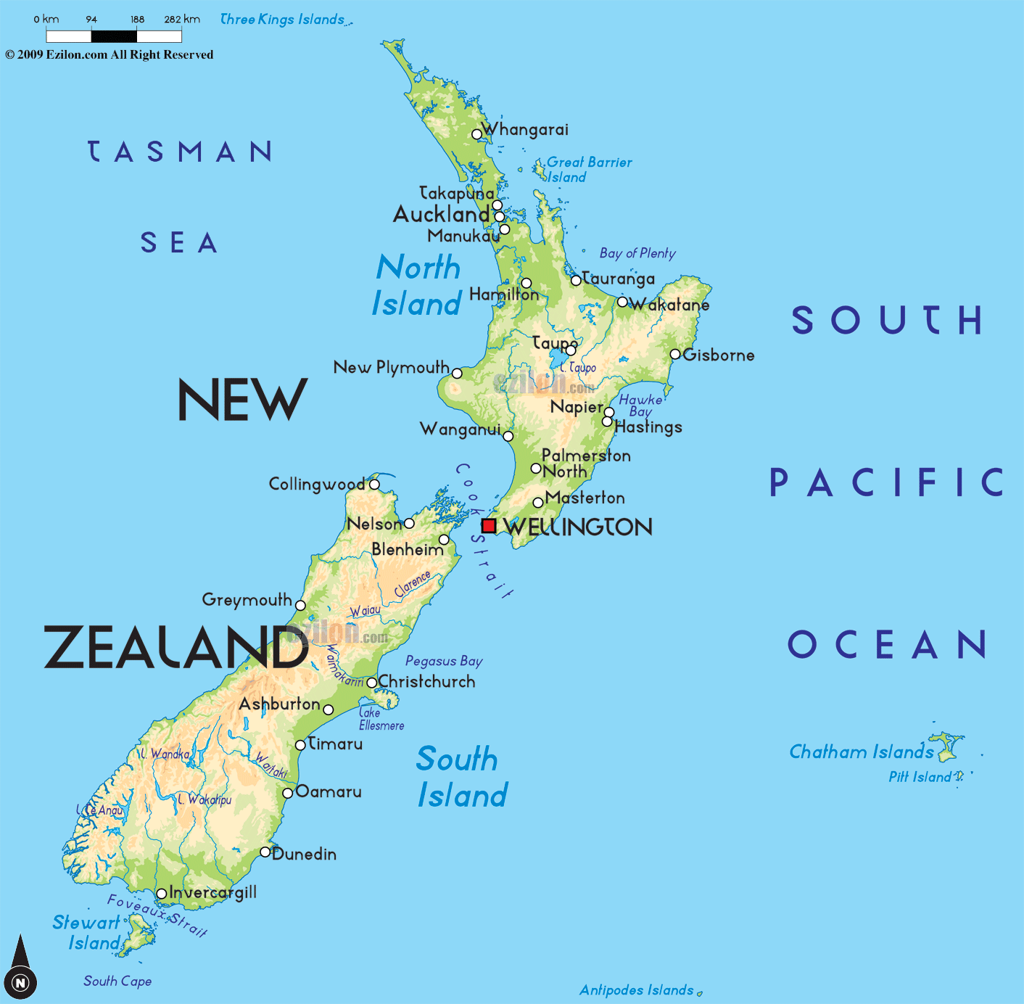
NEW ZEALAND
By Megan Lunt
This Photo by Unknown Author is licensed under CC BY-SA

Slide 2
Why, New Zealand????
As Trip Savvy describes, New Zealand has some of the most incredibly diverse and unspoiled sceneries in the world. It is located on the South Eastern Islands of Australia.
From the Island home to the “8th Wonder of the World” there are numerous outdoor adventures to experience, exciting wildlife, unique cultural celebrations, and lush vineyards to explore.

Slide 3
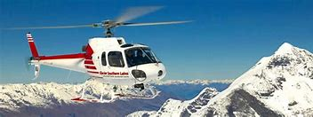
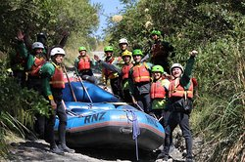
Great Outdoors!
Hikes and More!!
Wanaka-Roy’s Peak Hike
Hike through beautiful land and glaciers
Kjet High Flyer
Queenstown
Combo deal for $379 for Adult, 289 for Children
Includes KJet Experience, Helicopter Landing, Scenic Helicopter Ride, Gondola Ride, 3 Luge Rides, and free admission to Queenstown Underwater Observatory.
White Water Rafting
Family Friendly Adventure is $96.96

Slide 4
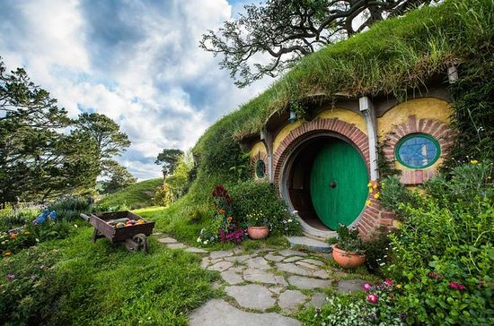
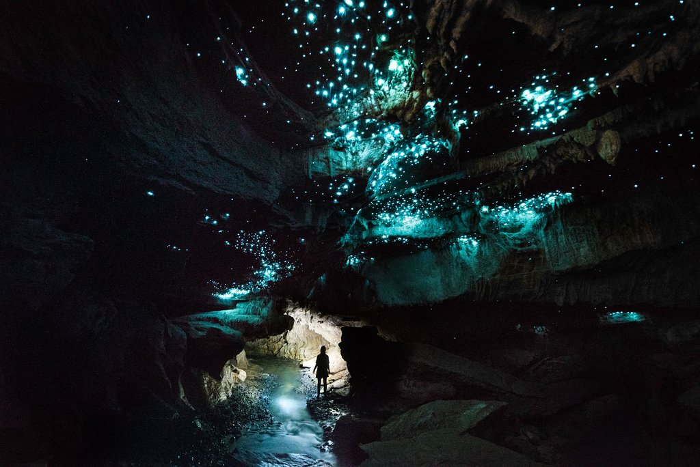
Sight Seeing Tours!
Tours
Sky Tower
Cost 20.23 for General Admission
1,076 feet tall
Hobbiton Movie Set
$58.60 per person
2 hour Movie Set Walking Tour
GlowWorm Cave Tour
Waitomo District
$110.92 per person for Adventure Tour

Slide 5
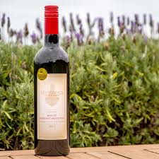
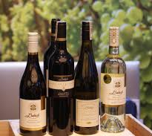
Wineries
Mudbrick Wine Tasting
Standard wine tasting is $10 per person, premium wine tasting $15 per person. Each tasting goes through 4 different varietals and takes around 30 minutes.
Babich Wines
Cellar door for Wine
Prices not available online but, yelp has Mudbrick as $$$ and Babich with $$.

Slide 6
Must Try Food!
Hangi
Hokey Poke
Kiwi Burger
Meat Cooked Underground with Vegetables. Find it in Auckland but best spot is in Rotorua. Experience Maori Culture!
Caramelized Honey Comb Ice Cream!! Find it at Giapo in Auckland
Beef Patties with Beetroot and Fried Egg. Though it is easy to find in New Zealand Fergburger in Queenstown has a lot of great reviews.

Slide 7
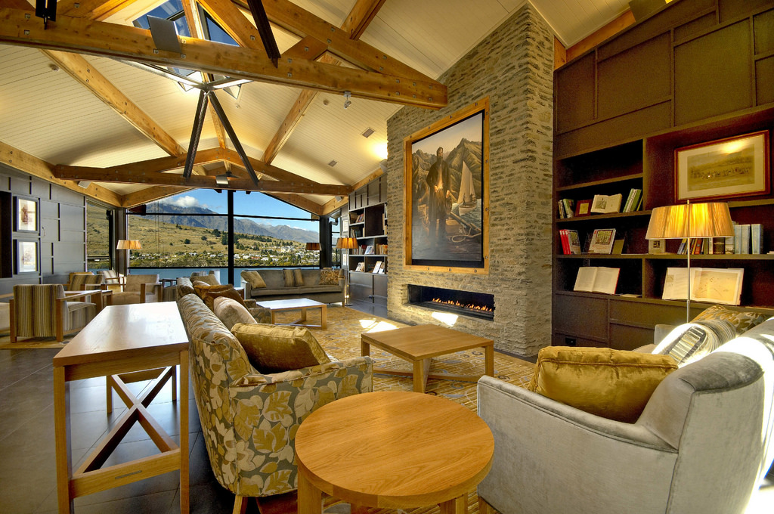
Accommodations
Name | Type | Location | Average nightly Rate in USD | Rating
Mudbrick’s The Lodge | Lodge on Vineyard | (Auckland) Waiheke Island | $963.65 | 4.5 out of 5 Stars
Hilton | Hotel: King Deluxe | Auckland | $396.72 | 4.5 out of 5 Stars
The Octagon | AirBnB: Room | Queenstown | $52.00 | 5 out of 5
The Rees Hotel | Hotel: Luxury King Bed | Queenstown | $362.00 | 4.5 out of 5 Stars
This Photo by Unknown Author is licensed under CC BY. Queenstown The Rees Hotel

Slide 8
Travel
January is summer in new Zealand. March is Fall for NZ. This is when it is warm enough to hike but, cool enough to enjoy the vineyards. Ideally March is the time to visit!
Flights: Auckland at Kayak.com, are typically between $900 and $1200 USD.
Price includes 1 stop and 20-35 hours total travel time each way!
Flights from Auckland to Queenstown range from $60-323 USD One Way
Rental Option: 5 passenger sedans range from $130-$250

Slide 9
Weather!
March is the beginning of autumn.
summer is the busy season.
Enjoy New Zealand in March to avoid the crowds!

Slide 10
Money!!!
Conversion Table from New Zealand Dollars(s) (NZD) to U.S. Dollar(s) (USD)
NZD | USD
1 | 0.69
10 | 6.89
25 | 17.21
50 | 34.43
75 | 51.64
100 | 68.85
150 | 103.28
1,000 | 688.52
1,500 | 1,032.78

Slide 11
Additional Considerations
Financial
Navy Federal Debit Card and ATM Rates for Foreign Transactions

Slide 12
References
To Do
Food, Money, and Travel
To Stay
Trip Savvy 10 Reasons
Wanaka-Roy’s Peak
Sky Tower
Hobbiton Movie Set
GlowWorm Cave Tour
Mudbrick Winery
Babich Wines
Rotorua
Giapo in Auckland
Fergburger
Weather
Money
Sedans
Kayak.com
Auckland to Queenstown
Mudbrick’s The Lodge
4.5 out of 5 Stars
Hilton
4.5 out of 5 Stars
The Octagon
5 out of 5
The Rees Hotel
4.5 out of 5 Stars

