Slide 1
Lets Go To Bali
By andres septien moyano

Slide 2
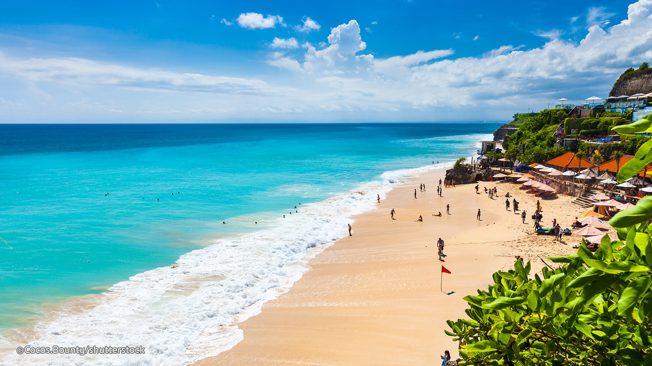
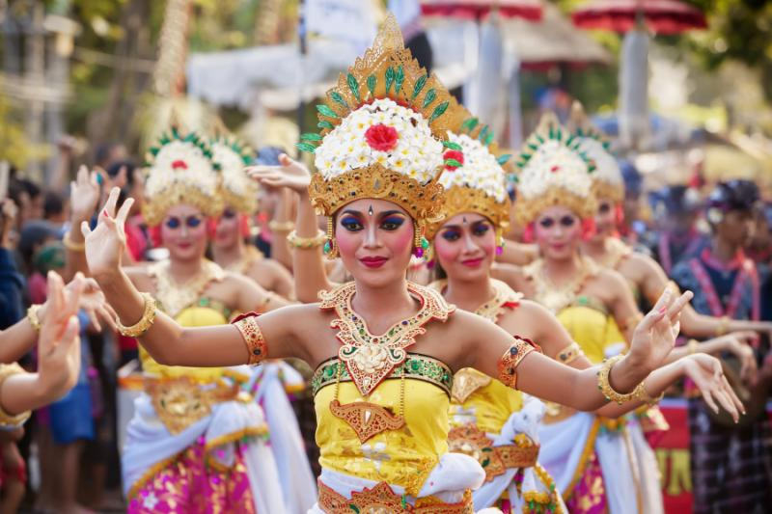
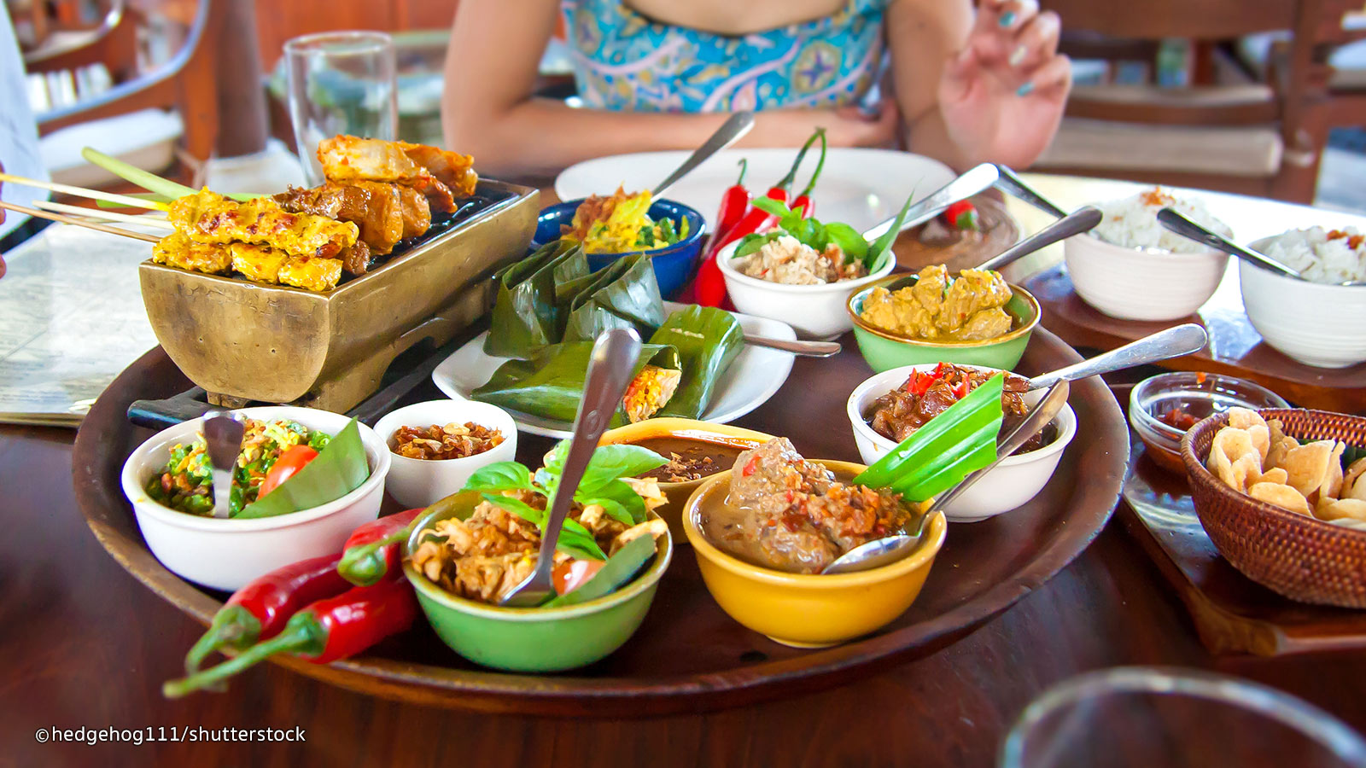
Why Bali???
Beaches
Food
Local Culture

Slide 3
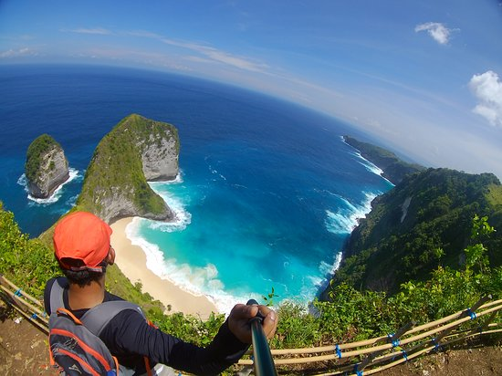
Bali Monkey Forest Forest, Mengwi Temple, and Tanah Lot Afternoon Tour
Things To Do
Kelingking Beach

Slide 4
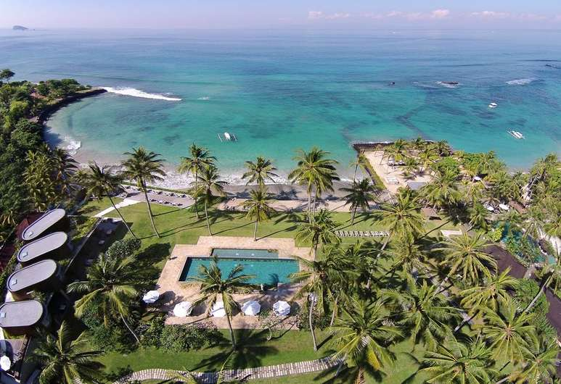
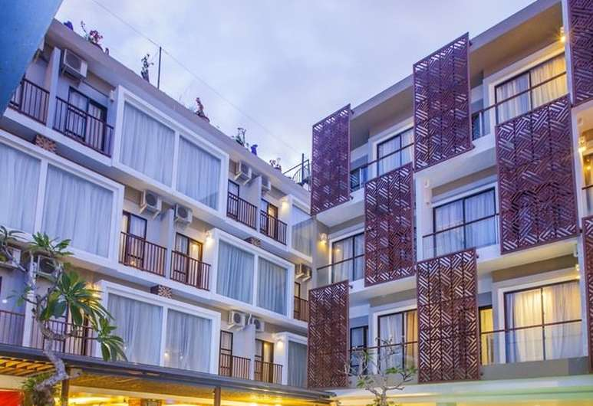
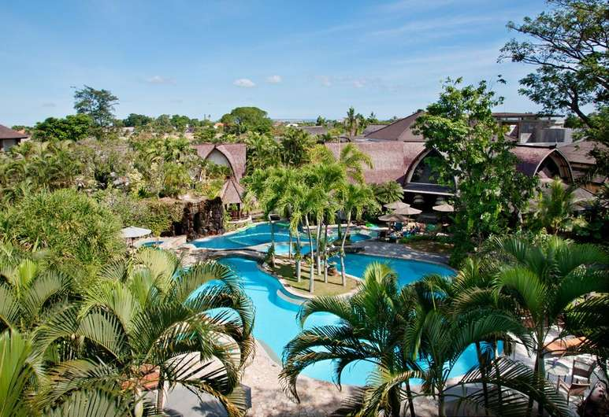
Places to Stay
Candi Beach Resort and Spa
$70-$180
Horison Seminyak Bali
$60-$120
Hotel Vila Lumbung
$60-$120

Slide 5
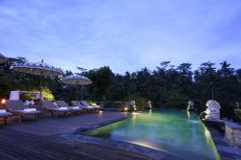
Restaurants
MAURI Restaurant
$36- $107
Kepitu Restaurant
$10-50

Slide 7
References
Candi Beach Resort and Spa
Horison Seminyak Bali
Hotel Vila Lumbung
Bali Monkey Forest Forest, Mengwi Temple, and Tanah Lot Afternoon Tour
Kelingking Beach
MAURI Restaurant
Kepitu Restaurant

