Slide 1
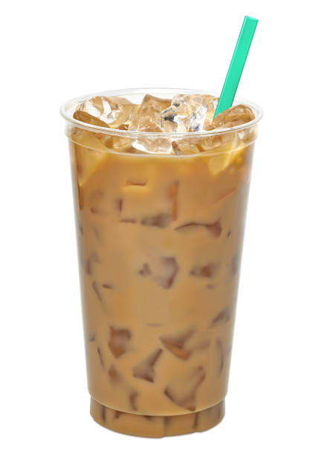
U of San Diego’s Fastest Coffee

Slide 2
Placement
Outside the Immaculata/ field outside of Camino/Founders

Slide 3
Food and drink served
Coffee (basic), Bagels, Muffins, and fruit.

Slide 4
Service Enhancement
Pre-made ready to go coffee and food items during busy hours.
Avoid long lines at La Paloma, Bert Bistros, and Aromas.
Self serve style for milk, flavoring and sugars etc.

Slide 5
Advertising
Have a rewards program/punchcard to insure returning loyal customers.
Have all forms of social media to promote our truck.

