Slide 1
Purple Bowls
Cristina, Hayden, Phillip, Tyler

Slide 2
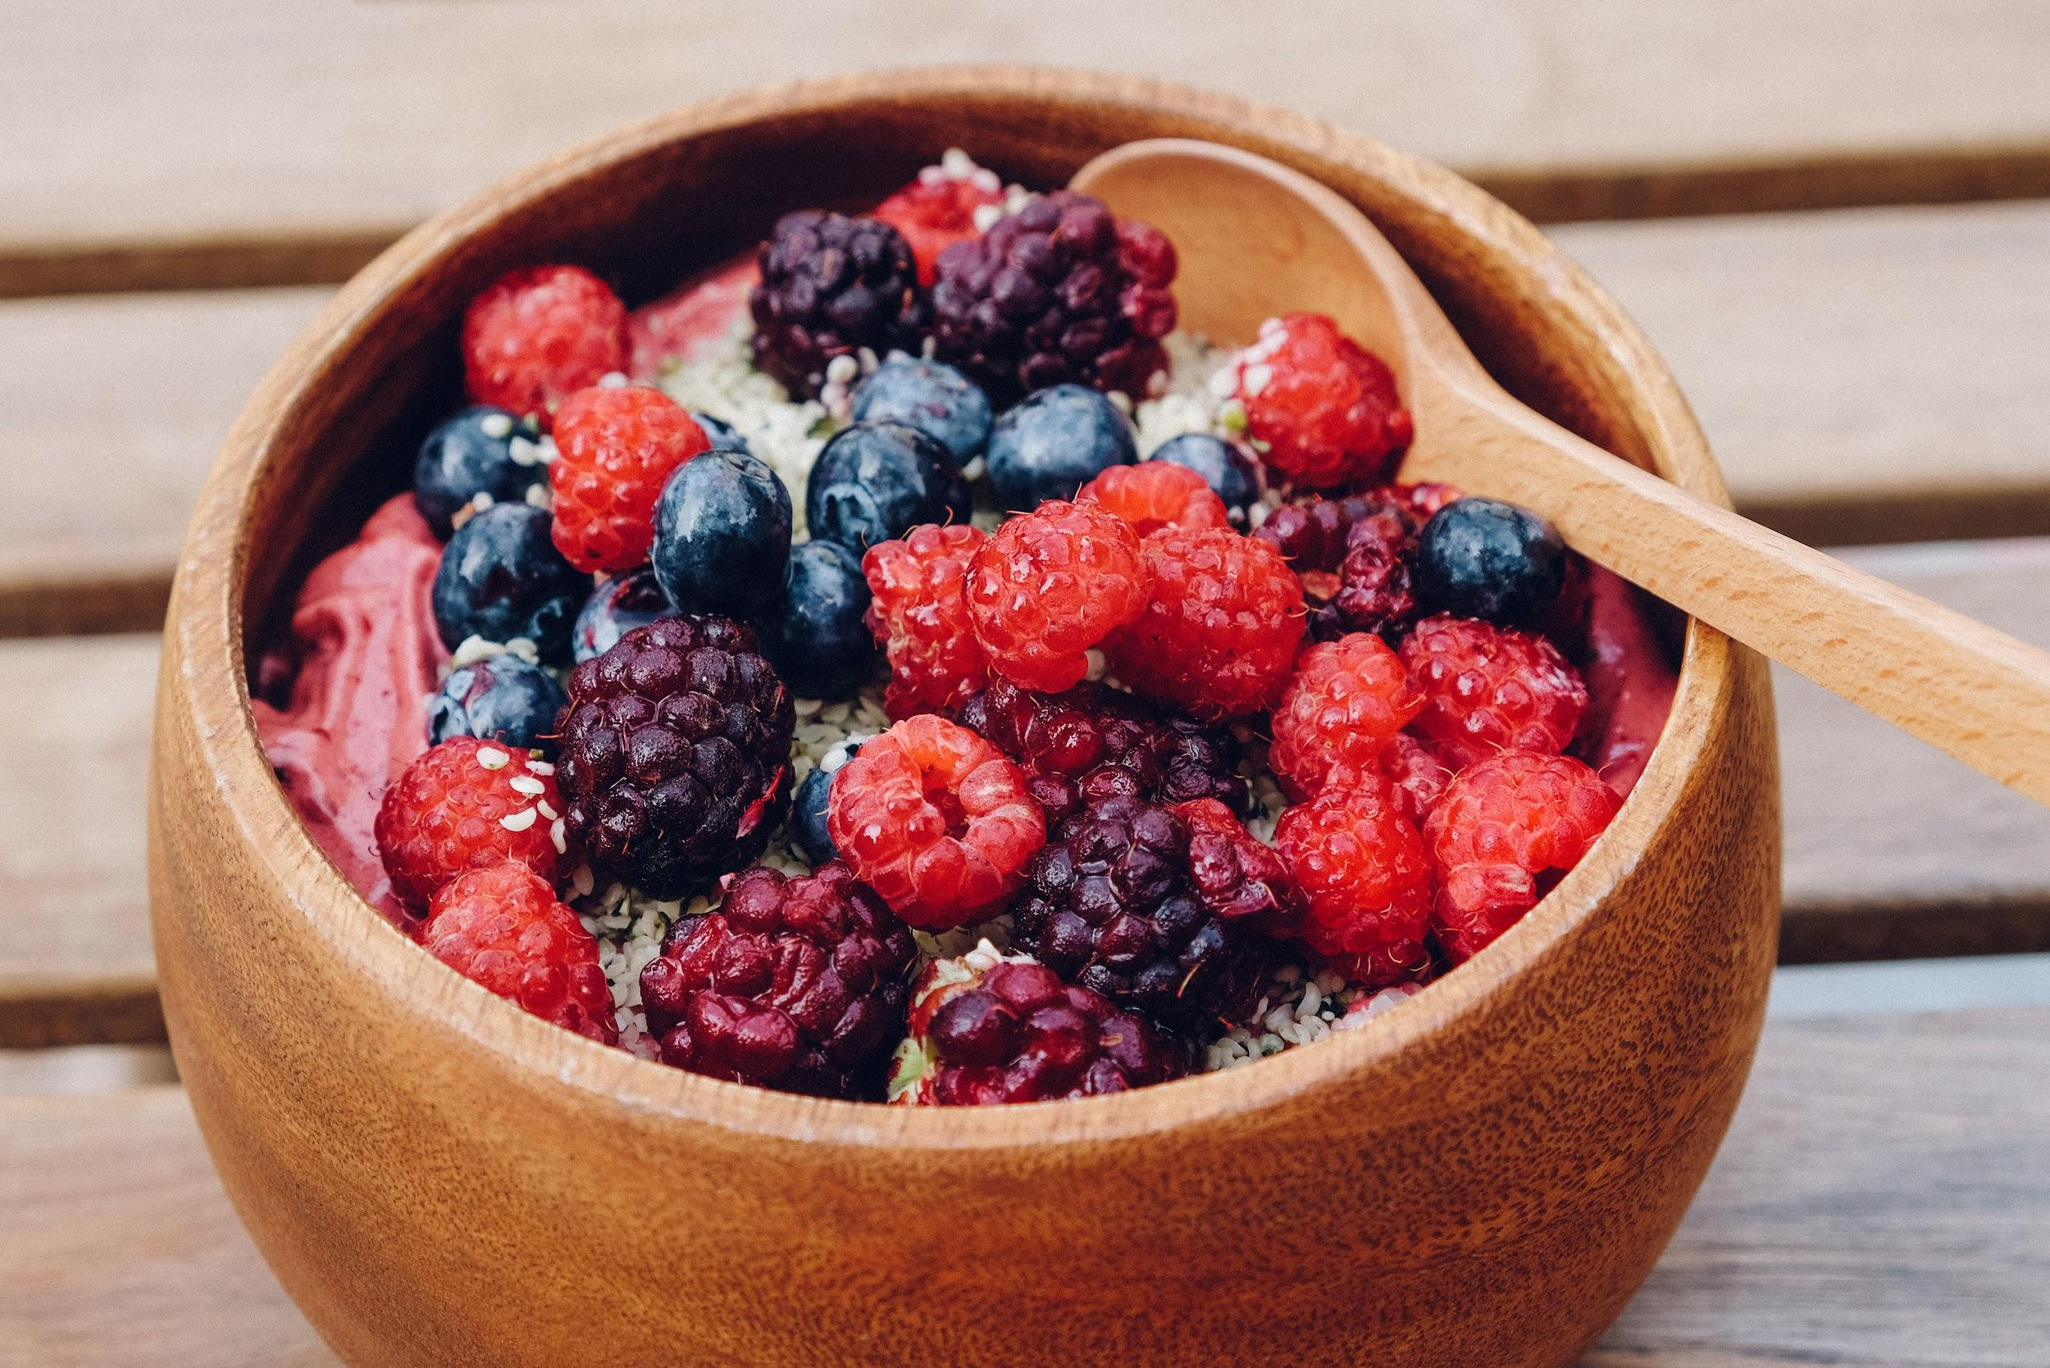
Description
Totally customizable acai bowls, made by you (unless you want something other than acai and strawberries)! Our system allows the customer to choose exactly what and how much they would like in their bowl. We have options for everyone regardless of dietary restrictions.

Slide 3
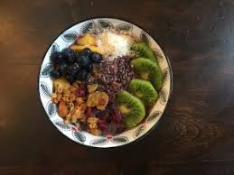
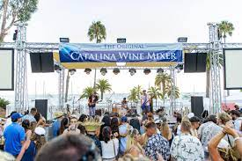
Location
Located everywhere
Catalina Island

Slide 4
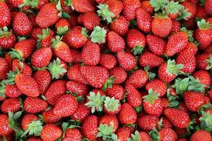
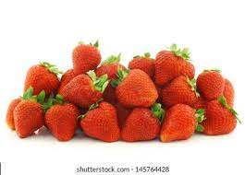
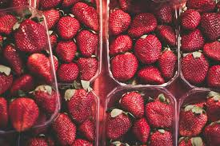
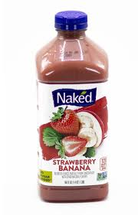
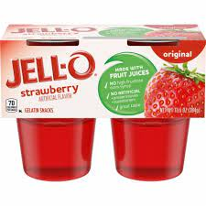
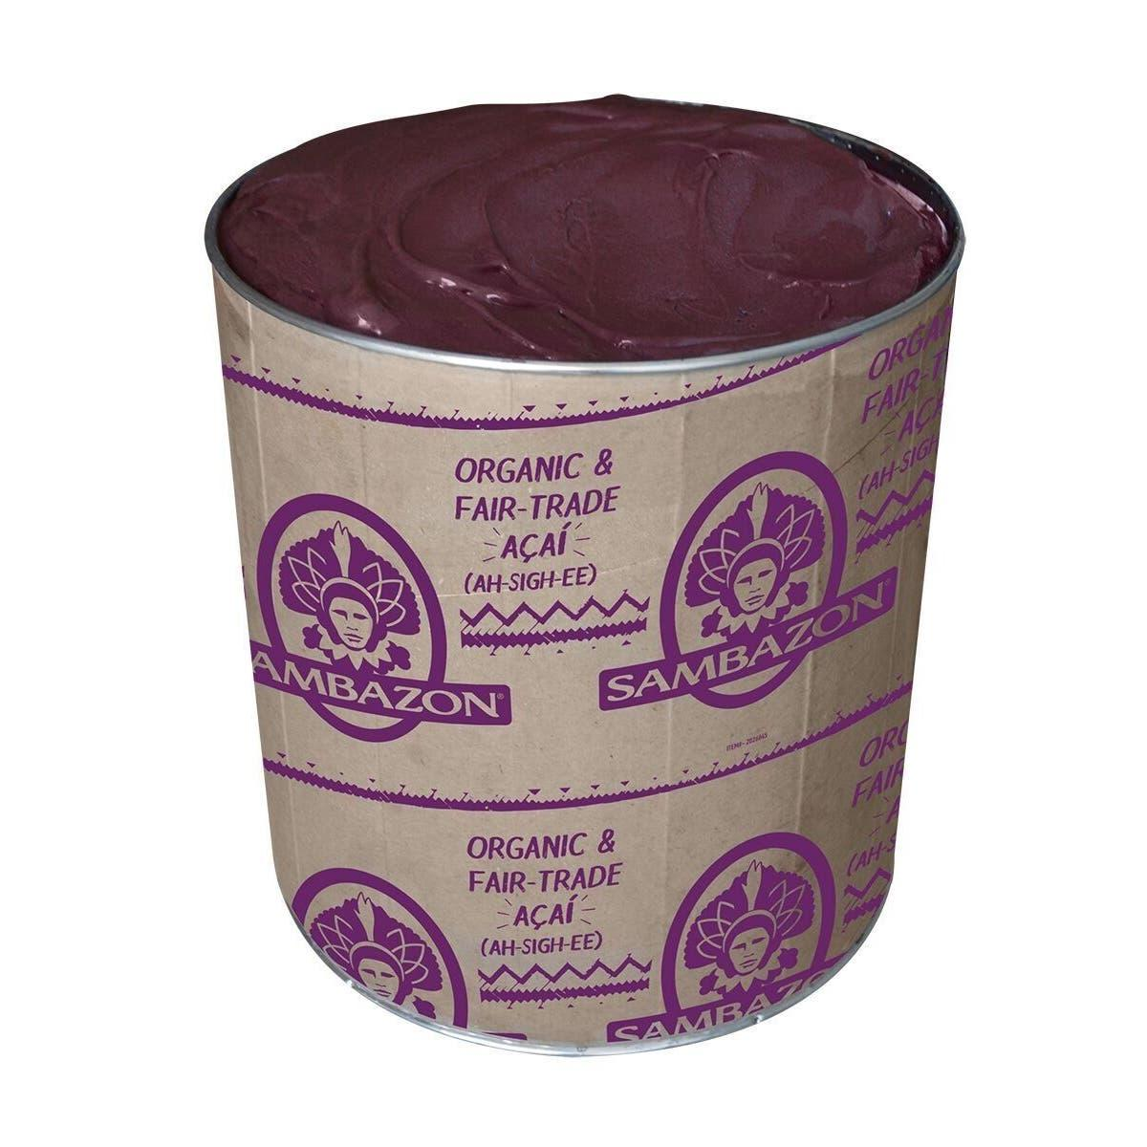
Menu
Acai
Buncha strawberries

Slide 5
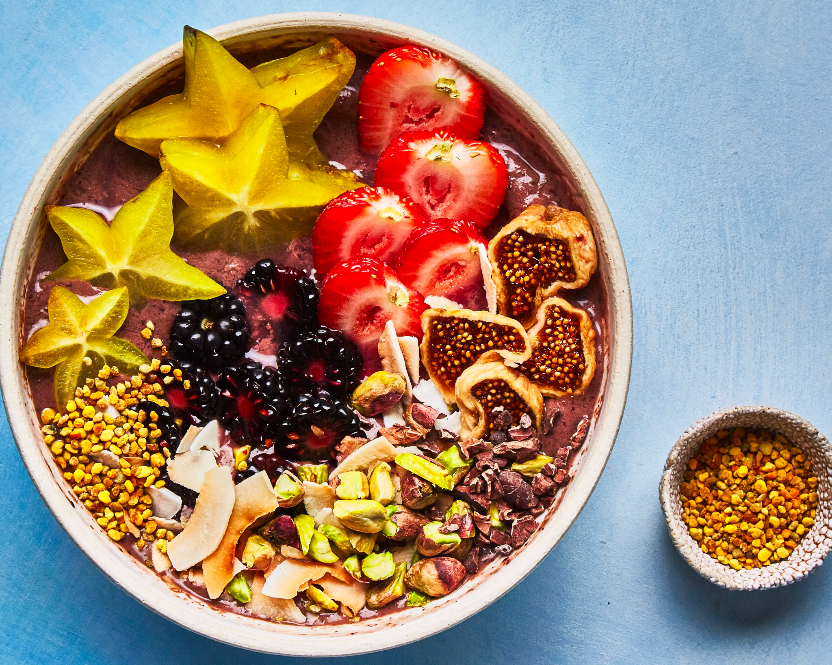
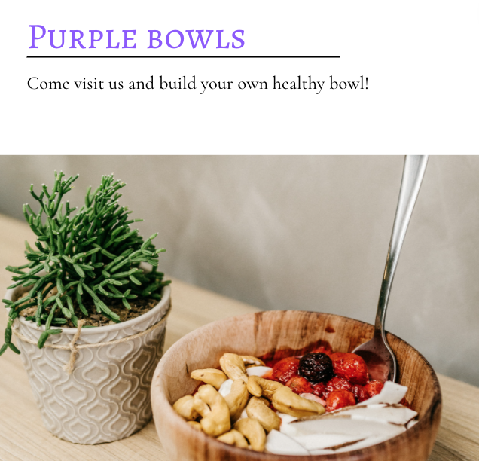
Advertising
Found on Social Media Platforms
Website pop up ads
Billboards
Plane banners
Google Ads

