Slide 1
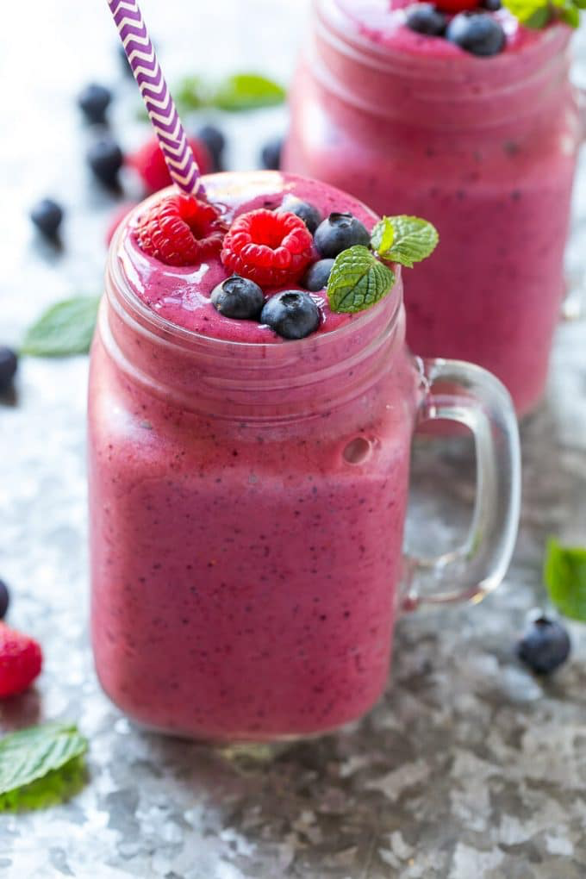
🍓FRESH BLENDZ🍓
Smoothie, Acai Bowls & More!
Mariia Tyrina, Catherine Silvey, Khaled Al Rabah, John Castro, Shaya Rouhifar

Slide 2
Our Vision
We wanted to create something different from the standard acai bowl vendor formula, so we came up with an idea--helping our customer create his or her dream acai bowl
At Fresh Blendz, every customer is able to create his or her own bowl, changing up the ingredients and mixing different flavors at a fixed price.
Our concept is to not only fill you up with a bowl of pure nutrients, but also to let you explore your creative side through our delicious bowls.

Slide 3
Competitive Advantage -> Differentiation
Build Your Own
Fresh
Organic
Fixed Price

Slide 4
Location:
Breakfast – Torero Way
Lunch (Dead Hours) – Colachis Plaza
After Classes – Marian Way

