Slide 1
My Life
By Nathan Warmington

Slide 2
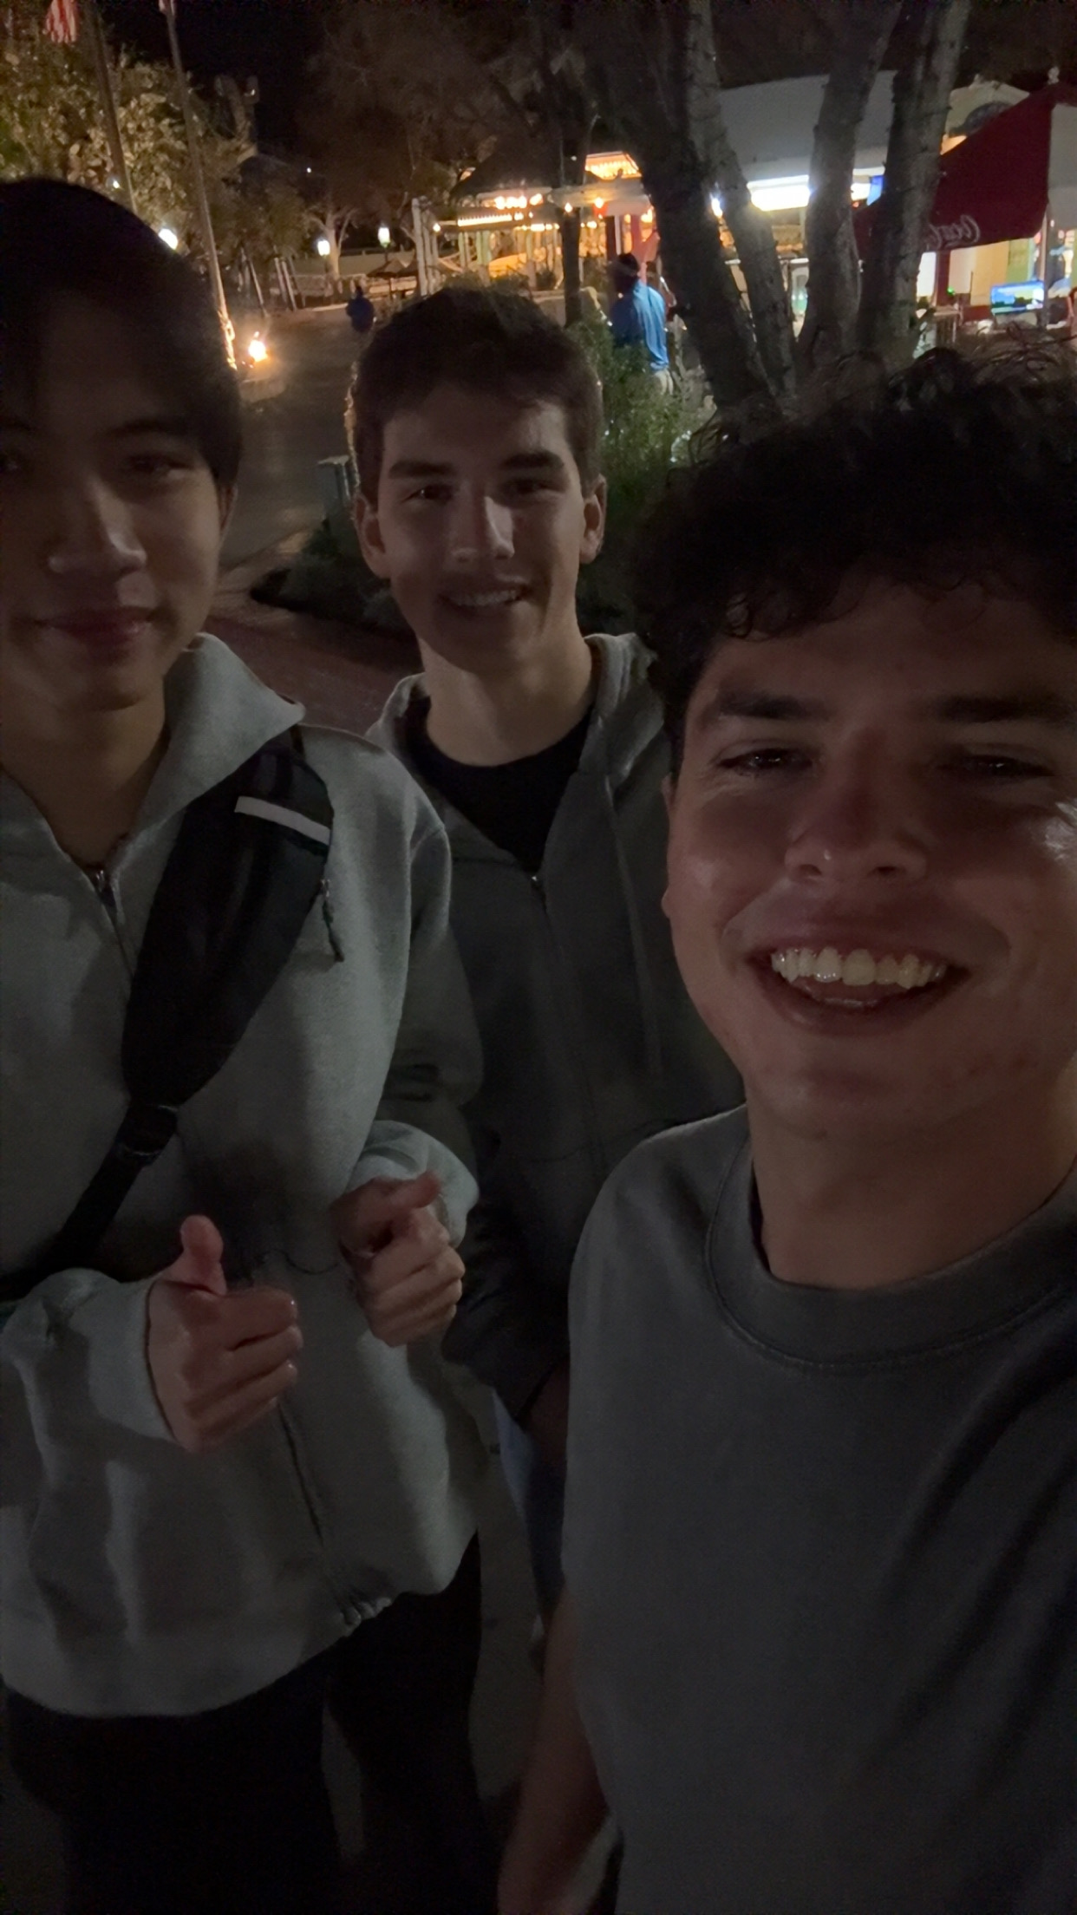
Items that happened in the semester individually, with friends, groups, locally, nationally
Six Flags with roommates

Slide 3
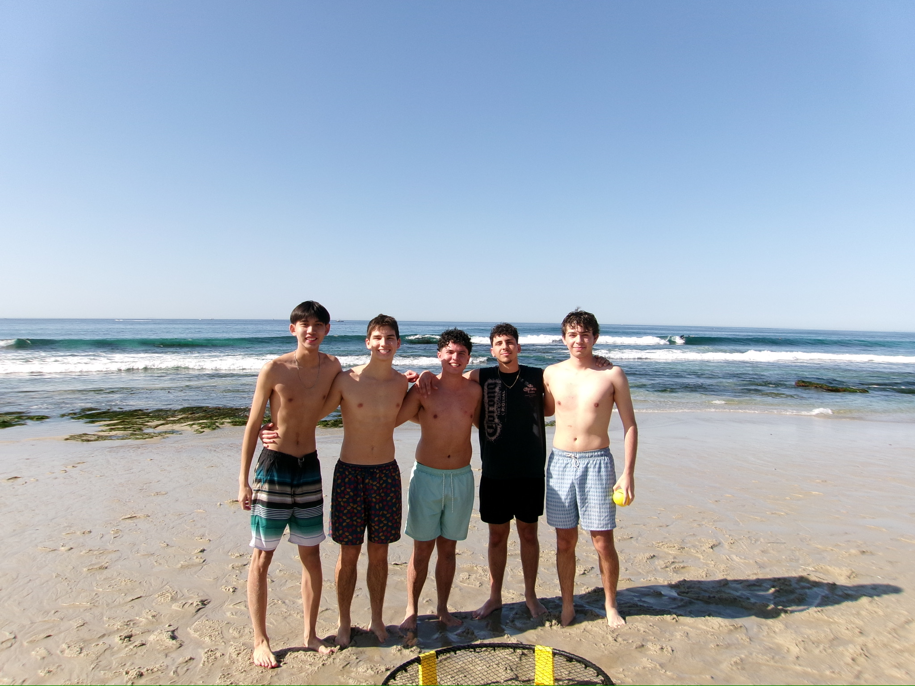
Beach Day
First week back and went to Wind and Sea with friends

Slide 4
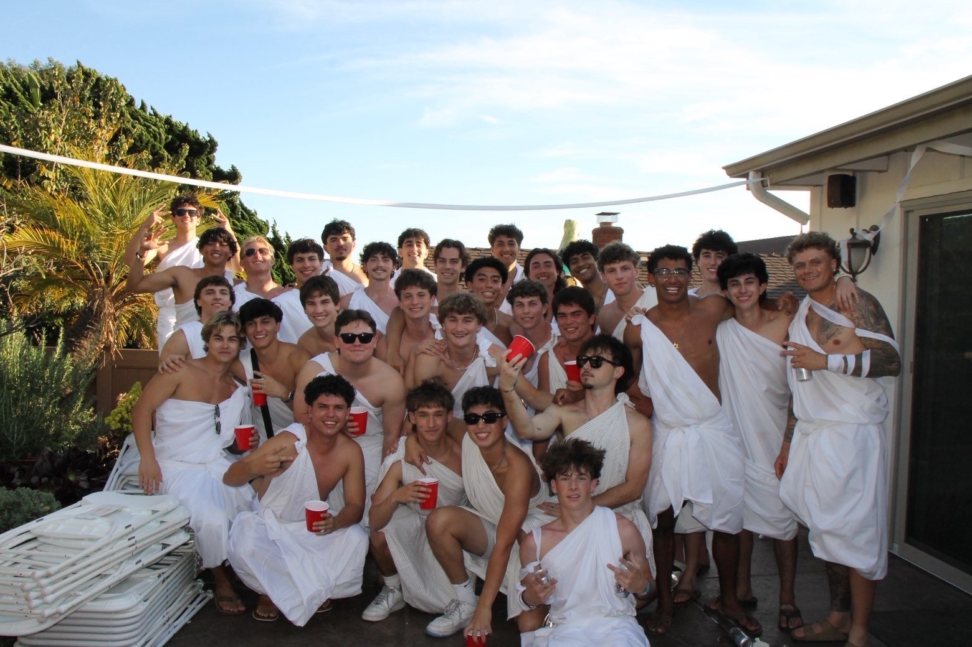
Fraternity Party
Got Closer and bonded more with my pc through this party

Slide 5
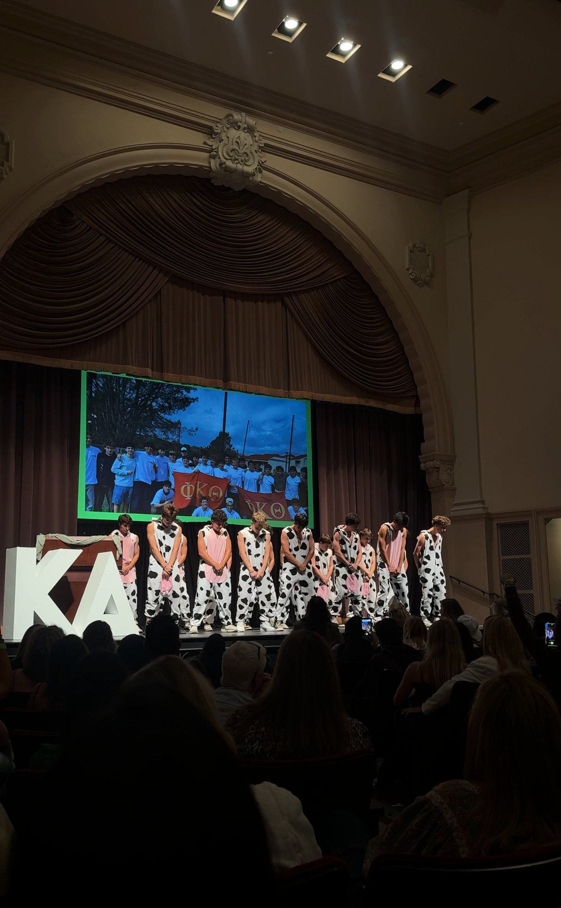
Shamrock
Performance Infront of crowd with my fraternity brothers

Slide 6
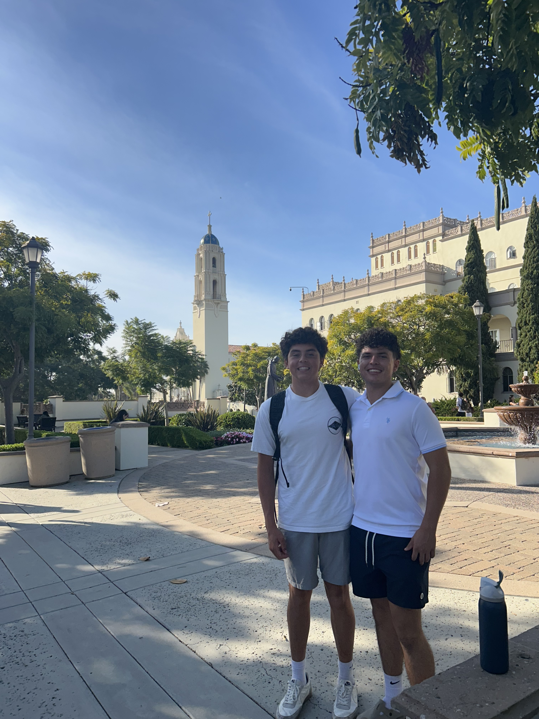
Cousin Visit
Toured campus for the day and nice to see family

Slide 7
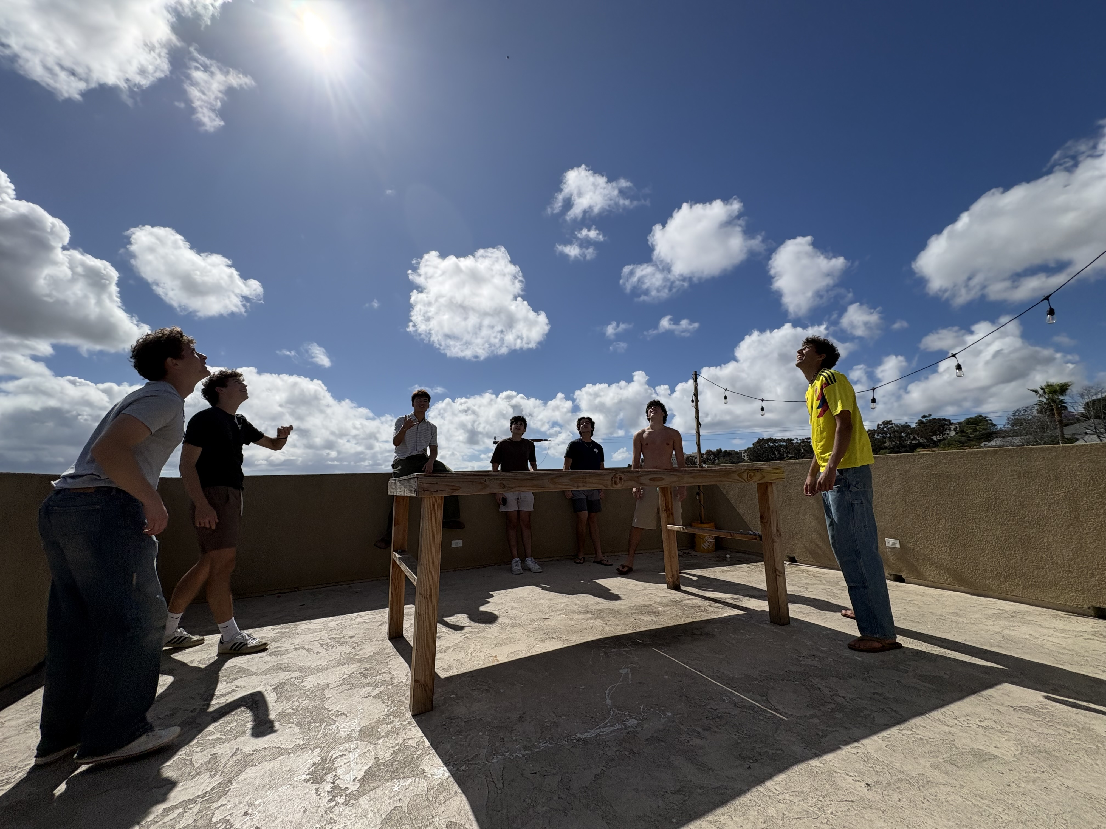
Hanging out with Brothers
Pause during the day to go hangout before finals began

Slide 8
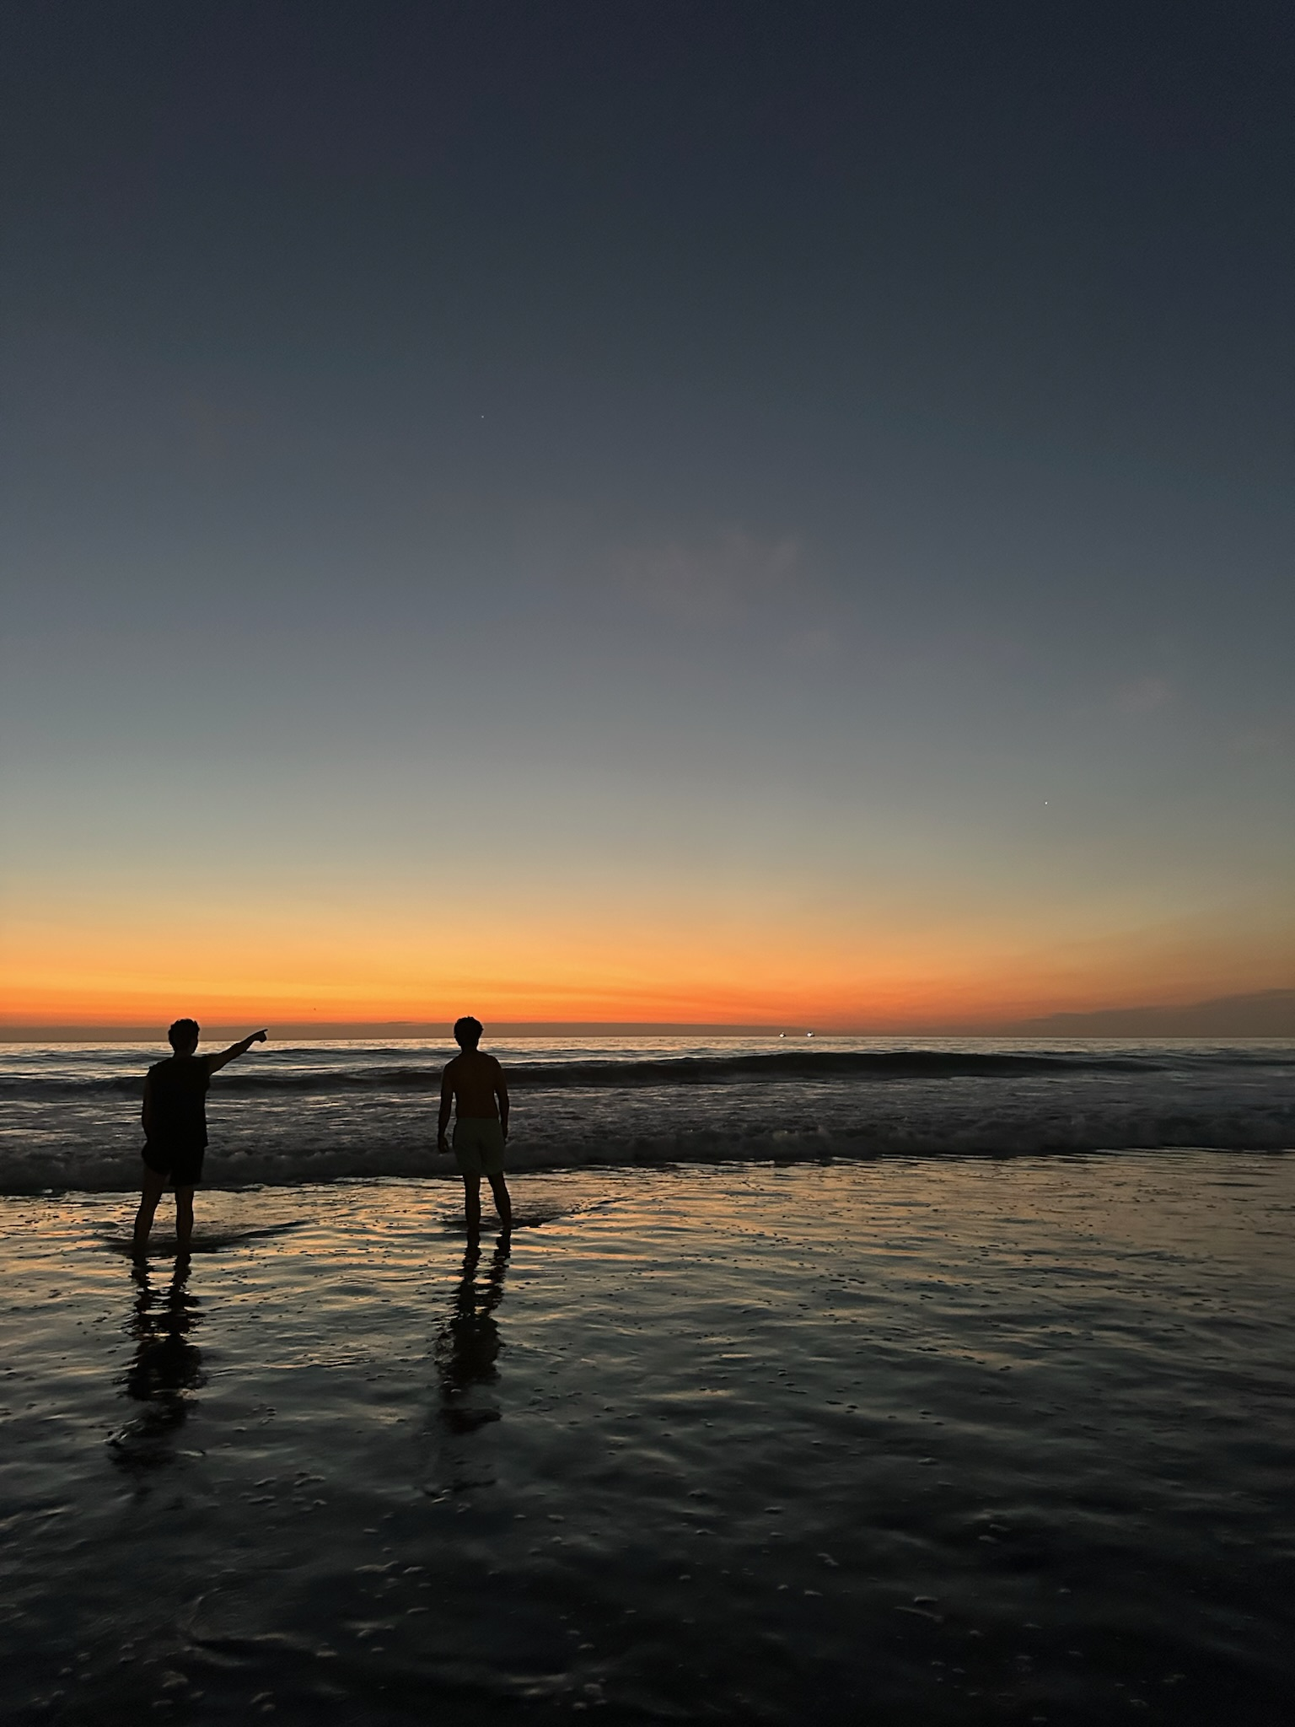
Items that were highlighted by news, media advertisements/messages, government, other countries, other sources
Found out it was a low tide at sunset and decided to go to Mission Beach

Slide 9
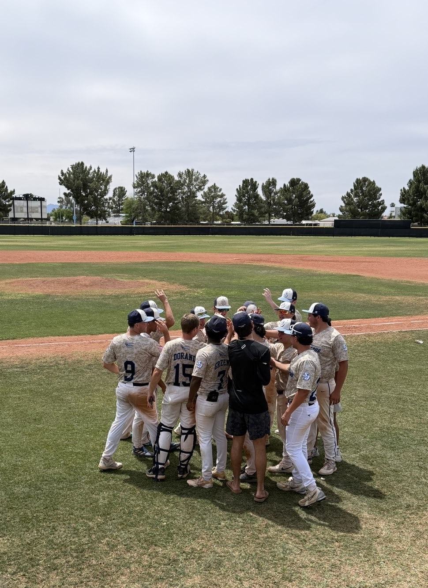
Phoenix Trip
Played baseball for the weekend in Arizona

Slide 10
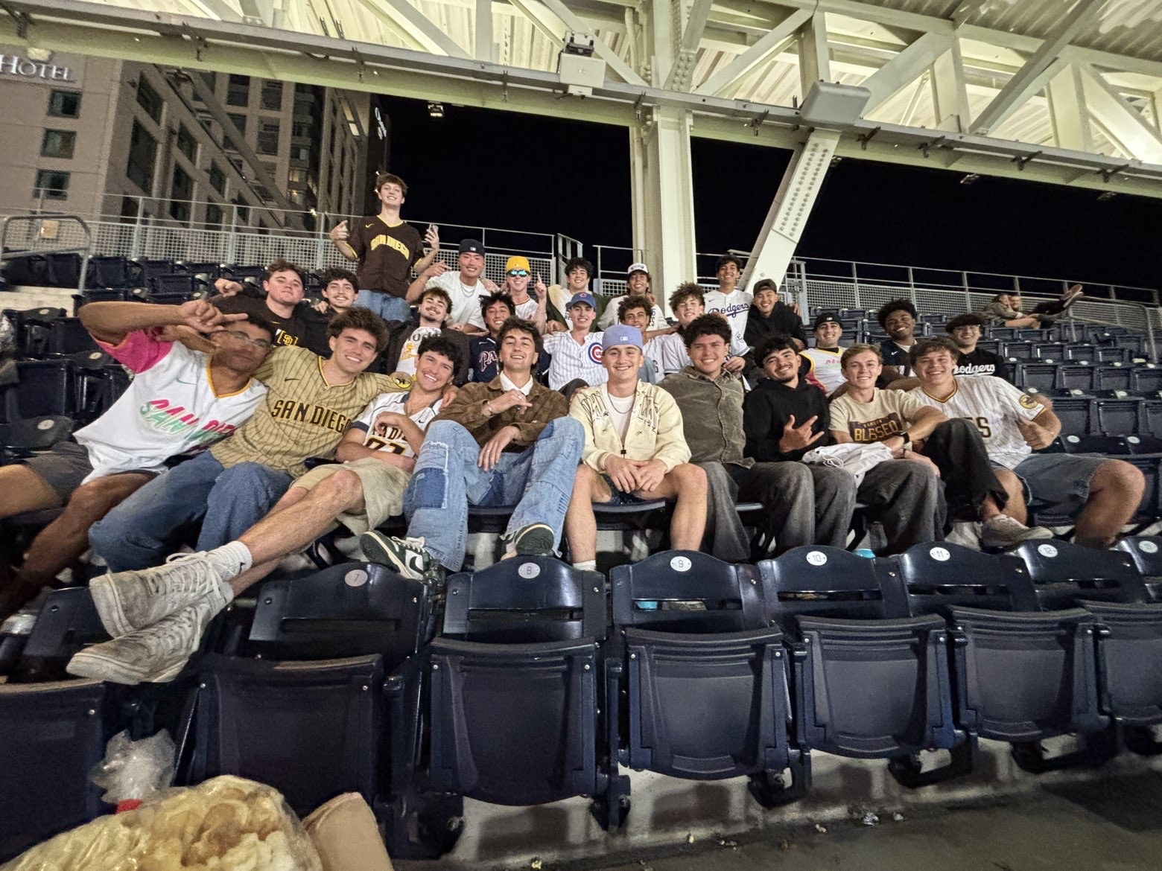
Items that you experienced that were sad or negative that you wish not to be experienced again
Padre game with the fraternity

Slide 11
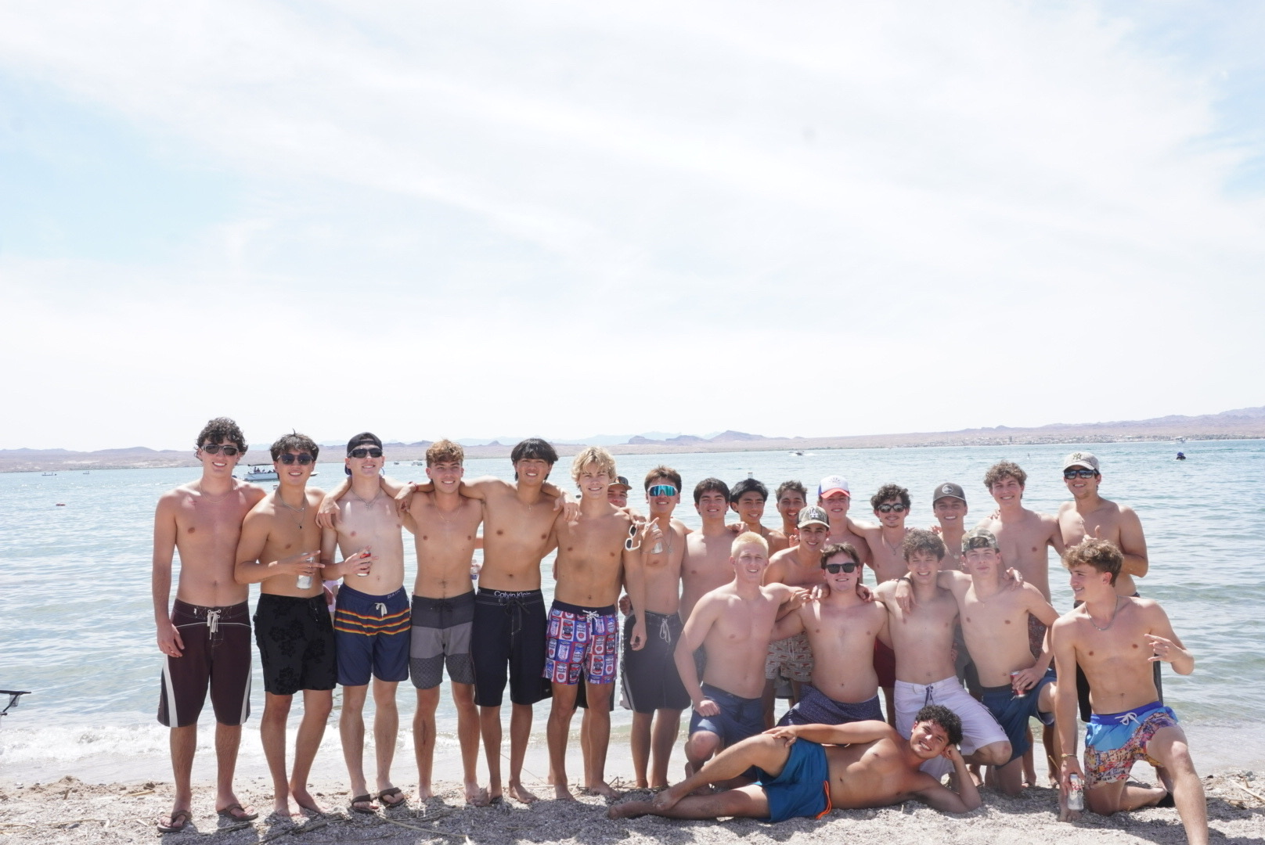
Items that illustrates changes to processes (buying food other items), laws/restrictions
Lake Havasu Trip with my friends

Slide 12
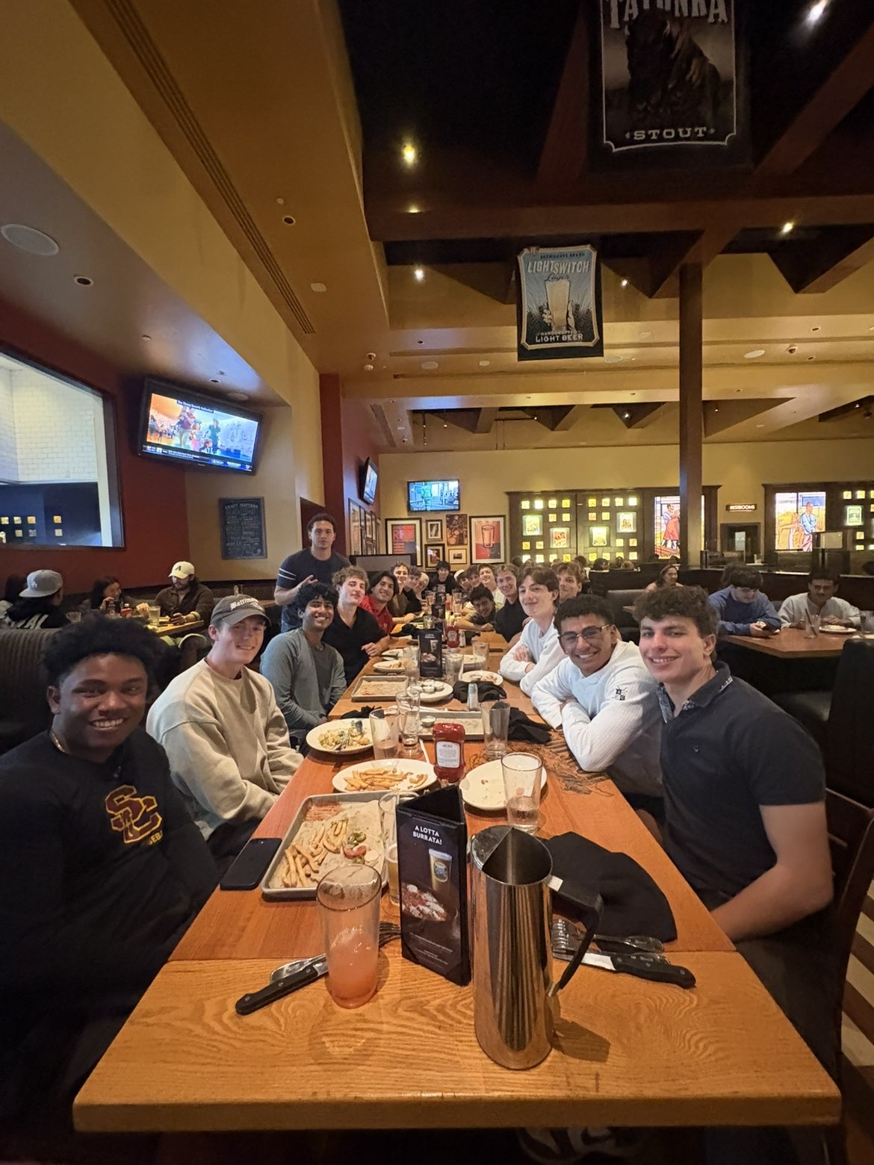
Dinner with Family
Post initiation dinner with the boys

Slide 13
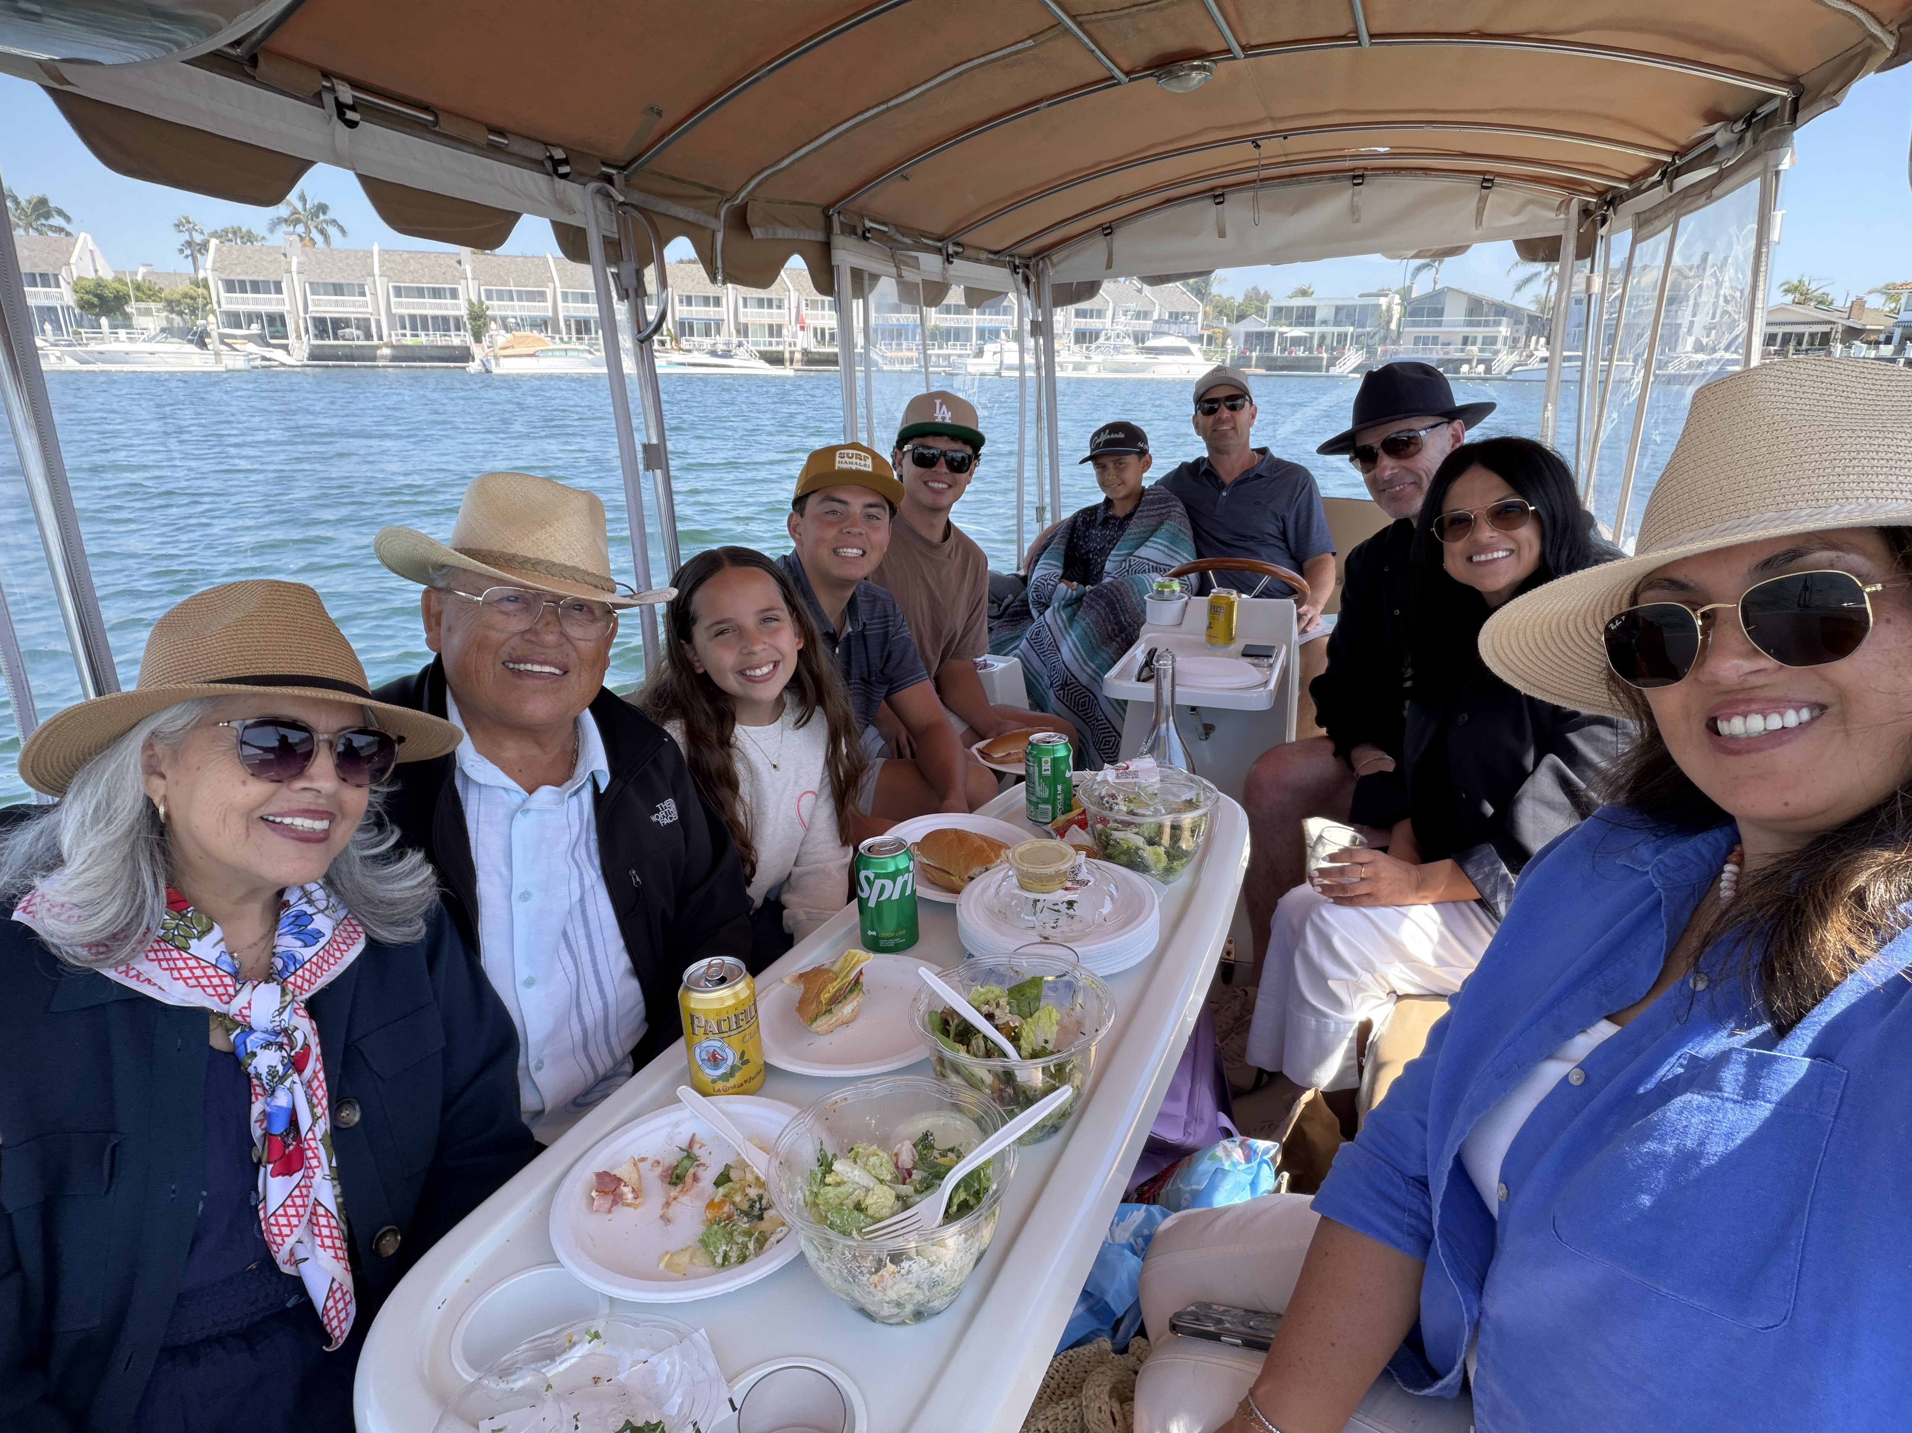
Boat Day
Spent time with family back home after an interview

Slide 14
Written statement
This semester wasn’t just about hitting milestones, it was about the evolution of perspective. Looking back at where I started in January, the distance traveled is visible not just in the final output, but in the refinement of my process. This visual represents the intersection of technical discipline and the moments that defined my time here at USD.

