Slide 1

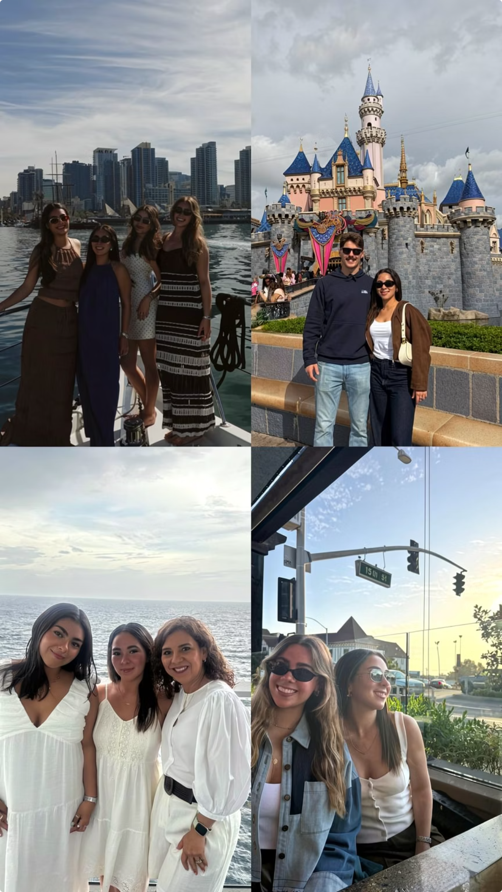
Documenting My Semester
A Personal Time Capsule
By: Analucia Perez

Slide 2
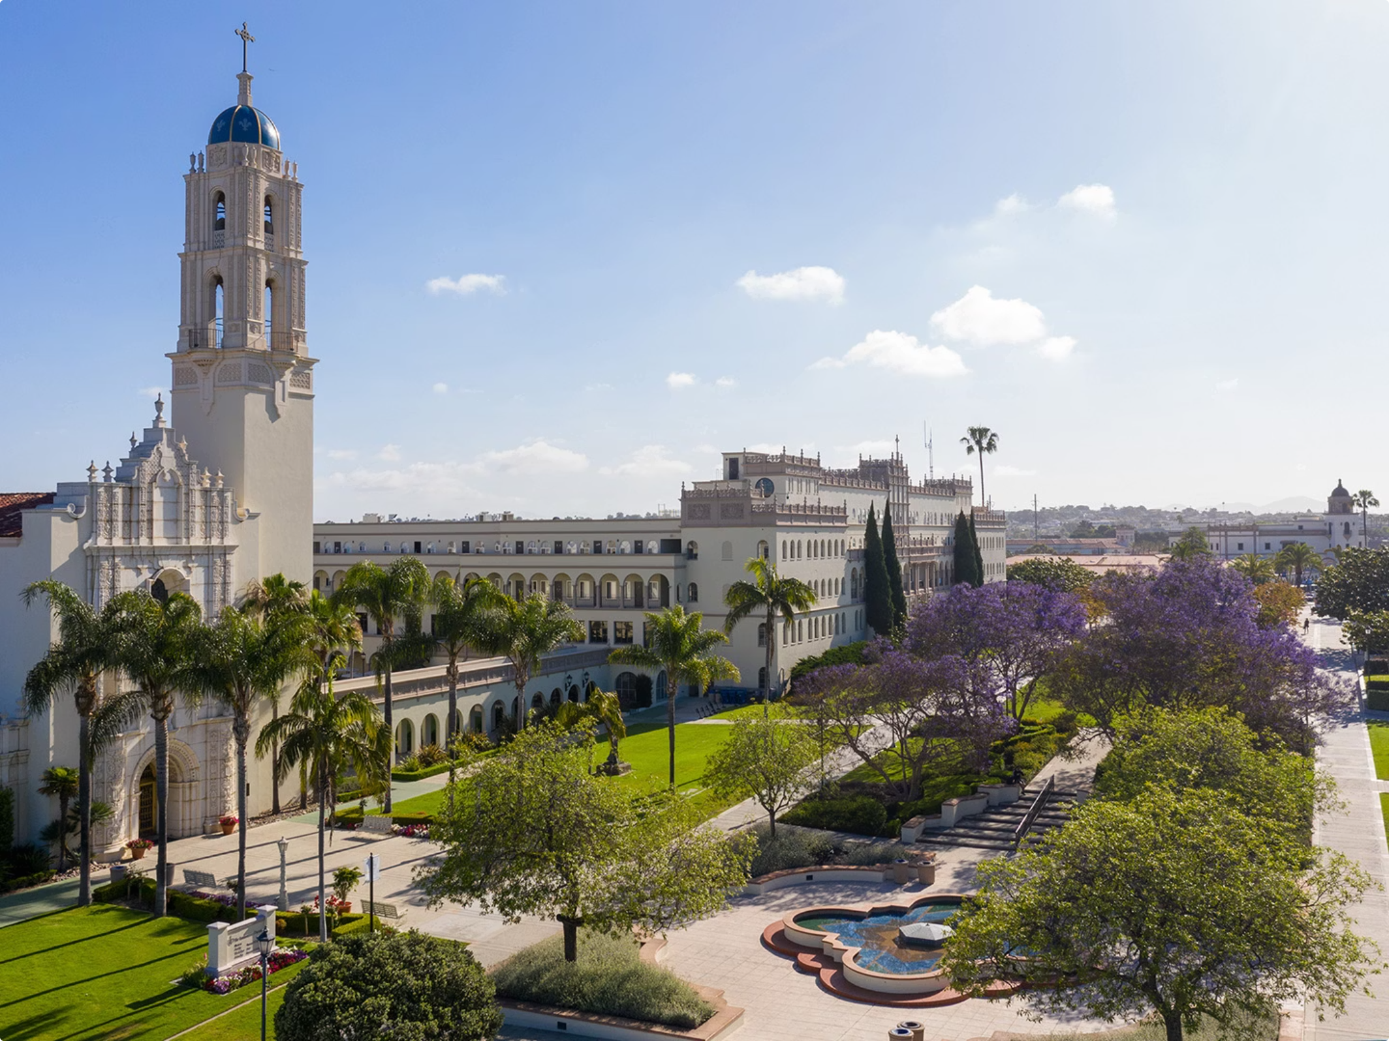
This Semester in My Life
This presentation captures meaningful moments, setbacks, achievements, and memories from the semester. Life this semester was filled with growth, unexpected challenges, exciting milestones, and unforgettable experiences.
From personal accomplishments to family celebrations, from professional setbacks to breakthroughs, each moment contributed to who I am today.

Slide 3
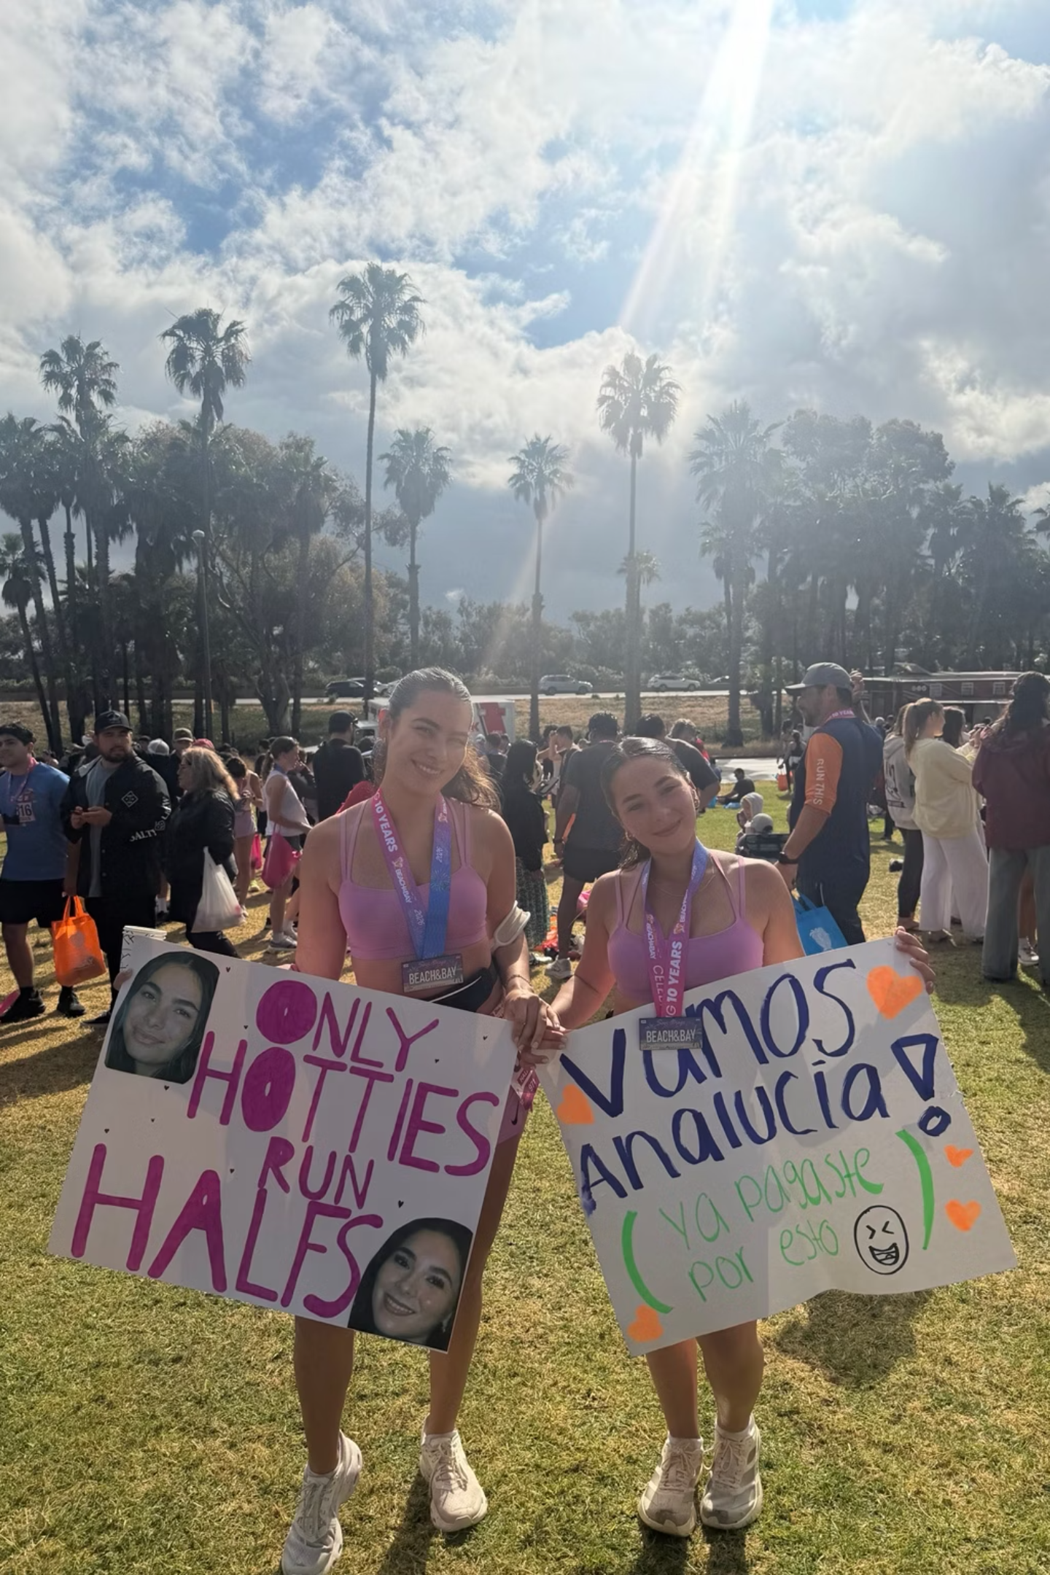
My First Half Marathon
April 11
Three Years of Training
Discipline & Resilience
Even after breaking my foot twice, I never gave up on this goal.
Finishing taught me how rewarding it feels to persevere.
Biggest Personal Goal
One of my proudest accomplishments this semester.
Items that happened in the semester:

Slide 4

The Trip That Never Happened
Spring Break
I had a spring break trip planned to Mexico with my friends that I was really excited about. Unfortunately, unexpected circumstances caused the trip to get canceled. Even though it was disappointing, it reminded me that not everything goes according to plan.
Items that did not happened that you wanted/ expected:

Slide 5
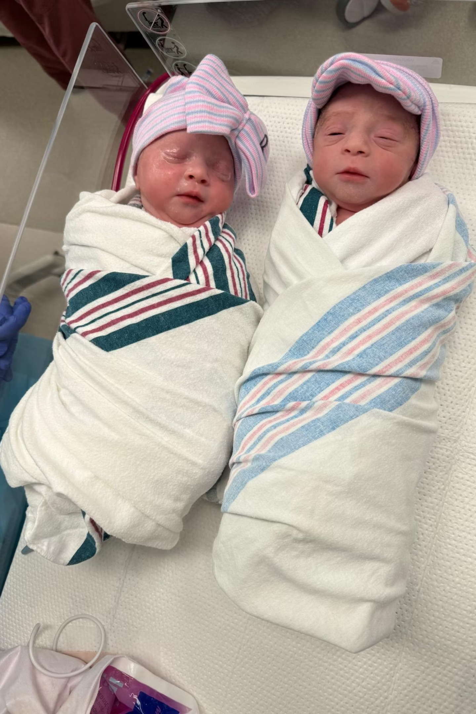
Welcoming New Life
February 10
Twin Baby Cousins
Their arrival brought so much happiness and excitement to my family.
Family Connections
Reminded me how special family bonds are.
Items that I experienced that have touched my life in a positive way:

Slide 6
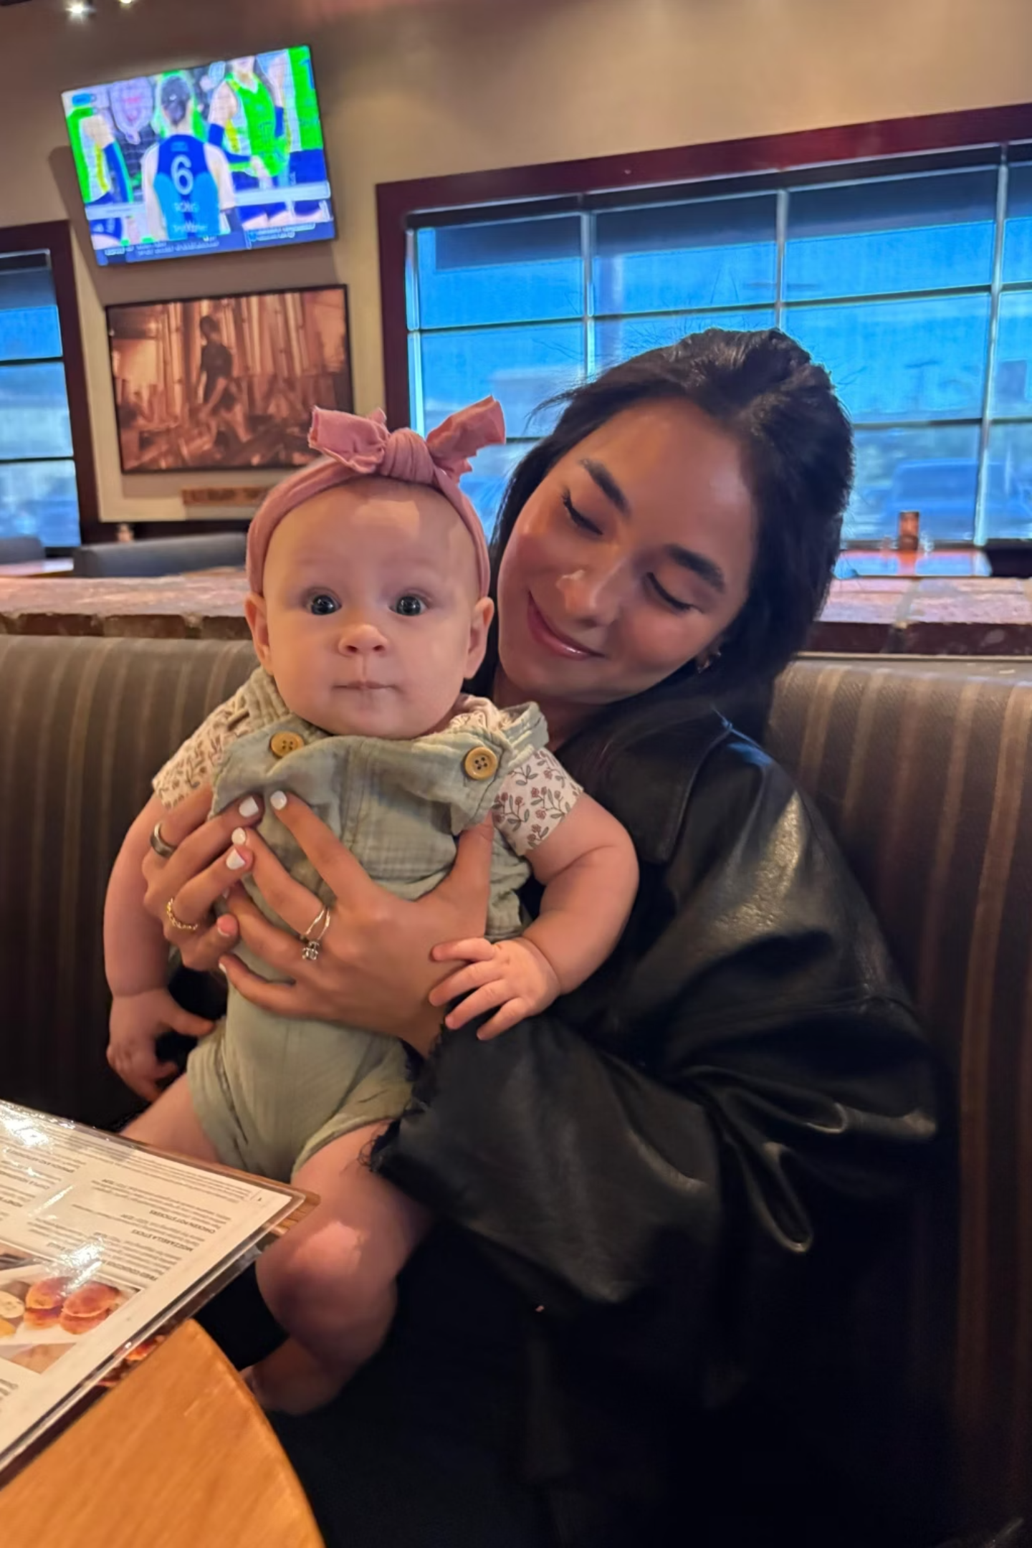
Becoming a Godmother
February 12
Just days after my twin cousins were born, I was asked to become the godmother of another baby cousin. This moment meant so much to me because it represented love, trust, and responsibility within my family.
Items that I experienced that have touched my life in a positive way:

Slide 7

Learning Through Rejection
Throughout the Semester
100+
90
Jobs Applied
Rejections Received
Over 100 applications submitted this semester
Discouraging but taught me persistence
1
Success Achieved
After months of searching
Items that I experienced that were sad:

Slide 8
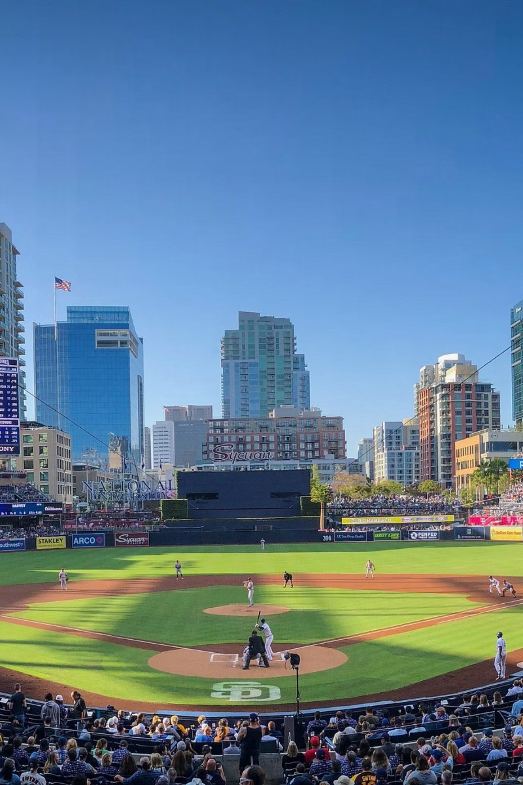
A Reward After Hard Work
Three Weeks Ago
After months of searching and many rejections, I finally received a job offer from the San Diego Padres. This became one of the most exciting accomplishments of my semester and reminded me that hard work eventually pays off.
Items that I experienced that have touched my life in a positive way:

Slide 9

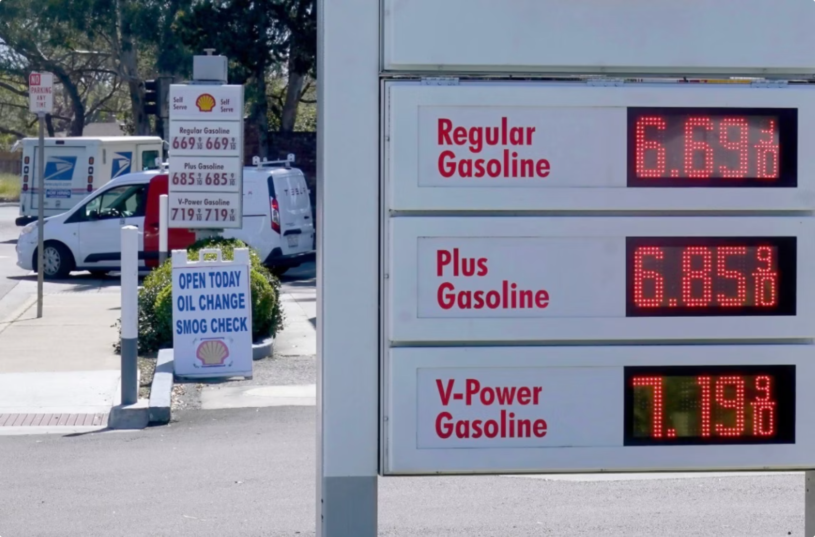
Changes Happening Around Us
Throughout the Semester
Rising Gas Prices
Constantly discussed in media this semester, especially in California.
Everyday Impact
Affected daily life and became something people talked about constantly.
Items that were highlighted by the news, media advertisements/messages:

Slide 10
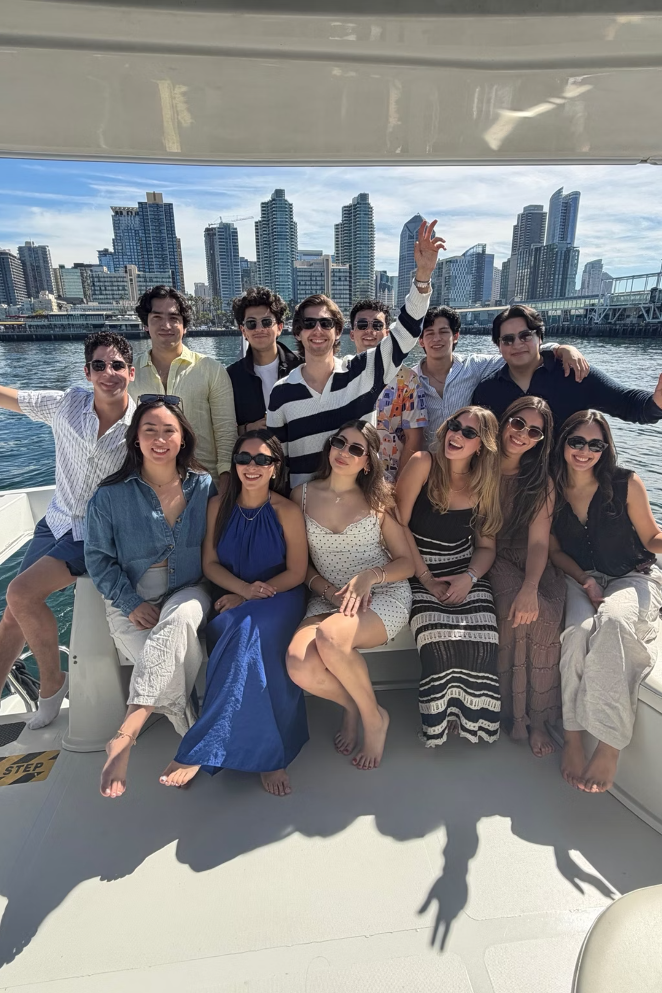
Feeling Loved
February 14
For my birthday, my friends surprised me with a birthday celebration. Their effort and creativity made me feel incredibly appreciated and reminded me how important friendships are.
Items that illustrates people's creativity to assist others:

