Slide 1
Time Capsule
Final Project
By: Isabella Lopez

Slide 2
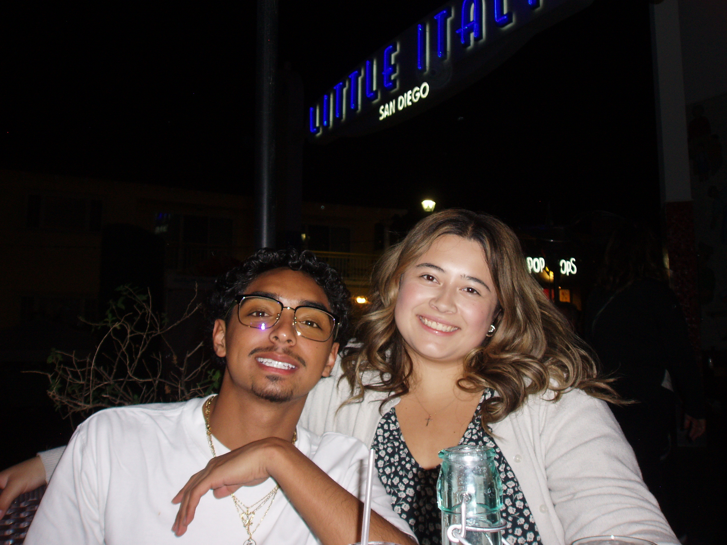
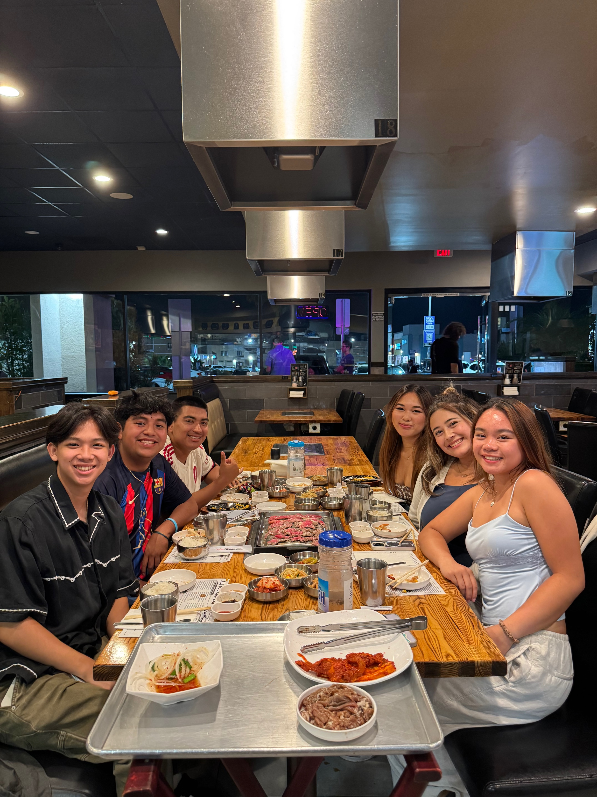
Items that happened in the semester individually, with friends, groups, locally, nationally
Friends from home visited frequently since it’s only two hours away.
My friends from SDSU and UCSD came down to have dinner.

Slide 3
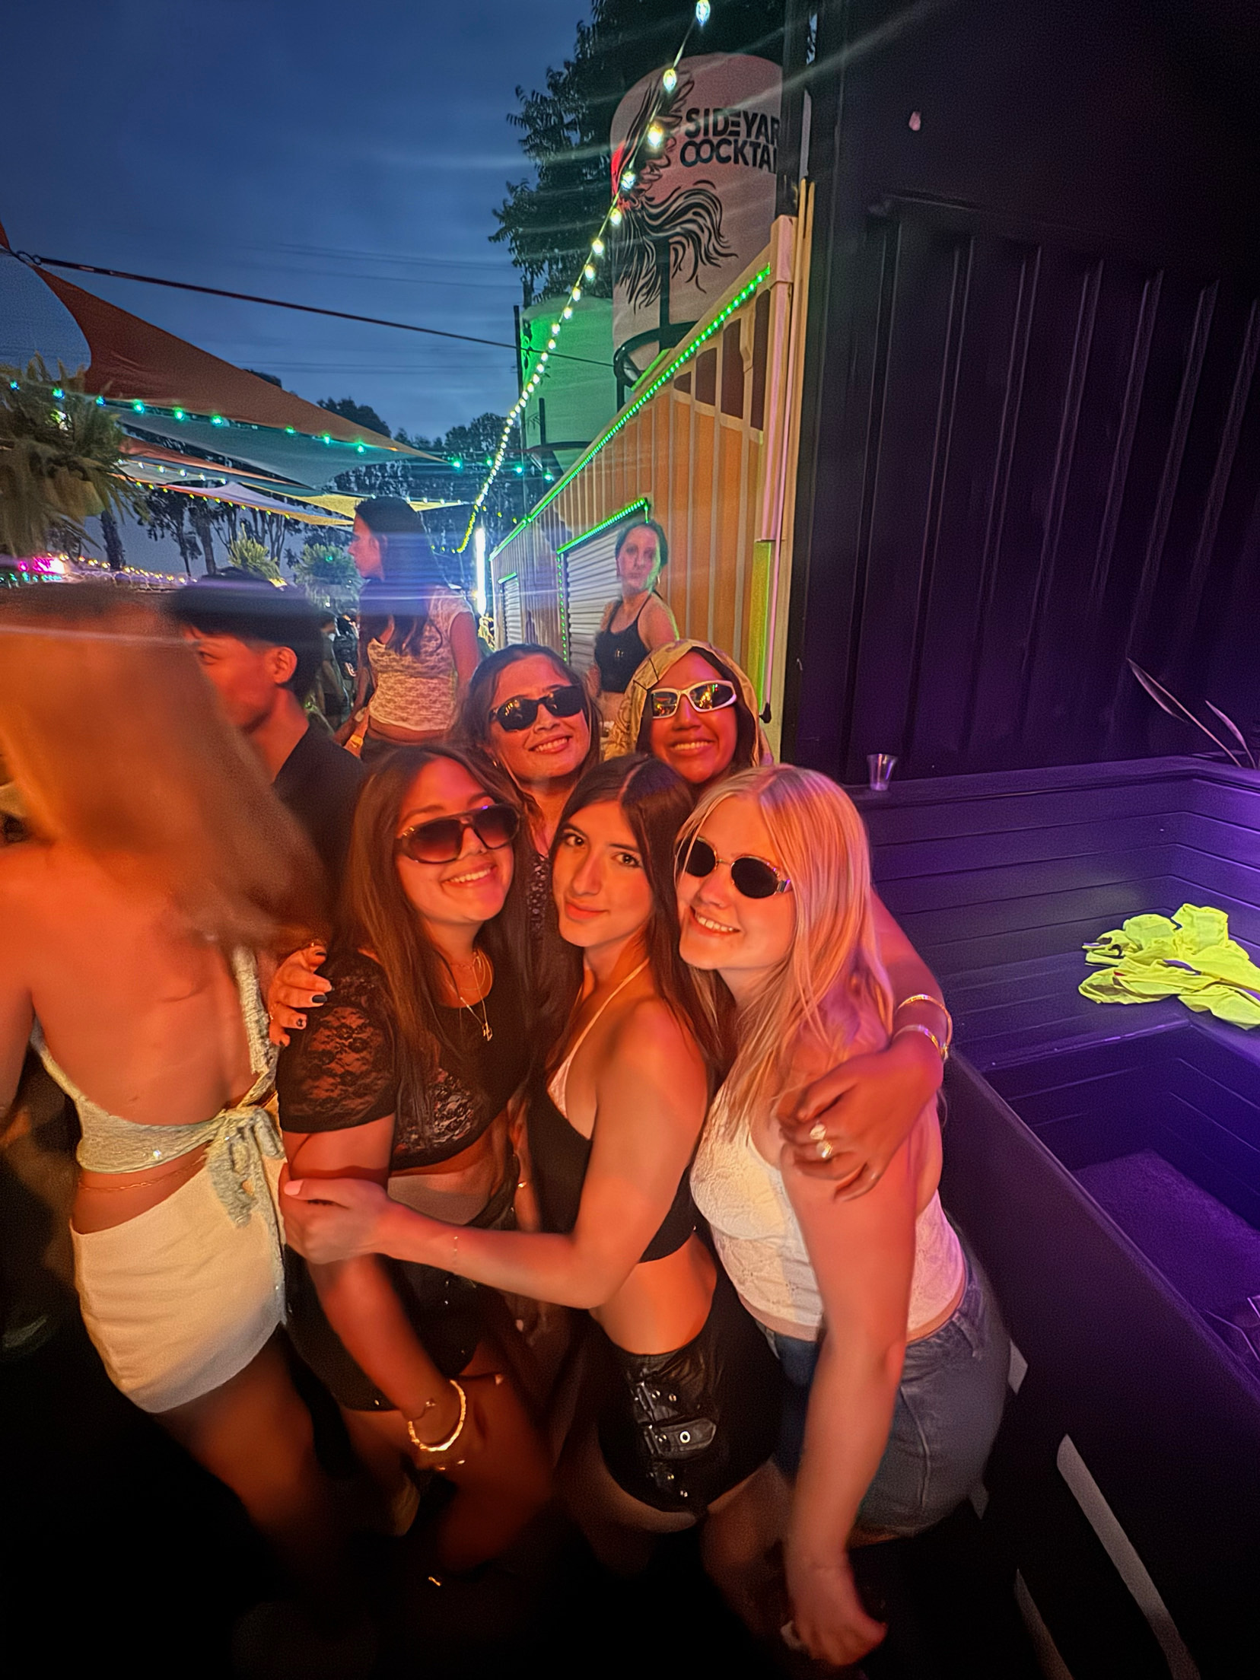
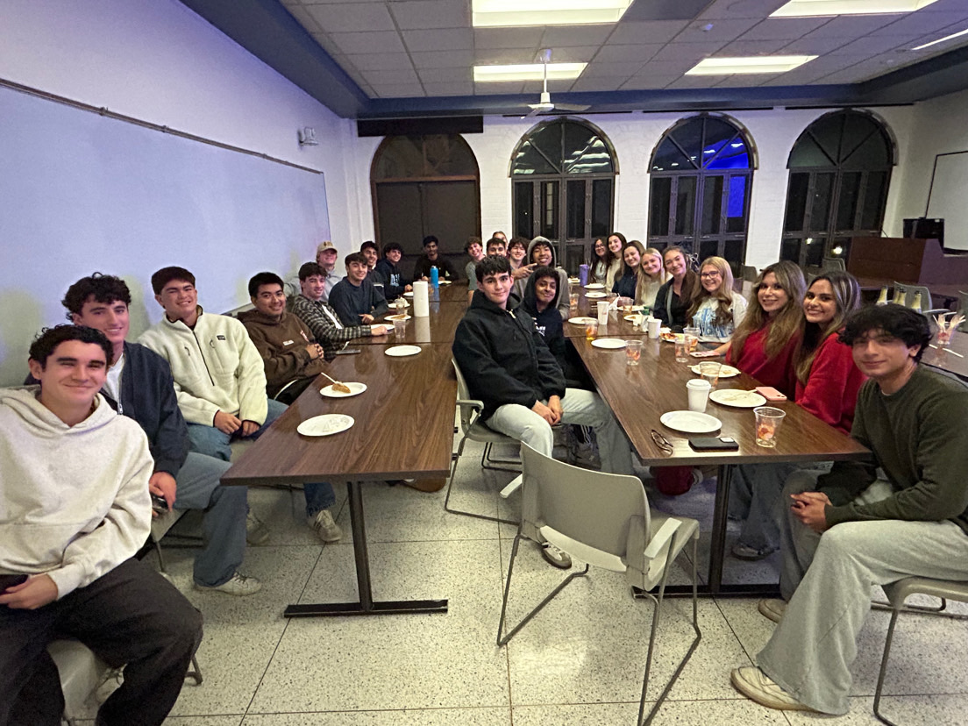
Items that happened in the semester individually, with friends, groups, locally, nationally
I became friends with everyone on my floor in Maher

Slide 4
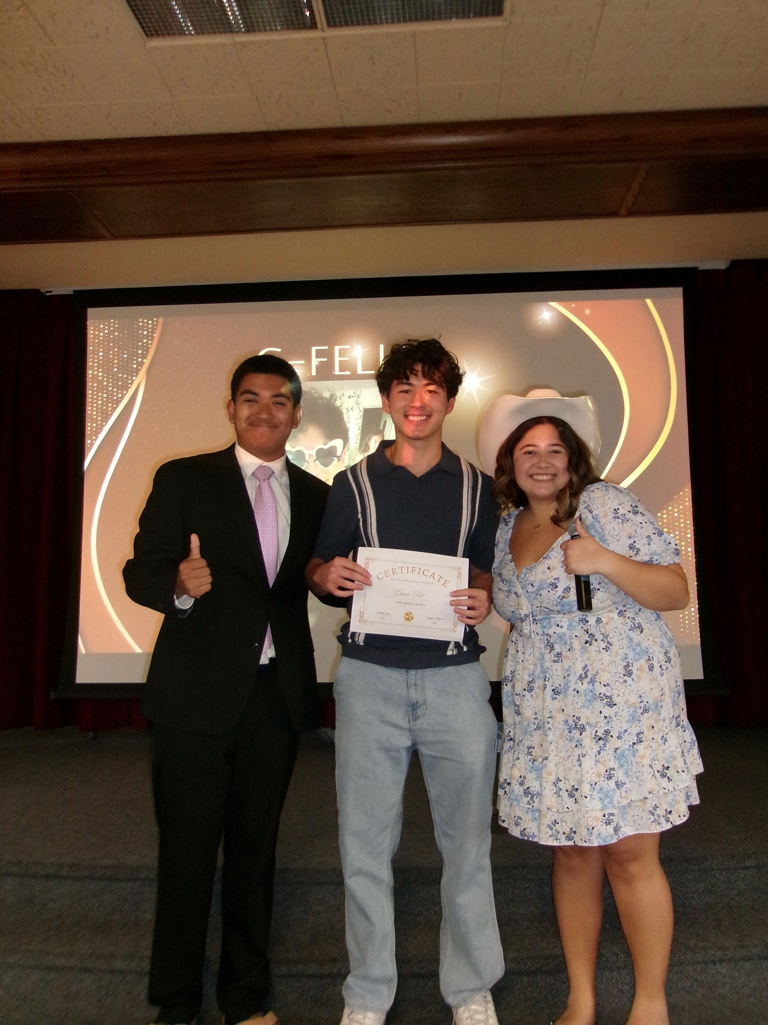
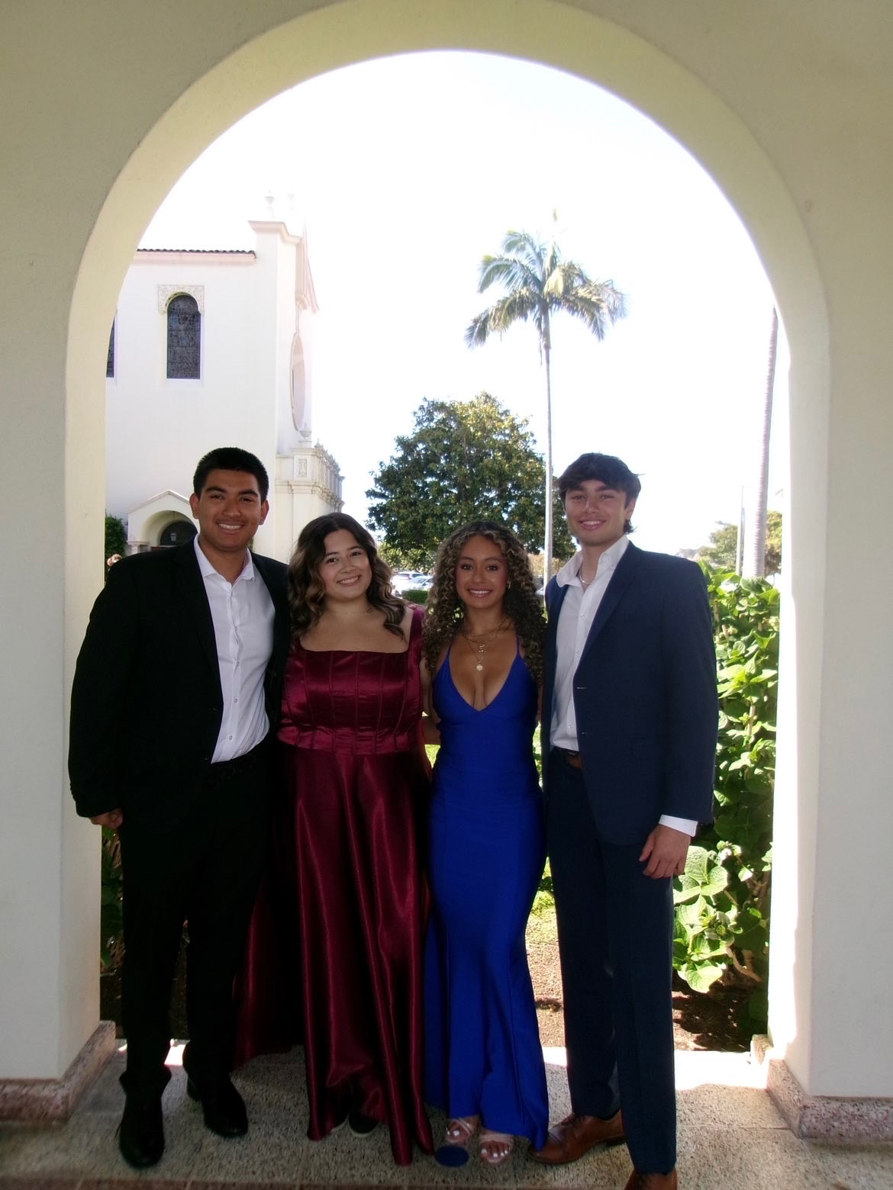
Items that happened in the semester individually, with friends, groups, locally, nationally
My best friend and I hosted a Maher award show full of superlatives
I went to formal with my friends

Slide 5
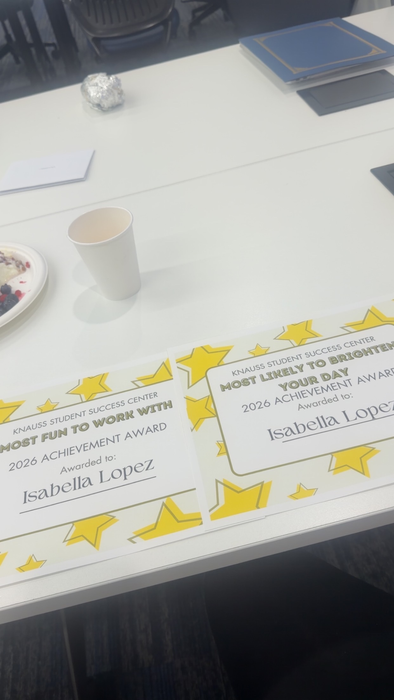
Items that did not happen that you
wanted/expected
I expected more freedom and free time but my job prevented me from it.

Slide 6
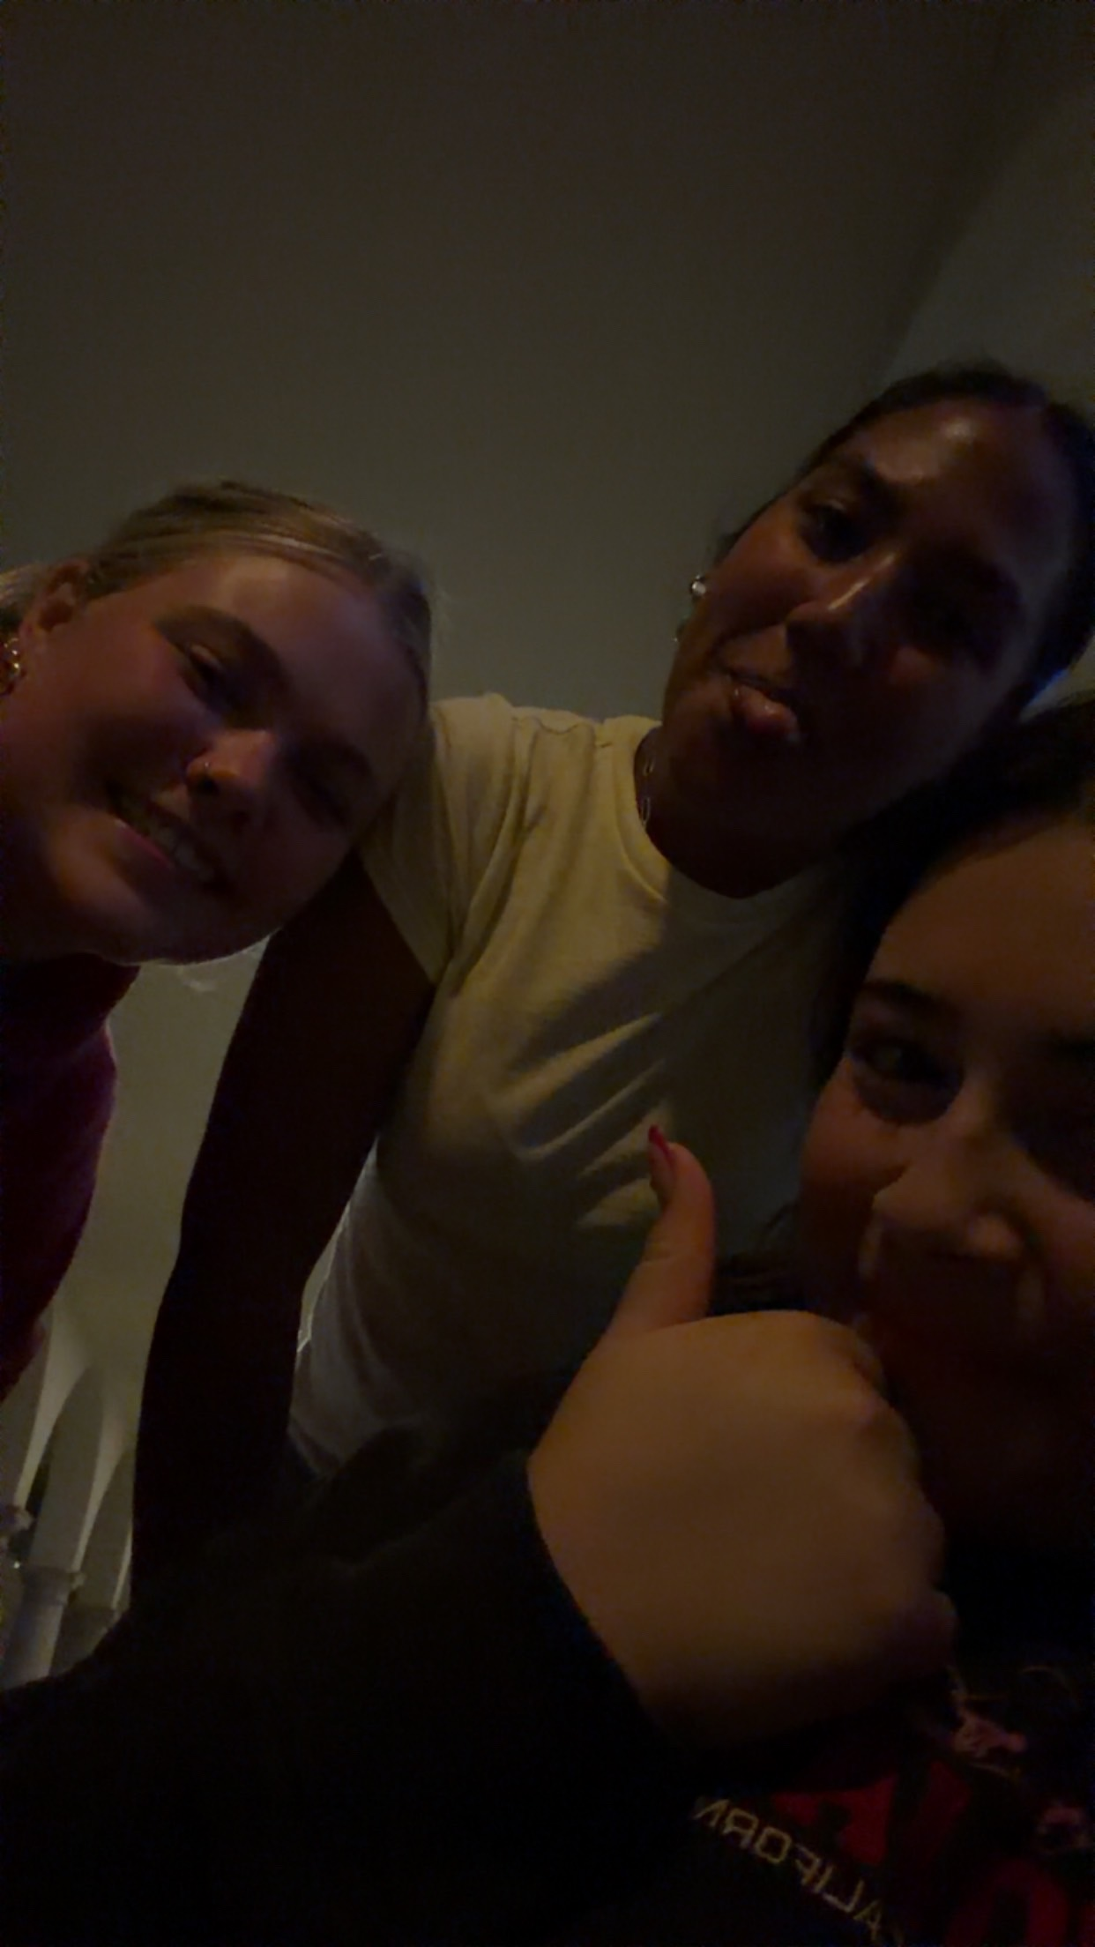
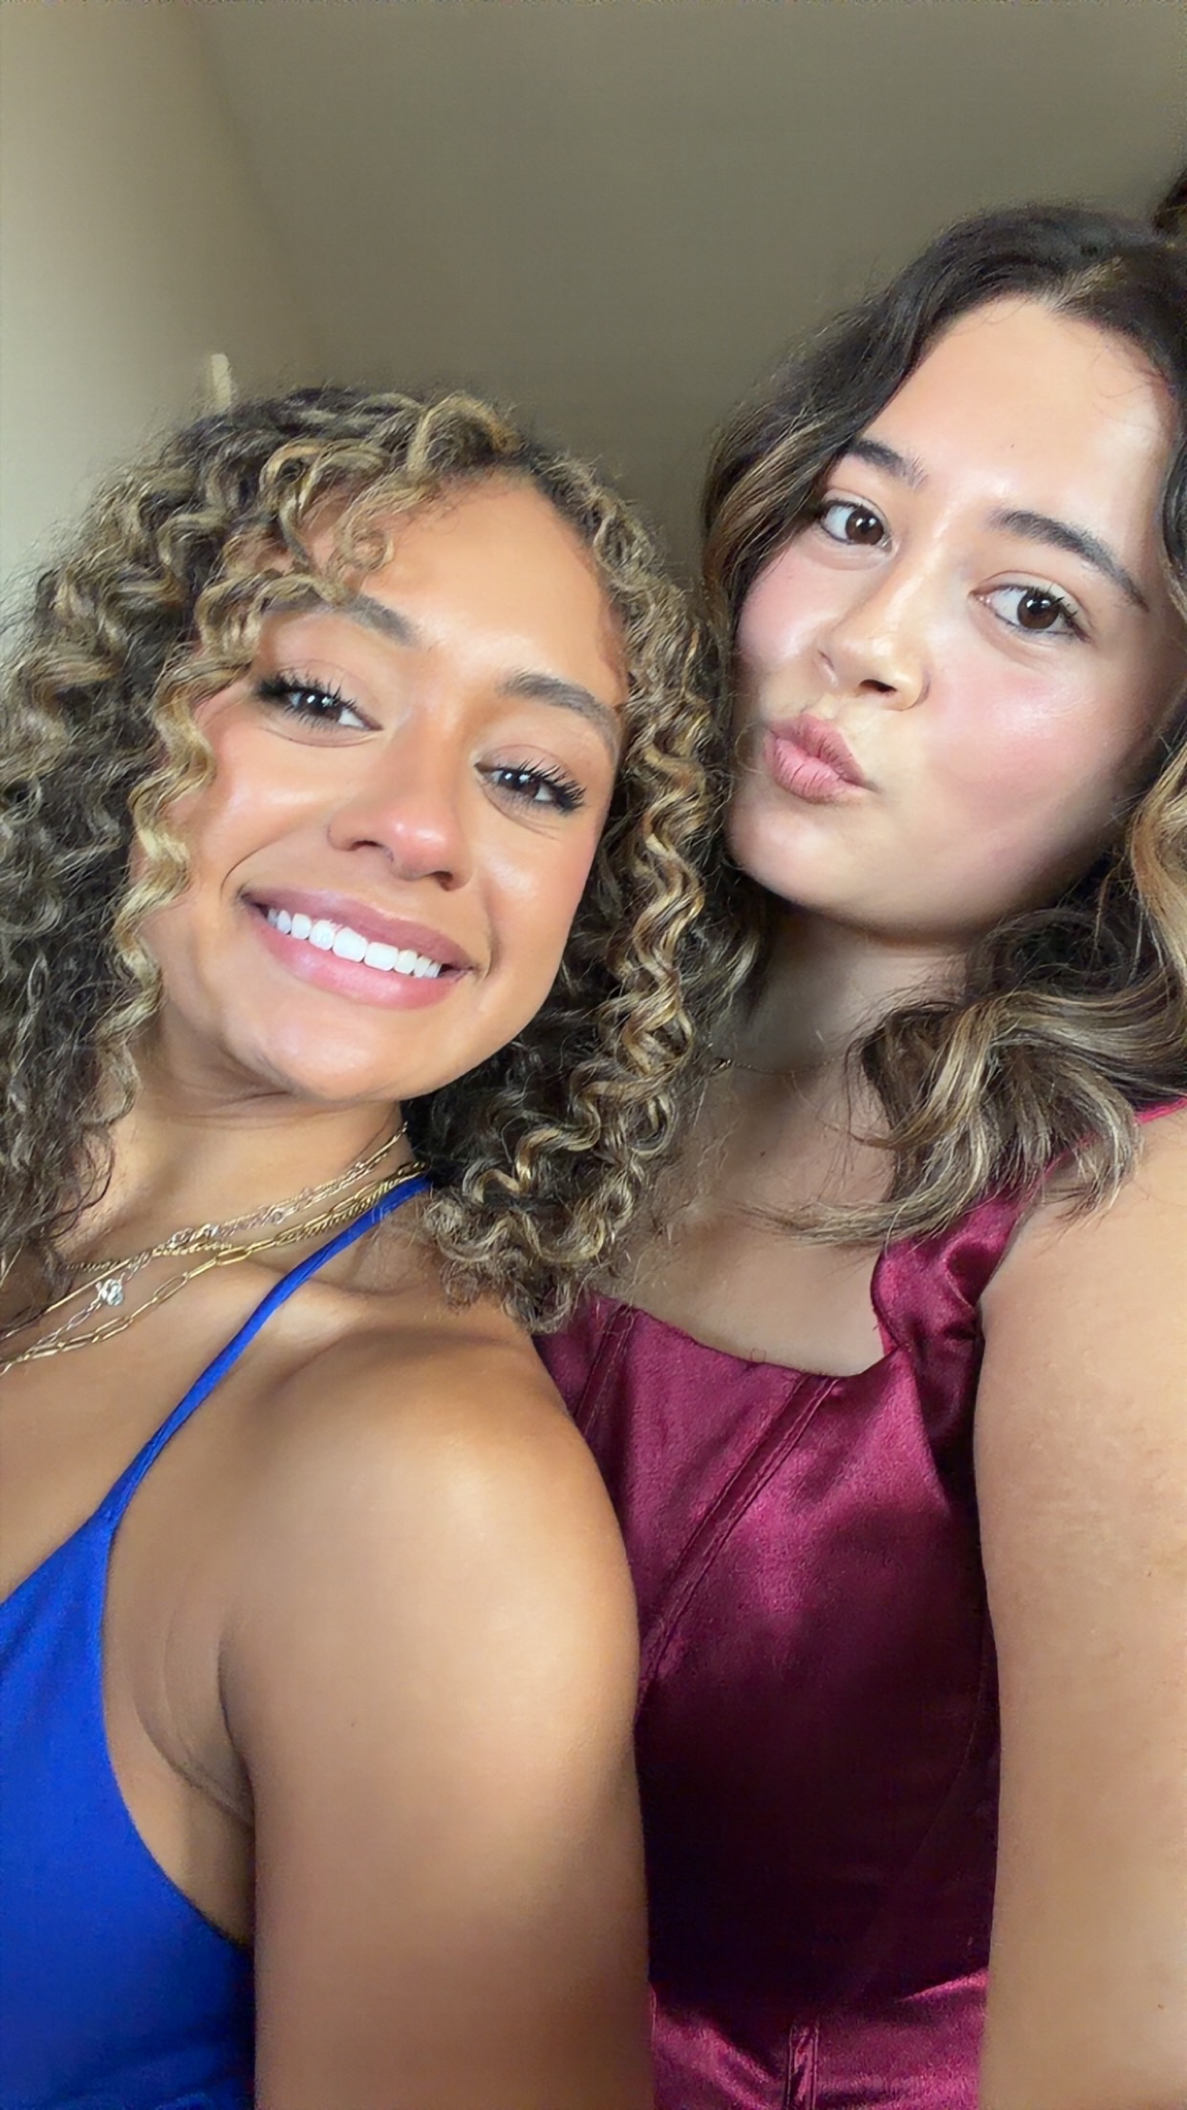
Items that you experienced that have touched your life this semester in a positive way
Meeting my roommates for next year and creating unbreakable bonds with them

Slide 7
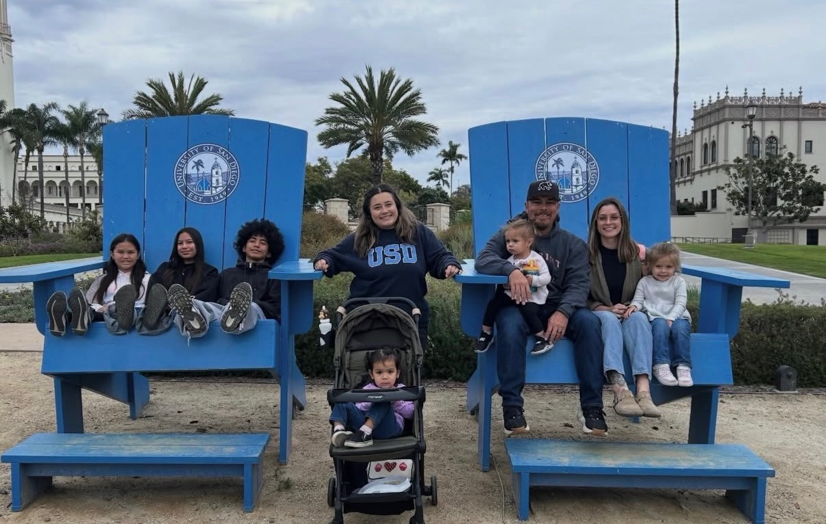
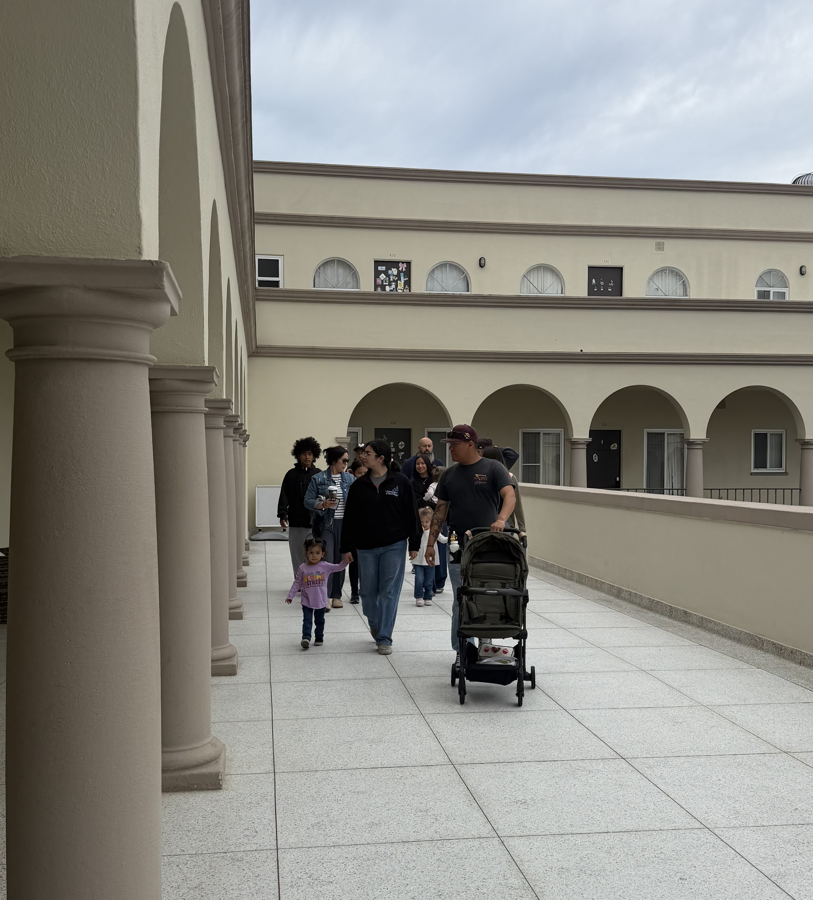
Items that you experienced that have touched your life this semester in a positive way
My family making the effort to visit me at school

Slide 8
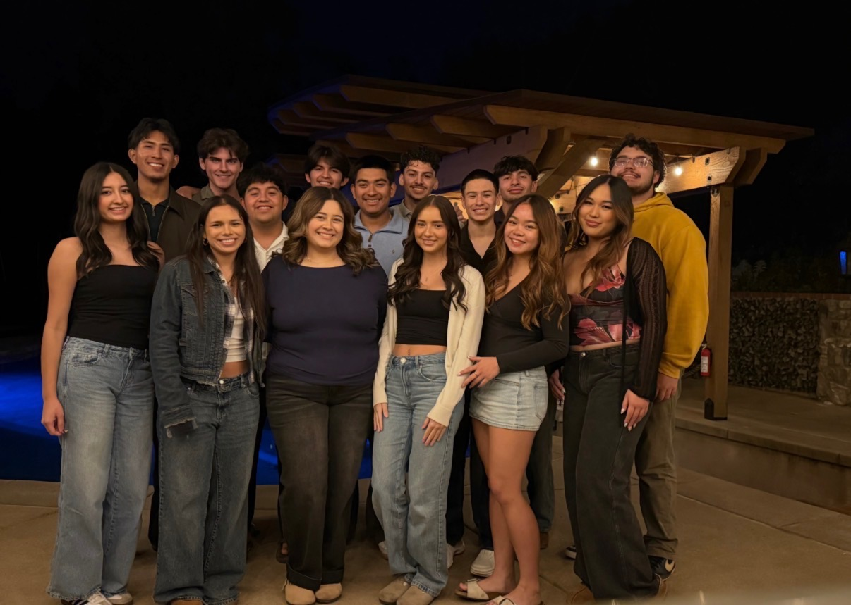
Items that you experienced that were sad or negative that you wish not to be experienced again
Losing the close connections I had with my friends from home

Slide 9
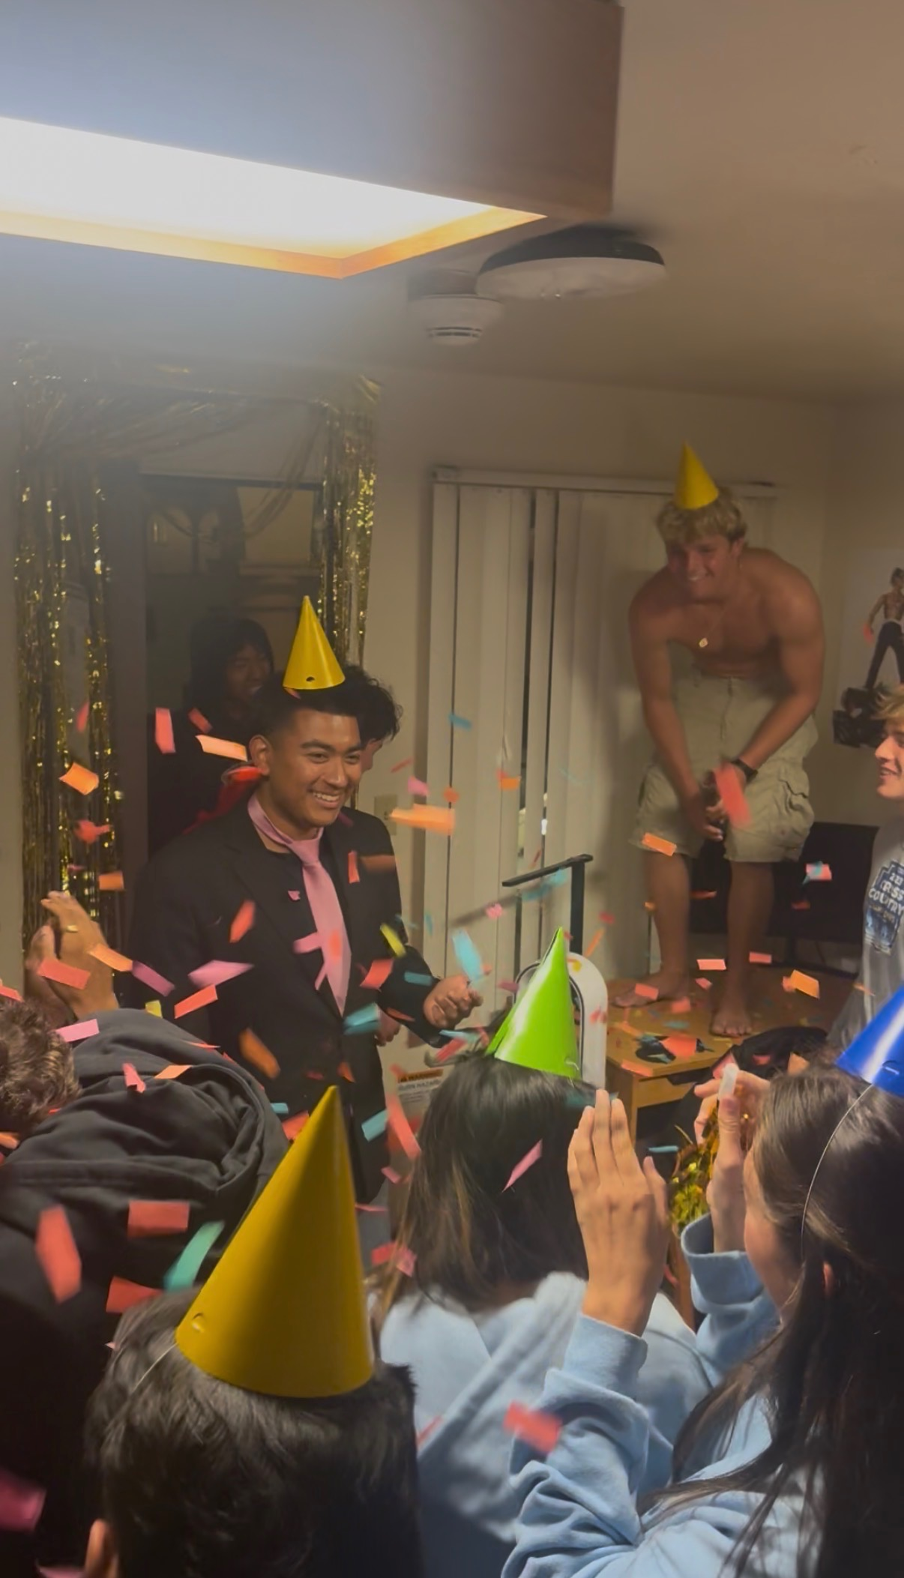
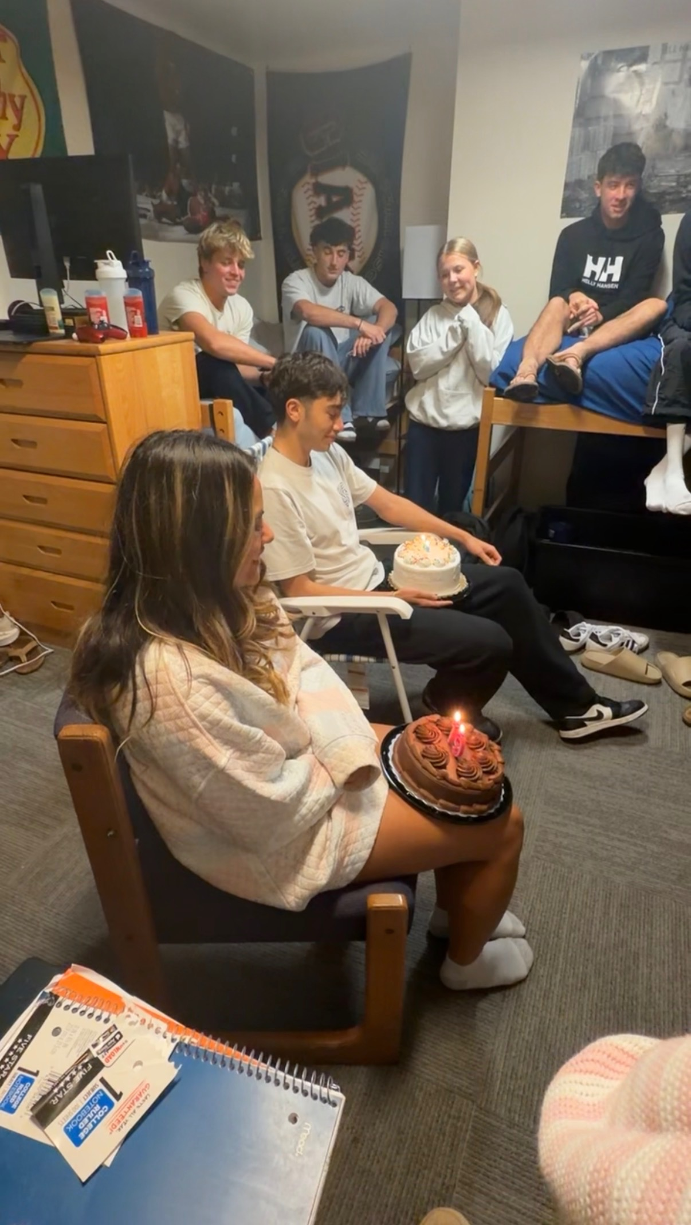
Items that illustrates people’s creativity to assist others (i.e. drive by birthday parties)
I threw a birthday party for my friend and we also celebrated other birthdays throughout the year for the people on my floor

Slide 10
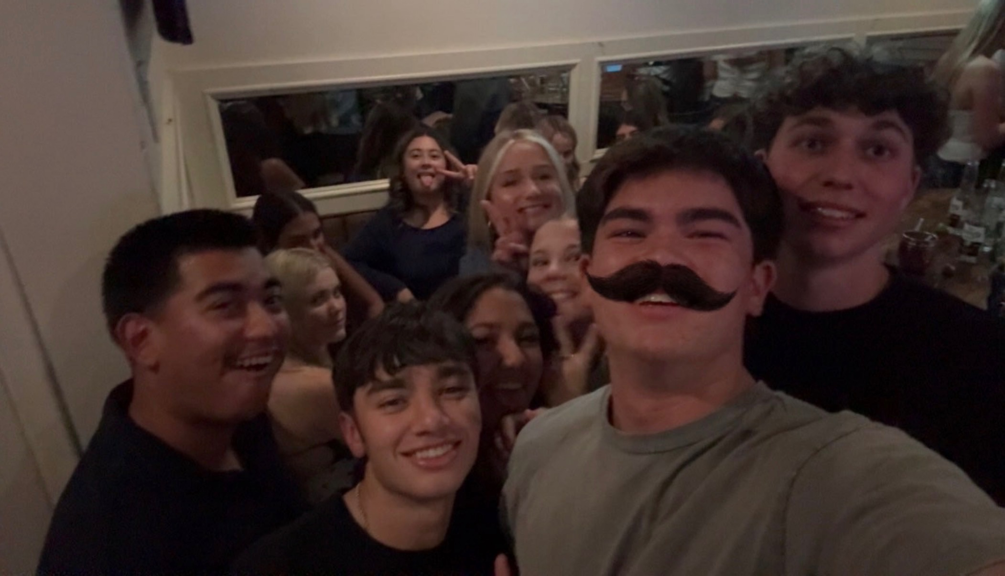
Other relevant items to discuss the semester you had, the semester you wanted, and the semesters that you wish to have in the future.
I had a great semester full of many memories which is exactly what I was hoping to get out of my first year of college. I hope to continue getting good grades, study harder and keep my true friends close for many semesters to come.

