Slide 1
My Time Capsule
Documenting the Present for the Future
By: D’arrae Goodwin

Slide 2
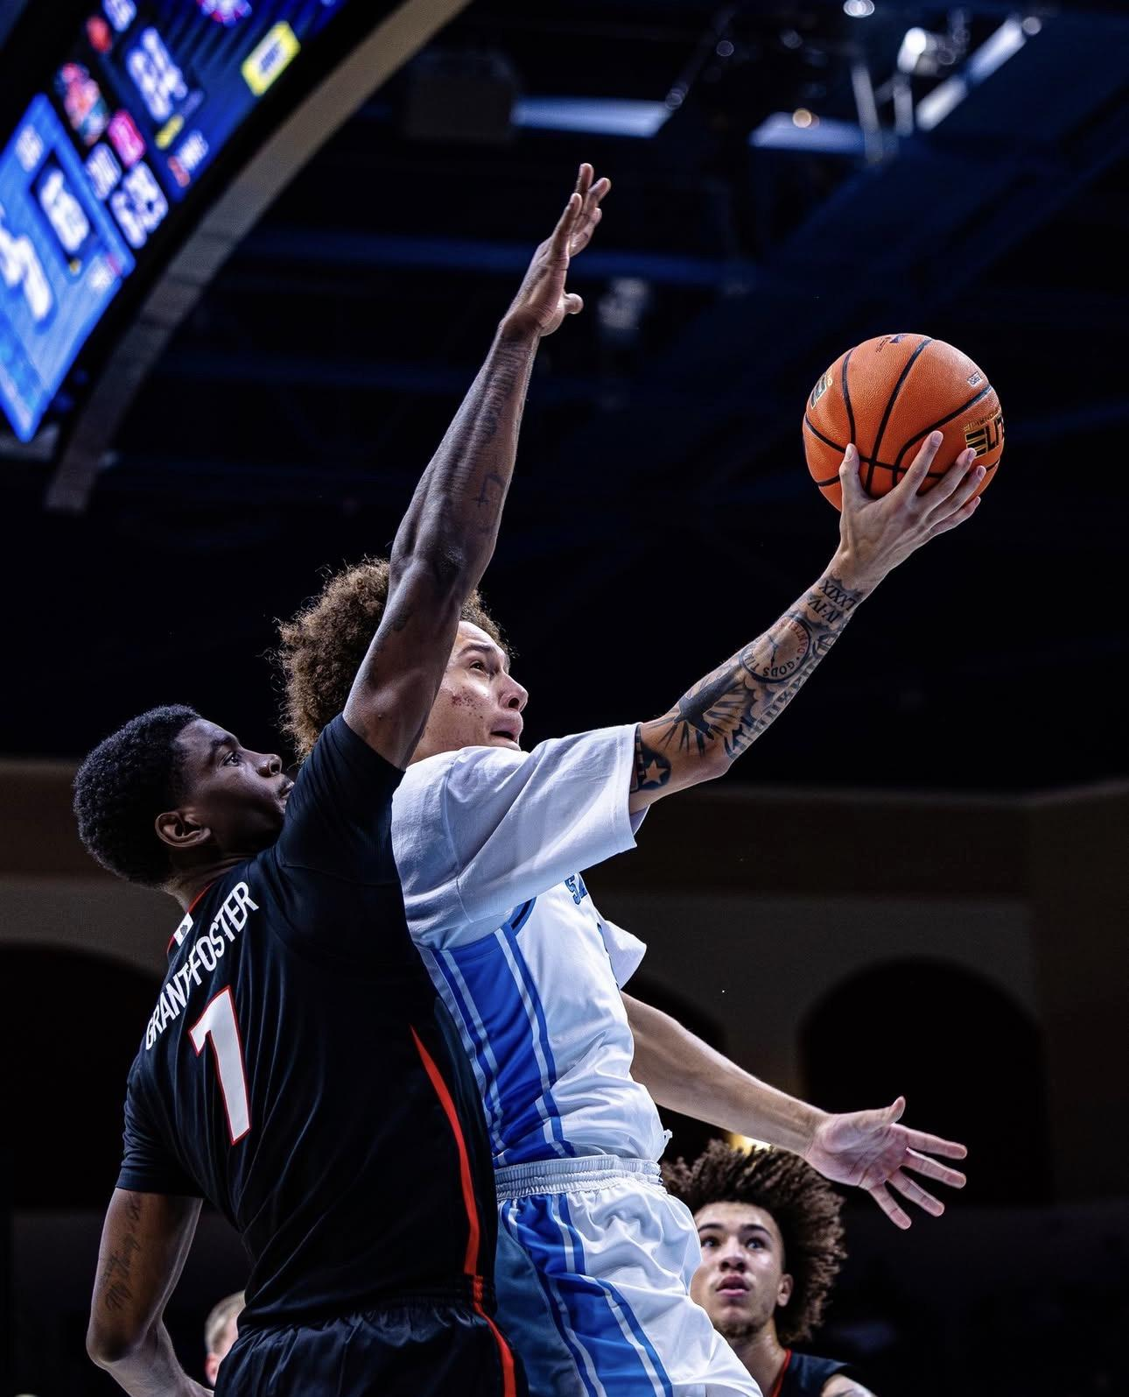
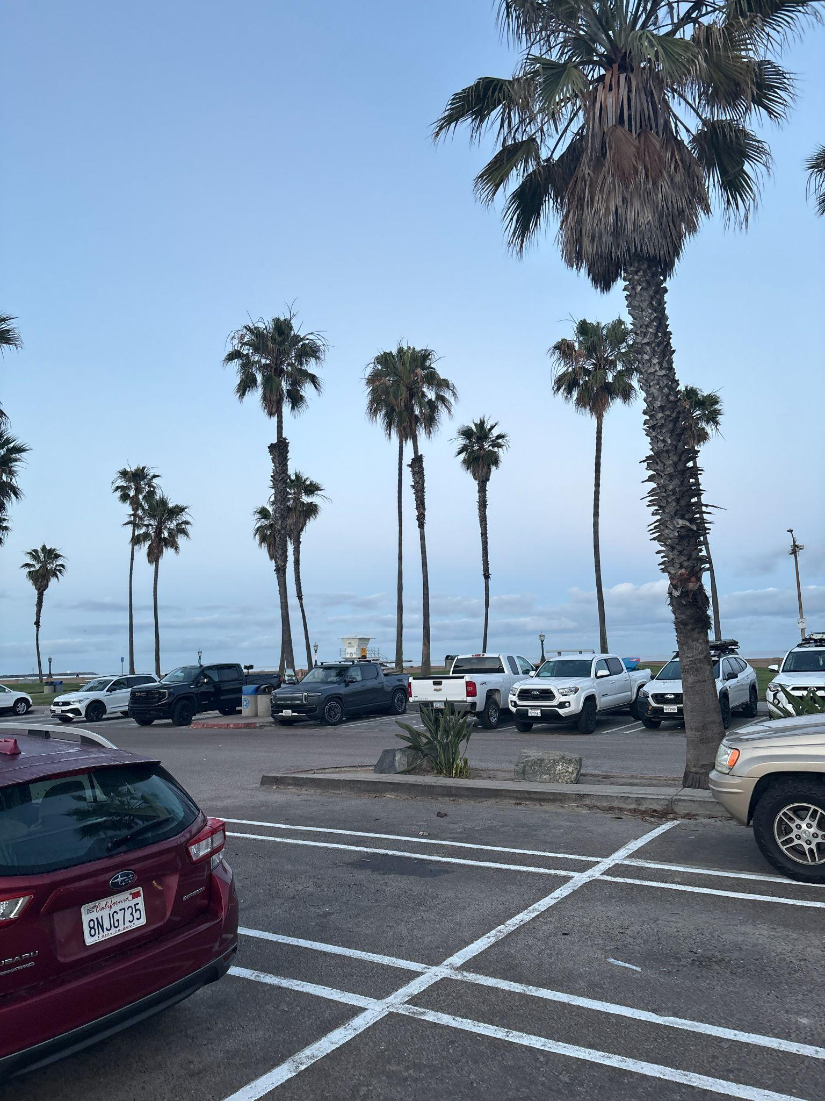
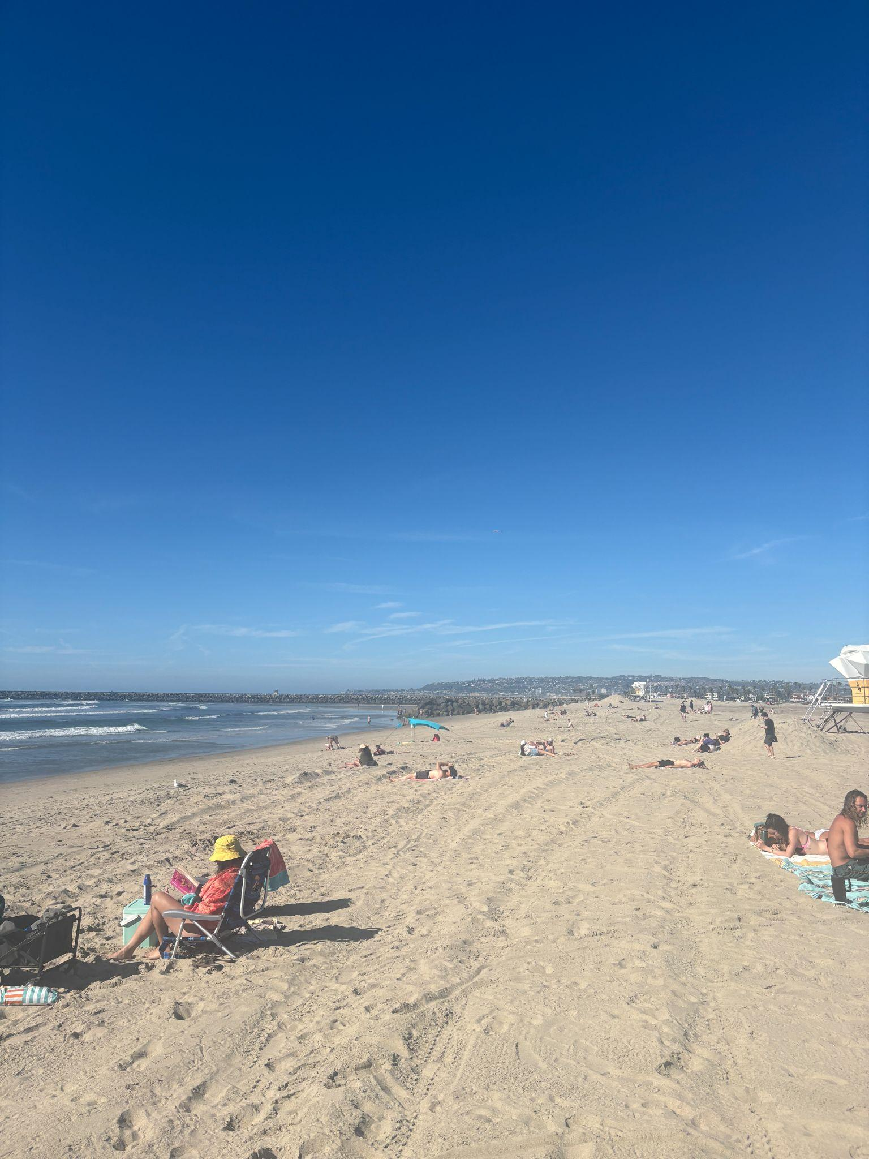
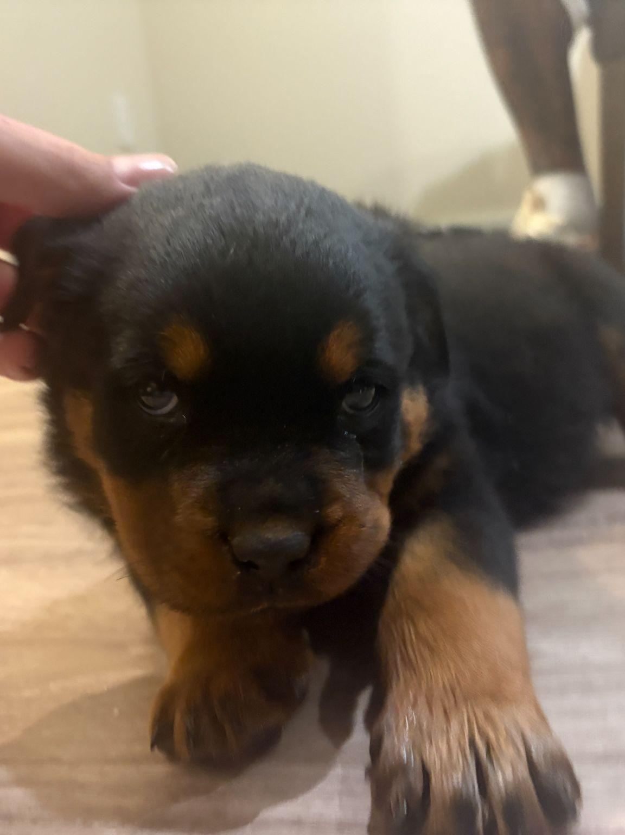
Semester Recap

Slide 3
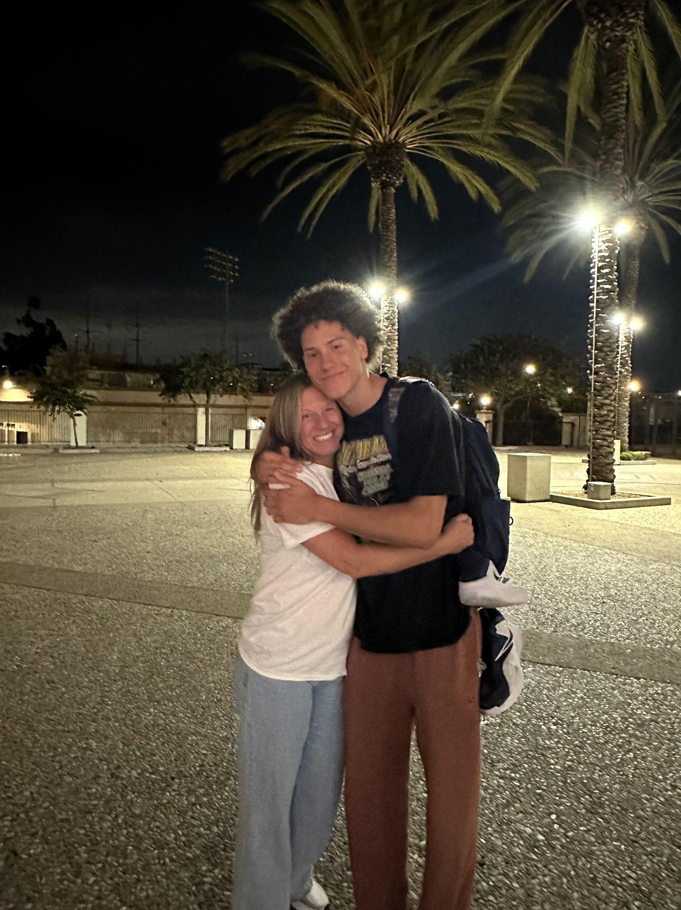
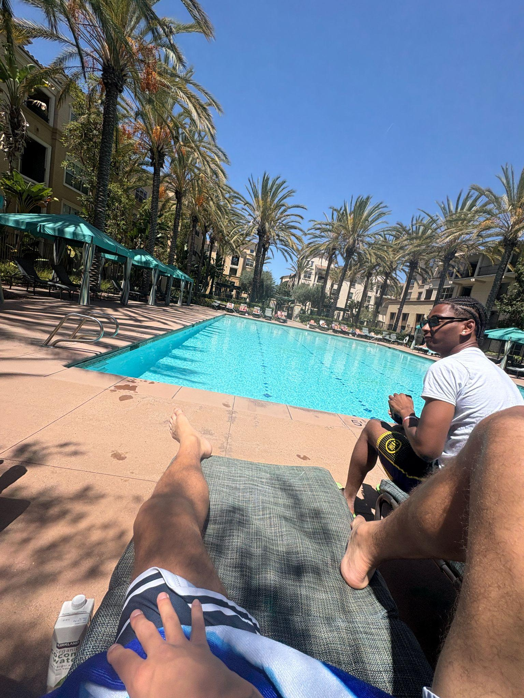
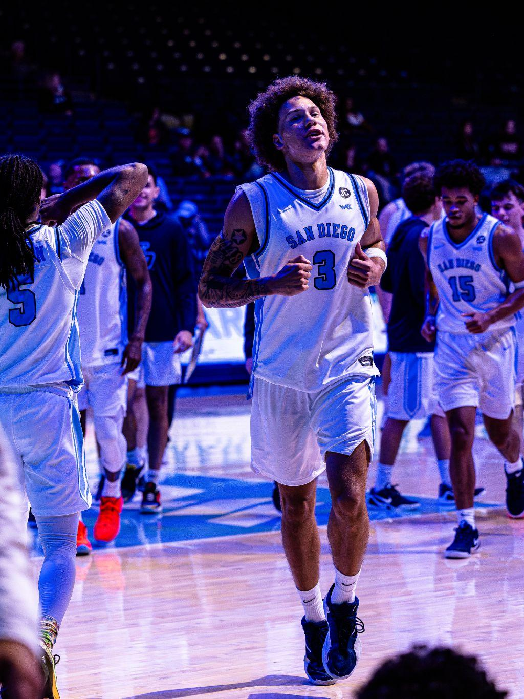
Shared Moments With Friends & Family
My mom got to watch me play my first college basketball game
Basketball Season with my teammates!
Pool days with my roomates!

Slide 4
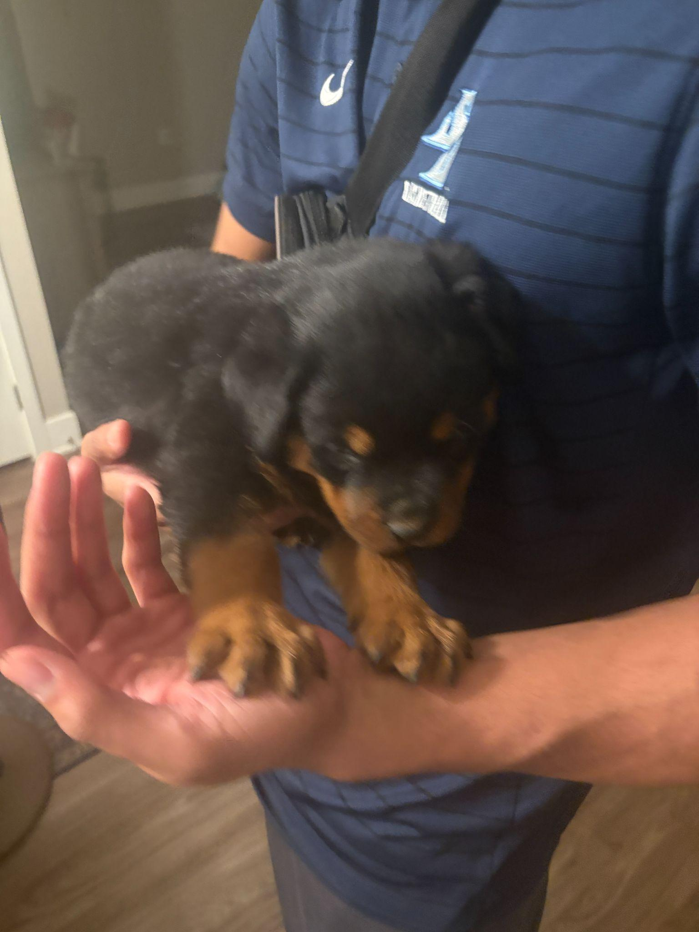
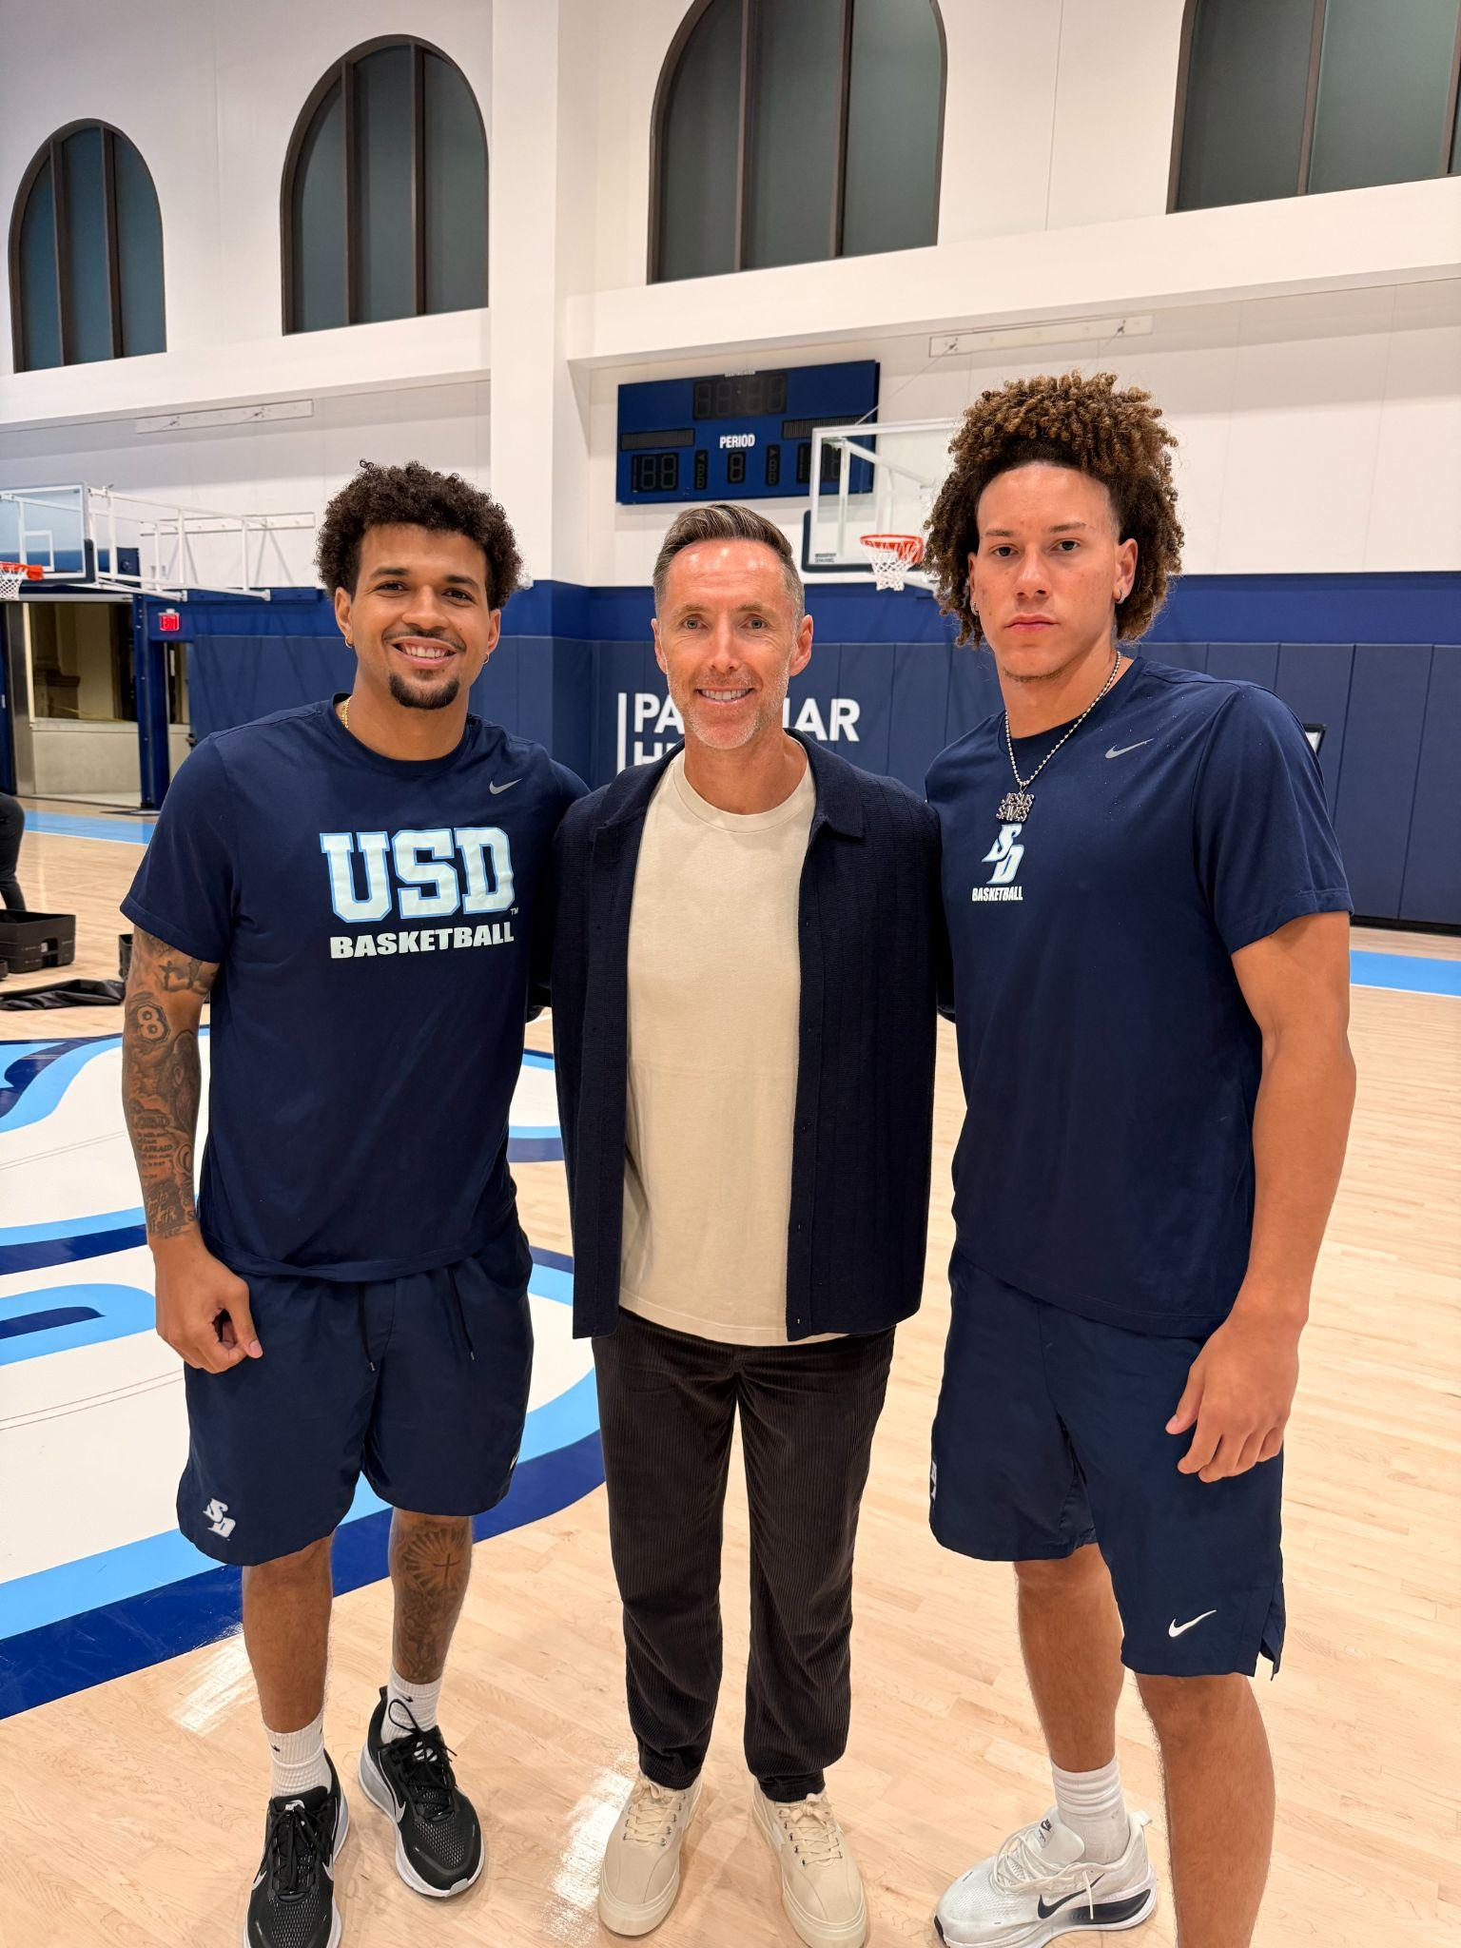
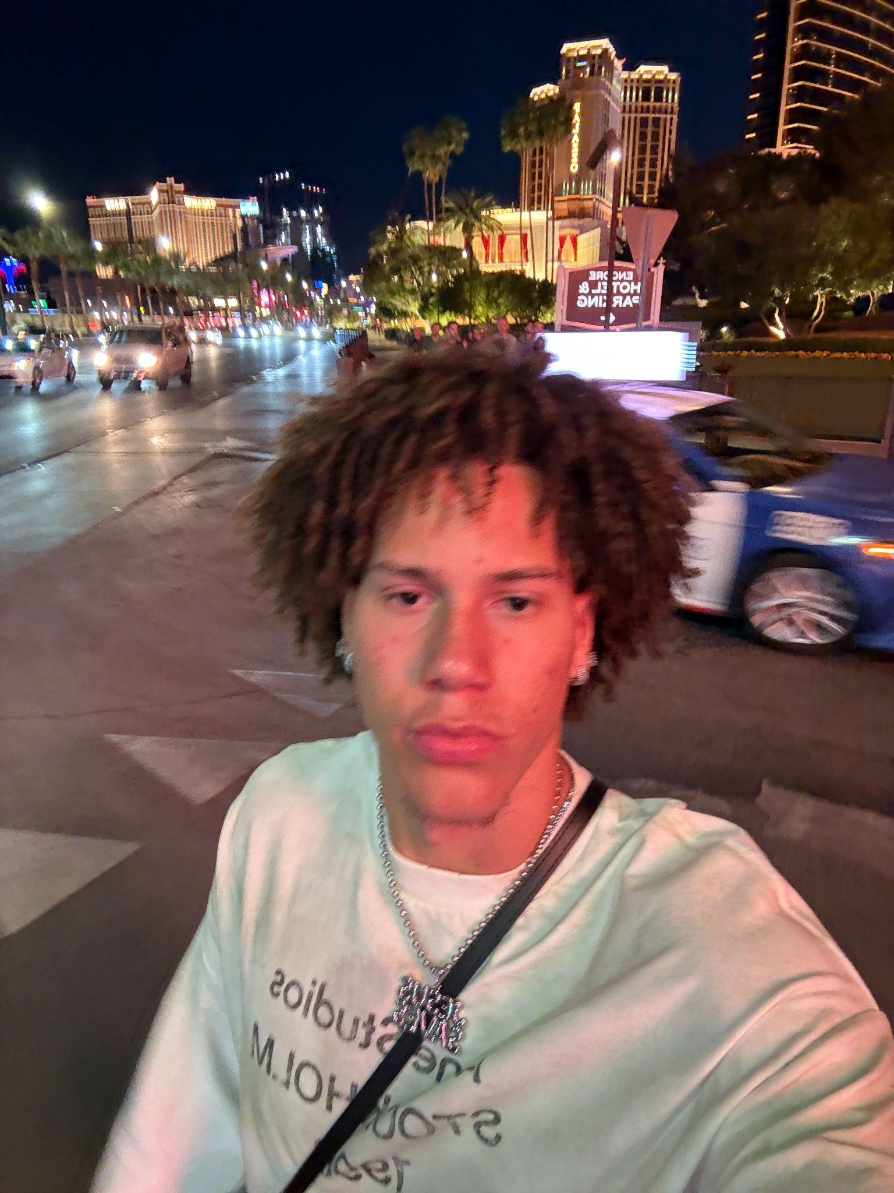
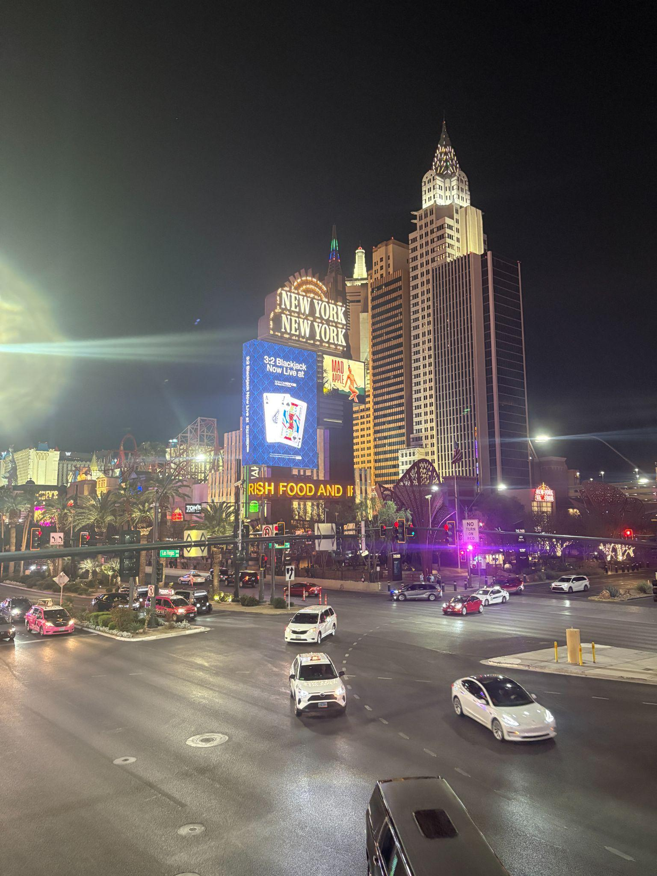
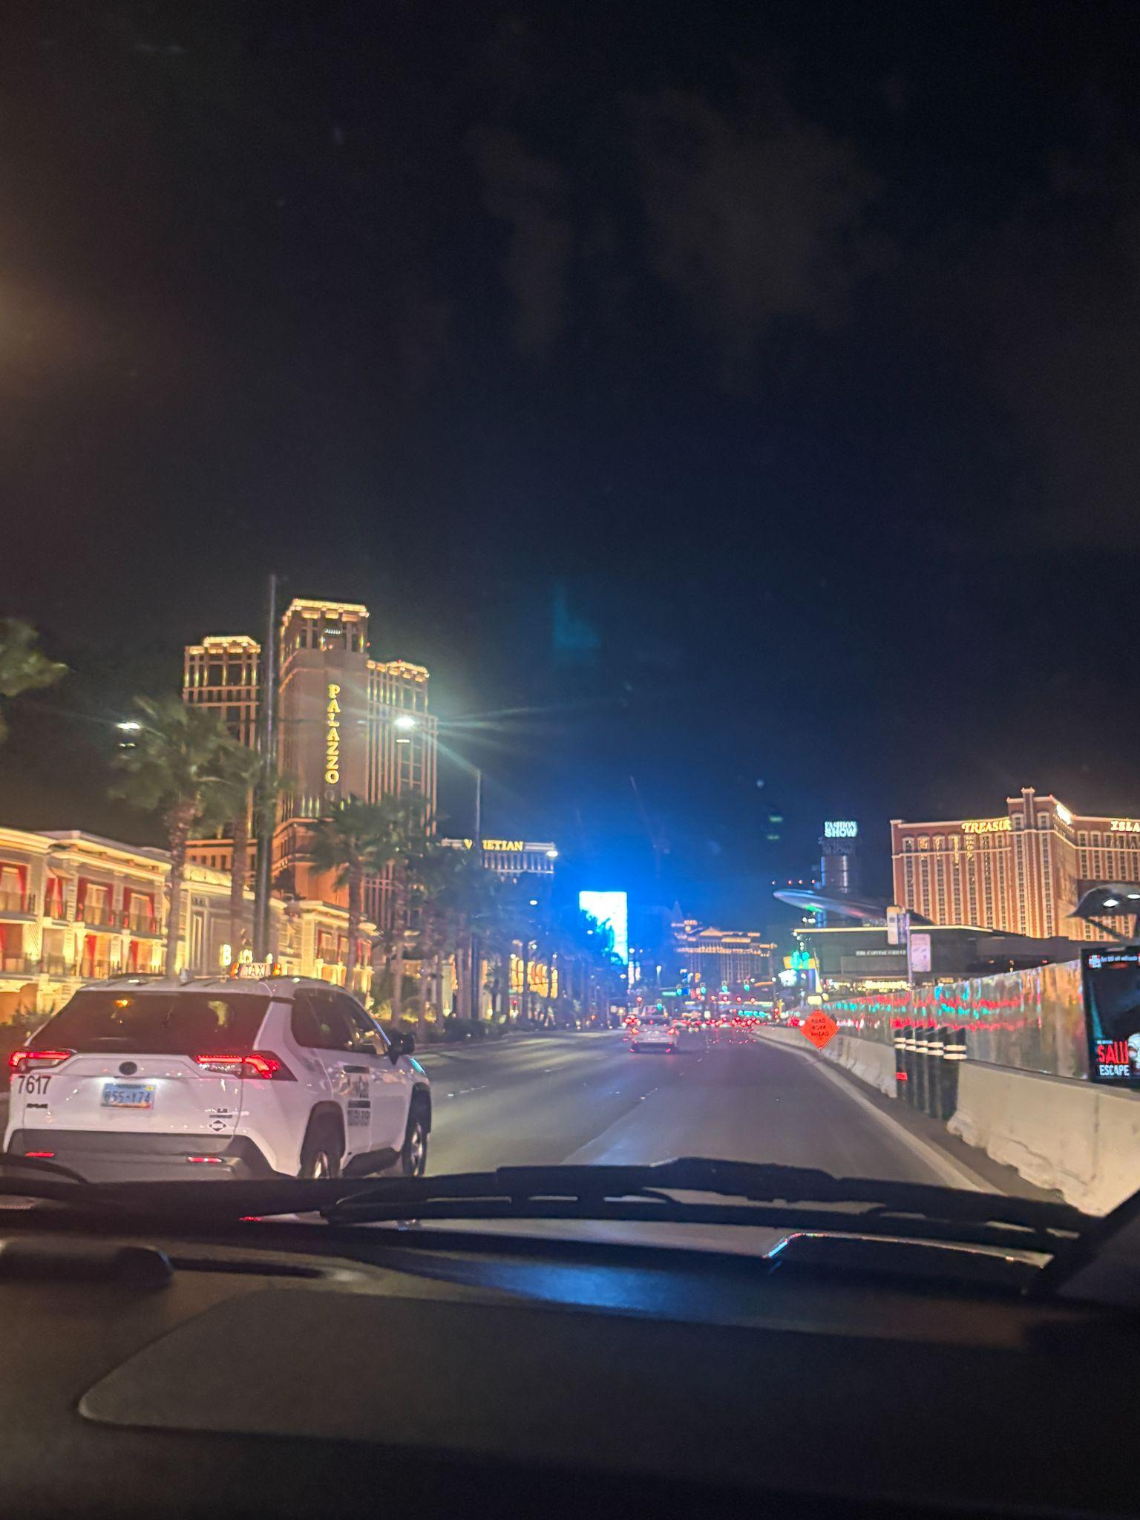
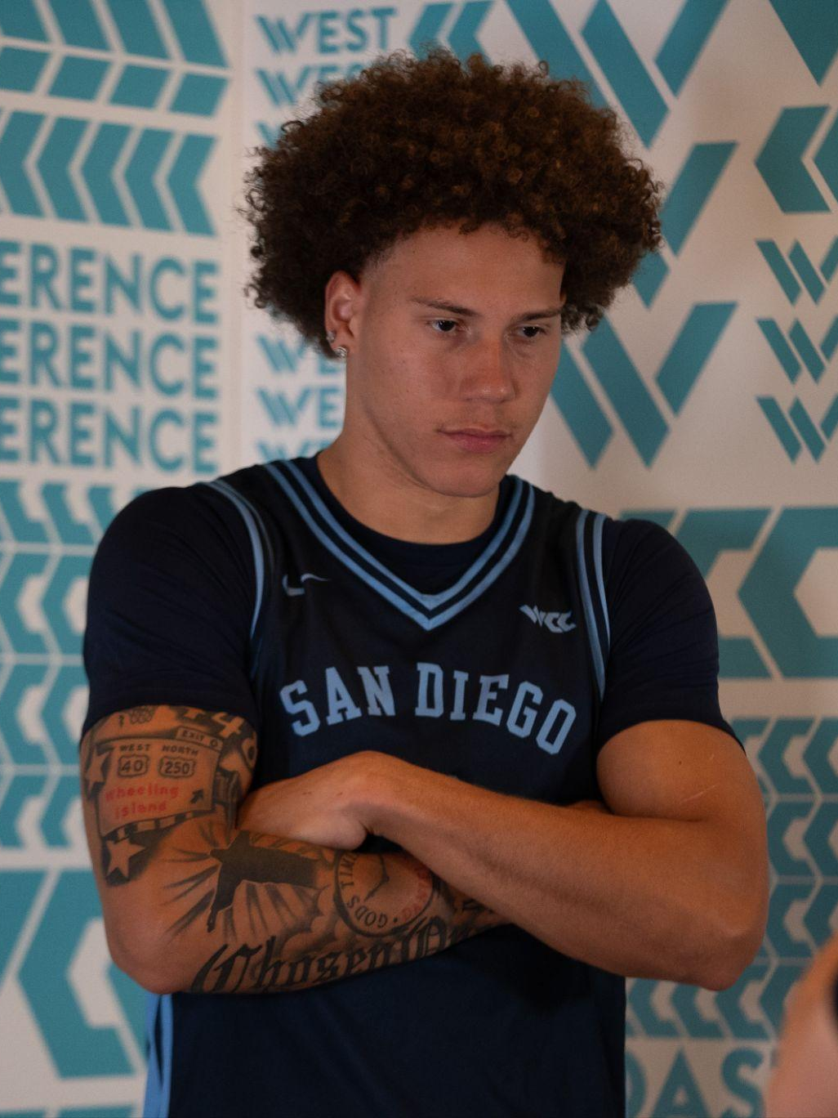
Unexpected Events…
A few Vegas trips
My roomates and I sporadically bought a puppy and named him Enoch
Got some basketball advice from NBA Hall of Famer Steve Nash!

Slide 5
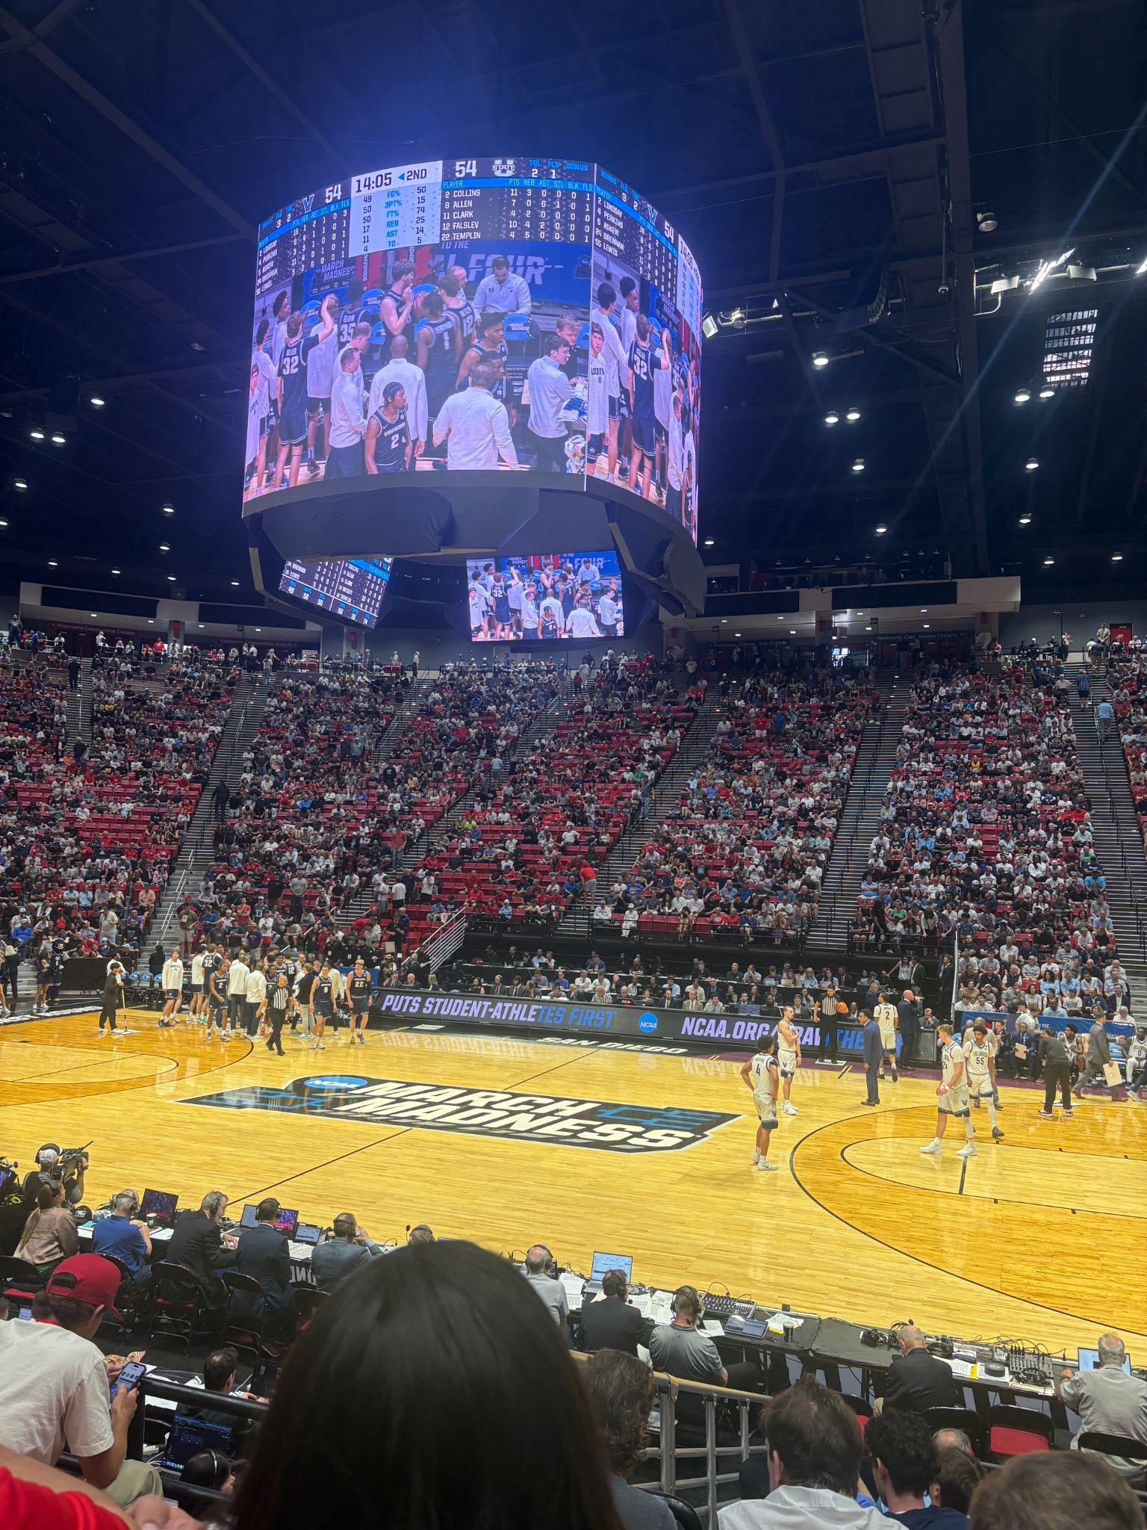
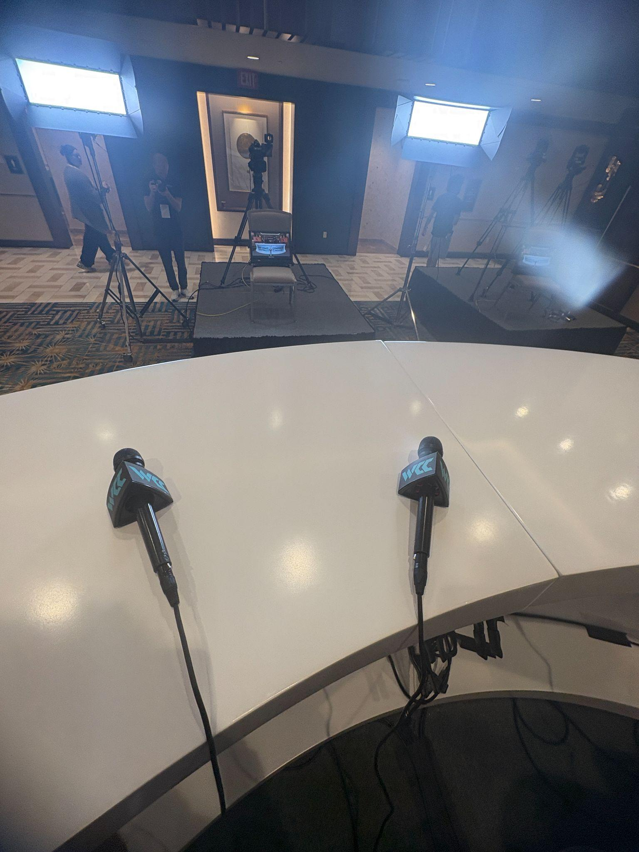
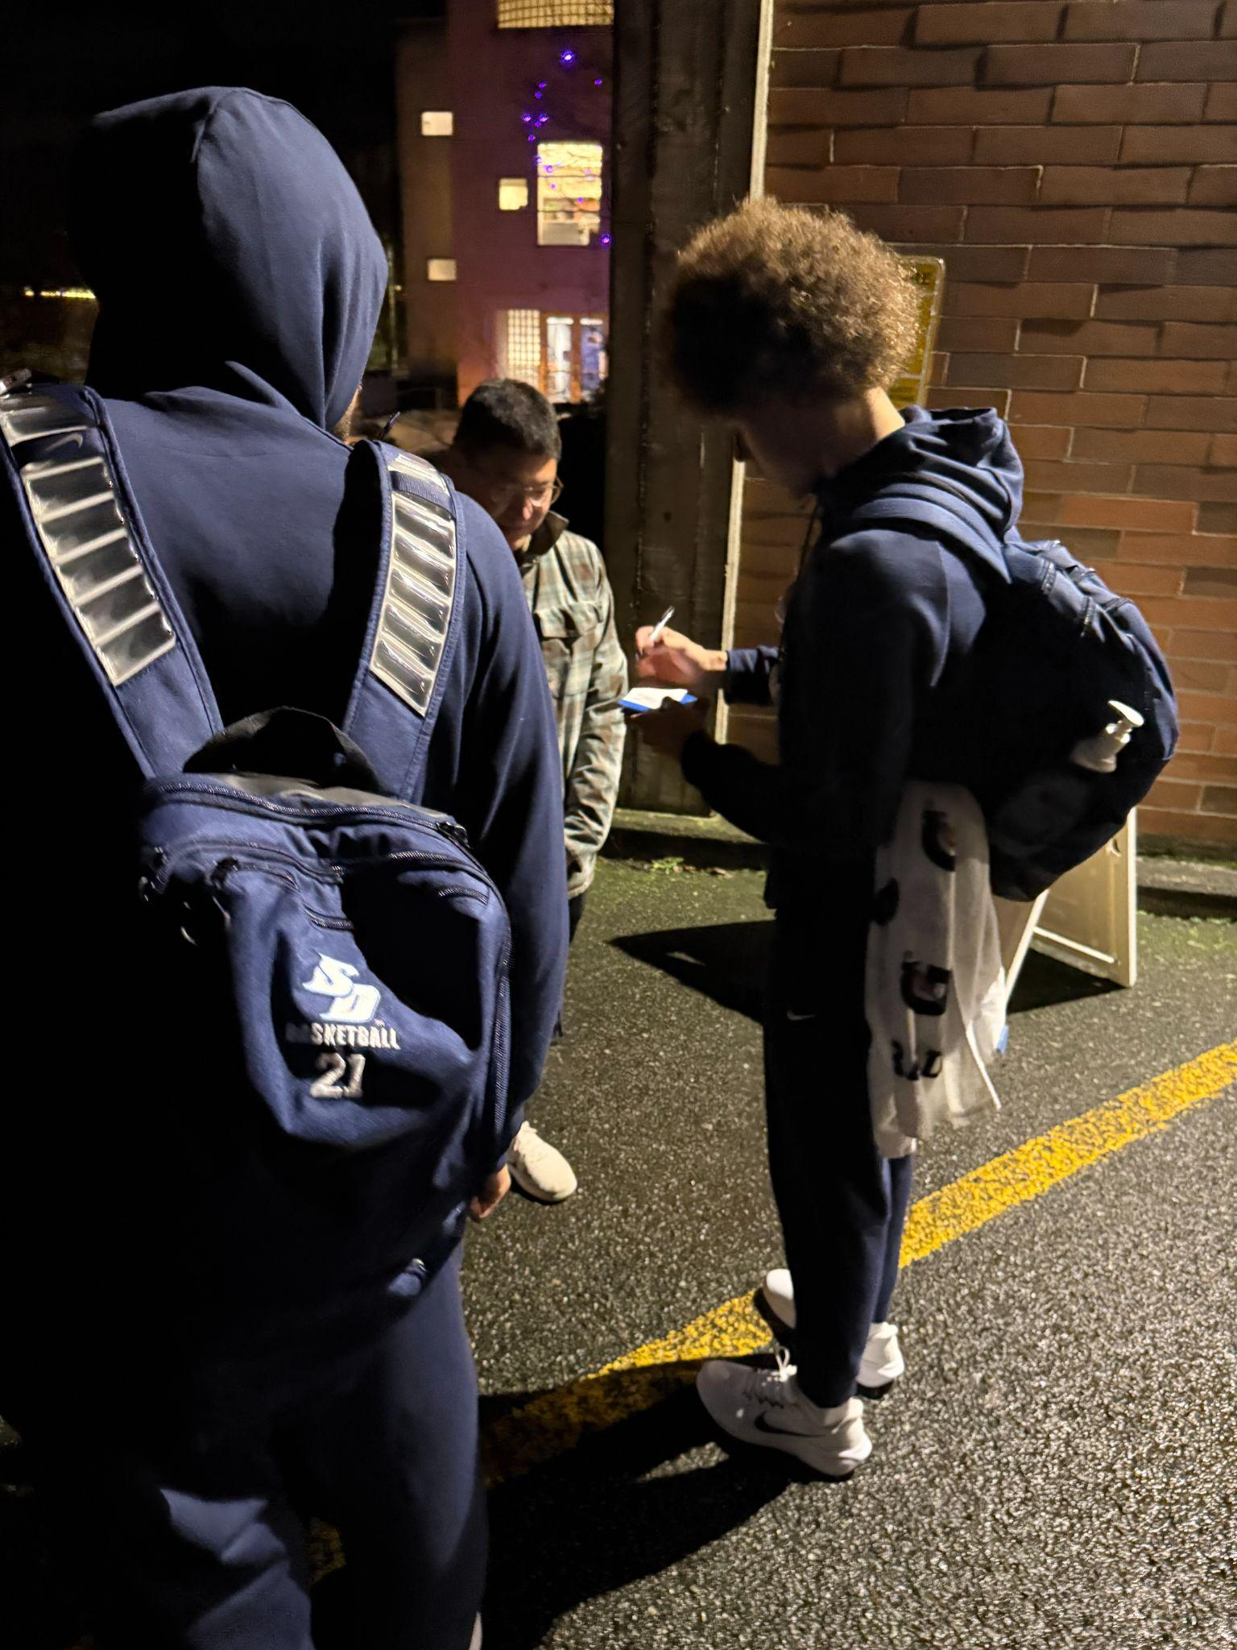
A couple “Firsts” that touched my life this semester
My first NCAA March Madness game
First autograph
My first ESPN interview

Slide 6
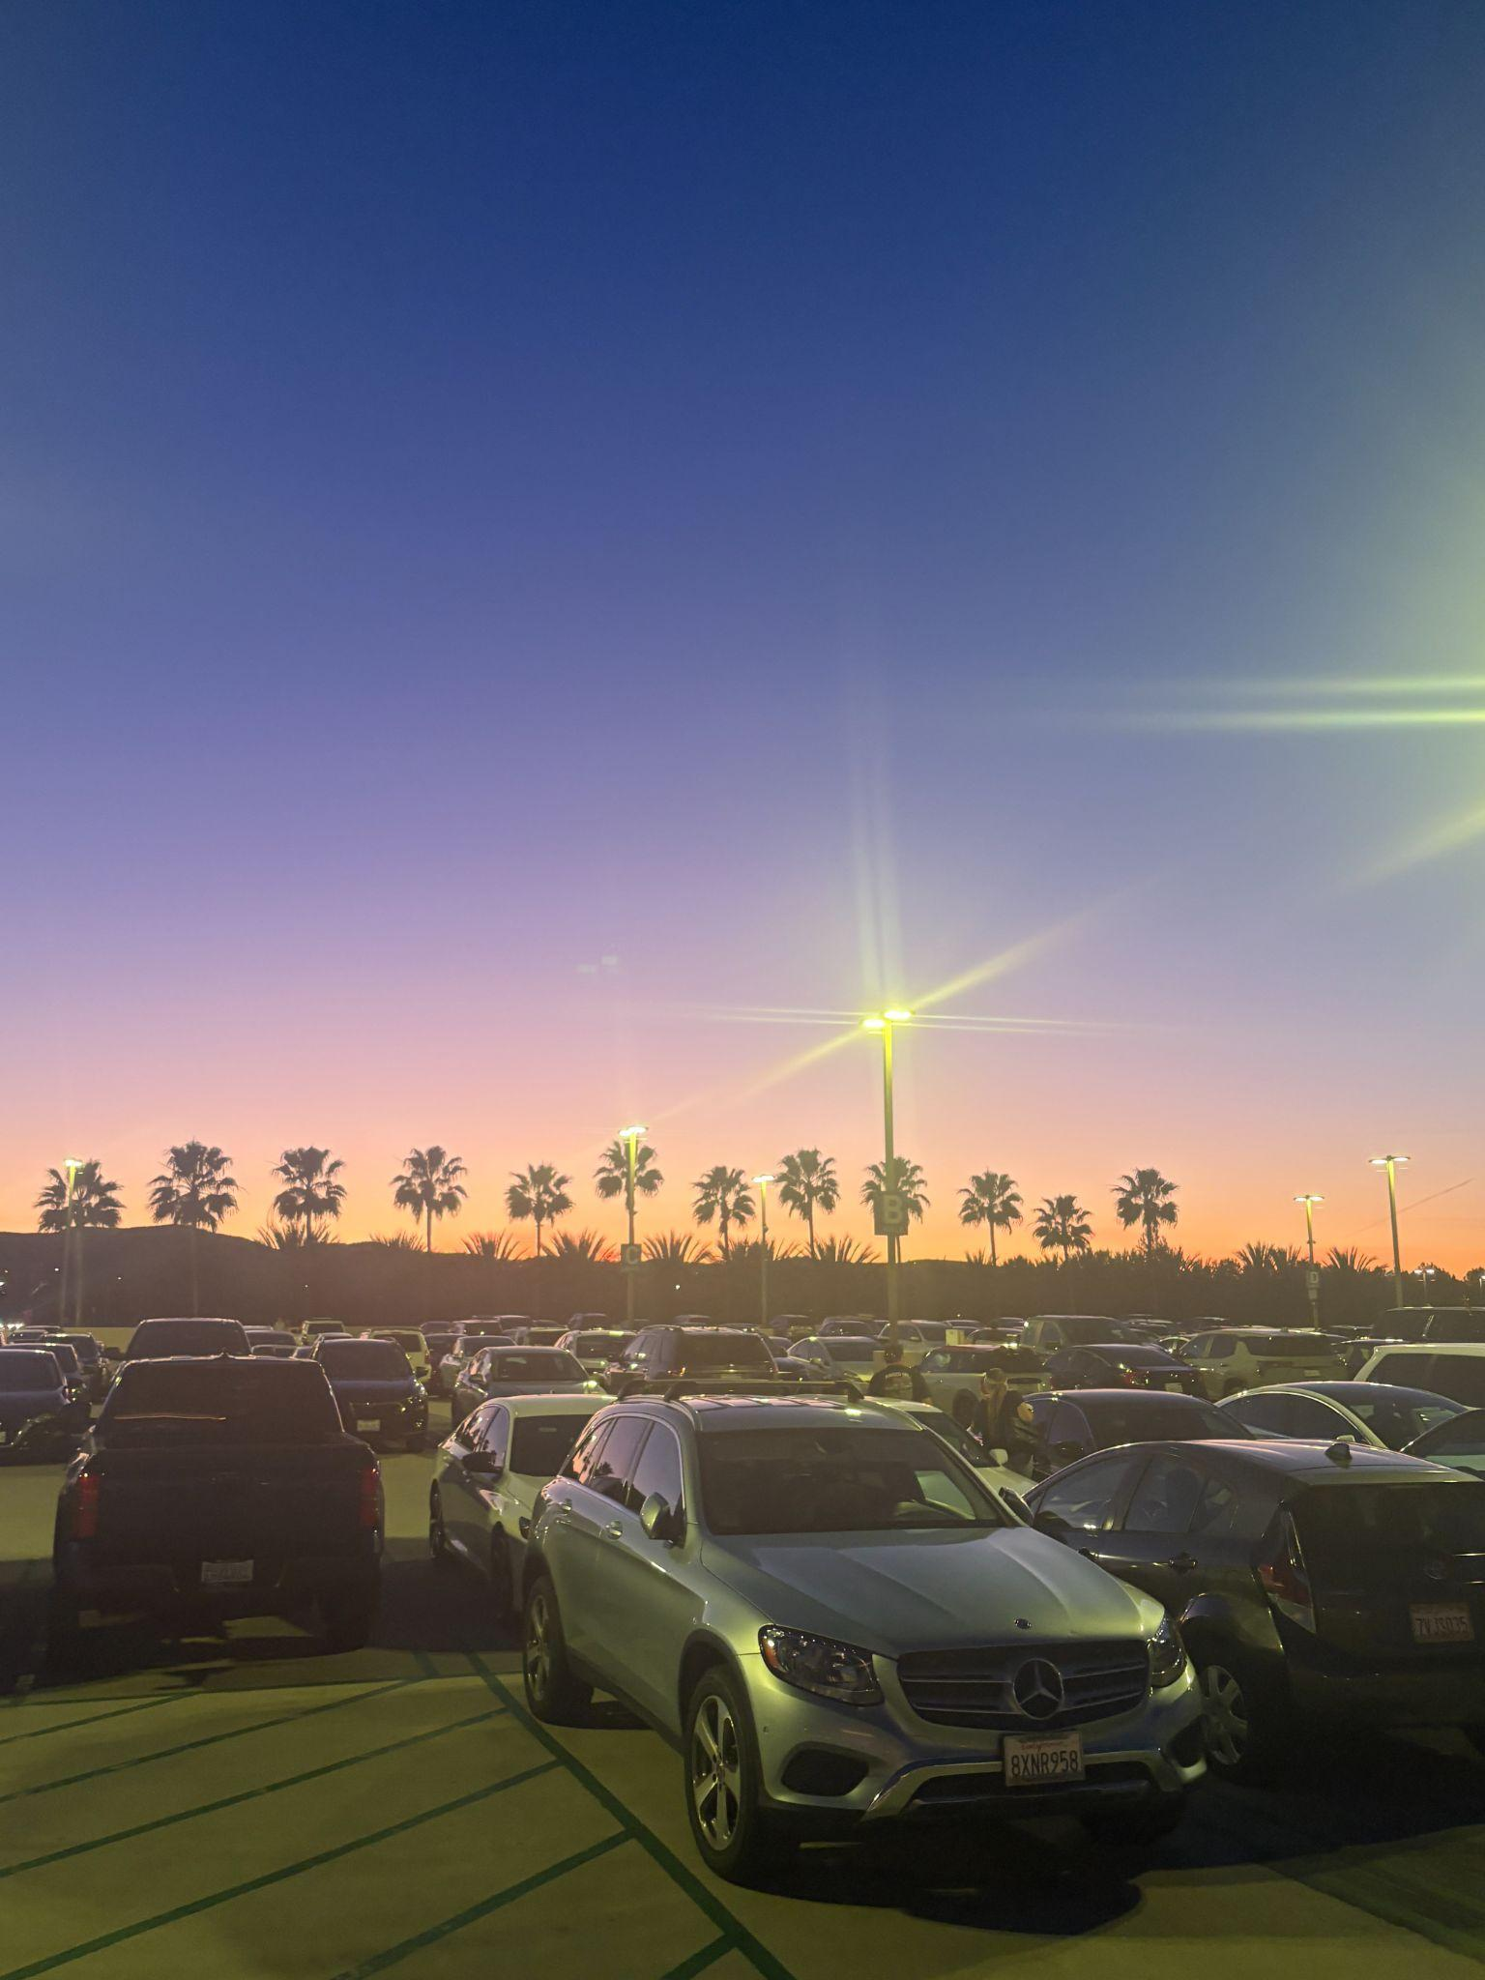
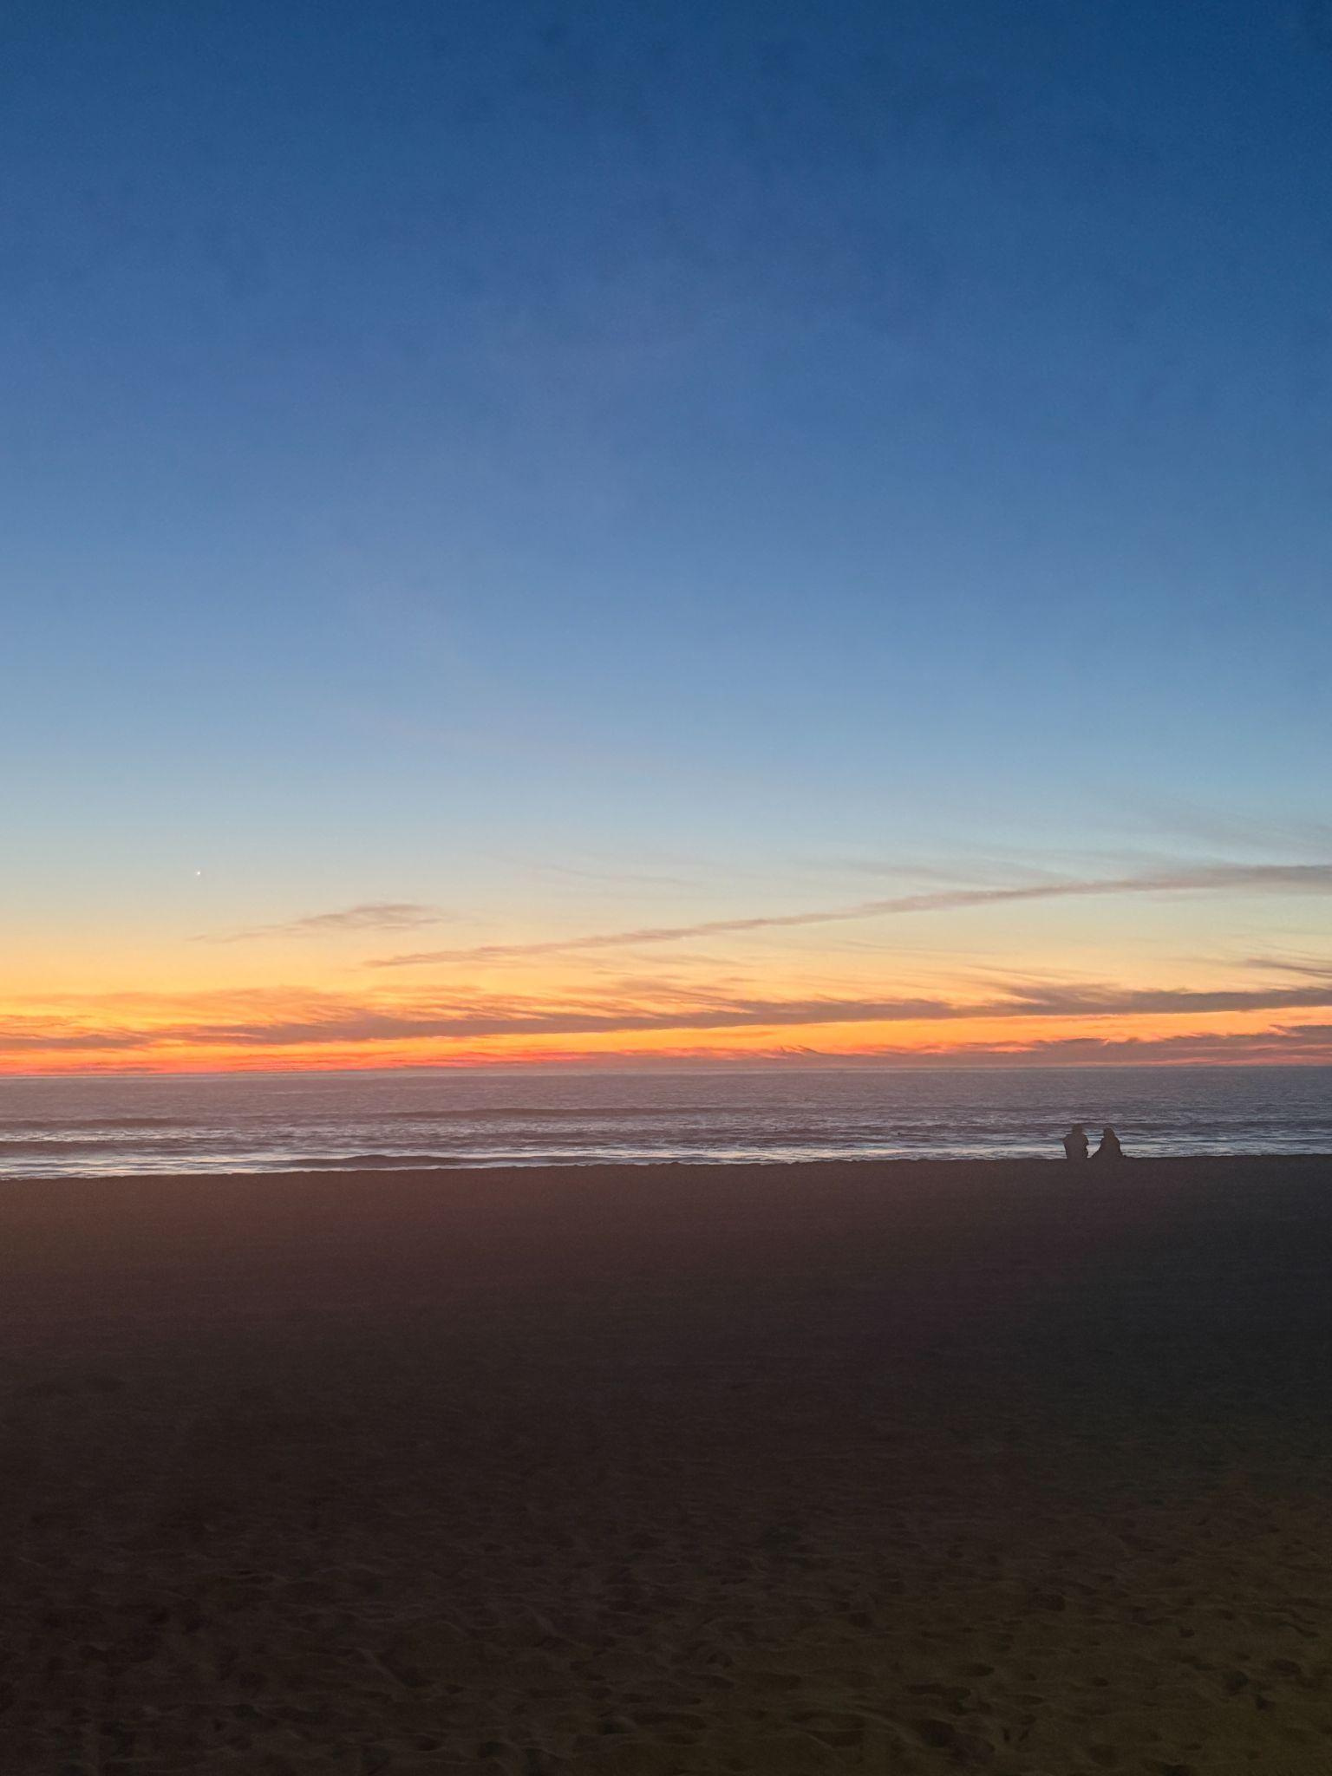

Many Sunsets

Slide 7
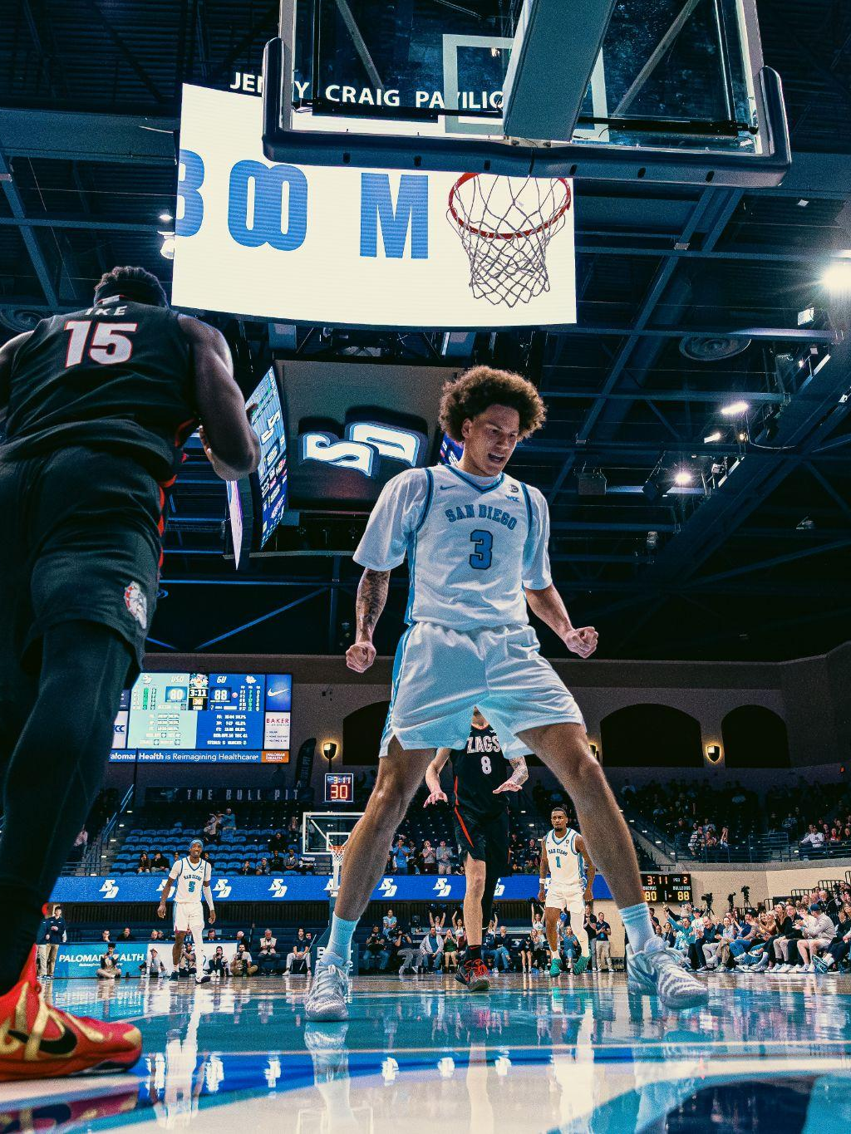
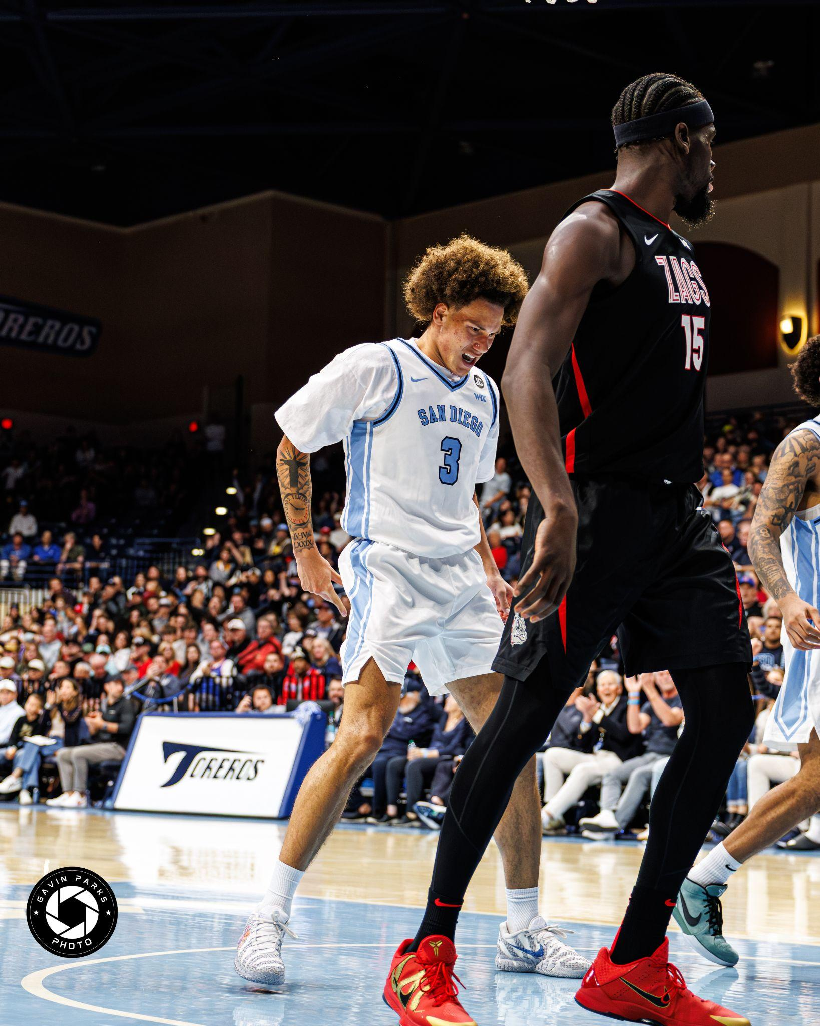
Sad/Unfortunate Moments
Season ending injury…
*Actual pictures of me in pain…*

Slide 8

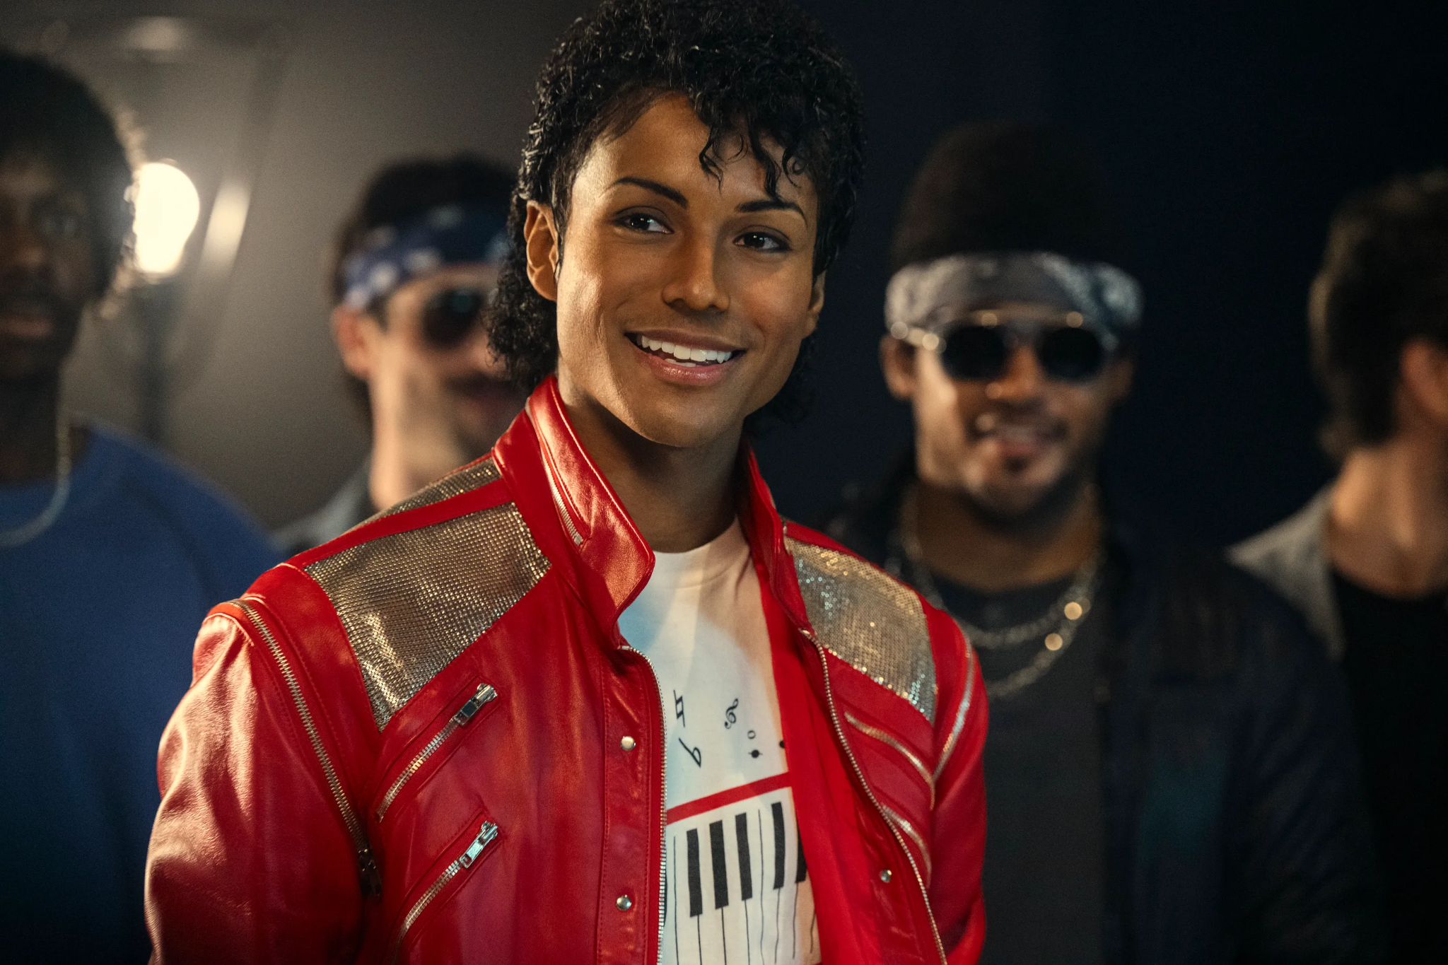
Items that were highlighted by news, media, other countries, etc.
Michael Jackson biopic, “Michael”
He is played by his nephew Jaafar Jackson!

Slide 9
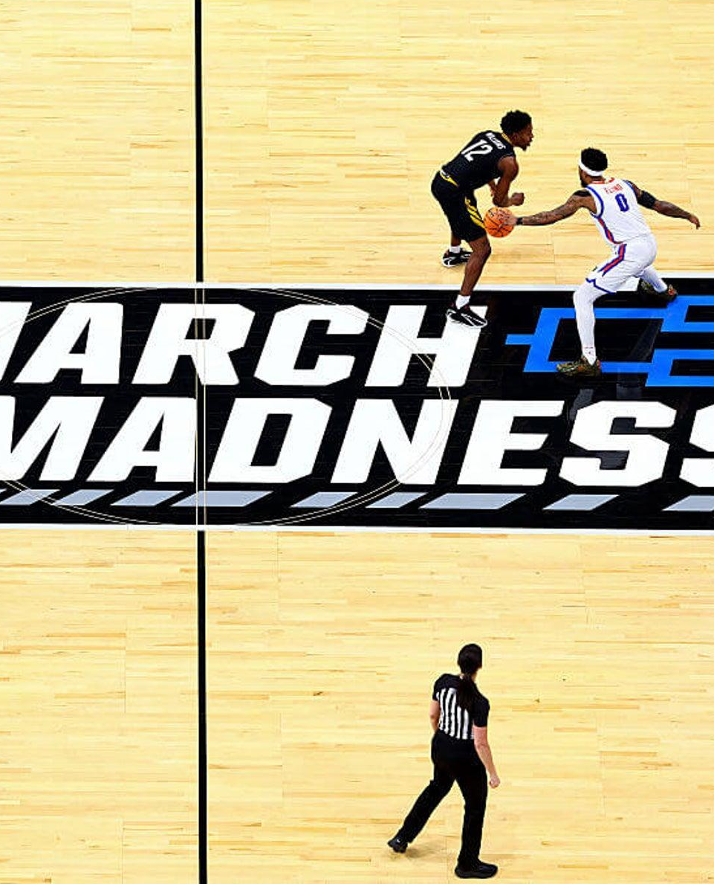
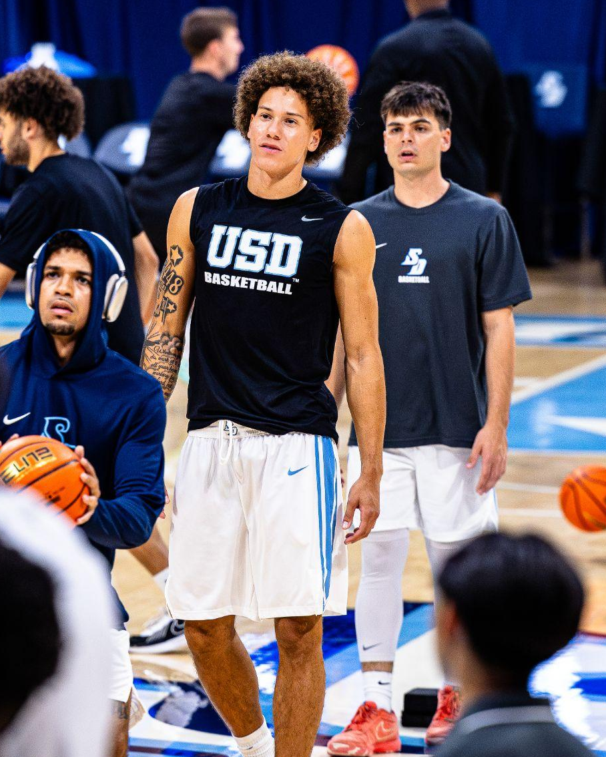
Items in Sports News
The long awaited decision of March Madness extension to 76 teams
It was previously 68 teams

Slide 10
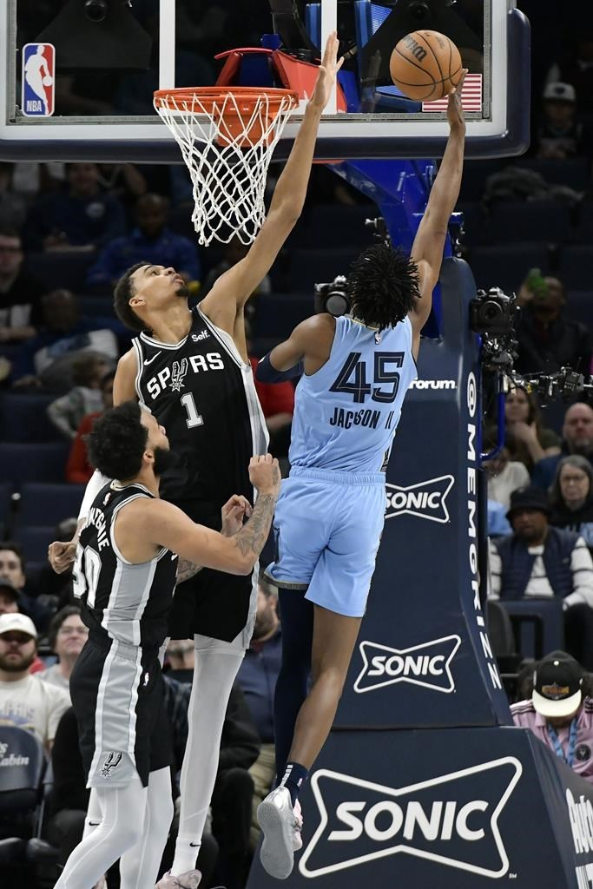

Items in Sports News
LeBron James plays his 23rd NBA season
Victor Wembanyama wins DOTY

Slide 11

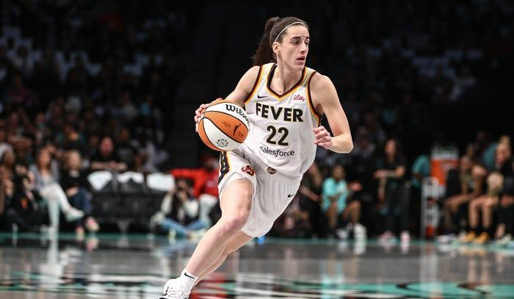
Items in Sports News
The 2026 WNBA Collective Bargaining Agreement (CBA) is a transformative seven-year deal (2026-2032) that significantly raises player pay, codifies benefits, and introduces comprehensive revenue sharing

Slide 12
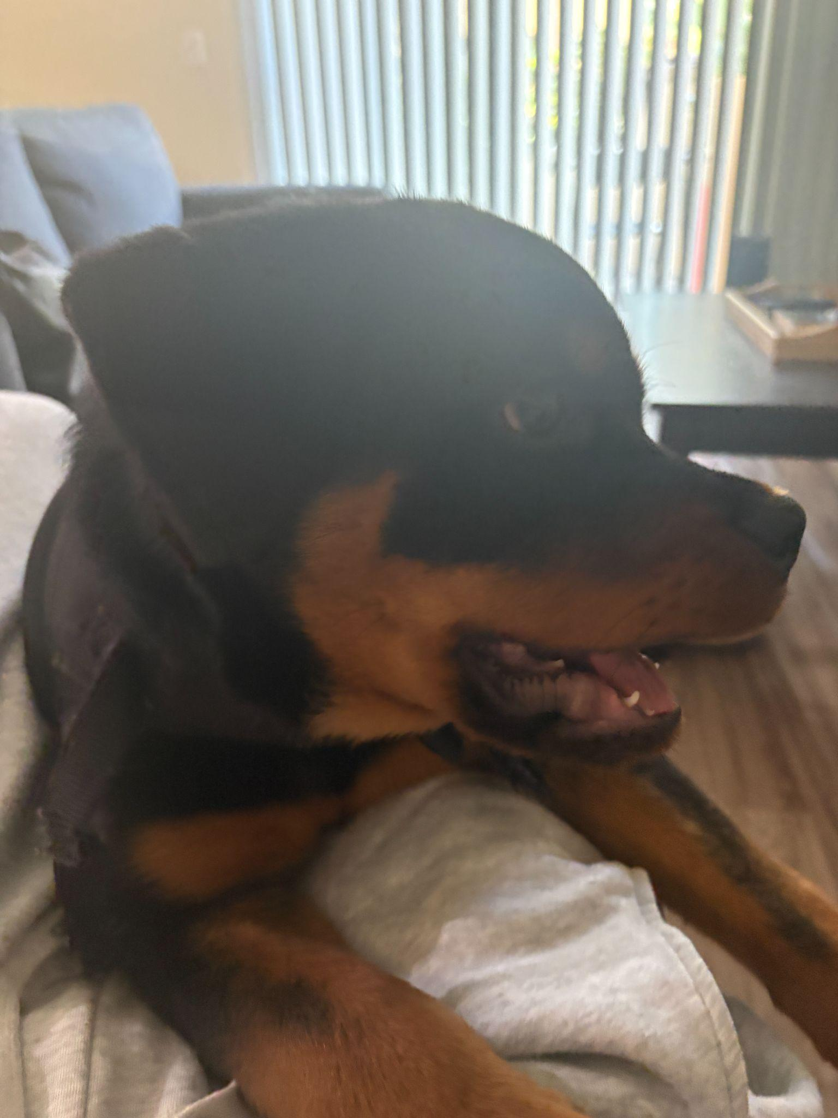
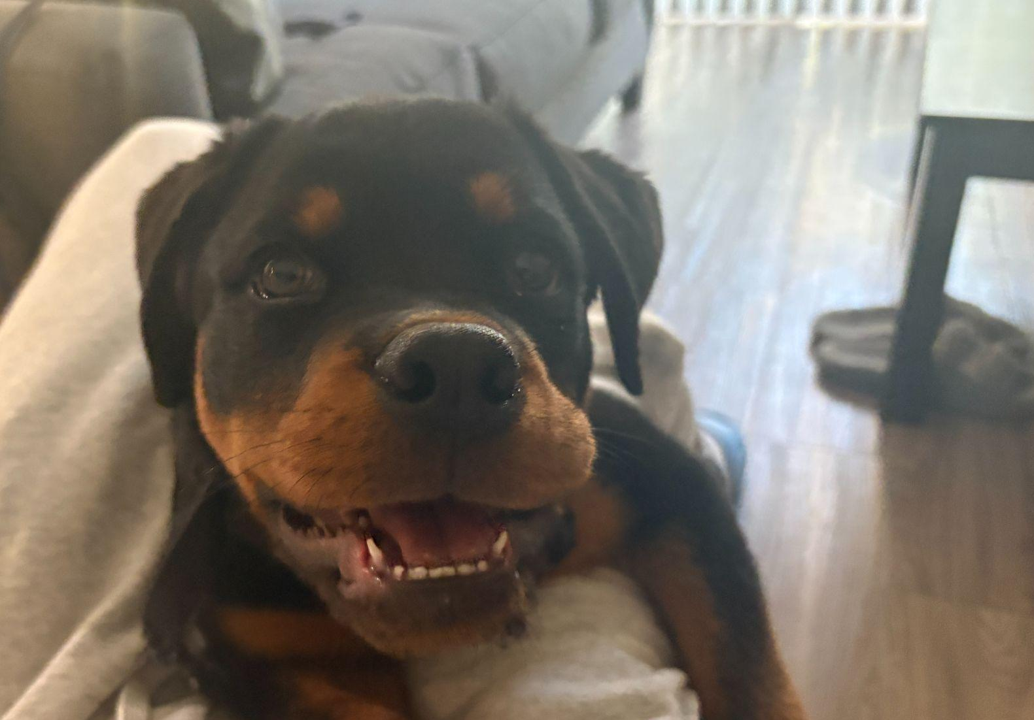
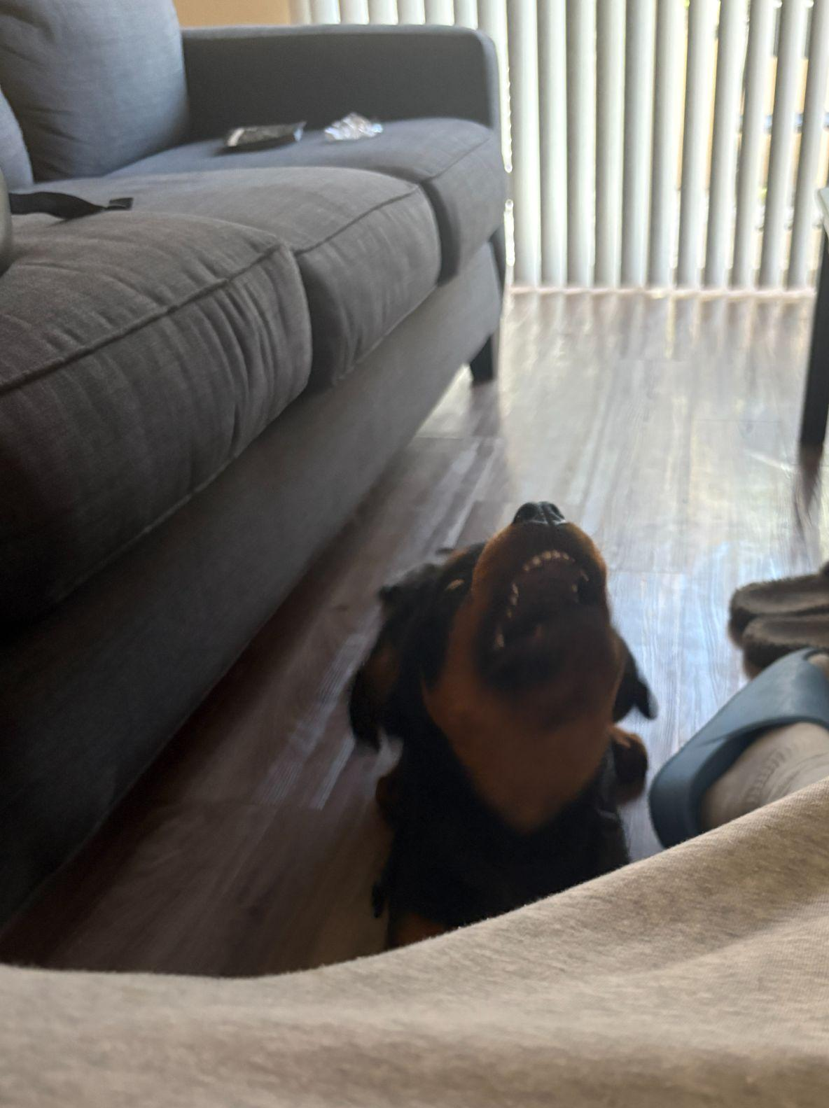
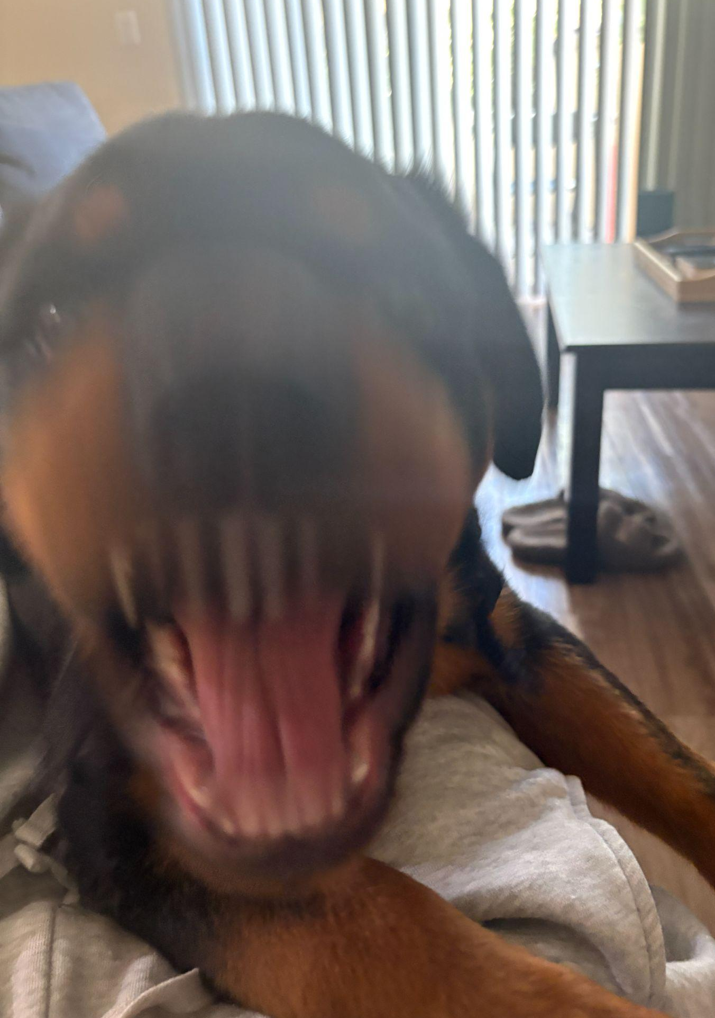
MORE ENOCH.

Slide 13
Thank You!

