Slide 1

Time capsule Final Project
Julien Chou

Slide 2

AGENDA
Items that happened in the semester
Individually
with friends
Groups
·

Slide 3
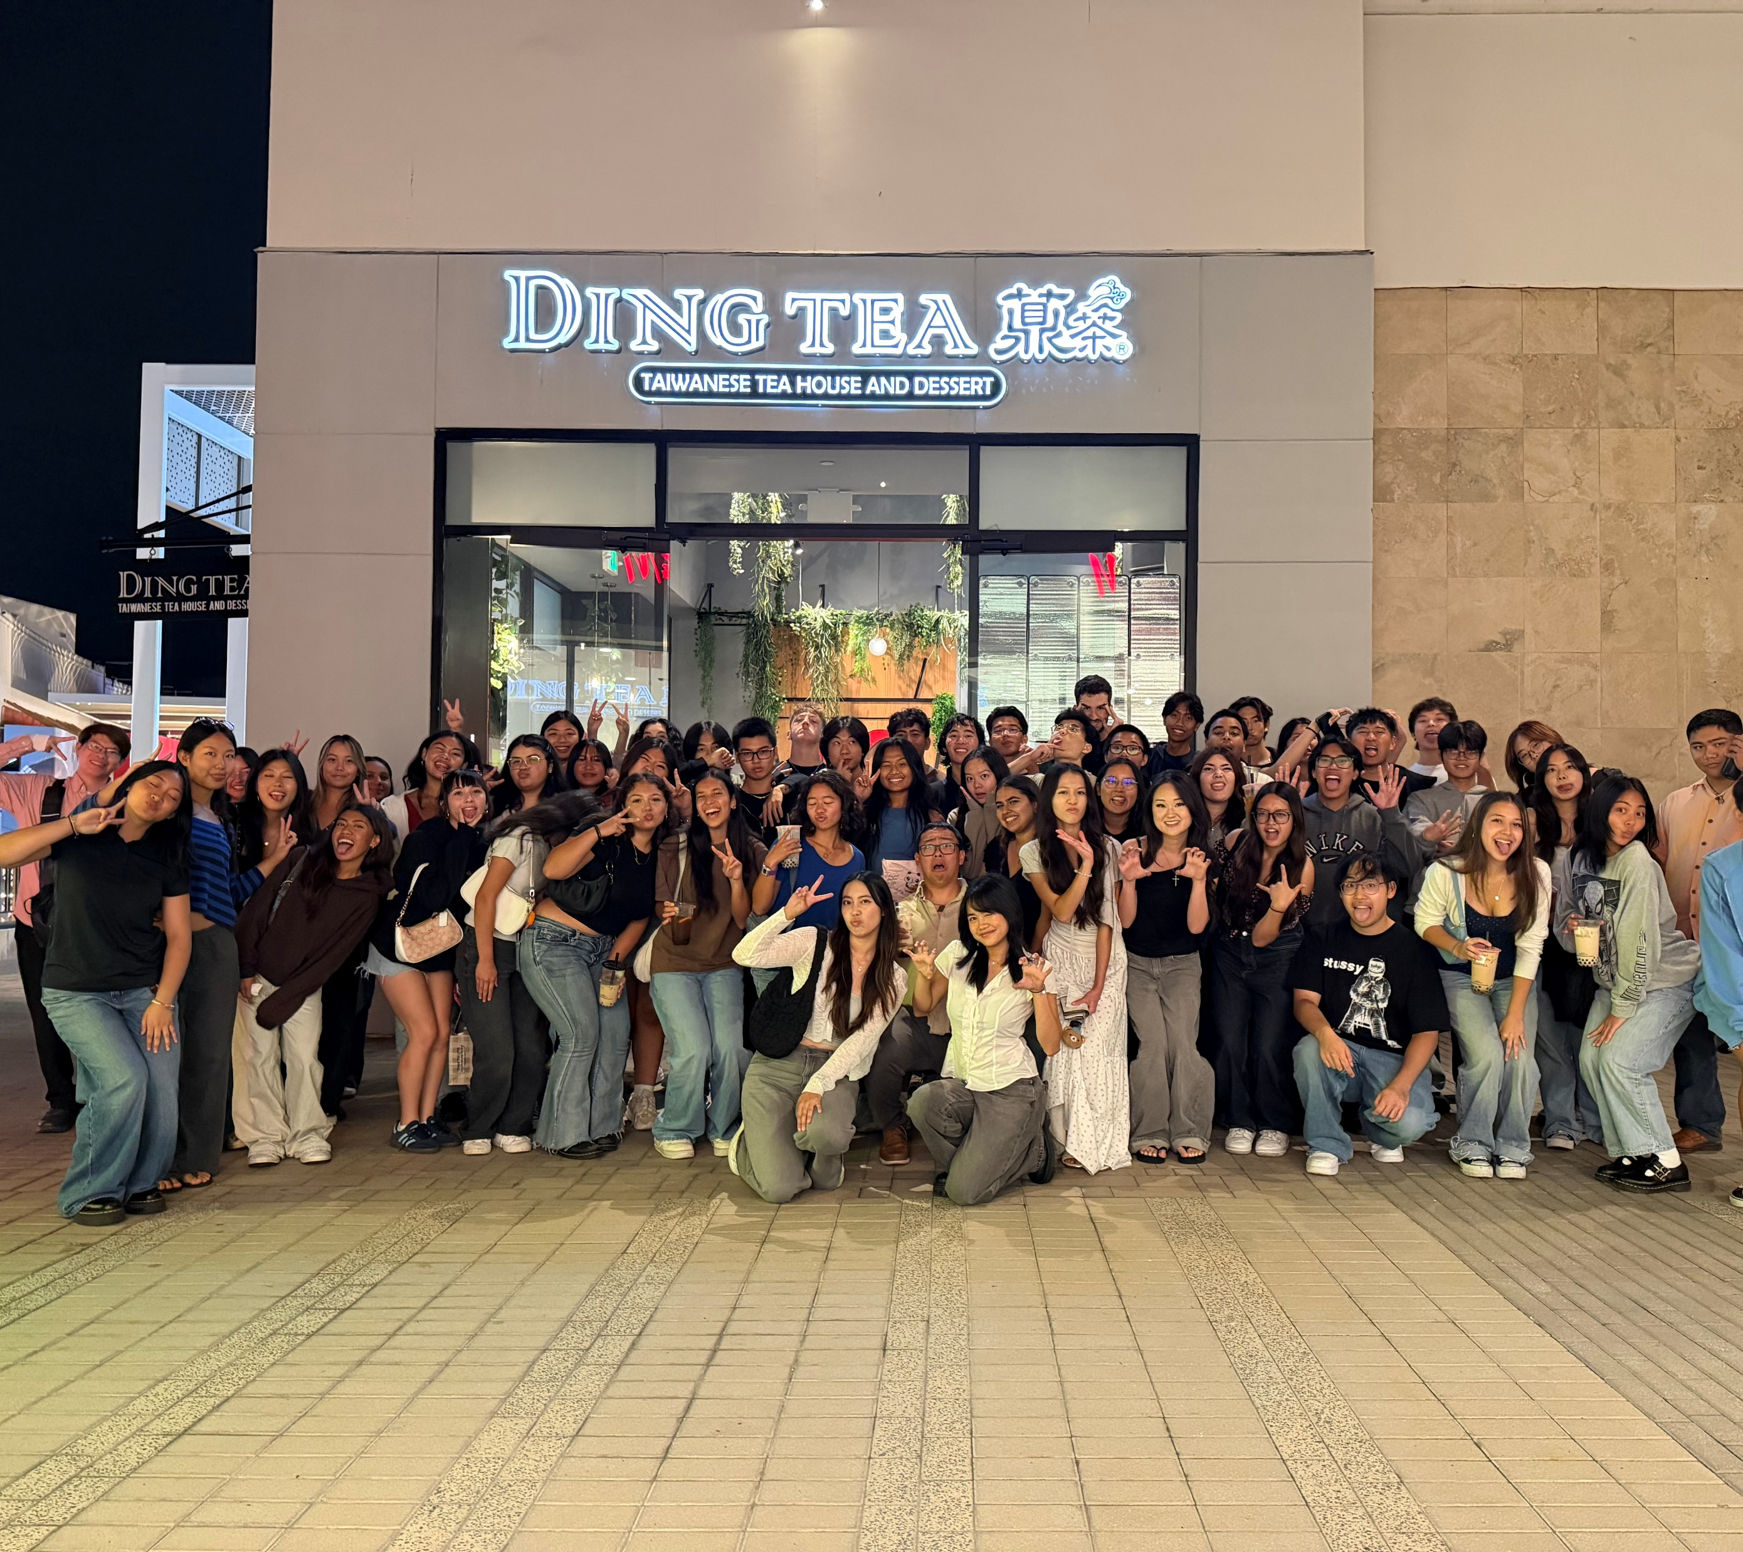
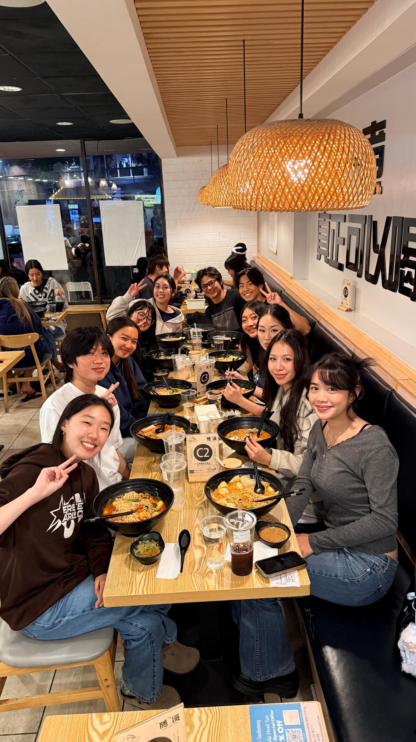
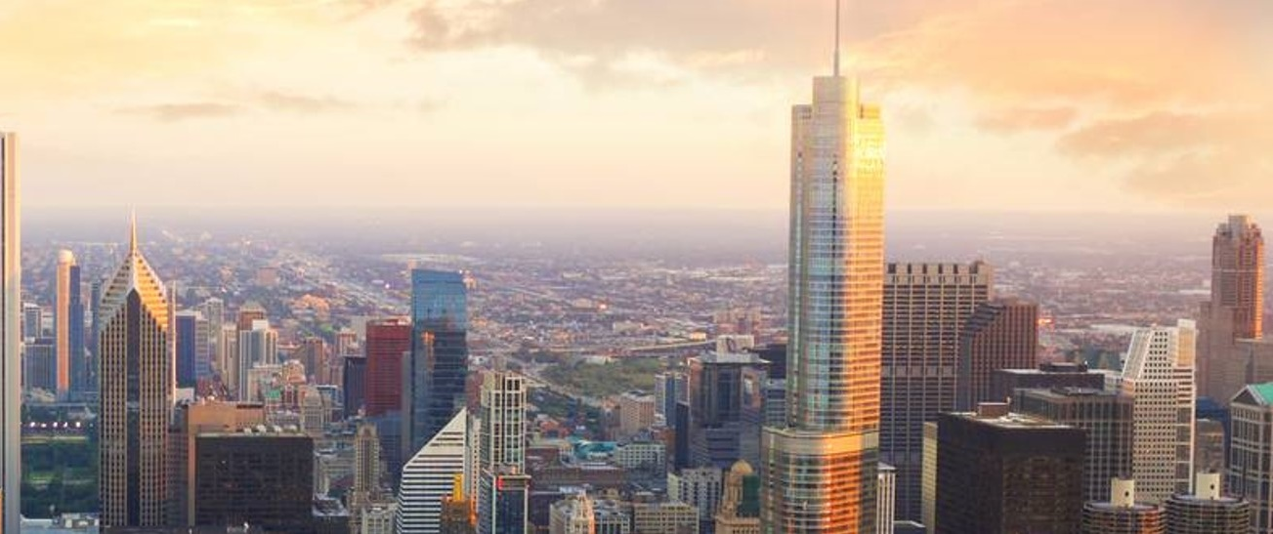
Individually/Group Became Events coordinator for ASA (Asian student association)

Slide 4
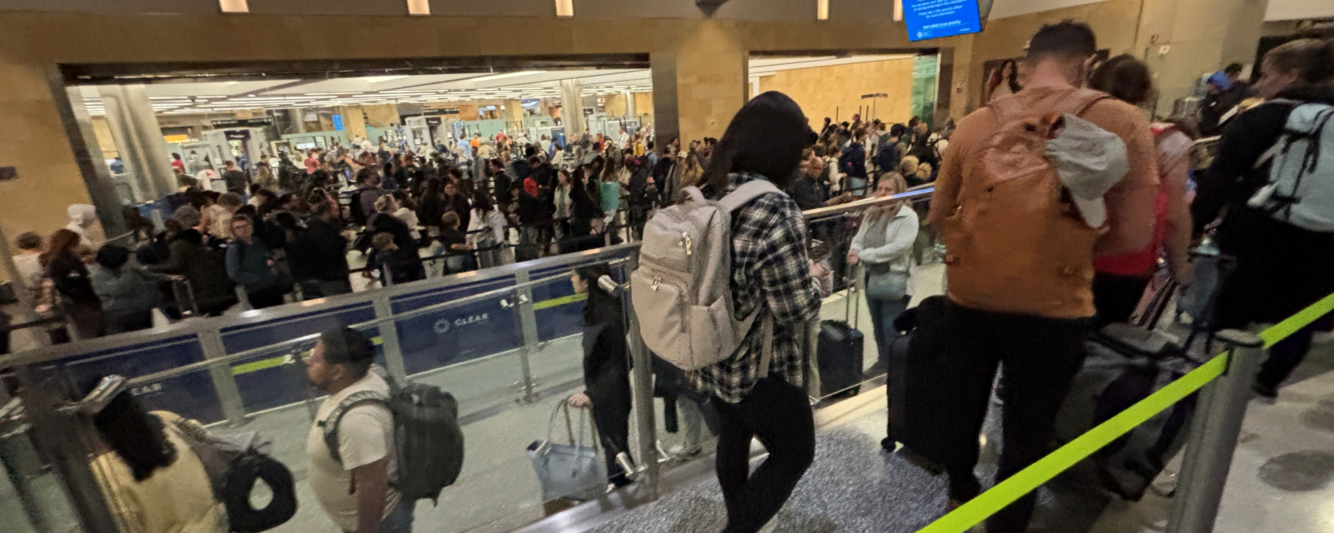
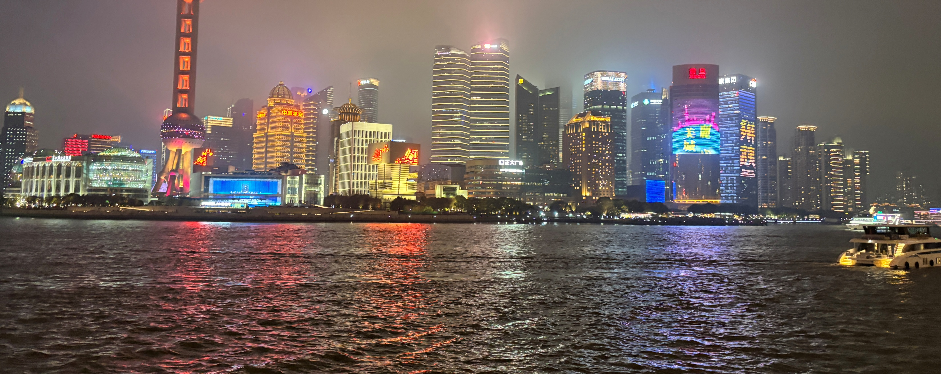
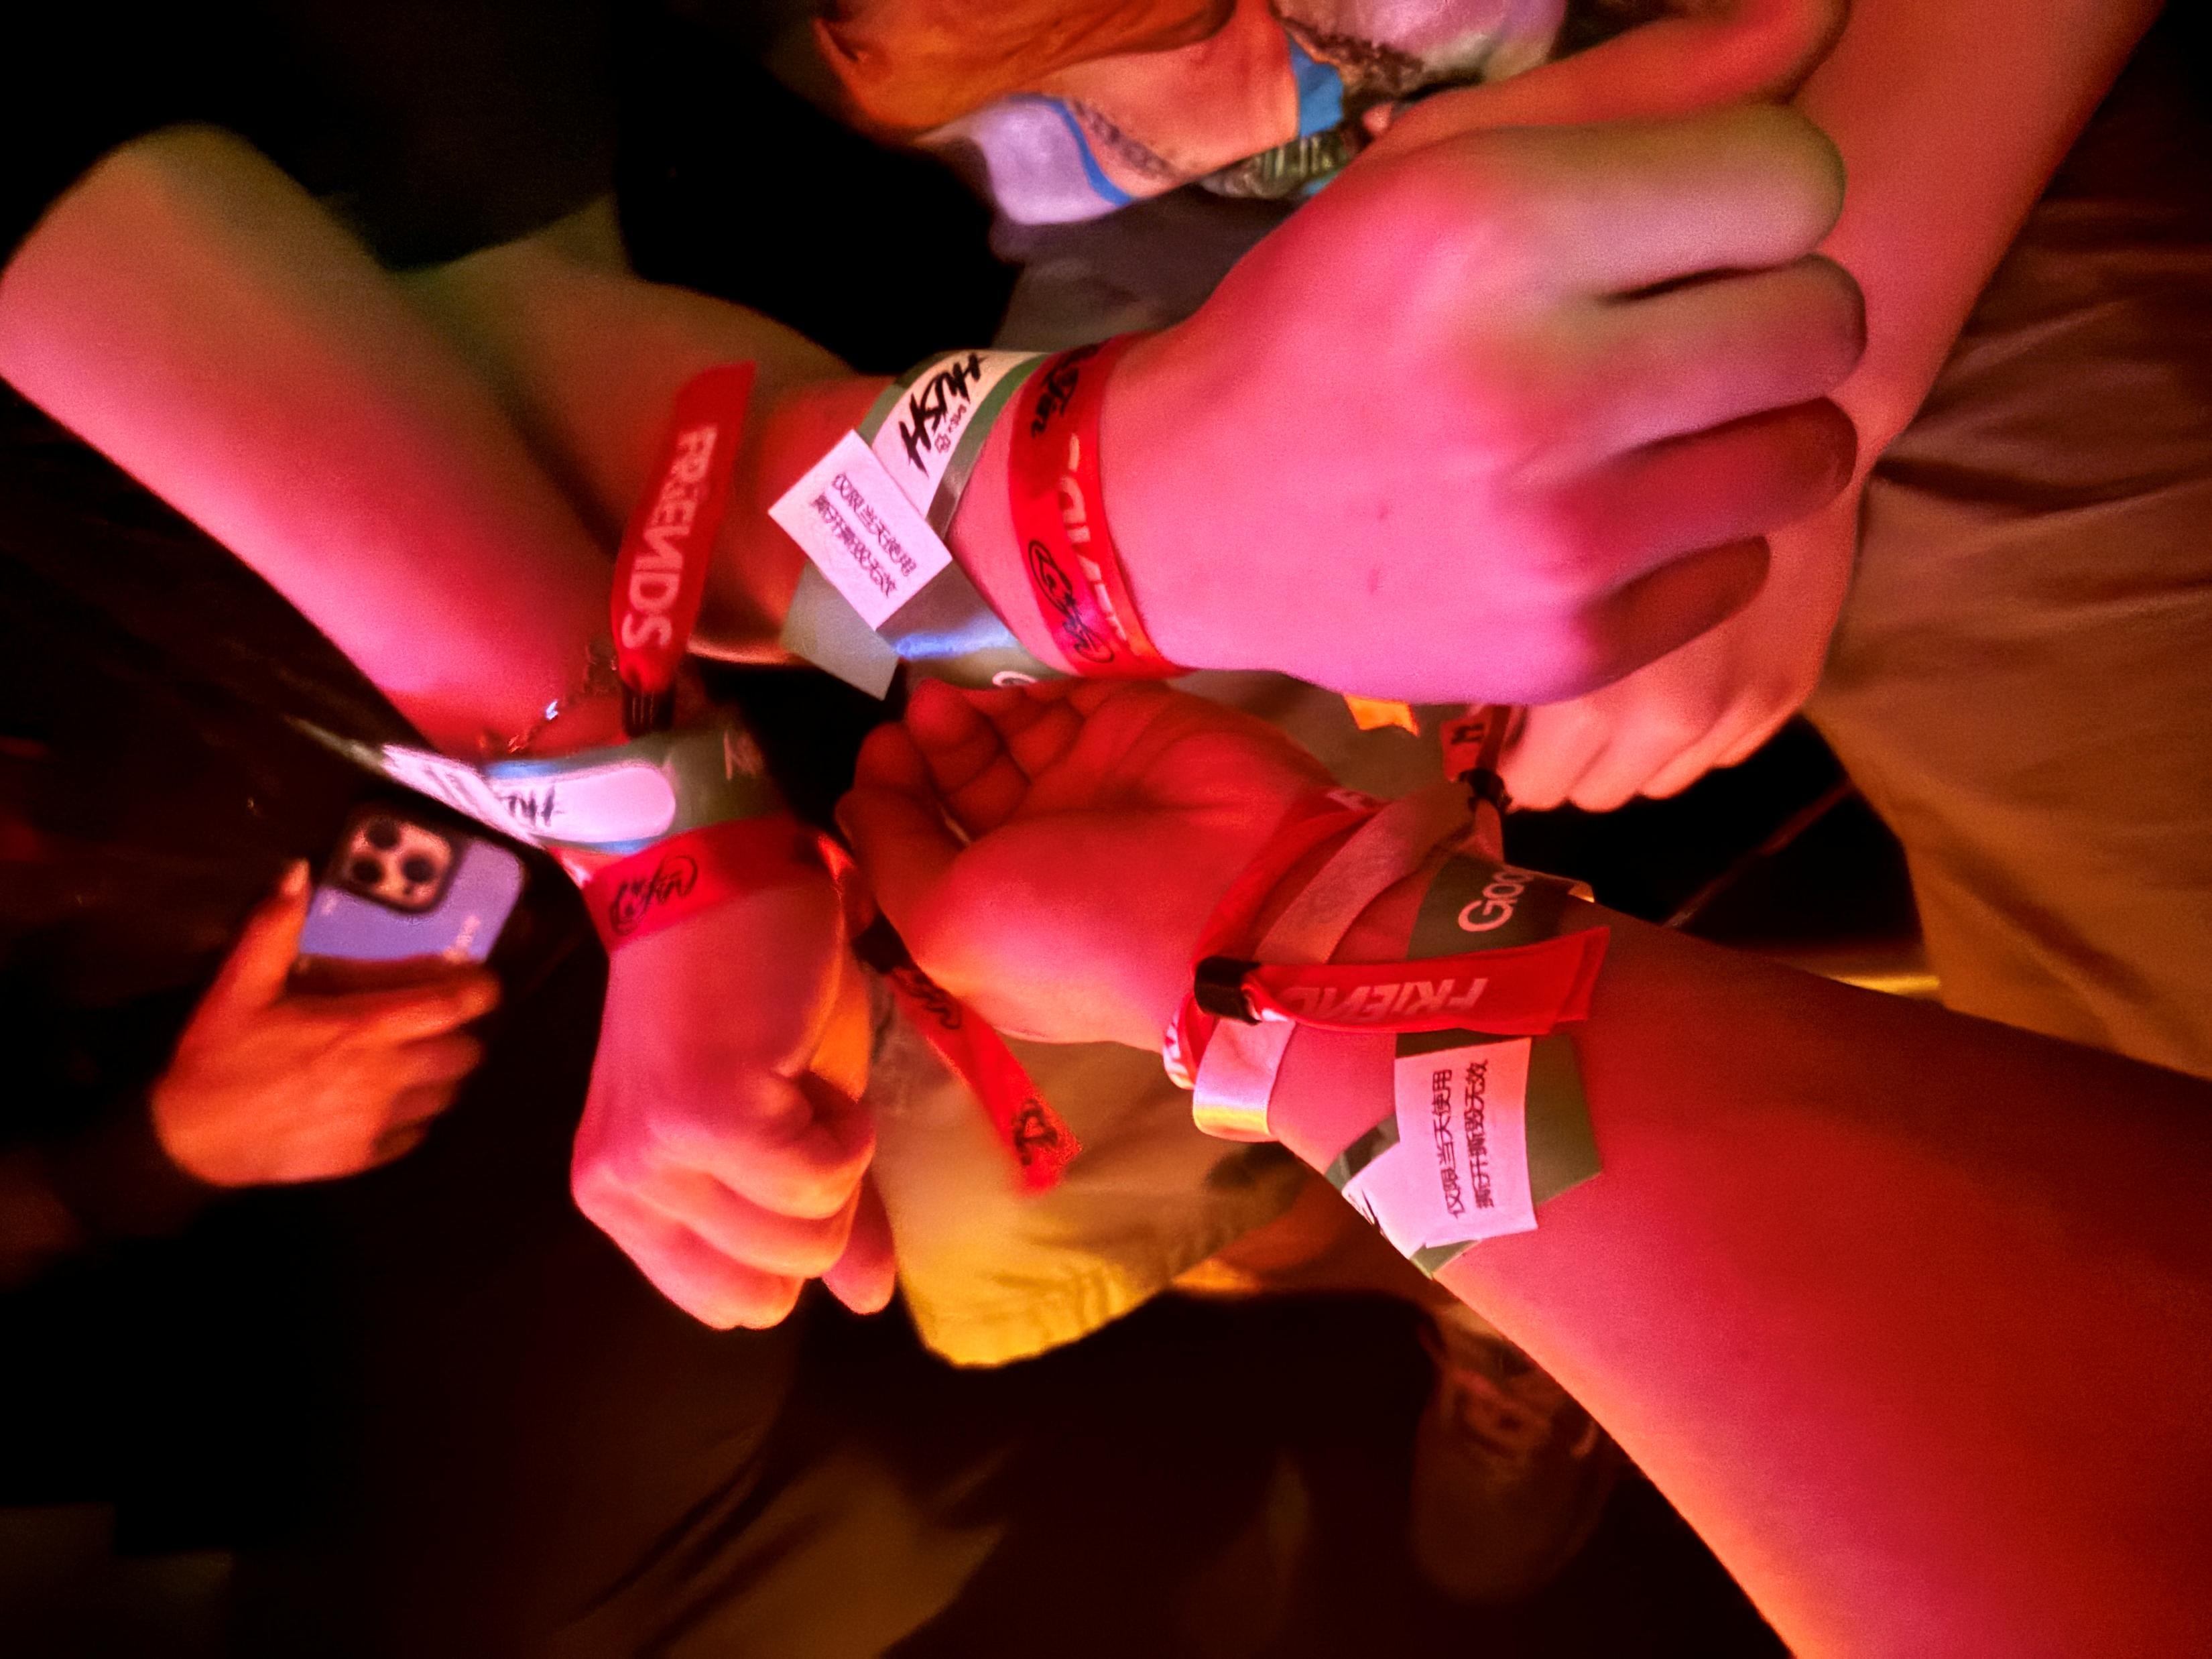
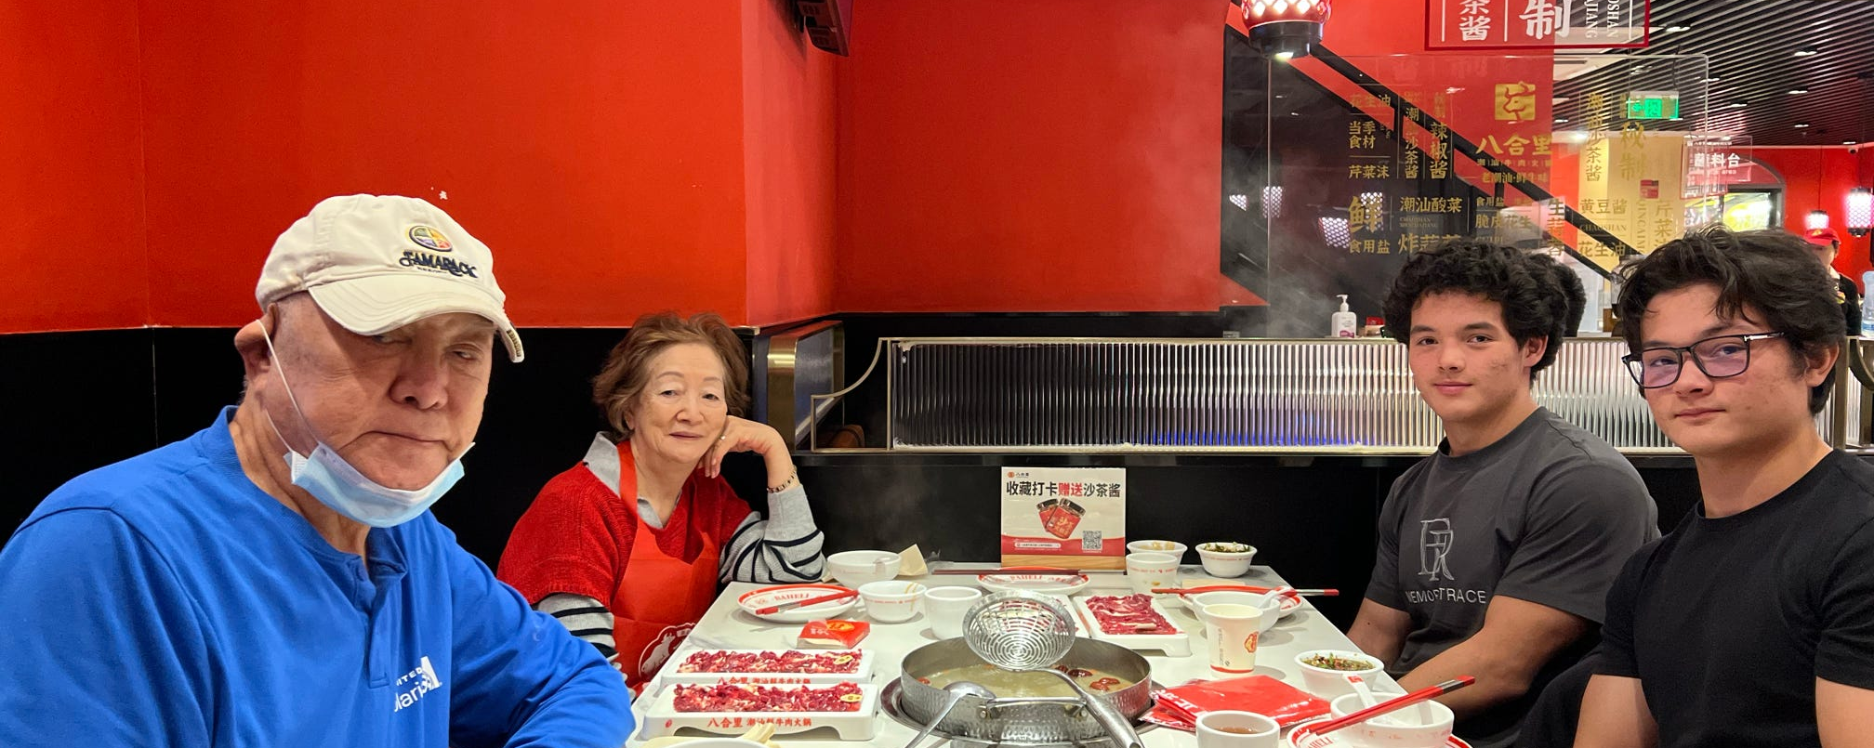
With Friends Went to China with my brother over spring break

Slide 5
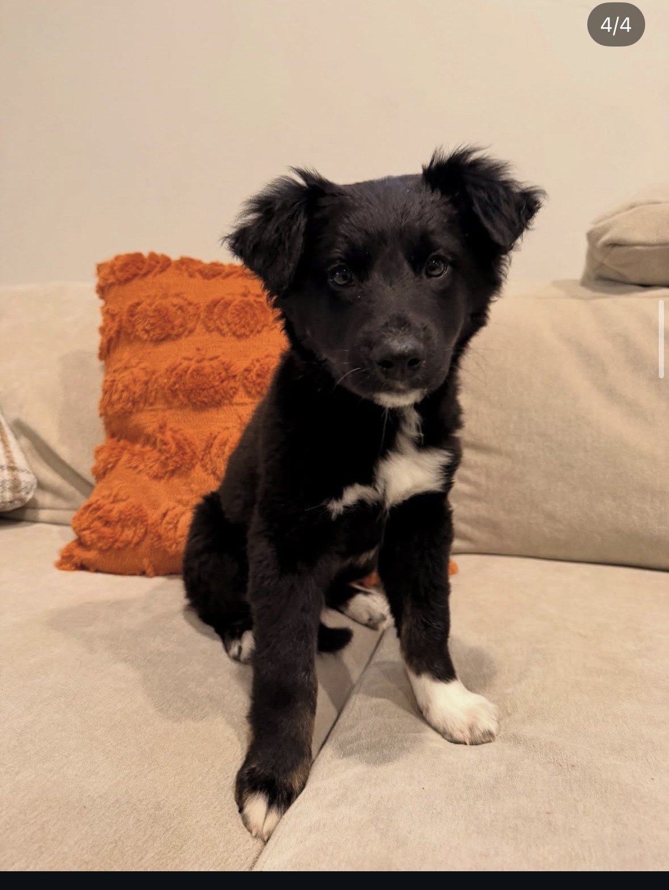
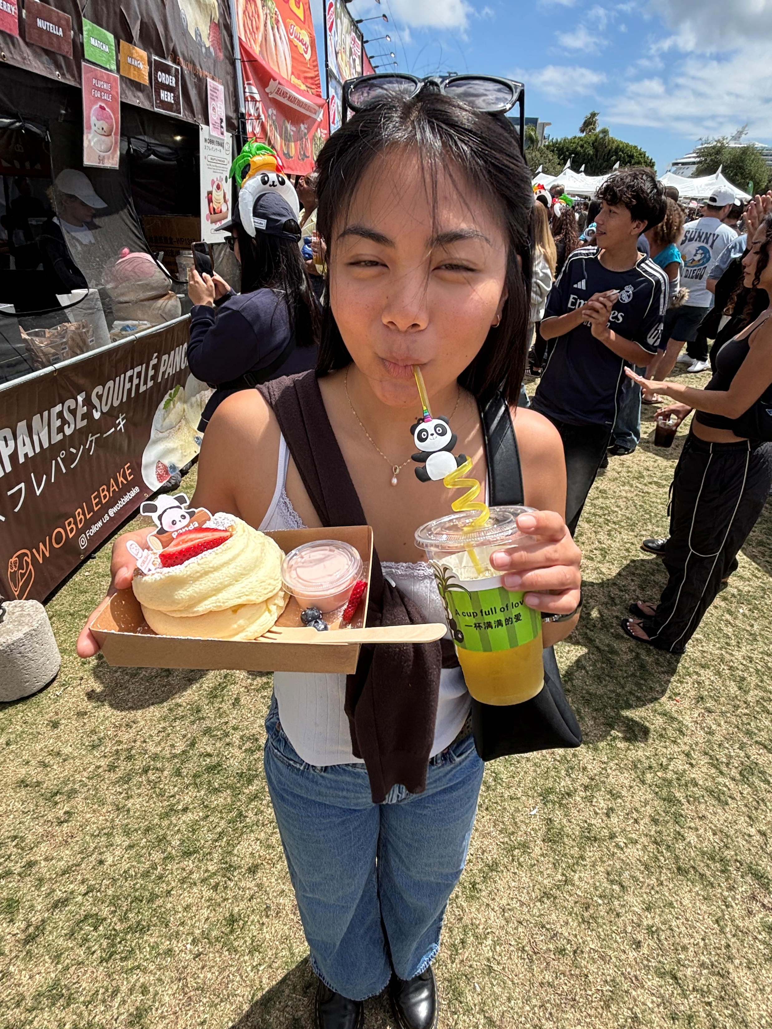
Items that I experienced that have touched your life this semester in an positive way -Family got a new puppy -Spending time with loved ones this semester

Slide 6
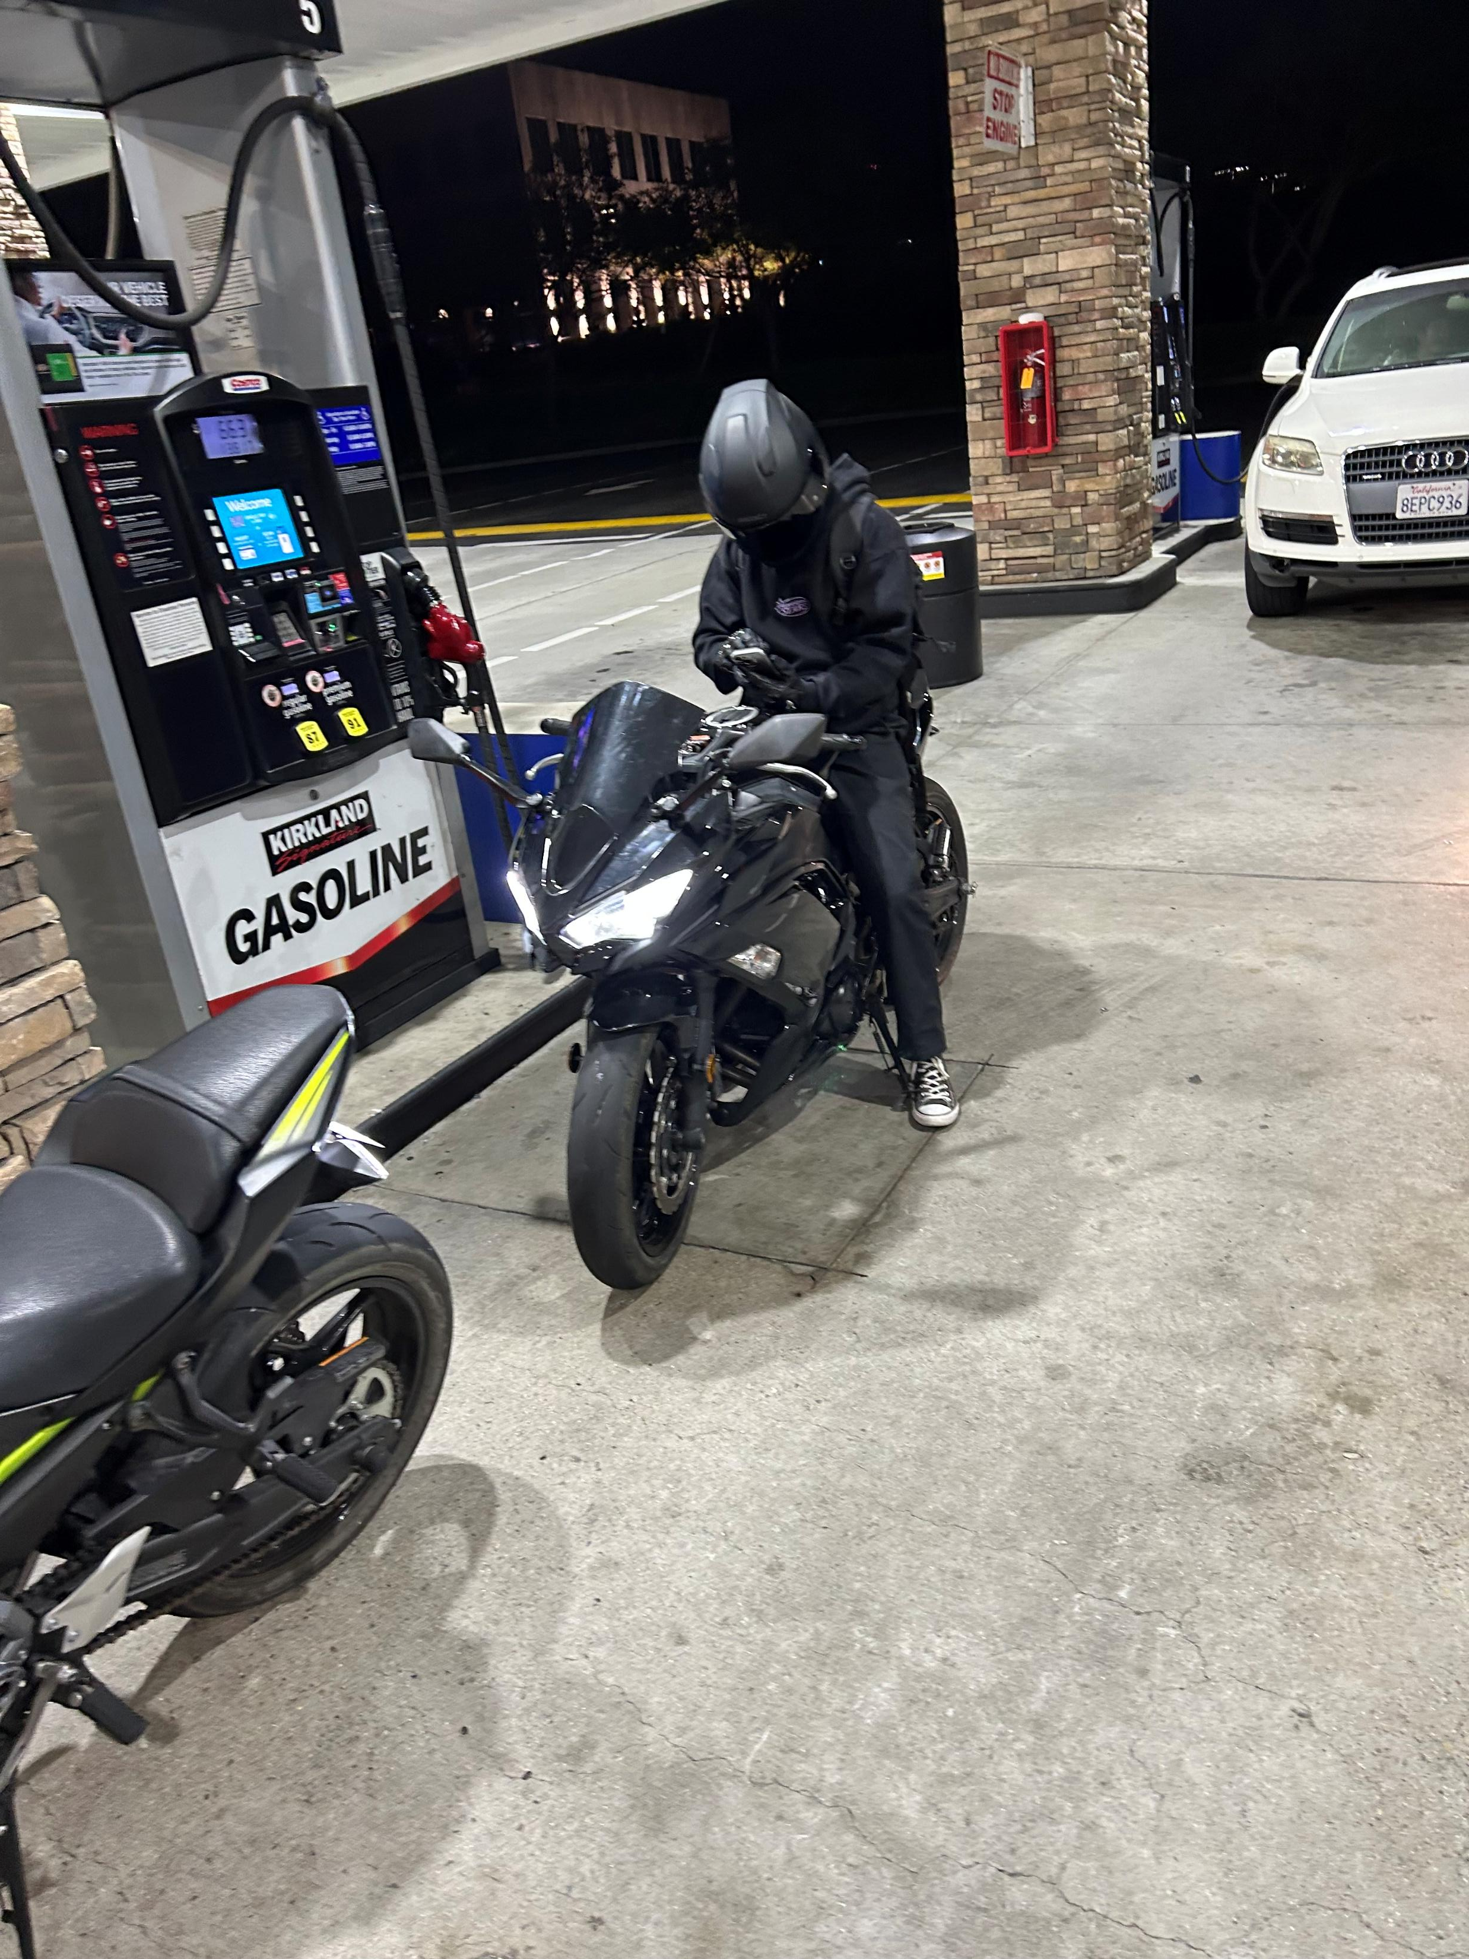
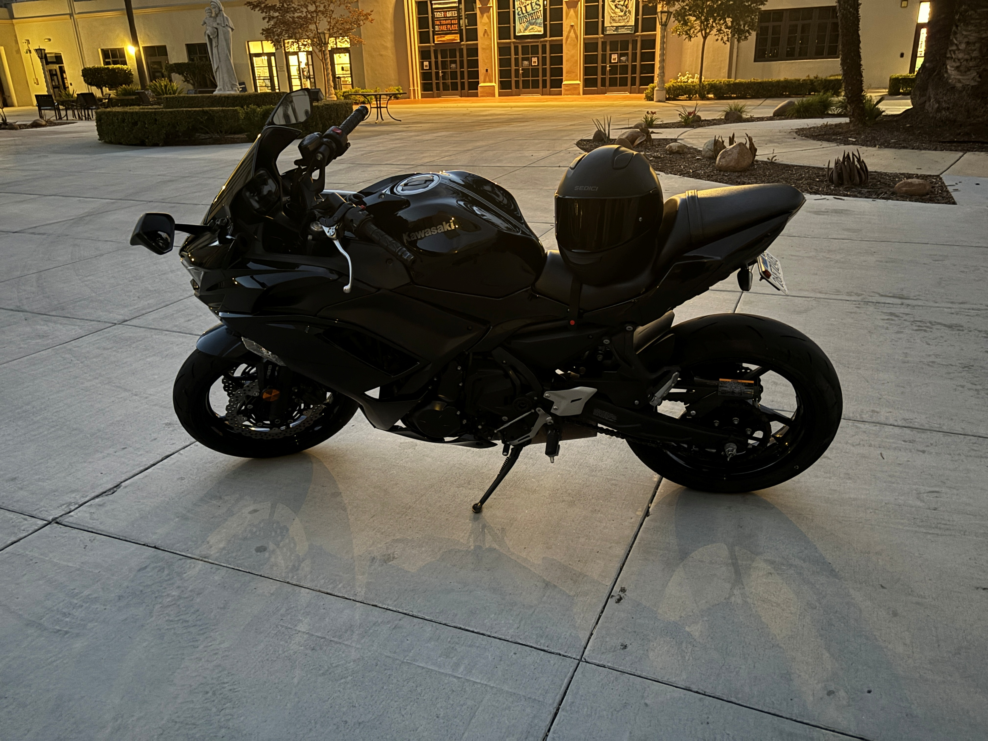
Items that you experienced that were sad or negative that you wish not to be experienced again
-Selling the motorcycle
- Changing my major

Slide 7


Items that were highlighted by news, media advertisements/messages, government, other countries, other sources
hantavirus outbreak on a cruise ship
(A hantavirus outbreak occurred in May 2026 aboard the MV Hondius cruise ship, causing at least 11 cases and 3 deaths among roughly 150 passengers and crew.)
Shaky truce with Iran
(Trump says month long truce with Iran is on “massive life support”(bbc News))
Banned from world cup

Slide 8
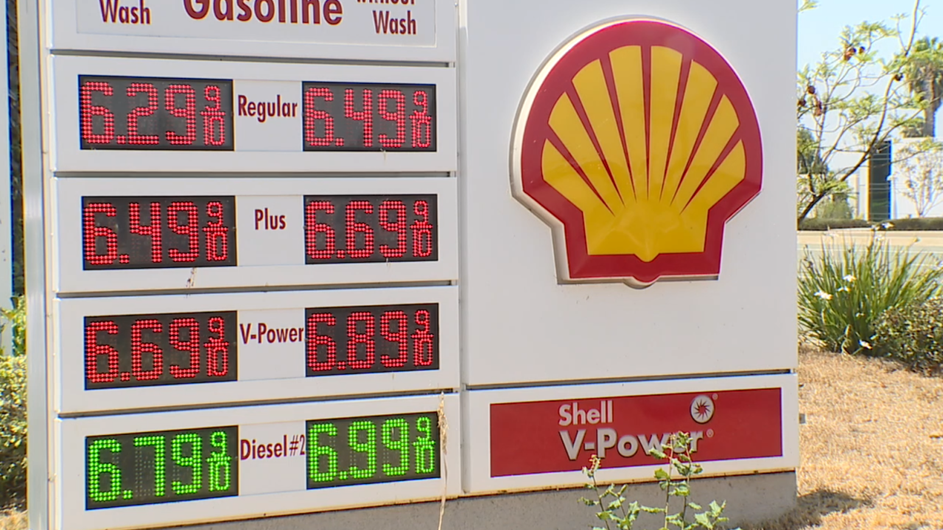

Items that illustrates changes to processes (buying food other items), laws/restrictions
Plastic bag bans / reusable bag requirements
In California, starting January 1, 2026, stores can no longer give customers plastic carryout bags, so shoppers need reusable bags or have to buy paper bags.
2. Gas inflation
AAA reported that by May 7, 2026, the national average price for regular gas reached $4.55 per gallon, which was $1.40 higher than a year earlier and the highest level since 2022.
Earlier, on March 26, 2026, AAA said the national average had jumped from $2.98 on February 26 to $3.98, meaning gas rose about one dollar per gallon in just one month.
Driven upwards of 30%+

Slide 9
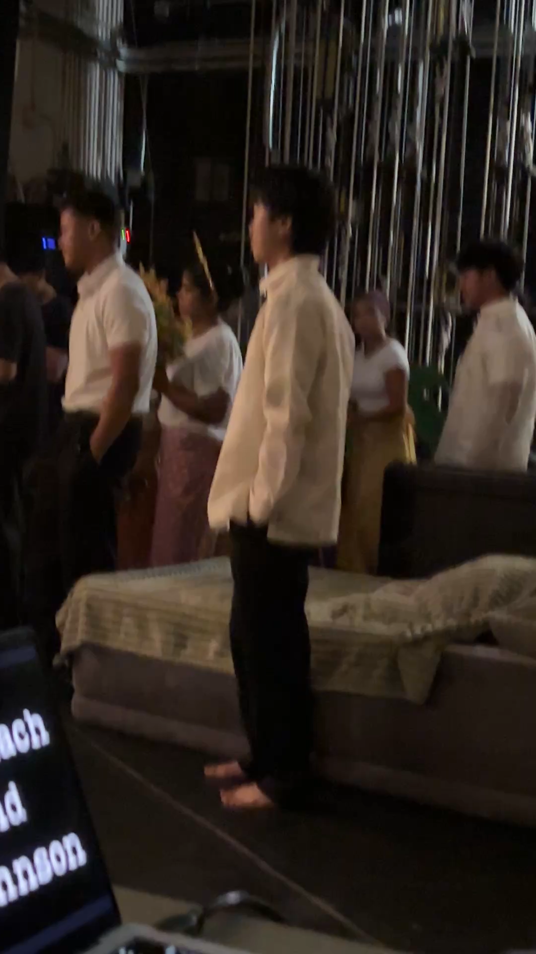
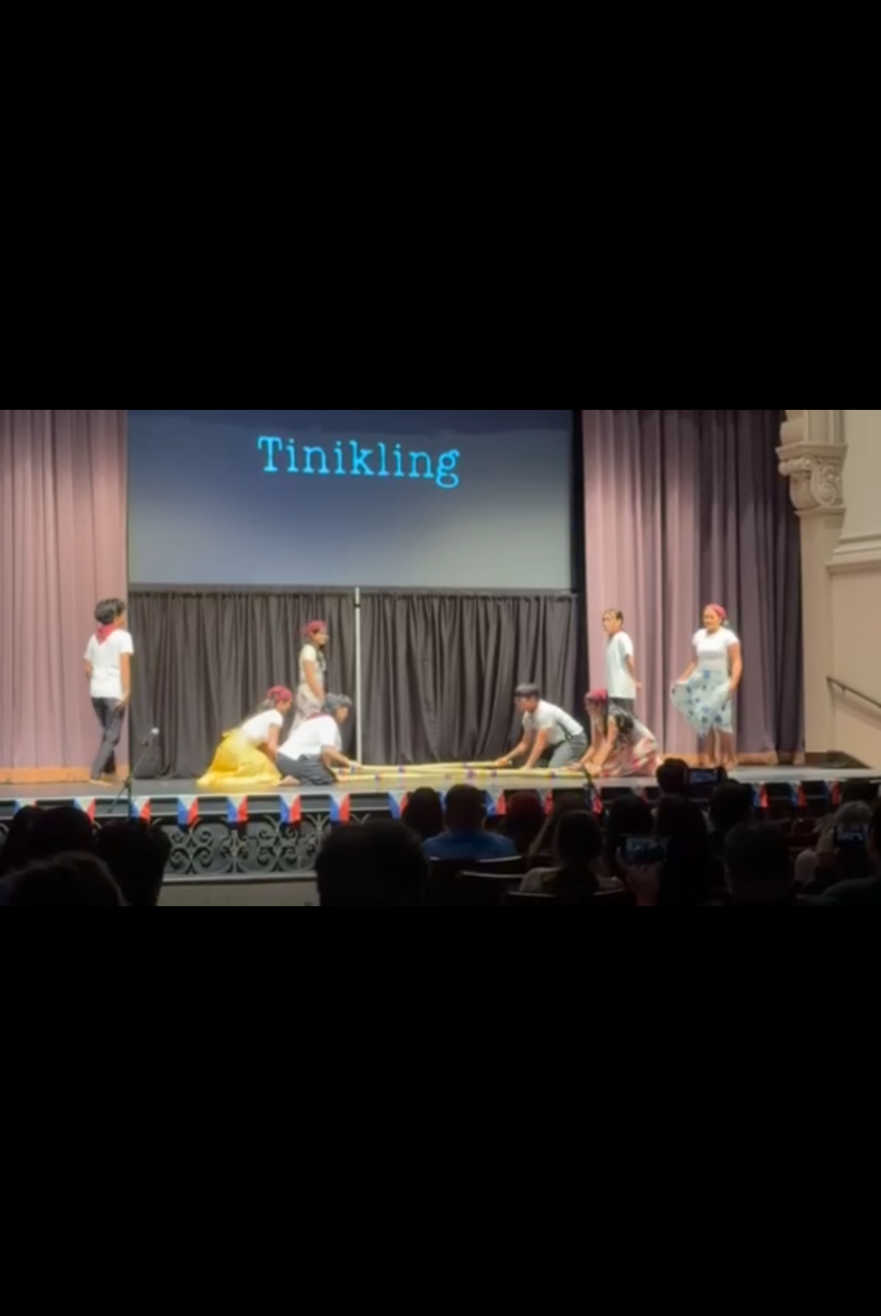
items that illustrates people’s creativity to assist others
Pilipino Cultural Night

Slide 10
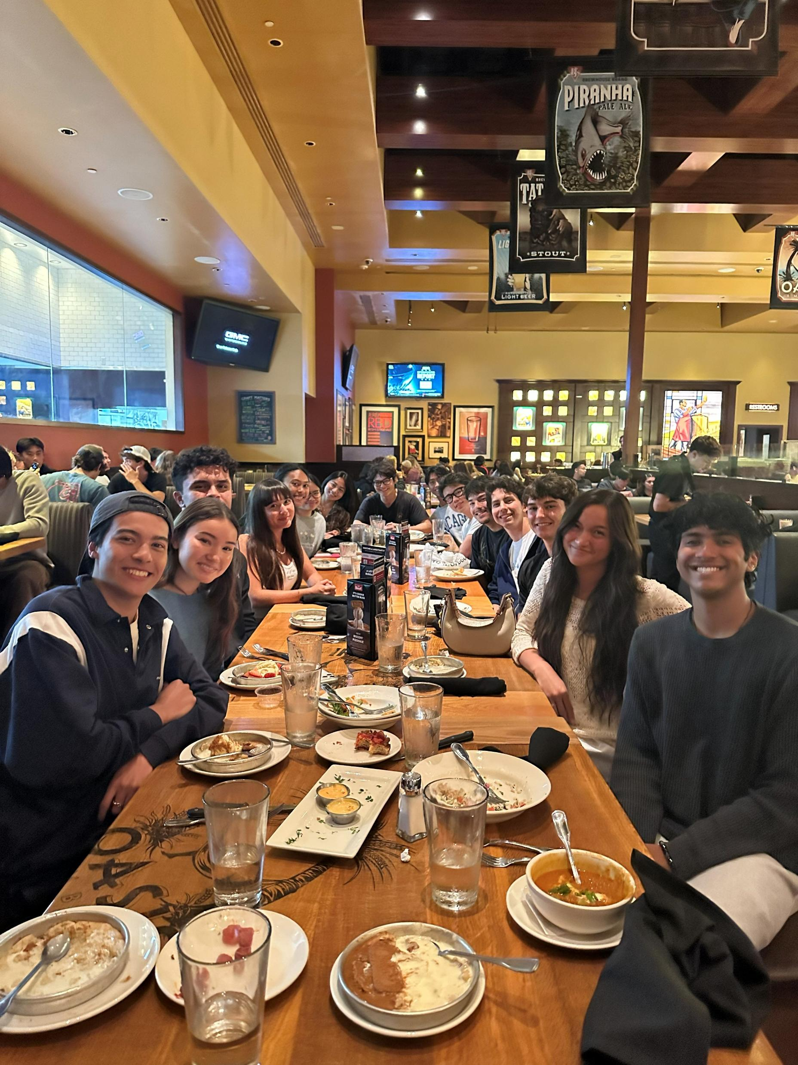
the semester you had, the semester you wanted, and the semesters that you wish to have in the future.
SPENDING TIME WITH FRIENDS

Slide 11

THANK YOU
JULIEN CHOU

